Slide 1
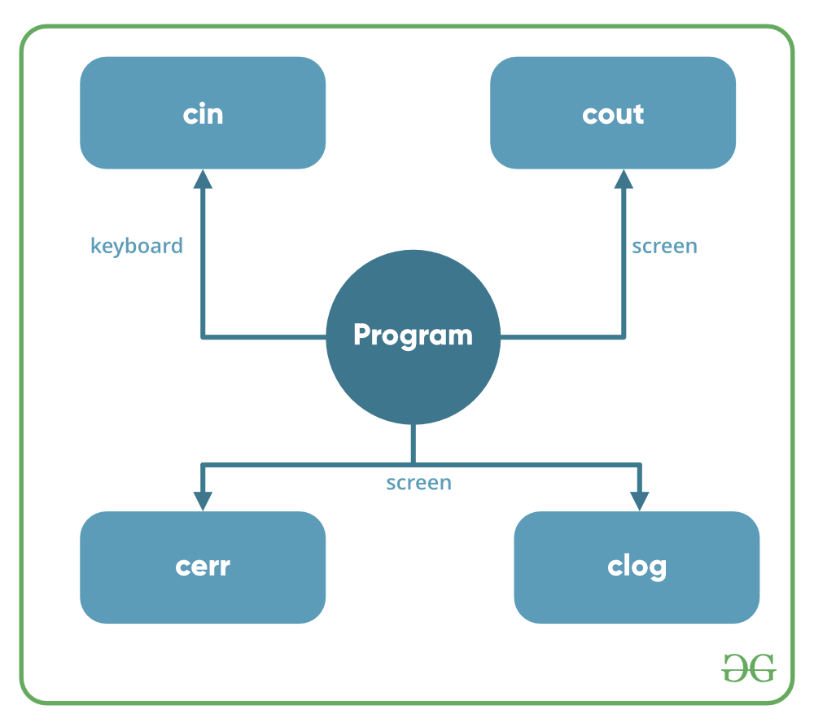
Basic Input / Output in C++

Slide 2
cout
cerr
#include <iostream>
using namespace std;
int main()
{
char sample[] = "GeeksforGeeks";
cout << sample << " - A portal for geeks";
return 0;
}
#include <iostream>
using namespace std;
int main()
{
cerr << "An error occurred";
return 0;
}

Slide 3
Cin=standard input stream
#include <iostream>
using namespace std;
int main()
{
int age;
cout << "Enter your age:";
cin >> age;
cout << "\nYour age is: " << age;
return 0;
}

