Slide 1
MAR ATHANASIUS COLLEGE OF ENGINEERING, KOTHAMANGALAM
Department of Computer Applications | MCA Mini Project (Semester 3)
Medical Specialty Classification using TF-IDF and Ensemble Machine Learning
FIRST PROJECT PRESENTATION
Clinical NLP
TF-IDF Vectorization
Supervised ML
Soft Voting Ensemble
Flask Deployment
PRESENTED BY
Jiphin George
Register No: MAC25MCA-2033 Course: Master of Computer Applications (MCA)
PROJECT GUIDE
Prof. Biju Skaria
Department of Computer Applications Mar Athanasius College of Engineering, Kothamangalam

Slide 2
MCA MINI PROJECT | INTRODUCTION
Medical Specialty Classification using TF-IDF and Ensemble Machine Learning
Problem Statement & Project Overview
1. Clinical Text
Unstructured medical narratives & patient records
2. Text Preprocessing
Cleaning, lemmatization & medical stop-words
3. TF-IDF Extraction
Unigram/bigram numerical vectorization
4. Ensemble ML
Proposed Calibrated Soft-Voting Ensemble
5. Medical Specialty
Automated prediction across 40 departments
THE CLINICAL CHALLENGE: MANUAL CLASSIFICATION
THE PROPOSED SOLUTION: AUTOMATED ML PIPELINE
• Unstructured Clinical Narratives: Modern hospitals generate thousands of medical dictations, discharge summaries, and consult notes daily stored entirely as unstructured free text.
• High Vocabulary Diversity & Jargon: Medical terminology varies drastically between subdomains, containing dense Latin roots, complex clinical abbreviations, and doctor-specific phrasing.
• Labor-Intensive & Error-Prone Tagging: Manual review and indexing across 40+ medical specialties is severely time-consuming, expensive, and subject to human cognitive fatigue.
• Inconsistent Cross-Department Labeling: Different human annotators assign conflicting specialty tags to overlapping patient cases, impairing hospital record retrieval and patient workflow.
✓ Automated NLP & TF-IDF Extraction: Transforms unstructured medical text through lowercasing, stop-word removal, and lemmatization into standardized, high-dimensional TF-IDF feature vectors.
✓ Multi-Classifier Supervised Learning: Evaluates four distinct algorithms: SVM, Random Forest, Logistic Regression, and Multinomial Naive Bayes.
✓ Soft Consensus Voting Ensemble: Synthesizes average probability distributions across candidate models to mitigate individual classifier bias and reduce variance.
✓ Live Interactive Web Deployment: Integrates the serialized pipeline into a lightweight Flask web application, delivering instant specialty predictions and confidence scores for clinicians.
Department of Computer Applications | MACE
Mar Athanasius College of Engineering, Kothamangalam
Slide 2 of 15

Slide 3
MCA MINI PROJECT | LITERATURE REVIEW
Medical Specialty Classification using TF-IDF and Ensemble Machine Learning
Literature Review: Background & Research Landscape
1. Prior Literature
Validation of ML for clinical text
2. Key Methodologies
TF-IDF vectorization & linear classifiers
3. Identified Gap
High compute requirements & model variance
4. Proposed Architecture
Lightweight soft voting ensemble on web
Clinical NLP & Preprocessing
• Clinical narratives contain abbreviations, punctuation noise, and non-standard doctor shorthand.
• Implements a 5-step sequence: Cleaning, Lowercasing, Tokenization, Stop-word removal, and Lemmatization.
• Morphological lemmatization normalizes inflected clinical terms while preserving diagnostic root semantics.
TF-IDF Feature Representation
• Converts unstructured medical text into standardized, high-dimensional sparse numerical feature vectors.
• Sublinear scaling (1 + log(TF)) dampens repetitive non-informative terms while highlighting discriminative tokens.
• Computationally lightweight; enables rapid CPU-based real-time inference on web platforms.
Supervised ML Classifiers
• Linear models (SVM, Logistic Regression) excel on high-dimensional sparse text representations.
• Random Forest introduces non-linear decision partitioning and bagging variance reduction.
• Multinomial Naive Bayes provides fast, effective probabilistic likelihood estimation for text vectors.
Ensemble Learning & Research Gap
• Identified Gap: Many deep learning approaches demand heavy GPU resources, while single models show variance on rare specialties.
• Proposed Solution: An accessible Soft Voting Ensemble combining calibrated base models for balanced classification.
• Practical Outcome: Achieves robust multi-class accuracy across all 40 specialties on standard CPU hardware.
Department of Computer Applications | MACE
Mar Athanasius College of Engineering, Kothamangalam
Slide 3 of 15

Slide 4
MCA MINI PROJECT | LITERATURE REVIEW
Medical Specialty Classification using TF-IDF and Ensemble Machine Learning
Summary of Key Research Papers
PAPER 1
Clinical Text Classification with Word Representation Features and Machine Learning
Authors: Omar AM, Elhoseny M, Hassanien AM (2023)
METHODOLOGY & DATASET:
EMR Clinical Transcriptions | Evaluated BOW, TF-IDF, and Word2Vec across LR, SVM, Naive Bayes, and k-NN.
KEY RESEARCH FINDING:
Linear classifiers and SVM proved highly effective and computationally efficient on high-dimensional text vectors.
DIRECT RELEVANCE TO OUR SYSTEM:
Establishes our multi-phase text preprocessing and TF-IDF feature representation pipeline.
PAPER 2
Medical Specialty Classification Based on Semiadversarial Data Augmentation
Authors: Zhang H, Zhu D, Tan H, Shafiq M, Gu Z (2023)
METHODOLOGY & DATASET:
Kaggle Medical Specialty Dataset | Evaluated domain noun weighting and feature representations across specialty classes.
KEY RESEARCH FINDING:
Domain-specific medical nouns carry the strongest discriminative signal for specialty categorization.
DIRECT RELEVANCE TO OUR SYSTEM:
Highlights class imbalance in MTSamples; motivates an accessible TF-IDF ensemble for all 40 classes on standard CPUs.
PAPER 3
A Keyword-Enhanced Approach to Handle Class Imbalance in Clinical Text
Authors: Blanchard AE, Gao S, Yoon HJ, Tourassi G (2022)
METHODOLOGY & DATASET:
Clinical Pathology Reports | Evaluated keyword-constrained weighting on imbalanced clinical narratives.
KEY RESEARCH FINDING:
Targeted keyword features improved classification on minority classes without degrading majority performance.
DIRECT RELEVANCE TO OUR SYSTEM:
Confirms n-gram keyword weighting preserves rare specialty signals, justifying TF-IDF and stratified evaluation.
Department of Computer Applications | MACE
Mar Athanasius College of Engineering, Kothamangalam
Slide 4 of 15

Slide 5
MCA MINI PROJECT | DATA EXPLORATION
Medical Specialty Classification using TF-IDF and Ensemble Machine Learning
Dataset Overview: Kaggle MTSamples Corpus
4,999
INITIAL RAW RECORDS
Total transcription files in Kaggle dataset
~40
MEDICAL SPECIALTIES
Multi-class medical classification targets
4,966
USABLE REPORTS AFTER CLEANING
Complete records after dropping blank nulls
33
DROPPED NULL SAMPLES
Zero-length empty text reports identified
DATASET PROVENANCE & CLINICAL CONTEXT
• Public Benchmark Dataset: The MTSamples dataset is a publicly available collection of medical transcription samples commonly used for text classification research.
• Privacy Consideration: Enables machine learning experimentation on realistic clinical narratives without requiring access to private hospital records.
• Diverse Medical Narratives: Contains actual physician dictations spanning operative notes, discharge summaries, emergency consultations, physical examinations, and patient histories.
• Multi-Class Domain Breadth: Encompasses 40 distinct specialty disciplines from General Medicine and Surgery to Neurosurgery, Cardiology, and Pediatrics.
KEY DATASET ATTRIBUTES & ROLES
• transcription (Primary Feature Input): Contains full free-text clinical narrative. Serves as the raw textual input for our 5-step NLP preprocessing and TF-IDF feature extraction pipeline.
• medical_specialty (Target Class Label): The ground-truth categorical specialty label (40 distinct classes) to be learned and predicted by the supervised machine learning models.
• description (Secondary Context): Short clinician summary of the medical case; utilized during exploratory validation to verify narrative diagnostic alignment.
• keywords (Omitted Attribute): Free-form clinician tags containing 21.36% missing values. Omitted from the model pipeline to prevent sparse keyword noise.
Department of Computer Applications | MACE
Mar Athanasius College of Engineering, Kothamangalam
Slide 5 of 15

Slide 6
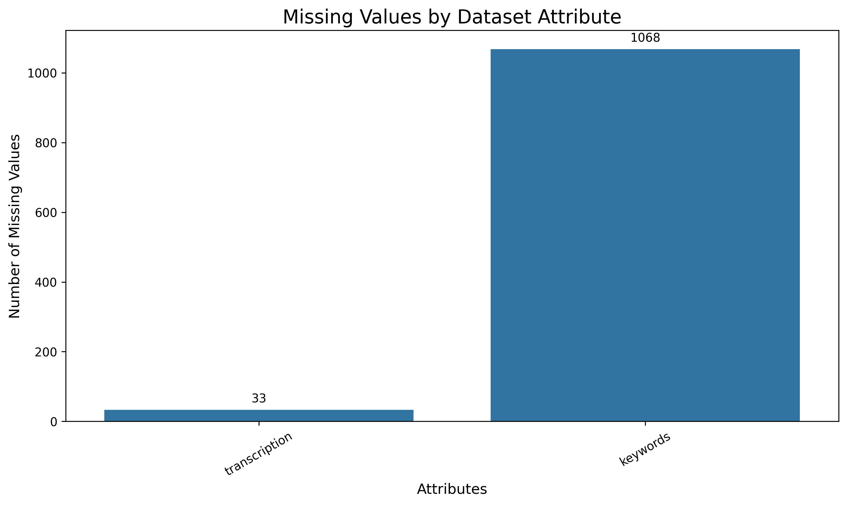
MCA MINI PROJECT | DATA EXPLORATION
Medical Specialty Classification using TF-IDF and Ensemble Machine Learning
Data Exploration: Dataset Quality & Missing Value Analysis
CRITICAL DATA QUALITY OBSERVATIONS
✓ Transcription Missing Values (33 Records)
Exploratory audit revealed exactly 33 records (0.66%) with completely blank/null transcription text. Because clinical narrative is the core model input, these 33 rows were safely pruned.
✓ Target Label Completeness (0 Missing)
The target variable 'medical_specialty' exhibits 100% data integrity with zero null values across all 4,999 records, ensuring dependable supervised classification ground truth.
✓ Keywords Attribute Sparsity (1,068 Missing)
The 'keywords' field contains 1,068 missing entries (21.36%). To avoid artificial noise and severe missingness imputation, it was excluded from feature vectorization.
✓ Final Usable Dataset (4,966 Records)
Following systematic data cleaning, a pristine subset of 4,966 high-integrity clinical reports remains, providing robust data for model training and cross-validation.
Figure: Missing Value Distribution across Dataset Attributes
Systematic missing value analysis verifies that transcription has minimal nulls (0.66%), medical_specialty is 100% complete, and keywords has severe sparsity (21.36%).
Department of Computer Applications | MACE
Mar Athanasius College of Engineering, Kothamangalam
Slide 6 of 15

Slide 7
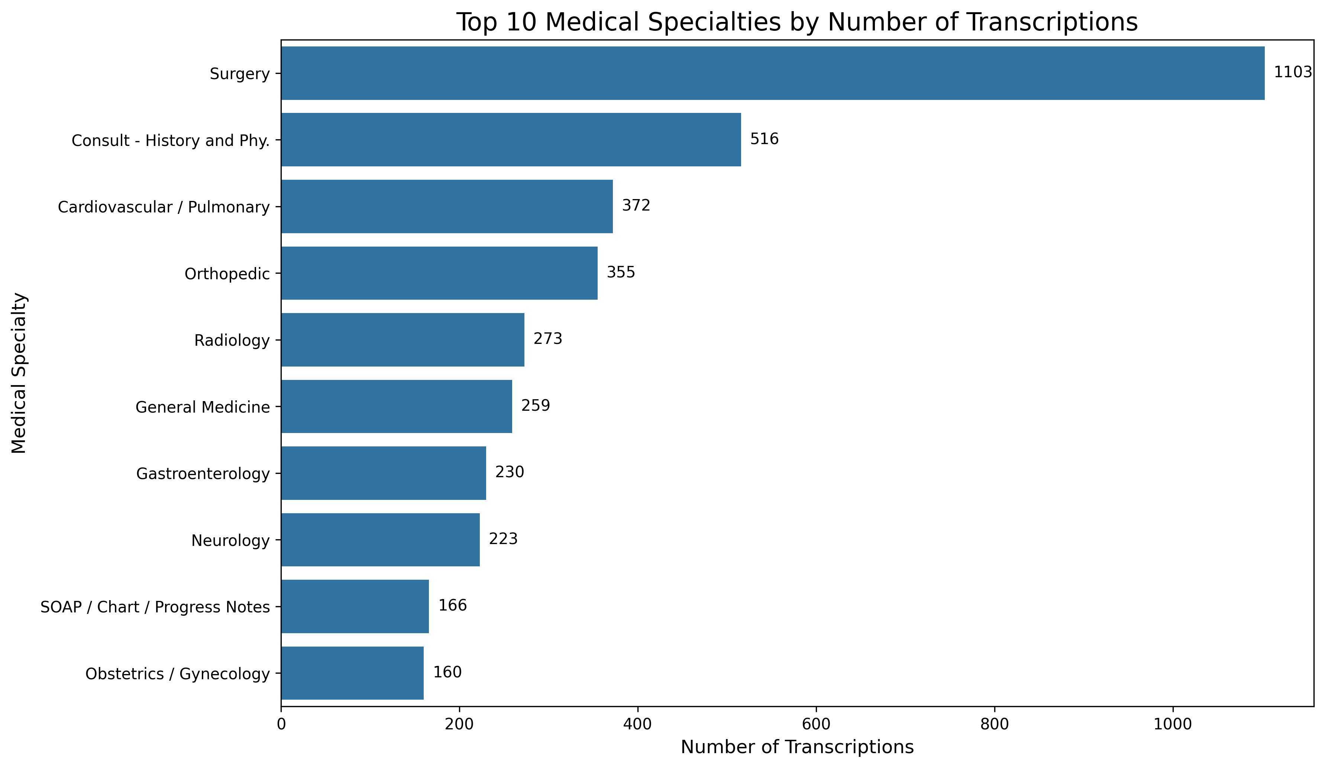
MCA MINI PROJECT | DATA EXPLORATION
Medical Specialty Classification using TF-IDF and Ensemble Machine Learning
Data Exploration: Medical Specialty Class Distribution
DISTRIBUTION INSIGHTS & STRATEGY
• Prominent Class Imbalance
Surgery represents 1,103 out of 4,999 records (~22.1%), while minority specialties (e.g., Hospice, Allergy) contain fewer than 20 cases each.
• Top 10 High Concentration
The top 10 medical specialties collectively account for over 70% of all clinical reports, forming a pronounced majority cluster.
• Mandatory Stratified Splitting
To prevent minority classes from being excluded during train-test partitioning, stratified sampling (80% train / 20% test) is strictly required.
• Multi-Metric Evaluation Design
Accuracy alone is misleading on imbalanced data. Evaluation must incorporate Macro-Precision, Macro-Recall, and Weighted F1-Score.
Figure: Frequency Distribution of Top 10 Medical Specialties
Surgery dominates the dataset with 1,103 reports, followed by Consult - History and Phy. (516) and Cardiovascular / Pulmonary (372), creating a clearly imbalanced multi-class distribution.
Department of Computer Applications | MACE
Mar Athanasius College of Engineering, Kothamangalam
Slide 7 of 15

Slide 8
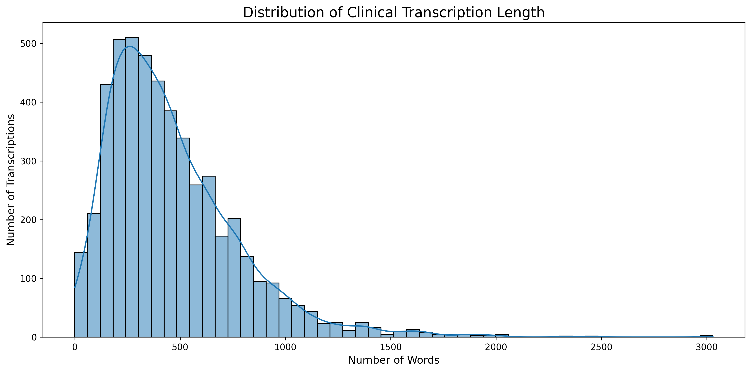
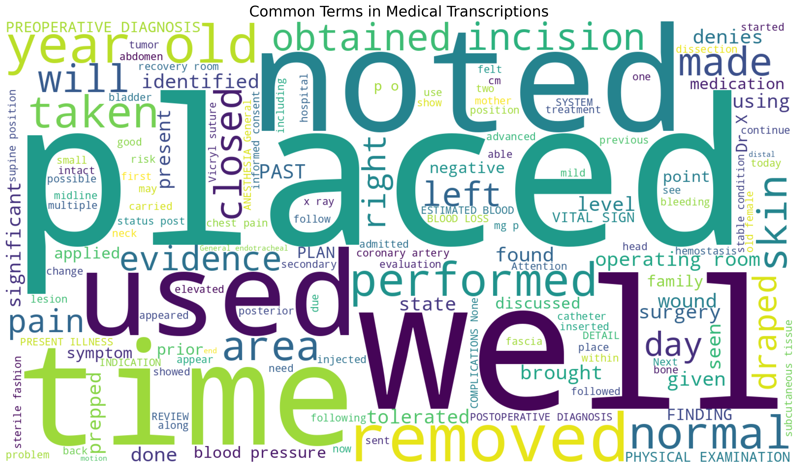
MCA MINI PROJECT | DATA EXPLORATION
Medical Specialty Classification using TF-IDF and Ensemble Machine Learning
Data Exploration: Clinical Transcription Text & Lexical Analysis
KEY FINDINGS: TEXT LENGTH DISTRIBUTION
• Right-Skewed Distribution: Most clinical notes span 200 to 700 words, reflecting concise clinical summaries.
• Detailed Operative Reports: A long tail extends beyond 1,500+ words for complex surgical procedures and multi-system consults.
• Impact on Feature Representation: Variation in document length supports the use of normalized TF-IDF representations to reduce the influence of document magnitude on feature comparison.
KEY FINDINGS: CLINICAL LEXICAL PATTERNS
• Dominant Clinical Jargon: Pervasive occurrences of clinical terms like 'patient', 'procedure', 'history', 'diagnosis', 'left', 'right'.
• Stop-word Handling: Common non-informative words are removed during preprocessing while preserving clinically meaningful terminology.
• Sublinear Term Frequency: Sublinear scaling (1 + log(TF)) dampens repetitive non-informative terms to highlight discriminative features.
Department of Computer Applications | MACE
Mar Athanasius College of Engineering, Kothamangalam
Slide 8 of 15

Slide 9
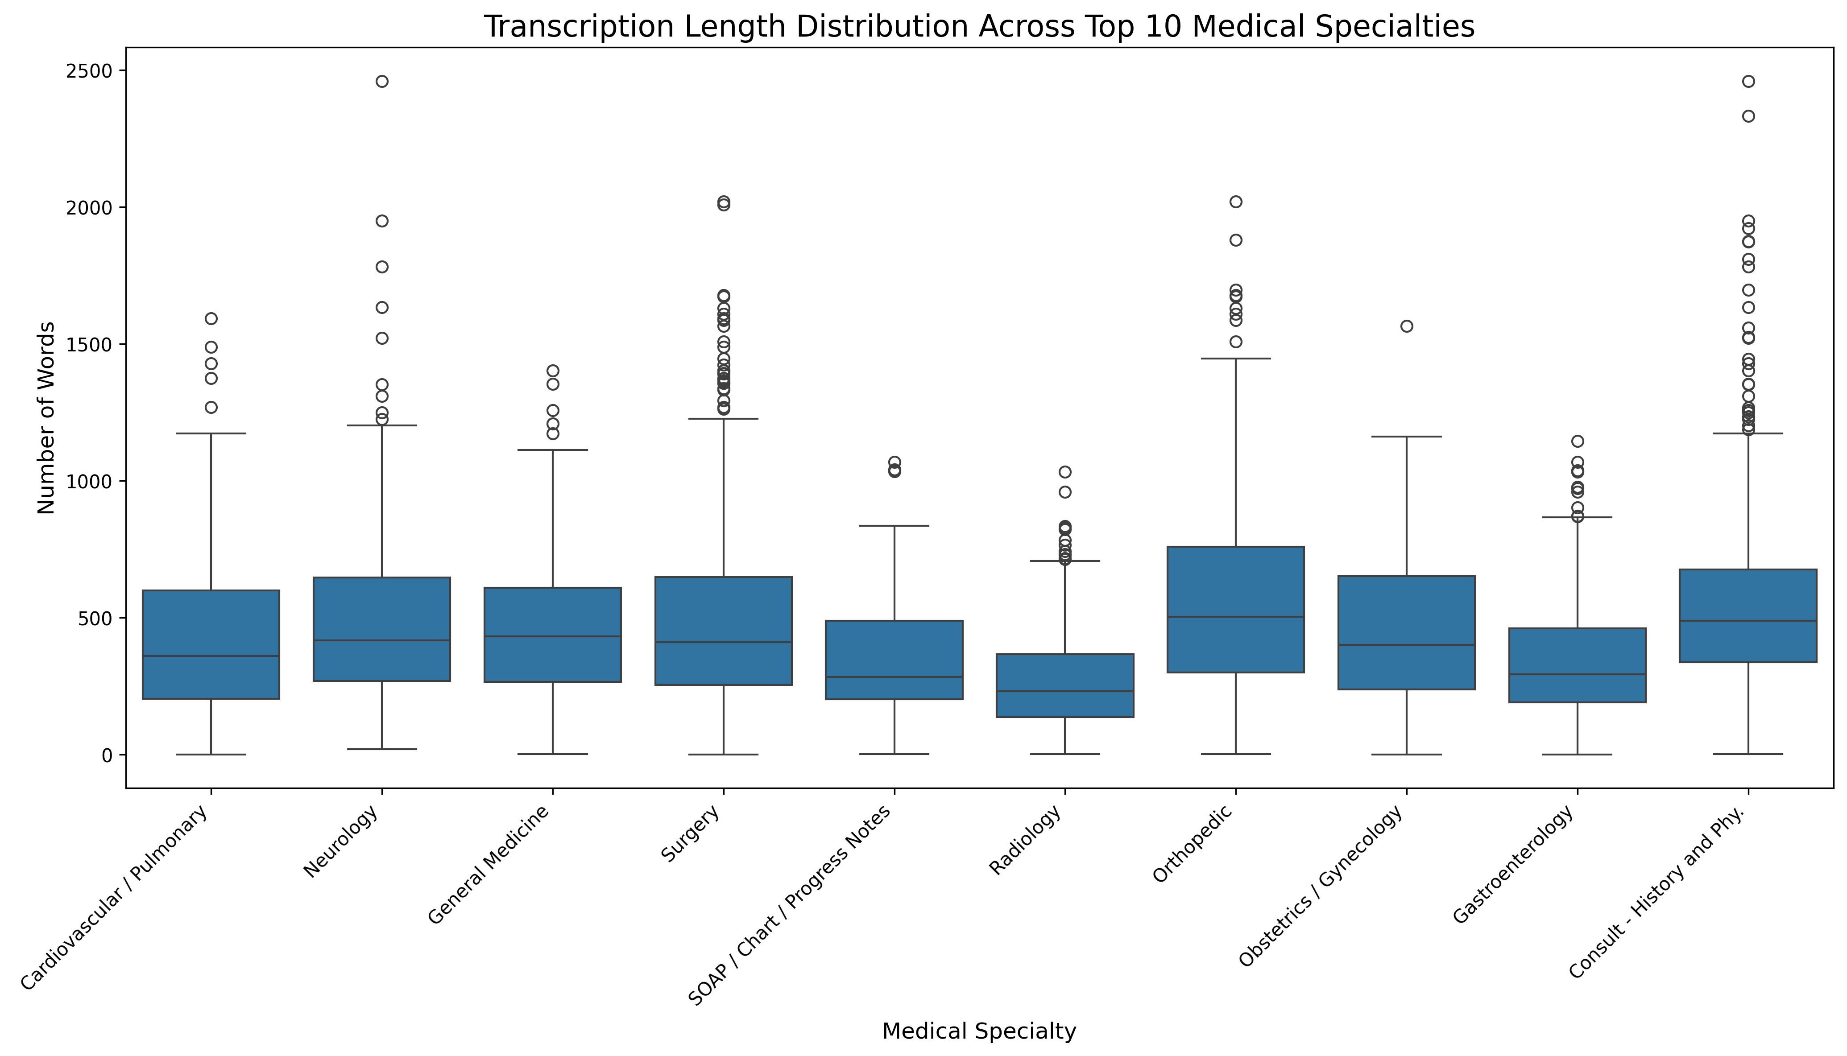
MCA MINI PROJECT | DATA EXPLORATION
Medical Specialty Classification using TF-IDF and Ensemble Machine Learning
Transcription Length Across Medical Specialties & EDA Summary
SPECIALTY-WISE VARIATION
• Procedural vs Diagnostic Documentation: Specialties like Surgery and Orthopedic require comprehensive documentation of intra-operative procedures, yielding longer texts with heavy technical outliers.
• Concise Clinical Encounters: Fields like Dermatology and Radiology center around concise focal findings, presenting substantially tighter word count distributions.
EDA PHASE CONCLUSION
The comprehensive exploratory analysis confirms that the clinical corpus exhibits diverse document lengths, lexical sparsity, missing values, and severe class imbalance. These empirical findings establish the foundation for our 5-step NLP preprocessing, sublinear TF-IDF vectorization, stratified partitioning, and soft voting ensemble modeling.
Figure: Transcription Length Boxplots Across Top 10 Specialties
Substantial variance exists between specialties: surgical notes feature high median lengths and widespread upper outliers, whereas consultative and diagnostic notes are comparatively concise.
Department of Computer Applications | MACE
Mar Athanasius College of Engineering, Kothamangalam
Slide 9 of 15

Slide 10
MCA MINI PROJECT | PROPOSED ALGORITHMS
Medical Specialty Classification using TF-IDF and Ensemble Machine Learning
Details of Proposed Machine Learning Algorithms
FOUNDATIONAL DISTINCTION: FEATURE EXTRACTION vs. CLASSIFICATION ESTIMATORS
TF-IDF (Term Frequency–Inverse Document Frequency) is the mathematical feature representation technique that vectorizes text into sparse matrices. The four algorithms below are the distinct Supervised Machine Learning Classifiers evaluated in our pipeline.
Logistic Regression (LR)
LINEAR PROBABILISTIC BASELINE
• Formulation: Multi-class linear model using cross-entropy loss and softmax probability mapping.
• High-Dimensional Efficacy: Highly efficient and fast convergence on sparse, high-dimensional TF-IDF vectors.
• Probability Output: Naturally provides class probability estimates, making it suitable for soft-voting ensemble aggregation.
Support Vector Machine (SVM)
MAXIMUM-MARGIN HYPERPLANE
• Formulation: Constructs optimal decision boundaries by maximizing the margin between different medical specialty classes.
• Sparse Vector Superiority: Consistently recognized in clinical NLP literature as a top performer for high-dimensional text classification.
• Decision Boundary Optimization: Effectively establishes robust decision boundaries across high-dimensional clinical feature vectors.
Random Forest (RF)
BAGGED DECISION TREE ENSEMBLE
• Formulation: Ensemble of decorrelated decision trees trained via bootstrap aggregating and random feature subsets.
• Non-Linear Interactions: Effectively captures complex term co-occurrences and non-linear clinical relationships.
• Variance Reduction: Bagging and aggregation across multiple decision trees help reduce variance and improve robustness compared with a single decision tree.
Multinomial Naïve Bayes (MNB)
PROBABILISTIC FEATURE MODEL
• Formulation: Applies Bayes' theorem with conditional feature independence to compute posterior class probabilities.
• Feature Compatibility: Effectively handles non-negative TF-IDF feature representations for probabilistic text classification.
• Laplace Smoothing: Handles zero-probability terms for unobserved medical tokens in test transcriptions.
Department of Computer Applications | MACE
Mar Athanasius College of Engineering, Kothamangalam
Slide 10 of 15

Slide 11
MCA MINI PROJECT | PROPOSED ALGORITHMS
Medical Specialty Classification using TF-IDF and Ensemble Machine Learning
Ensemble Machine Learning Architecture: Soft Voting Strategy
TF-IDF VECTORS
Sublinear frequency Unigrams & Bigrams Sparse Matrix
Calibrated SVM
SOFT VOTING ENSEMBLE
Probability Consensus Average Probability Aggregation Variance Reduction
FINAL PREDICTION
Predicted Specialty + Confidence Score
Random Forest
Logistic Regression
Multinomial Naive Bayes
Why Soft Voting Over Hard Voting?
• Probability Granularity: Hard voting counts binary majority votes, ignoring confidence. Soft voting averages class probability distributions.
• Preserves Subtle Confidence: Ambiguous clinical notes yield smooth probability distributions rather than abrupt majority deadlocks.
• Potential Reduction in Misclassification: Leverages agreement across diverse inductive biases to mitigate individual classifier variance.
SVM in the Ensemble
• SVM is used as one of the base machine learning classifiers for medical specialty classification.
• Probability calibration enables the SVM classifier to contribute class probability estimates to the soft-voting ensemble.
• It learns decision boundaries between different medical specialty categories using the TF-IDF feature representation.
Expected Ensemble Advantages
• Bias-Variance Trade-off: Combines linear hyperplanes (SVM, LR) with tree partitioning (RF) and probabilistic priors (MNB) to reduce prediction variance.
• Minority Specialty Sensitivity: Potentially improves recognition of under-represented medical classes with fewer training notes.
• Production Reliability: Is expected to deliver robust, dependable inference prior to serializing the pipeline for Flask web serving.
Department of Computer Applications | MACE
Mar Athanasius College of Engineering, Kothamangalam
Slide 11 of 15

Slide 12
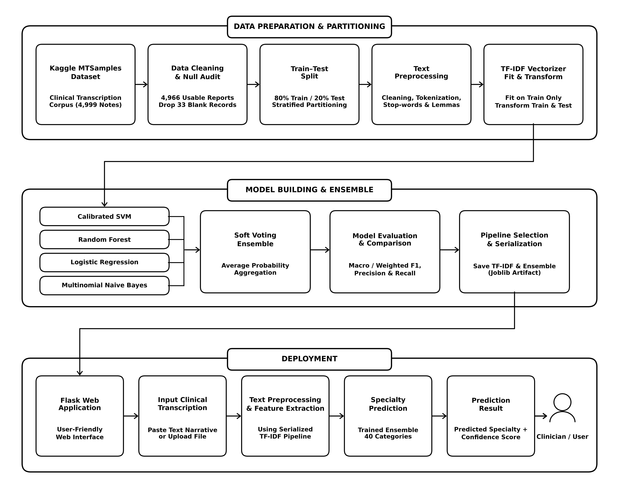
MCA MINI PROJECT | PROJECT PIPELINE
Medical Specialty Classification using TF-IDF and Ensemble Machine Learning
Proposed End-to-End System Project Pipeline
CONTAINER 1: DATA PREPARATION
• Kaggle MTSamples: 4,966 cleaned multi-specialty clinical transcriptions.
• Stratified Train-Test Split: 80% train / 20% test partitioning performed prior to vectorization to strictly prevent data leakage.
• Preprocessing & TF-IDF: 5-step NLP pipeline; TF-IDF vectorizer fitted on training data only, transforming both train and test splits.
CONTAINER 2: MODEL BUILDING & ENSEMBLE
• Parallel Training: Calibrated SVM, Random Forest, Logistic Regression, and Multinomial Naive Bayes on training features.
• Soft Voting Ensemble: Synthesizes probability consensus via average pooling to reduce model variance.
• Evaluation & Serialization: Evaluated across multi-class metrics (Macro F1, Recall); fitted pipeline serialized with Joblib.
CONTAINER 3: DEPLOYMENT STAGE
• Flask Web Application: Interactive clinician-facing dashboard for clinical note entry and automated triage.
• Live Prediction Pipeline: Loads serialized TF-IDF vectorizer and ensemble model for instant inference.
• Confidence Output: Returns predicted specialty category and associated classification confidence percentage.
Department of Computer Applications | MACE
Mar Athanasius College of Engineering, Kothamangalam
Slide 12 of 15

Slide 13
MCA MINI PROJECT | PROGRESS & ROADMAP
Medical Specialty Classification using TF-IDF and Ensemble Machine Learning
Current Project Progress & Implementation Roadmap
CURRENT PROGRESS (PHASE 1 / SPRINT RELEASE I)
✓ Comprehensive Literature Review: Surveyed clinical NLP and machine learning papers, establishing preprocessing standards.
✓ Dataset Acquisition & Cleaning Audit: Acquired Kaggle MTSamples (4,999 records); identified and pruned 33 blank transcripts.
✓ Complete Exploratory Data Analysis: Generated 6 specialized visual distributions covering missing values, class imbalance, and text lengths.
✓ Class Imbalance Profiling: Characterized severe class skew across 40 specialties, formulating stratified sampling strategy.
✓ NLP Preprocessing Pipeline Design: Finalized 5-step sequence: Character Cleaning, Lowercasing, Tokenization, Stop-word Removal, and Lemmatization.
✓ TF-IDF Vectorization Architecture: Selected unigram/bigram tokenization with sublinear term-frequency scaling and L2 normalization.
✓ Model & Ensemble Architecture Formulated: Selected Calibrated SVM, RF, LR, MNB and soft voting probability consensus aggregation.
PLANNED NEXT STEPS (PHASE 2 / SPRINT RELEASE II)
→ Execute Automated Preprocessing Pipeline: Implement modular Python text cleaner to generate clean tokenized transcripts.
→ TF-IDF Vectorizer & Feature Representation: Fit and persist TF-IDF vectorizer; generate high-dimensional sparse feature matrix.
→ Candidate Model Training: Train Calibrated SVM, Random Forest, Logistic Regression, and Multinomial Naive Bayes classifiers.
→ Soft Voting Ensemble Implementation: Implement soft consensus probability aggregation combining all four candidate estimators.
→ Rigorous Multi-Class Model Evaluation: Compute multi-class evaluation metrics: Macro/Weighted Precision, Recall, F1, and Confusion Matrices.
→ Model Serialization & Web Deployment: Serialize trained ensemble with Joblib; build interactive clinician dashboard using Flask.
→ System Testing & Validation: Validate inference latency, specialty prediction accuracy, and confidence score reliability.
CURRENT STATUS SUMMARY & MILESTONE ALIGNMENT
The project has successfully completed the literature review, dataset exploration, and architectural design phases (Sprint Release I). The implementation phase is now commencing according to the project timeline.
Department of Computer Applications | MACE
Mar Athanasius College of Engineering, Kothamangalam
Slide 13 of 15

Slide 14
MCA MINI PROJECT | PROJECT TIMELINE
Medical Specialty Classification using TF-IDF and Ensemble Machine Learning
Project Timeline & Milestone Schedule
ACADEMIC TIMELINE & PRESENTATION MILESTONES (SEMESTER 3 MCA MINI PROJECT)
PHASE 1: FOUNDATION & SPRINT RELEASE I
✓ [17.07.2026] Project Proposal & Synopsis Approval by Guide
Formal approval of project scope, objectives, and feasibility by faculty guide.
✓ [20.07.2026 – 21.07.2026] Project Proposal Presentation
Presented proposal before Department Project Approval Committee.
✓ [Weeks 1–2] Dataset Collection & Exploratory Data Analysis
Acquired Kaggle MTSamples (4,999 records); audited nulls and generated 6 EDA plots.
✓ [Weeks 3–4] Clinical Text Preprocessing Pipeline
Designed 5-step sequence: Cleaning, Lowercasing, Tokenization, Stop-words, Lemmatization.
✓ [Week 5] TF-IDF Vectorization Architecture
Formulated unigram/bigram tokenization with sublinear scaling and sparse matrix layout.
★ [08.09.2026] First Project Presentation ★
Current Milestone — Phase 1 Faculty Review & Initial Progress Defense.
★ [09.09.2026] Sprint Release I ★
Formal submission: EDA diagrams, architecture specifications, and Phase 1 report.
PHASES 2 & 3: MODEL BUILDING, ENSEMBLE & DEPLOYMENT
→ [Week 6] Candidate Model Training & Baseline Evaluation
Train Calibrated SVM, Random Forest, Logistic Regression, and MNB.
★ [18.09.2026] Sprint Release II ★
Milestone release: Trained baseline classifiers and preliminary metrics.
→ [Week 7] Hyperparameter Tuning & Model Comparison
Systematic tuning and comparative performance profiling across candidate estimators.
→ [Week 8] Soft Voting Ensemble Implementation
Construct soft voting ensemble; aggregate consensus probability distributions.
★ [29.09.2026 – 30.09.2026] Interim Project Presentation ★
Progress review and working model demonstration before faculty committee.
→ [Week 9] Flask Web Integration & Serialization
Serialize pipeline with Joblib; build interactive clinician UI for live inference.
★ [09.10.2026] Sprint Release III ★
Integrated system release: Flask web application and serialized ensemble.
→ [Weeks 10–11] Evaluation & System Testing
Multi-class metrics (Macro F1, Recall), confusion matrix analysis, and validation.
★ [22.10.2026 – 23.10.2026] Final Project Presentation ★
Comprehensive final project defense before the examination board.
★ [30.10.2026] Final Report Submission ★
Submission of finalized documentation, technical report, and source code.
Department of Computer Applications | MACE
Mar Athanasius College of Engineering, Kothamangalam
Slide 14 of 15

Slide 15
Thank You!
Questions & Discussion
PROJECT TITLE
Medical Specialty Classification using TF-IDF and Ensemble Machine Learning
STUDENT DETAILS
Jiphin George (MAC25MCA-2033)
Master of Computer Applications (MCA - S3) Department of Computer Applications
PROJECT GUIDE & INSTITUTION
Prof. Biju Skaria
Department of Computer Applications Mar Athanasius College of Engineering, Kothamangalam

