Slide 1
MAR ATHANASIUS COLLEGE OF ENGINEERING, KOTHAMANGALAM
Department of Computer Applications | MCA Mini Project (Semester 3)
Medical Specialty Classification using TF-IDF and Ensemble Machine Learning
FIRST PROJECT PRESENTATION — SPRINT RELEASE I
Clinical NLP
TF-IDF Vectorization
Supervised ML
Soft Voting Ensemble
Flask Deployment
PRESENTED BY
Jiphin George
Register No: MAC25MCA-2033
Course: Master of Computer Applications (MCA)
PROJECT GUIDE
Prof. Biju Skaria
Department of Computer Applications
Mar Athanasius College of Engineering, Kothamangalam

Slide 2
MCA MINI PROJECT | INTRODUCTION
Medical Specialty Classification using TF-IDF and Ensemble Machine Learning
Problem Statement & Project Overview
1. Clinical Text
Unstructured medical narratives & patient records
2. Text Preprocessing
Cleaning, lemmatization & medical stop-words
3. TF-IDF Extraction
Unigram/bigram numerical vectorization
4. Ensemble ML
Calibrated soft-voting classification
5. Medical Specialty
Automated prediction across 40 departments
THE CLINICAL CHALLENGE: MANUAL CLASSIFICATION
THE PROPOSED SOLUTION: AUTOMATED ML PIPELINE
• Unstructured Clinical Narratives: Modern hospitals generate thousands of medical dictations, discharge summaries, and consult notes daily stored entirely as unstructured free text.
• High Vocabulary Diversity & Jargon: Medical terminology varies drastically between subdomains, containing dense Latin roots, complex clinical abbreviations, and doctor-specific phrasing.
• Labor-Intensive & Error-Prone Tagging: Manual review and indexing across 40+ medical specialties is severely time-consuming, expensive, and subject to human cognitive fatigue.
• Inconsistent Cross-Department Labeling: Different human annotators assign conflicting specialty tags to overlapping patient cases, impairing hospital record retrieval and patient workflow.
✓ Automated NLP & TF-IDF Extraction: Transforms unstructured medical text through lowercasing, stop-word removal, and lemmatization into standardized, high-dimensional TF-IDF feature vectors.
✓ Multi-Classifier Supervised Learning: Evaluates four distinct algorithms: SVM, Random Forest, Logistic Regression, and Multinomial Naive Bayes.
✓ Soft Consensus Voting Ensemble: Synthesizes calibrated class probability distributions across all candidate models to mitigate individual classifier bias and reduce variance.
✓ Live Interactive Web Deployment: Integrates the serialized pipeline into a lightweight Flask web application, delivering instant specialty predictions and confidence scores for clinicians.
Department of Computer Applications | MACE
Mar Athanasius College of Engineering, Kothamangalam
Slide 2 of 15

Slide 3
MCA MINI PROJECT | LITERATURE REVIEW
Medical Specialty Classification using TF-IDF and Ensemble Machine Learning
Literature Review: Background & Research Landscape
1. Prior Literature
Validation of ML for clinical text
2. Key Methodologies
TF-IDF vectorization & linear classifiers
3. Identified Gap
High variance & heavy GPU requirements
4. Proposed Architecture
Lightweight soft voting ensemble on web
Clinical NLP & Preprocessing
• Medical text contains distinct lexical noise: contractions, special characters, and non-informative clinical stops.
• Studies establish a standard 5-step sequence: Cleaning, Lowercasing, Stop-word removal, Lemmatization, and Tokenization.
• Domain-specific lemmatization normalizes inflected clinical roots without losing diagnostic context.
TF-IDF Feature Representation
• Clinical notes exhibit high dimensional vocabulary with extreme word frequency variance across specialties.
• TF-IDF with sublinear scaling (1 + log(TF)) dampens repetitive clinical terms ('patient', 'procedure').
• Significantly faster and more lightweight than Word2Vec or deep embeddings, enabling instant local web deployment.
Supervised ML Classifiers
• Literature demonstrates that SVM and Logistic Regression excel at high-dimensional sparse text vectors.
• Random Forest introduces non-linear feature interactions and bagging robustness.
• Multinomial Naive Bayes provides strong, rapid probabilistic likelihoods for word frequency text representations.
Ensemble Learning & Research Gap
• Individual models show variable recall across the 40 imbalanced medical specialties in clinical practice.
• Deep transformer models (BioBERT) require heavy GPU servers, unsuitable for lightweight hospital web apps.
• Research Gap: Need for a fast, accessible Soft Voting Ensemble combining calibrated base estimators.
Department of Computer Applications | MACE
Mar Athanasius College of Engineering, Kothamangalam
Slide 3 of 15

Slide 4
MCA MINI PROJECT | LITERATURE REVIEW
Medical Specialty Classification using TF-IDF and Ensemble Machine Learning
Summary of Key Research Papers
PAPER 1
Clinical Text Classification using Machine Learning
Authors: Almazaydeh et al. (2023)
METHODOLOGY & DATASET:
Kaggle MTSamples Dataset | 5-Stage Modular NLP Pipeline (Cleaning, Lowering, Stop-words, Lemmatization, Tokenization) + TF-IDF Vectorization.
KEY RESEARCH FINDING:
Demonstrated that thorough clinical text preprocessing and TF-IDF feature weighting are critical to prevent sparse lexical noise and boost classification accuracy.
DIRECT RELEVANCE TO OUR SYSTEM:
Establishes our exact 5-step NLP preprocessing pipeline and proves the efficacy of the public Kaggle MTSamples benchmark dataset.
PAPER 2
Clinical Vectorization and Multi-Class Supervised Learning
Authors: Omar et al. (2023)
METHODOLOGY & DATASET:
EMR Narrative Records | Evaluated Logistic Regression, SVM, Multinomial Naive Bayes, and k-NN across clinical categories.
KEY RESEARCH FINDING:
SVM and Logistic Regression outperformed complex non-linear models on high-dimensional text vectors, achieving peak accuracy (92%) with rapid convergence.
DIRECT RELEVANCE TO OUR SYSTEM:
Directly justifies our selection of SVM and Logistic Regression as core candidate estimators for sparse TF-IDF text matrices.
PAPER 3
Medical Subdomain Classification & Ensemble Aggregation
Authors: Weng et al. (2017) / Al-Garadi et al.
METHODOLOGY & DATASET:
Multi-Specialty Clinical Narratives | Multi-estimator aggregation, probability consensus, and tree-based decision ensembles.
KEY RESEARCH FINDING:
Ensemble voting across complementary classifiers significantly mitigates individual estimator variance and improves multi-class minority specialty recognition.
DIRECT RELEVANCE TO OUR SYSTEM:
Provides the foundational justification for our proposed Soft Consensus Voting Ensemble combining SVM, Random Forest, LR, and MNB.
Department of Computer Applications | MACE
Mar Athanasius College of Engineering, Kothamangalam
Slide 4 of 15

Slide 5
MCA MINI PROJECT | DATA EXPLORATION
Medical Specialty Classification using TF-IDF and Ensemble Machine Learning
Dataset Overview: Kaggle MTSamples Corpus
4,999
INITIAL RAW RECORDS
Total transcription files in Kaggle dataset
~40
MEDICAL SPECIALTIES
Multi-class medical classification targets
4,966
USABLE REPORTS AFTER CLEANING
Complete records after dropping blank nulls
33
DROPPED NULL SAMPLES
Zero-length empty text reports identified
DATASET PROVENANCE & CLINICAL CONTEXT
• Public Academic Benchmark: Sourced from the verified Kaggle MTSamples repository, comprising real-world anonymized medical transcription dictations.
• Overcoming HIPAA Constraints: HIPAA privacy regulations legally restrict distribution of private hospital electronic health records (EHR). MTSamples provides an authentic, ethically validated substitute.
• Diverse Medical Narratives: Contains actual physician dictations spanning operative notes, discharge summaries, emergency consultations, physical examinations, and patient histories.
• Multi-Class Domain Breadth: Encompasses 40 distinct specialty disciplines from General Medicine and Surgery to Neurosurgery, Cardiology, and Pediatrics.
KEY DATASET ATTRIBUTES & ROLES
• transcription (Primary Feature Input): Contains full free-text clinical narrative. Serves as the raw textual input for our 5-step NLP preprocessing and TF-IDF feature extraction pipeline.
• medical_specialty (Target Class Label): The ground-truth categorical specialty label (40 distinct classes) to be learned and predicted by the supervised machine learning models.
• description (Secondary Context): Short clinician summary of the medical case; utilized during exploratory validation to verify narrative diagnostic alignment.
• keywords (Omitted Attribute): Free-form clinician tags containing 21.36% missing values. Omitted from the model pipeline to prevent sparse keyword noise.
Department of Computer Applications | MACE
Mar Athanasius College of Engineering, Kothamangalam
Slide 5 of 15

Slide 6
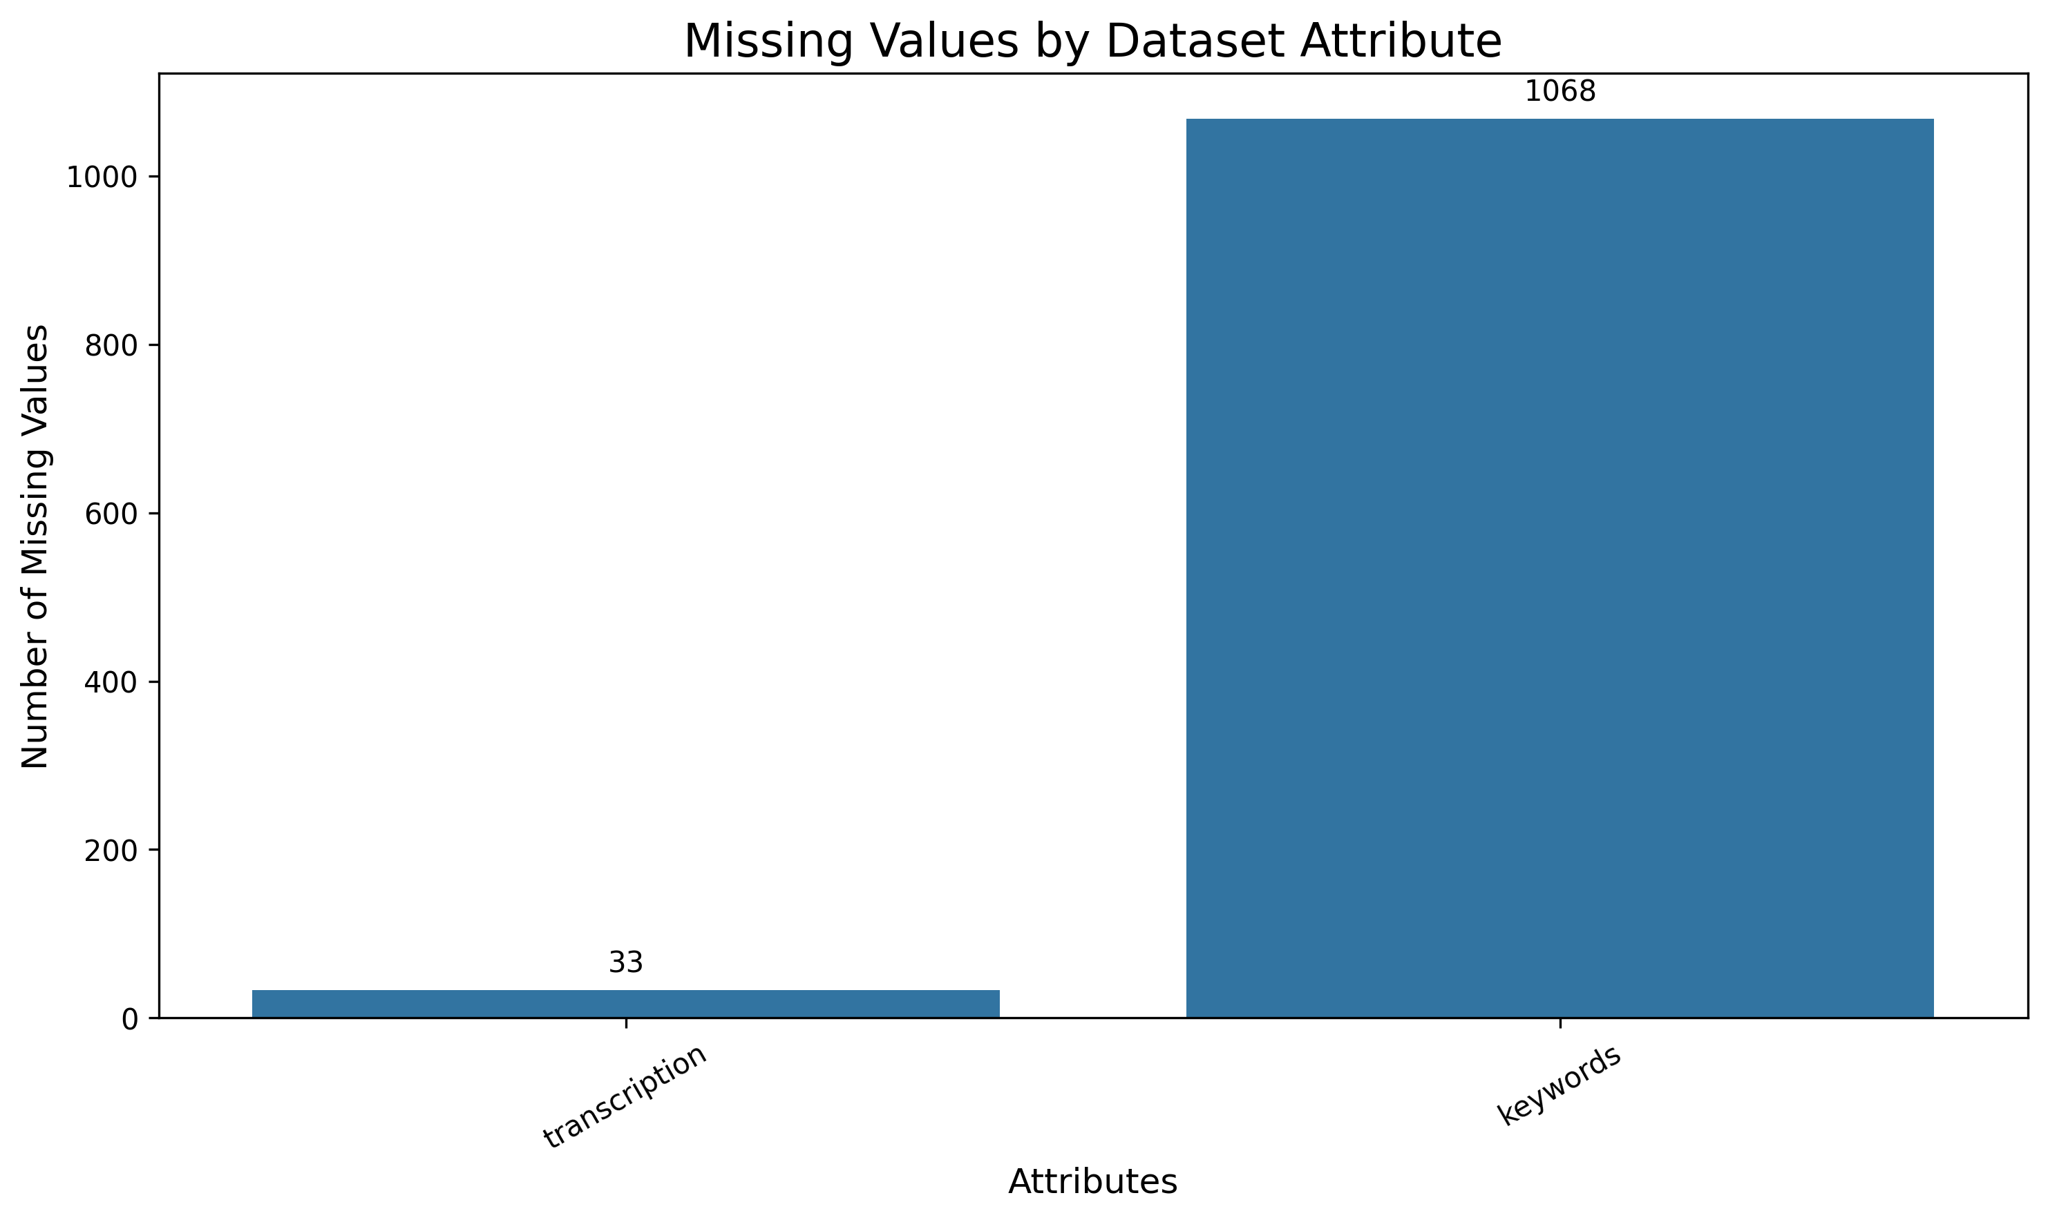
MCA MINI PROJECT | DATA EXPLORATION
Medical Specialty Classification using TF-IDF and Ensemble Machine Learning
Data Exploration: Dataset Quality & Missing Value Analysis
CRITICAL DATA QUALITY OBSERVATIONS
✓ Transcription Missing Values (33 Records)
Exploratory audit revealed exactly 33 records (0.66%) with completely blank/null transcription text. Because clinical narrative is the core model input, these 33 rows were safely pruned.
✓ Target Label Completeness (0 Missing)
The target variable 'medical_specialty' exhibits 100% data integrity with zero null values across all 4,999 records, ensuring dependable supervised classification ground truth.
✓ Keywords Attribute Sparsity (1,068 Missing)
The 'keywords' field contains 1,068 missing entries (21.36%). To avoid artificial noise and severe missingness imputation, it was excluded from feature vectorization.
✓ Final Usable Dataset (4,966 Records)
Following systematic data cleaning, a pristine subset of 4,966 high-integrity clinical reports remains, providing robust data for model training and cross-validation.
Figure: Missing Value Distribution across Dataset Attributes
Systematic missing value analysis verifies that transcription has minimal nulls (0.66%), medical_specialty is 100% complete, and keywords has severe sparsity (21.36%).
Department of Computer Applications | MACE
Mar Athanasius College of Engineering, Kothamangalam
Slide 6 of 15

Slide 7
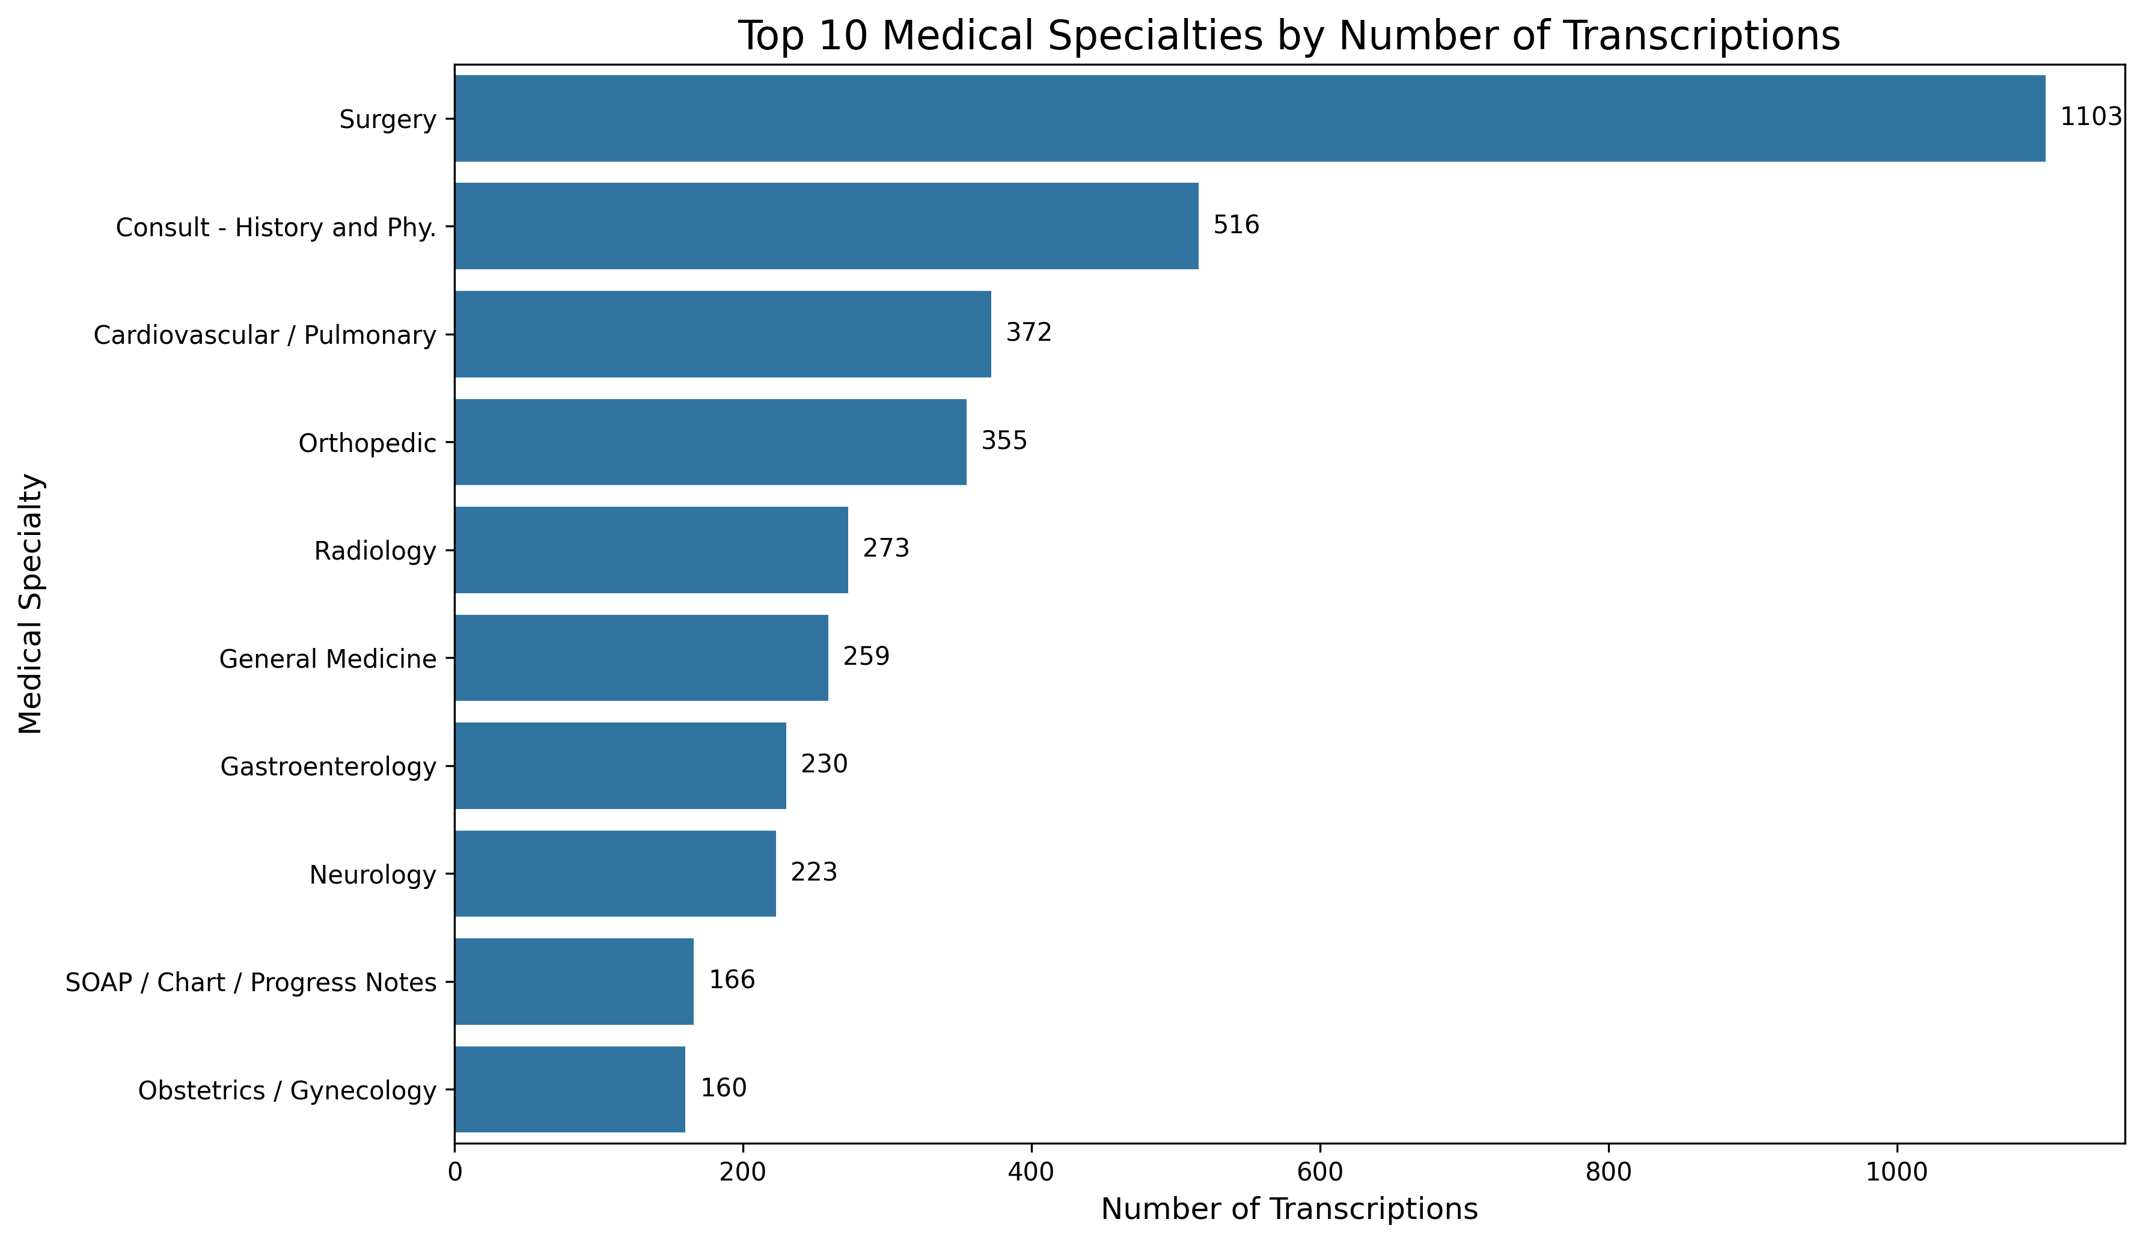
MCA MINI PROJECT | DATA EXPLORATION
Medical Specialty Classification using TF-IDF and Ensemble Machine Learning
Data Exploration: Medical Specialty Class Distribution
DISTRIBUTION INSIGHTS & STRATEGY
• Prominent Class Imbalance
Surgery represents 1,088 out of 4,966 records (~21.9%), while minority specialties (e.g., Hospice, Allergy) contain fewer than 20 cases each.
• Top 10 High Concentration
The top 10 medical specialties collectively account for over 70% of all clinical reports, forming a pronounced majority cluster.
• Mandatory Stratified Splitting
To prevent minority classes from being excluded during train-test partitioning, stratified sampling (80% train / 20% test) is strictly required.
• Multi-Metric Evaluation Design
Accuracy alone is misleading on imbalanced data. Evaluation must incorporate Macro-Precision, Macro-Recall, and Weighted F1-Score.
Figure: Frequency Distribution of Top 10 Medical Specialties
Surgery dominates the dataset with 1,088 reports, followed by Consultative Medicine (516) and Cardiovascular (371), creating a classic long-tailed multi-class distribution.
Department of Computer Applications | MACE
Mar Athanasius College of Engineering, Kothamangalam
Slide 7 of 15

Slide 8
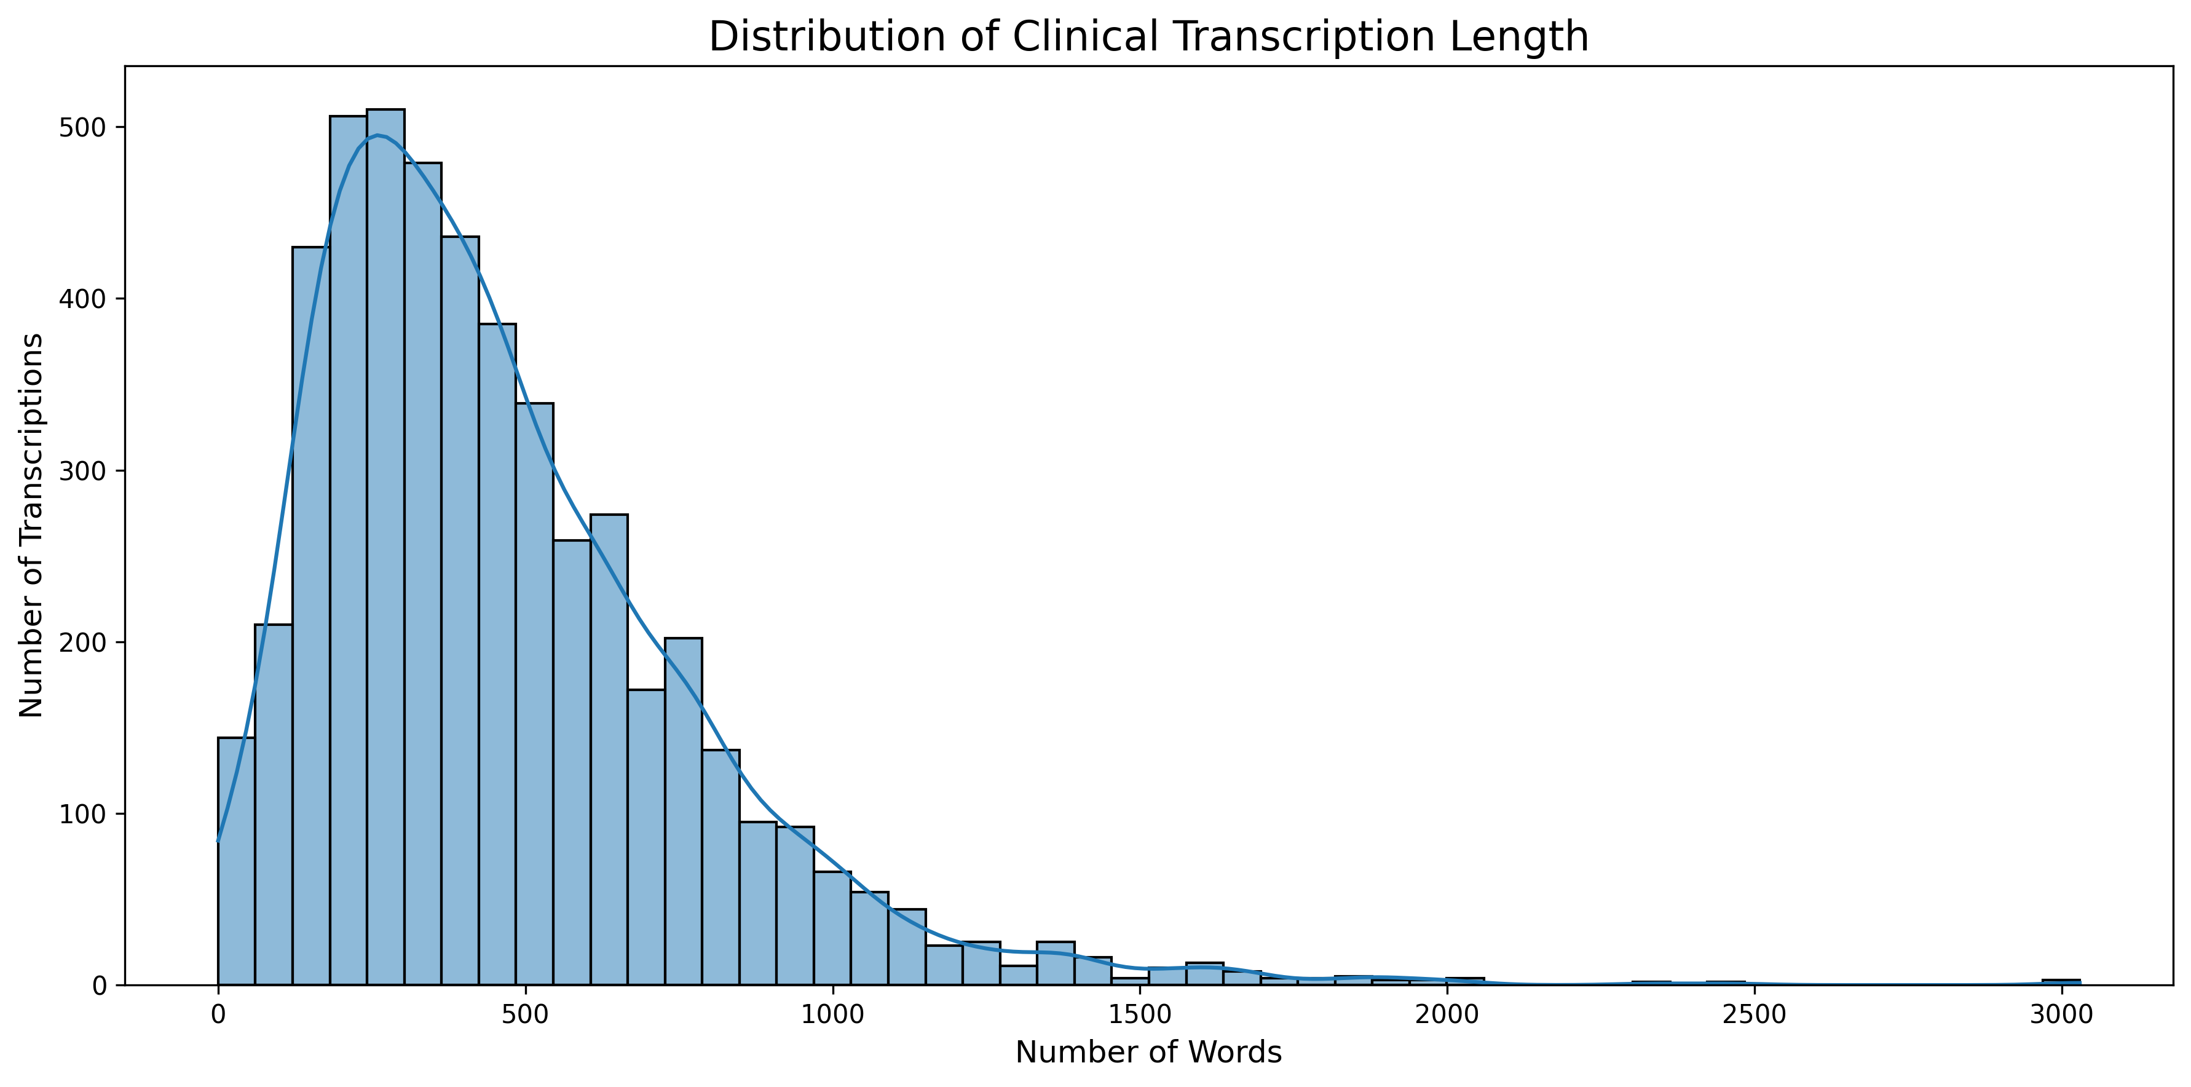
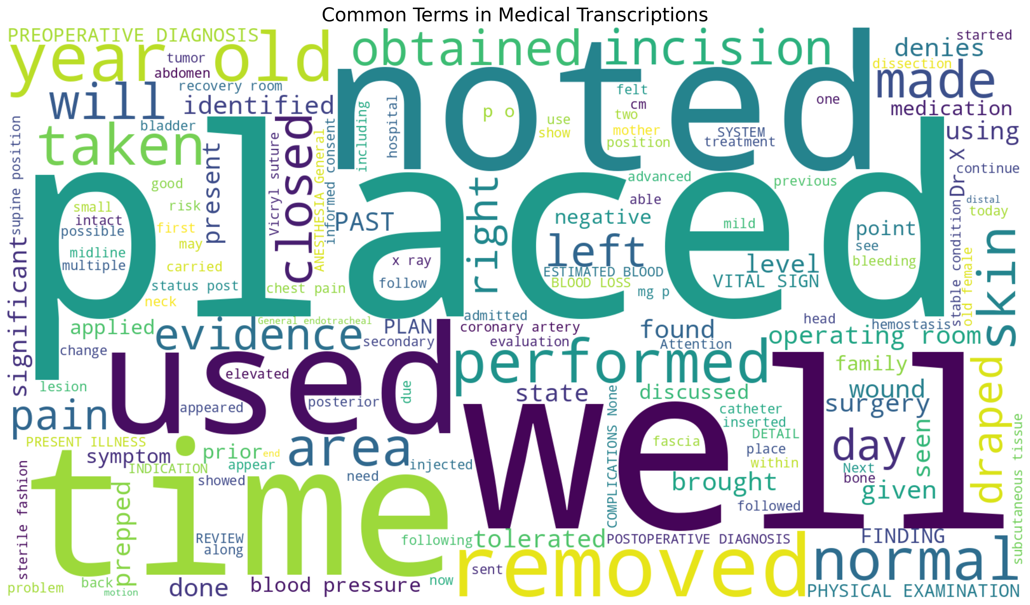
MCA MINI PROJECT | DATA EXPLORATION
Medical Specialty Classification using TF-IDF and Ensemble Machine Learning
Data Exploration: Clinical Transcription Text & Lexical Analysis
KEY FINDINGS: TEXT LENGTH DISTRIBUTION
• Right-Skewed Distribution: Most clinical notes span 200 to 700 words, reflecting concise clinical summaries.
• Detailed Operative Reports: A long tail extends beyond 1,500+ words for complex surgical procedures and multi-system consults.
• Impact on Feature Space: Extreme length disparity necessitates L2 Euclidean vector normalization in TF-IDF.
KEY FINDINGS: CLINICAL LEXICAL PATTERNS
• Dominant Clinical Jargon: Pervasive occurrences of terms like 'patient', 'procedure', 'history', 'diagnosis', 'left', 'right'.
• Stop-word Removal & Sublinear Scaling: Validates removing non-discriminative medical stopwords and applying sublinear term frequency weighting.
Department of Computer Applications | MACE
Mar Athanasius College of Engineering, Kothamangalam
Slide 8 of 15

Slide 9
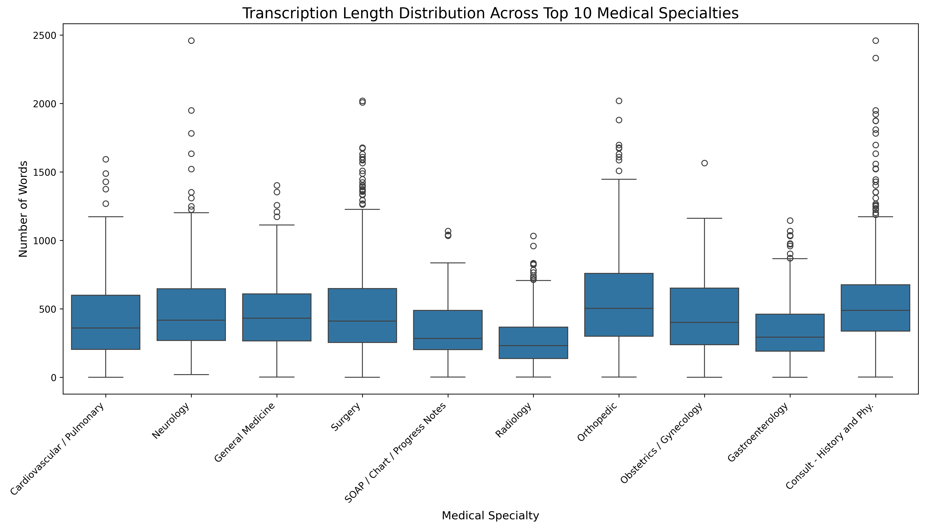
MCA MINI PROJECT | DATA EXPLORATION
Medical Specialty Classification using TF-IDF and Ensemble Machine Learning
Transcription Length Across Medical Specialties & EDA Summary
SPECIALTY-WISE VARIATION
• Operational vs Diagnostic Depth: Specialties like Surgery and Orthopedic require comprehensive documentation of intra-operative procedures, yielding longer texts with heavy technical outliers.
• Concise Clinical Encounters: Fields like Dermatology and Radiology center around concise focal findings, presenting substantially tighter word count distributions.
EDA PHASE CONCLUSION
The comprehensive exploratory analysis confirms that the clinical corpus exhibits diverse document lengths, lexical sparsity, missing values, and severe class imbalance.
These empirical findings establish the foundation for our 5-step NLP preprocessing, sublinear TF-IDF vectorization, stratified partitioning, and soft voting ensemble modeling.
Figure: Transcription Length Boxplots Across Top 10 Specialties
Substantial variance exists between specialties: surgical notes feature high median lengths and widespread upper outliers, whereas consultative and diagnostic notes are comparatively concise.
Department of Computer Applications | MACE
Mar Athanasius College of Engineering, Kothamangalam
Slide 9 of 15

Slide 10
MCA MINI PROJECT | PROPOSED ALGORITHMS
Medical Specialty Classification using TF-IDF and Ensemble Machine Learning
Details of Proposed Machine Learning Algorithms
FOUNDATIONAL DISTINCTION: FEATURE EXTRACTION vs. CLASSIFICATION ESTIMATORS
TF-IDF (Term Frequency–Inverse Document Frequency) is the mathematical feature representation technique that vectorizes text into sparse matrices. The four algorithms below are the distinct Supervised Machine Learning Classifiers evaluated in our pipeline.
Logistic Regression (LR)
LINEAR PROBABILISTIC BASELINE
• Formulation: Multi-class linear model using cross-entropy loss and softmax probability mapping.
• High-Dimensional Efficacy: Highly efficient and fast convergence on sparse, high-dimensional TF-IDF vectors.
• Calibrated Outputs: Inherently yields smooth, well-calibrated class probability estimates for soft voting.
Support Vector Machine (SVM)
MAXIMUM-MARGIN HYPERPLANE
• Formulation: Identifies optimal separating hyperplanes maximizing the functional margin between specialty classes.
• Sparse Vector Superiority: Consistently recognized in clinical NLP literature as a top performer for text classification.
• Decision Boundary Optimization: Effectively establishes robust decision boundaries across high-dimensional clinical feature vectors.
Random Forest (RF)
BAGGED DECISION TREE ENSEMBLE
• Formulation: Ensemble of decorrelated decision trees trained via bootstrap aggregating and random feature subsets.
• Non-Linear Interactions: Effectively captures complex term co-occurrences and non-linear clinical relationships.
• Robustness to Overfitting: High resistance to individual feature noise and document length variations.
Multinomial Naïve Bayes (MNB)
PROBABILISTIC WORD-FREQUENCY MODEL
• Formulation: Applies Bayes' theorem with independence assumptions tailored for discrete term frequency vectors.
• Laplace Smoothing: Handles zero-probability terms for unobserved medical tokens in test transcriptions.
• Computational Efficiency: Exceptionally lightweight and rapid, providing diverse complementary probabilities.
Department of Computer Applications | MACE
Mar Athanasius College of Engineering, Kothamangalam
Slide 10 of 15

Slide 11
MCA MINI PROJECT | PROPOSED ALGORITHMS
Medical Specialty Classification using TF-IDF and Ensemble Machine Learning
Ensemble Machine Learning Architecture: Soft Voting Strategy
TF-IDF VECTORS
Sublinear frequency
Unigrams & Bigrams
Sparse Matrix
SVM
SOFT VOTING ENSEMBLE
Probability Consensus
Weighted / Average Pooling
Variance Reduction
FINAL PREDICTION
Predicted Specialty +
Confidence Score
Random Forest
Logistic Regression
Multinomial Naive Bayes
Why Soft Voting Over Hard Voting?
• Probability Granularity: Hard voting counts binary majority votes, ignoring confidence. Soft voting sums class probabilities.
• Weighting Subtle Signals: If an ambiguous clinical note gives 49% probability to Neurology across models, soft voting preserves that critical confidence gradient.
• Reduced Misclassification: Mitigates abrupt decision boundary errors common in single-vote deadlocks.
SVM in the Ensemble
• SVM is used as one of the base machine learning classifiers for medical specialty classification.
• It learns decision boundaries between different medical specialty categories using the TF-IDF feature representation.
• Its predictions contribute to the overall ensemble decision together with Random Forest, Logistic Regression, and Multinomial Naive Bayes.
Expected Ensemble Advantages
• Bias-Variance Trade-off: Combines linear hyperplanes (SVM, LR) with tree-based partitioning (RF) and probabilistic priors (MNB).
• Minority Specialty Sensitivity: Improves recognition rates on under-represented medical classes with fewer training notes.
• Production Reliability: Ensures robust, dependable inference before serializing the pipeline for Flask web serving.
Department of Computer Applications | MACE
Mar Athanasius College of Engineering, Kothamangalam
Slide 11 of 15

Slide 12
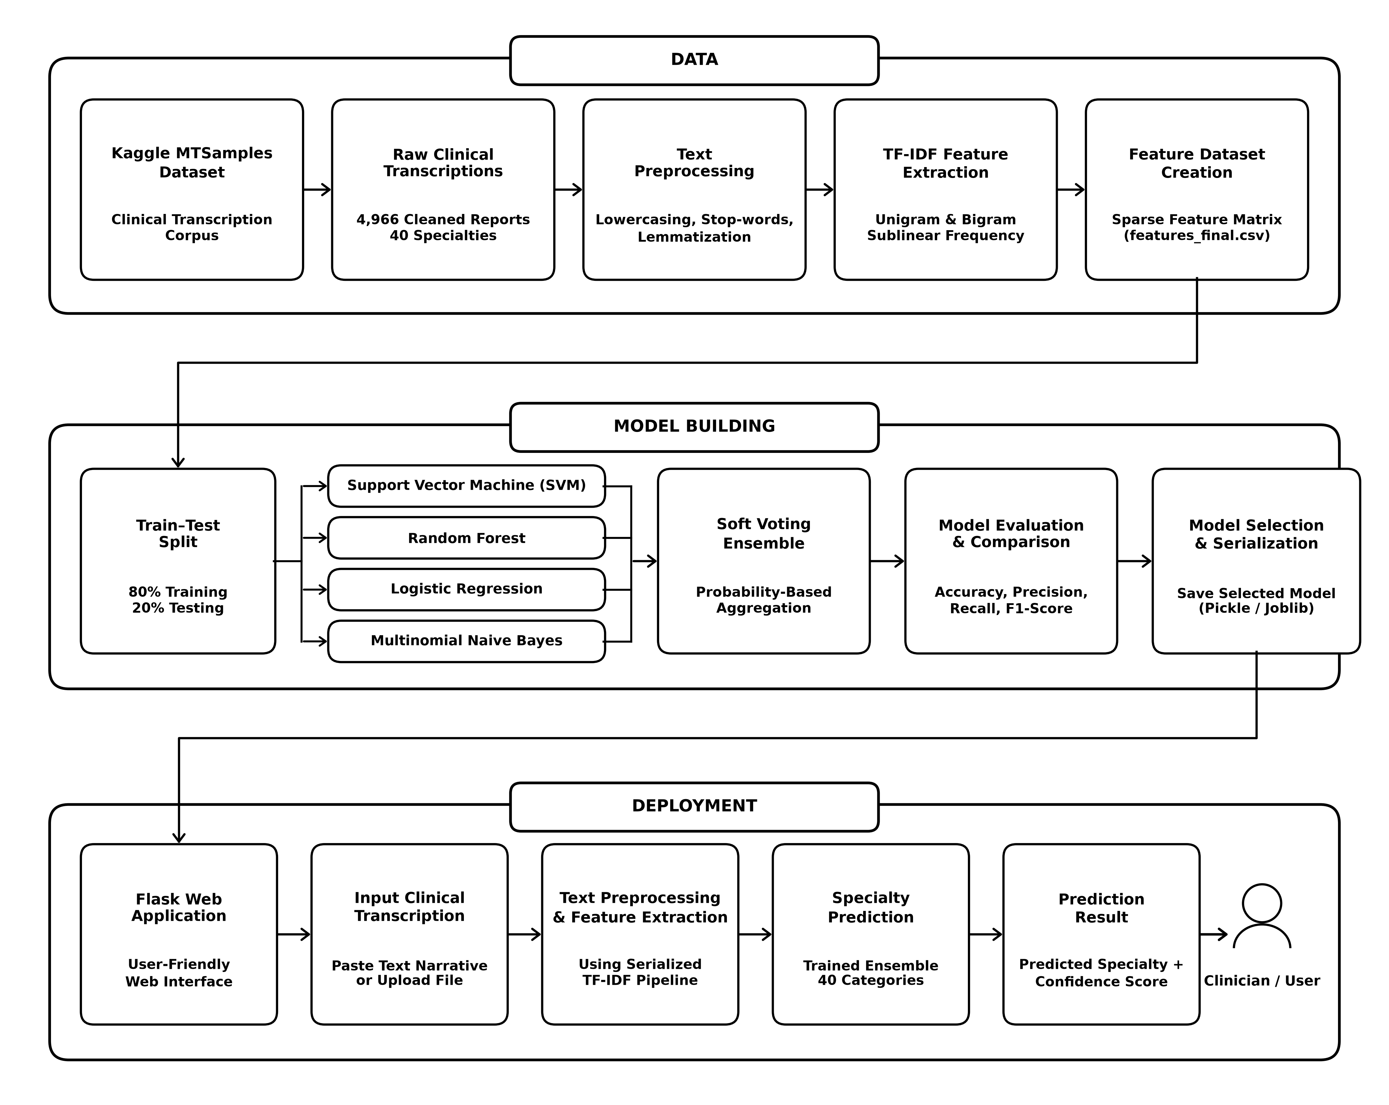
MCA MINI PROJECT | PROJECT PIPELINE
Medical Specialty Classification using TF-IDF and Ensemble Machine Learning
Proposed End-to-End System Project Pipeline
CONTAINER 1: DATA STAGE
• Kaggle MTSamples: 4,966 cleaned multi-specialty clinical transcriptions.
• Text Preprocessing: Lowercasing, medical stop-word filtering, WordNet lemmatization.
• TF-IDF Vectorization: Unigram & bigram features with sublinear scaling (features_final.csv).
CONTAINER 2: MODEL BUILDING
• 80/20 Stratified Split: Strict preservation of minority class proportions across all 40 specialties.
• Parallel Training: SVM (calibrated), Random Forest, Logistic Regression, Multinomial Naive Bayes.
• Soft Voting Ensemble: Synthesizes probability consensus, evaluated via multi-class metrics & serialized.
CONTAINER 3: DEPLOYMENT STAGE
• Flask Web Application: Interactive clinician-facing dashboard for note entry / file upload.
• Live Prediction Pipeline: Transforms input text using serialized TF-IDF vectorizer.
• Confidence Output: Returns predicted specialty and classification confidence percentage.
Department of Computer Applications | MACE
Mar Athanasius College of Engineering, Kothamangalam
Slide 12 of 15

Slide 13
MCA MINI PROJECT | PROGRESS & ROADMAP
Medical Specialty Classification using TF-IDF and Ensemble Machine Learning
Current Project Progress & Implementation Roadmap
CURRENT PROGRESS (PHASE 1 / SPRINT RELEASE I)
✓ Comprehensive Literature Review: Surveyed clinical NLP and machine learning papers, establishing preprocessing standards.
✓ Dataset Acquisition & Cleaning Audit: Acquired Kaggle MTSamples (4,999 records); identified and pruned 33 blank transcripts.
✓ Complete Exploratory Data Analysis: Generated 6 specialized visual distributions covering missing values, class imbalance, and text lengths.
✓ Class Imbalance Profiling: Characterized severe class skew across 40 specialties, formulating stratified sampling strategy.
✓ NLP Preprocessing Pipeline Design: Finalized 5-step sequence: Lowercasing, character cleaning, stop-word removal, and lemmatization.
✓ TF-IDF Vectorization Architecture: Selected unigram/bigram tokenization with sublinear term-frequency scaling and L2 normalization.
✓ Model & Ensemble Architecture Formulated: Selected SVM (calibrated), RF, LR, MNB and soft voting probability consensus aggregation.
PLANNED NEXT STEPS (PHASE 2 / SPRINT RELEASE II)
→ Execute Automated Preprocessing Pipeline: Implement modular Python text cleaner to generate clean tokenized transcripts.
→ TF-IDF Matrix Generation & Feature Export: Fit and persist TF-IDF vectorizer; compile high-dimensional sparse feature matrix.
→ Candidate Model Training: Train SVM, Random Forest, Logistic Regression, and Multinomial Naive Bayes candidate classifiers.
→ Soft Voting Ensemble Implementation: Implement soft consensus probability aggregation combining all four candidate estimators.
→ Rigorous Multi-Class Model Evaluation: Compute multi-class evaluation metrics: Macro/Weighted Precision, Recall, F1, and Confusion Matrices.
→ Model Serialization & Web Deployment: Serialize trained ensemble with Joblib; build interactive clinician dashboard using Flask.
→ System Testing & Validation: Validate inference latency, specialty prediction accuracy, and confidence score reliability.
CURRENT STATUS SUMMARY & MILESTONE ALIGNMENT
The project has successfully completed the literature review, dataset exploration, and architectural design phases (Sprint Release I). The implementation phase is now commencing according to the project timeline.
Department of Computer Applications | MACE
Mar Athanasius College of Engineering, Kothamangalam
Slide 13 of 15

Slide 14
MCA MINI PROJECT | PROJECT TIMELINE
Medical Specialty Classification using TF-IDF and Ensemble Machine Learning
Project Timeline & Milestone Schedule
ACADEMIC TIMELINE & PRESENTATION MILESTONES (SEMESTER 3 MCA MINI PROJECT)
Period / Date | Planned Activity / Presentation Milestone
Week 1–2 | Dataset Collection, Exploratory Data Analysis, and Initial Data Cleaning
21.07.2026 | Project Proposal Approval
Week 3–4 | Clinical Text Preprocessing, Medical Stop-word Removal, and Lemmatization
Week 5 | TF-IDF Feature Extraction and Feature Representation Analysis
08.09.2026 | First Project Presentation (Current Milestone — Phase 1 Faculty Review)
09.09.2026 | Sprint Release I (Dataset Exploration & Pipeline Architecture Completed)
Week 6 | Candidate ML Model Training (SVM, Random Forest, Logistic Regression, MNB) and Baseline Evaluation
18.09.2026 | Sprint Release II
Week 7–8 | Soft Voting Ensemble Formulation, Grid Search Hyperparameter Tuning, and Web UI Design
29.09.2026 – 30.09.2026 | Interim Project Presentation
Week 9 | Flask Web Application Integration, Route Setup, and Serialized Pipeline Deployment
09.10.2026 | Sprint Release III
Week 10–11 | Multi-Class Evaluation, Confusion Matrix Analysis, Threshold Tuning, and System Testing
22.10.2026 – 23.10.2026 | Final Project Presentation
30.10.2026 | Final Report Submission
Department of Computer Applications | MACE
Mar Athanasius College of Engineering, Kothamangalam
Slide 14 of 15

Slide 15
Thank You!
Questions & Discussion
PROJECT TITLE
Medical Specialty Classification using TF-IDF and Ensemble Machine Learning
STUDENT DETAILS
Jiphin George (MAC25MCA-2033)
Master of Computer Applications (MCA - S3)
Department of Computer Applications
PROJECT GUIDE & INSTITUTION
Prof. Biju Skaria
Department of Computer Applications
Mar Athanasius College of Engineering, Kothamangalam

