Slide 1
MAR ATHANASIUS COLLEGE OF ENGINEERING, KOTHAMANGALAM
MCA MINI PROJECT | FIRST PRESENTATION
Medical Specialty Classification Using TF-IDF and Ensemble Machine Learning
Clinical NLP & Supervised Multi-Class Learning on MTSamples Medical Corpus
PRESENTED BY
Jiphin George
Register No: MAC25MCA-2033
Course: Master of Computer Applications (MCA)
PROJECT GUIDE
Prof. Biju Skaria
Department of Computer Applications
Mar Athanasius College of Engineering, Kothamangalam
Clinical NLP
TF-IDF Vectorization
Supervised ML
Soft Voting Ensemble
Flask Deployment
Notes:
Good morning / afternoon. My project is titled Medical Specialty Classification Using TF-IDF and Ensemble Machine Learning, presented as my MCA Mini Project's first review from the Department of Computer Applications, Mar Athanasius College of Engineering, Kothamangalam. In this presentation I will walk through the literature I reviewed, the exploratory analysis I performed on the clinical transcription dataset, my proposed preprocessing and TF-IDF feature extraction approach, the ensemble machine learning algorithms I plan to use, the overall project pipeline, and a proposed GUI for deployment. Let's begin with the problem this project addresses.

Slide 2
MCA MINI PROJECT | INTRODUCTION
Problem Statement & Objectives
!
Problem
→
Objective
Clinical transcription data is unstructured and can belong to any of several medical specialties, making manual categorization by medical coders slow, inconsistent, and prone to human error as patient volumes grow.
Develop an automated NLP and Ensemble Machine Learning system that predicts the correct medical specialty from a clinical transcription, reducing administrative overhead and speeding up document routing.
Key Project Objectives
EDA
NLP
TF
⊕
Explore & Analyze
Preprocess Text
Extract Features
Ensemble & Deploy
Conduct EDA on the Kaggle MTSamples clinical transcription dataset.
Clean, tokenize, remove stop-words and lemmatize clinical narratives.
Vectorize clinical text into numeric form using TF-IDF.
Combine SVM, RF, LR, MNB via Voting; deploy on a Flask web app.
Department of Computer Applications | MACE
Mar Athanasius College of Engineering, Kothamangalam
Slide 2 of 20
Notes:
Manual sorting of clinical transcription reports into specialties like Cardiology or Orthopedic is time-consuming and inconsistent between reviewers. My objective is to automate this using NLP and ensemble machine learning. On the left is the problem, on the right the objective. Below I list four concrete project objectives: exploring the dataset, building a text preprocessing pipeline, extracting TF-IDF features, and finally combining four classifiers using a voting ensemble, which will be deployed through a Flask web application so a clinician could paste in a report and get a predicted specialty.

Slide 3
MCA MINI PROJECT | SUPPORTING LITERATURE
Literature Review
Paper 1 • 2023
Paper 2 • 2023
Paper 3 • 2022
Omar et al. — iJOE
Zhang et al. — Hindawi CIN
Blanchard et al. — IEEE JBHI
METHOD
METHOD
METHOD
BOW / TF-IDF / Word2Vec + LR, SVM, Naive Bayes, k-NN
SemiADA synthetic data augmentation + BERT, on an 18-class MTSamples subset
CNN with keyword-constrained loss on the NCI SEER pathology registry
KEY FINDING
KEY FINDING
KEY FINDING
Word2Vec + k-NN achieved the highest accuracy of 92%, but k-NN scales poorly for large databases.
Achieved a +14.9% average gain in accuracy and F1-score over baseline, but needs GPU-heavy BERT fine-tuning.
Keyword injection improved macro F1 and recall on rare classes without hurting majority performance.
RELEVANCE TO THIS PROJECT
RELEVANCE TO THIS PROJECT
RELEVANCE TO THIS PROJECT
Establishes the standard 4-phase text preprocessing & vectorization pipeline used in this project.
Highlights class imbalance in MTSamples and motivates a lightweight TF-IDF + ensemble alternative.
Justifies using TF-IDF keyword / n-gram weighting to preserve signal for rare specialty classes.
Department of Computer Applications | MACE
Mar Athanasius College of Engineering, Kothamangalam
Slide 3 of 20
Notes:
I reviewed three key papers. Omar and colleagues compared classical and neural text representations and found Word2Vec with k-NN gave the best accuracy at 92 percent, but distance-based k-NN is slow at scale; their 4-phase pipeline of preprocessing, vectorization, feature reduction, and classification inspired my own workflow. Zhang and colleagues used synthetic data augmentation and BERT on a smaller 18-class version of the same MTSamples dataset, gaining 14.9 percent, but needing GPU infrastructure. Blanchard and colleagues showed that keyword-weighted features help rare classes, which supports using TF-IDF n-grams instead of manually curated keyword dictionaries. Together, these gaps motivate my lightweight, CPU-friendly TF-IDF plus ensemble approach.

Slide 4
MCA MINI PROJECT | DATA ANALYSIS
Dataset Overview
Kaggle Medical Transcriptions (MTSamples) Dataset
4,999
40
6
Source: kaggle.com/datasets/tboyle10/medicaltranscriptions
Clinical Records
Medical Specialties
Dataset Columns
Authentic clinical dictations covering patient histories, diagnostic evaluations, physical exams, and surgical procedures across many healthcare sub-disciplines.
Dataset Columns
Input Variable
Unnamed: 0
Record index / row identifier
IN
transcription — the primary clinical narrative text
description
Short one–two sentence clinical abstract
medical_specialty
Target label — 40 specialty classes
Target Variable
sample_name
Dictation / report title
Y
medical_specialty — 40 unique clinical specialty classes
transcription
Primary clinical narrative (input feature)
keywords
Comma-delimited extracted clinical terms
Sparsity: transcription is 99.3% complete (33 missing); medical_specialty has zero missing values.
Department of Computer Applications | MACE
Mar Athanasius College of Engineering, Kothamangalam
Slide 4 of 20
Notes:
The dataset is the Kaggle Medical Transcriptions or MTSamples dataset, containing 4,999 real clinical dictation reports spread across 40 medical specialties. It has six columns: an index, a short description, the target medical_specialty label, a sample name, the main transcription narrative, and extracted keywords. The transcription column is my primary input feature since it holds the full clinical narrative, and medical_specialty is the target I am predicting. The dataset is nearly complete for the target label with zero missing values, while the transcription field has only 33 missing records out of 4,999, which is under one percent.

Slide 5
MCA MINI PROJECT | DATA ANALYSIS
Statistical Analysis of the Dataset
Libraries Used
df.info() — representative output
pandas
numpy
Column
Dtype
Missing
Exploration Functions Applied
Unnamed: 0
int64
0
shape
.info()
.dtypes
description
object
6
.describe()
.head()
.columns
medical_specialty
object
0
sample_name
object
0
Key Findings
transcription
object
33
4,999 rows × 6 columns confirmed via shape and info() — no structural corruption
medical_specialty (target) has zero missing values across all 4,999 records
transcription has 33 missing records (0.66%)
keywords has 1,068 missing records — too sparse for primary modeling
describe() confirms transcription is free-form text of variable length
keywords
object
1,068
Total: 4,999 entries, 6 columns (RangeIndex 0–4998)
Department of Computer Applications | MACE
Mar Athanasius College of Engineering, Kothamangalam
Slide 5 of 20
Notes:
For statistical analysis I used pandas and numpy. I applied dataset exploration functions such as shape, info(), dtypes, describe(), head(), and columns to understand the structure. The table on the right is a representative info()-style summary: it confirms 4,999 rows and 6 columns with no structural corruption. The key findings box on the left summarizes what this told me: the target column medical_specialty has zero missing values, which is great for supervised learning, transcription is 99.3 percent complete, and keywords is missing over a thousand records, so I exclude it from the primary feature set.

Slide 6
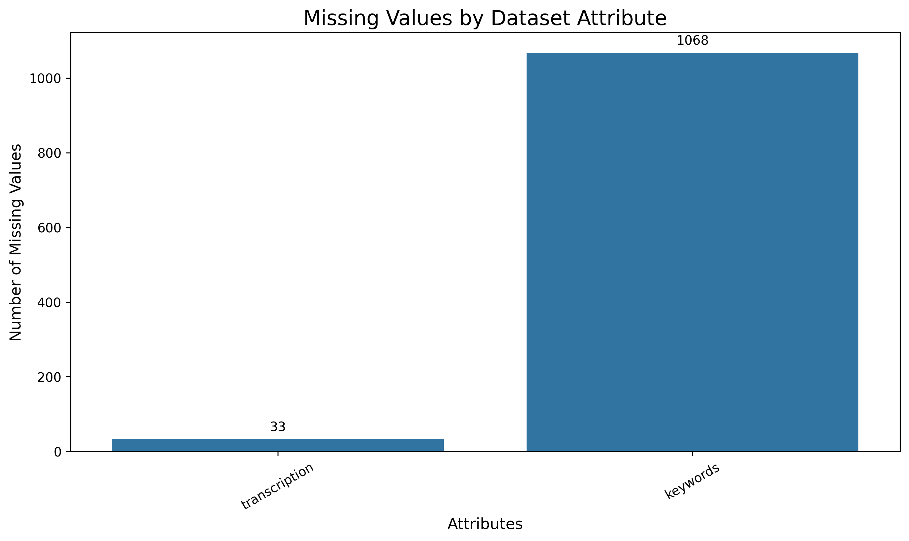
MCA MINI PROJECT | DATA ANALYSIS
Exploratory Data Analysis: Data Quality
Functions & Libraries
pandas: .isnull().sum(), .duplicated()
matplotlib / seaborn for the bar chart
Observations
transcription: 33 missing records (0.66%) — dropped during cleaning
keywords: 1,068 missing records — excluded from primary features
description: 6 missing records
medical_specialty (target): 0 missing values
Duplicate check via .duplicated() confirmed no duplicate clinical reports in the corpus
Figure: Missing Values by Dataset Attribute (isnull().sum())
Department of Computer Applications | MACE
Mar Athanasius College of Engineering, Kothamangalam
Slide 6 of 20
Notes:
Data quality was checked using pandas' isnull().sum() and duplicated() functions, visualized here with matplotlib and seaborn. The chart shows that transcription, my primary input, is missing only 33 out of 4,999 records — well under one percent. The keywords column is missing 1,068 records, so I am excluding it from primary modeling since it is too sparse to rely on. The target column, medical_specialty, has zero missing values, which is ideal since a supervised classifier needs every training example labeled. I also verified there are no duplicate clinical reports in the corpus.

Slide 7
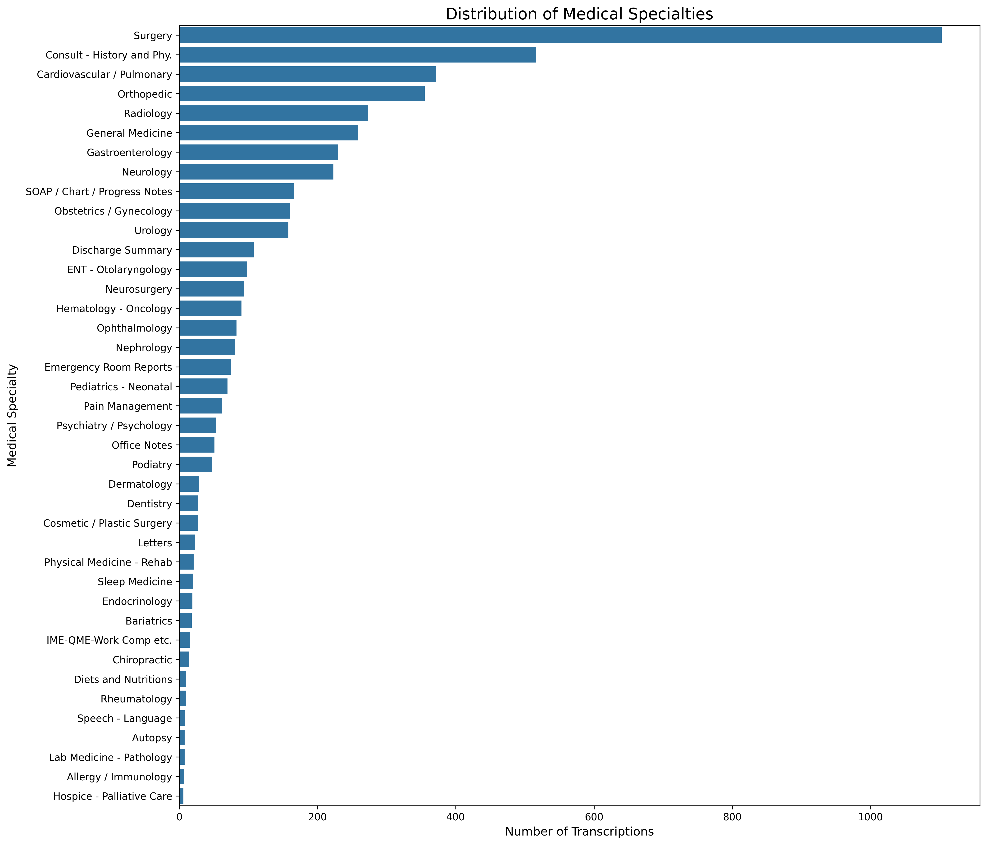
MCA MINI PROJECT | DATA VISUALIZATION
Class Distribution Across 40 Specialties
Library: Matplotlib / Seaborn
1,103
Surgery — largest class
2
Autopsy & Executive Evaluation — smallest classes
Insight
The dataset exhibits severe class imbalance — majority classes contain hundreds to over a thousand records while minority specialties have under 10. This motivates stratified 80:20 train-test splitting to preserve class proportions, and soft-voting ensemble consensus to avoid bias toward majority classes.
Figure: Full Distribution of Medical Specialties (40 classes)
Department of Computer Applications | MACE
Mar Athanasius College of Engineering, Kothamangalam
Slide 7 of 20
Notes:
This chart, built with matplotlib and seaborn, shows the full class distribution across all 40 medical specialties. Surgery dominates with 1,103 records, while specialties like Autopsy and Executive Evaluation have only 2 records each. This is a textbook case of severe class imbalance. It directly affects my modeling choices: I plan to use stratified 80:20 train-test splitting so every specialty is proportionally represented in both sets, and a soft-voting ensemble so no single classifier's bias toward the majority class dominates the final prediction.

Slide 8
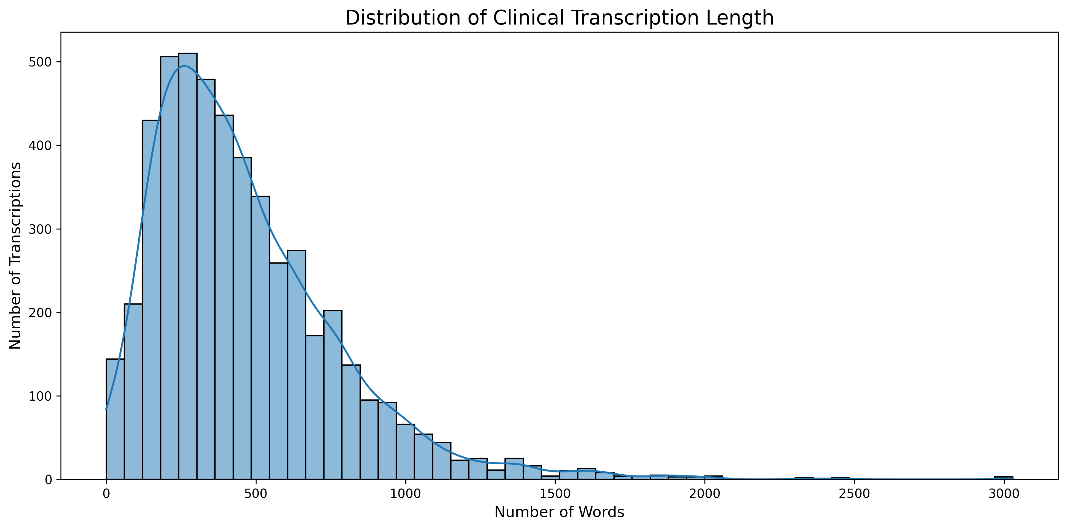
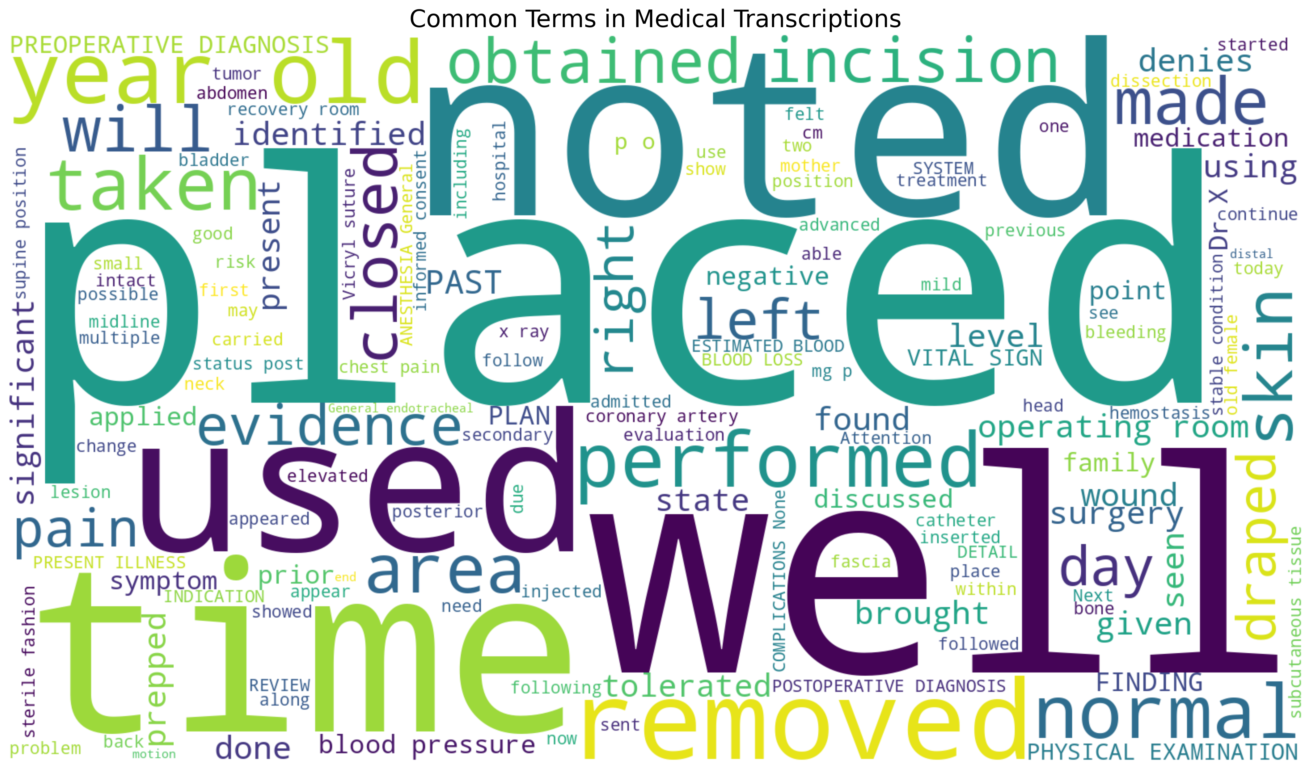
MCA MINI PROJECT | DATA VISUALIZATION
Clinical Transcription Text Analysis
Library: Matplotlib / Seaborn / WordCloud
Fig: Transcription Length Distribution
Fig: Word Cloud of Common Clinical Terms
Key Insights
Median narrative length is ~350–500 words; distribution is right-skewed, extending up to ~3,000 words
Frequent terms (“placed”, “noted”, “used”, “time”, “removed”) are generic clinical-documentation vocabulary shared across specialties
Variable length and generic high-frequency terms motivate TF-IDF's IDF weighting and L2 normalization to emphasize specialty-specific vocabulary
Department of Computer Applications | MACE
Mar Athanasius College of Engineering, Kothamangalam
Slide 8 of 20
Notes:
Looking at the text itself: the left chart shows transcription length is right-skewed, with most reports between 200 and 600 words but some extending to nearly 3,000 words. The word cloud on the right, generated with the WordCloud library, shows the most frequent terms across the whole corpus — words like placed, noted, used, and removed. These are generic documentation words that appear in almost every specialty, not distinguishing vocabulary. This is exactly why TF-IDF is useful: its inverse-document-frequency term automatically down-weights these common words and up-weights rarer, more specialty-specific medical terms.

Slide 9
MCA MINI PROJECT | DATA ANALYSIS
EDA Insights & Conclusions
⚠
Severe Class Imbalance
↔
Variable Text Length
≡
High-Dimensional Text
Surgery (1,103) vs. Autopsy (2) — requires stratified splitting & ensemble voting.
200–3,000 words per report — needs TF-IDF with L2 normalization.
Large free-text vocabulary → sparse, high-dimensional TF-IDF vectors.
⊘
Generic Vocabulary Noise
✗
Sparse Keywords Field
✓
Multi-Metric Evaluation
Common words dominate raw counts → IDF weighting needed to surface specialty terms.
1,068 missing keyword entries — excluded from the primary feature set.
Accuracy alone is misleading under imbalance — use precision, recall & F1.
Department of Computer Applications | MACE
Mar Athanasius College of Engineering, Kothamangalam
Slide 9 of 20
Notes:
To summarize the exploratory analysis: the dataset has severe class imbalance, highly variable transcription length, a very high-dimensional and noisy vocabulary dominated by generic clinical documentation words, a keywords field too sparse to use directly, and it demands multi-metric evaluation rather than relying on plain accuracy. Every one of these findings directly shapes a design decision later in the project — from stratified splitting, to TF-IDF weighting, to choosing an ensemble of diverse classifiers, to the evaluation metrics I will report.

Slide 10
MCA MINI PROJECT | DATA PREPROCESSING
Clinical Text Data Cleaning Pipeline
Eight sequential operations transform raw, noisy clinical dictations into clean input suitable for TF-IDF vectorization.
1
2
3
4
Remove Missing Values
Remove Duplicates
Lowercasing
Remove Punctuation
Drop 33 records with empty transcription
Verify no duplicate clinical reports exist
Standardize character casing
Strip commas, periods, symbols
5
6
7
8
Remove Special Characters
Tokenization
Stop-Word Removal
Lemmatization
Remove digits & non-alphanumeric symbols
Segment narratives into word tokens
Filter generic words, preserve clinical terms
Map tokens to base form (WordNet Lemmatizer)
Department of Computer Applications | MACE
Mar Athanasius College of Engineering, Kothamangalam
Slide 10 of 20
Notes:
Text preprocessing runs as eight sequential steps. First, records with missing transcriptions — 33 of them — are removed, and duplicate reports are verified absent. Then the text is lowercased, punctuation and special characters or digits are stripped, and the narrative is tokenized into individual words. Generic English stop-words are removed while preserving clinical vocabulary, and finally each token is lemmatized to its base form using the WordNet Lemmatizer — for example, 'suffers' becomes 'suffer'. This cleaned, normalized token stream is what feeds into TF-IDF vectorization next. Note that scaling and categorical encoding are not applicable here since we're working with raw text, not numeric tabular features.

Slide 11
MCA MINI PROJECT | DATA PREPROCESSING
Feature Extraction Using TF-IDF
TF-IDF (Term Frequency – Inverse Document Frequency) converts preprocessed clinical text into high-dimensional numeric feature vectors that machine learning classifiers can use.
Term Frequency
Inverse Document Frequency
TF-IDF Weight
TF(t,d) = 1 + log( fₜ,d )
IDF(t,D) = log( (1+|D|) / (1+df(t)) ) + 1
TF-IDF(t,d,D) = TF(t,d) × IDF(t,D)
Vectorization Flow
Clinical
Text
Text
Preprocessing
TF-IDF
Vectorizer
Sparse Feature
Matrix (L2-norm)
⚠ TF-IDF is a feature extraction / vectorization technique — it is NOT a classification algorithm. It transforms text into numeric vectors; SVM, Random Forest, Logistic Regression and Multinomial Naive Bayes are the classifiers that use these vectors to predict a specialty. The vectorizer also extracts unigrams and bigrams (e.g. “coronary artery”) and applies sublinear TF scaling with Euclidean L2 normalization.
Department of Computer Applications | MACE
Mar Athanasius College of Engineering, Kothamangalam
Slide 11 of 20
Notes:
TF-IDF stands for Term Frequency – Inverse Document Frequency. Term frequency measures how often a word occurs in one document, scaled logarithmically; inverse document frequency measures how rare that word is across the whole corpus. Multiplying them gives a weight that is high for words that are frequent in one report but rare across the corpus — exactly the kind of specialty-distinguishing medical term we want to emphasize. The flow is: clean text goes through preprocessing, then the TF-IDF vectorizer, producing a sparse, L2-normalized numeric feature matrix. It's important to stress that TF-IDF itself does not classify anything — it only produces the numeric input that my four classifiers will use.

Slide 12
MCA MINI PROJECT | DATA ANALYSIS
Pre-Processed Dataset Structure
CURRENT: Explored & Cleaned Dataset
PROPOSED: Fully Text-Preprocessed Output
After removing 33 records with missing transcription (Table 6 audit):
Once the full 8-step cleaning pipeline (Slide 10) and lemmatization are executed, the transcription column will hold clean, lowercase, lemmatized token text — ready for TF-IDF fitting.
shape
(4,966, 6)
columns
6 fields
Planned verification functions:
target classes
40
head() / tail() — preview cleaned narrative text
shape — confirm 4,966 rows retained post-cleaning
info() / dtypes — confirm object dtype for text columns
describe() — summarize categorical target distribution
dtypes
Unnamed: 0
int64
description
object
medical_specialty
object
sample_name
object
This stage is a proposed methodology step — not yet executed as final results. It will be implemented in the upcoming model-development phase.
transcription
object
keywords
object
Department of Computer Applications | MACE
Mar Athanasius College of Engineering, Kothamangalam
Slide 12 of 20
Notes:
This slide distinguishes what I have already done from what is proposed. On the left is the currently explored and cleaned dataset: after dropping the 33 missing-transcription records, the shape becomes 4,966 rows by 6 columns, spanning the same 40 target classes, with dtypes as shown. On the right is the proposed fully preprocessed output once the 8-step text-cleaning pipeline I described earlier is executed — lowercase, punctuation-free, lemmatized narrative text ready for TF-IDF. I want to be transparent that this full text-cleaning execution is a planned next step, not a completed result, and I will verify it using head, shape, info and describe once implemented.

Slide 13
MCA MINI PROJECT | PROPOSED ALGORITHMS
Proposed Machine Learning Algorithms
SVM
RF
LR
MNB
Support Vector Machine
Random Forest
Logistic Regression
Multinomial Naive Bayes
Finds the maximum-margin hyperplane; excels on sparse, high-dimensional TF-IDF vectors with natural linear separability.
Aggregates many decision trees via bagging; captures non-linear keyword interactions other models may miss.
Multinomial Softmax baseline; highly interpretable odds ratios for clinical term importance.
Probabilistic, count-based model; computationally efficient and reliable even on smaller class subsets.
FEATURE EXTRACTION
CLASSIFICATION
ENSEMBLE
TF-IDF
SVM + Random Forest + Logistic Regression + Multinomial NB
Voting Classifier (Soft Voting)
SVM is used as one of the base machine learning classifiers for medical specialty classification. It learns optimal decision boundaries between different medical specialty categories using the TF-IDF feature representation within the soft-voting ensemble.
Department of Computer Applications | MACE
Mar Athanasius College of Engineering, Kothamangalam
Slide 13 of 20
Notes:
I propose four base classifiers on top of the TF-IDF features: Support Vector Machine, which handles sparse high-dimensional text very well; Random Forest, which captures non-linear keyword interactions; Logistic Regression, a highly interpretable probabilistic baseline; and Multinomial Naive Bayes, a fast count-based model. The strip below makes the pipeline explicit: TF-IDF handles feature extraction, these four models handle classification, and a Voting Classifier handles the final ensemble decision. One important technical note: since I plan to use soft voting, every classifier must output probability estimates, and because Linear SVM does not natively provide those, its scores will need probability calibration before joining the ensemble.

Slide 14
MCA MINI PROJECT | DETAILS OF ALGORITHMS
Algorithm Activity Diagrams: SVM & Multinomial Naive Bayes
SVM (SUPPORT VECTOR MACHINE) ACTIVITY FLOW
MULTINOMIAL NAIVE BAYES ACTIVITY FLOW
1. High-Dimensional Input
Sparse TF-IDF feature vector x ∈ R^V representing clinical narrative vocabulary.
1. Term Frequency Vector Input
Vector of clinical token counts and TF-IDF weights for each vocabulary term t_k.
2. Linear Decision Mapping
Constructs decision hyperplane w·x + b = 0 in sparse high-dimensional term space.
2. Prior Class Probability P(c)
Estimates empirical prior for each specialty: P(c) = N_c / N_total from training data.
3. Maximum Margin Optimization
Solves quadratic program: min 1/2 ||w||² subject to y_i(w·x_i + b) ≥ 1 - ξ_i.
3. Feature Likelihood with Smoothing
Calculates P(t|c) = (count(t,c) + α) / (Σ count(w,c) + α·|V|) using Laplace smoothing (α=1).
4. Support Vector Identification
Identifies critical borderline transcripts that define category separation margins.
4. Log Posterior Accumulation
Computes log P(c|d) = log P(c) + Σ f_t · log P(t|c) to prevent floating-point underflow.
5. Platt Probability Scaling
Calibrates decision distances via sigmoid fitting: P(c|x) = 1 / (1 + exp(A·f(x) + B)).
5. Softmax Normalization
Converts log-likelihoods into normalized probability distribution: P(c|d) = exp(s_c)/Σ exp(s_k).
6. Class Probability Output
Outputs calibrated probability distribution across all 40 medical specialty categories.
6. Class Probability Output
Generates probabilistic score distribution over 40 categories for ensemble soft voting.
Department of Computer Applications | MACE
Mar Athanasius College of Engineering, Kothamangalam
Slide 14 of 20
Notes:
This is the training workflow, designed carefully to avoid data leakage. Starting from the full 4,999-record dataset, I first do initial cleaning and a null audit, then perform the stratified 80:20 train-test split before any text vectorization happens. Text preprocessing is applied to both partitions, but critically, the TF-IDF vectorizer is fit only on the training data — highlighted here — and then used to transform both the training and test sets. This prevents information from the test set leaking into the vocabulary or IDF weights. After that, the four base classifiers are trained, combined through soft voting, evaluated with standard metrics, and the final pipeline is serialized for deployment.

Slide 15
MCA MINI PROJECT | DETAILS OF ALGORITHMS
Algorithm Activity Diagrams: Random Forest & Logistic Regression
RANDOM FOREST (RF) ACTIVITY FLOW
LOGISTIC REGRESSION (LR) ACTIVITY FLOW
1. Dataset & Feature Matrix Input
Receives training matrix X (TF-IDF features) and multi-class labels Y (40 classes).
1. Standardized Vector Input
Sparse TF-IDF vector x with L2 Euclidean normalization representing clinical narrative.
2. Bootstrap Sampling (Bagging)
Generates B bootstrap sample sets by sampling rows with replacement to induce diversity.
2. Linear Logit Computation
Computes linear combination z_c = w_c · x + b_c for each medical specialty class c ∈ {1..40}.
3. Random Feature Subspace Split
At each decision node, randomly selects m = √|V| features and finds optimal split.
3. L2 Ridge Regularization
Applies L2 penalty λ/2 ||w||² in objective function to shrink weights & prevent overfitting.
4. Decision Tree Induction
Recursively splits nodes using Gini Impurity: Gini = 1 - Σ p_i² until stopping criterion.
4. Softmax Probability Mapping
Transforms logits to calibrated probabilities via Softmax: P(y=c|x) = exp(z_c) / Σ exp(z_k).
5. Forest Ensemble Assembly
Combines B independently trained decision trees into an uncorrelated forest ensemble.
5. Cross-Entropy Loss Optimization
Optimizes parameter weights using L-BFGS quasi-Newton gradient ascent solver.
6. Ensemble Averaged Probability
Calculates consensus class probabilities: P_RF(c) = (1/B) Σ P_tree_b(c) across all B trees.
6. Multi-Class Probability Output
Generates calibrated posterior probability distribution vector across all 40 categories.
Department of Computer Applications | MACE
Mar Athanasius College of Engineering, Kothamangalam
Slide 15 of 20
Notes:
In plain English, here is how the whole system will work end to end: load the raw dataset, clean it, split it in a stratified way so all specialties are represented in both partitions, preprocess the clinical text, fit TF-IDF only on the training partition, transform both partitions into numeric vectors, train the four base classifiers, combine them with soft voting, evaluate using accuracy, precision, recall and F1, and finally serialize the winning pipeline so it can be used for real-time prediction. This ten-step summary is the backbone of both my model-development phase and the Flask deployment that follows it.

Slide 16
MCA MINI PROJECT | DETAILS OF ALGORITHMS
Soft Voting Ensemble: Architecture & Activity Flow
STAGE 1: INPUT NARRATIVE & VECTORIZATION INFERENCE
Unseen Clinical Transcription Text → 8-Step Preprocessing Pipeline → TF-IDF Transformation (V vocabulary features) → Normalized Sparse Vector x
MODEL 1: SVM Classifier
Support Vector Machine
Platt Calibrated Scaling
Output: P_SVM(c|x) ∈ R^40
MODEL 2: Random Forest
Ensemble Decision Trees
Tree Mean Voting
Output: P_RF(c|x) ∈ R^40
MODEL 3: Logistic Regression
Multinomial Softmax
L2 Regularized Logits
Output: P_LR(c|x) ∈ R^40
MODEL 4: Multinomial NB
Naïve Bayes Estimator
Laplace Smoothed Prior
Output: P_MNB(c|x) ∈ R^40
STAGE 2: SOFT VOTING CONSENSUS & PROBABILITY AGGREGATION
Formula: P_Ensemble(c | x) = 1/4 · [ P_SVM(c | x) + P_RF(c | x) + P_LR(c | x) + P_MNB(c | x) ] for all 40 categories c ∈ {1..40}
Decision Rule: Predicted Medical Specialty c* = argmax_c P_Ensemble(c | x) with Confidence Score = max_c P_Ensemble(c | x) · 100%
Why Soft Voting? Averages confident probability outputs rather than simple discrete votes; mitigates individual estimator errors and smooths noise.
FINAL SYSTEM PREDICTION OUTPUT (STAGE 3)
• Primary Prediction: Assigned Medical Specialty Class (e.g., 'Cardiovascular / Pulmonary') • Confidence Estimate: Aggregated ensemble probability score (%) verifying clinical prediction certainty
Department of Computer Applications | MACE
Mar Athanasius College of Engineering, Kothamangalam
Slide 16 of 20
Notes:
Here is a consolidated view of how every algorithm participates. A clinical transcription first goes through text preprocessing, then TF-IDF feature extraction turns it into a numeric vector. That same vector is fed in parallel to all four classifiers — SVM, Random Forest, Logistic Regression, and Multinomial Naive Bayes — each producing its own probability estimate for every one of the 40 specialties. The Voting Ensemble then averages these probability estimates and picks the specialty with the highest combined score as the final predicted medical specialty.

Slide 17
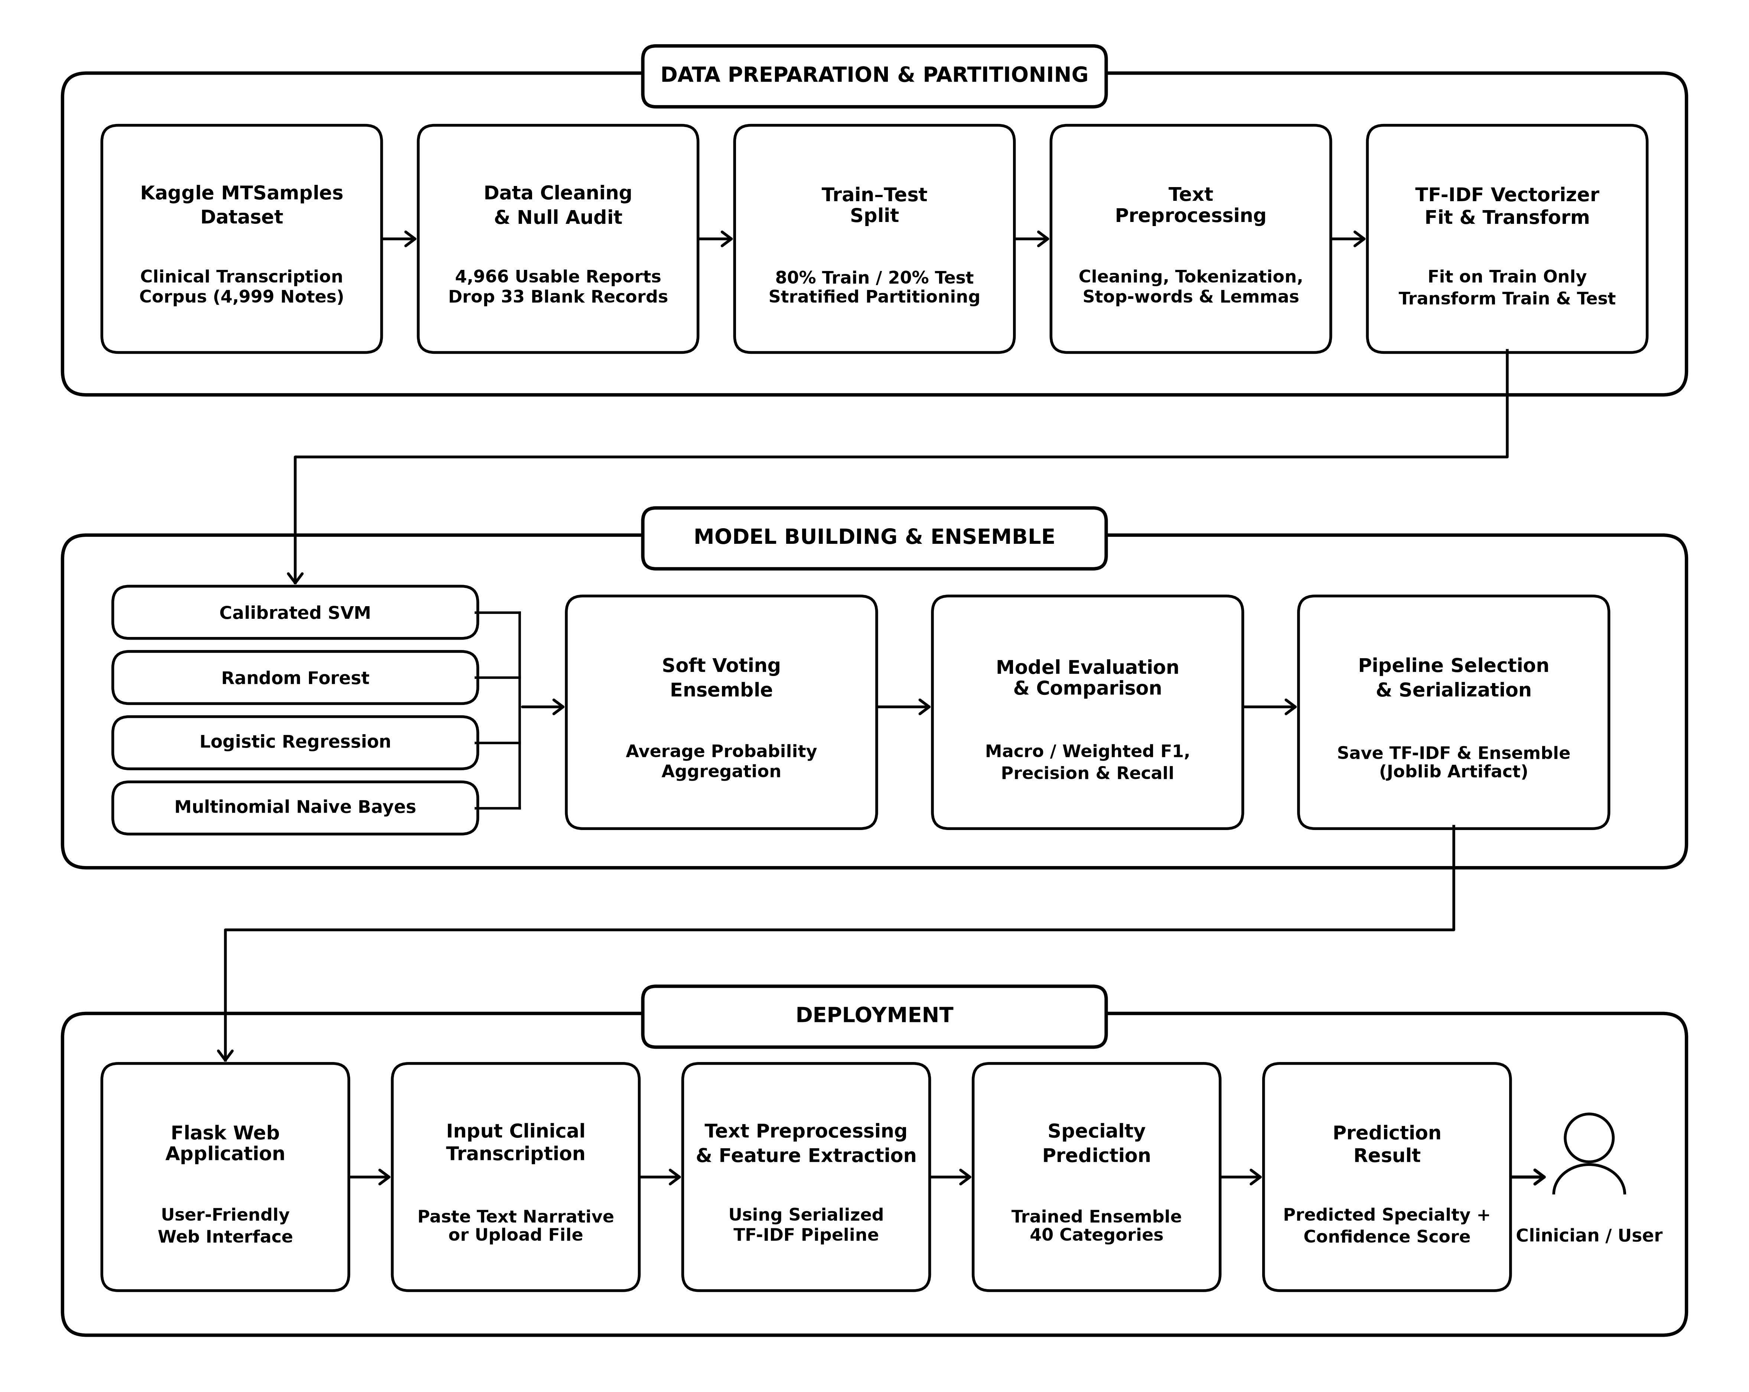
MCA MINI PROJECT | PROJECT PIPELINE
Complete End-to-End Project Pipeline
Three-stage pipeline: Data Preparation & Partitioning → Model Building & Ensemble → Deployment. TF-IDF is fit strictly on training data; the Flask deployment stage reuses the saved preprocessing + TF-IDF + ensemble pipeline.
Department of Computer Applications | MACE
Mar Athanasius College of Engineering, Kothamangalam
Slide 17 of 20
Notes:
This diagram brings everything together into the full project pipeline, organized into three stages. Data Preparation & Partitioning covers ingesting the Kaggle MTSamples dataset, cleaning and null auditing, the stratified train-test split, text preprocessing, and fitting the TF-IDF vectorizer only on the training data. Model Building & Ensemble covers training the calibrated SVM, Random Forest, Logistic Regression and Multinomial Naive Bayes, combining them with soft voting, evaluating with macro and weighted F1, precision and recall, and finally serializing the selected pipeline with Joblib. The Deployment stage takes that saved pipeline into a Flask web application where a clinician can input a transcription and receive a predicted specialty.

Slide 18
MCA MINI PROJECT | PROGRESS & ROADMAP
Current Project Progress & Implementation Roadmap
CURRENT PROGRESS (PHASE 1 / SPRINT RELEASE I)
✓ Literature Review & Paper Benchmarking: Surveyed clinical NLP literature (Omar et al., Zhang et al., Blanchard et al.), establishing preprocessing standards.
✓ Dataset Acquisition & Cleaning Audit: Acquired Kaggle MTSamples (4,999 cases); identified and removed 33 empty transcription records.
✓ Exploratory Data Analysis & Visualization: Executed 6 statistical distributions covering missing values, token lengths, and specialty frequencies.
✓ Class Imbalance Characterization: Audited extreme long-tail class skew across 40 medical specialties; formulated stratified sampling strategy.
✓ NLP Cleaning Pipeline Design: Finalized sequence: Cleaning, Lowercasing, Alphanumeric Filtering, Stop-word Removal, and Lemmatization.
✓ TF-IDF Architecture Formulation: Configured unigram/bigram tokenization with sublinear TF scaling and Euclidean L2 normalization.
✓ Model & Ensemble Formulation: Selected SVM, Random Forest, Logistic Regression, and MNB combined via Soft Voting probability consensus.
PLANNED NEXT STEPS (PHASE 2 / SPRINT RELEASE II & III)
→ Full Text Preprocessing Implementation: Execute the 8-step cleaning module across 4,966 records to produce normalized narrative corpus.
→ TF-IDF Feature Matrix Generation: Fit vectorizer strictly on training partition (80:20 split) to eliminate data leakage; transform test set.
→ Candidate Model Training & Optimization: Train SVM, Random Forest, Logistic Regression, and Multinomial Naive Bayes classifiers.
→ Soft Voting Ensemble Development: Implement weighted/soft probability aggregation combining decision outputs across all base estimators.
→ Multi-Class Performance Evaluation: Benchmark multi-class Macro/Weighted Precision, Recall, F1-score, and cross-class Confusion Matrices.
→ Pipeline Serialization & Web Deployment: Serialize end-to-end pipeline with Joblib; construct interactive clinician dashboard using Flask.
→ Validation & Clinical Usability Testing: Validate latency, prediction confidence calibration, and reliability on unseen clinical records.
Phase 1 Status: Literature Review, Data Exploration, Preprocessing Pipeline, and Ensemble Architecture are fully completed (Sprint Release I). The project is on schedule to commence candidate model training.
Department of Computer Applications | MACE
Mar Athanasius College of Engineering, Kothamangalam
Slide 18 of 20
Notes:
This is a proposed wireframe for the Flask-based deployment, not a finished application. The clinician would paste a clinical transcription into the text area, optionally upload a file instead, and click Predict Specialty. The result panel would then show the predicted medical specialty along with a confidence score bar, since the project pipeline I showed earlier explicitly plans a prediction result with a confidence score. The example specialty shown here is only illustrative — no model has actually been trained or deployed yet; this is purely a design mockup for the upcoming GUI development phase.

Slide 19
MCA MINI PROJECT | PROJECT TIMELINE
Project Timeline & Milestone Schedule
ACADEMIC TIMELINE & PRESENTATION MILESTONES (SEMESTER 3 MCA MINI PROJECT)
PHASE 1: FOUNDATION & SPRINT RELEASE I
✓ [17.07.2026] Project Proposal & Synopsis Approval by Guide Formal approval of project scope, objectives, and feasibility by faculty guide.
✓ [20.07.2026 – 21.07.2026] Project Proposal Presentation Presented proposal before Department Project Approval Committee.
✓ [Weeks 1–2] Dataset Collection & Exploratory Data Analysis Acquired Kaggle MTSamples (4,999 records); audited nulls and generated 6 EDA plots.
✓ [Weeks 3–4] Clinical Text Preprocessing Pipeline Designed 5-step sequence: Cleaning, Lowercasing, Tokenization, Stop-words, Lemmatization.
✓ [Week 5] TF-IDF Vectorization Architecture Formulated unigram/bigram tokenization with sublinear scaling and sparse matrix layout.
★ [08.09.2026] First Project Presentation ★ Current Milestone — Phase 1 Faculty Review & Initial Progress Defense.
★ [09.09.2026] Sprint Release I ★ Formal submission: EDA diagrams, architecture specifications, and Phase 1 report.
PHASES 2 & 3: MODEL BUILDING, ENSEMBLE & DEPLOYMENT
→ [Week 6] Candidate Model Training & Baseline Evaluation Train SVM, Random Forest, Logistic Regression, and Multinomial Naive Bayes.
★ [18.09.2026] Sprint Release II ★ Milestone release: Trained baseline classifiers and preliminary metrics.
→ [Week 7] Hyperparameter Tuning & Model Comparison Systematic tuning and comparative performance profiling across candidate estimators.
→ [Week 8] Soft Voting Ensemble Implementation Construct soft voting ensemble; aggregate consensus probability distributions.
★ [29.09.2026 – 30.09.2026] Interim Project Presentation ★ Progress review and working model demonstration before faculty committee.
→ [Week 9] Flask Web Integration & Serialization Serialize pipeline with Joblib; build interactive clinician UI for live inference.
★ [09.10.2026] Sprint Release III ★ Integrated system release: Flask web application and serialized ensemble.
→ [Weeks 10–11] Evaluation & System Testing Multi-class metrics (Macro F1, Recall), confusion matrix analysis, and validation.
★ [22.10.2026 – 23.10.2026] Final Project Presentation ★ Comprehensive final project defense before the examination board.
★ [30.10.2026] Final Report Submission ★ Submission of finalized documentation, technical report, and source code.
Department of Computer Applications | MACE
Mar Athanasius College of Engineering, Kothamangalam
Slide 19 of 20
Notes:
On the left are the planned GUI components: a text input area for pasting clinical narratives, an optional file upload, a predict button that triggers the preprocessing and ensemble pipeline, a result panel showing the predicted specialty, and a confidence display. On the right is my current project progress. Completed so far: the literature review, dataset collection, statistical and exploratory data analysis, data visualization, and the design of the preprocessing and TF-IDF methodology, along with algorithm selection and the overall architecture. Still upcoming: implementing the full preprocessing and TF-IDF pipeline, training and tuning the four classifiers, building the voting ensemble, evaluating it, and finally developing and deploying the Flask GUI.

Slide 20
MCA MINI PROJECT | CONCLUSION
Conclusion & Implementation Roadmap
KEY PHASE 1 ACHIEVEMENTS (SPRINT RELEASE I)
✓ Problem Addressed: Formulated automated routing for unstructured clinical narratives across 40 distinct medical specialties.
✓ Data Audit Complete: Cleaned 4,999 MTSamples records; audited nulls and isolated 4,966 validated clinical transcripts.
✓ In-Depth EDA Executed: Characterized severe long-tail class skew, document token density, and vocabulary distribution patterns.
✓ Leakage-Free Pipeline: Designed modular 8-step NLP cleaner with strict train-only TF-IDF vectorization to avoid data leakage.
✓ Architecture Established: Selected 4 diverse classifiers (SVM, RF, LR, MNB) unified under a Soft-Voting probability consensus model.
PLANNED NEXT STEPS (PHASES 2 & 3)
→ Execute Cleaning Pipeline: Apply modular character normalization, stop-word pruning, and lemmatization across 4,966 records.
→ Feature Matrix Extraction: Fit TF-IDF vectorizer strictly on training split (80:20) with sublinear term-frequency scaling.
→ Train & Tune Estimators: Train SVM, Random Forest, Logistic Regression, and MNB classifiers; execute hyperparameter grid tuning.
→ Build Soft Voting Ensemble: Implement soft consensus probability aggregation combining calibrated predictive distributions.
→ Multi-Class Evaluation: Benchmark Macro/Weighted F1, Recall, Precision, and cross-category Confusion Matrices.
→ Deployment & Serialization: Serialize pipeline with Joblib; construct interactive clinician dashboard using Flask.
THANK YOU!
Questions, Suggestions & Discussions are Welcome
Student: Jiphin George (MAC25MCA-2033) | Project Guide: Prof. Biju Skaria | MCA Mini Project (Semester 3)
Department of Computer Applications | MACE
Mar Athanasius College of Engineering, Kothamangalam
Slide 20 of 20
Notes:
To conclude: this project addresses automating medical specialty classification from unstructured clinical transcriptions. So far I have completed dataset exploration and statistical analysis of all 4,999 MTSamples records across 40 specialties, identified class imbalance and text-length variation through EDA, and designed an 8-step preprocessing pipeline together with a TF-IDF feature extraction approach and a 4-model voting ensemble. The next phase of work is implementing this pipeline end to end: fitting TF-IDF, training and tuning the four classifiers, calibrating SVM and building the soft-voting ensemble, evaluating with standard multi-class metrics, and finally deploying the Flask web application. Thank you, and I welcome any questions.

