Slide 1

Engineering Ethics — Professional Life
Presented by:
Sr.no | Name | Roll.no
1 | Rahul Bhimanna Jirankalgi | 2075
2 | Riya Hanmant Pawar | 2076
3 | Dhanashree Prashant Raskar | 20
4 | Pravin Pramod Gaikwad | 2081
Course Name: Universal Human Values
College Name: Annasaheb Dange College of Engineering and Technology, Ashta

Slide 2
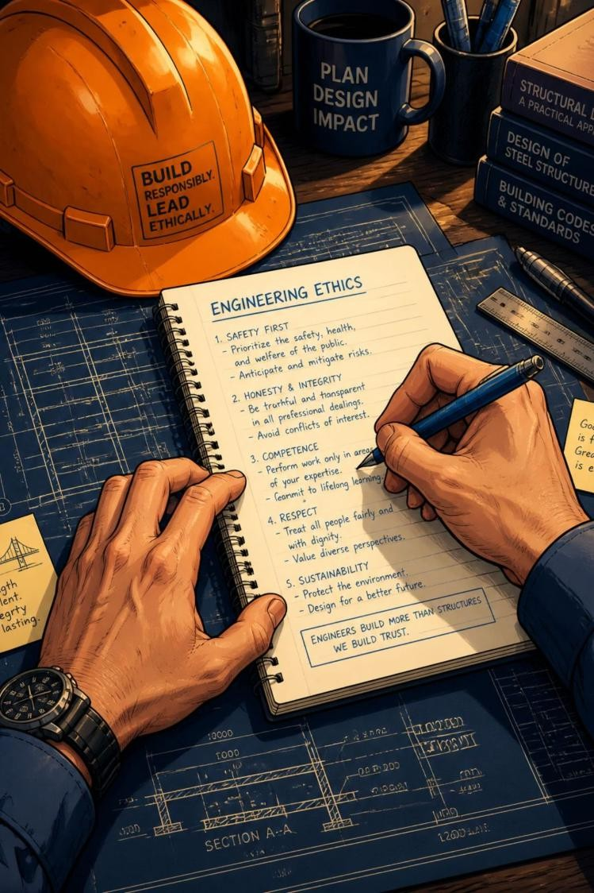

What Is Engineering Ethics?
Engineering ethics is the practice of applying moral principles and professional standards to engineering work. It guides engineers to make decisions that are responsible, fair, and considerate of broader impacts.
Considers effects on people, society, environment, and organizations
Balances technical goals with moral responsibility
Example: Never ignore a safety issue to save time or cost

Slide 3




Why Engineering Ethics Matters
Protect Public Safety
Ethical practice prevents harm by prioritizing safety in design, testing, and
maintenance.
Build Trust
Honest communication and transparency maintain public and client confidence.
Promote Responsibility
Engineers must accept accountability for decisions and their outcomes.

Slide 4
Core Principles of Engineering Ethics
Honesty
Provide truthful information in reports, estimates, and communications.
Responsibility
Own the consequences of your decisions; act when problems arise.
Safety
Prioritize human life and wellbeing above cost or schedule pressures.
Fairness
Treat colleagues, clients, and vendors impartially and respectfully.
Confidentiality
Protect sensitive company and client information appropriately.
Professional Competence
Maintain and update skills through learning and peer review.

Slide 5
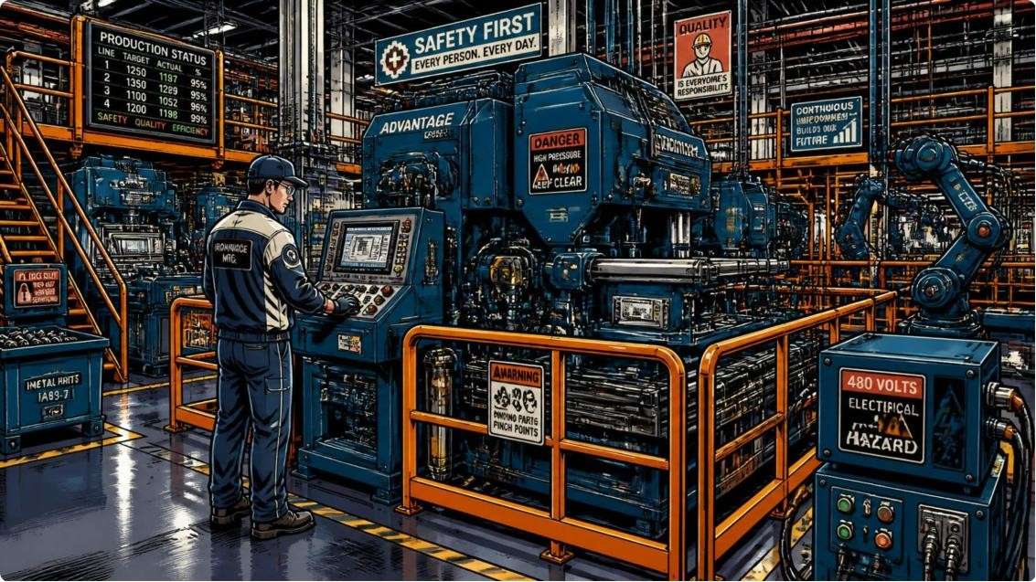
Where Ethical Decisions Arise
Workplace safety and hazard reporting
Product quality and testing standards
Data and information security
Environmental protection and sustainability
Responsible use of AI and automation
Handling confidential or proprietary data
Reporting errors, defects, or near-
misses
Avoiding conflicts of interest
Example: Reporting a defect promptly prevents accidents and legal consequences.

Slide 6
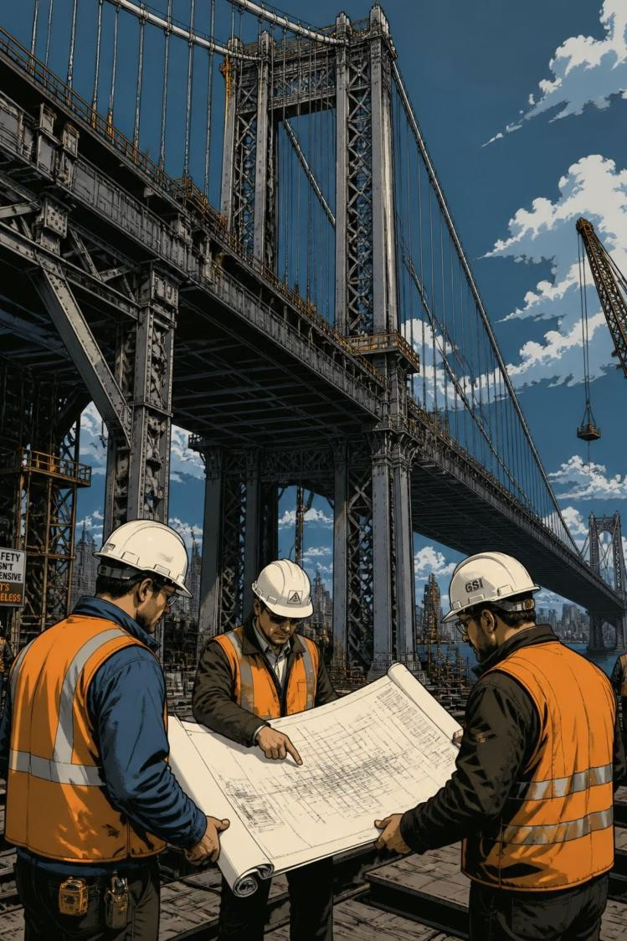

Case Study — Unsafe Bridge Design
Situation: A designer finds a serious safety flaw. Management pressures to proceed to avoid cost and delay.
1. Report the Issue
Document the flaw and notify the responsible authorities immediately.
2. Provide Technical Evidence
Supply calculations, simulations, and risk assessments to support your claim.
3. Prioritize Public Safety
Refuse to approve unsafe work; suggest safe, cost-aware alternatives.

Slide 7
How to Act Ethically — Practical Steps
01
02
03
Speak Up Early
Report concerns through proper channels; use documented evidence.
Consult Standards
Refer to codes of conduct, national standards, and company policies.
Seek Peer Review
Involve colleagues or an independent expert when in doubt.
04
05
Document Your Actions
Keep records of communications, decisions, and technical data.
Escalate When Necessary
If ignored, escalate to higher management or appropriate regulatory bodies.

Slide 8



Benefits of Ethical Engineering
Other outcomes:
Improved workplace relationships and morale
Fewer accidents, recalls, and legal issues
Support for sustainable development goals
Safer Products s Infrastructure
Designs that protect people and minimize accidents.
Environmental Protection
Sustainable choices reduce long-term harm and costs.
Stronger Reputation
Ethical practice enhances trust and career
prospects.

Slide 9





Summary — Key Takeaways
Ethics Is Central
Ethical reasoning is integral to every engineering decision.
Safety First
Prioritize human life and public welfare above deadlines and profits.
Be Accountable
Document, consult standards, and escalate when necessary.
Continuous Learning
Maintain competence and keep up-to-date with evolving technologies and rules.

Slide 10
Conclusion
Ultimately, engineering ethics serves as the moral compass that guides professionals through the complex intersection of technology, business, and society. It demands that engineers look beyond mere technical feasibility to prioritize the safety, health, and welfare of the public above all else. Maintaining unyielding integrity and transparency in every decision ensures that innovations are built on a solid foundation of public trust and accountability.

Slide 11
Thank You!!

