Slide 1
DentService
6432022721 Jirayut Phothawilkiat
GitHub Link:
https://github.com/JirayutP/Dentist
1

Slide 2
Project#4: Dentist Booking
The system shall allow a user to register by specifying the name, telephone number, email, and password.
After registration, the user becomes a registered user, and the system shall allow the user to log in to use the system by specifying the email and password. The system shall allow a registered user to logout.
After login, the system shall allow the registered user to book only ONE session by specifying the date and the preferred dentist. The dentist list is also provided to the user. A dentist information includes the dentist’s name, years of experience, and area of expertise.
The system shall allow the registered user to view his booking.
The system shall allow the registered user to edit his booking.
The system shall allow the registered user to delete his booking.
The system shall allow the admin to view any bookings.
The system shall allow the admin to edit any bookings.
The system shall allow the admin to delete any bookings
2

Slide 3
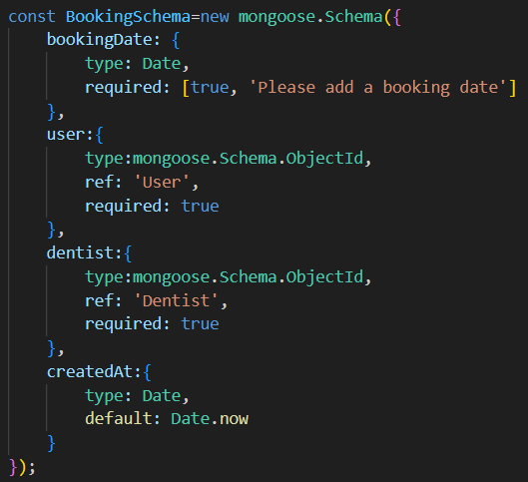
models/Booking.js
3

Slide 4
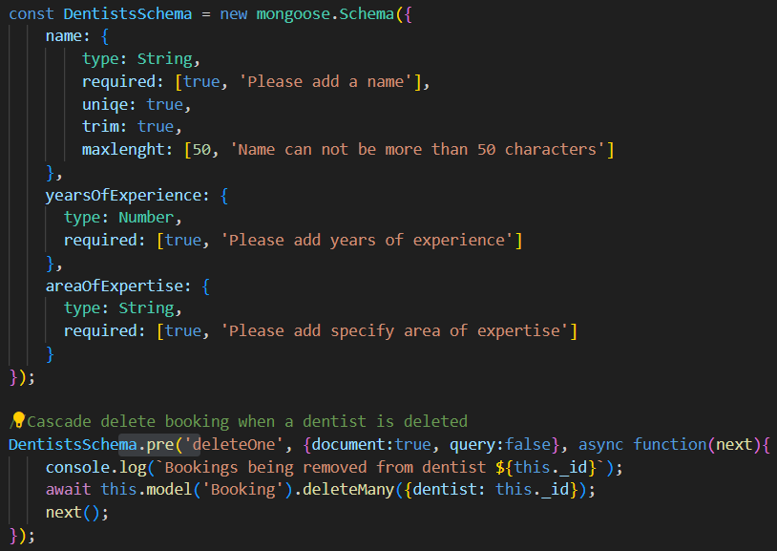
models/Dentist.js
4

Slide 5
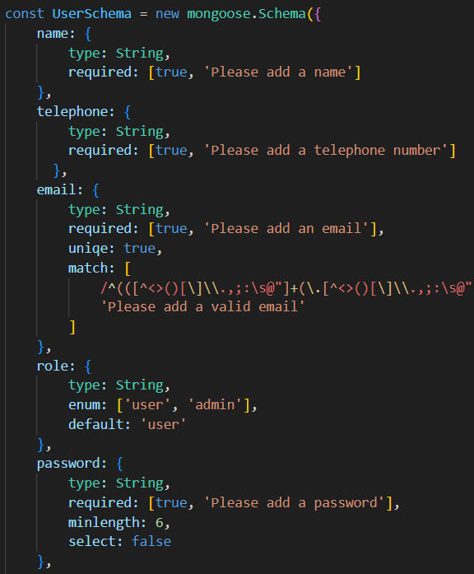
models/User.js
5

Slide 6
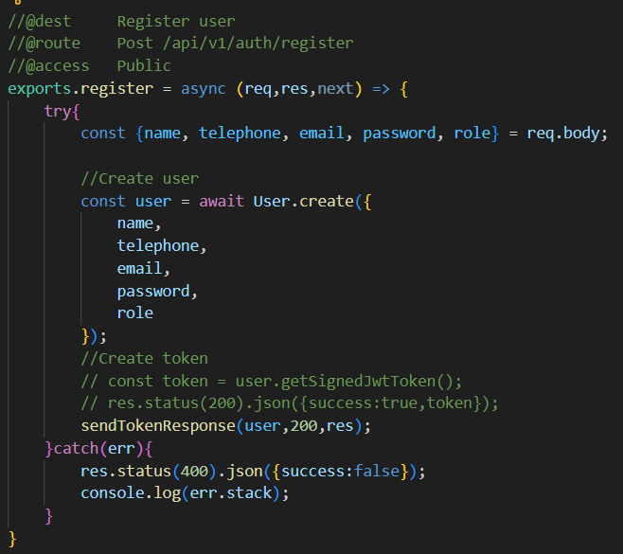
controller/auth.js
6

Slide 7
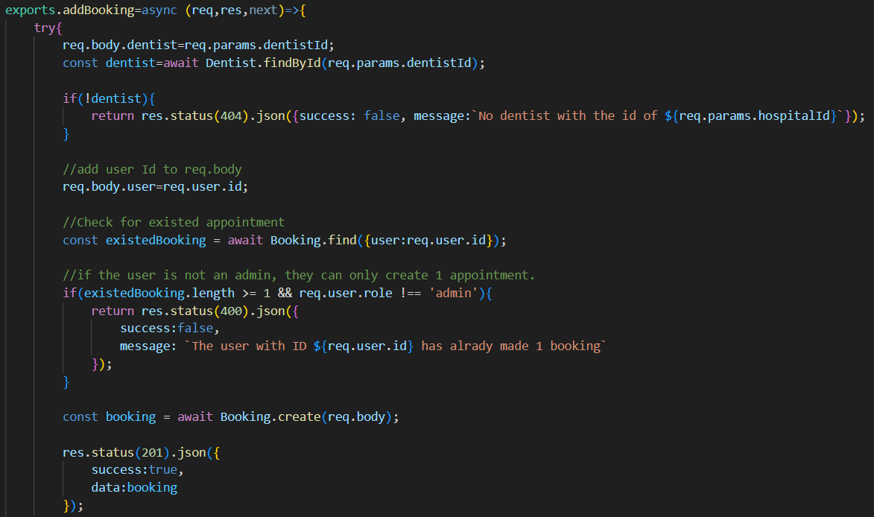
controller/bookings.js
7

Slide 8
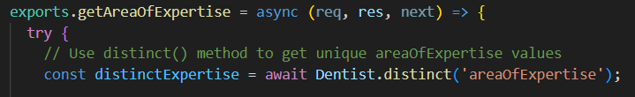
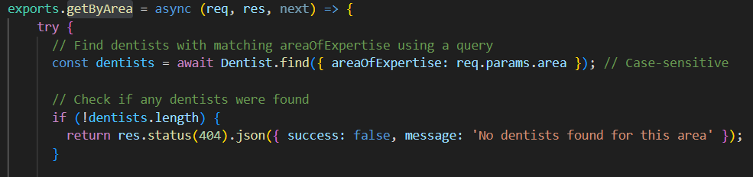
controller/dentist.js
8

Slide 9
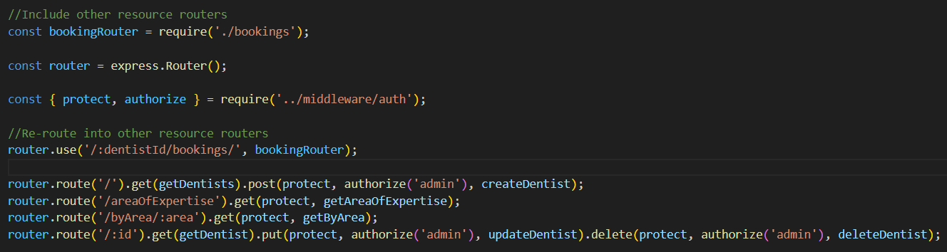
routes/dentist.js
9

Slide 10
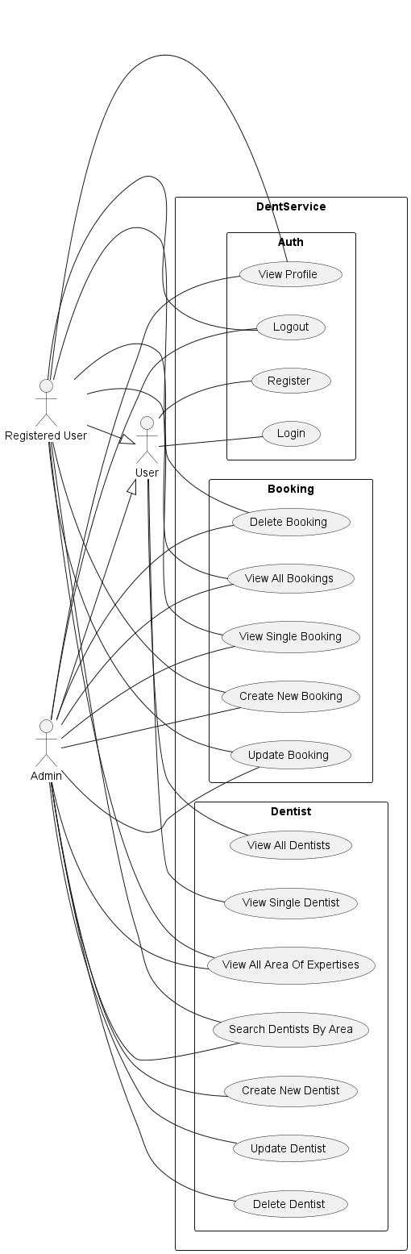
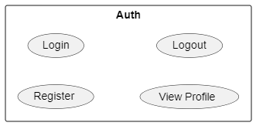
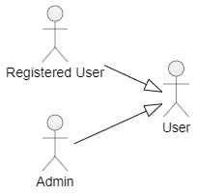
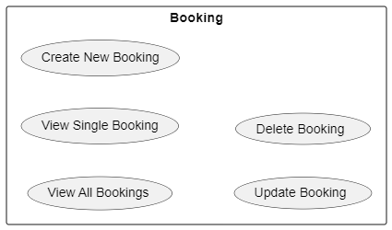
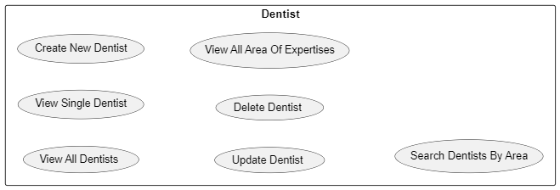
UML Use Case Diagram
10

Slide 11
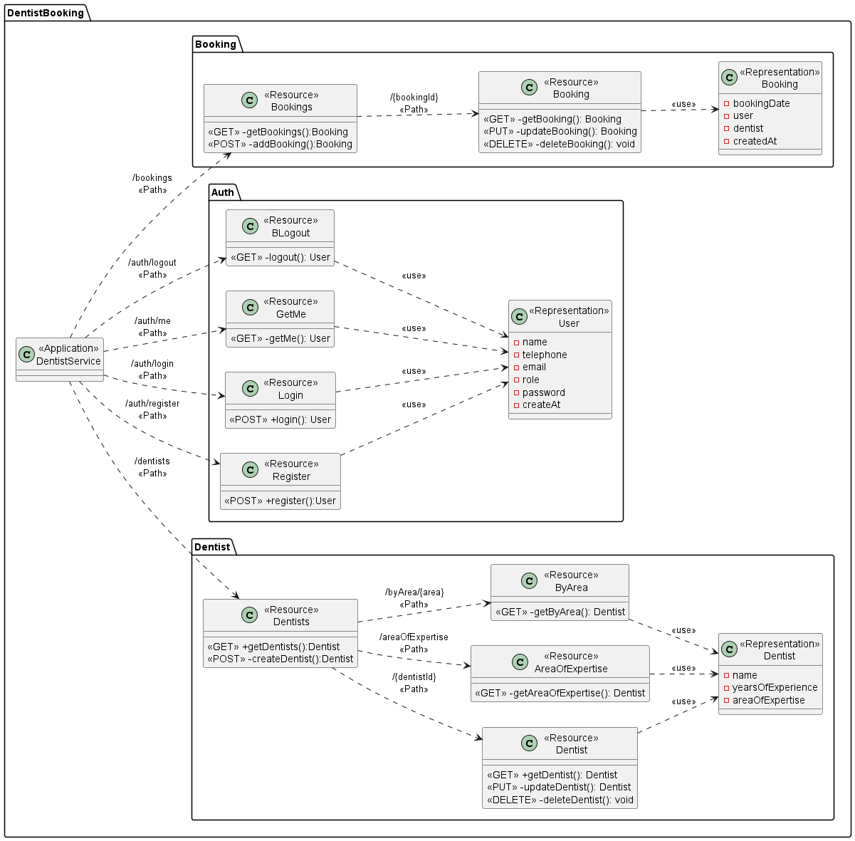
Class Diagram: UML Profile
11

Slide 12
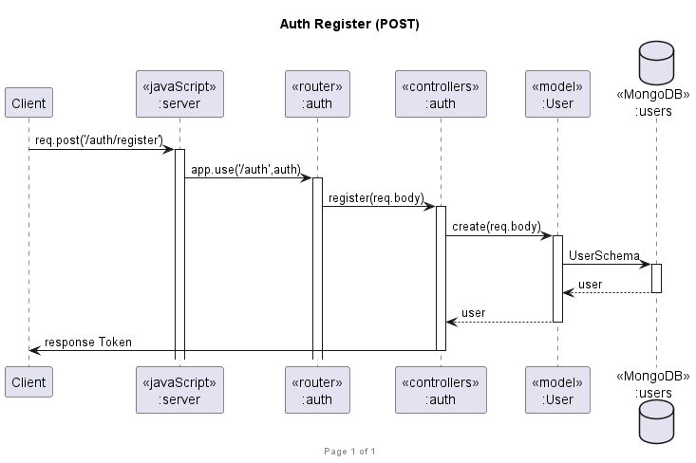
Sequence Diagram: Register (POST)
12

Slide 13
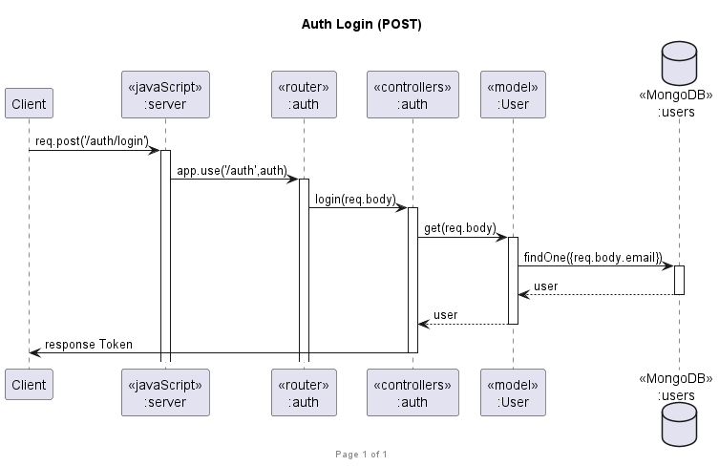
Sequence Diagram: Login (POST)
13

Slide 14
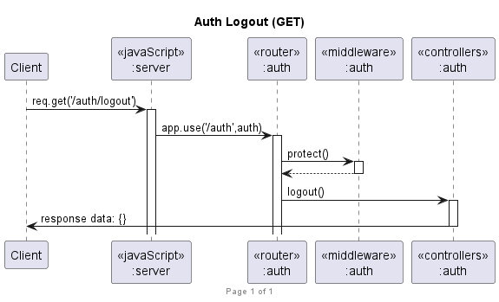
Sequence Diagram: Logout (GET)
14

Slide 15
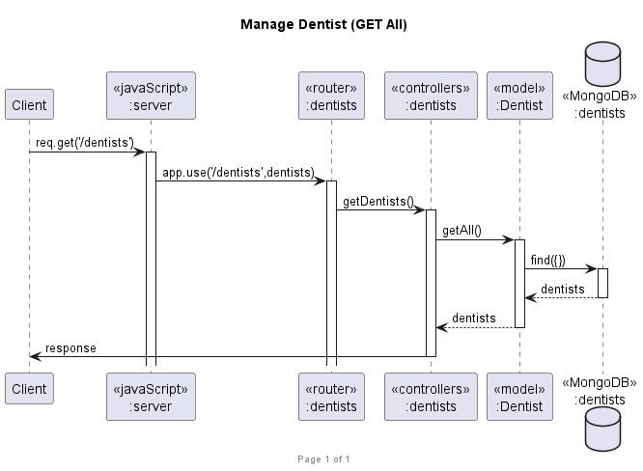
Sequence Diagram: Get All Dentist (GET)
15

Slide 16
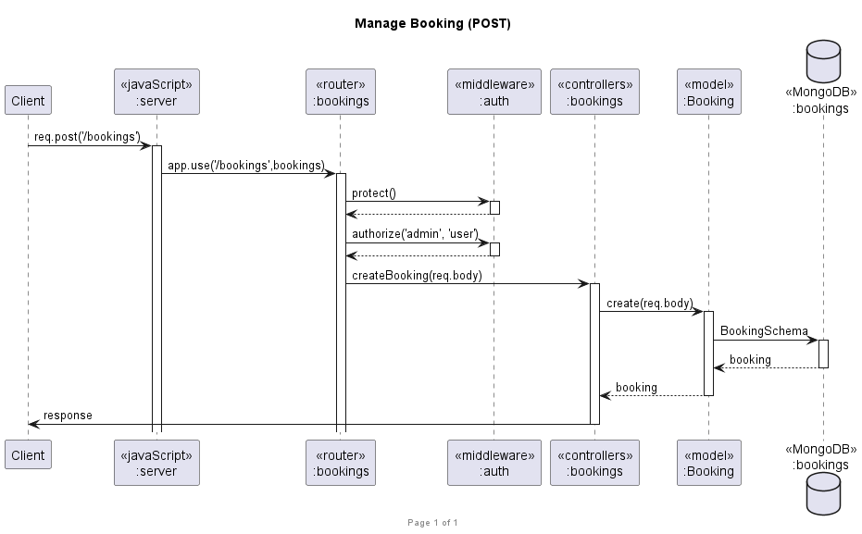
Sequence Diagram: Create Booking (POST)
16

Slide 17
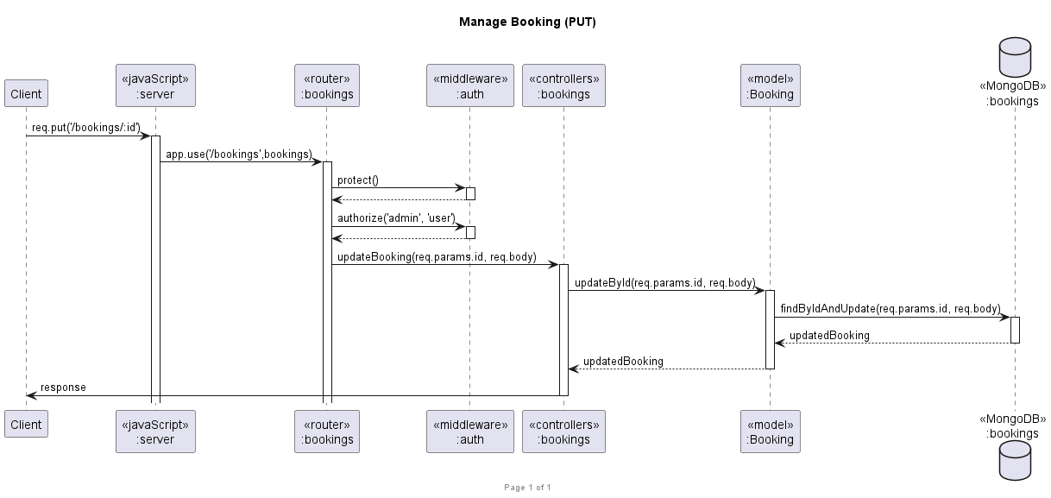
Sequence Diagram: Update Booking (PUT)
17

Slide 18
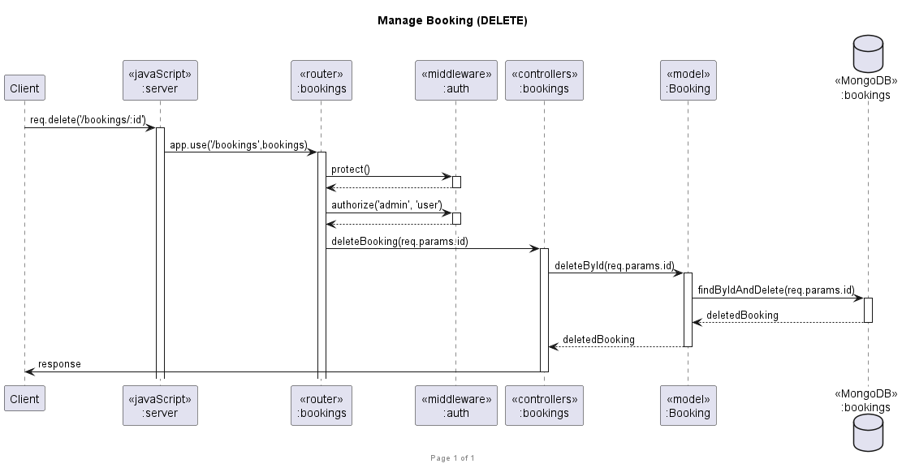
Sequence Diagram: Delete Booking (DELETE)
18

Slide 19
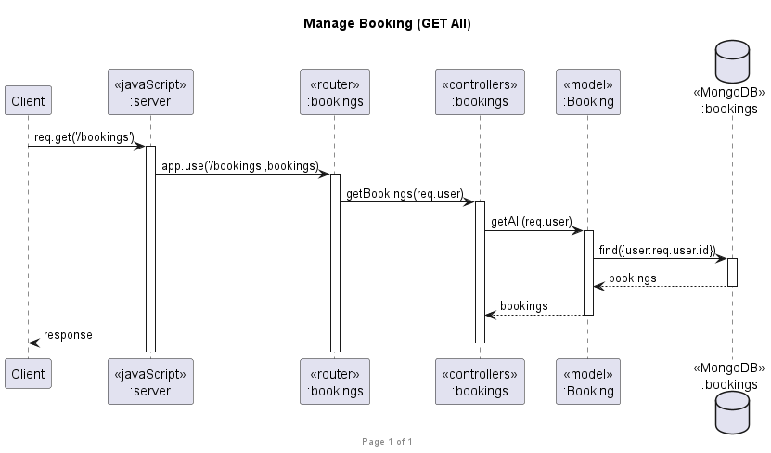
Sequence Diagram: Get All Booking (GET)
19

Slide 20
Additional Requirement
The system shall allow the admin to create dentist information.
The system shall allow the admin to delete any dentist information.
The system shall allow the registered user to search dentist information by area of expertise. (getAreaOfExpertise and getByArea: The area used to search must match an existing area only to be found.)
GitHub Link:
https://github.com/JirayutP/Dentist
Video Link:
(Describe additional requirement)
https://shorturl.at/cfgT1
or
https://chula-my.sharepoint.com/:v:/g/personal/6432022721_student_chula_ac_th/EV4lBv_M9wxIssOnYs14QoIBTVD-ZUKo-b-w3333oMlDig?nav=eyJyZWZlcnJhbEluZm8iOnsicmVmZXJyYWxBcHAiOiJPbmVEcml2ZUZvckJ1c2luZXNzIiwicmVmZXJyYWxBcHBQbGF0Zm9ybSI6IldlYiIsInJlZmVycmFsTW9kZSI6InZpZXciLCJyZWZlcnJhbFZpZXciOiJNeUZpbGVzTGlua0NvcHkifX0&e=CSVfYY
20

