Slide 1
DentService
6432022721 Jirayut Phothawilkiat
1

Slide 2
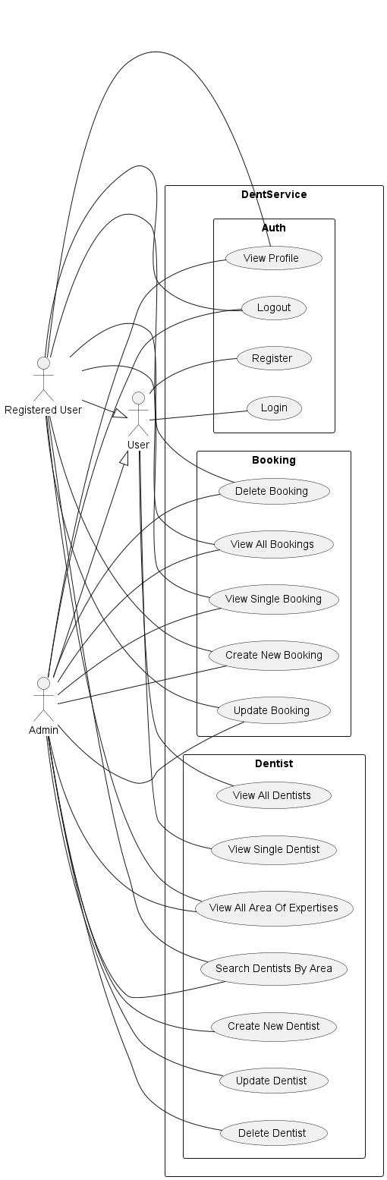
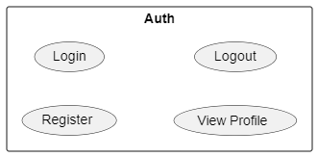
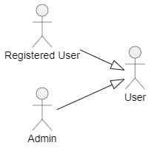
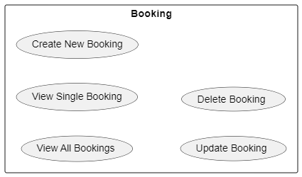
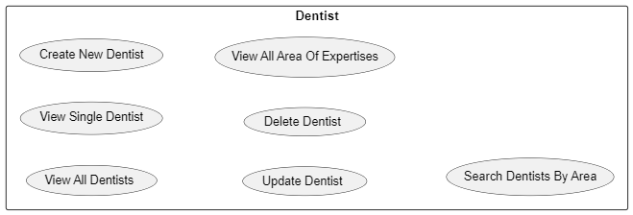
UML Use Case Diagram
2

Slide 3
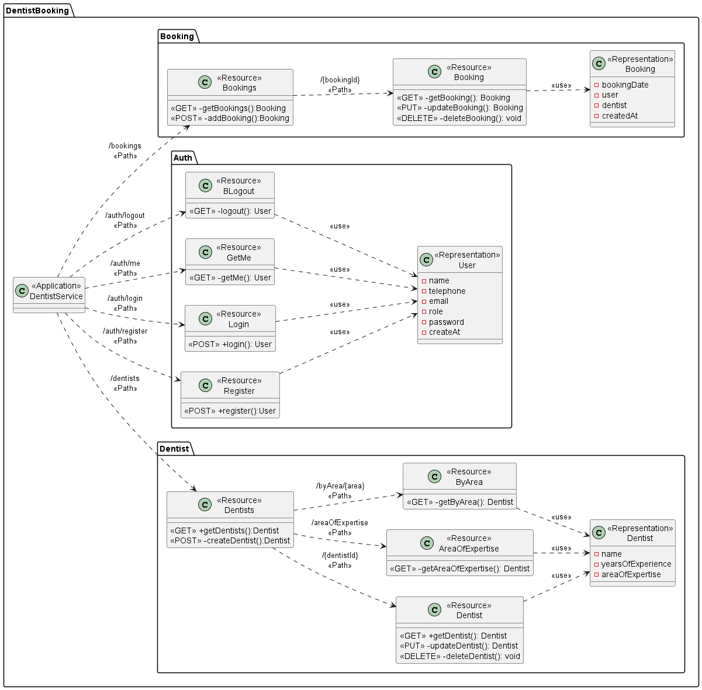
Class Diagram: UML Profile
3

Slide 4
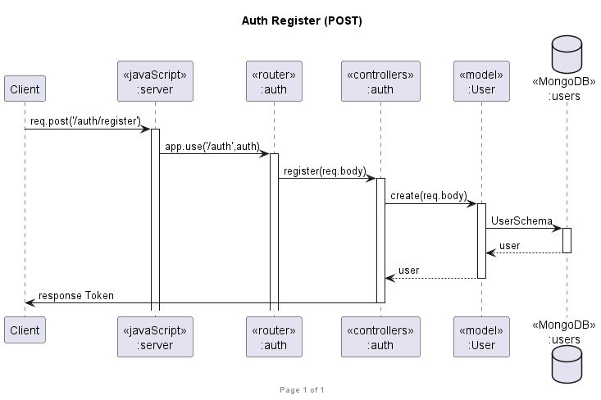
Sequence Diagram: Register (POST)
4

Slide 5
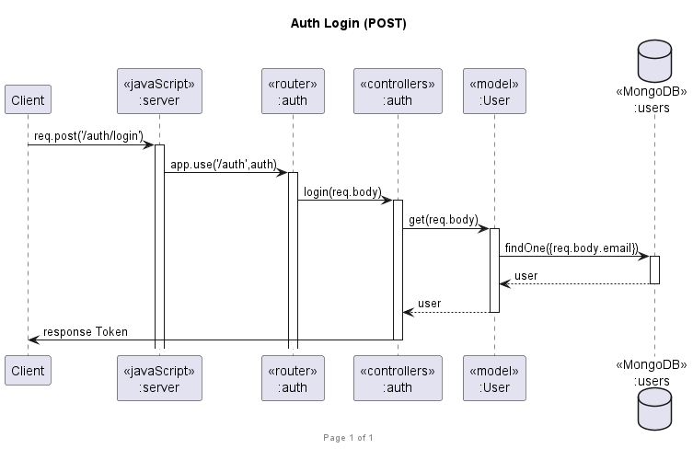
Sequence Diagram: Login (POST)
5

Slide 6
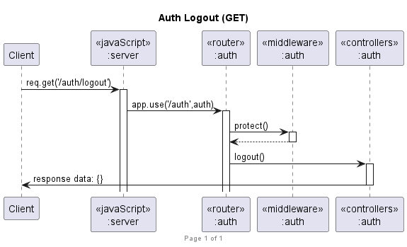
Sequence Diagram: Logout (GET)
6

Slide 7
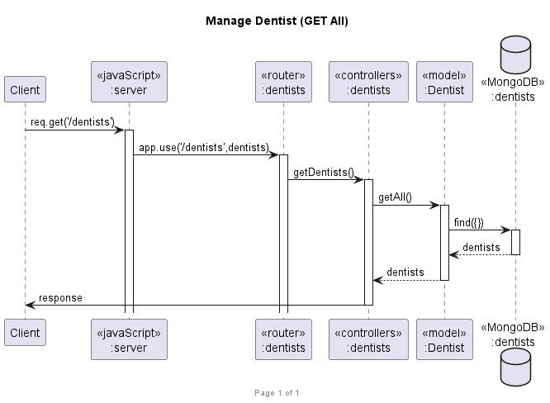
Sequence Diagram: Get All Dentist (GET)
7

Slide 8
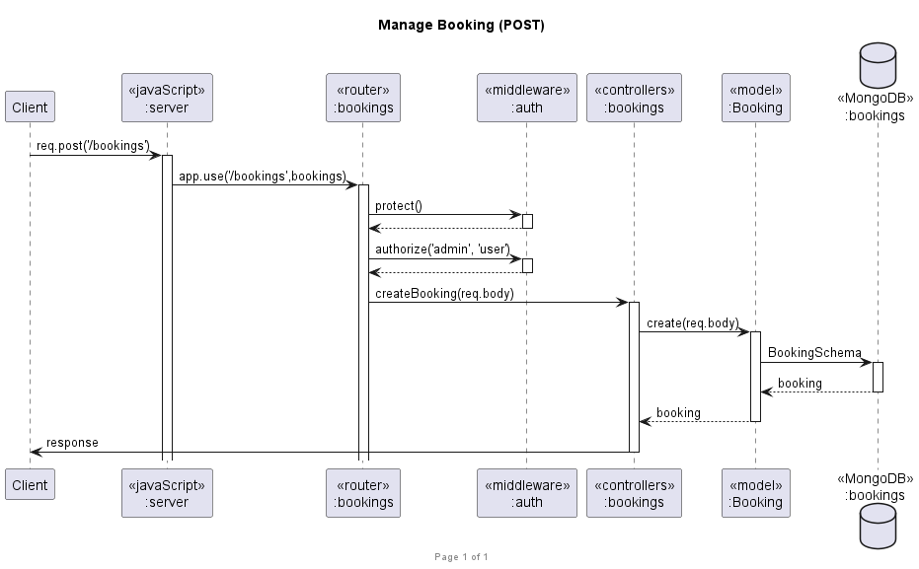
Sequence Diagram: Create Booking (POST)
8

Slide 9
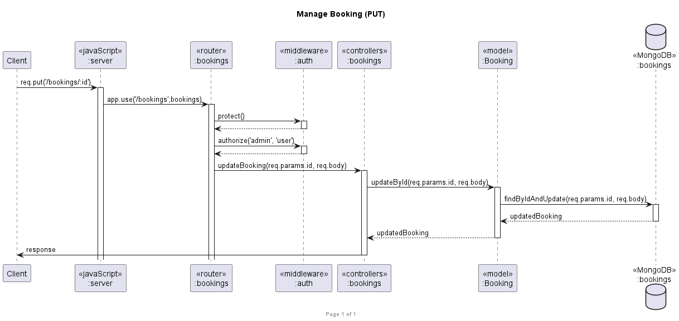
Sequence Diagram: Update Booking (PUT)
9

Slide 10
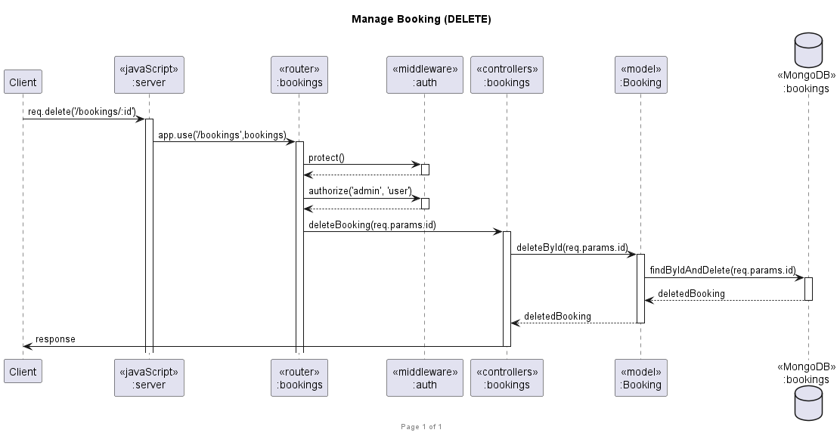
Sequence Diagram: Delete Booking (DELETE)
10

Slide 11
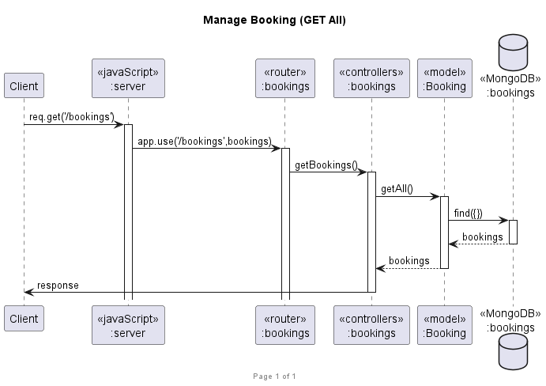
Sequence Diagram: Get All Booking (GET)
11

Slide 12
Source Code and Video
GitHub Link:
https://github.com/JirayutP/Dentist
Video Link:
(Describe additional requirement)
https://chula-my.sharepoint.com/:v:/g/personal/6432022721_student_chula_ac_th/EV4lBv_M9wxIssOnYs14QoIBTVD-ZUKo-b-w3333oMlDig?nav=eyJyZWZlcnJhbEluZm8iOnsicmVmZXJyYWxBcHAiOiJPbmVEcml2ZUZvckJ1c2luZXNzIiwicmVmZXJyYWxBcHBQbGF0Zm9ybSI6IldlYiIsInJlZmVycmFsTW9kZSI6InZpZXciLCJyZWZlcnJhbFZpZXciOiJNeUZpbGVzTGlua0NvcHkifX0&e=CSVfYY
12

