Slide 1
OpenAPI – basics
PCaPAC 2022
Jiří Švácha
Date:
4.10.2022

Slide 2
What will we talk about?
How will we do it?
Introduction to OpenAPI
Analysis of the use case for the tutorial – Systems database
Systems database specification using OpenAPI 3.0
Possibilities of auto-generated code
Server implementation
Test the implemented server using swagger docs and VS Code
Clients – React app, Grafana
Future - GraphQL, AsyncAPI
Date:
4.10.2022
Page:
<number>

Slide 3
Introduction to OpenAPI
I
Date:
4.10.2022
Page:
<number>

Slide 4
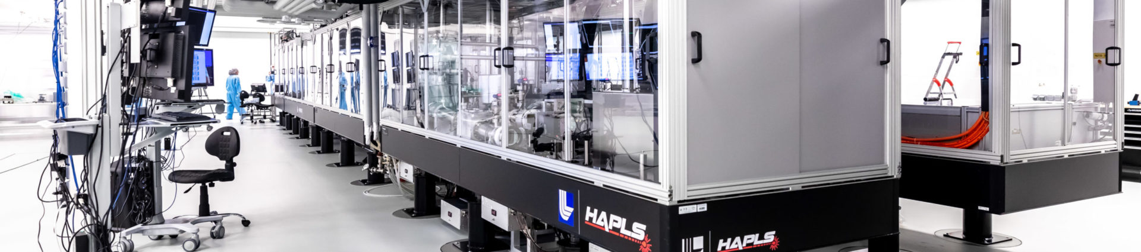
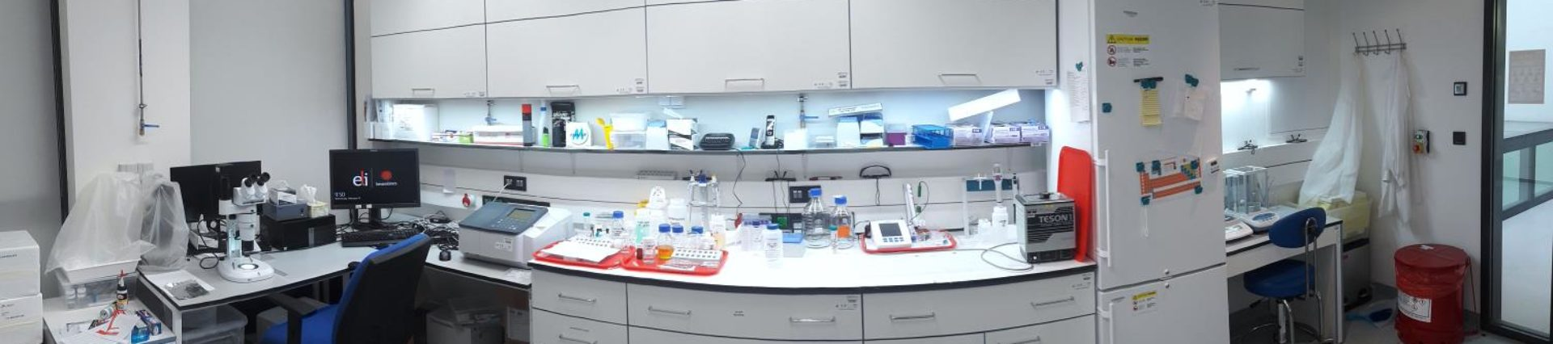
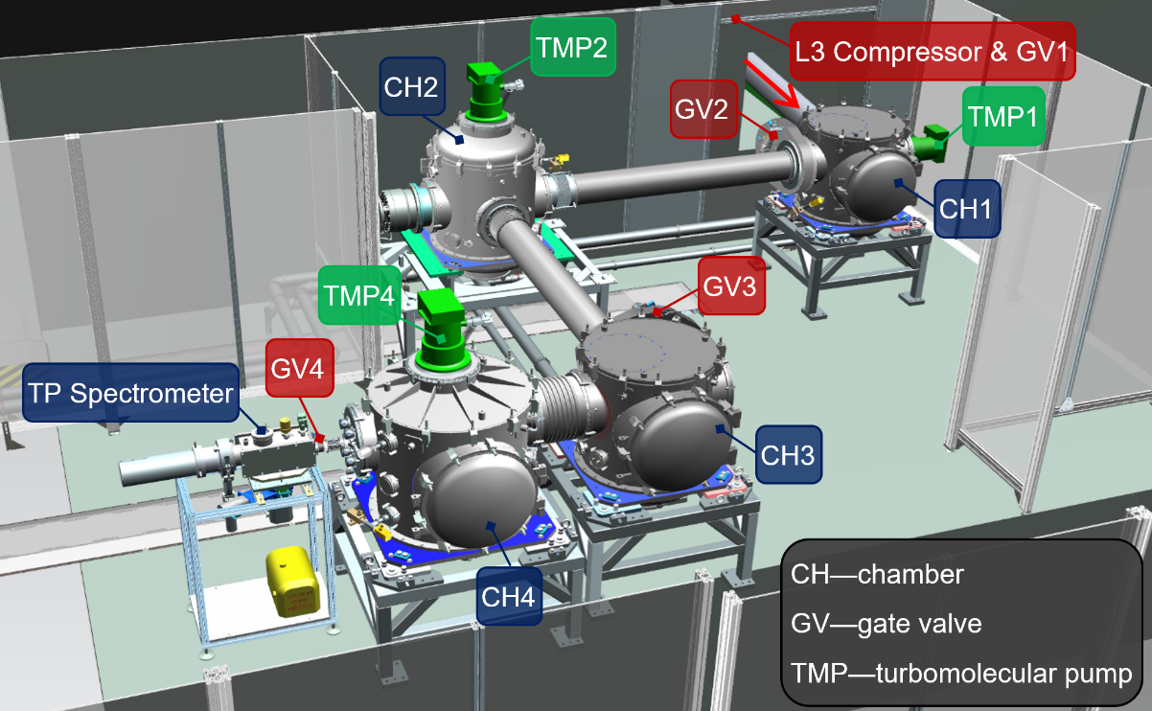

Analysis of the tutorial use case
Systems database
Laser engineer
Laser scientist
Control systems engineer
Date:
4.10.2022
Page:
<number>

Slide 5
Analysis of the tutorial use case
Systems database
Laser engineer
Reporting
Laser scientist
Manager(s)
Control systems engineer
Date:
4.10.2022
Page:
<number>

Slide 6
Analysis of the tutorial use case
Systems database
Pump
Oscillator
Mirror
Crystal
Spectrometer
System
Equipment
Switch
Valve
Sensors
PLC
Device
Date:
4.10.2022
Page:
<number>

Slide 7
Analysis of the tutorial use case
Systems database
System
Name
Code
HAS_SUBSYSTEM
Config
Key
Value
HAS
WAS_MAINTAINED_BY
LOG
User
Username
TimeValue
Time
Value
Unit
Date:
4.10.2022
Page:
<number>

Slide 8
OpenAPI specification and implementation
Use open-source swagger editor
Date:
4.10.2022
Page:
<number>

Slide 9
Thank you
for your attention!
Jiří Švácha
Author:
Date:
4.10.2022
Page:
<number>

