Slide 1
OpenAPI
PCaPAC 2022
Jiří Švácha
Date:
4.10.2022

Slide 2
What will we talk about?
How will we do it?
Introduction to OpenAPI
Analysis of the use case for the tutorial – Systems database
Systems database specification using OpenAPI 3.0
Possibilities of auto-generated code
Server implementation
Test the implemented server using swagger docs and VS Code
Clients – React app, Grafana
Future - GraphQL, AsyncAPI
Date:
4.10.2022
Page:
<number>

Slide 3
Introduction to OpenAPI
REST is an acronym for REpresentational State Transfer and an architectural style for distributed hypermedia systems. Roy Fielding first presented it in 2000 in his famous dissertation.
A Web API (or Web Service) conforming to the REST architectural style is a REST API.
In 2009, Tony Tam of Wordnik (an online dictionary service) had begun working on what would become the Swagger Specification.
Tam published the first version of the Swagger Specification (1.0) in August 2011
September 2014 saw the release of the Swagger Specification 2.0. This saw a reorganisation from the two-file format of Swagger 1.2 and earlier into a single document structure
In March 2015, SmartBear Software, a leading API testing and development tool company
In December 2015, the Swagger Specification was donated by SmartBear Software to a new open-governance organisation, set up under the auspices of the Linux Foundation: the OpenAPI Initiative
The OpenAPI Specification is now managed by a Technical Steering Committee (TSC)
In July 2017, the OpenAPI Initiative announced the release of version 3.0.0
Date:
4.10.2022
Page:
<number>

Slide 4
OpenAPI definition
The OpenAPI Initiative defines the OpenAPI Specification in these terms:
"The OpenAPI Specification (OAS) defines a standard, programming language-agnostic interface description for REST APIs, which allows both humans and computers to discover and understand the capabilities of a service without requiring access to source code, additional documentation, or inspection of network traffic. When properly defined via OpenAPI, a consumer can understand and interact with the remote service with a minimal amount of implementation logic. Similar to what interface descriptions have done for lower-level programming, the OpenAPI Specification removes guesswork in calling a service."
Date:
4.10.2022
Page:
<number>

Slide 5
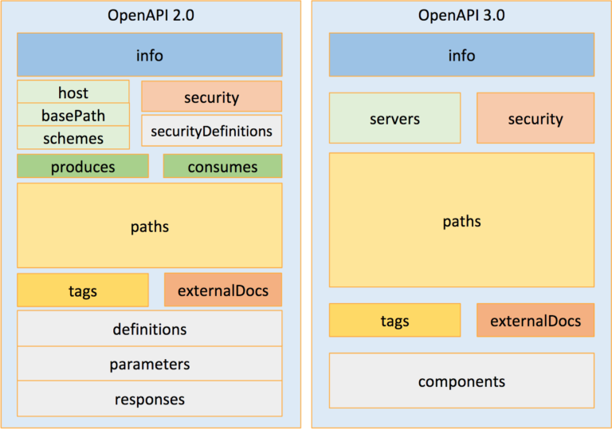
OpenAPI structure
Let’s discover:
https://openapi-map.apihandyman.io/
and:
https://swagger.io/specification/
Date:
4.10.2022
Page:
<number>

Slide 6


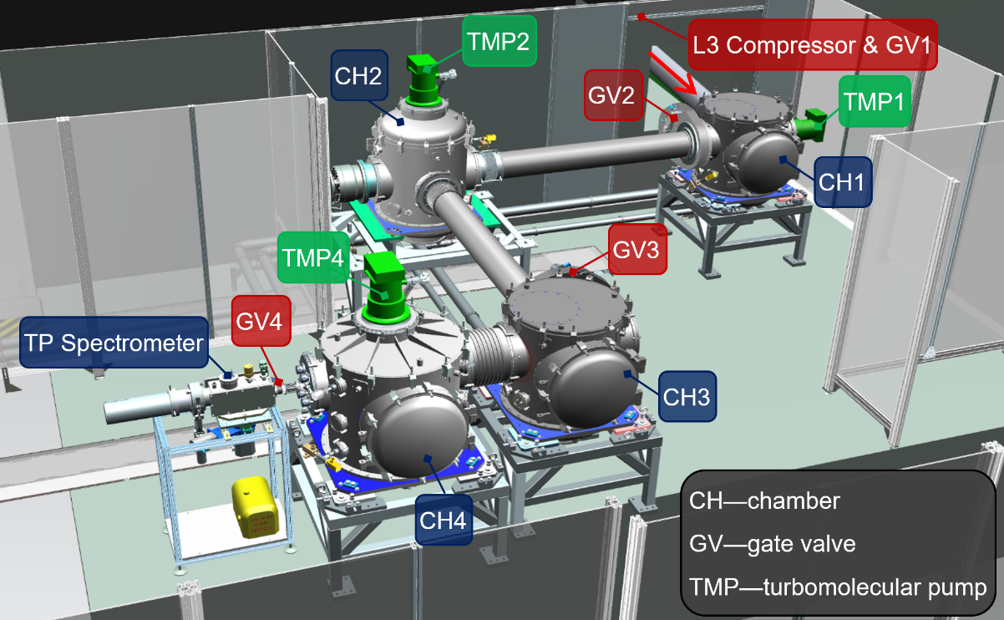

Analysis of the tutorial example
Systems database
Laser engineer
Laser scientist
Control systems engineer
Date:
4.10.2022
Page:
<number>

Slide 7
Analysis of the tutorial example
Systems database
Laser engineer
Reporting
Laser scientist
Manager(s)
Control systems engineer
Date:
4.10.2022
Page:
<number>

Slide 8
Analysis of the tutorial example
Systems database
Pump
Oscillator
Mirror
Crystal
Spectrometer
System
Equipment
Switch
Valve
Sensors
PLC
Device
Date:
4.10.2022
Page:
<number>

Slide 9

Analysis of the tutorial example
Systems database
System
Name
Code
HAS_SUBSYSTEM
Config
Key
Value
HAS
WAS_MAINTAINED_BY
LOG
User
Username
TimeValue
Time
Value
Unit
neo4j docs
Date:
4.10.2022
Page:
<number>

Slide 10

OpenAPI specification and implementation
GitHub project:
https://github.com/JiriSvachaEliBeams/OpenAPI-Tutorial
Use open-source swagger editor:
https://editor.swagger.io/
Now it’s time for programmers...
Date:
4.10.2022
Page:
<number>

Slide 11
Thank you
for your attention!
Jiří Švácha
Author:
Date:
4.10.2022
Page:
<number>

