Slide 1


Fake News Detection System
Prepared by :
Mohammadjisan Shaikh

Slide 2

Project Objectives
Problem Statement
Project Overview – Introduction
End Users
Wow Factor in Project
Modelling/Block Diagram/Flow of Project
Result/outcomes
Conclusion
Future Perspective

Slide 3
Problem Statement
The rapid spread of fake news online has become a significant concern, leading to misinformation, confusion, and public distrust. Fake news, including fabricated stories and misleading headlines, can manipulate public opinion and cause harm, especially during critical events like elections or public health crises.
Currently, manual fact-checking is the primary method for identifying fake news, but it is inefficient and unable to keep up with the large volume of news being produced. Fact-checking takes time, allowing misinformation to spread before it can be addressed.
There is a pressing need for an automated system to identify fake news based on content analysis. Such a system would help quickly assess the credibility of news articles, flag misleading claims, and prevent the spread of false information, ultimately reducing the impact of fake news on society.

Slide 4
Project overview - Introduction
The rise of digital media has led to an increase in the spread of fake news, which includes misleading, fabricated, or exaggerated stories designed to deceive the public. Fake news can have serious consequences, such as influencing elections, causing panic, and eroding trust in credible information sources.
Current methods of fact-checking are time-consuming and inefficient, especially with the volume of news being produced every minute. To address this, the Fake News Detection System aims to develop an automated solution using Machine Learning (ML) techniques. The system will analyze news content, identify linguistic patterns, and assess source credibility to classify articles as fake or real.
The goal is to create a scalable tool that can quickly process large volumes of news and help reduce the spread of misinformation, supporting journalists, media organizations, and the public in making informed decisions.

Slide 5
End User
The Fake News Detection System serves multiple end users, each with specific needs in combating misinformation:
Journalists: Verifying News Authenticity
Use Case: Helps journalists quickly verify news articles and flag fake content.
Benefit: Saves time and ensures reliable reporting, maintaining credibility.
Social Media Platforms: Flagging Fake Content Automatically
Use Case: Automatically flags fake news articles and posts based on analysis.
Benefit: Reduces the spread of misinformation and improves content moderation.
General Public: Real-Time Verification via Browser Extensions/Apps
Use Case: Provides real-time fake news detection through browser extensions or apps.
Benefit: Empowers users to verify content before sharing and helps reduce misinformation.

Slide 6
Wow Factor in Solution
The Fake News Detection System stands out with the following key features:
Hybrid Model: Combines Multiple ML Algorithms for Higher Accuracy
Description: Uses a combination of algorithms (e.g., Random Forest, Gradient Boosting, SVM) for more accurate predictions.
Benefit: Increases accuracy by leveraging the strengths of multiple models, reducing false positives and negatives.
Real-Time Prediction: Demo with User-Input News Text
Description: Allows users to input news text and receive immediate feedback on its authenticity.
Benefit: Provides instant verification, making the system highly interactive and practical for daily use.
Scalable: Can Integrate with APIs (e.g., Twitter, News Aggregators)
Description: Can connect with APIs to analyze content from platforms like Twitter or news aggregators.
Benefit: Enables large-scale detection and monitoring of fake news across multiple platforms.

Slide 7
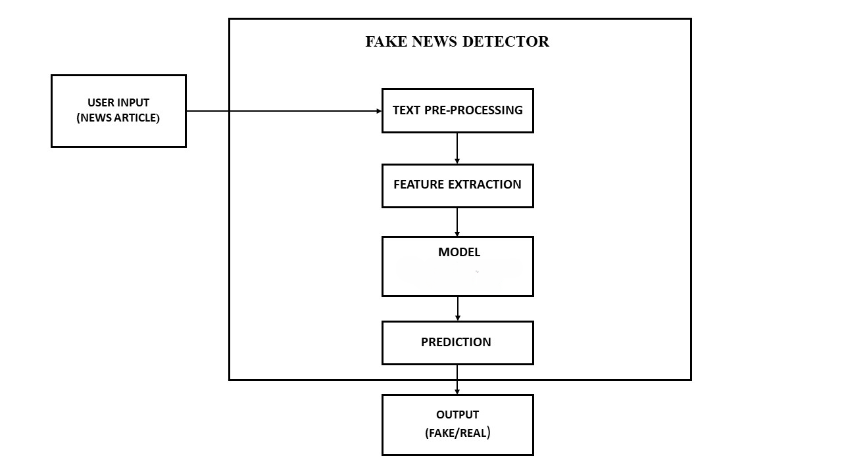
Modelling

Slide 8
Result / Outcomes
Ensemble Model with Voting Mechanism:
Multiple models were trained:
Passive Aggressive Classifier (PAC)
Gradient Boosting Classifier
Random Forest Classifier
Decision Tree Classifier
Each model predicts True (Real) or False (Fake) for a given news article.
Final prediction is based on majority voting — the class (True/False) predicted by most models is selected as the final result.
Accuracy:
Achieved about 99% accuracy with consistent performance across models.
The ensemble voting approach reduces individual model bias and improves reliability.

Slide 9
Result / Outcomes
Demo Example :
Input: "COVID-19 cure discovered in 24 hours!“
PAC: Fake | RF: Fake | DT: Fake | GB: Real → Final: Fake
Input: "Government unveils new education policy“
All models: Real → Final: Real

Slide 10
Conclusion
The Fake News Detection project effectively applies machine learning techniques to identify misinformation with high accuracy. By combining multiple models—Passive Aggressive, Random Forest, Gradient Boosting, and Decision Tree—through a majority voting approach, the system achieves around 99% accuracy in classifying news as real or fake.
The solution supports real-time predictions and can be integrated into digital platforms to automate fact-checking and reduce the spread of fake news. This project demonstrates the potential of AI-driven solutions in combating misinformation and sets the stage for future enhancements like multilingual and multimedia support.

Slide 11
Future Perspective
Multilingual Support
The system is currently optimized for English news content. In the future, integrating multilingual support would allow the detection system to handle news from different regions and languages, broadening its global applicability.
Advanced Deep Learning Models
To improve the model’s ability to understand context and semantics, the use of deep learning techniques such as BERT and GPT could be explored. These models are capable of grasping nuanced language patterns and offering more accurate predictions, especially for complex or ambiguous news content.
Real-World Expansion
Browser Plugin / Mobile App: Developing a browser extension or mobile app could provide users with real-time fake news detection while browsing.
API Integration: An API could be built to allow news websites, social media platforms, and other digital services to seamlessly integrate the system into their existing workflows, enabling automated content validation at scale.

Slide 12
Thank you...!
Notes:
12

