Slide 1

A Mini Project on Water Body Segmentation
Under the guidance of Dr. Upendra Kumar Sahoo
Submitted by- Anirudh Tikoo, Jisas Patel,
Nishad Sanjay Patil, Tanushree Das, Adarsh, Saswat Suvam Kumar

Slide 2
Introduction / Problem Statement
• Importance of water-body segmentation
• Satellite-based flood monitoring
• Need for lightweight & accurate models
• Challenges with traditional thresholding methods

Slide 3
Objectives
• Build lightweight U-Net model
• Improve segmentation accuracy
• Apply Kalman smoothing
• Robust postprocessing

Slide 4
SOFTWARE / TOOLS USED
Programming Language: Python 3.12
Key Python Libraries
OpenCV (cv2) – Image processing, thresholding, morphological ops
NumPy – Numeric computations
Matplotlib – Visualization of probability maps & masks
Development Environment: Jupyter Notebook / VS Code and Windows 11 system
Additional Tools:
Kalman Filtering Implementation (Custom Python code)
Google Colab :(for interactive execution)
Image viewers (Windows Photos) for inspecting outputs

Slide 5
Dataset Description
The Satellite Images of Water Bodies dataset, originally published by Escobar . The dataset consists of paired RGB satellite images and manually annotated binary masks indicating the presence of water.
The images capture a wide variety of landscapes including rivers, lakes, coastal boundaries, wetlands, and inland water reservoirs.

Slide 6
Proposed Methodology
Input Acquisition
Feature Extraction for Initial Water Probability
Kalman Spatial Smoothing
Thresholding & Binary Mask Generation
Morphological Post-Processing

Slide 7
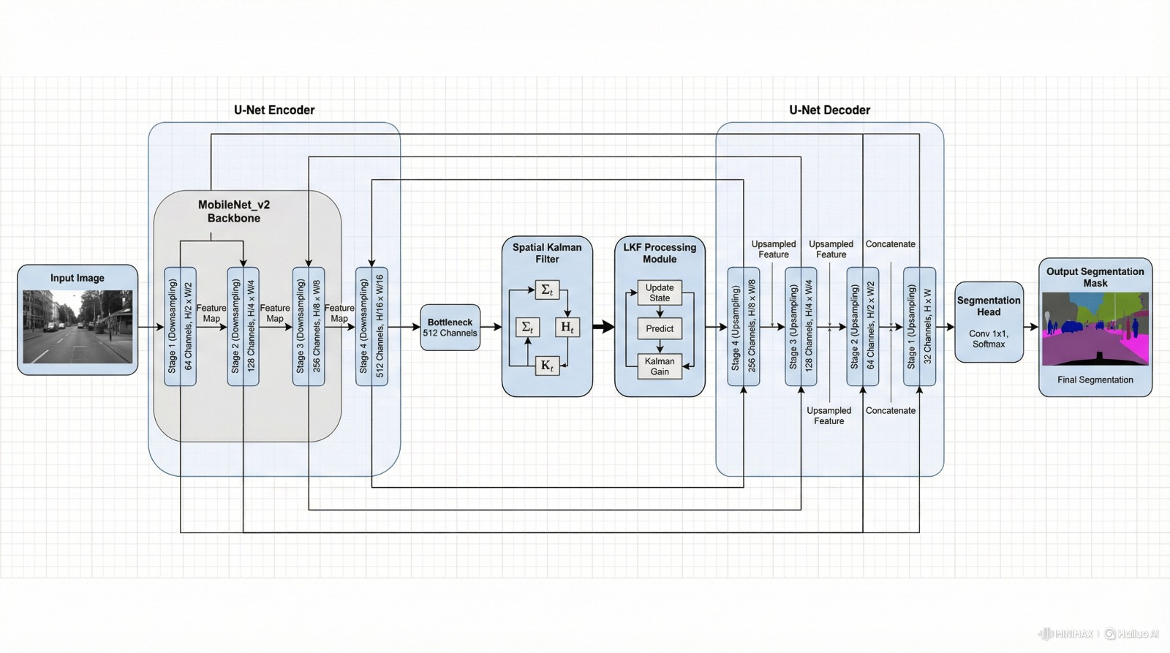
U-Net style segmentation pipeline

Slide 8
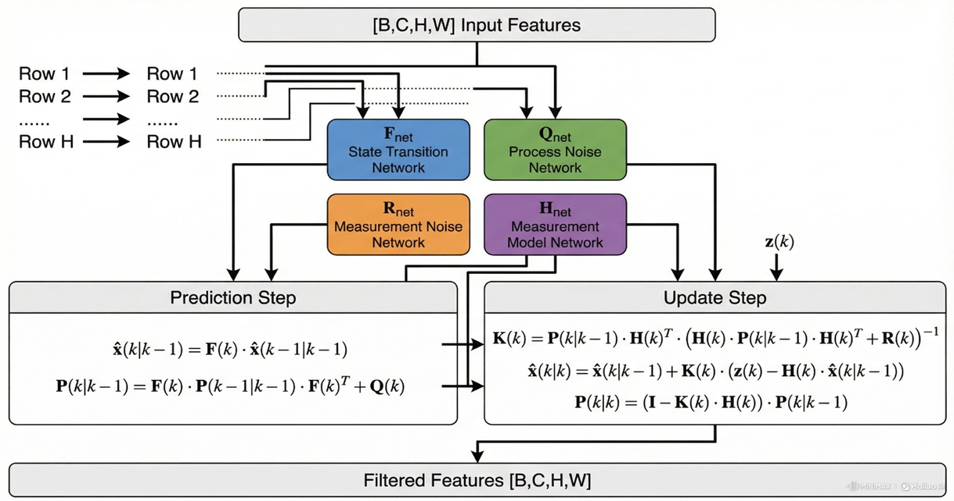
Row-wise Learnable Kalman Filter Mechanism

Slide 9
Temporal smoothing
Reduces frame-to-frame fluctuations (flicker) in predicted masks
Improves stability for drone/satellite monitoring scenarios
Provides consistent water-body estimates across sequential patches
Enables next-frame prediction without needing temporal training data

Slide 10
Temporal smoothing
A large satellite image is divided into overlapping patches → forms a synthetic temporal sequence
Each patch is segmented by LKF-SegNet → produces probability maps ztz_tzt​
A scalar Kalman filter is applied per pixel across frames
Two outputs:
  Filtered mask xtx_txt​: smoothed over time
  Predicted mask xt∣t−1x_{t|t-1}xt∣t−1​: one-step-ahead forecast

Slide 11
Results
Water Probability Map
Final Segmentation Mask
Performance Observations: Thresholding combined with postprocessing produces accurate and stable masks.
Metric Used: Mean Absolute Error

Slide 12
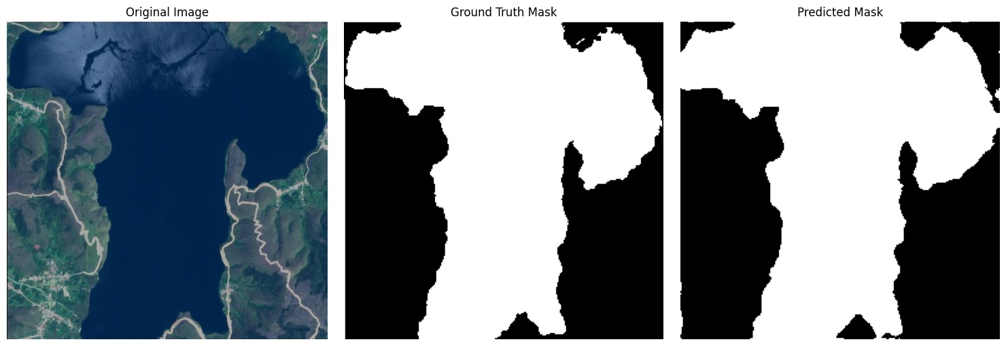
Qualitative Results:
Sample Segmentation Result

Slide 13
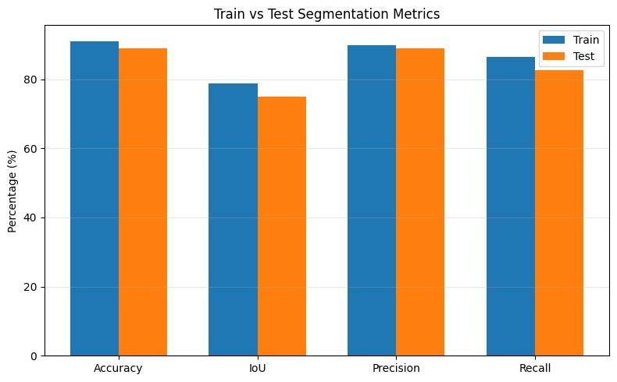
Train vs Test Segmentation Metrics:
Comparison across Accuracy, IoU, Precision, and Recall

Slide 14
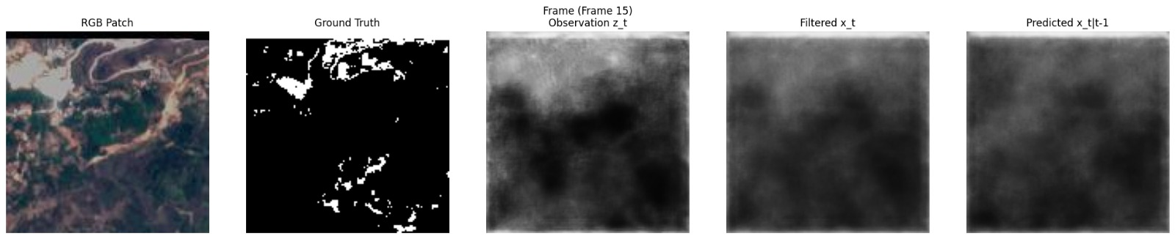
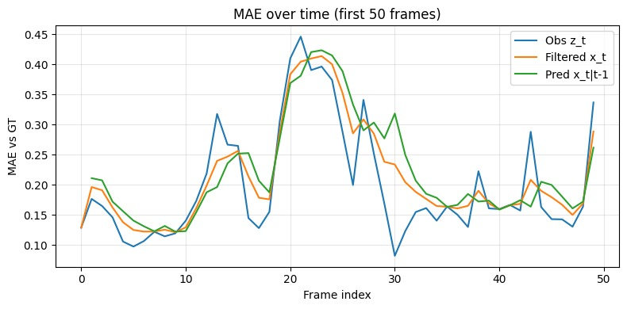
Temporal Filtering Outputs and Temporal MAE

Slide 15
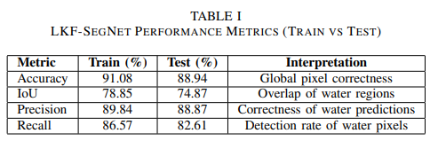
Quantitative Results

Slide 16
Discussion
• Model performance
• Strengths
• Observed improvements
• Limitations

Slide 17
Conclusion
• Achieved lightweight, high-quality segmentation
• Kalman improved output
• Efficient model

Slide 18
Future Scope
• Real-time deployment
• Multi-class segmentation
• GIS integration

Slide 19
References
[1] D. Liao, J. Sun, Z. Deng, Y. Zhao, J. Zhang, and D. Ou, “A Lightweight Network for Water Body Segmentationin Agricultural Remote Sensing Using Learnable Kalman Filters and Attention Mechanisms,” Applied Sciences, vol. 15, no. 11, p. 6292, 2025.
[2] M. Wieland, S. Martinis, R. Kiefl, and V. Gstaiger, “Semantic segmentation of water bodies in very high-resolution satellite and aerial images,” Remote Sensing of Environment, vol. 287, p. 113452, 2023.
[3] Z. Miao, K. Fu, H. Sun, X. Sun, and M. Yan, “Automatic Water Body Segmentation From High-Resolution Satellite Images via Deep Networks,” IEEE Geoscience and Remote Sensing Letters, vol. 15, no.4, pp. 602–606, 2018.
[4] J. Bersvendsen et al., “Automated Segmentation of the Right Ventriclein 3D Echocardiography: A Kalman Filter State Estimation Approach,”IEEE Transactions on Medical Imaging, vol. 35, no. 1, pp. 42–51, 2016.
[5] O. Ronneberger, P. Fischer, and T. Brox, “U-Net: Convolutional Networks for Biomedical Image Segmentation,” in MICCAI, 2015.

