Slide 1
Electronic Voting Machine
Jishnu Das
7th May 2023

Slide 2
Salient Features
The salient features of this machine are :-
Master Control to restrict any unauthorized access.
Debouncer to prevent unwanted votes.
Count option for counting votes at the time of necessity.
Display option for number of votes of winning candidate.
Display option for winner.
7th May 2023
Page 1 of 7

Slide 3
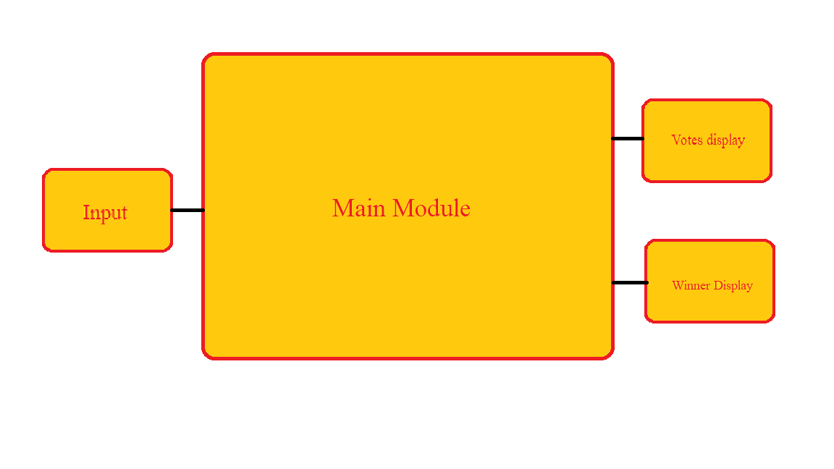
Block Diagram
7th May 2023
Page 2 of 7

Slide 4
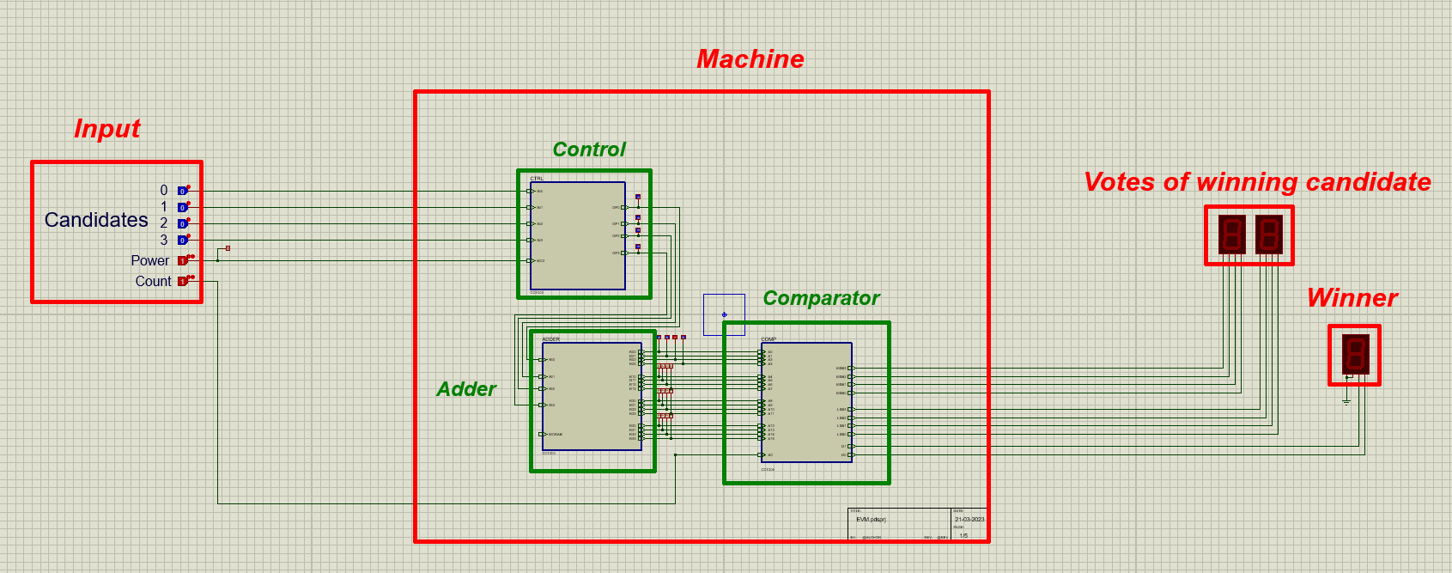
Circuit Diagram
7th May 2023
Page 3 of 7

Slide 5
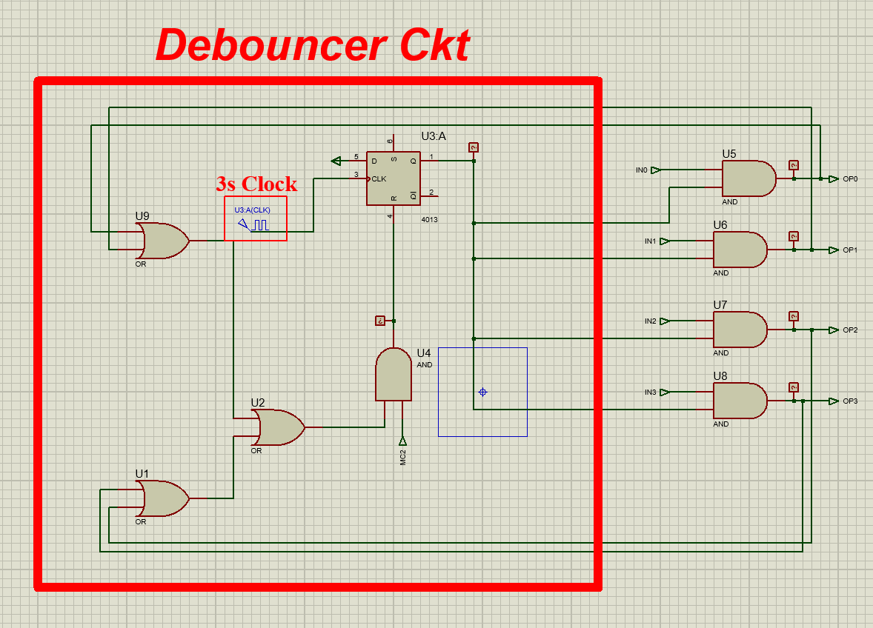
Control Module Internal
7th May 2023
Page 4 of 7

Slide 6
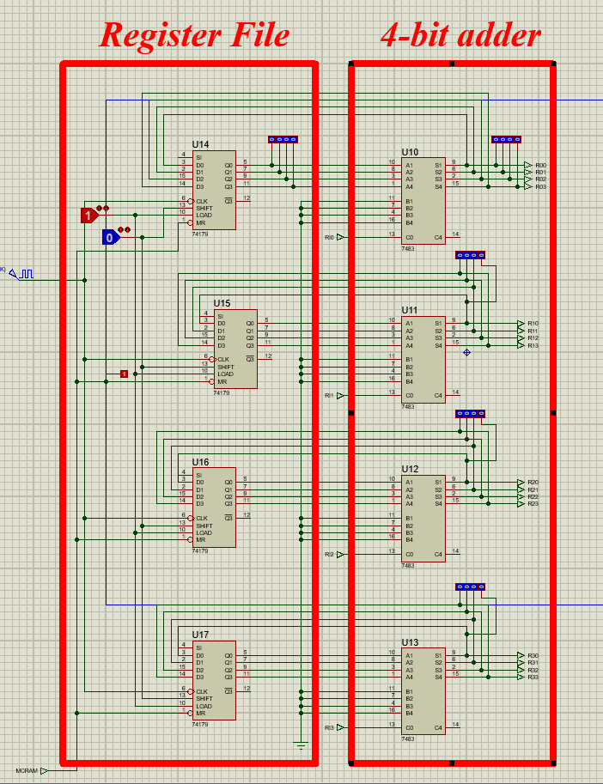
Adder Module Internal
7th May 2023
Page 5 of 7

Slide 7
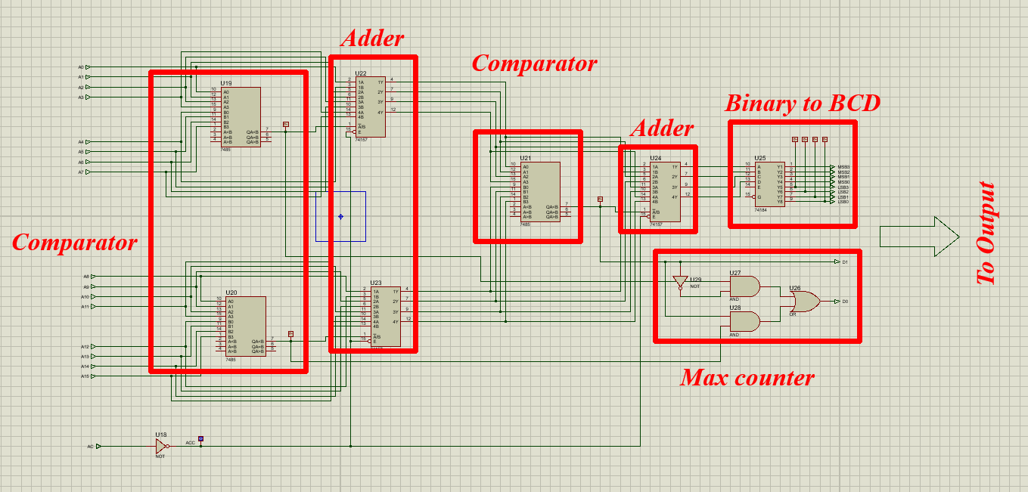
Comparator module Internals
7th May 2023
Page 6 of 7

Slide 8
Link for Video Demonstration
Basic Structure and Operation
Sum demo
Master-control demo
Debouncing prevention demo
Count demo
Comparator Demo
7th May 2023
Page 7 of 7

