Slide 1
floydCycle_hardware Proteus Simulation and Implementation of Floyd’s cycle finding algorithm in a blockchain
Jishnu Das
Hobby project
IIT-BHU
29 June 2023

Slide 2
Outline
Theory
Cyclic Right Shifting
Problem Statement
Implementation Algorithm
Back of napkin sketch
Block Diagram
Sub-blocks
Entire Circuit Diagram
Links for Video Demonstration
Notes:
Here is the outline of the rest of my talk.
First, I would like to start with explaining basic DRAM operations and building motivation for an infrastructure to characterize real DRAM chips.

Slide 3
Theory
What is Blockchain - Decentralized (access to all) database of all transactions/ data.
How is data stored
Linked list fashion. Generally the data is encrypted to ensure that no one can access it without authorization.
The list contains 2 elements - data and next data’s address
In our case, data is converted into binary and encrypted in a right cyclic shifting of the next node address by 3 bits

Slide 4
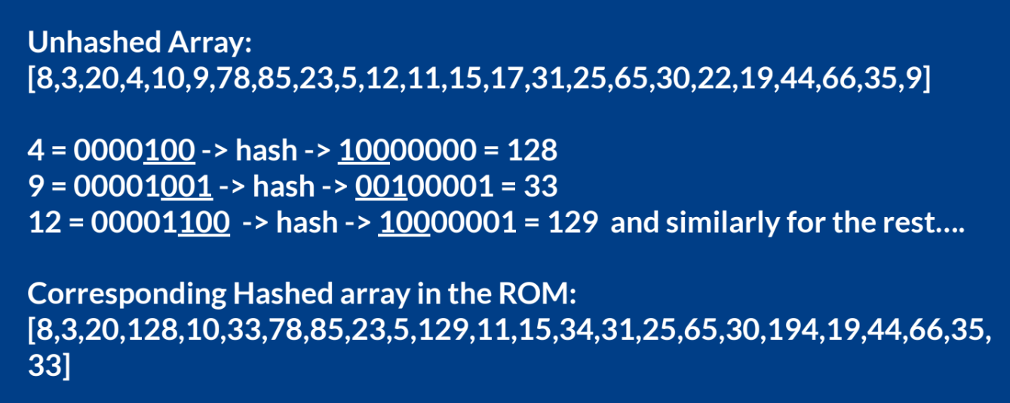
Cyclic Right Shifting

Slide 5
Problem Statement
Data will be in unhashed 8 bits. The address to the next data is hashed 5 bits
We given this hashed array in the ROM.
Probably someone has tampered with the data and there is a cycle in the linked list, which would collapse the entire linked list.
Find if there is any such cycle formed and if present, find the decrypted address of the head.

Slide 6
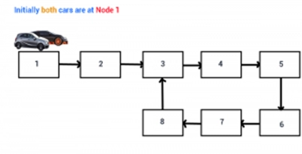
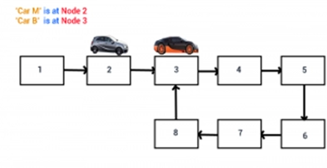
Implementation Algorithm
Floyd Cycle Detection Algorithm
Initialize 2 pointer - Fast and Slow pointer
Move the fast pointer by two steps while slow pointer by 1 step

Slide 7
Implementation Algorithm
Algorithm
Initialize them (fast ptr and slow ptr) to head of the linked list
In the implementation the fast pointer goes by one step in every clock cycle and the slow pointer goes one step in every two clock cycles.
Either fast pointer meets the end. The end pointer’s address is 255 or 256. In this case no loop is detected.
If fast pointer’s address is less than slow pointer’s address, then cycle is detected.
The address of the fast pointer will determine the address of head.

Slide 8
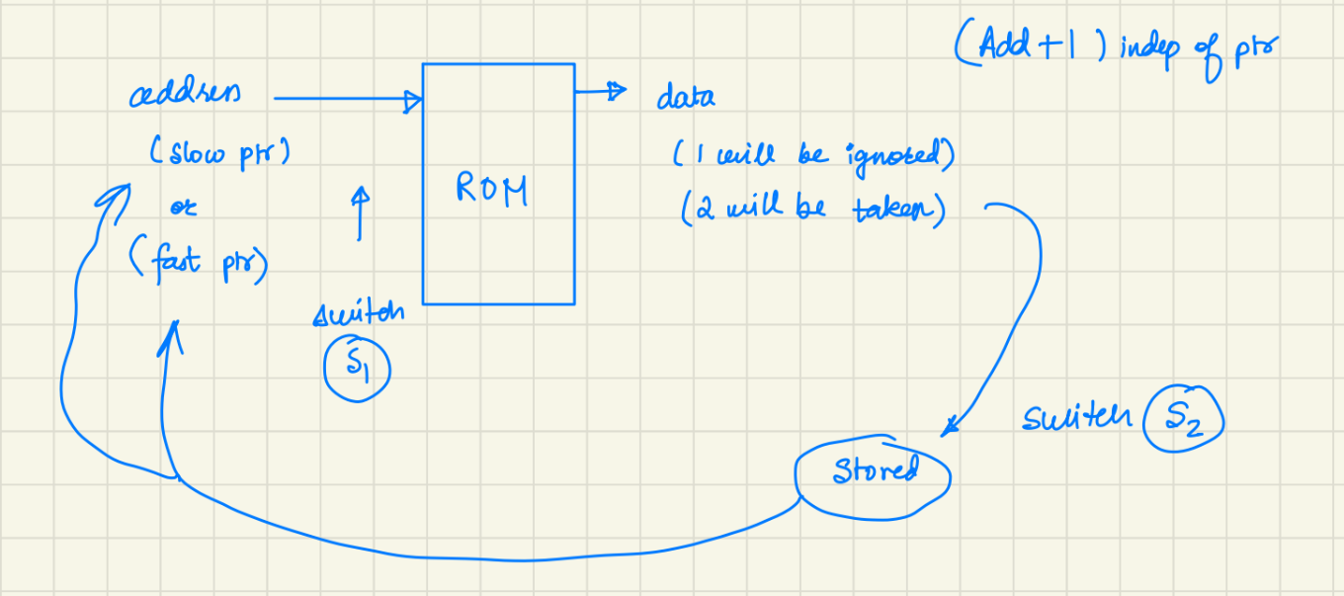
Back of napkin block diagram

Slide 9
Block diagram
Add_plus1
Fast_ptr reg
Add_in
ROM
Add_nxt
Cycle_detector
Slow_ptr reg
Add_in logic
Output display
Add_nxt logic

Slide 10
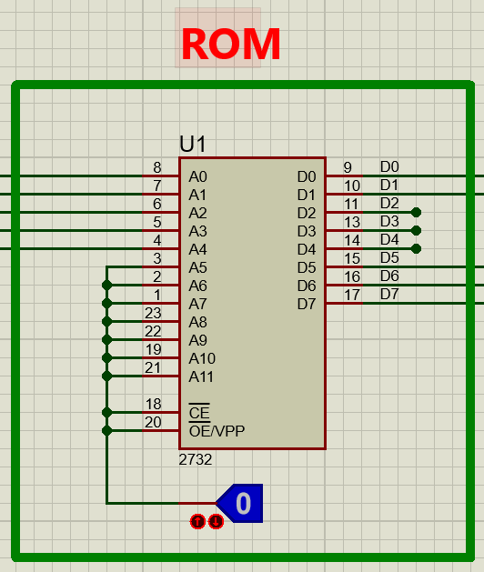
ROM block

Slide 11
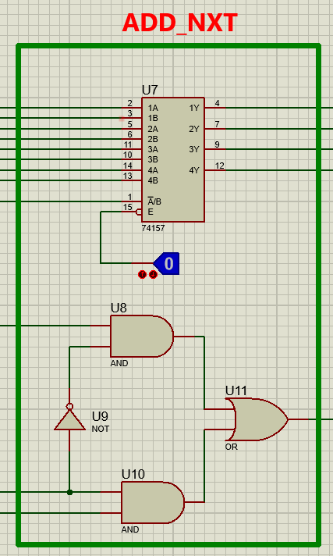
Add_nxt block

Slide 12
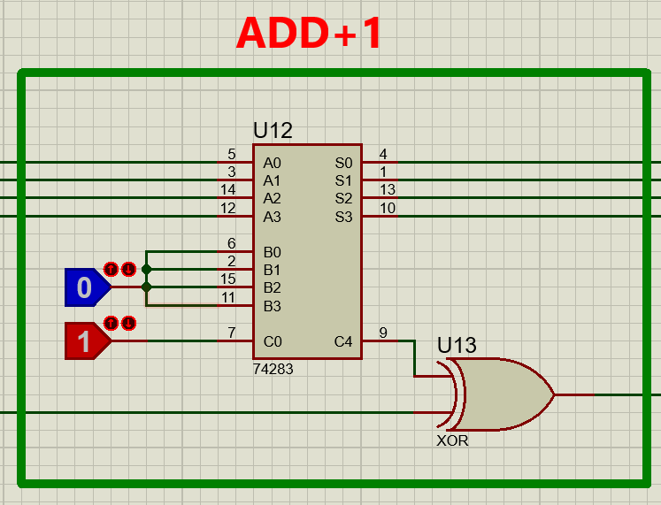
Add_plus1 block

Slide 13
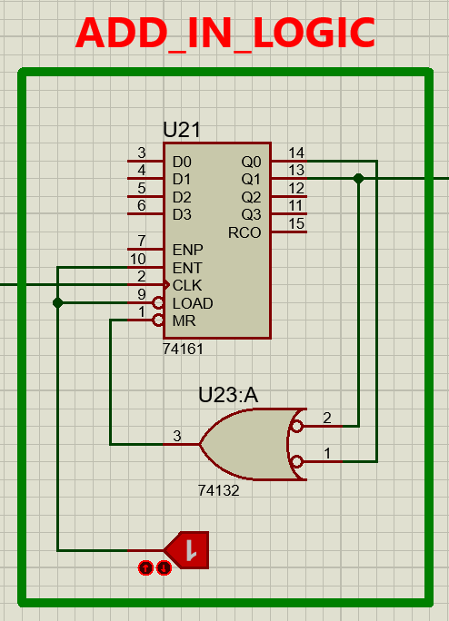
Add_in logic

Slide 14
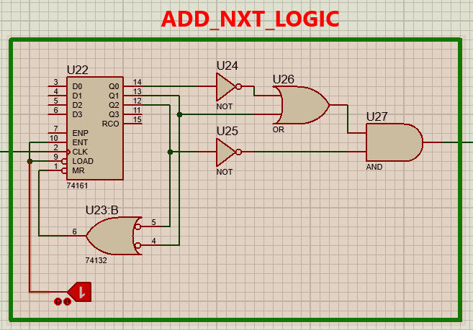
Add_nxt logic

Slide 15
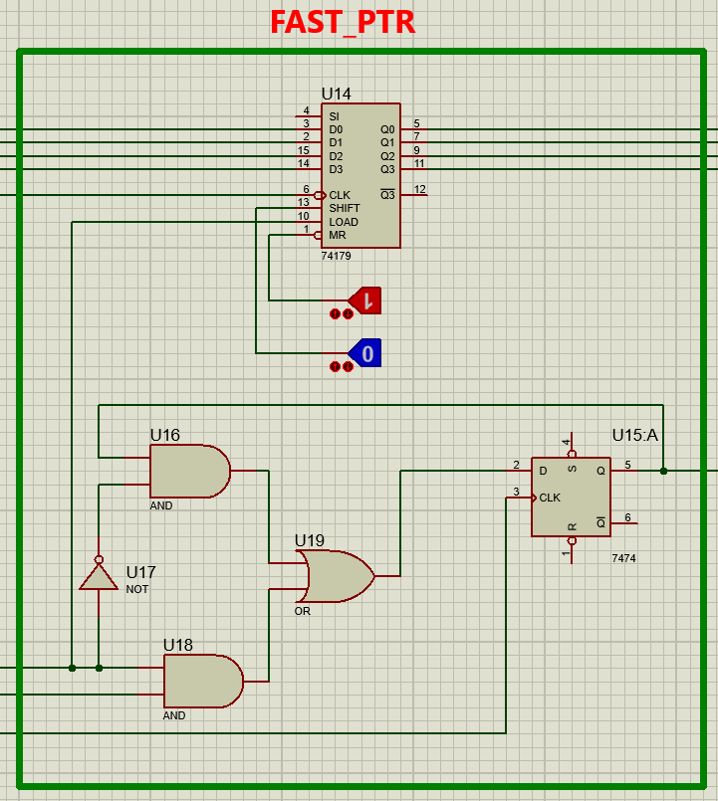
Fast_ptr reg

Slide 16
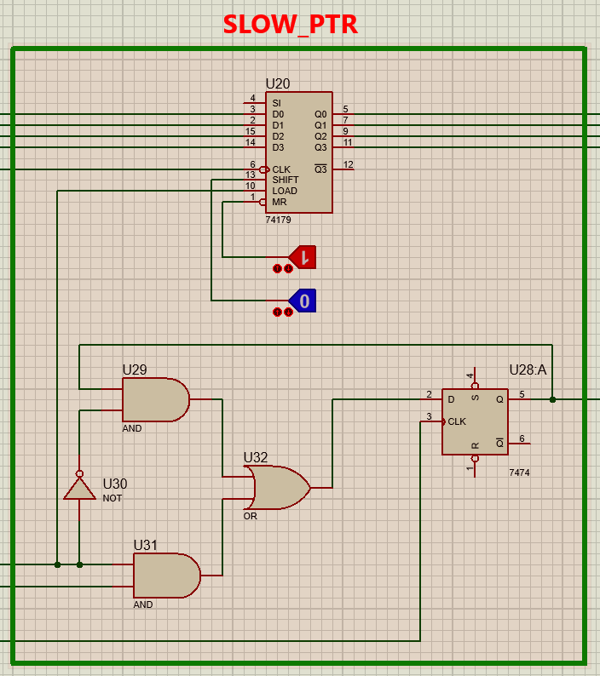
Slow_ptr reg

Slide 17
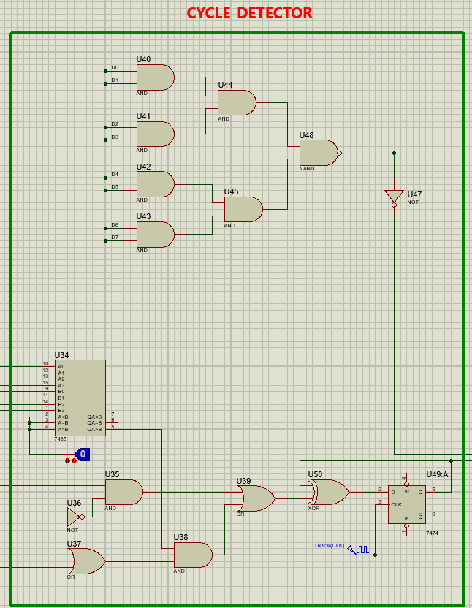
Cycle_detector logic

Slide 18
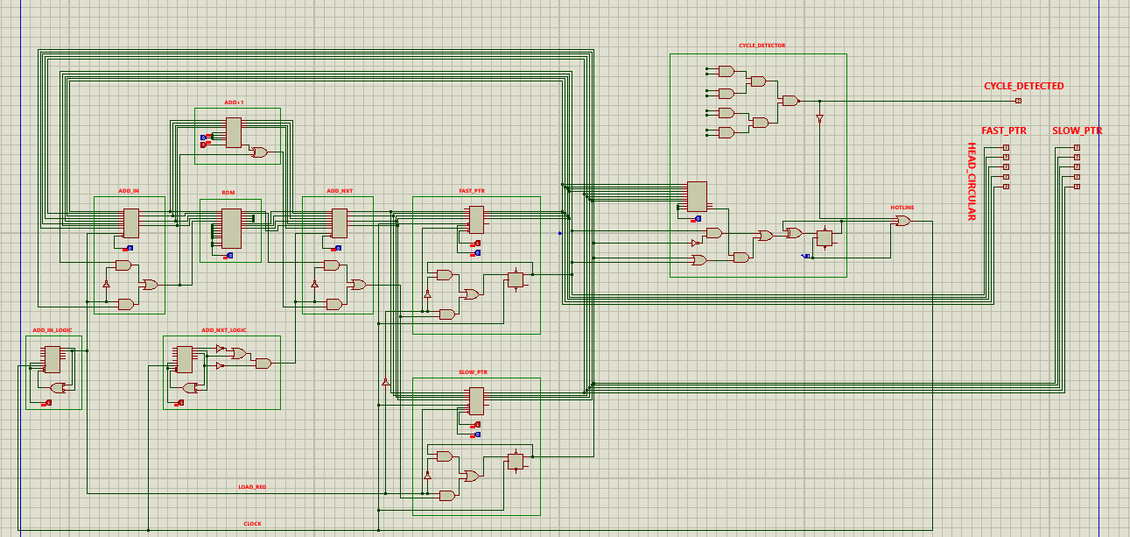
Entire Circuit Diagram

Slide 19
Links for Video Demonstration

