Slide 1
ANSIBLE.

Slide 2
WHAT IS CONFIGURATION MANAGEMENT.
Configuration management in terms of Ansible means that it maintains configuration of the product performance by keeping a record and updating detailed information which describes an enterprise’s hardware and software.
Such information typically includes the exact versions and updates that have been applied to installed software packages and the locations and network addresses of hardware devices. For e.g. If you want to install the new version of WebLogic/WebSphere server on all of the machines present in your enterprise, it is not feasible for you to manually go and update each and every machine.
You can install WebLogic/WebSphere in one go on all of your machines with Ansible playbooks and inventory written in the most simple way. All you have to do is list out the IP addresses of your nodes in the inventory and write a playbook to install WebLogic/WebSphere. Run the playbook from your control machine & it will be installed on all your nodes.
Beauty of Ansible is that it removes the modules once those are installed so effectively it connects to host machine , executes the instructions and if it’s successfully installed removes the code which was copied on the host machine which was executed.

Slide 3
ANSIBLE INTRODUCTION.
Ansible is an IT automation tool. It can configure systems, deploy software, and orchestrate more advanced IT tasks such as continuous deployments or zero downtime rolling updates.
Ansible is a very simple IT automation engine that automates provisioning, configuration, application deployment, intra-service orchestration and many other IT needs.
Ansible’s main goals are simplicity and ease-of-use. It also has a strong focus on security and reliability, featuring a minimum of moving parts, usage of OpenSSH for transport
Ansible is appropriate for managing all environments, from small setups with a handful of instances to enterprise environments with many thousands of instances.

Slide 4
ANSIBLE INTRODUCTION.
Ansible by default manages machines over the SSH protocol.
Once Ansible is installed, it will not add a database, and there will be no daemons to start or keep running. You only need to install it on one machine (which could easily be a laptop) and it can manage an entire fleet of remote machines from that central point.
Ansible uses playbook to describe automation jobs, and playbook uses very simple language i.e. YAML
Ansible is designed for multi-tier deployment. Ansible does not manage one system at time, it models IT infrastructure by describing all of your systems are interrelated. Ansible is completely agentless which means Ansible works by connecting your nodes through ssh(by default). But if you want other method for connection like Kerberos, Ansible gives that option to you.

Slide 5
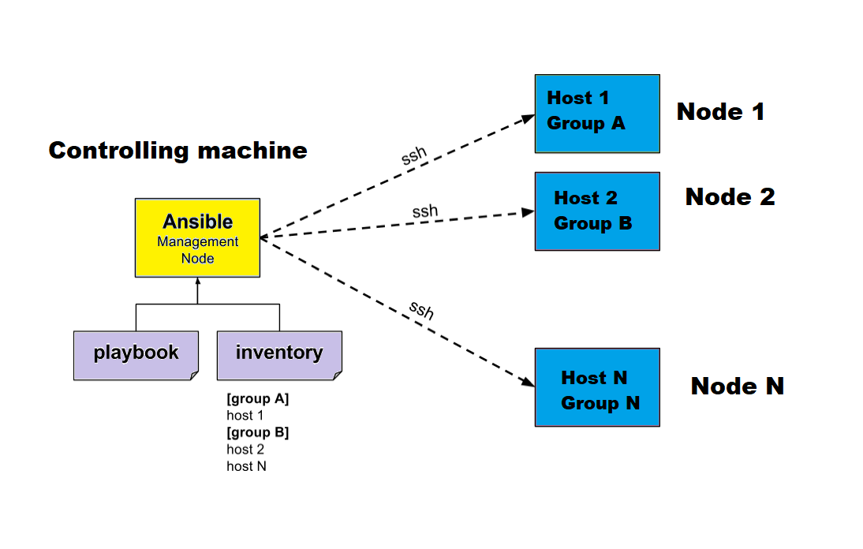
ANSIBLE INTRODUCTION.

Slide 6
ANSIBLE.
Mainly, there are two types of machines when we talk about deployment −
Control machine − Machine from where we can manage other machines.
Remote machine − Machines which are handled/controlled by control machine.
There can be multiple remote machines which are handled by one control machine. So, for managing remote machines we have to install Ansible on control machine.
Note − Windows does not support control machine.
Ansible can be run from any machine with Python 2 (versions 2.6 or 2.7) or Python 3 (versions 3.5 and higher) installed.

Slide 7
ANSIBLE INSTALLATION.
Requirements for Ansible :
SSH client (OpenSSH)
Python
$ sudo apt-get update
$ sudo apt-get install software-properties-common
$ sudo apt-add-repository ppa:ansible/ansible
$ sudo apt-get update
$ sudo apt-get install ansible

Slide 8
ANSIBLE FEATURES.
Agentless : No need for agent installation and management.
Built on top of python and hence provides a lot of python's functionality.
Uses SSH for secure connection.
Follow push based architecture for sending configurations.
Very easy and fast to setup, minimal requirements.

Slide 9
PULL BASED vs PUSH BASED
Tool like Puppet and Chef are pull based.
Agents on the server periodically checks for the configuration information from the central server(master).
Ansible is push based
Central server pushes the configuration information on the target servers.
You control when the changes are made on the servers.

Slide 10
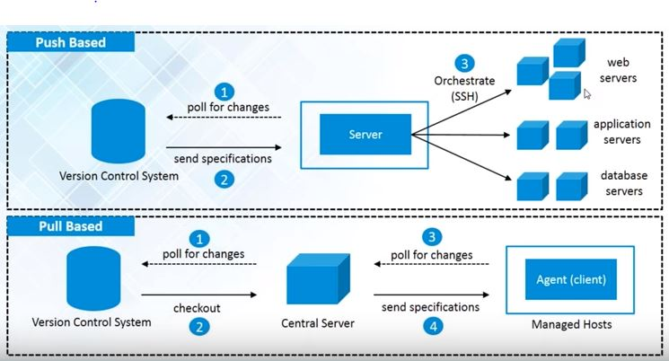
PULL BASED vs PUSH BASED.

Slide 11
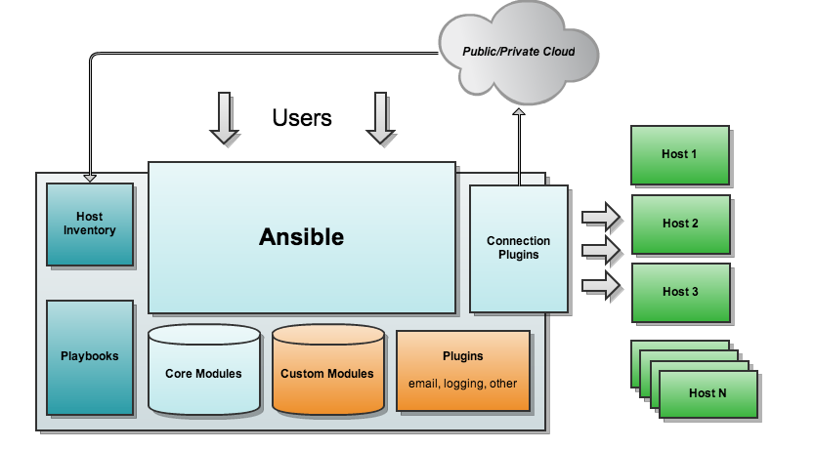
ANSIBLE ARCHITECTURE.

Slide 12
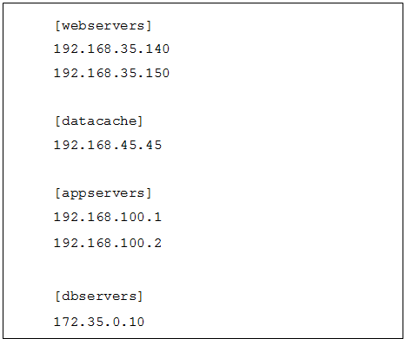
ANSIBLE – HOST INVERNTORY.
It contains the list of your hosts, grouped together.
Default location is /etc/ansible/hosts

Slide 13
ANSIBLE MODULES.
Playbook - plays - tasks - modules.
Ansible modules Modules are the ones which actually get executed inside a playbook. These are scripts that come packaged with Ansible and perform some kind of action on a host.
example:
apt : installs or removes packagaes using the apt package manager.
copy : copies a file from local machine to the hosts.
file : sets the attribute of a file, symlink or directory
Service : starts, stops or restarts a service.

Slide 14
ANSIBLE AD-HOC COMMANDS.
An ad-hoc command is something that you might type in to do something really quick, but do not want to save later.
ansible all-s-n shell -a 'uptime' : uptime of all the machines.
ansible all-s-n shell -a 'date' : date of all the machines.
ansible all-s-n shell -a 'cat/etc/redhat-release' : redhat release of all the machines.
ansible all-s-n shell -a 'service sshd status' : check the service status on all the machines

Slide 15
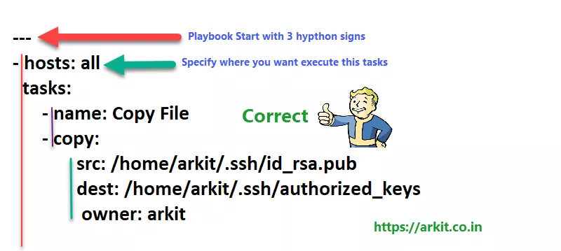
ANSIBLE PLAYBOOK.
Ansible's configuration, deployment and orchestration language.
Written in YAML, declaratively define your configurations.
Human-readable and are developed in a basic text language.
Command to run the playbook : ansible-playbook file.yml

Slide 16
ANSIBLE CONFIGURATION FILE.
Certain settings in Ansible are adjustable via a configuration file (ansible.cfg). The stock configuration should be sufficient for most users, but there may be reasons you would want to change them.
Configuration file will be processed in the following order.
ANSIBLE_CONFIG (an environment variable)
ansible.cfg (in the current directory)
.ansible.cfg (in the home directory)
/etc/ansible/ansible.cfg

Slide 17
ANSIBLE CONFIGURATION FILE.
If installing ansible from a package manager, the latest ansible.cfg should be present in /etc/ansible, possibly as a ”.rpmnew” file (or other) as appropriate in the case of updates.
ask_pass This controls whether an Ansible playbook should prompt for a password by default. The default behavior is no: ask_pass = True
ask_sudo_pass Similar to ask_pass, this controls whether an Ansible playbook should prompt for a sudo password by default when sudoing. The default behavior is also no: ask_sudo_pass = True
display_skipped_hosts If set to False, ansible will not display any status for a task that is skipped. The default behavior is to display skipped tasks: display_skipped_hosts = True
inventory : This is the default location of the inventory file, script, or directory that Ansible will use to determine what hosts it has available to talk to: inventory = /etc/ansible/hosts
jinja2_extensions This is a developer-specific feature that allows enabling additional Jinja2 extensions: jinja2_extensions = jinja2.ext.do,jinja2.ext.i18n

Slide 18
ANSIBLE CONFIGURATION FILE.
library : This is the default location Ansible looks to find modules: library = /usr/share/ansible
nocolor : By default ansible will try to colorize output to give a better indication of failure and status information. If you dislike this behavior you can turn it off by setting ‘nocolor’ to 1: nocolor = 0
private_key_file : If you are using a pem file to authenticate with machines rather than SSH agent or passwords, you can set the default value here to avoid re-specifying --private-key with every invocation: private_key_file=/path/to/file.pem
remote_port : This sets the default SSH port on all of your systems, for systems that didn’t specify an alternative value in inventory. The default is the standard 22: remote_port = 22
remote_user : This is the default username ansible will connect as for /usr/bin/ansible-playbook. Note that /usr/bin/ansible will always default to the current user if this is not defined: remote_user = root
timeout : This is the default SSH timeout to use on connection attempts: timeout = 10

Slide 19
THE HOSTS FILE/INVENTORY FILE.
Ansible works against multiple systems in your infrastructure at the same time. It does this by selecting portions of systems listed in Ansible’s inventory file, which defaults to being saved in the location /etc/ansible/hosts.
You can specify a different inventory file using the -i <path> option on the command line.
Hosts and Groups
The format for /etc/ansible/hosts is an INI-like format and looks like this: mail.example.com
[webservers]
foo.example.com
bar.example.com
[dbservers]
one.example.com
two.example.com
three.example.com

Slide 20
THE HOST FILE/INVENTORY FILE
Suppose you have just static IPs and want to set up some aliases that live in your host file, or you are connecting through tunnels. You can also describe hosts via variables: jumper ansible_port=5555 ansible_host=192.0.2.50
If you are adding a lot of hosts following similar patterns, you can do this rather than listing each hostname:
[webservers]
www[01:50].example.com
For numeric patterns, leading zeros can be included or removed, as desired. Ranges are inclusive. You can also define alphabetic ranges:
[databases]
db-[a:f].example.com

Slide 21
THE HOST FILE/INVENTORY FILE.
Host Variables : As described above, it is easy to assign variables to hosts that will be used later in playbooks:
[atlanta]
host1 http_port=80 maxRequestsPerChild=808
host2 http_port=303 maxRequestsPerChild=909
Group Variables : Variables can also be applied to an entire group at once:
[atlanta]
host1
host2
[atlanta:vars]
ntp_server=ntp.atlanta.example.com
proxy=proxy.atlanta.example.com

Slide 22
THE HOST FILE/INVERNTORY FILE.
Default groups : There are two default groups: all and ungrouped. all contains every host. ungrouped contains all hosts that don’t have another group aside from all. Every host will always belong to at least 2 groups.
Splitting Out Host and Group Specific Data : The preferred practice in Ansible is to not store variables in the main inventory file. In addition to storing variables directly in the inventory file, host and group variables can be stored in individual files relative to the inventory file (not directory, it is always the file). These variable files are in YAML format. Valid file extensions include ‘.yml’, ‘.yaml’, ‘.json’, or no file extension.

Slide 23
ANSIBLE – CONNECTING TO REMOTE MACHINES.
First generate the key in the control machine using ssh-keygen –t rsa.
Copy the ssh key to remote machines using the below command.
Ssh-copy-id root@hostname.
Ssh root@hostname.
Ansible all –m ping –ask-pass

Slide 24
ANSIBLE – COMMAND LINE TOOLS.
ansible : Define and run a single task ‘playbook’ against a set of hosts
ansible-playbook : Runs Ansible playbooks, executing the defined tasks on the targeted hosts.
Ansible-pull : pulls playbooks from a VCS repo and executes them for the local host
ansible-doc : plugin documentation tool
ansible-galaxy : command to manage Ansible roles in shared repostories, the default of which is Ansible Galaxy https://galaxy.ansible.com.
ansible-console : REPL (read–eval–print loop) console for executing Ansible tasks.
ansible-config : View, edit, and manage ansible configuration.

Slide 25
PLAYBOOKS.
Ansible playbooks are a way to send commands to remote computers in a scripted way. At a basic level, playbooks can be used to manage configurations of and deployment to remote machines. At a more advances level, they can sequence multi-tier rollouts involving rolling updates, and can delegate actions to other hosts, interacting with monitoring servers and load balancers along the way.
Playbooks are designed to be human-readable and are developed in a basic test language written in the YAML data serialization format.

Slide 26
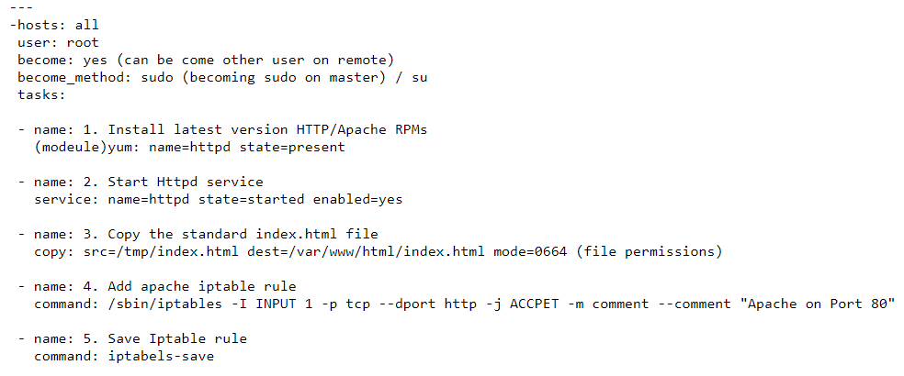
PLAYBOOK.

Slide 27
PLAYBOOK.
ansible-playbook <playbook-name> --check : syntax check
ansible-playbook <playbook-name> -i /etc/ansible/hosts -l addgroup
rpm -qa | grep http
service httpd status
iptables -L

Slide 28
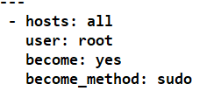
TARGET SECTION.
Target section is where we specify all the hosts that we want to connect to.
We can also specify various parameters like if you want to become a sudo once connected to the remote machine.
You can specify the username with which you want to connect to the remote machine and so on.

Slide 29
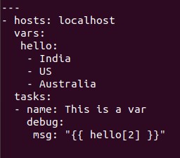
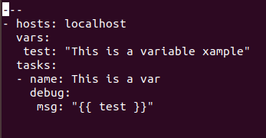
VARIABLE SECTION.
Ansible variables help to determine how the tasks execute on different systems based on the values assigned to these variables.
Ansible variable names should be letters, numbers, underscores and they should always start with a characters.
In the playbook, we can give a variable in ‘variable_name: variable_value‘ format. we can use the variable_name inside double braces anywhere in the playbook.

Slide 30
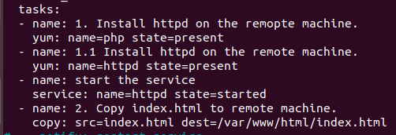
TASK SECTION.
The task section includes a list of plays or tasks to be executed in the current playbook.
Within the tasks we will have the module which are the actual tasks that get executed when we execute the playbook.

Slide 31
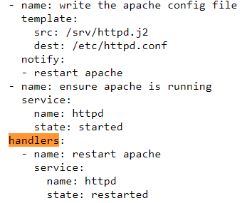
HANDLER SECTION.
Handlers are lists of tasks, not really any different from regular tasks, that are referenced by a globally unique name, and are notified by notifiers. If nothing notifies a handler, it will not run. Regardless of how many tasks notify a handler, it will run only once, after all of the tasks complete in a particular play.

Slide 32
SYSTEM FACTS.
Facts is automatically called by playbooks to gather useful variables about remote hosts that can be used in playbooks. It can also be executed directly by /usr/bin/ansible to check what variables are available to a host. Ansible provides many facts about the system, automatically.
Parameters:
fact_path - Default: (/etc/ansible/facts.d) : path used for local ansible facts (*.fact) - files in this dir will be run (if executable) and their results be added to ansible_local facts if a file is not executable it is read. Check notes for Windows options. (from 2.1 on) File/results format can be json or ini-format
filter - Default: * : if supplied, only return facts that match this shell-style (fnmatch) wildcard.

Slide 33
SYSTEM FACTS.
gather_subset - Default: all : if supplied, restrict the additional facts collected to the given subset. Possible values: all, min, hardware, network, virtual, ohai, and facter Can specify a list of values to specify a larger subset. Values can also be used with an initial ! to specify that that specific subset should not be collected. For instance: !hardware, !network, !virtual, !ohai, !facter. If !all is specified then only the min subset is collected. To avoid collecting even the min subset, specify !all and !min subsets. To collect only specific facts, use !all, !min, and specify the particular fact subsets. Use the filter parameter if you do not want to display some collected facts.
gather_timeout - Default: 10 : Set the default timeout in seconds for individual fact gathering
# Display only facts regarding memory found by ansible on all hosts and output them.
# ansible all -m setup -a 'filter=ansible_*_mb'
# Collect only facts returned by facter.
# ansible all -m setup -a 'gather_subset=!all,!any,facter'
gather_timeout

Slide 34
ANSIBLE – PLAYBOOK DRY RUN.
When ansible-playbook is executed with --check it will not make any changes on remote systems. Instead, any module instrumented to support ‘check mode’ (which contains most of the primary core modules, but it is not required that all modules do this) will report what changes they would have made rather than making them.
Ansible-playbook <playbook name> --check.

Slide 35
LOOKUP PLUGIN.
Lookup plugins allow access to outside data sources. Like all templating, these plugins are evaluated on the Ansible control machine, and can include reading the filesystem as well as contacting external datastores and services. This data is then made available using the standard templating system in Ansible.
Lookups occur on the local computer, not on the remote computer.
Lookups are an integral part of loops. Wherever you see with_, the part after the underscore is the name of a lookup. This is also the reason most lookups output lists and take lists as input; for example, with_items uses the items lookup:

Slide 36

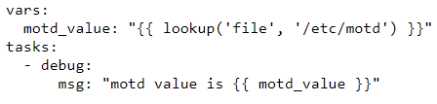
LOOKUP PLUGIN.

Slide 37
ASYNCHRONOUS AND POLLING.
By default tasks in playbooks block, meaning the connections stay open until the task is done on each node. This may not always be desirable, or you may be running operations that take longer than the SSH timeout.
To avoid blocking or timeout issues, you can use asynchronous mode to run all of your tasks at once and t hen poll until they are done.
To launch a task asynchronously, specify its maximum runtime and how frequently you would like to poll for status. The default poll value is 10 seconds if you do not specify a value for poll:

Slide 38
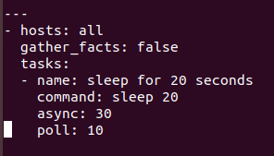

ASYNCHRONOUS AND POLLING.

Slide 39
RUN ONCE.
In some cases there may be a need to only run a task one time for a batch of hosts. This can be achieved by configuring “run_once” on a task:
run_once: true
This directive forces the task to attempt execution on the first host in the current batch and then applies all results and facts to all the hosts in the same batch.`

Slide 40
LOCAL ACTION.
It may be useful to use a playbook locally, rather than by connecting over SSH.
To run an entire playbook locally, just set the “hosts:” line to “hosts: 127.0.0.1” and then run the playbook like so: ansible-playbook playbook.yml --connection=local

Slide 41
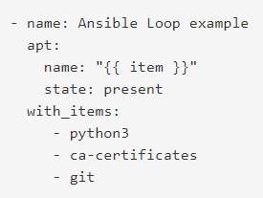
LOOPS.
Often you’ll want to do many things in one task, such as create a lot of users, install a lot of packages, or repeat a polling step until a certain result is reached.
Standard loops:

Slide 42
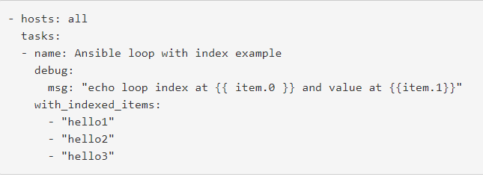
LOOPS.
Complex loops.

Slide 43
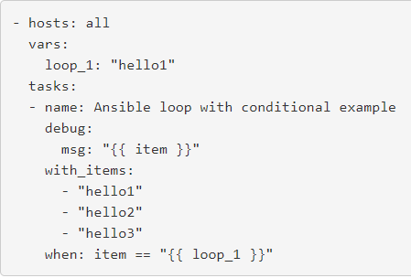
LOOPS.
Loops with conditional.

Slide 44
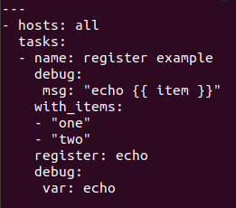
LOOPS.
Register.
Ansible registers are used when you want to capture the output of a task to a variable.

Slide 45
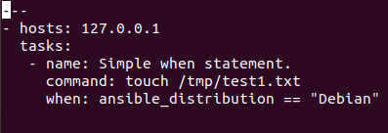
CONDITIONALS.
When statement : Sometimes you will want to skip a particular step on a particular host. This could be something as simple as not installing a certain package if the operating system is a particular version, or it could be something like performing some cleanup steps if a filesystem is getting full.

Slide 46
VAULTS.
Ansible Vault is a feature of ansible that allows you to keep sensitive data such as passwords or keys in encrypted files, rather than as plaintext in playbooks or roles. These vault files can then be distributed or placed in source control.
To enable this feature, a command line tool - ansible-vault - is used to edit files, and a command line flag (--ask-vault-pass or --vault-password-file) is used.
Creating Encrypted Files : ansible-vault create foo.yml

Slide 47
VAULTS.
Editing encrypted files : ansible-vault edit foo.yml
Rekeying encrypted files :ansible-vault rekey foo.yml bar.yml baz.yml
Encrypting unencrypted files : ansible-vault encrypt foo.yml bar.yml baz.yml
Decrypting encrypted files : ansible-vault decrypt foo.yml bar.yml baz.yml
Viewing encrypted files : ansible-vault view foo.yml bar.yml baz.yml

Slide 48
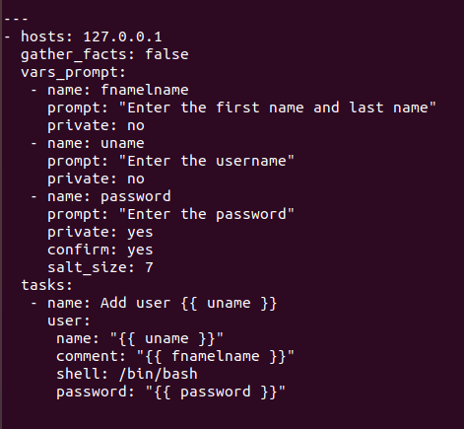
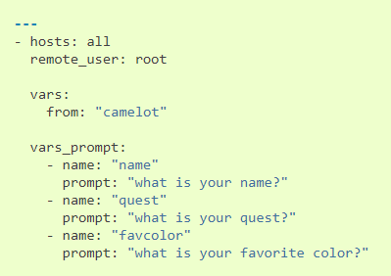
PROMPTS.
When running a playbook, you may wish to prompt the user for certain input, and can do so with the ‘vars_prompt’ section.
A common use for this might be for asking for sensitive data that you do not want to record.

Slide 49
INCLUDING AND IMPORTING.
All import* statements are pre-processed at the time playbooks are parsed.
All include* statements are processed as they encountered during the execution of the playbook.
Includes can be used in loops.
Imports cannot be used in loops.
Include_tasks, include, import_tasks, import_playbook.

Slide 50
TAGS.
If you have a large playbook it may become useful to be able to run a specific part of the configuration without running the whole playbook.
You can ONLY filter tasks based on tags from the command line with --tags or --skip-tags. Adding “tags:” in any part of a play (including roles) adds those tags to the contained tasks.
-- tags, --skip-tags, tags reuse, always, never.

Slide 51
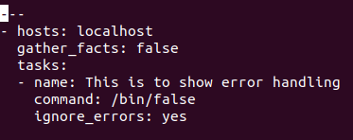

ERROR HANDLING.
Ignoring failed commands : Generally playbooks will stop executing any more steps on a host that has a task fail. Sometimes, though, you want to continue on. To do so, write a task that looks like this.
Suppose the error code of a command is meaningless and to tell if there is a failure what really matters is the output of the command, for instance if the string “FAILED” is in the output.

Slide 52
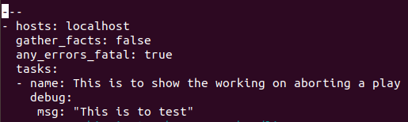
ERROR HANDLING.
Aborting a play : Sometimes it’s desirable to abort the entire play on failure, not just skip remaining tasks for a host.
The any_errors_fatal play option will mark all hosts as failed if any fails, causing an immediate abort:

Slide 53
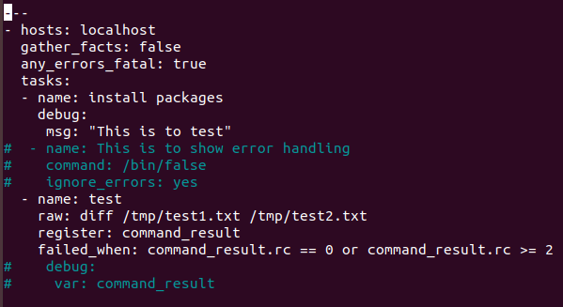
START AND STEP.
If you want to start executing your playbook at a particular task, you can do so with the --start-at-task option:
ansible-playbook playbook.yml --start-at-task="install packages“

Slide 54

START AND STEP.
This will cause ansible to stop on each task, and ask if it should execute that task. Say you had a task called “configure ssh”, the playbook run will stop and ask:
Perform task: configure ssh (y/n/c): Answering “y” will execute the task, answering “n” will skip the task, and answering “c” will continue executing all the remaining tasks without asking.

Slide 55
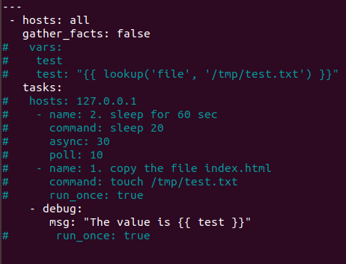
VARIABLES THROUGH COMMAND LINES.
--extra-vars is used to pass variables to the playbook from the command line.
-e can also be used to pass the variables from the command line.

Slide 56
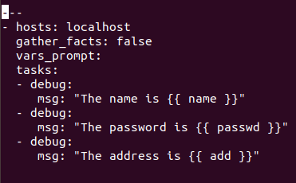
VARIABLE THROUGH COMMAND LINES.

Slide 57
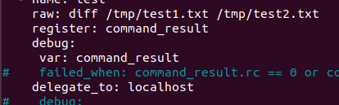
DELEGATE_TO
If you want to perform a task on one host with reference to other hosts, use the ‘delegate_to’ keyword on a task.

Slide 58
ROLES.
Roles in Ansible are next level of abstraction of ansible playbook. Roles are ways of automatically loading certain vars_files, tasks, and handlers based on a known file structure. Grouping content by roles also allows easy sharing of roles with other users.
Benefits of using roles.
Idea of include files and combine them to form clean, reusable abstractions.
Easy to maintain/troubleshooting the playbooks.

Slide 59
STRUCTURE OF ROLES.
Files : Contains regular files those needs to copied to the target hosts.
handlers : Event handlers
meta : role dependencies
templates : similar to files but it contains dynamic data
tasks : playbook tasks
vars/group_vars : variables definitions

Slide 60
ROLES.
Ansible-galaxy init apache –offline
Defaults : Data about the role / application and contains the default variables.
Files : Contains the static files and can be copied to the remote hosts.
Handlers : Contains the tasks which are based on some actions and will contain the triggers.
Meta : Information about the role like author, platform, dependencies, etc.
Tasks : Contains the core logic or the code. Like installing packages, copying files, etc.

Slide 61
ROLES.
Templates : These are similar to files except that templates support dynamic files.
Vars : Both vars and defaults store variables. Variables stored under ‘vars’ have high priority and difficult to override.

Slide 62
ANSIBLE TOWER.
Ansible Tower is the Web-based User Interface for Ansible, developed by the company behind the Ansible project.
It provides an easy-to-use dashboard, and role-based access control, so that it’s easier to allow individual teams access to use Ansible for their deployments, without having to rely on dedicated build engineers / DevOps teams to do it for them.
https://dl.fedoraproject.org/pub/epel/epel-release-latest-7.noarch.rpm
Yum update –y
Yum install ansible
https://releases.ansible.com/ansible-tower/setup/ansible-tower-setup-2.0.5.tar.gz
install python-dev python-yaml python-paramiko python-jinja2 python-pip sshpass

Slide 63
SUPPORTED VERSIONS FOR ANSIBLE TOWER.
Red Hat Enterprise Linux 7.2 or later 64-bit
CentOS 7.2 or later 64-bit
Ubuntu 14.04 LTS 64-bit
Ubuntu 16.04 LTS 64-bit
https://console.aws.amazon.com/ec2/home?region=us-east-1#launchAmi=ami-0a528c6e92c0e9df5

Slide 64
https://www.ansible.com/license
EC2 – ansible - inventory

