Slide 1
DOCKER.

Slide 2
INTRODUCTION TO DOCKER.
Docker is a tool designed to make it easier to create, deploy, and run applications by using containers.
Containers allow a developer to package up an application with all of the parts it needs, such as libraries and other dependencies, and ship it all out as one package.
By doing so, thanks to the container, the developer can rest assured that the application will run on any other Linux machine regardless of any customized settings that machine might have that could differ from the machine used for writing and testing the code.

Slide 3
DOCKER ENGINE.
Docker Engine is a client-server application with these major components:
A server which is a type of long-running program called a daemon process (the dockerd command).
A REST API which specifies interfaces that programs can use to talk to the daemon and instruct it what to do.
A command line interface (CLI) client (the docker command).
The daemon creates and manages Docker objects, such as images, containers, networks, and volumes.

Slide 4
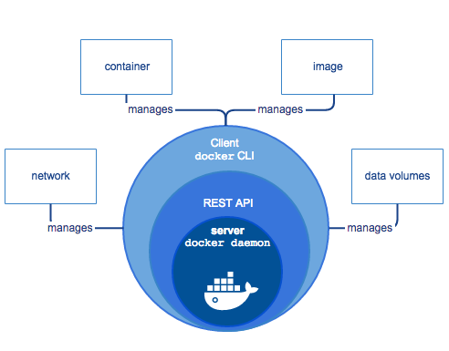
DOCKER ENGINE.

Slide 5
DOCKER.
Docker daemon : The Docker daemon (dockerd) listens for Docker API requests and manages Docker objects such as images, containers, networks, and volumes. A daemon can also communicate with other daemons to manage Docker services.
Docker client : The Docker client (docker) is the primary way that many Docker users interact with Docker. When you use commands such as docker run, the client sends these commands to dockerd, which carries them out. The docker command uses the Docker API. The Docker client can communicate with more than one daemon.

Slide 6
DOCKER REGISTRIES.
A Docker registry stores Docker images. Docker Hub and Docker Cloud are public registries that anyone can use, and Docker is configured to look for images on Docker Hub by default. You can even run your own private registry.
When you use the docker pull or docker run commands, the required images are pulled from your configured registry. When you use the docker push command, your image is pushed to your configured registry. Docker store allows you to buy and sell Docker images or distribute them for free. For instance, you can buy a Docker image containing an application or service from a software vendor and use the image to deploy the application into your testing, staging, and production environments. You can upgrade the application by pulling the new version of the image and redeploying the containers.

Slide 7
DOCKER IMAGES.
An image is a read-only template with instructions for creating a Docker container. Often, an image is based on another image, with some additional customization. For example, you may build an image which is based on the ubuntu image, but installs the Apache web server and your application, as well as the configuration details needed to make your application run.
You might create your own images or you might only use those created by others and published in a registry. To build your own image, you create a Dockerfile with a simple syntax for defining the steps needed to create the image and run it. Each instruction in a Dockerfile creates a layer in the image. When you change the Dockerfile and rebuild the image, only those layers which have changed are rebuilt. This is part of what makes images so lightweight, small, and fast, when compared to other virtualization technologies.

Slide 8
DOCKER CONTAINERS.
A container is a runnable instance of an image. You can create, start, stop, move, or delete a container using the Docker API or CLI. You can connect a container to one or more networks, attach storage to it, or even create a new image based on its current state.
The following command runs an ubuntu container, attaches interactively to your local command-line session, and runs /bin/bash.
docker run -i -t ubuntu /bin/bash

Slide 9
DOCKER CONTAINERS.
When you run this command, the following happens (assuming you are using the default registry configuration):
If you do not have the ubuntu image locally, Docker pulls it from your configured registry, as though you had run docker pull ubuntu manually.
Docker creates a new container, as though you had run a docker container create command manually.
Docker allocates a read-write filesystem to the container, as its final layer. This allows a running container to create or modify files and directories in its local filesystem.
Docker creates a network interface to connect the container to the default network, since you did not specify any networking options. This includes assigning an IP address to the container. By default, containers can connect to external networks using the host machine’s network connection.
Docker starts the container and executes /bin/bash. Because the container is running interactively and attached to your terminal (due to the -i and -t flags), you can provide input using your keyboard while the output is logged to your terminal.
When you type exit to terminate the /bin/bash command, the container stops but is not removed. You can start it again or remove it.

Slide 10
DOCKER SERVICES.
Services allow you to scale containers across multiple Docker daemons, which all work together as a swarm with multiple managers and workers. Each member of a swarm is a Docker daemon, and the daemons all communicate using the Docker API. A service allows you to define the desired state, such as the number of replicas of the service that must be available at any given time. By default, the service is load-balanced across all worker nodes.

Slide 11
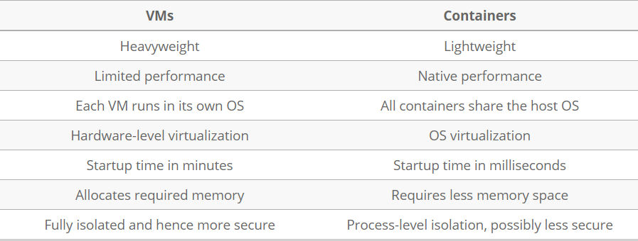
CONTAINERS VS VIRTUAL MACHINES.

Slide 12
DOCKER ARCHITECTURE.
Docker uses a client-server architecture. The Docker client talks to the Docker daemon, which does the heavy lifting of building, running, and distributing your Docker containers. ...
The Docker client and daemon communicate using a REST API, over UNIX sockets or a network interface.

Slide 13
DOCKER ARCHITECTURE.

Slide 14
DOCKER HUB.
Docker Hub is a registry service on the cloud that allows you to download Docker images that are built by other communities. You can also upload your own Docker built images to Docker hub.
The official site for Docker hub is − https://hub.docker.com/
First you need to do a simple sign-up on Docker hub.
Once you have signed up, you will be logged into Docker Hub.
Next, let’s browse and find the Jenkins image.
If you scroll down on the same page, you can see the Docker pullcommand. This will be used to download the Jenkins image onto the local Ubuntu server.
Now, go to the Ubuntu server and run the following command − docker pull jenkins
To run Jenkins, you need to run the following command −
docker run -p 8080:8080 -p 50000:50000 jenkins

Slide 15
INSTALLATION OF DOCKER.
To install docker in Ubuntu, you can run the command –
apt install docker.io
Once installation is completed, you can verify by running the below command.
Docker –version.
If docker was installed successfully , then you will get the below message.

Slide 16
BASIC DOCKER COMMANDS.
Docker Commands:
Docker version : information about docker client and server.
Docker –v : Version of docker. Can also run docker –version which gives the same result.
Docker info : detailed information about docker.
Docker –help : Information on any commands.
Docker login : login to the docker hub : hub.docker.com

Slide 17
BASIC DOCKER COMMANDS.
Images
Docker images : List the images.
Docker pull : Pulls the images from the docker hub.
Docker rmi : delete the docker image
Container:
Docker ps : list the containers
Docker run : To run the container
Docker start : Start the container
Docker stop : stop the container

Slide 18
BASIC DOCKER COMMANDS.
System
Docker stats : running containers memory usage.
Docker system df : disk usage of docker.
Docker system prune : Remove unused data.

Slide 19
DOCKER IMAGES.
Docker run –name Test –it ubuntu /bin/bash
Docker inspect <image-name>

Slide 20
DOCKER CONTAINER.
Docker ps
Docker run hello-world –it
Docker start ubuntu
Docker stop ubuntu
Docker pause ubuntu
Docker unpause ubuntu
Docker top ubuntu
Docker stats ubuntu
Docker attach ubuntu
Docker kill ubuntu
Docker rm ubuntu
Docker history ubuntu
Docker rm $(docker ps –a –q)

Slide 21
DOCKERFILE.
A Dockerfile is a text document that contains all the commands a user could call on the command line to assemble an image. Using docker build users can create an automated build that executes several command-line instructions in succession.
Dockerfile consists of 2 kind of main line blocks : comments and commands + arguments.
FROM - FROM directive is probably the most crucial amongst all others for dockerfile. IT defines the base image to use to use to start the build process.
FROM ubuntu.
RUN - The RUN command is the central executing directives for dockerfile. It takes a command as its argument and runs to form the image.
RUN apt-get install -y curl
CMD - The CMD command, similar to run, can be used for executing a specific command. However, unlike RUN it is not executed during build, but when a container is initiated using the image built.
CMD echo "Hello"

Slide 22
DOCKERFILE.
ENTRYPOINT - ENTRYPOINT argument sets the concrete default application that is used every time a container is created using the image.
CMD "Welcome"
ENTRYPOINT echo
Both ENTRYPOINT AND CMD work the same way, the difference is that CMD commands are overridden and ENTRYP0INT command are appended.
COPY - The COPY command gets arguments: a source and a destination. It basically copies the files from the source on the host into the container's own file system at the set destination.
COPY /myfolder /my_folder
ENV - The ENV command is used to set the environment variables (1 or 2). These variables consist of "key value" pairs which can be accessed within the container by scripts and applications.
ENV SERVER_WORKS 4
WORKDIR - The WORKDIR directive is used to set where the command defined with CMD is to be executed.
WORKDIR /path WORKDIR ~/

Slide 23
DOCKERFILE.
EXPOSE - The EXPOSE command is used to associate a specified port to enable networking between the running process inside the container and the outside world
EXPOSE 8080
MAINTAINER - This non-executing command declares the author, hence setting the author field of the images. It should come nonetheless after FROM
MAINTAINER name
VOLUME - The VOLUME command is used to enable access from your container to a directory on the host machine (mounting it)
VOLUME ["/files"]

Slide 24
DOCKER VOLUMES
docker run -it -p 8080:8080 -v /home/ec2-user/trial:/var/jenkins_home jenkins

Slide 25
DOCKER COMPOSE.
Docker compose is used to run multi-container applications. Each container will run as a stand alone application and it can communicate with other containers present in the same host.
With Compose, you use a YAML file (docker-compose.yml) to configure your application’s services. Then, with a single command, you create and start all the services from your configuration.
Install docker-compose : already installed on windows and macs.
Pip install –U docker-compose
Docker-compose config : checks the validity of the file.
Run docker-compose up : to run the file.
Docker-compose stop
Docker-compose scale database=2

Slide 26
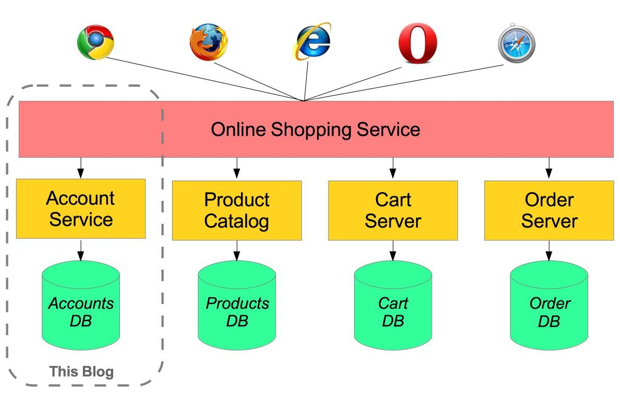
DOCKER COMPOSE.

Slide 27
DOCKER NETWORK.
Docker includes support for networking containers through the use of network drivers. By default, Docker provides two network drivers for you, the bridge and the overlay drivers.
Every installation of the Docker Engine automatically includes three default networks. You can list them:
Docker network ls
The network named bridge is a special network. Unless you tell it otherwise, Docker always launches your containers in this network.

Slide 28
DOCKER NETWORK.
Bridge networks are best when you need multiple containers to communicate on the same Docker host. Are the default network driver.
Host networks are best when the network stack should not be isolated from the Docker host, but you want other aspects of the container to be isolated. Are used for standalone containers.
Overlay networks are best when you need containers running on different Docker hosts to communicate, or when multiple applications work together using swarm services.
Macvlan networks are best when you are migrating from a VM setup or need your containers to look like physical hosts on your network, each with a unique MAC address.

Slide 29
USING THE DEFAULT BRIDGE NETWORK.
Docker network ls
docker run -dit --name alpine1 alpine ash
docker run -dit --name alpine2 alpine ash
docker container ls
docker network inspect bridge
docker attach alpine1
ip addr show
ping -c 2 google.com
ping -c 2 172.17.0.3
docker container stop alpine1 alpine2
docker container rm alpine1 alpine2

Slide 30
NETWORKING USING THE HOST NETWORK.
docker run --rm -d --network host --name my_nginx nginx
Localhost:80
Ip addr show
Netstat –tulpn | grep :80
Docker container stop my_nginx

Slide 31
NETWORKING USING OVERLAY NETWORKS.
Before creating an overlay network, you will need to create a swarm service.
docker swarm init --advertise-addr=<IP-ADDRESS-OF-MANAGER>
Docker swarm init
The above command will generate swarm join token that you can use to add other machines to the control machine.
Docker network create –d https://docs.docker.com/engine/reference/commandline/events/#format-the-output nginx-net

Slide 32
OVERLAY NETWORK
Docker swarm init.
Copy the token to the other machines.
Docker node ls
Docker network ls on all the machines.
Docker network create –d overlay nginx-net
Docker service create –name my-nginx --network nginx-net nginx
Docker service ls
Docker inspect nginx-net

Slide 33
OVERLAY NETWORK.
Docker network create –d overlay nginx-net2
Docker service update –-network-add nginx-net2 –network-rm nginx-net my-nginx
Docker service rm my-nginx
Docker network rm nginx-net nginx-net2

Slide 34
MACVLAN NETWORK
Macvlan allows a single physical interface to have multiple mac and ip addresses using macvlan sub-interfaces. This is different from creating sub-interface on a physical interface using vlan. With vlan sub-interfaces, each sub-interface belongs to a different L2 domain using vlan and all sub-interfaces have same mac address.

Slide 35
MACVLAN NETWORK.
docker network create –d macvlan –subnet=172.16.86.0/24 –gateway=172.16.86.1 test
Docker run –rm –itd –network test –name alpine-image alpine ash
Docker container inspect alpine-image
Docker exec alpine-image ip addr show eth0
Docker exec alpine-image ip route
Docker container stop alpine-image
Docker network rm test.

Slide 36
DOCKER EVENTS.
Docker events
Docker create –-name test alpine ash
Docker start test
Docker stop test
Docker events –since ‘10m’
Docker events –since ‘2017-01-05’
Docker events –filter ‘image=alpine’

Slide 37
PUSHING THE IMAGE TO DOCKER HUB.
Docker login
Docker tag test dgruploads/test
Docker push dgruploads/test

