Slide 1
SNAKE AND LADDER
Name: Jishan Thobhani

Slide 2
VIRTUAL SNAKE AND LADDER GAME
CONCEPT USED:
ARRAY
FUNCTION
Snake and ladder is a very common game that is being often played by youth. But to play this game virtually is quite different. This game is prepared by using Code in C language. In the code, the main concept which is being utilized is of array and user defined function. Overview of source code, source code and output is broadly mentioned over here.

Slide 3
OVERVIEW OF SOURCE CODE
• Array with name Board is defined whose size is 100. At various position positive increment numbers as ladders and negative decrement numbers as snakes is defined.
• Maximum four players and minimum 2 players can play the game.
• User defined function name rolldice() is defined in which rand() function is used which do the work of rolling dice.
• Another user defined function name playgame() is defined which makes the game run, tell player where they are and after rolling die tell them which number appeared, and take the player to that position keeping in mind the position of snakes and ladders.
• Another user defined function named checkoutofboard() is defined to check condition for winning after number appeared on die

Slide 4
SOURCE CODE
#include <stdio.h>
#include <stdlib.h>
#include <time.h>
#define BOARD_SIZE 100
int board[BOARD_SIZE] = {0, 0, 0, 14, 0, 0, 0, -7, 0, 0, 13, -6, 0, 0, 0, 0, 0, 0, 0, 0, 0, 0, 0, 0, -6, 0, 0, 7, -7, 20, -10, 0, 0, 7, 13, 0, -12, 0, -9, 0, 0, 0, 13, 0, -6, 0, 0, 0, 0, 0, 6, 0, 15, 0, 0, 0, -8, -9, 0, 0, 0, 0, 0, 0, 0, 0, -15, 0, -7, 0, 0, -7, 0, 0, 0, 0, 0, 0, 14, 0, 0, -12, 0, 5, -11, 0, 0, 0, 0, 0, -10, 0, 0, 0, 6, 0, 0, 0, -13, 0};
int player_position[4] = {0, 0, 0, 0};
int n;
stdio.h, stdlib.h, time.h header files are included.
Array name board whose size is 100 is defined. At various position snakes and ladders in form of negative numbers and positive numbers are kept which does either decrement or increment in position.
Since maximum 4 players can play, so initial position is defined as (0,0,0,0)

Slide 5
int rollDice() {
return (rand() % 6) + 1;
}
int checkeOutOfBoard(int pos){
if (pos>100){
return 1;
}
return 0;
Here, a user defined function named rolldice() is defined. Here the work of rolling a dice is done by rand() function.
Another function checkoutofboard() is defined which checks the position of player after every through of dice to see that he/she wins only when he/she reaches exactly 100 and not more that that.

Slide 6
void playGame() {
int cur_player = 1, num_dice, flag=1, player_pre_position;
char ch;
while(1){
if(flag){
printf("-----------------------Game Starts------------------------");
flag = 0;
scanf("%c", &ch);
continue;
}
if (cur_player > n){
printf("\n\n======================================================\n");
printf("Current positions of players:\n");
for(int i=0; i<n; i++){
printf("Player-%d: %d\n", i+1, player_position[i]);
}
printf("======================================================\n");
cur_player = 1;
}
printf("\n---------------------------------------------------------------\n");
printf("It's Player-%d turn to throw dice. (Press enter to throw the dice)\n", cur_player);
scanf("%c", &ch);
The important function which defines the entire game is playgame(). It’s code is mentioned deeply in this and the next slide.

Slide 7
num_dice = rollDice();
printf("Player-%d has thrown %d.\n", cur_player, num_dice);
if(!checkeOutOfBoard(player_position[cur_player-1] + num_dice)){
player_position[cur_player-1] += num_dice;
player_pre_position = player_position[cur_player-1];
player_position[cur_player-1] += board[player_position[cur_player-1]];
if(board[player_pre_position] == 0){
printf("Player-%d has reached position %d.\n", cur_player, player_position[cur_player-1]);
}
else if (board[player_pre_position] < 0){
printf("Player-%d was bitten by SNAKE and has been demoted to position %d.\n", cur_player, player_position[cur_player-1]);
}
else{
printf("Player-%d claimed the LADDER and reached to position %d.\n", cur_player, player_position[cur_player-1]);
}
}
else{
printf("Player-%d did not proceed.\n", cur_player);
}
if (player_position[cur_player-1] == 100){
break;
}
cur_player++;
}
printf("Player-%d wins!!!!!!!", cur_player);
}

Slide 8
int main() {
num_player:
printf("\nEnter the number of players (upto 4 players): ");
scanf("%d", &n);
if(n>4 || n<2){
n>4? printf("More than 4 players can't play.\n"): printf("Atleast 2 players are required to play\n");
goto num_player;
}
srand(time(NULL));
playGame();
return 0;
}
Here, main function is defined whose data type is integer.
This function includes the question from user regarding how many players are playing the game.
Finally, playgame() function is called out and the game begins.

Slide 9
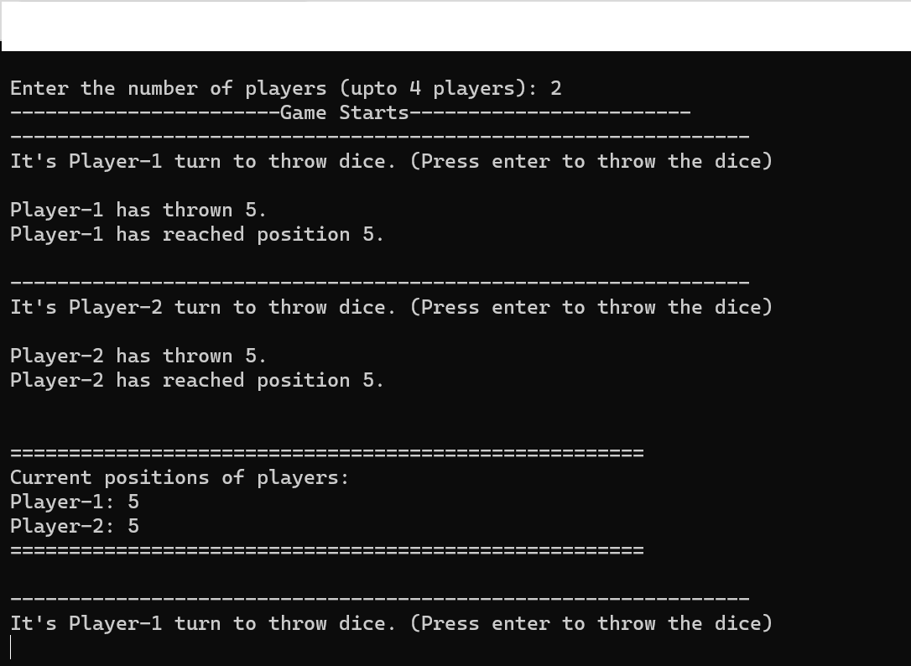
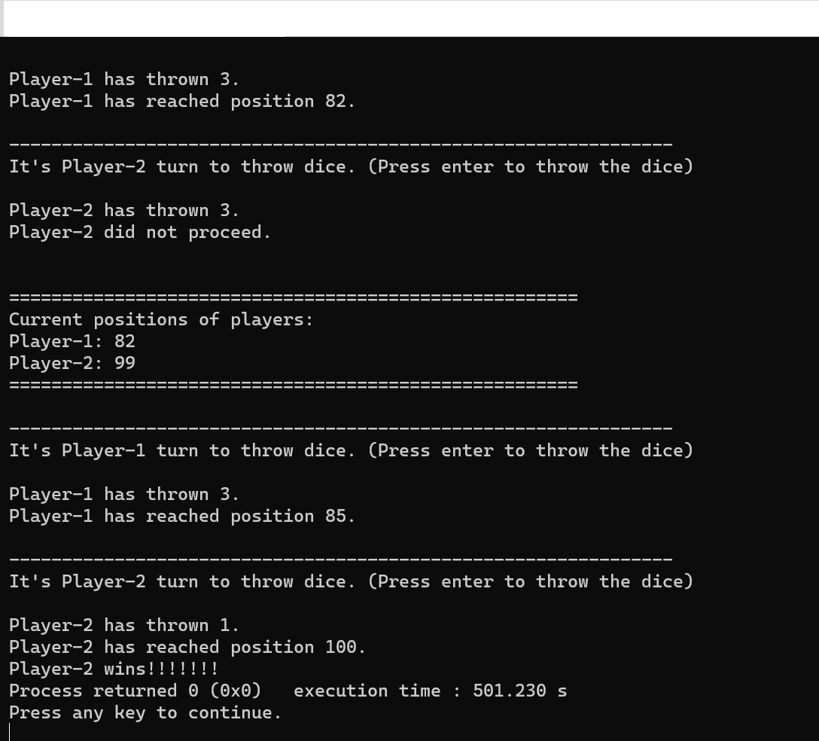
OUTPUT

Slide 10
THANK YOU

