Slide 1
Machine failure prediction

Slide 2
Introduction
Machine failures can lead to costly downtimes and operational inefficiencies in various industries. This project aims to utilize sensor data collected from various machines to predict failures in advance. By analyzing this data, we can implement predictive maintenance strategies that enhance operational reliability and reduce costs.

Slide 3
Dataset Overview
The dataset comprises sensor readings from multiple machines, with the primary goal of predicting machine failures. The data includes various parameters that provide insights into the machine's operating conditions and performance.
The dataset contains the following columns:
footfall: Represents the number of people or objects passing by the machine. This can indicate usage patterns and potential external impacts on machine performance.
temp Mode: Indicates the temperature setting of the machine, which is critical for assessing operational efficiency.
AQ: The air quality index near the machine, which can influence machine performance and longevity.
USS: Ultrasonic sensor data indicating proximity measurements, helpful for understanding spatial dynamics around the machine.
CS: Current sensor readings that reflect the electrical current usage of the machine, a vital parameter for monitoring energy consumption and detecting anomalies.

Slide 4
VOC: Levels of volatile organic compounds detected near the machine, which can affect both the environment and machine functionality.
RP: Rotational position or RPM (revolutions per minute) of the machine parts, essential for evaluating mechanical performance.
IP: Input pressure to the machine, which can affect operational stability.
Temperature: The operating temperature of the machine, critical for ensuring it operates within safe limits.
fail: A binary indicator of machine failure (1 for failure, 0 for no failure). This is the target variable for predictive modeling.

Slide 5
Model Training and Evaluation
The dataset was split into training and test sets. Models were trained on the training set and evaluated on the test set using metrics such as:
Accuracy
Precision
Recall
F1-Score
ROC-AUC

Slide 6
Results
The Random Forest model demonstrated the best performance with an accuracy of 88% (insert actual percentage), suggesting that it effectively captured the complexities of the data.
precision recall f1-score support
0 0.89 0.88 0.89 102
1 0.86 0.87 0.87 87
accuracy 0.88 189
macro avg 0.88 0.88 0.88 189
weighted avg 0.88 0.88 0.88 189

Slide 7
Summary of Model Evaluation Results
The evaluation results of the Random Forest model, as indicated by the classification report, provide insights into its performance in predicting machine failures.
1. Precision, Recall, and F1-Score
Class 0 (No Failure):
Precision: 0.89
This indicates that 89% of the instances predicted as "no failure" were correct. The model is effective at identifying non-failing machines.
Recall: 0.88
This shows that 88% of the actual non-failure cases were correctly predicted. The model captures most of the non-failure instances.
F1-Score: 0.89
The F1-score, which balances precision and recall, indicates a strong performance in predicting non-failures.
Class 1 (Failure):
Precision: 0.86
This means that 86% of the instances predicted as "failure" were accurate. While slightly lower than for Class 0, it still demonstrates good predictive capability.
Recall: 0.87
The model correctly identified 87% of the actual failure cases, showing that it effectively detects machine failures.
F1-Score: 0.87
This score reflects a solid balance between precision and recall for predicting failures.

Slide 8
2. Overall Accuracy
Accuracy: 0.88
The model achieved an overall accuracy of 88%, indicating that it correctly predicted 88% of the total instances (both failures and non-failures). This is a strong performance metric, suggesting that the model generalizes well to the data.
3. Macro and Weighted Averages
Macro Average:
Precision: 0.88
Recall: 0.88
F1-Score: 0.88
The macro averages provide an unweighted mean of the metrics across both classes, showing consistent performance
Weighted Average:
Precision: 0.88
Recall: 0.88
F1-Score: 0.88
The weighted averages account for the number of instances in each class, reaffirming the model's robustness across different classes.

Slide 9
Conclusion
The Random Forest model demonstrates effective predictive capabilities for both machine failure and non-failure classes, with solid precision, recall, and F1-scores. The overall accuracy of 88% highlights the model's ability to generalize well to unseen data, making it a valuable tool for implementing predictive maintenance strategies. Future work could involve further tuning the model or incorporating additional features to enhance performance even more.

Slide 10
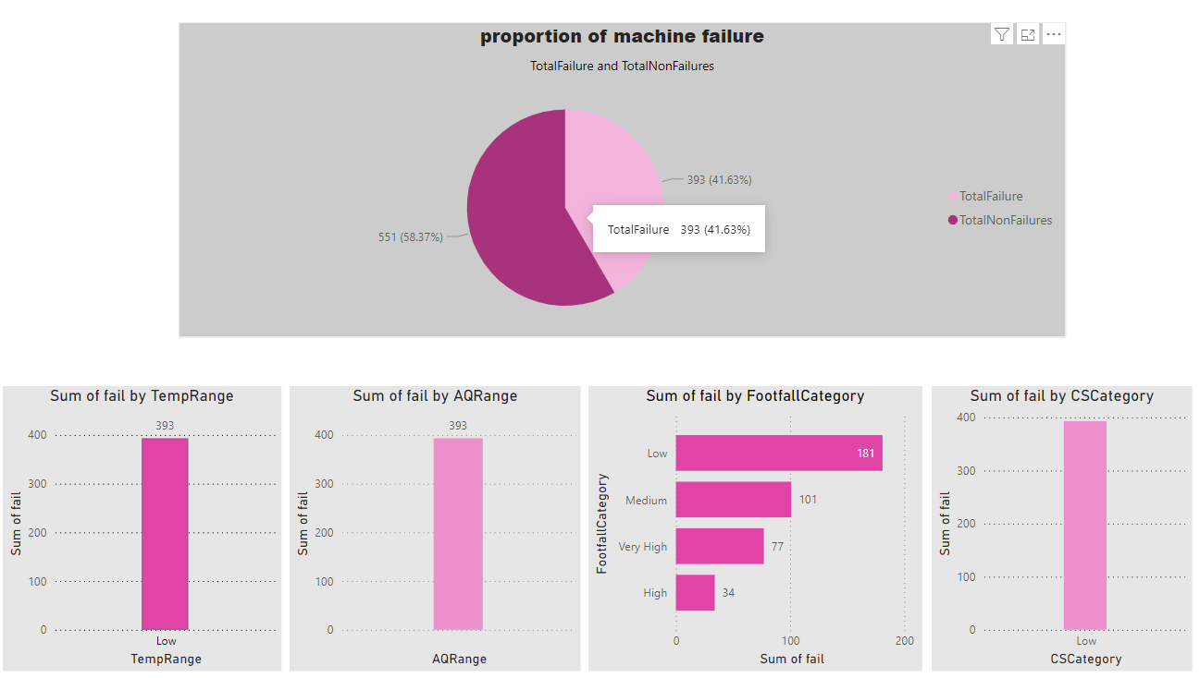
Power bi Report

