Slide 1
SMS SPAM DETECTION

Slide 2
SMS spam detection
SMS spam detection is the process of identifying and filtering unsolicited and often harmful text messages, commonly referred to as "spam," from legitimate or "ham" messages. This task is crucial for maintaining the quality of communication and protecting users from potential fraud, phishing attempts, and unwanted advertisements.
Key Concepts:
Spam: Unwanted, unsolicited messages typically sent in bulk for commercial purposes. They can include promotional offers, scams, phishing attempts, or malicious content.
Ham: Legitimate messages that are desired and expected by the recipient. They include personal communication, important notifications, and other relevant messages.

Slide 3
Objective
To develop a classification model that accurately identifies SMS messages as either "ham" or "spam" using the SMS Spam Collection Dataset. The model will help automate the filtering of spam messages in real-world applications.
Future Directions
Enhanced Models: Using advanced machine learning techniques and pre-trained language models to improve accuracy and adaptability.
Adaptive Systems: Developing models that can dynamically adjust to new types of spam.
Multilingual Detection: Creating systems capable of detecting spam in various languages and dialects.
Personalization: Tailoring spam filters based on individual user preferences and behavior.

Slide 4
Tools and Environment
Programming Language: Python
Development Environment: Jupyter Notebook
Libraries:
pandas for data manipulation
numpy for numerical operations
scikit-learn for machine learning
nltk for natural language processing
matplotlib and seaborn for data visualization

Slide 5
Techniques for Spam Detection
Rule-Based Systems:
. Regular Expressions: Using patterns to match and filter out known spam structures.
-> Machine Learning Models:
. Logistic regression
->Term Frequency-Inverse Document Frequency (TF-IDF):
.Measures the importance of words in a document relative to the entire corpus
->Natural Language Processing (NLP) Techniques:
. Text Preprocessing: Includes tokenization, stemming, lemmatization, and stopword removal.
. Semantic Analysis: Understanding the context and meaning of words in a message

Slide 6
Logistic regression
Logistic regression is a fundamental statistical method used for binary classification tasks. It predicts the probability that a given input belongs to a certain class

Slide 7
Term Frequency-Inverse Document Frequency
Measures the importance of words in a document relative to the entire corpus. TF-IDF helps to account for the fact that some words appear frequently across all documents (e.g., "the") and might not be as informative.
Process:
Term Frequency (TF): Measures how frequently a word appears in a document.
Inverse Document Frequency (IDF): Measures how important a word is by considering its frequency across all documents.
TF-IDF Score: Combines TF and IDF to give a weighted importance score for each word in each document

Slide 8
Dataset Overview
Total Messages: 5,574
Labels:
Ham: 87% (4,844 messages)
Spam: 13% (730 messages)
Columns:
label: Label (either "ham" or "spam")
messages: Raw text of the SMS message

Slide 9
Data Sources:
The dataset is compiled from multiple sources:
Grumble Text Website: 425 spam messages manually extracted.
NUS SMS Corpus (NSC): 3,375 randomly chosen ham messages collected by volunteers from the National University of Singapore.
Caroline Tag's PhD Thesis: 450 ham messages.
SMS Spam Corpus v.0.1 Big: 1,002 ham messages and 322 spam messages.
Data Breakdown:
Ham Messages: These represent legitimate, non-spam messages. Examples include personal communications or transactional notifications.
Spam Messages: These include unsolicited messages such as advertisements or fraudulent offers.

Slide 10
Overall performace:
precision recall f1-score support
ham 0.96 1.00 0.98 965
spam 0.99 0.75 0.86 150
accuracy 0.97 1115
macro avg 0.98 0.88 0.92 1115
weighted avg 0.97 0.97 0.96 1115

Slide 11
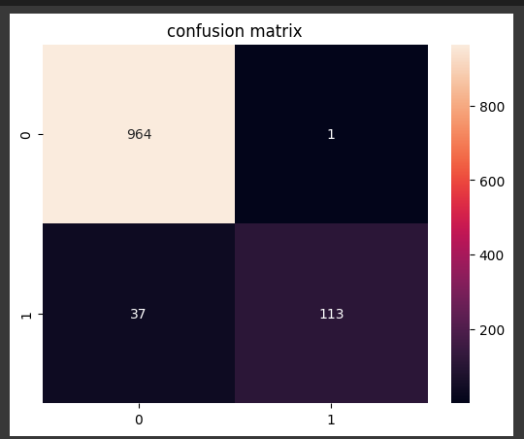
Visualizatoin result:

Slide 12
summary
The results provided are from a classification report, likely for a spam detection model. Here's a summary of the performance metrics:
Class Performance:
Ham (Non-Spam):
Precision: 0.96 – The model correctly identified 96% of the messages classified as ham.
Recall: 1.00 – The model identified 100% of the actual ham messages.
F1-Score: 0.98 – The harmonic mean of precision and recall, indicating excellent performance for ham classification.
Support: 965 – The number of actual ham messages in the dataset.

Slide 13
Spam:
Precision: 0.99 – The model correctly identified 99% of the messages classified as spam.
Recall: 0.75 – The model identified 75% of the actual spam messages.
F1-Score: 0.86 – The harmonic mean of precision and recall for spam, which is good but not as high as for ham.
Support: 150 – The number of actual spam messages in the dataset.
Overall Performance:
Accuracy: 0.97 – The model correctly classified 97% of all messages.
Macro Average:
Precision: 0.98 – Average precision across both classes, treating each class equally.
Recall: 0.88 – Average recall across both classes, treating each class equally.
F1-Score: 0.92 – Average F1-Score across both classes, treating each class equally.

Slide 14
Weighted Average:Precision: 0.97 – Precision weighted by the number of instances in each class.
Recall: 0.97 – Recall weighted by the number of instances in each class.
F1-Score: 0.96 – F1-Score weighted by the number of instances in each class.

Slide 15
Summary: The model performs very well overall, with high accuracy and strong performance in classifying ham messages. It has slightly lower recall for spam, which might suggest that it misses some spam messages, though precision for spam is excellent.

