Slide 1
Customer Segmentation
By Jishnu Jayaraj

Slide 2
Input Dataset
Has Features
Age
Gender
Status
Account_type_1
Account_type_2
Amount
Scale
Ziel
Risk
Total number of 1377
Has Features
Age
Gender
Status
Account_type_1
Account_type_2
Amount
Scale
Ziel
Risk
Customer_id
Total number of 1159
cleaning

Slide 3
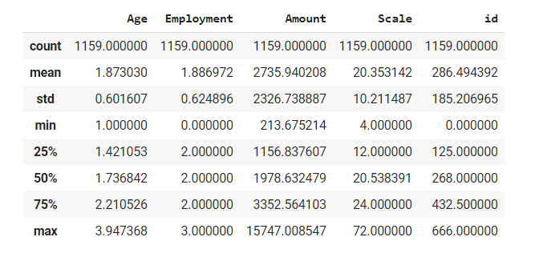
Dataset properties for Numerical data

Slide 4
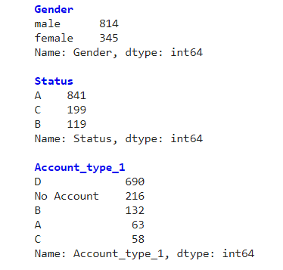
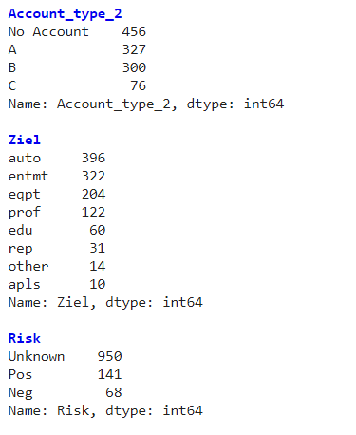
Dataset properties for Categorical data

Slide 5
Dataset Cleaning
Age and Status:
Since the number of "NaN" values in this column is relatively low and having average age as substitute also makes no sense, we decide to discard these rows. Same with Status column.
Account type:
This values were substituted with 'No Account' phrase inplace for NaN values.
Scale:
Since these are continuous values, the NaN values were substituted with column average. This would make the total average the same and is expected not to interfere with our analysis.
Risk
Most of the values in this column are NaN and were subtituted with 'Unknown'

Slide 6
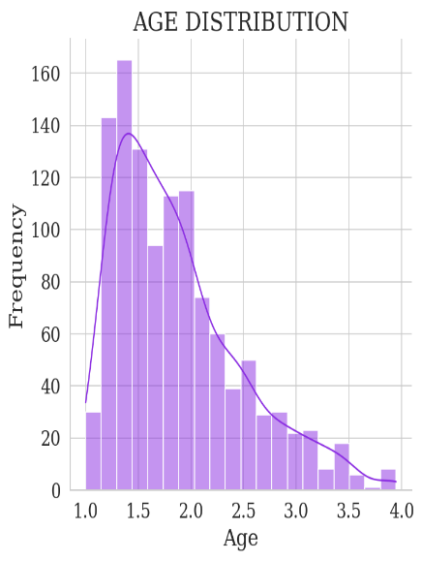
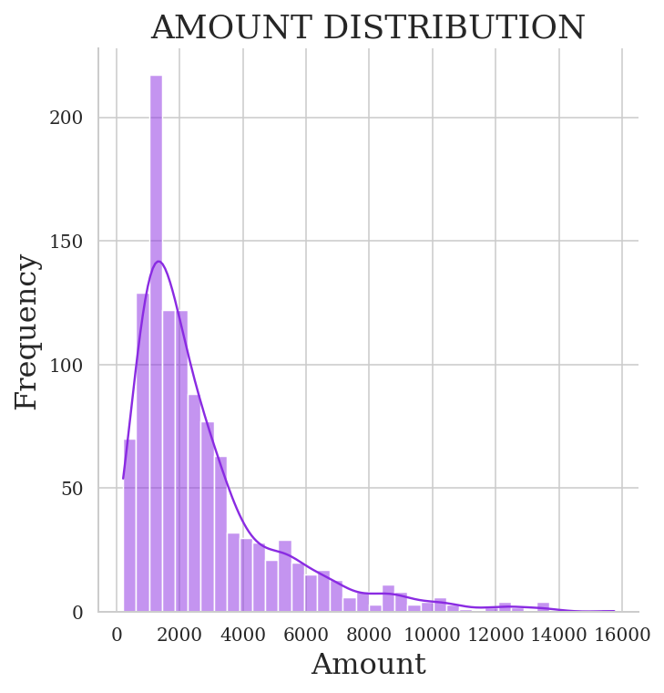
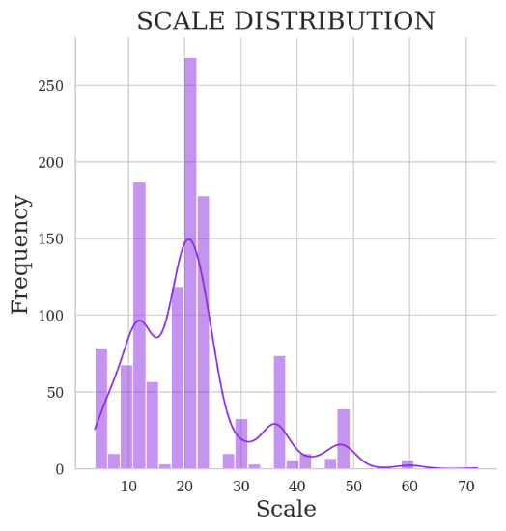
Dataset Exploration
All data are positively skewed! Not ideal for k-means clustering

Slide 7
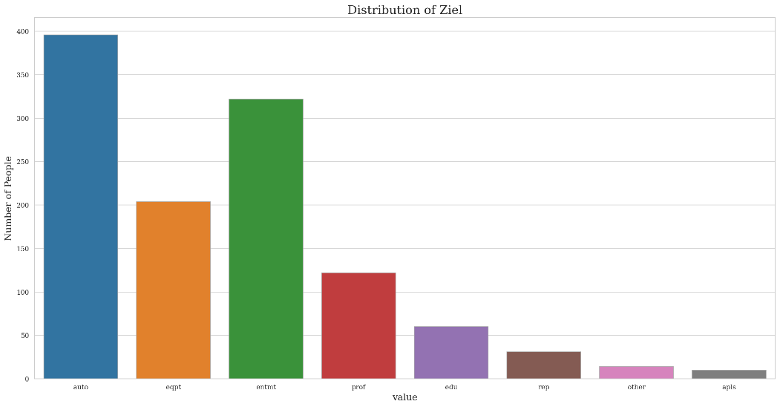
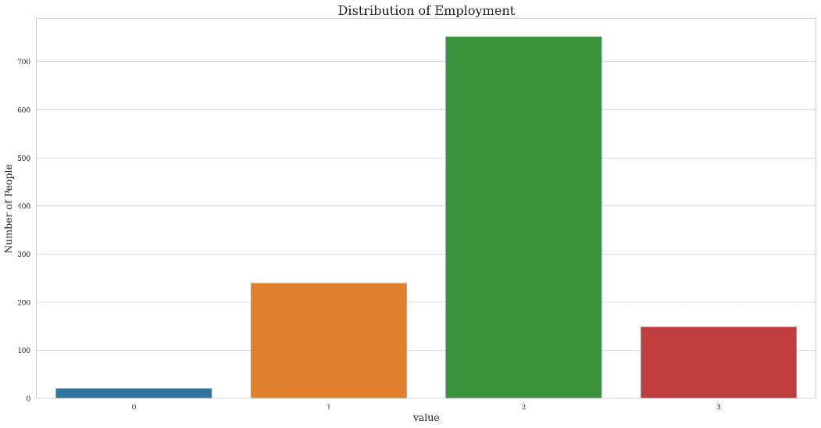
Dataset Exploration

Slide 8
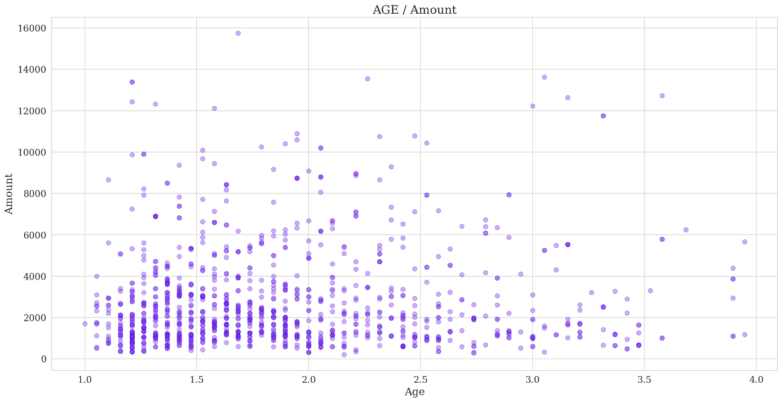
Dataset Exploration
General upward trend in age 0 – 1.5 and then decreases

Slide 9
Dataset Preprocessing
Remove unused columns for the clustering:
Gender (assumed no impact on result, depend on data)
Id (no impact on result)
Risk (lack of useful data)
Distribution is skewed, so logarithm was taken
Features were in different scale, hence was normalized using scaling

Slide 10
Clustering
K-means works best on numerical data, but our features is a combination of numerical and categorical dataset.
Hence use k-prototype
Can handle categorical and numerical simultaneously
based on the number of matching categories between data points
support for multiprocessing via the joblib library
Evaluation
Optimal cluster was found with elbow method on cost variable.
Silhouette score was used to validate cluster quality

Slide 11
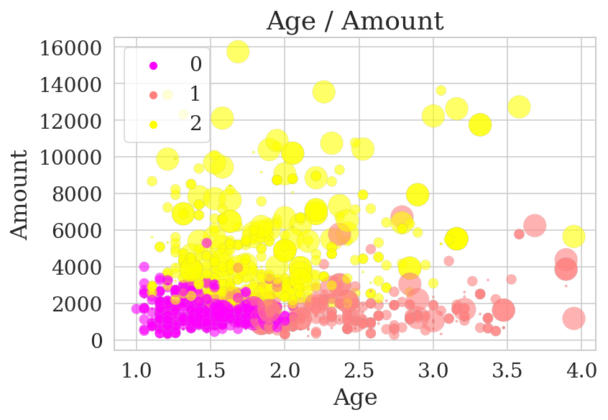
Results
Age and Amount as the axis
Cluster label as color
Circle area as employment
Well defined clusters showing 3 clusters and employment distinction is also visible

Slide 12
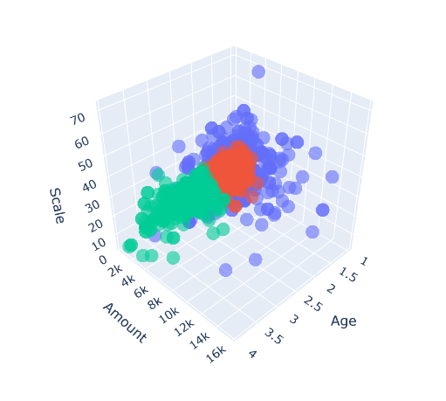
Result: 3d plot

Slide 13
Troubleshooting
Employment column is a categorical value but is encoded as type int, which I didn’t notice
Setting up self implemented silhouette score for both categorical and numerical value is an experiment, not sure how reliable it is.
The dataset was a toydataset (most were abstract values, like age range from 1-4!). So followed my gut feeling in selecting and processing features

Slide 14

Thank You

