Slide 1



JISHNU JAYARAJ | MAY 7TH 2021
Customer Segmentation

Slide 2


What is segmentation
Dividing people into groups that reflects similarity
Targeted marketing
Product features
optimize market spend

Slide 3


Outline
Clustering
Cleaning
Analyze
Preprocessing

Slide 4

Data
Age
Amount
Gender
Scale
Status
Ziel
Account_type_1
Risk
Account_tpe_2
Customer_ID

Slide 5
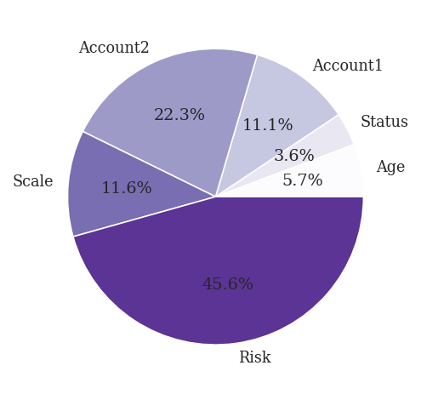
Data cleaning
NaN values removal
Duplicate removal
Account → "No account"
Scale → column average
Risk → "unknown"
NaN values

Slide 6

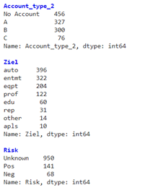
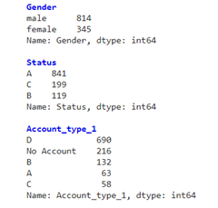
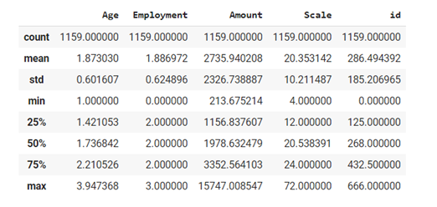
Feature Analysis

Slide 7

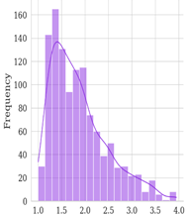
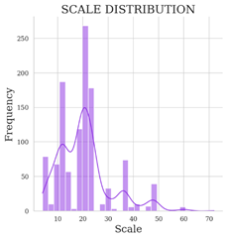
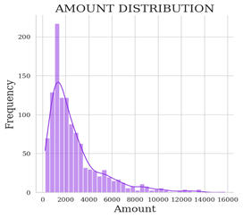
Data Exploration
Age
Amount
Scale

Slide 8
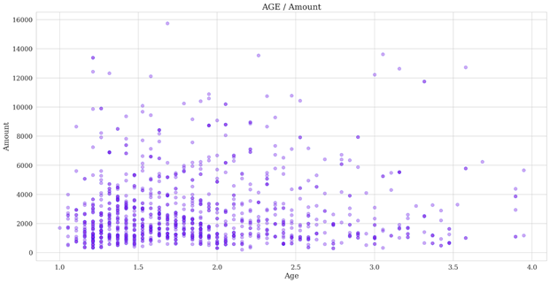
Data Exploration
Amount - Age

Slide 9
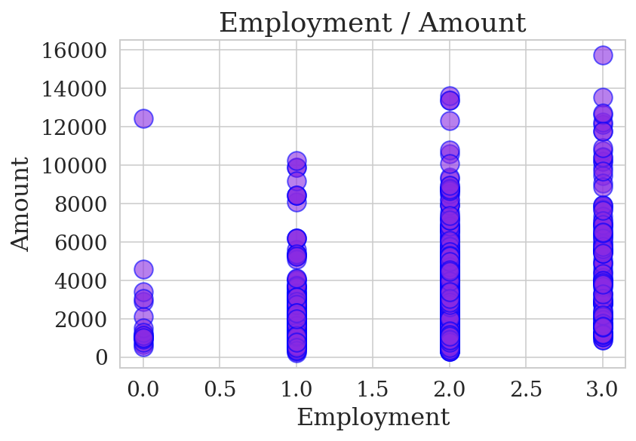
Data Exploration
Employment-Amount

Slide 10
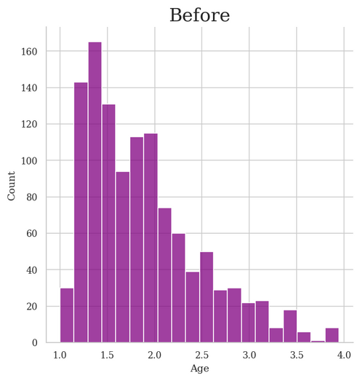
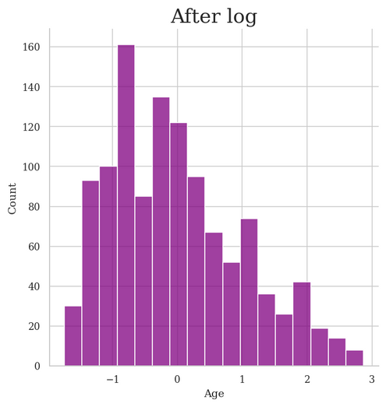
Data processing
Remove features
Skewness
Normalization
Gender
customer_id
Risk
variance
Age and Amount

Slide 11

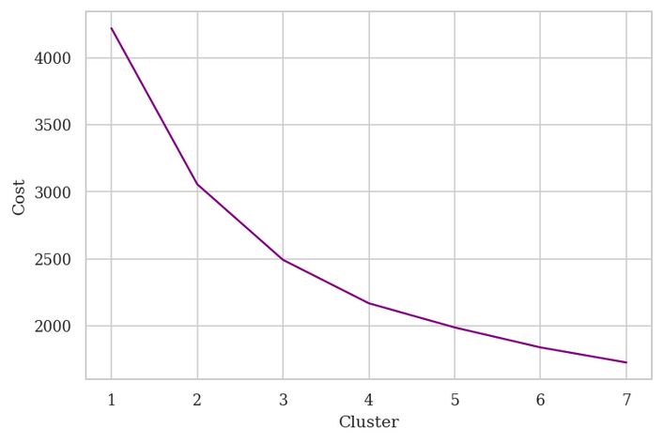
Clustering
kmeans: Euclidian distance based
+ fast
+ scalable
- linear boundary
- outlier
- numerical only
kmode: modified kmeans
matching category points
+ category features
k-prototype: combines both

Slide 12
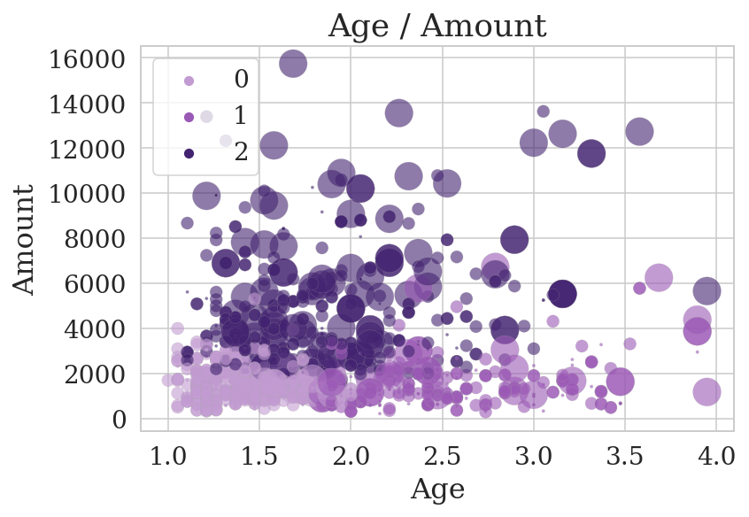
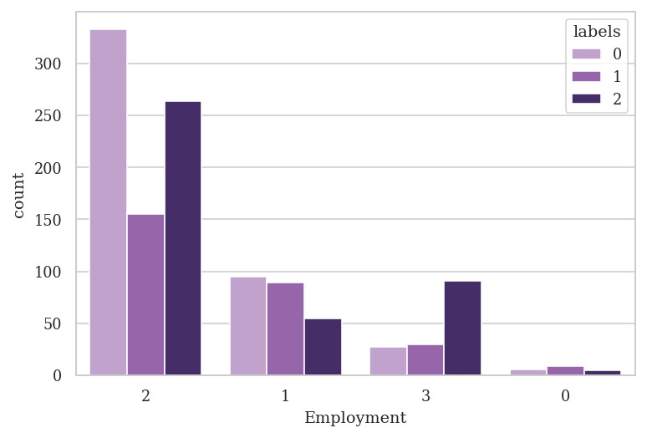
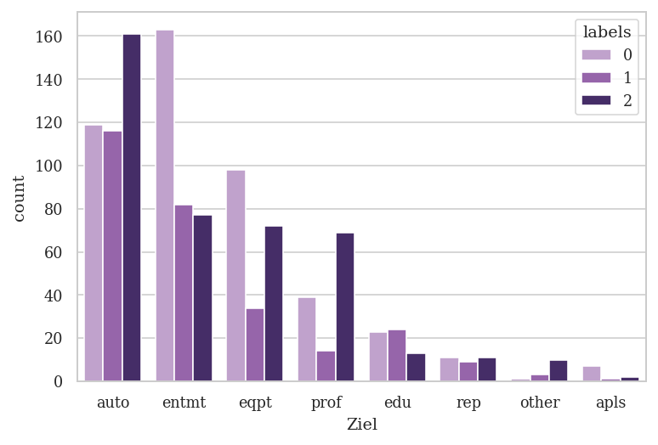

Slide 13
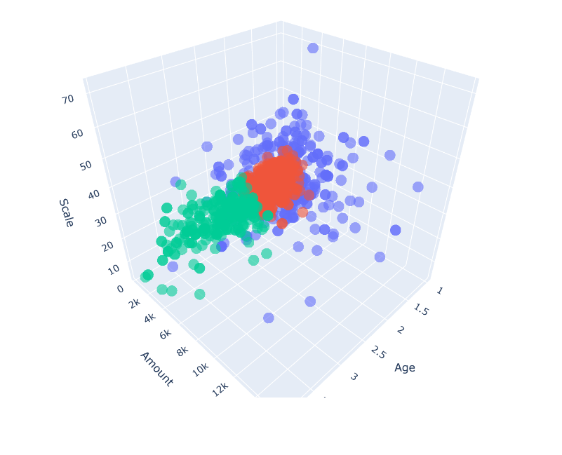

Slide 14

Thank You!

Slide 15
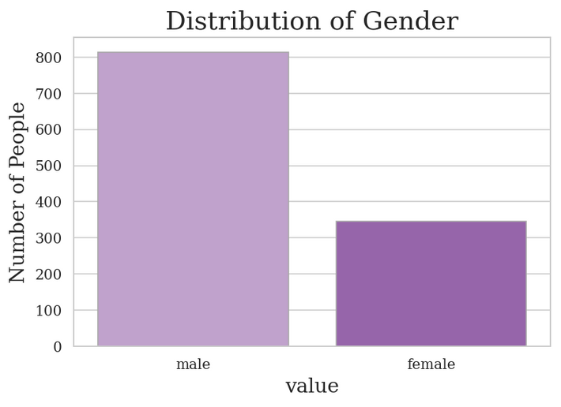
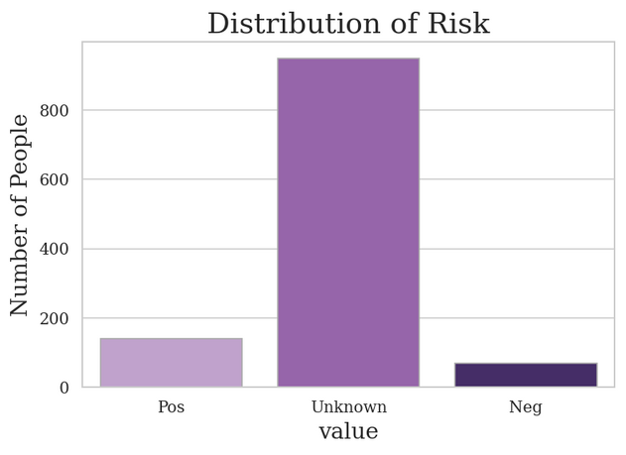
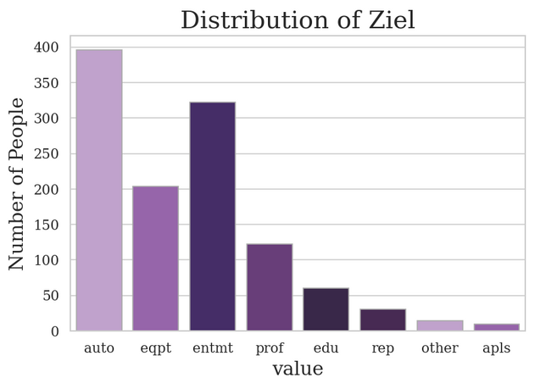
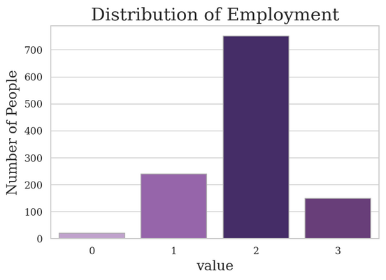
Number of duplicate rows are: 322
Number of unique customers: 667

Slide 16
Troubleshooting
Missed some features: account
sillhouete score: check
heirarchical clustering : non linear boundary

Slide 17
kmodes
eucledian distance to mathing category between data points
Modifications
- dissimilarity measure
- mean repalced with mode
- WSSE with freq method

