Slide 1


Analysis of Cryptocurrencies
Sentiment and price analysis of bitcoin, ethereum and ripple
Jishnu Nair
PGID : 71721014

Slide 2
8 Template Slides for Practicum Presentation
Executive Summary (Practicum Extract)
Business Problem
Data Requirements & Data Collections
Data Understanding
Data Preparation
Modeling, Evaluation and Feedback
Business Recommendations
Assumptions, Limitations & Further Work

Slide 3
1) Executive Summary
Motivation: Investigate the relation between sentiments for major cryptocurrencies and their prices. Analyse trends for global cryptocurrency markets.
Method: Collect historical and daily data of prices and social media data for top 3 cryptocurrencies, perform data preparation and sentiment analysis, compare trends for sentiments and prices
Means: Google trends, Coinmarketcap API and TwitterSearch Python Library for data collection, Python and Bash scripts for data collection and analysis, and Python libraries like nltk, plotly and seaborn for sentiment analysis and data visualization.

Slide 4
2) Business Problem
Business Understanding
Cryptocurrency markets are very volatile, and also attracting huge investments. There is a need to understand the trends in the prices of cryptocurrencies and the factors which affect the stakeholders.
Analytics Approach
Collect price and social media data, both historical data and daily real time data from Google Trends, CoinmarketCap API, and Twitter API.
Process and visualize the data, perform sentiment analysis to analyse the trends of prices and sentiments, to compare prices and to understand the global trends in the market.
Understand the factors affecting the market and influencing the stakeholders.

Slide 5
3) Data Requirements & Collections
Data Requirements
Historical data of prices, volumes, market capitalization.
Historical data of sentiments related to top cryptocurrencies
Real time / Daily data of prices,volumes, market capitalization.
Real time / Daily data of sentiments
Data Collections
Historical data of prices : Coinmarketcap (One time)
Historical data of sentiments : Google Trends (One time)
Daily data of prices : Coinmarketcap API (Python, scheduled using scripts)
Daily data of sentiments : Twitter API (Python, scheduled using scripts)

Slide 6
4) Data Understanding
Data Understanding
The historical prices data includes the closing prices, volumes and market capitalization for the past year.
The historical sentiments data includes the Google search trends for the past year, with the online interest for the particular keyword is quantified.
The daily data from Coinmarketcap API includes listings data, ticker data and global data for each cryptocurrency.
The daily data from Twitter includes tweets related to the three keywords(bitcoin, ethereum and ripple).

Slide 7
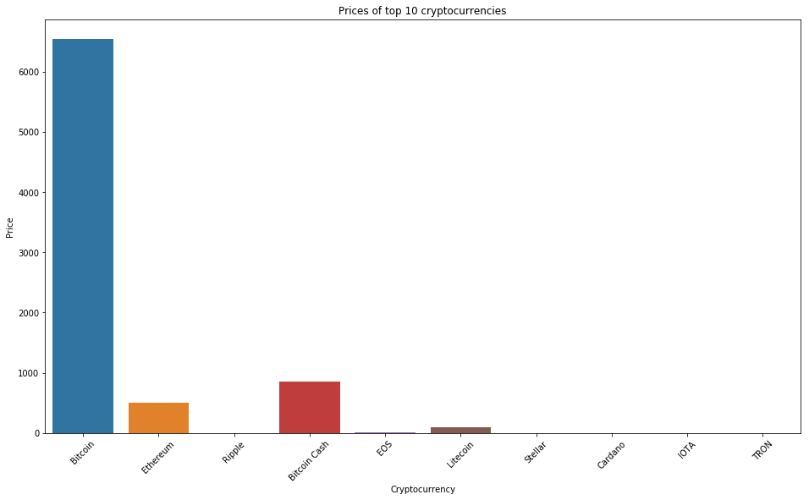
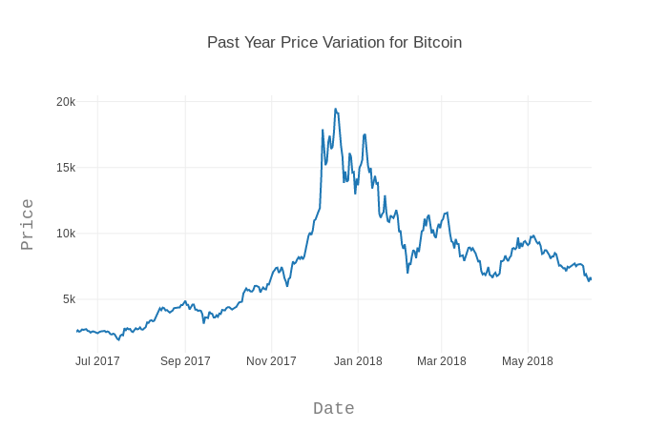
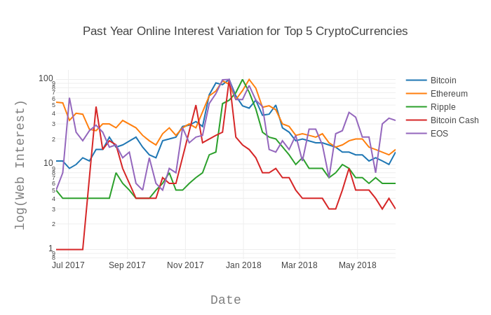
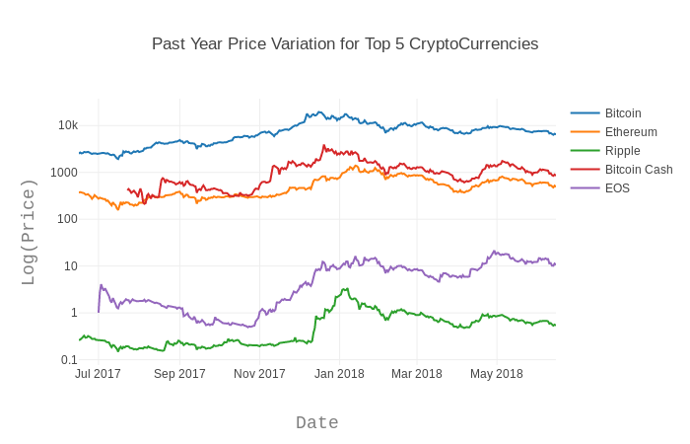
First Cut Analysis and Visual Explorations

Slide 8
5) Data Preparation
The data from Coinmarketcap API and Google Trends is structured, with no missing values.
The Twitter data however, requires a lot of data preparation. First the tweets with newlines were transformed to have just one line, using bash script. The “@” ,“#” and other special characerters were removed, along with stopwords. The words were then lemmatized before performing the sentiment analysis.
The percentage of tweets with negative sentiment was derived and used for analysing the sentiment trends.
As new data is extracted everyday, python code was written to consider all the days’ worth of data when doing the analysis.

Slide 9
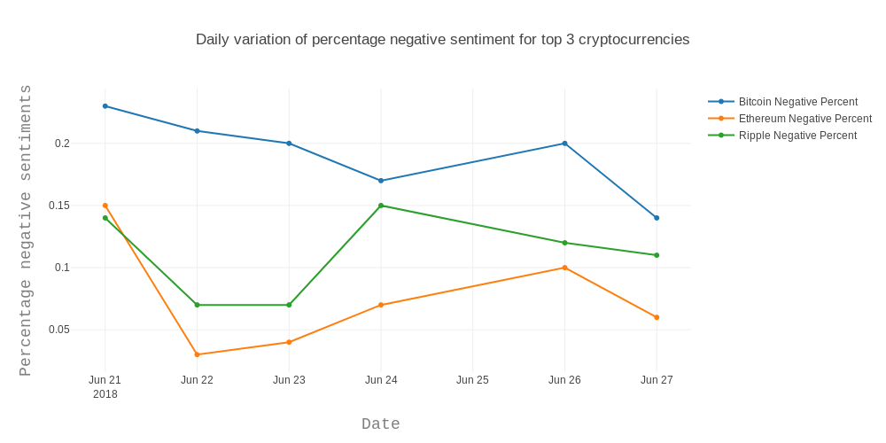
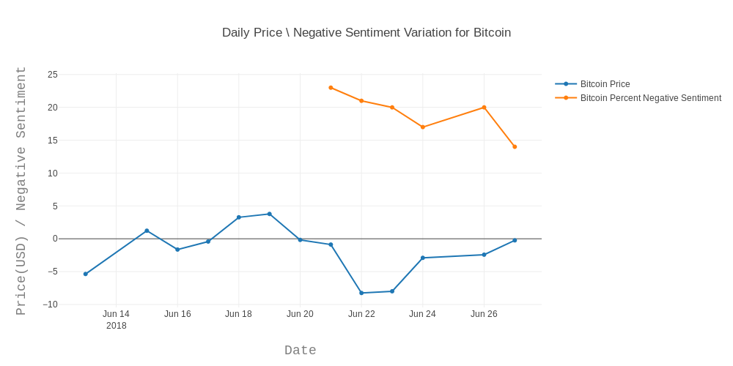
6) Evaluation and Feedback

Slide 10
6) Modeling, Evaluation and Feedback
What models are chosen? Why?
What Evaluation Metrics? Why?
What Optimization Techniques? Why?
What is the feedback? How did feedback change your model(s) and metric(s)?
Model Comparison (Visual, Tabular and Descriptive)
Which is the best model and why?

Slide 11
7) Business Recommendations
What is the response(s) of the model(s)?
What action items do you recommend to the business sponsors based on the response(s)?
Is the outcome quality in tune with the expectations of the business sponsor(s)? Why? Why not?
How do you propose to deploy your work?

Slide 12
8) Assumptions, Limitations & Further Works
What are the assumptions you have taken?
What are the limitations of your analysis?
What could be the further work?
Are there any inherent flaws in the approach, model or findings?

