Slide 1

1. Introduction to Git
What is Git?
A distributed version-control system for tracking changes in source code during software development.
It is designed for coordinating work among programmers, but it can be used to track changes in any set of files. Its goals include speed, data integrity, and support for distributed, non-linear workflows.
Notes:
https://code.visualstudio.com/docs/getstarted/introvideos

Slide 2
1. Introduction to Git
What is version control?
A system that records changes to a file or set of files over time so that you can recall specific versions later.
It allows you to
revert selected files or the entire project back to a previous state,
compare changes over time,
see who last modified something that might be causing a problem,
who introduced an issue and when, and more.
Notes:
https://code.visualstudio.com/docs/getstarted/introvideos

Slide 3

1. Introduction to Git
Local Version Control System
Notes:
https://code.visualstudio.com/docs/getstarted/introvideos

Slide 4
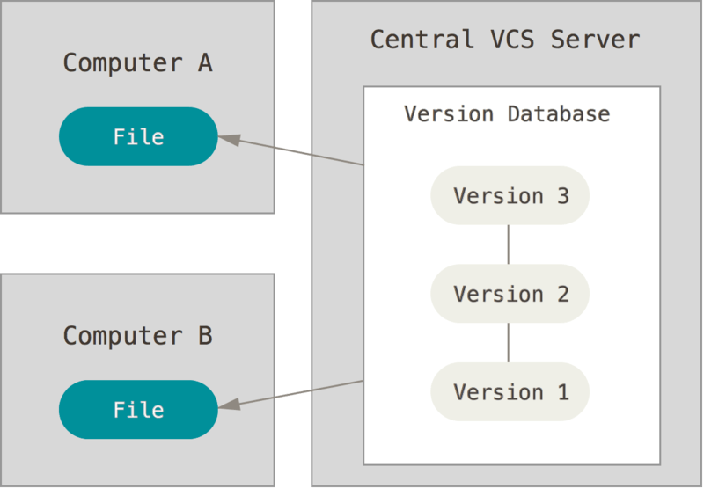
1. Introduction to Git
Centralized Version Control System
What happens when the server goes down?
Notes:
https://code.visualstudio.com/docs/getstarted/introvideos

Slide 5
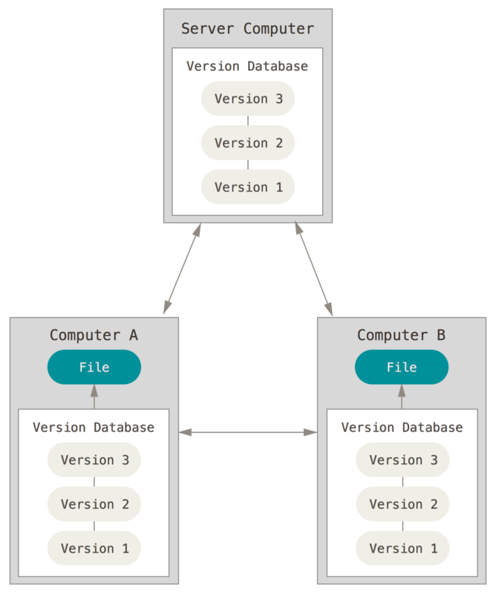
1. Introduction to Git
Distributed Version Control System
Notes:
https://code.visualstudio.com/docs/getstarted/introvideos

Slide 6
0. Review – Git Rebase
Merging is nice because it’s a non-destructive operation. The existing branches are not changed in any way.
Rebasing re-writes the project history by creating brand new commits for each commit in the original branch.

Slide 7
0. Review – Git Rebase

