Slide 1
2. CSS
Cascading Style Sheet
A style sheet language to decide the visual style of a HTML document
Font color, size, style (bold, italic), page layout, transparency and so on

Slide 2
2. CSS
Problems with html when it comes to styling
The style needs to be defined for every element repeatedly
=> The size of the document increases
=> Difficult to maintain and update the document.
<html>
<head>
</head>
<body>
<p style=“font-size: 20px”> Hello </p>
</body>
</html>

Slide 3
2. CSS
Solution 1: Embedded Styling
Define the style all at once inside <head>
Saves space, easy to maintain the code
But, it needs to be copied to all documents
<html>
<head>
<style> p { font-size: 20px } </style>
</head>
<body>
<p> Hello </p>
</body>
</html>

Slide 4
2. CSS
Solution 2: External File
Using CSS
Make a separate style file as an external file, and use link element to embed the style
It is easy to set styles of different groups just by linking different css files
HTML
<html>
<head>
<link rel=“stylesheet” href=“mystyle.css”>
</head>
<body>
<p> Hello </p>
</body>
</html>
mystyle.css
p { font-size: 20px }

Slide 5
2. CSS
Grouping examples
- body { color: red } <- applies to body only
p { color: red} <- to all paragraphs
a { color: red } <- to all hyperlinks
h1 a { color: red } <- to all hyper links inside h1

Slide 6
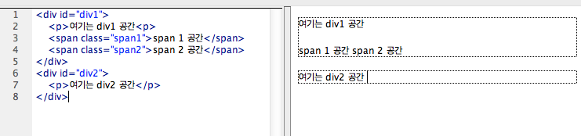
2. CSS
Elements of groupings
div: block
span: inline

Slide 7
2. CSS
Applying different styles to individual elements
id attribute (only to single element)
<html>
<head>
<link rel=“stylesheet” href=“mystyle.css”>
</head>
<body>
<p id=“text1”> Hello </p>
</body>
</html>
mystyle.css
#text1 { font-size: 20px }

Slide 8
2. CSS
Applying different styles to individual elements
2. class attribute (can be applied to multiple elements)
<html>
<head>
<link rel=“stylesheet” href=“mystyle.css”>
</head>
<body>
<p class=“text1”> Hello </p>
<p class=“text1”> How are you? </p>
</body>
</html>
mystyle.css
.text1 { font-size: 20px }

Slide 9
2. CSS
id vs. class
The number of times that can be used in a doc
One id per doc
Class has no limit per doc
id attributes have higher priority than class’
=> id attribute does can get affected by class attributes

Slide 10
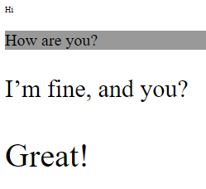
2. CSS
Applying different styles to individual elements
3. Pseudo-class
<html>
<head>
<link rel=“stylesheet” href=“mystyle.css”>
</head>
<body>
<div id=“wrapper”>
<p class=“text1”>Hi </p>
<p class=“text2”> How are you? </p>
<p class=“text3”> I’m fine, and you? </p>
<p class=“text4”> Great! </p>
</div>
</body>
</html>
mystyle.css
.text1 { font-size: 10px }
.text2 { font-size: 20px }
.text3 { font-size: 30px }
.text4 { font-size: 40px }
p:nth-child(2) {
background: #999999;
}

Slide 11
2. CSS
Applying different styles to individual elements
3. Pseudo-class
Other exampels
p:nth-child(odd), p:nth-child(even)
p:first-child{}, p:last-child{}
* {} <- applies to the entire document
:not(p) {} <- applies to the entire document but paragraphs

Slide 12

2. CSS
CSS Example
CSS File (ex.css)
body {
color: red;
background-color: #808080;
font-size: 12px;
font-style: bold;
font-family: Arial;
}
.mystyle { font-style: italic }
HTML 파일
<html>
<head>
<link rel=“stylesheet” href=“ex.css” type=“text/css” />
</head>
<body>
<h1 class=“mystyle”> Hello! </h1>
How are you?
</body>
</html>

Slide 13
2. CSS
FYI) Units related to font size
px (such as font-size: 12px) is the unit for pixels.
em (such as font-size: 2em) is the unit for the calculated size of a font. So “2em”, for example, is two times the current font size.
pt (such as font-size: 12pt) is the unit for points, for measurements typically in printed media.
% (such as width: 80%) is the unit for percentages.

Slide 14
2. CSS
Box model
The CSS box model is essentially a box that wraps around every HTML element. It consists of: margins, borders, padding, and the actual content.

Slide 15
2. CSS
Explanation of the different parts:
Content - The content of the box, where text and images appear
Padding - Clears an area around the content. The padding is transparent
Border - A border that goes around the padding and content
Margin - Clears an area outside the border. The margin is transparent

Slide 16
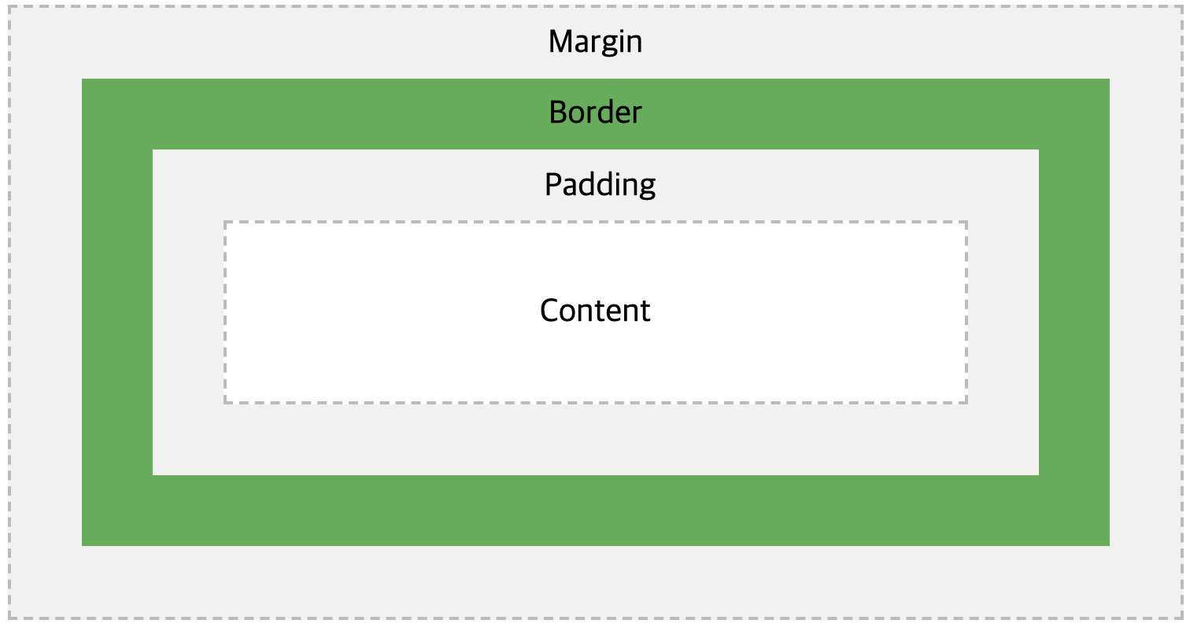
2. CSS

Slide 17
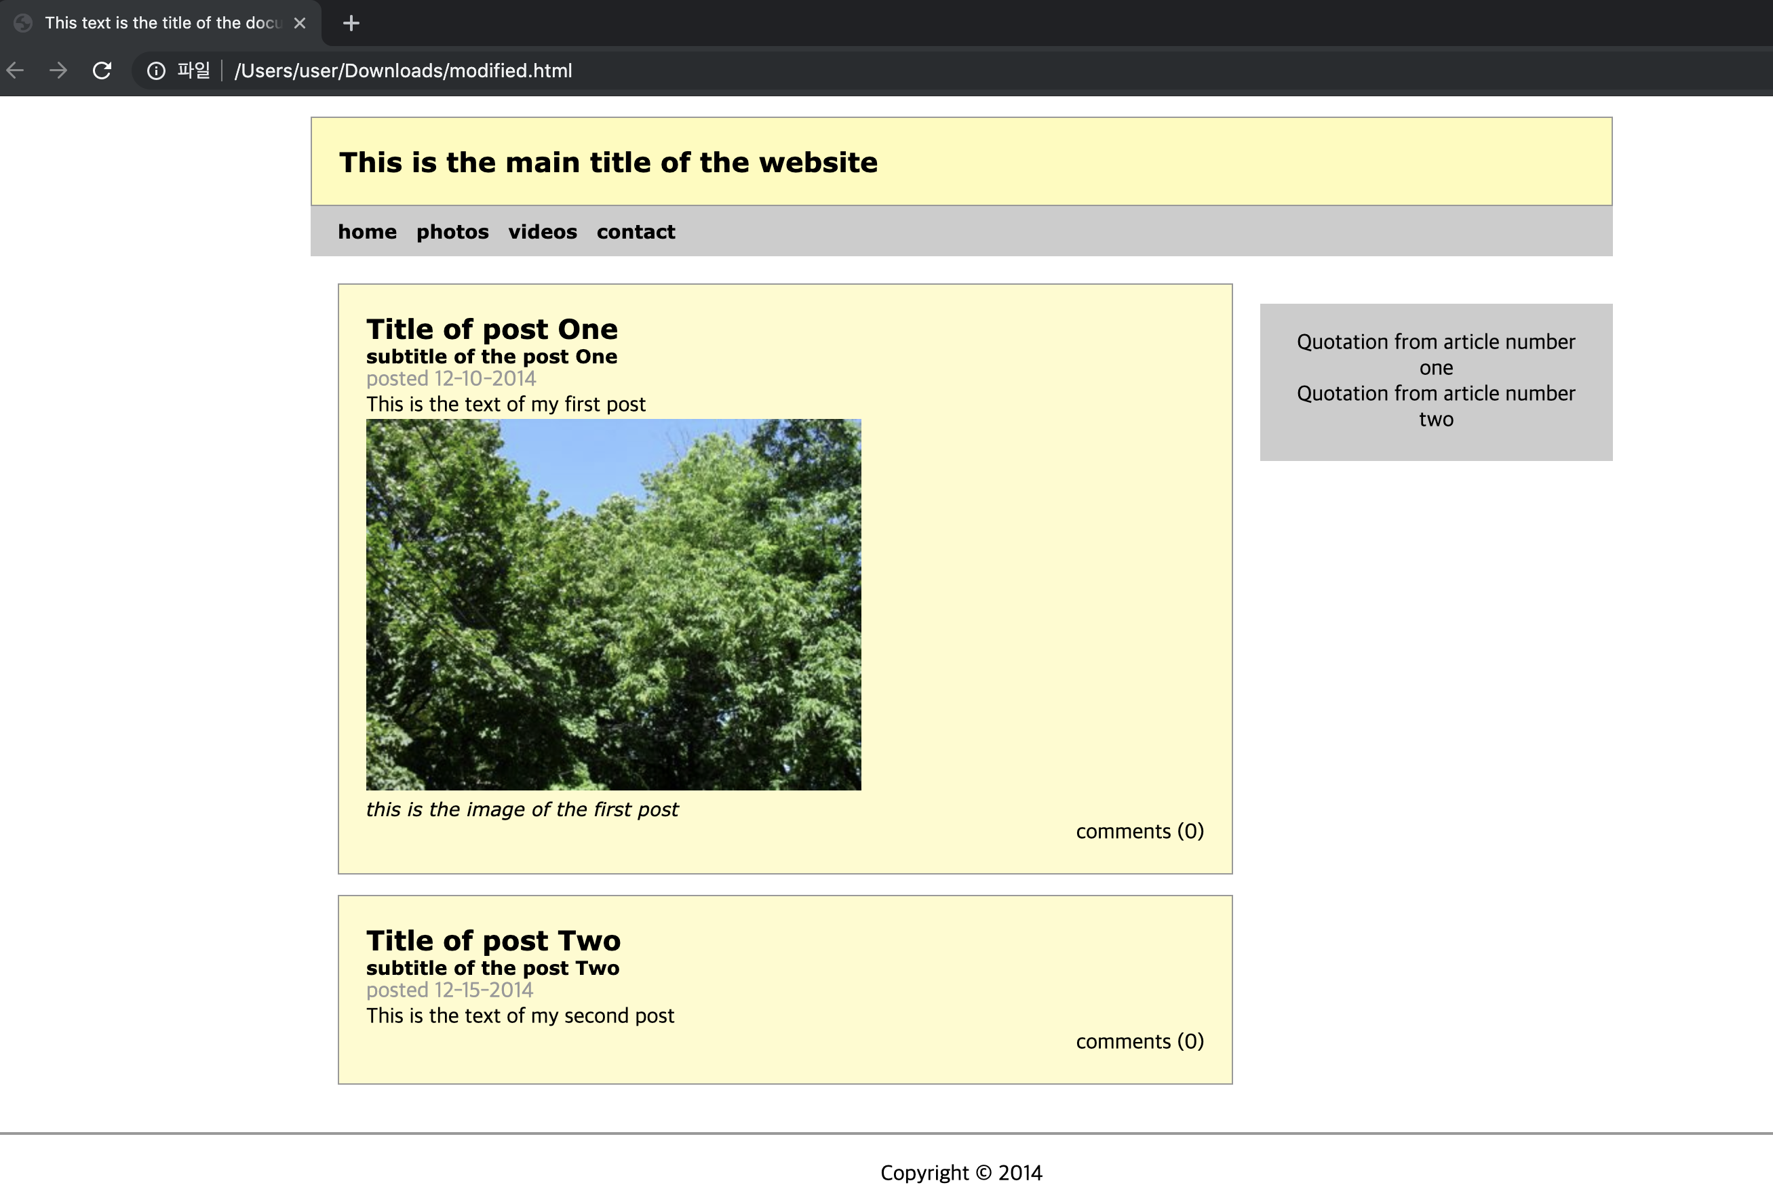
4. CSS Exercise
Step 2: Add styles to that HTML file

Slide 18
4. CSS Exercise
Complete the page by adding links to all menu items:
Display the same navigation bar whichever link is clicked
You should have at least three menu items, and you are free to have any menu names and content for each item.
Upload at least 3 images or videos
Use different colors but within the same theme
Color pallettes! https://www.color-hex.com/color-palettes/popular.php
<nav id="main_menu"> <ul> <li><a href=”home.html">home</a></li> <li><a href=”contact.html">contact </a> </li> </ul> </nav>

Slide 19
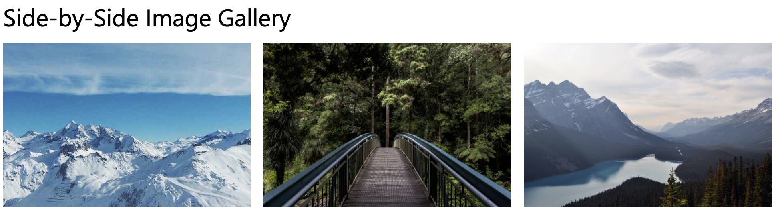
<div class="row"> <div class="column"> <img src="img_snow.jpg" alt="Snow" style="width:100%"> </div> <div class="column"> <img src="img_forest.jpg" alt="Forest" style="width:100%"> </div> <div class="column"> <img src="img_mountains.jpg" alt="Mountains" style="width:100%"> </div> </div>

