Slide 1

Generator

Slide 2

Reference
Corey Schafer’s Youtube and github
Youtube
Code

Slide 3
Task Given [1,2,3,4,5] Produce [1**2,2**2,3**2,4**2,5**2]

Slide 4
List

Slide 5
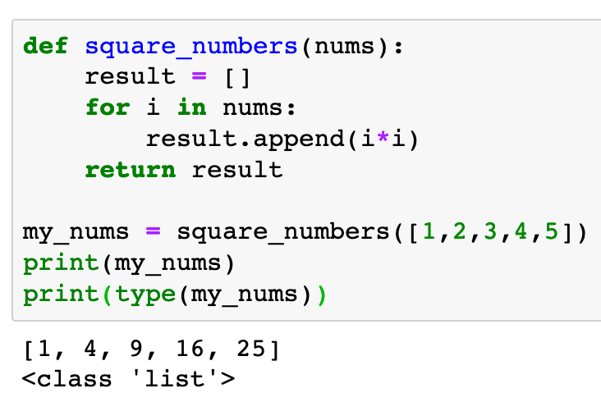

Slide 6
Generator

Slide 7
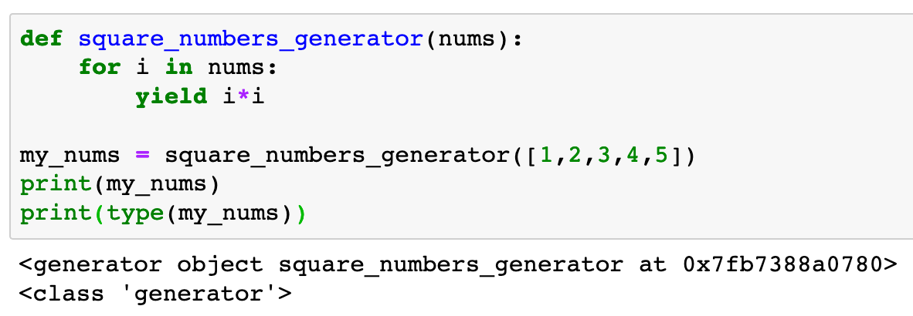

Slide 8
Generator

Slide 9
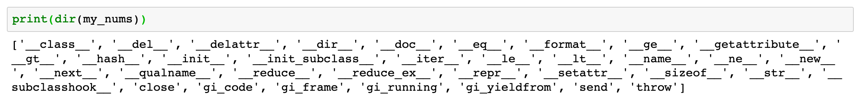

Slide 10
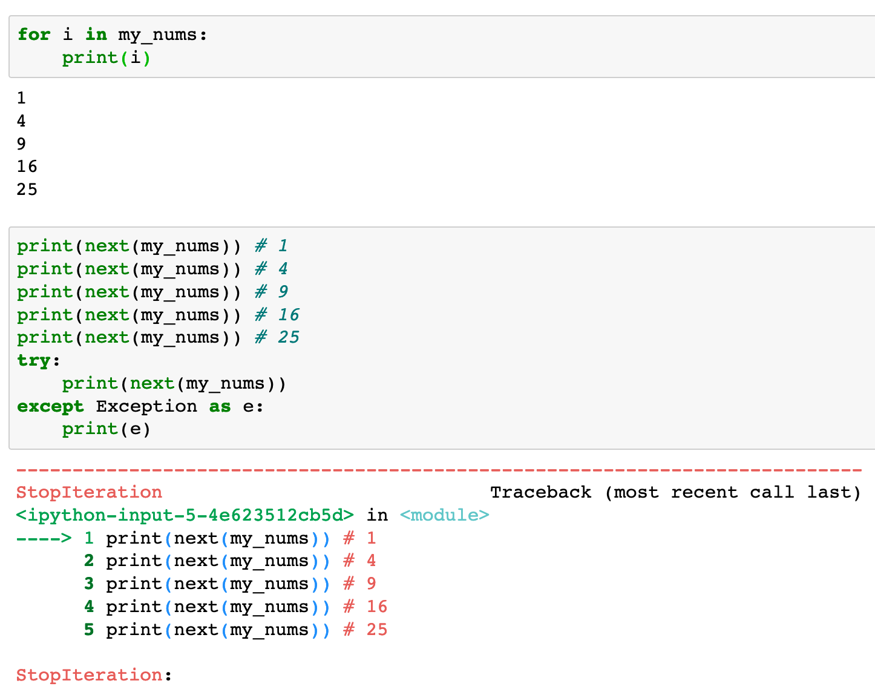

Generator is iterable
Now this generator
is empty

Slide 11
Generator is iterable
Now this generator
is empty

Slide 12
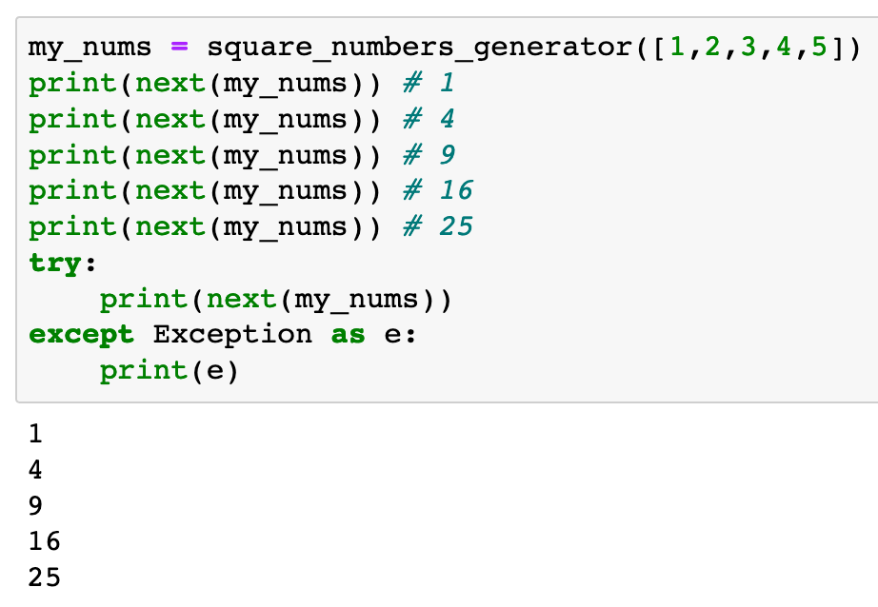
This new generator
is not empty

Slide 13
List Comprehension and Generator Comprehension

Slide 14
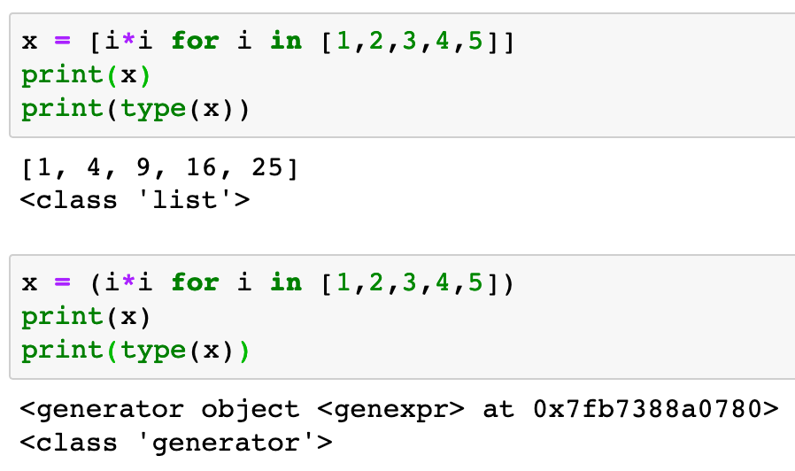

List Comprehension
Generator Comprehension

Slide 15
List Comprehension
Generator Comprehension

Slide 16
Both List and Generator are iterable

Slide 17
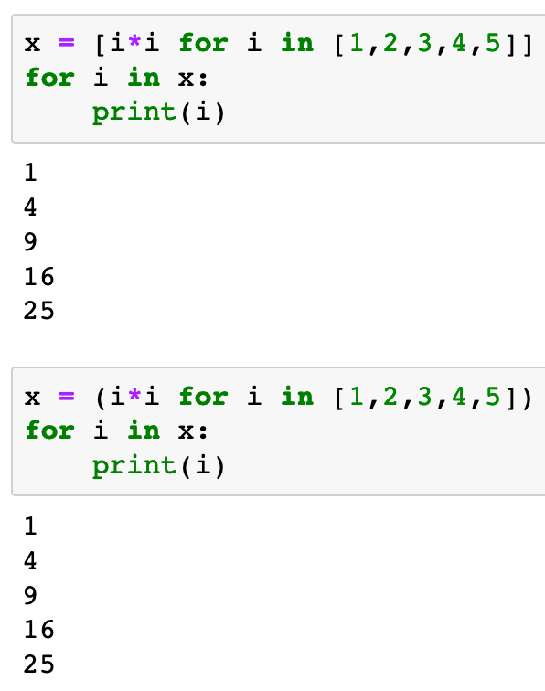
List Comprehension
Generator Comprehension

Slide 18
List Comprehension
Generator Comprehension

Slide 19
Now
Let’s Play with Code

