Slide 1
ACOUSTIC EFFECTS OF VARIOUS
FACE MASKS ON SPEECH SIGNALS
Jitanshu Shaw
(201901292)
COURSE INSTRUCTOR: PROF. HEMANT PATIL

Slide 2
INTRODUCTION
How a different types of masks effects on speech signals
What type of cloths or materials is used
What are the differences masked and no mask speech

Slide 3
METHOD
The masks used is: 2-layer cloth mask
For this experiment we will be using microphone of the mobile phones for getting the most practical scenario.
The sentence we will be using for our experiment is “The quick brown fox jumps over the lazy dog”.
Then the following feature extraction methods will be used MFCC,LFCC,LPCC,LPC
Then differentiating between the two speech signal

Slide 4
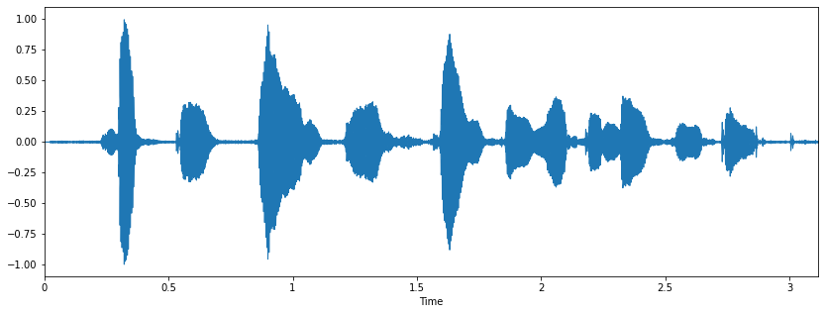
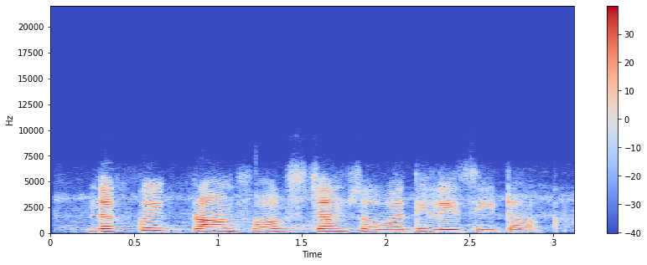

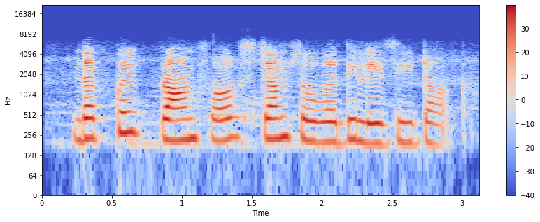
Audio with no mask

Slide 5
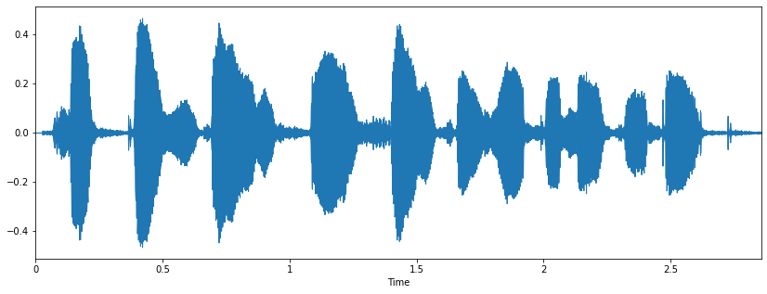
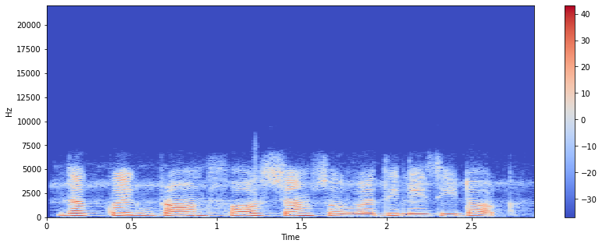
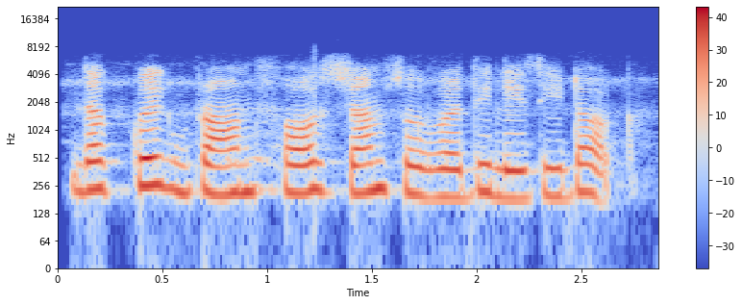
2 Layered Cloth

Slide 6
Feature extractions
MFCC
LPC
LPCC
LFCC

Slide 7
Block diagram for MFCCs(Mel-frequency cepstral coefficients)
Audio
Pre- emphasis
Framing
Windowing
FFT
Mel scale filter bank
MFCCs
DCT
Log

Slide 8
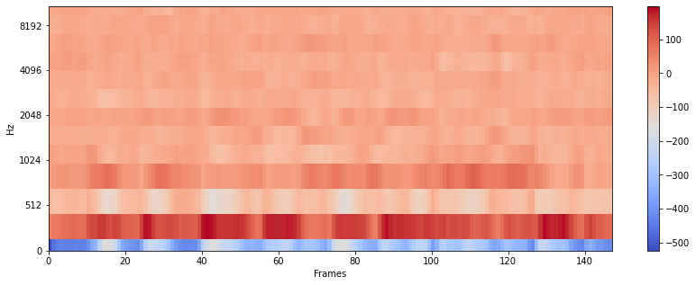
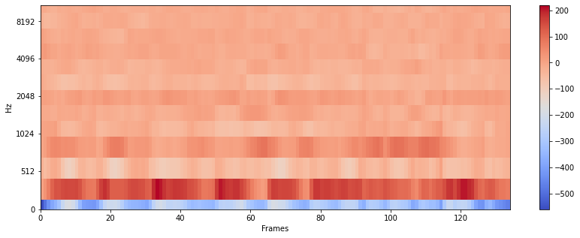
Comparison between masked and no mask using MFCCs
No mask
Cloth Mask

Slide 9
Block diagram for LFCCs(linear frequency cepstral coefficients)
Audio
Pre- emphasis
Framing
Windowing
FFT
Linear scale filter bank
LFCCs
DCT
Log

Slide 10
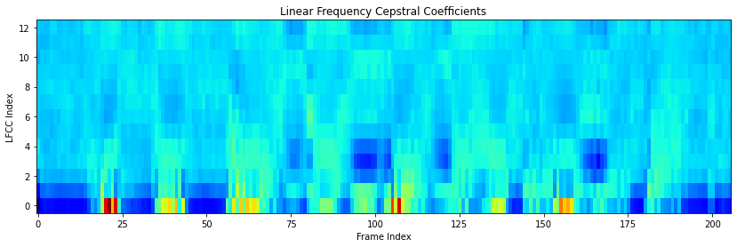
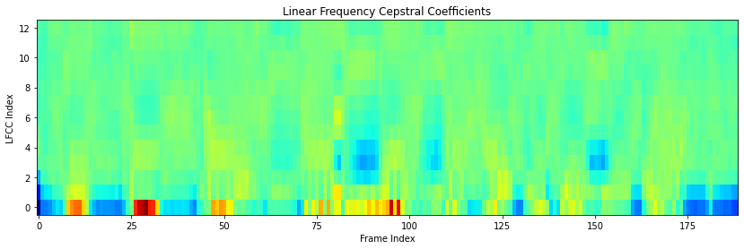
Comparison between masked and no mask using LFCCs
No mask
Cloth Mask

Slide 11
Block diagram for LPCs(Linear Prediction Coefficient)
Audio
Pre- emphasis
Framing
Windowing
Linear prediction
LPCs

Slide 12
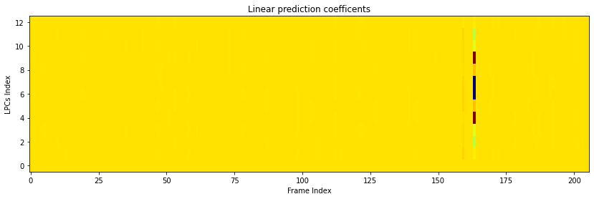
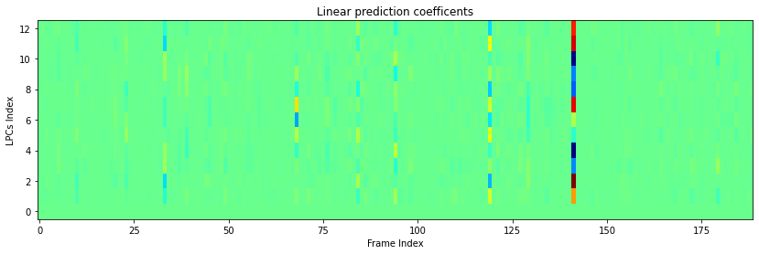
Comparison between masked and no mask using LPCs
No mask
Cloth Mask

Slide 13
Block diagram for LPCCs(Linear Prediction Cepstral Coefﬁcients)
Audio
Pre- emphasis
Framing
Windowing
Linear prediction
LPC parameters conversion
LPCCs

Slide 14

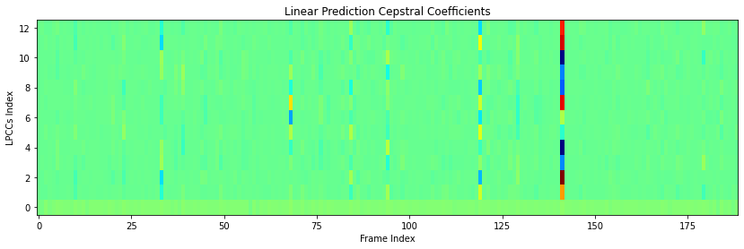
Comparison between masked and no mask using LPCCs
No mask
Cloth Mask

Slide 15
References
Ryan M. Corey, Uriah Jones, and Andrew C. Singer , "Acoustic effects of medical, cloth, and transparent face masks on speech signals", The Journal of the Acoustical Society of America 148, 2371-2375 (2020) https://doi.org/10.1121/10.0002279 last accessed:03-12-2022(13:13)
Jung, Youngmoon & Kim, Younggwan & Lim, Hyungjun & Kim, Hoirin. (2017). Linear-scale filterbank for deep neural network-based voice activity detection. 1-5. 10.1109/ICSDA.2017.8384446. Last accessed : 20-12-2022(05:56)
Yadav, M. S., & Kumar Jain, A. P. (2017, December). MFCC AND LPCC ANALYSIS OF SPEECH SIGNAL FOR DIFFERENT LANGUAGES. https://www.jetir.org Retrieved December 20, 2022, from https://www.jetir.org/papers/JETIR1712146.pdf

