Slide 1
ALPRo
Computer Vision Traffic Workflows AI Assistance
A Machine Learning-Based ALPR Platform for Romanian Traffic Services
Rareș-Ștefan Jitariu Supervisor: Assoc. Prof. PhD Sanda-Maria AVRAM Bachelor Thesis - 2026

Slide 2
Problem and Motivation
Traffic services need workflow-ready vehicle data, not raw OCR strings.
Manual checks are slow
Raw OCR is uncertain
Records must connect
Police, parking and insurance workflows rely on fast plate-based lookup.
A model can return plausible text, but that text still needs application handling.
Detections become useful only when linked with cases, parking, insurance and audit.
Operational path
01
Vehicle image
02
Plate candidate
03
Application decision
04
Operational record
visual input
ML output
backend rules
workflow data
Goal: turn uncertain visual input into auditable vehicle records.
ALPRo - Bachelor Thesis 2026
2

Slide 3
System Architecture
Each layer has a focused responsibility.
React frontend
Spring Boot backend
PostgreSQL
Role-specific interface and workflows
Authentication, business logic, audit and persistence
Operational data storage
Why Python ML?
YOLO, OpenCV and PaddleOCR fit naturally in Python; FastAPI exposes them as HTTP endpoints.
FastAPI ML service
OpenAI API
Python inference for image and video ALPR
Copilot and vehicle attribute suggestions
ALPRo - Bachelor Thesis 2026
3

Slide 4
Python ML Service
YOLO localizes the plate; PaddleOCR reads the cropped region.
Image / Video
YOLO detector
Plate crop
PaddleOCR
JSON result
Detector
OCR
Service output
Default model: keremberke/yolov5n-license-plate. It localizes candidate plate regions.
PaddleOCR reads text from the cropped plate, not from the full image.
plateText, confidence, bbox and alternative candidates are returned as JSON.
ALPRo - Bachelor Thesis 2026
4

Slide 5
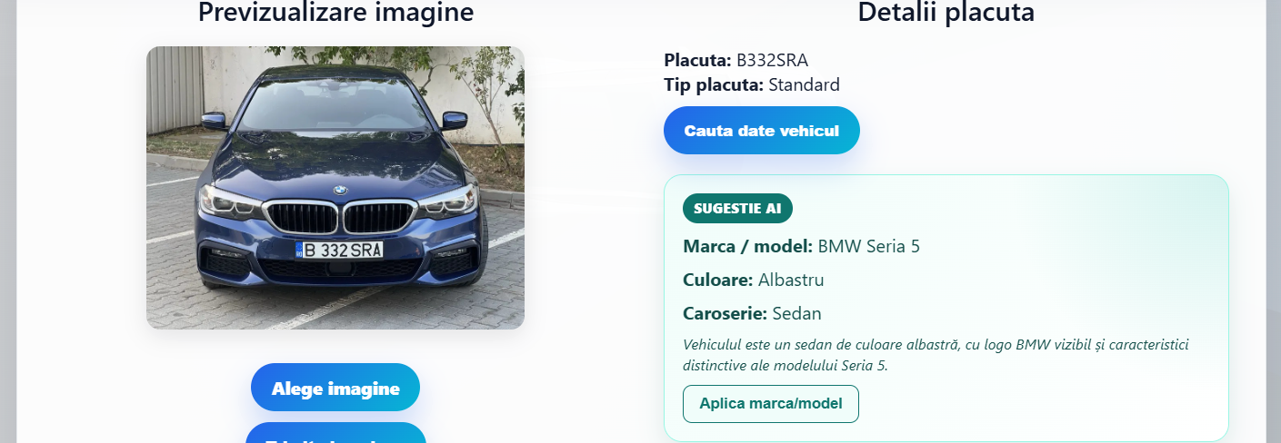
Image Recognition Workflow
The image workflow continues after ML inference.
1. ML candidate
Text, bounding box and confidence returned by the Python service.
2. Backend processing
Normalize, check and persist the recognition result.
3. Operational use
Detection appears in vehicle lookup, audit, review and reports.
ALPRo - Bachelor Thesis 2026
5

Slide 6
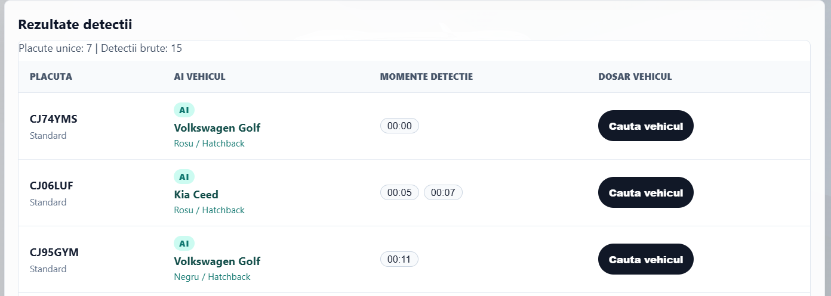
Video Recognition Workflow
The goal is compact plate-level results, not frame-by-frame OCR spam.
Long video input
Sampling + tracking
Unique results
Many frames, repeated vehicles and possible motion blur.
Process selected frames and group repeated appearances.
Plate strings, timestamps and representative visual context.
Reduces inference time compared with processing every frame
Avoids duplicate detections overwhelming the user
Keeps representative frames for vehicle attribute recognition
OpenAI analysis is applied only to selected images
ALPRo - Bachelor Thesis 2026
6

Slide 7
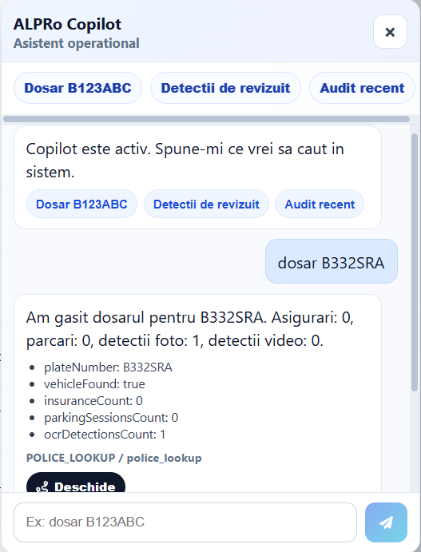
AI Assistance
Model helps interaction and context
Copilot
Natural language requests are mapped to predefined safe backend intents.
Vehicle attributes
Representative images can produce make, model, color and body type suggestions.
Model choice
gpt-4o-mini: strong small-model benchmark results, text + vision support, good cost/latency.
Integrated through API calls, prompt engineering and constrained outputs; not trained locally.
ALPRo - Bachelor Thesis 2026
7

Slide 8
Evaluation Results
Measured prototype behavior using the implemented backend workflows.
Metric
Result
Interpretation
Photo exact plate match
18/20 90.0%
correct normalized plate strings
Average image processing time
2.73 s/image
client-observed full backend request
Average video processing time
28.4 s/video
full asynchronous video workflow
Video recognition F1 score
82.4%
compact summary of video recognition behavior
Copilot correct responses
11/12 91.7%
controlled prompts mapped to intended actions
Average Copilot response time
2.13 s/prompt
client-observed request duration
Video plate strings are stored only after Romanian plate validation, text-stability checks and the configured 0.70 confidence threshold.
ALPRo - Bachelor Thesis 2026
8

Slide 9
Future Work
The strongest next step is better data, then stronger deployment conditions.
Dataset expansion
ML improvement
Camera streams
Larger Romanian image and video dataset with harder visual conditions.
Fine-tune or replace the local detector; improve OCR and frame selection.
Connect to parking entrances, exits or traffic-monitoring cameras.
Vehicle attributes
Production hardening
Complement AI suggestions with a local classifier if labeled data becomes available.
Add privacy controls, retention policies, encryption and institutional API integration.
ALPRo - Bachelor Thesis 2026
9

Slide 10
Conclusion
Recognition is only valuable when it becomes trustworthy workflow data.
Recognition is only the first step.
Workflow integration
Human and backend control
AI as assistance
The result becomes useful through vehicle cases, parking, insurance, audit and reports.
Backend rules and review workflows keep the system predictable.
AI improves navigation and context without replacing application logic.
ALPRo turns computer vision output into operational traffic-service software.
ALPRo - Bachelor Thesis 2026
10

