Slide 1
Language Translator
Sem: 6
Div: H
Term Project: Create an own language using YACC/FLEX for Scientific Calculator.
By,
Jiten Dhimmar(IT020)
Dhairya Shah(IT019)

Slide 2
Designing scanner for scientific calculator.
We have used Flex to perform lexical analysis on input string which should a valid mathematical expression. Flex is a lexical analyzer generator that takes in a set of description of possible tokens and produce a C file that performs lexical analysis and identifies Tokens.
Keywords: sin, cos, tan, sqrt, ln.
Identifiers: Identifiers are identified and added to the symbol table. The rule followed is represented by the regular expression [0-9]+[(0-9)*|[.0-9]+].

Slide 3
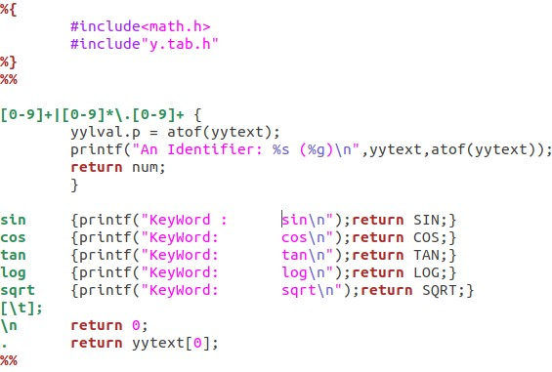
L-file

Slide 4
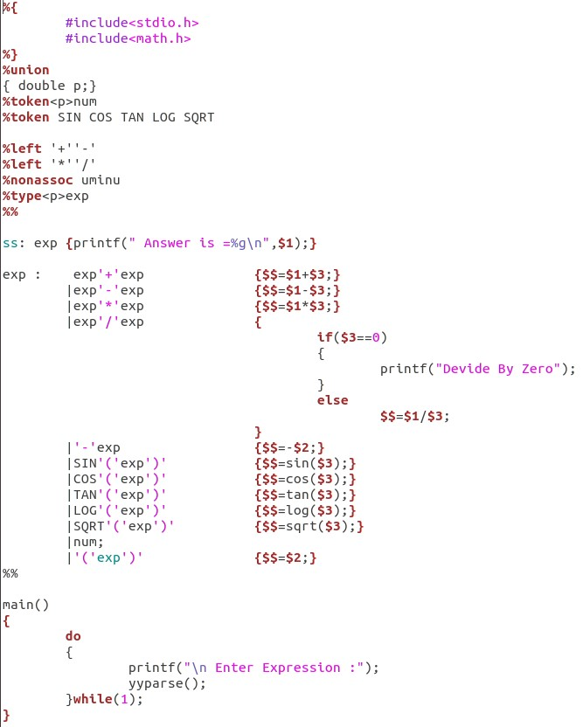
Y-file

Slide 5
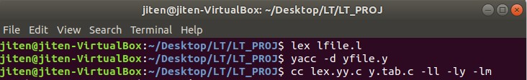
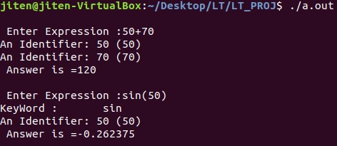
Output

