Slide 1
MATHEMATICS → MACHINE LEARNING
Linear & Logistic Regression — Mathematics from First Principles
A detailed teaching deck: arithmetic, algebra, functions, calculus, probability, derivations, worked examples, optimization, interpretation, and diagnostics.
Numbers → Equations → Loss → Optimization → Probability
1

Slide 2
Learning map
FOUNDATIONS
• Why regression exists
• Variables, constants, coordinates
• Functions and graphs
• Summation notation Σ
• Mean, variance, covariance
• Vectors and matrices
• Derivatives and gradients
• Linear regression derivation
• Least squares and MSE
• Probability, odds, log-odds
• Sigmoid and likelihood
• Cross-entropy and logistic optimization
2

Slide 3
1. Start with variables and equations
FOUNDATIONS
y = 2x + 3
Example
x=0 → y=3
x=1 → y=5
x=2 → y=7
• x is the input / independent variable.
• y is the output / dependent variable.
• 2 is the slope: y changes by 2 when x increases by 1.
• 3 is the intercept: predicted y when x = 0.
3

Slide 4
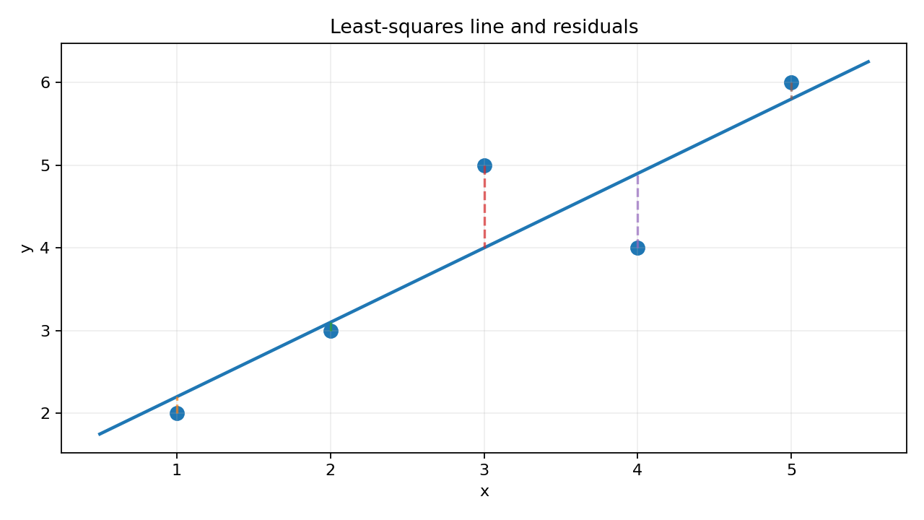
2. Coordinates and a straight line
FOUNDATIONS
A data point (x, y) is a coordinate.
Regression asks: can one mathematical function summarize the relationship among many observed points?
line: y = mx + c
4

Slide 5
3. Functions: input → transformation → output
FOUNDATIONS
f(x) = 2x + 3
f(4) = 2(4) + 3 = 11
• A function assigns an output to an input.
• Linear regression uses a linear function.
• Logistic regression composes a linear function with the sigmoid function.
5

Slide 6
4. Summation notation Σ
FOUNDATIONS
Σᵢ₌₁ⁿ xᵢ = x₁ + x₂ + ··· + xₙ
Example: x = [2, 4, 6, 8]
Σxᵢ = 2+4+6+8 = 20
Σxᵢ² = 4+16+36+64 = 120
• Σ lets us write dataset-wide calculations compactly.
• Regression loss functions sum errors over all observations.
6

Slide 7
5. Mean: the center of observed values
FOUNDATIONS
x̄ = (1/n) Σᵢ₌₁ⁿ xᵢ
For x = [1,2,3,4,5]:
x̄ = (1+2+3+4+5)/5 = 3
Why it matters
The closed-form slope compares how x and y move away from their means.
7

Slide 8
6. Variance: how spread out are values?
FOUNDATIONS
Var(x) = (1/n) Σ (xᵢ − x̄)²
• Deviation: xᵢ − x̄
• Square it so negative and positive deviations do not cancel.
• Average squared deviations to quantify spread.
• In sample statistics, 1/(n−1) is commonly used instead of 1/n.
8

Slide 9
7. Covariance: do x and y move together?
FOUNDATIONS
Cov(x,y) = (1/n) Σ (xᵢ−x̄)(yᵢ−ȳ)
• Positive covariance: x↑ tends to accompany y↑
• Negative covariance: x↑ tends to accompany y↓
• Near zero: no strong linear co-movement
• Covariance magnitude depends on units
9

Slide 10
8. Derivative: instantaneous rate of change
CALCULUS
f'(x) = limₕ→₀ [f(x+h) − f(x)] / h
If f(x)=x²:
(x+h)² = x²+2xh+h²
[(x+h)²−x²]/h = 2x+h
h→0 ⇒ f′(x)=2x
• Derivative tells us which direction increases a function.
• For minimizing loss, move in the opposite direction of the derivative.
10

Slide 11
9. Partial derivatives and the gradient
CALCULUS
∇J = [ ∂J/∂θ₀, ∂J/∂θ₁, …, ∂J/∂θₚ ]ᵀ
• A model has multiple parameters.
• A partial derivative changes one parameter while holding others fixed.
• The gradient packages all partial derivatives into one vector.
• −∇J points locally downhill.
11

Slide 12
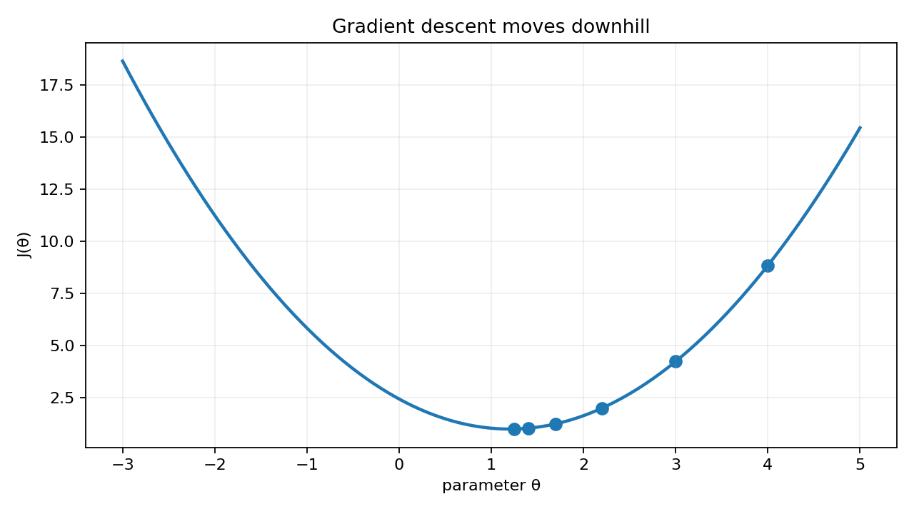
10. Gradient descent
OPTIMIZATION
θ ← θ − α ∇J(θ)
• θ: parameter(s)
• α: learning rate
• ∇J: slope of loss
• Repeat until convergence
12

Slide 13
11. Linear Regression: the model
LINEAR
ŷᵢ = β₀ + β₁xᵢ
• ŷ: model prediction
• β₀: intercept
• β₁: slope / coefficient
• x: feature
• y: observed target
• Residual eᵢ = yᵢ − ŷᵢ
13

Slide 14
12. What does “best line” mean?
LINEAR
For each observation:
eᵢ = yᵢ − ŷᵢ
• Positive residual: point is above the line.
• Negative residual: point is below the line.
• We need one objective measuring all residuals.
14

Slide 15
13. Why square the errors?
LINEAR
SSE = Σ (yᵢ − ŷᵢ)²
• Errors cannot cancel each other.
• Large mistakes receive a larger penalty.
• Squared error is differentiable, enabling calculus.
• Under Gaussian noise assumptions, minimizing squared error is also maximum likelihood estimation.
15

Slide 16
14. SSE, MSE, RMSE
LINEAR
SSE = Σeᵢ² MSE = (1/n)Σeᵢ² RMSE = √MSE
• SSE grows with dataset size.
• MSE is average squared error.
• RMSE returns to target units.
• All have the same minimizer for fixed n.
16

Slide 17
15. Deriving the intercept β₀
LINEAR
S(β₀,β₁)=Σ[yᵢ−(β₀+β₁xᵢ)]²
Differentiate with respect to β₀ and set to zero:
∂S/∂β₀ = −2Σ[yᵢ−β₀−β₁xᵢ] = 0
Σyᵢ = nβ₀ + β₁Σxᵢ
ȳ = β₀ + β₁x̄
β₀ = ȳ − β₁x̄
17

Slide 18
16. Deriving the slope β₁
LINEAR
Differentiate SSE with respect to β₁:
∂S/∂β₁ = −2Σ xᵢ[yᵢ−β₀−β₁xᵢ] = 0
Substitute β₀ = ȳ − β₁x̄ and rearrange. The centered form becomes:
β₁ = Σ(xᵢ−x̄)(yᵢ−ȳ) / Σ(xᵢ−x̄)²
18

Slide 19
17. The slope is covariance divided by variance
LINEAR
β₁ = Cov(x,y) / Var(x)
• Numerator: how x and y move together.
• Denominator: how much x itself varies.
• Therefore β₁ measures target change per unit feature change.
• Units of β₁ = units(y) / units(x).
19

Slide 20
18. Worked linear-regression example
LINEAR
Data: x=[1,2,3,4,5], y=[2,3,5,4,6]
x̄=3, ȳ=4
Σ(x−x̄)(y−ȳ)=9
Σ(x−x̄)²=10
β₁ = 9/10 = 0.9
β₀ = 4 − 0.9(3) = 1.3
ŷ = 1.3 + 0.9x
20

Slide 21
19. Predict and calculate a residual
LINEAR
For x=4: ŷ = 1.3 + 0.9(4) = 4.9
Observed y = 4
Predicted ŷ = 4.9
Residual e = y−ŷ = 4−4.9 = −0.9
Squared error = 0.81
Interpretation
The model over-predicted this observation by 0.9 target units.
21

Slide 22
20. Multiple Linear Regression
LINEAR
ŷ = β₀ + β₁x₁ + β₂x₂ + ··· + βₚxₚ
Example: house price
ŷ = β₀ + β₁(area) + β₂(bedrooms) + β₃(age)
• Each coefficient is interpreted while holding other included features constant.
• This is a conditional linear association, not automatically a causal effect.
22

Slide 23
21. Matrix form
LINEAR
ŷ = Xβ
X = design matrix (rows=observations, columns=features)
β = coefficient vector
y = target vector
β̂ = (XᵀX)⁻¹Xᵀy
Normal equation: closed-form OLS solution when the required inverse exists.
23

Slide 24
22. Where does the normal equation come from?
LINEAR
J(β) = (y−Xβ)ᵀ(y−Xβ)
Expand:
yᵀy − 2βᵀXᵀy + βᵀXᵀXβ
Differentiate:
∇J = −2Xᵀy + 2XᵀXβ
Set ∇J=0:
XᵀXβ = Xᵀy
β̂=(XᵀX)⁻¹Xᵀy
24

Slide 25
23. Linear regression assumptions
LINEAR
• Linearity of conditional mean
• Independent observations/errors
• No perfect multicollinearity
• Constant error variance (for classical inference)
• Normally distributed errors mainly for exact small-sample inference
• Correct model specification matters
Violations affect prediction and/or statistical inference differently; they do not all “invalidate” the model in the same way.
25

Slide 26
24. R²: variance explained relative to a mean-only baseline
LINEAR
R² = 1 − SSE / SST
• R²=1 means perfect in-sample fit.
• R²=0 means no improvement over predicting the sample mean.
• R² can be negative on new data or for some model setups.
• High R² does not prove causality or good generalization.
SSE = Σ(yᵢ−ŷᵢ)²
SST = Σ(yᵢ−ȳ)²
26

Slide 27
25. Why linear regression is unsuitable for binary probability
LOGISTIC
Binary target: y ∈ {0,1}
• A straight line can predict values below 0 or above 1.
• Probability must stay between 0 and 1.
• Binary outcomes have non-constant conditional variance p(1−p).
• We need a nonlinear mapping from a linear score to probability.
27

Slide 28
26. Probability basics
LOGISTIC
0 ≤ P(A) ≤ 1
• p=0 → impossible
• p=0.5 → even chance
• p=1 → certain
• For binary y: P(y=1)=p
• P(y=0)=1−p
• Expected value E[y]=p
28

Slide 29
27. Odds: probability expressed as a ratio
LOGISTIC
odds = p / (1−p)
p=0.5 → odds=0.5/0.5=1
p=0.8 → odds=0.8/0.2=4
p=0.2 → odds=0.2/0.8=0.25
Odds of 4 means the event is four times as likely as the non-event in odds terms.
29

Slide 30
28. Log-odds (logit)
LOGISTIC
logit(p) = ln[p/(1−p)]
• Odds range: 0 to ∞.
• Log-odds range: −∞ to +∞.
• That matches the unrestricted output range of a linear predictor.
ln[p/(1−p)] = β₀ + β₁x
30

Slide 31
29. Derive the sigmoid from log-odds
LOGISTIC
Start:
ln[p/(1−p)] = z
Exponentiate both sides:
p/(1−p)=eᶻ
p=eᶻ(1−p)
p=eᶻ−peᶻ
p(1+eᶻ)=eᶻ
p = eᶻ/(1+eᶻ) = 1/(1+e⁻ᶻ)
31

Slide 32
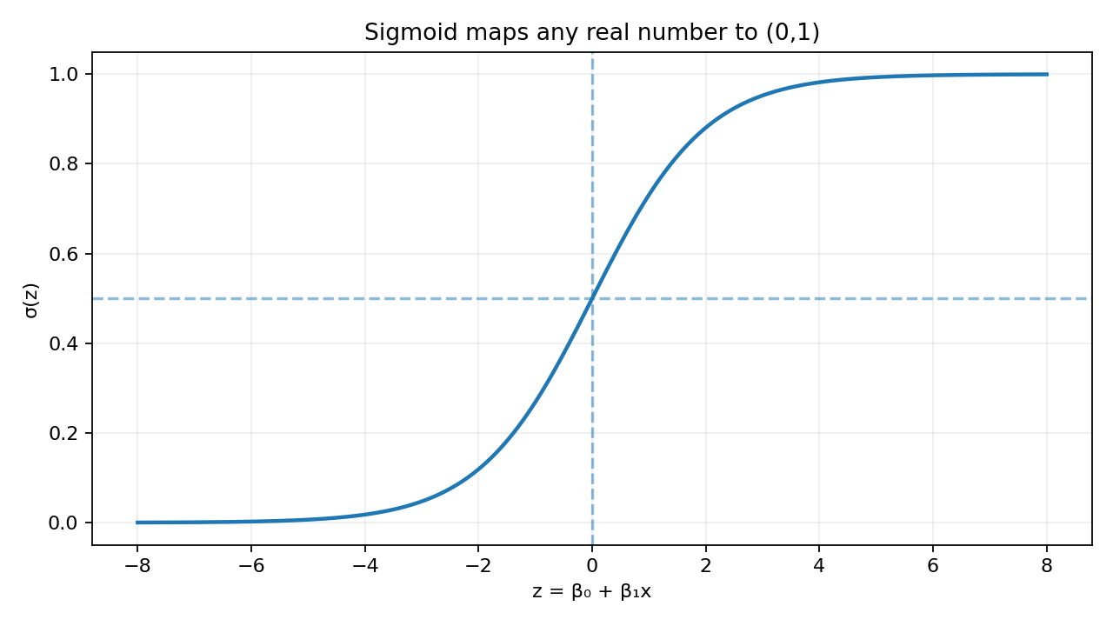
30. Sigmoid function
LOGISTIC
σ(z) = 1 / (1 + e⁻ᶻ)
• z→−∞ ⇒ σ(z)→0
• z=0 ⇒ σ(z)=0.5
• z→+∞ ⇒ σ(z)→1
32

Slide 33
31. What does e mean?
LOGISTIC
e ≈ 2.718281828…
• e is the natural exponential base.
• eˣ is its own derivative: d(eˣ)/dx = eˣ.
• ln(x) is the inverse of eˣ.
• This derivative structure makes exponential-family probability models mathematically convenient.
33

Slide 34
32. Logistic model
LOGISTIC
pᵢ = P(yᵢ=1|xᵢ) = σ(β₀ + β₁xᵢ)
Linear score: z = β₀+β₁x
Probability: p = σ(z)
Decision (optional): predict class 1 if p ≥ threshold
Important
The model itself estimates a probability. The classification threshold is a separate decision rule.
34

Slide 35
33. A numerical sigmoid calculation
LOGISTIC
z = −1 + 0.8(3) = 1.4
p = 1/(1+e⁻¹·⁴)
e⁻¹·⁴ ≈ 0.2466
p ≈ 1/1.2466
p ≈ 0.802
Interpretation
For x=3, the model assigns about an 80.2% probability to y=1.
35

Slide 36
34. Bernoulli probability model
LOGISTIC
P(y|p) = pʸ(1−p)¹⁻ʸ
• If y=1: p¹(1−p)⁰ = p
• Correct positive predictions should have p near 1.
• If y=0: p⁰(1−p)¹ = 1−p
• Correct negative predictions should have p near 0.
36

Slide 37
35. Likelihood over the whole dataset
LOGISTIC
L(β) = Πᵢ pᵢʸⁱ (1−pᵢ)¹⁻ʸⁱ
• Assuming observations are conditionally independent, multiply their probabilities.
• Choose β that makes the observed labels collectively most probable.
• Products of many probabilities become numerically tiny, so we take logs.
37

Slide 38
36. Log-likelihood
LOGISTIC
ℓ(β) = Σ [ yᵢ ln(pᵢ) + (1−yᵢ) ln(1−pᵢ) ]
• log converts products into sums.
• ln is monotonic: maximizing L is equivalent to maximizing ln L.
• Optimization libraries commonly minimize, so negate log-likelihood.
38

Slide 39
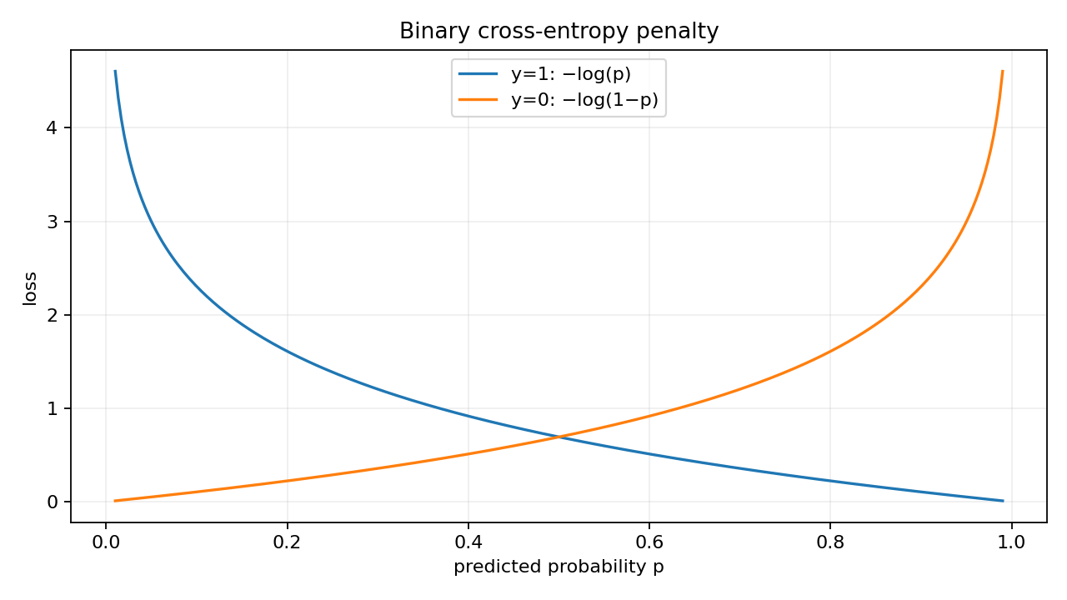
37. Binary cross-entropy / log loss
LOGISTIC
J = −(1/n)Σ[y ln p + (1−y)ln(1−p)]
• Confident correct prediction → small loss.
• Confident wrong prediction → very large loss.
• This is negative average Bernoulli log-likelihood.
39

Slide 40
38. Why not MSE for logistic regression?
LOGISTIC
• MSE can be used mathematically, but it is not the canonical likelihood-based objective for Bernoulli outcomes.
• With sigmoid, MSE can produce less convenient optimization geometry.
• Cross-entropy follows directly from Bernoulli maximum likelihood.
• Its gradient simplifies elegantly to prediction error times feature.
40

Slide 41
39. Sigmoid derivative — step by step
LOGISTIC
σ(z) = (1+e⁻ᶻ)⁻¹
dσ/dz = −(1+e⁻ᶻ)⁻² · (−e⁻ᶻ)
= e⁻ᶻ/(1+e⁻ᶻ)²
σ(z)[1−σ(z)]
= 1/(1+e⁻ᶻ) · e⁻ᶻ/(1+e⁻ᶻ)
= e⁻ᶻ/(1+e⁻ᶻ)²
σ′(z)=σ(z)[1−σ(z)]
41

Slide 42
40. Gradient of logistic loss
LOGISTIC
∇J(β) = (1/n) Xᵀ(p − y)
• p is the vector of predicted probabilities.
• p−y is the prediction error in probability space.
• Xᵀ aggregates feature-weighted errors.
• Gradient descent: β ← β − α(1/n)Xᵀ(p−y).
42

Slide 43
41. Coefficient interpretation: odds ratios
LOGISTIC
log-odds = β₀ + β₁x
odds(x+1) / odds(x) = eᵝ¹
If β₁ = 0.7:
e⁰·⁷ ≈ 2.01
A one-unit increase in x multiplies the odds by about 2.01, holding other model features fixed.
43

Slide 44
42. Probability change is not constant
LOGISTIC
• In linear regression, β₁ is a constant change in predicted y per unit x.
• In logistic regression, β₁ is a constant change in log-odds per unit x.
• The probability change depends on the current probability because sigmoid is nonlinear.
∂p/∂xⱼ = βⱼ · p(1−p)
44

Slide 45
43. Classification threshold and confusion matrix
LOGISTIC
ŷclass = 1 if p ≥ t, otherwise 0
• TP: predicted 1, actual 1
• FP: predicted 1, actual 0
• TN: predicted 0, actual 0
• FN: predicted 0, actual 1
Threshold t is a decision parameter; 0.5 is common but not universally optimal.
45

Slide 46
44. Precision, recall, specificity, accuracy
LOGISTIC
Precision=TP/(TP+FP) Recall=TP/(TP+FN)
Specificity=TN/(TN+FP) Accuracy=(TP+TN)/N
• Metric choice depends on the cost of false positives and false negatives.
• For imbalanced data, accuracy alone can be misleading.
46

Slide 47
45. Regularization
BOTH
L2: Jregularized = J + λ Σ βⱼ²
L1: Jregularized = J + λ Σ |βⱼ|
• λ controls the strength of the penalty.
• L2 shrinks coefficients smoothly.
• L1 can drive some coefficients exactly to zero.
• Feature scaling matters when penalties compare coefficient magnitudes.
47

Slide 48
46. Linear vs Logistic Regression — mathematical comparison
SUMMARY
LINEAR REGRESSION
LOGISTIC REGRESSION
• Target: continuous y
• Model: ŷ=Xβ
• Objective: squared error
• Closed-form OLS may exist
• Coefficient: change in predicted y
• Target: binary y∈{0,1}
• Model: p=σ(Xβ)
• Objective: negative log-likelihood
• Usually iterative optimization
• Coefficient: change in log-odds
48

Slide 49
47. One mental model for both
SUMMARY
features x → linear score z=Xβ → output mapping → loss → optimize β
• Linear: output mapping is identity.
• Prediction can be any real value.
• Loss commonly squared error.
• Logistic: output mapping is sigmoid.
• Prediction is probability in (0,1).
• Loss is Bernoulli cross-entropy.
49

Slide 50
48. End-to-end checklist
SUMMARY
• Understand variables and functions
• Compute mean/variance/covariance
• Understand derivatives and gradients
• Derive OLS slope/intercept
• Use matrix notation for many features
• Understand probability and odds
• Transform odds with logarithm
• Derive sigmoid from log-odds
• Derive cross-entropy from likelihood
• Optimize and interpret coefficients
50

Slide 51
49. Practice problems
PRACTICE
• Fit a line manually to x=[1,2,3], y=[2,4,5]: compute x̄, ȳ, β₁, β₀.
• For ŷ=1+2x, compute residuals and MSE for three observations.
• Convert p=0.75 to odds and log-odds.
• Evaluate σ(z) for z=−2, 0, 2.
• For y=1 and p=0.9 vs p=0.1, compare log loss.
• If logistic β₁=0.4, compute the odds ratio e⁰·⁴.
51

Slide 52
50. Key equations to remember
SUMMARY
Linear Regression
Logistic Regression
ŷ=β₀+β₁x
p=1/(1+e⁻ᶻ), z=Xβ
β₁=Σ(x−x̄)(y−ȳ)/Σ(x−x̄)²
J=−(1/n)Σ[ylnp+(1−y)ln(1−p)]
β₀=ȳ−β₁x̄
∇J=(1/n)Xᵀ(p−y)
Understand the derivation; then the formulas become easy to remember.
52

