Slide 1
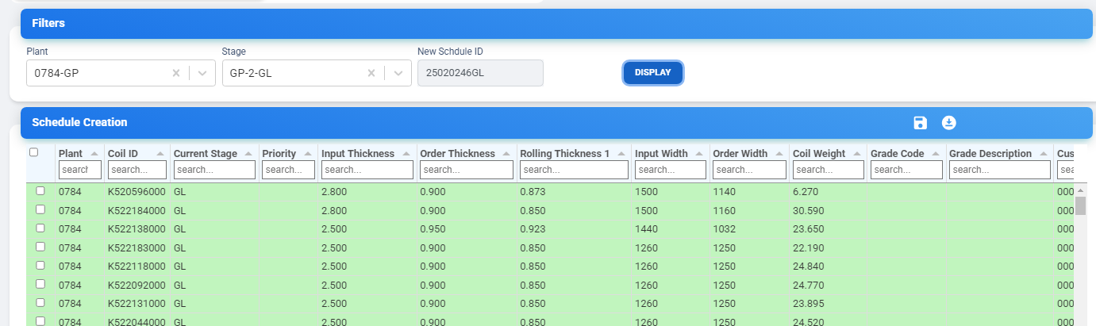
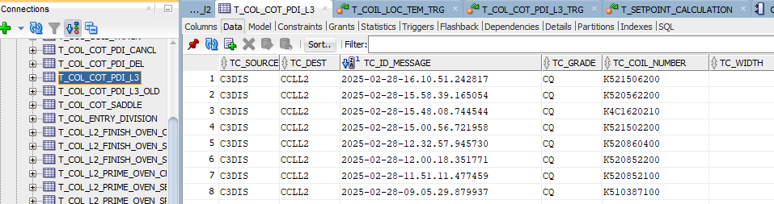
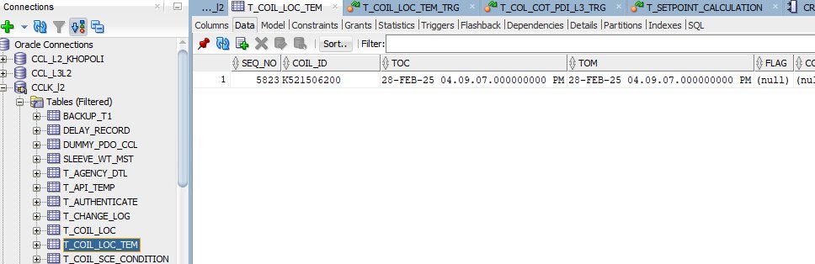
MES _Application
When new coil will be scheduled through MES, it will insert into PDI table of level 2
On uncoiler signal coil_Id will insert into T_COIL_LOG
T_COIL_LOC_TEM
T_COL_COT_PDI_L3
By trigger on PDI table coil_id will insert into T_COIL_LOC_TEM Table
T_COIL_LOC

Slide 2

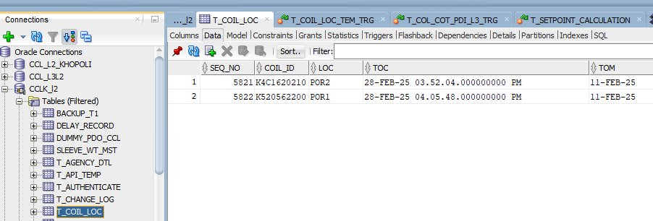
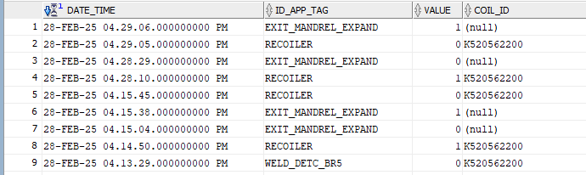
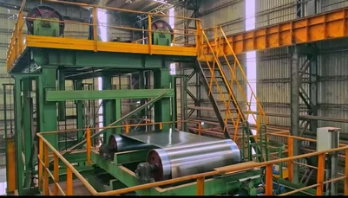
As each Coil_Id will be scheduled from MES, then sequence no. By increasing 1 , New row into T_Temp_Loc_Temp will be inserted.
NOTE
T_COIL_LOC_TEM
On every Uncoiler(POR1/POR2) selection Coil_Id and with minimum No. of SEQ_No. data(Seq_No.,Coil_Id) will be updated as Loc(POR) selection into T_COIL_LOC Table and deleted from T_COIL_LOC_TEM table.
Coiler 1
Coiler 2
Signal(POR1)
Signal(POR2)
T_COIL_LOC
JOIN crosses from tag, it gives a signal ,Then Tag name with having minimum no. of Seq_No. ,the Coil_ID is inserted into T_EVENT_LOC Table.
T_EVENT_LOG

Slide 3
T_EVENT_LOG

Slide 4
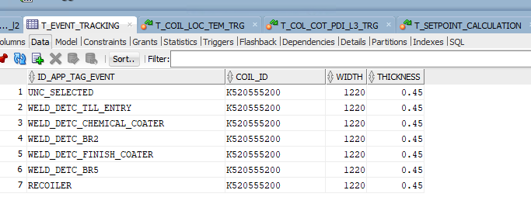
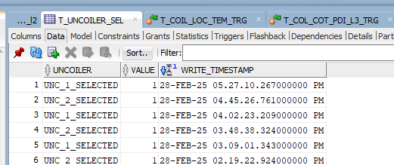
T_EVENT_TRACKING
T_COIL_LOC_TEM

Slide 5
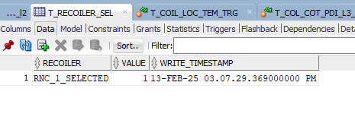
T_COIL_LOC

Slide 6
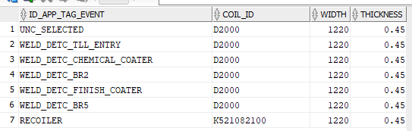
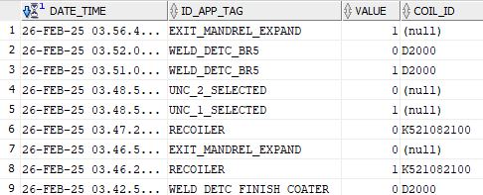
SEQUENCE
What will happen if signal will not come
CoilId ,Timestamp will insert
T_Uncoiler_sel
SHEDULE
If ok
T_COL_COT_PDI_L3
Uncoiler/(Por selection)
By trigger in PDI table
T_Coil_Loc_Temp
WELD_DETC_TLL_ENTRY
On uncoiler selection
T_Coil_Loc
WELD_DETC_CHEMICAL_COATER
T_EVENT_TRACKING
WELD_DETC_BR2
T_EVENT_LOG
WELD_DETC_FINISH_CO
What is reason to not inserting data into PDO table
On every recoiler signal new doughter will generate of mother coil it shold be available on PDI table
ATER WELD_DETC_BR5
T_COL_COIL_INFO_PDO
RECOILER

Slide 7
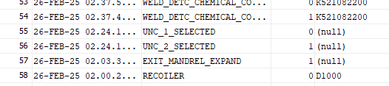
What will happen if Por not selected and uncoiler will start
When we need to add dummy coil ?
If uncoiler selection signal is missing then in t_coil_loc coil id wont get updated from t_coil_loc_tem and not in t_event_tracking so multiple parts of previous coil will be generated.
SHEDULE(Por selection)
I am getting 3 different data coilId,null value,Dummycoil ?
Explain 0 and 1 data at value location
T_EVENT_LOG

Slide 8
Case 1: No coil is available in t_coil_loc_tem(no coil is scheduled) in that case if uncoiler selected then if signal is from Uncoiler1 the D1000 will be updated to unc_selected position in T_EVENT TRACKING but no daughter batch will be generated but can be seen in t_event log.
Case 2: Initially 4 coils were scheduled with sequence no 10, 11, 12, 13 .two of them processed and now 2 coils 12, 13 are available in t_coil_loc_tem then user need to click on create dummy button with por selection in PDI page. This will update the t_coil_loc_tem with D1000 or D2000 With new seq no(min(seq_no_-1=11).

Slide 9
Process of Scheduling the Coil MIS Report
Select Coil History - - Enter Coil ID & find IEO (Details of Coil)
Copy Coil & read SoNo (IEO) Go to planning & scheduling in MES Select Level 2 Scheduling a) Select plant (UPSC 0784 GP) b) Stage (GP2-GI) [Display] Paste Coil ID & verify SoNo (IEO)
Select checkbox & Save data Mill Operation In Mill → Line Scheduling ---Here is the text as written in the image: --- Select plant & stage type Confirm scheduling & display Search & select Coil & check So & Save Confirm Scheduling --
- Discuss 1. What will happen if you do not select POR User
problem _--Before cutting the Coil, PDO is generating & displaying a sticker So, how are we displaying weight in the sticker?

