Slide 1
Lending Club Case Study
Group Facilitator: Jitendra Dua

Slide 2
PROBLEM STATEMENT
The business problem is related to a consumer finance company which specialises in lending various types of loans to urban customers. When the company receives a loan application, the company has to make a decision for loan approval based on the applicant’s profile. Two types of risks are associated with the bank’s decision:
If the applicant is likely to repay the loan, then not approving the loan results in a loss of business to the company.
If the applicant is not likely to repay the loan, i.e. he/she is likely to default, then approving the loan may lead to a financial loss for the company.
The data which is provided gives information about past loan applicants and whether they ‘defaulted’ or not. The aim is to identify patterns which indicate if a person is likely to default, which may be used for taking actions such as denying the loan, reducing the amount of loan, lending (to risky applicants) at a higher interest rate, etc.

Slide 3
Business Objective:
The objective is to identify the risky loan applicants, then such loans can be reduced thereby cutting down the amount of credit loss. Identification of such applicants using EDA is the aim of this case study.
In other words, the company wants to understand the driving factors (or driver variables) behind loan default, i.e. the variables which are strong indicators of default. The company can utilise this knowledge for its portfolio and risk assessment.
The company wants to understand the driving factors (or driver variables) behind loan default, i.e. the variables which are strong indicators of default. The company can utilise this knowledge for its portfolio and risk assessment.

Slide 4
Important results and charts

Slide 5
Bivariate Analysis of various variables
Loan Status Number of Employment Years
Charged Off 4.98
Current 5.92
Fully Paid 4.91
Loan Status Number of Employment Years
Charged Off 335.81
Current 395.25
Fully Paid 319.92
Term Loan_status Number of records
36 months Charged Off 3221
Fully Paid 25823
60 months Charged Off 2395
Current 1139
Fully Paid 7067

Slide 6
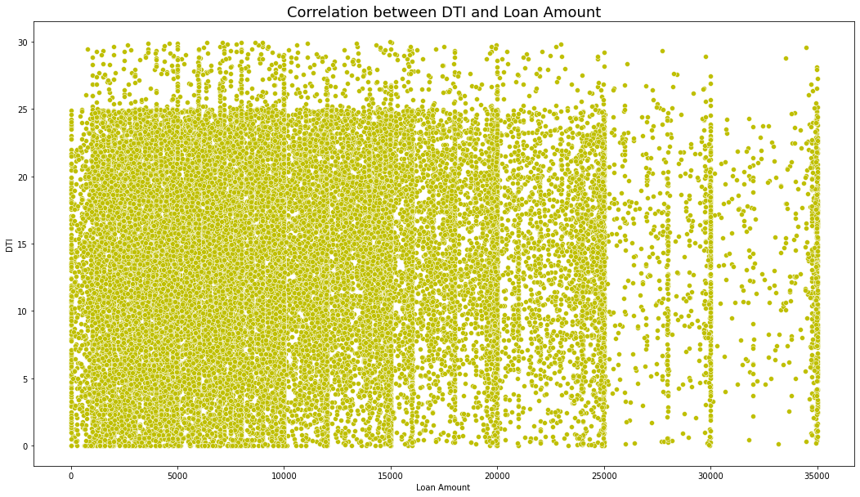

Slide 7
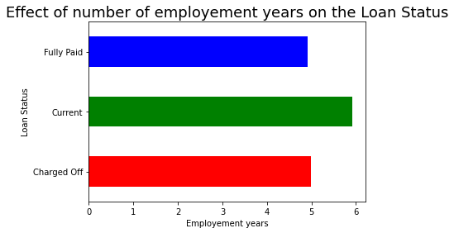
The given Bar Chart depicts the relationship between the average number of Employment Years and Loan Status.

Slide 8
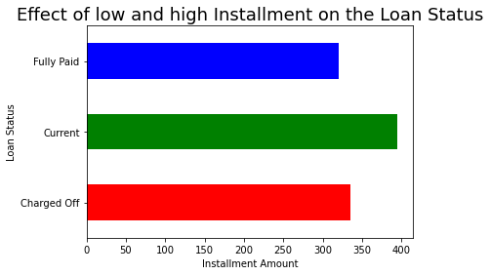
The given Bar Chart depicts the relationship between the average Installment amount and Loan Status.
Analysis: A greater Installment Amount may result into higher chances of default.

Slide 9
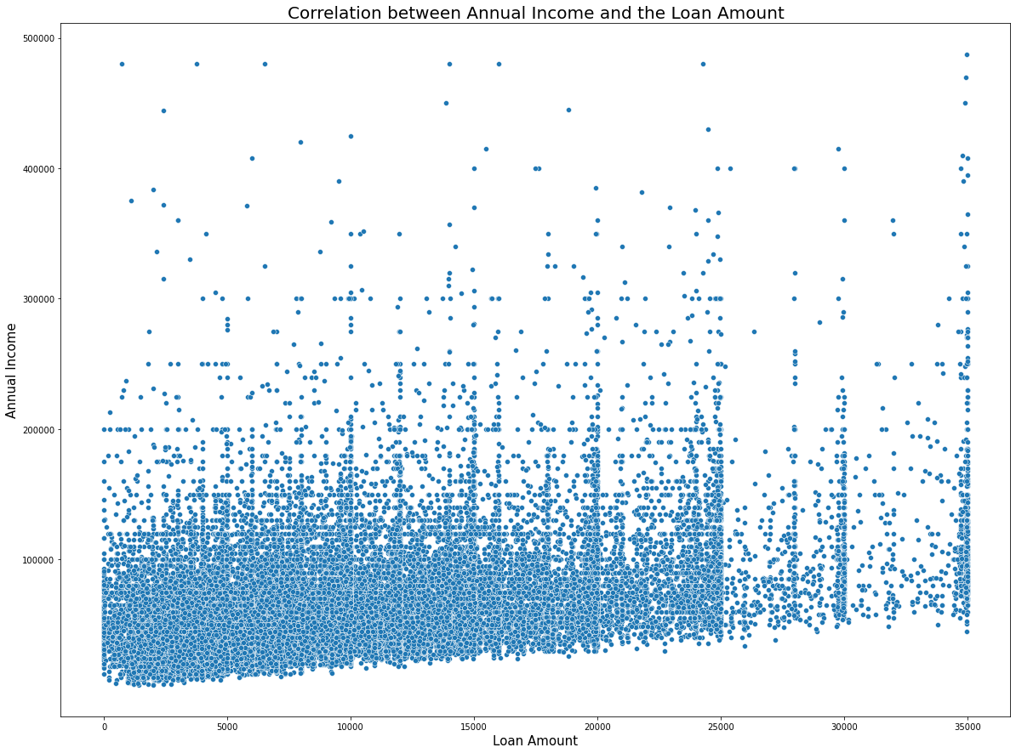
Correlation between Annual Income and Loan Amount
The given Scatter chart depicts an increase the Loan Amount as per the Annual Income of the Customer,

Slide 10
Recommendations
Loan should be approved in the following situations
Loan should be Considered and carefully verified in the following situations
Annual Income of the Customer is high
DTI (Debt To Income) ratio is low
DTI (Debt To Income) ratio is low
Low Annual Income
Number of employment years are lesser

