Slide 1
CLOUD GOVERNANCE
Azure Policy Governance
for Resource Tagging & Regions
P
A governance architecture for controlling resource locations, enforcing CostCenter metadata, and remediating non-compliance.
T
Our Team:
R
2400030143-Jitendra.D
2400030209-Sudhendra Sivanadh.Y
2400030219-Chanakya.P
24002086-Harshitha.V
POLICY • TAGS • REGIONS

Slide 2
01 • PROBLEM
02
What problem are we solving?
01 Region control
02 CostCenter control
03 Governance gap
Resources must be created only in approved Azure regions.
A deployment outside the approved list should be blocked at deployment time.
Resources should carry a valid CostCenter tag so ownership and cloud spend can be associated with the right project or department.
Existing resources may already be non-compliant, and strict controls can create friction for legitimate urgent deployments.
The project therefore needs both • prevention • visibility • remediation • controlled exceptions
Azure Policy Governance • Review Presentation
KL University

Slide 3
02 • FOUNDATION
03
Azure Policy in one picture
1
2
3
4
5
Policy
Definition
Assignment
Evaluation
Effect
Compliance
Definition
Assignment
Effect
The rule: IF a resource matches a condition, apply an effect.
Attach the rule to a management group, subscription, resource group or resource.
Examples: Deny, Audit, Modify, DeployIfNotExists.
Azure Policy Governance • Review Presentation
KL University

Slide 4
03 • USE CASE 01
04
Deny resource creation outside approved regions
Business rule
“Only approved Azure regions may host governed resources.”
Developer request
Azure Policy
VM → Japan East
Check location
• Create a parameterized list of approved locations.
• Evaluate the resource location during deployment.
• If the location is not approved → Deny the request.
• If the location is approved → deployment can continue.
NOT APPROVED → DENY
Deployment is blocked
Approved
Result
Deployment proceeds
No unauthorized region
Azure Policy Governance • Review Presentation
KL University

Slide 5
USE CASE 02
05
Enforce a CostCenter tag
Why tagging matters
Turn resource metadata into usable cost & ownership information.
Resource
VM • Central India • Environment=Prod
• Required tag: CostCenter
• Example values: CSE001, FIN001, HR001
• Choose the enforcement method based on how the correct value is known.
• Modify is suitable when a trusted source can supply the value.
• Deny is suitable when the creator must provide a valid value.
Policy evaluation
Is CostCenter present and valid?
MODIFY
DENY
Add / update tag
Reject invalid request
Azure Policy Governance • Review Presentation
KL University

Slide 6
GOVERNANCE
06
The two bottlenecks
01
Strict Deny can block a legitimate urgent deployment
Why: Strict Deny policies can block legitimate emergency deployments in unapproved regions.
Problems
Required region may not be approved.
Deployment gets rejected.
Business operations may be delayed.
Emergency exception may be required.
Example
A company allows East US and Central India.
During an emergency, a VM is needed in West Europe → Policy denies the deployment.
Key Point
Provide a controlled exception process for genuine emergencies.
Azure Policy Governance • Review Presentation
KL University

Slide 7
GOVERNANCE
02
Existing resources can remain non-compliant
Why: Resources created before the policy may already be missing required tags or configurations.
Problems caused
Older resources may not have required tags.
Resources may exist in non-approved configurations.
Administrators must identify which resources are non-compliant.
Manually fixing hundreds of resources is time-consuming.
Non-compliant resources can continue to create governance and cost-management issues.
Small real-life example
Example:
A company already has 100 Azure VMs before introducing the CostCenter policy.
After the policy is assigned, 20 VMs are found without a CostCenter tag.
These 20 resources are reported as Non-Compliant and need to be corrected.
Key takeaway
Governance must not only prevent future violations; it must also provide a way to identify and remediate existing non-compliant resources.

Slide 8
06 • RESPONSE
07
How we overcome the bottlenecks
Controlled exemption
Audit before Deny
Emergency deployment → documented reason → approval → temporary exemption → review/expiry
Test policy impact first; identify false positives and legitimate exceptions before enforcing the hard block.
Modify + remediation
Parameters
Use Modify when a reliable CostCenter source exists, then remediate existing non-compliant resources.
Keep approved regions, tag name, and allowed values configurable rather than hard-coded.
Azure Policy Governance • Review Presentation
KL University

Slide 9
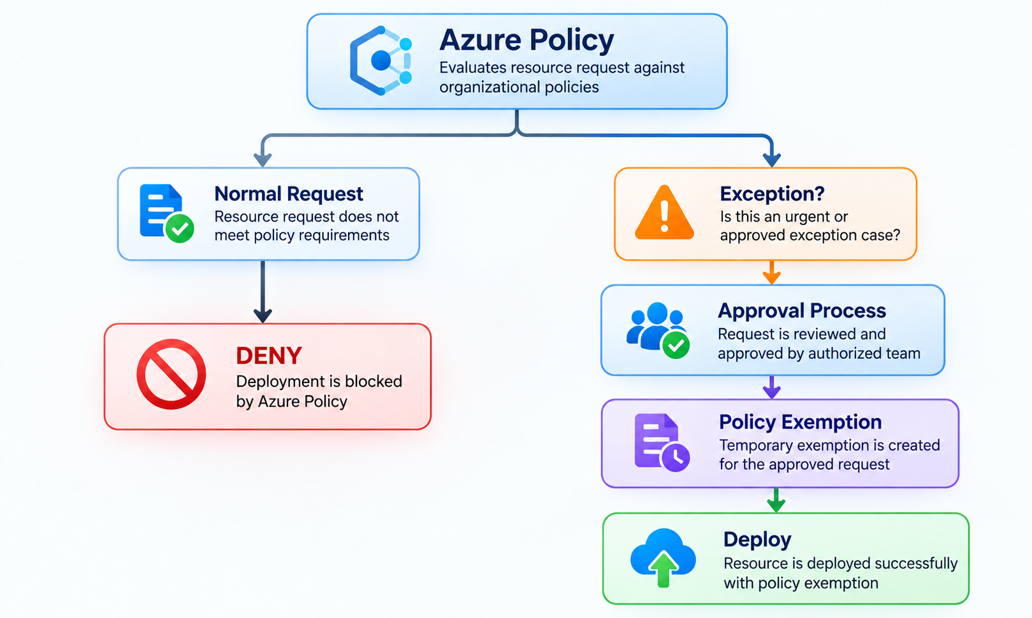
Solution — Controlled exception
Architecture:
This allows governance without making governance completely inflexible.

Slide 10

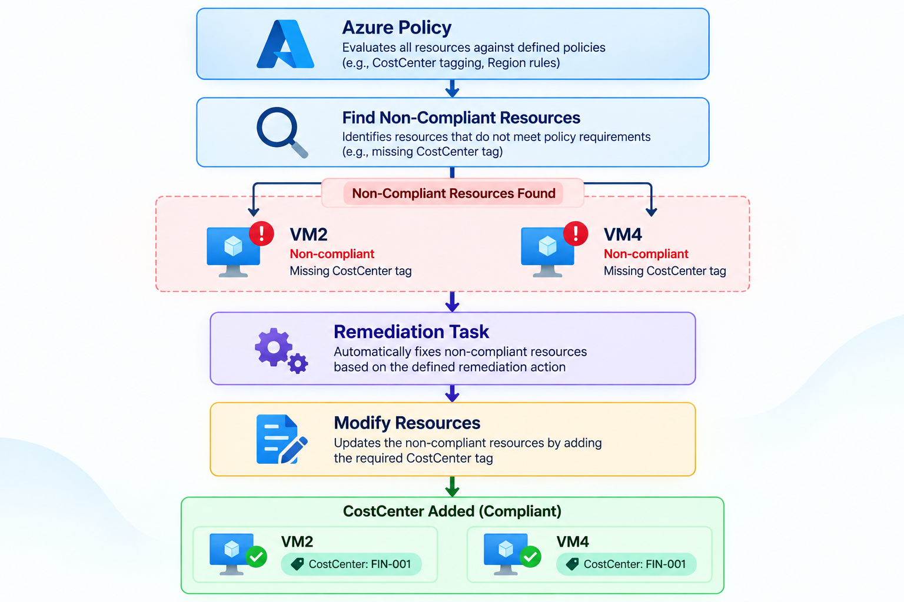
Remediation
Azure Policy supports remediation tasks for existing resources for policies using effects such as Modify and DeployIfNotExists.
Microsoft documents that remediation tasks use the managed identity associated with the policy assignment to make the required changes.

Slide 11
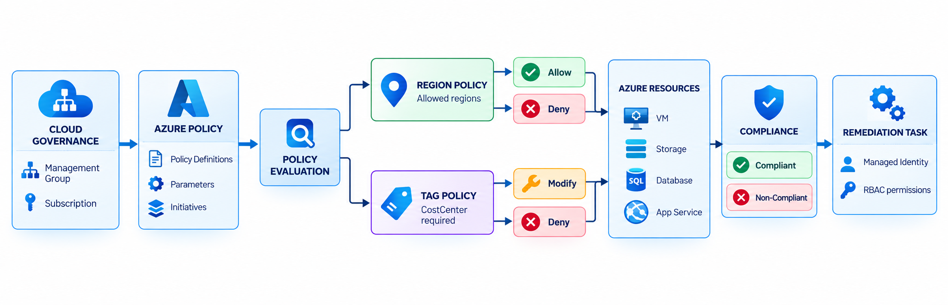
Architectural Design for Our Project:

Slide 12
07 • ARCHITECTURE
08
Proposed Azure Policy governance architecture
Developer / CI-CD
Azure Resource Manager
Azure Policy
Policy Effects
Azure
Deployment request
Create / update
Evaluate rules
Deny / Modify / Audit
Resources
Governance scope
Compliance
Remediation
Operations
Management Group / Subscription / Resource Group
Compliant / Non-compliant resources
Managed Identity + RBAC permissions
Admin review
Core request path
1
Request
2
Evaluate
3
Enforce
4
Govern
Azure Policy Governance • Review Presentation
KL University

Slide 13
08 • ARCHITECTURE
09
What each component actually does
1
Developer / CI-CD
Initiates the deployment request through portal, CLI, IaC or pipeline.
2
Azure Resource Manager
Receives the resource deployment/update request.
3
Azure Policy
Evaluates resource properties against assigned definitions.
4
Policy Effect
Decides the action: allow, deny, audit, modify or deploy supporting configuration.
5
Compliance
Records the governance state so administrators can see violations.
6
Remediation
Corrects applicable existing violations using the policy assignment identity and permissions.
Azure Policy Governance • Review Presentation
KL University

Slide 14
09 • POLICY DESIGN
10
Conceptual policy logic
POLICY A / ALLOWED LOCATIONS
POLICY B / COSTCENTER
IF
resource.location
NOT IN allowedLocations
THEN
effect = Deny
Parameter
allowedLocations = [approved regions]
IF
CostCenter is missing
OR value is invalid
THEN
Modify → trusted value
OR
Deny → require valid value
Parameter
tagName = CostCenter
PARAMETERIZED • REUSABLE
Azure Policy Governance • Review Presentation
KL University

Slide 15
10 • END-TO-END
11
How the solution behaves in practice
01
02
03
04
05
Request
Evaluate
Enforce
Comply
Remediate
Developer creates or updates a resource.
Azure Policy checks location and CostCenter.
Deny blocks invalid requests; Modify corrects supported properties.
Resource appears as compliant when requirements are satisfied.
Existing violations are fixed through supported remediation tasks.
Key design principle
Prevent new violations where possible; make existing violations visible and fixable; keep legitimate exceptions controlled and auditable.
Azure Policy Governance • Review Presentation
KL University

Slide 16
11 • IMPLEMENTATION
12
Suggested implementation plan
PHASE 1
Define
PHASE 2
Build
PHASE 3
Test
Approved regions • CostCenter format • exception process
Create policies • parameters • initiative • assignments
Audit mode • test resources • inspect false positives
PHASE 4
Enforce
PHASE 5
Remediate
PHASE 6
Operate
Move appropriate controls to Deny / Modify
Identify existing violations • run remediation
Compliance review • exception review • policy change control
Azure Policy Governance • Review Presentation
KL University

Slide 17
14 • OUTCOME
15
What the project delivers
Prevent
Standardize
Visualize
Unauthorized regions are blocked before deployment.
CostCenter metadata follows a defined governance rule.
Compliance state is visible to administrators.
Remediate
Govern
Scale
Applicable existing violations can be corrected.
Exceptions become controlled, documented and reviewable.
The same governance model can be applied across scopes.
Prevent → Detect → Remediate → Govern at scale
Azure Policy Governance • Review Presentation
KL University

Slide 18
15 • CLOSING
16
One-line project summary
“Govern Azure resources by policy —
not by manual inspection.”
Control regions • enforce CostCenter • expose compliance • remediate violations • manage exceptions
AZURE POLICY GOVERNANCE
Thank you
Azure Policy Governance • Review Presentation
KL University

