Slide 1

DATA ANALYTICS CAPSTONE PROJECT
UPI Transaction
Analytics
Business Understanding, KPI Framework & Analytical Hypotheses for a Digital Payments Platform
100,000
₹42.4L+
2.0%
5.87%
Transactions
Value Processed
Fraud Flagged
Failure Rate
Prepared by Jitendra Kumar

Slide 2
ROADMAP
What We'll Cover
01
Data Foundation
The 7-table UPI transaction schema behind this analysis
02
Business Challenges
Where digital payment platforms feel the most pain
03
Analytical Goals & KPIs
The BI framework this project is built to serve
04
Data Quality Assurance
How the dataset was validated before analysis
05
Hypotheses & Statistical Testing
What we suspected, and what the data confirmed
06
Dashboard Preview & Next Steps
Turning insight into an ongoing BI product
02 / 12

Slide 3
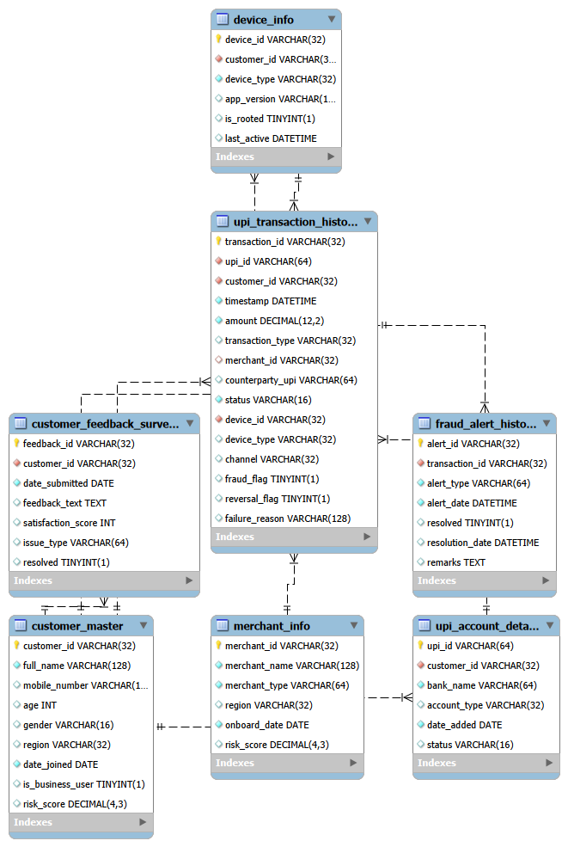
THE FOUNDATION
A Seven-Table Transaction Schema
Customer, merchant, device and account records feed a central transaction fact table, which in turn drives fraud alerts and customer feedback — a 360° view of every UPI payment.
DATASET SCALE
10,000
500
Customers
Merchants
12,000
12,000
Devices
UPI Accounts
100,000
2,000
Transactions
Fraud Alerts
4,000
Feedback Records
03 / 12

Slide 4
BUSINESS CONTEXT
Challenges Facing the UPI Platform
01
02
Fraud Risk
Transaction Failures
2% of transactions are already flagged — exposure grows with scale and device sophistication.
5.87% of transactions fail, spread evenly across PIN, network, bank and account causes.
03
04
Customer Retention
Merchant Engagement
4,000+ feedback records signal where satisfaction — and churn risk — concentrates.
500 merchants vary widely in volume; activity concentrates in a small top tier.
05
06
Device & Channel Risk
Regulatory Compliance
12,000 devices across Android/iOS and multiple channels carry uneven risk.
Accurate fraud logs and audit-ready data are essential for RBI/NPCI reporting.
04 / 12

Slide 5





BI PERSPECTIVE
Analytical Goals
Real-Time Visibility
Give stakeholders a live read on transaction volume, value and success rate.
Proactive Fraud Detection
Surface fraud patterns by device, channel and merchant before losses scale.
Root-Cause Diagnosis
Break down failed transactions by reason, hour and device to guide fixes.
Customer & Merchant Segmentation
Identify high-value, high-risk and at-risk segments for targeted action.
Compliance-Ready Reporting
Maintain a validated, audit-ready data layer for regulatory reporting.
05 / 12

Slide 6






BI FRAMEWORK
Core KPIs — Current Baseline
Transaction Volume
100,000
Value Processed
₹42.4L+
Active Merchants
500
Failure Rate
5.87%
Fraud Flag Rate
2.0%
Devices Tracked
12,000
06 / 12

Slide 7
DATA PREPARATION
Built on a Validated Dataset
Before analysis, every table passed a structured QA pass — format standardization, duplicate checks, foreign-key validation and category cleanup — logged row by row.
Check | Result
Primary key duplicate checks (all 7 tables) | No duplicates found — all keys valid
Foreign key validation (all relationships) | 100% match — 0 orphaned records
Date / datetime format standardization | Normalized to a single format across all tables
Mobile number length validation | 969 of 10,000 records (9.69%) flagged for review
Category standardization (e.g. Gender) | Variants merged into standard labels
Numeric / boolean range checks (risk score, amount, flags) | All values within valid range
07 / 12

Slide 8
FRAMING THE ANALYSIS
Hypotheses Formulated
H1
Device type (Android vs. iOS) influences average transaction amount.
H2
Transaction channel affects the average value of a transaction.
H3
Device type is associated with transaction status (Success / Failed / Pending).
H4
Higher transaction amounts correlate with higher fraud likelihood.
H5
Rooted or higher-risk devices are associated with elevated fraud rates.
08 / 12

Slide 9

STATISTICAL TESTING
Hypotheses Validation
Test | Comparison | Statistic | p-value | Result
Independent t-test | Amount: Android vs. iOS | t = -0.54 | 0.589 | Not significant
Chi-square | Device type vs. status | χ² = 5.93 | 0.431 | Not significant
One-way ANOVA | Amount across channels | F = 0.55 | 0.576 | Not significant
Pearson correlation | Amount vs. fraud flag | r = -0.0003 | 0.936 | No correlation
Reading the Result
None of the tested factors (device OS, channel, amount) show a statistically significant link to transaction status or fraud on their own (all p > 0.05). This suggests fraud and failure risk are driven by combinations of factors — device integrity (rooted status), region and behavioral patterns — rather than any single variable, pointing the next phase toward multivariate and device-risk-specific modeling.
09 / 12

Slide 10
EXPLORATORY ANALYSIS
Key Insights from the Data
FAILED-TRANSACTION REASONS
92.14%
of transactions succeed — 5.87% fail, 1.99% remain pending
7–8 AM, 1–3 PM & 8 PM
are the busiest transaction hours of the day
2.0%
of all transactions (2,000 of 100,000) are fraud-flagged
₹42.4L+
in total transaction value processed in the dataset
Near-even split across all four causes — signals a systemic issue, not one isolated root cause.
10 / 12

Slide 11

BI DELIVERABLE
Dashboard Preview
Executive Dashboard
Fraud Analyst Dashboard
Transactions by month — trend line
Alert volume by month — trend line
Transaction type — donut split
Fraud rate per year
Transactions by device type
Transaction failure reasons — treemap
Total transactions by region
Live alert detail table
Avg. transactions by merchant type
Interactive filters by device & region
11 / 12

Slide 12
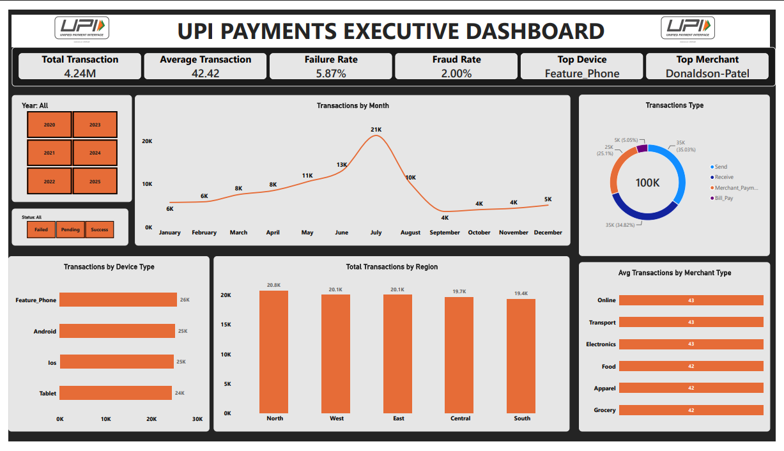
Dashboard
11 / 12

Slide 13
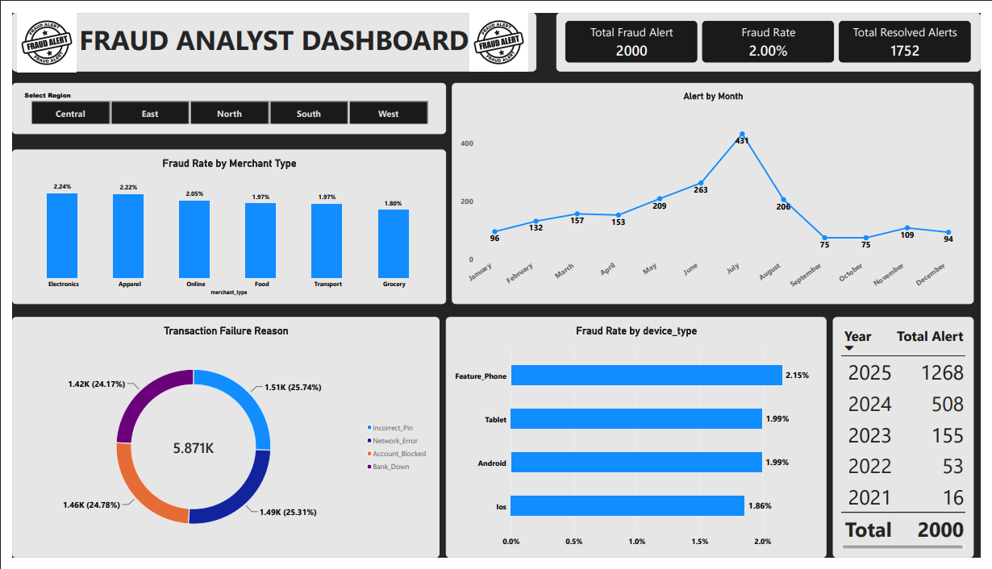
Dashboard
11 / 12

Slide 14


From Insight to Ongoing BI Product
Deepen the device-risk hypothesis using rooted-device flags against fraud outco
Move from single-factor tests to a multivariate fraud-risk model.
Automate the data-quality log so validation runs with every new data refresh.
Operationalize the Executive and Fraud Analyst dashboards for weekly review.
Thank You
12 / 12

