Slide 1

Major Project Review-I
Batch No: 16
Project Title: FinRAG AI - A Unified AI Framework for Financial Risk and Retrieval-Augmented Intelligence
S.No | Reg.No | Student Name
1 | 23A81A4361 | T. Jitendra Sri
2 | 23A81A4314 | G.UshaRani
3 | 23A81A4357 | S.V.M.S.Vishal
4 | 23A81A4334 | M.Charan Krishna Varma
Project Guide
Mr. K. Kalyan, M. Tech. Asst. Prof., Dept. of CSD

Slide 2
Major Project Review-I — Contents
FinRAG AI | Review-I
1
Abstract
2
Introduction
3
Literature Survey
4
Problem Statement in Existing System
5
Proposed System
6
Objectives
7
Project Domain
8
Requirement Analysis
9
System Architecture
10
Methodology
2

Slide 3
Abstract
FinRAG AI: evidence-grounded financial question answering and transaction intelligence
FinRAG AI is an integrated financial intelligence platform designed to provide reliable, evidence-grounded
answers from complex financial documents. Financial analysts, investors, and compliance professionals often
spend significant time searching lengthy annual reports, SEC filings, financial statements, and tables for
relevant information. Traditional keyword search may miss semantic relationships, while standalone large
language models can generate unsupported or hallucinated responses. The proposed system uses Financial
Retrieval-Augmented Generation (RAG) to address these challenges. It processes financial documents through
parsing, metadata-rich and table-aware chunking, embedding, hybrid dense and BM25 retrieval, and
cross-encoder reranking before generating answers with an LLM. The system further incorporates HyDE-based
query expansion and multi-hop query decomposition for complex questions. Precise page, section, and table
citations improve transparency and verification. The framework is also designed for Indian financial documents
through BSE/NSE sources and integrates transaction intelligence for anomaly detection, risk scoring, and alerts,
supporting informed human decision-making and compliance investigations.
3

Slide 4
Introduction
Why a domain-specific financial RAG system is required
The project aims to develop FinRAG AI, an intelligent financial question-answering platform that uses Retrieval-Augmented Generation (RAG) to provide accurate, evidence-grounded responses from complex financial documents such as annual reports, SEC filings, and financial statements. Traditional keyword-based search can miss semantic relationships, while standalone Large Language Models (LLMs) may generate unsupported or hallucinated information. FinRAG AI addresses these challenges through document parsing, metadata-rich and table-aware chunking, dense and BM25 hybrid retrieval, cross-encoder reranking, and LLM-based answer generation. The system also supports complex multi-hop queries through query decomposition and improves retrieval using HyDE-based query expansion. To enhance transparency, answers are supported with precise page, section, and table-level citations. The proposed framework can also be extended to Indian financial documents through BSE/NSE sources and integrated with transaction intelligence for anomaly detection, risk scoring, and alerts, enabling efficient and informed financial analysis.
4

Slide 5
Literature Survey
Base paper, datasets and technical foundation
Base Paper
Base-Paper Pipeline
• Title: “Metadata-Driven Retrieval-Augmented Generation for Financial Question Answering.”
• Authors: Michail Dadopoulos, Anestis Ladas, Stratos Moschidis and Ioannis Negkakis.
• 2025 arXiv preprint • arXiv:2510.24402.
• Core idea: metadata-driven, multi-stage RAG for financial QA.
• LLM-generated document/chunk metadata.
• Pre-retrieval filtering and query rewriting.
• Metadata-enriched embeddings.
• Hybrid retrieval + post-retrieval reranking.
FinanceBench
FinDER
SEC EDGAR
• Financial question-answering benchmark.
• More than 1,000 financial QA pairs.
• Useful for evaluating financial QA accuracy.
• 5,703 expert-annotated query-evidence-answer triplets.
• Useful for retrieval and evidence-grounded QA evaluation.
• U.S. SEC electronic filing system.
• Public corporate filings such as 10-K and 10-Q.
• Primary source for the base-paper financial documents.
5

Slide 6
Problem Statement in Existing System
Gaps observed in current financial information-access workflows
1. Retrieval Challenges
2. Document & Table Challenges
3. Generation & Usability Challenges
• Keyword search can miss semantic relationships.
• Relevant evidence may be scattered across sections.
• Exact financial terms, entities and values require precise matching.
• Top-k retrieval can contain redundant or weakly related chunks.
• Financial statements contain structured tables.
• Plain-text extraction may break row/column relationships.
• Page, section and table context can be lost.
• Static ingestion makes continuous updates difficult.
• LLM answers may be unsupported or hallucinated.
• Citations may not point to exact evidence.
• Complex questions may require multiple retrieval steps.
• High retrieval/generation latency reduces practical usability.
6

Slide 7
Proposed System
FinRAG AI — integrated Financial RAG + Transaction Intelligence
1
Document
Sources
2
Document
Processing
3
Query
Intelligence
4
Hybrid
Retrieval
5
Reranking
6
Grounded
Generation
SEC EDGAR + financial reports + proposed BSE/NSE sources
Parsing • metadata • table-aware chunking
NER • HyDE/query expansion • query decomposition
Dense vectors + BM25 + metadata filters
Cross-encoder relevance scoring
LLM answer + precise citations
Transaction Intelligence Engine
Unified Output
• Transaction analysis • anomaly detection • risk scoring • alerts • investigation dashboard
• Evidence-grounded answers • citations • risk insights • analyst-facing dashboard
7

Slide 8
Objectives
Specific goals of the proposed system
Objective 1
Objective 2
• Develop a financial-domain RAG pipeline for grounded question answering.
• Improve retrieval relevance using metadata-aware hybrid search.
Objective 3
Objective 4
• Preserve financial table structure during document processing and retrieval.
• Support multi-hop questions using query decomposition and evidence chaining.
Objective 5
Objective 6
• Generate precise page/section/table citations for traceability.
• Extend ingestion toward Indian financial documents and BSE/NSE sources.
Objective 7
Objective 8
• Introduce transaction anomaly detection and risk scoring as complementary intelligence.
• Optimize latency, caching and retrieval efficiency for practical deployment.
8

Slide 9
Project Domain
Interdisciplinary foundation
Artificial Intelligence
NLP
Information Retrieval
FinTech
• Large Language Models
• Machine Learning
• Anomaly Detection
• Decision Support
• Model-assisted reasoning
• Query understanding
• Named Entity Recognition
• Query expansion
• Semantic similarity
• Question answering
• Embeddings
• Vector search
• BM25
• Hybrid retrieval
• Cross-encoder reranking
• Financial filings
• Financial QA
• Risk analysis
• Compliance support
• Transaction intelligence
9

Slide 10
Requirement Analysis
Functional, non-functional, software and hardware requirements
Functional Requirements
Non-Functional Requirements
• Ingest financial documents and metadata.
• Parse text and tables while preserving structure.
• Create embeddings and searchable indexes.
• Retrieve, rerank and generate grounded answers.
• Return source citations and support transaction-risk analysis.
• High retrieval relevance and answer faithfulness.
• Low response latency and scalable indexing.
• Reliable document processing and traceability.
• Secure access, maintainability and usability.
• Caching and efficient resource utilization.
Software Requirements
Hardware Requirements
• Frontend: React + TypeScript + Tailwind CSS.
• Backend: Python + FastAPI.
• RAG: LangChain; parsing: Docling.
• Vector DB: Qdrant; sparse retrieval: BM25.
• Reranker, LLM, Redis, database, Docker, Git/GitHub.
• Modern multi-core CPU and sufficient RAM for development.
• Adequate storage for document collections and indexes.
• GPU is beneficial for local model inference/ML workloads.
• Cloud compute can be used for scalable deployment.
• Stable network access for external model/data services.
10

Slide 11
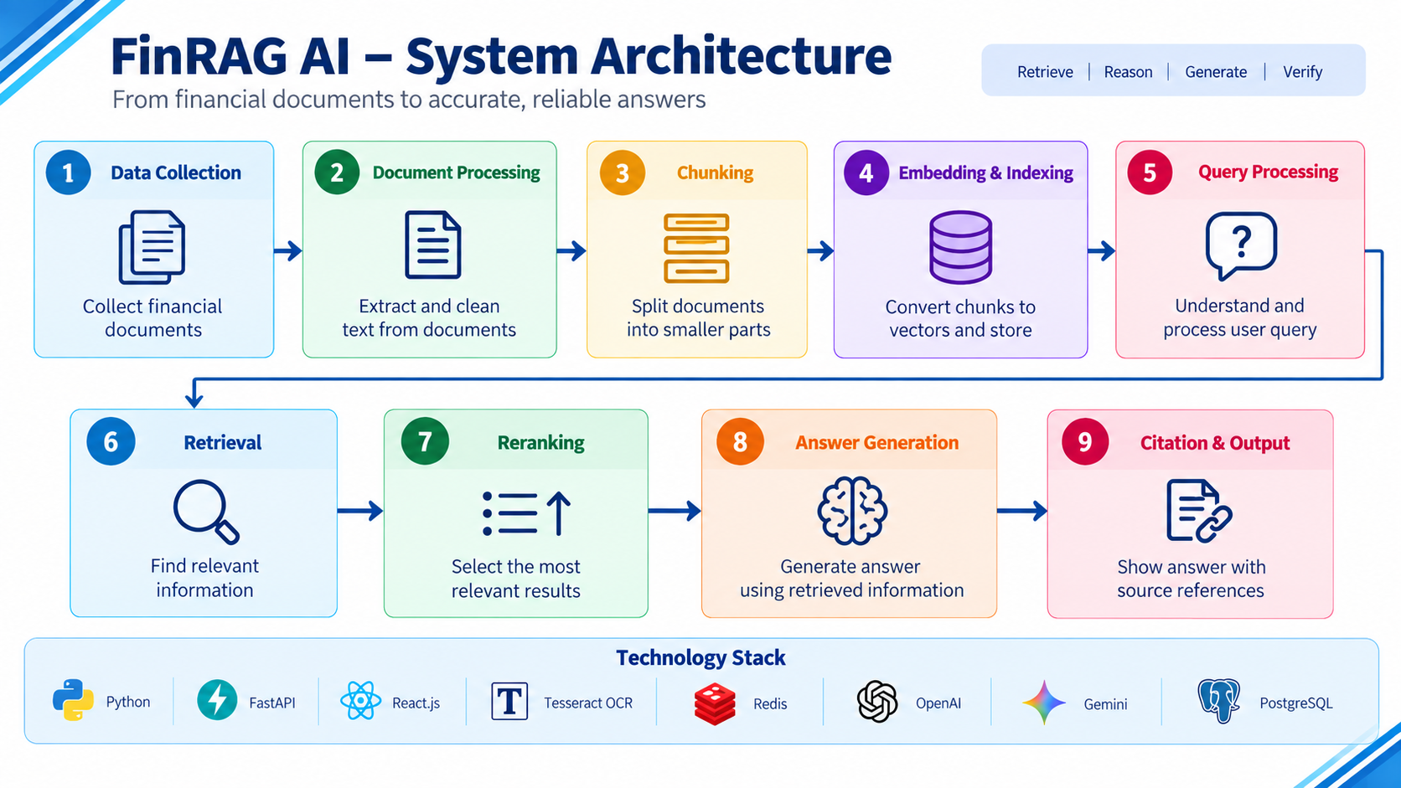
System Architecture
Layered architecture for scalable financial intelligence

Slide 12
Methodology
End-to-end workflow from financial documents to evaluated answers
Data Collection
Document Processing
Metadata + Chunking
• FinanceBench / FinDER for evaluation; SEC EDGAR and supported financial reports for knowledge sources.
• Parse documents, extract text/tables, clean content and preserve document hierarchy.
• Generate metadata-rich chunks; retain page, section and table context.
Embedding + Indexing
Query Processing
Hybrid Retrieval
• Create dense embeddings and store vectors plus metadata for fast retrieval.
• Identify entities; expand/rewrite query; decompose complex multi-hop questions.
• Combine semantic vector search, BM25 keyword search and metadata filtering.
Reranking
Context + Generation
Citation + Evaluation
• Use a relevance model/cross-encoder to reorder candidate evidence.
• Assemble high-quality evidence and generate an answer grounded in retrieved context.
• Attach source references and evaluate retrieval, generation, latency and usability.
12

Slide 13
THANK YOU

