Slide 1
Webpack
What is webpack :
Webpack is a module bundler. Its main purpose is to bundle JavaScript files for usage in a browser, yet it is also capable of transforming, bundling, or packaging just about any resource or asset.
How it works : When webpack processes any application, it internally builds a dependency graph from one or more entry points and then combines every module, the project needs into one or more bundles, which are static assets to serve the content from.

Slide 2
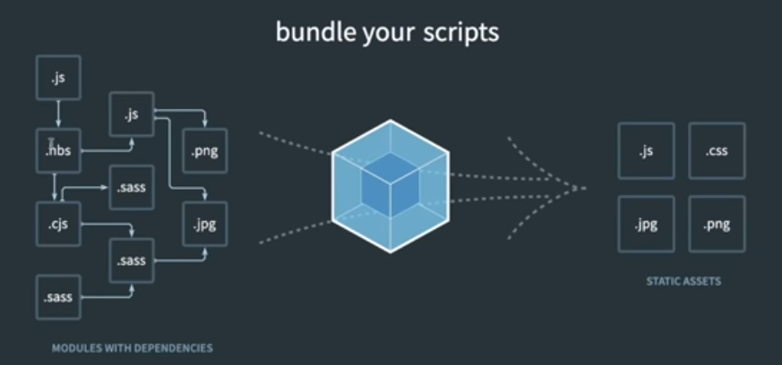
Webpack

Slide 3
Webpack
Frameworks using webpack
Create a sample project in pure html js where one js file is creating instances of dom elements, other is having functions and binding part , turn by turn change the order of inclusion of js to show what the problem is without webpack.
Additionally , we are not normally minifying our code.
Setup in basic project where index js is dependent on other js

Slide 4
Webpack
Convert the project into a node project by steps below :
Use import export in the project
Install webpack and webpack cli
Run the build command of webpack to check the result in dist folder and use the resultant js file in index html
Install any 3rd party module eg uuid and use it in index js and re-run the webpack build to check the new main.js in dist file.
Install and use HTMLWebpackPlugin to build html file in dist as wel.

Slide 5
Webpack
Create webpack.config.js file with configuration for entry and output for the webpack command as below.
const path = require(‘path’);
module.exports={
mode : ‘development’,
entry : path.resolve(__dirname , “src/index.js”),
output : {
path : path.resolve(__dirname, ‘dist’),
filename : ‘target.js’
}
}

Slide 6
Webpack Loaders
Webpack enables use of loaders to preprocess files.
This allows us to bundle any static resource way beyond JavaScript.
We can easily write your own loaders using Node.js.
Loaders are activated by using loadername! prefixes in require() statements, or are automatically applied via regex from our webpack configuration.

Slide 7
Webpack Loaders Example
This example is for loading sass file into javascript and bundle into static files.
Step 1 : npm i –D sass style-loader css-loader sass-loader . Each of these 3 loaders have tasks as below.
a. sass-loader - Transforms Sass to CSS. (Input: Sass, Output: CSS)
b. css-loader - Transforms CSS to a JavaScript module. (Input: CSS, Output: JavaScript)
c. style-loader - Injects the CSS, that is exported by the JavaScript module, into a <style> tag at runtime. (Input: JavaScript, Output: JavaScript).

Slide 8
Webpack Loaders Example
Create main.sass file in styles folder and some css in it.
In the webpack configuration file , add the module key with following values and run npm run build.
module:{
rules:[
{test:/\.sass$/,
use:[
'style-loader',
'css-loader',
'sass-loader'
]
}
]
}

