Slide 1


B.R.Harne college of Engineering & Technology
FINEXO EXPENCE TRACKER
Coding Languages : Python (Back-end) | HTML, CSS (Front-end)

Slide 2
01
ADITYA S. NAIK
FRONT-END DEVELOPER
02
JITESH KALEKAR
CREATORS
BACK-END DEVELOPER
03
AASHISH NIKAM
BACK-END DEVELOPER
04
RAMKRISHNA CHOUDHARY
BACK-END DEVELOPER

Slide 3
CONTENTS
Introduction & Objectives
Scope
Feature & Functionality
Problem Identified /Solution Purposed
Technology Stack
Flowchart
Expected Outcome
Future Scope
Conclusion

Slide 4
1
INTRODUCTION
An expense tracker project aims to create a system often a software application.
That allows users to easily record, categorize, and analyze their financial transactions, ultimately.
helping them gain insights into their spending habits and make better financial decisions

Slide 5
OBJECTIVE
The Expense Tracker project has been designed with several
key objectives in mind:
1.User Interface: To develop an intuitive and userfriendly interface that simplifies the process of logging
and managing daily expenses.
2.Expense Categorization: To enable the efficient
categorization of expenses, allowing users to analyze
their spending patterns and create more effective
budgets.
3.Data Management: To implement SQL-based data
storage solutions that ensure secure, structured, and
scalable management of financial records.
4. Report Generation: To provide tools for generating
detailed financial reports that offer insights into users'
spending habits, helping them to identify areas for
financial improvement and make informed decisions

Slide 6
SCOPE OF FET
2
This project's scope encompasses the development of a desktop-based application utilizing Java for the front end and SQL for data storage. The application will include core features such as:
Expense Management: Adding, editing, and deleting expense records
Categorization: Grouping expenses into categories for easier tracking and analysis.
Reporting: Generating visual and textual reports to provide insights into spending habits

Slide 7
FEATURE / FUNCTIONALITY
3
1. User-Friendly Interface
• Simple Navigation: The application features an intuitive
interface that allows users to easily navigate through
various sections, such as adding expenses, viewing
reports, and managing categories.
• Quick Access: Frequently used functions, like adding a
new expense or generating a report, are easily accessible
from the main dashboard.

Slide 8
2. Expense Management
• Add/Edit/Delete Expenses: Users can quickly add new
expenses by specifying the amount, date, category, and
description. They can also edit or delete existing
expenses, allowing for flexibility in managing their
financial records.
• Recurring Expenses: The system allows users to set up
recurring expenses (e.g., monthly bills), which are
automatically added to their expense list on a scheduled
basis.
1
2
3
4
5
6
7
8
9
10
11
12
Add your words here,according to your need to draw the text box size.Please read the instructions and more work at the end of the manual template.
Add your words here,according to your need to draw the text box size.Please read the instructions and more work at the end of the manual template.
TOTAL

Slide 9
PROBLEM IDENTIFIED
4
• In the fast-paced modern world, many individuals find it
challenging to keep an accurate and up-to-date record of
their daily expenses. This often results in poor financial
management, leading to budget overruns and a lack of
financial discipline.
• Consequently, there is a clear need for an expense
tracking tool that is both user-friendly and feature-rich,
capable of providing clear insights into spending habits
without requiring extensive technical expertise from the
user.

Slide 10
SOLUTION PROPOSED
￭The primary purpose of this project is to develop a
comprehensive Expense Tracker application
designed to assist users in effectively managing and
monitoring their finances.
￭The goal is to empower users with the tools
necessary to make informed financial decisions,
thus enhancing their budgeting skills and overall
financial well-being.

Slide 11
5
TECHNOLOGY STACK
The Expense Tracker system is designed with a focus on performance, scalability, and security.

Slide 12
SOFTWARE COMPONENT
• Firebase is a google technology for
managing and manipulating relational databases. It
enables efficient querying, dataretrieval and transaction
management, ensuring data integrity and security.
• Java offers tools to compile, debug, and run Java
applications. It’s optimized for cross-platform desktop
development. Ideal for building robust applications with
modern Java features.
• Note-JS is an integrated development
environment (IDE) for Java and other programming
languages. It provides tools for coding, debugging,
and deploying applications, featuring a user_x0002_friendly interface and support for various plugins.
• Bootstrap, enabling the creation
of rich desktop applications. It offers a set of lightweight,
customizable components like buttons, tables, and text
fields, allowing developers to build interactive user
interfaces

Slide 13
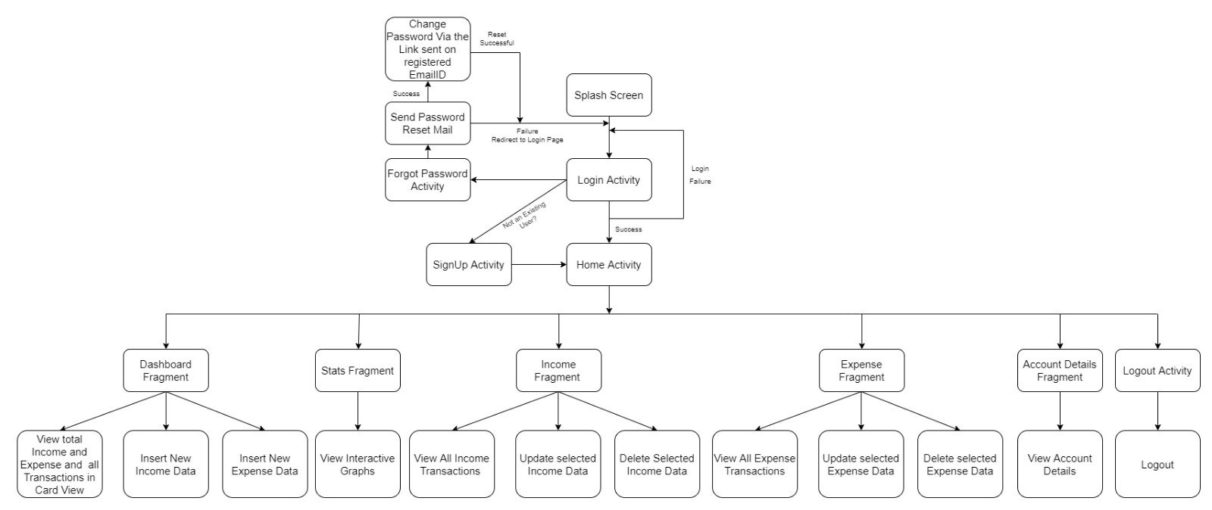
FLOWCHART

Slide 14
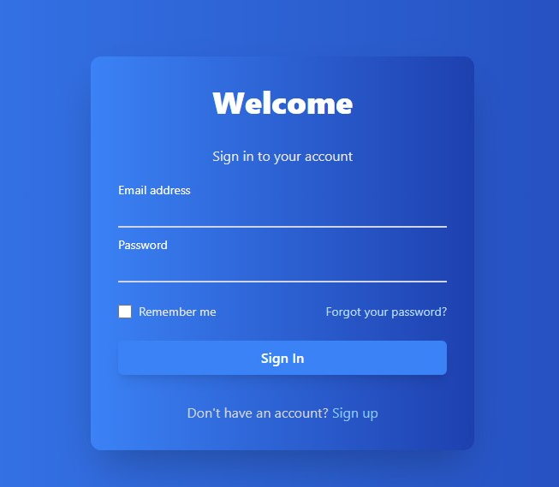
SIGN-UP PAGE
LOG-IN
SIGN-UP

Slide 15
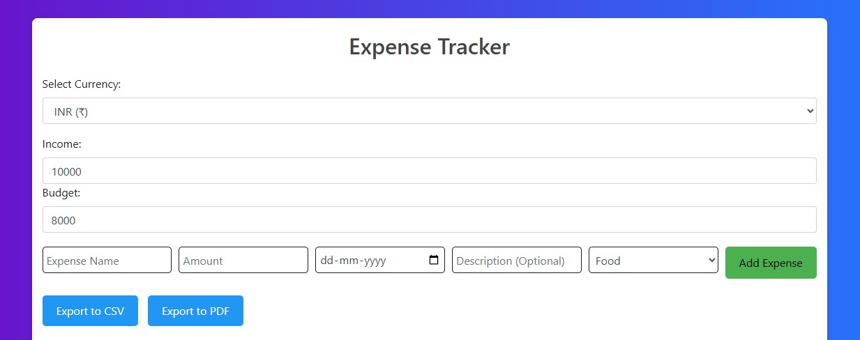
USER INTERFACE(UI)
DASHBOARD

Slide 16
FUTURE SCOPE
6
While the current version of the Personal Expense Trackerprovides valuable features for financial management, there isa wide range of opportunities for future enhancements and growth:
Multi-Platform Support: Consider expanding the app's compatibility to include various platforms such as desktop applications, tablet interfaces, and smartwatch applications to cater to a broader user base.
Machine Learning and Predictive Analytics: Implement machine learning algorithms to provide users with predictive insights, such as forecasting future expenses based on historical data.

Slide 17
CONCLUSION
The Expense Tracker project presents a robust and user solution for managing personal finances. Byleveraging Java for application development.
SQL for data storage, the system ensures both performance and scalability, offering users a reliable tool to keep track of their expenses.

Slide 18
Thanks
THANK YOU FOR LISTENING

