Slide 1
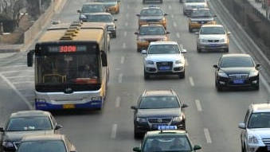
SCOOT 8 AI
1
SENSE
TRAFFIC
MANAGEMENT
SYSTEMS
2
UNDERSTAND
3
DECIDE
Why cities need a live feedback loop
4
ACT
Sense demand → coordinate signals → measure outcomes
5
LEARN
Traffic is dynamic.
Signals must be dynamic too.
Jitesh Anand • Roll 124109004 • IIoT A-(1)
Visual: internet-sourced traffic image • Source: Adaptive Traffic Signal Timer repository

Slide 2
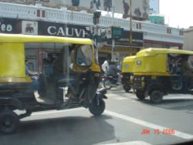

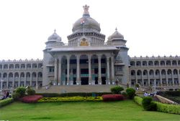
THE NEED
02
Bengaluru: the cost of unmanaged demand
36:09
13.9 km/h
168 h
per 10 km
rush-hour speed
lost each year
average travel time
citywide average
per rush-hour driver
Demand changes by minute; fixed plans change by schedule.
Weather • events • crashes • school peaks • bus bunching
74.4% congestion
2025
Traffic figures: TomTom Traffic Index, Bengaluru 2025 • City images: Wikispeedia/Wikipedia archive
Jitesh Anand • 124109004 • IIoT A-(1)

Slide 3
WHY ADAPTIVE CONTROL
03
From fixed-time to predictive control
⏱
↻
+30
FIXED
ADAPTIVE
PREDICTIVE
Repeat a plan
Respond to now
Prepare for next
reactive
proactive
same sequence
live demand
forecast horizon
Conceptual progression; predictive horizon based on TRL’s SCOOT 8 AI announcement
Jitesh Anand • 124109004 • IIoT A-(1)

Slide 4
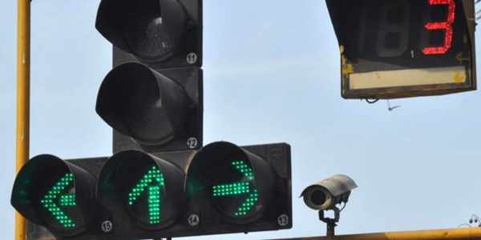
DEVELOPMENT
04
SCOOT: an evolving control philosophy
Nearly 50 years of field evolution
Small, frequent timing changes across a coordinated network
Split • Cycle • Offset
Optimisation Technique
1977
1980s–2000s
2024
2025
350+
Research birth
Global rollout
SCOOT 8
SCOOT 8 AI
towns & cities
SCOOT family footprint
Sources: TRL Software SCOOT 8 (2024) and SCOOT 8 AI launch (2025) • Signal image: Adaptive Traffic Signal Timer repo
Jitesh Anand • 124109004 • IIoT A-(1)

Slide 5
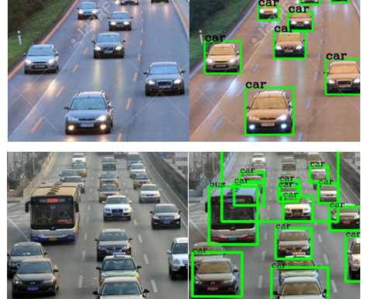
DEVELOPMENT
05
SCOOT 8: the development leap
AUTO-VALIDATE
ANALYTICS
Initial validation + continuous revalidation
Second-by-second performance measures
MULTIMODAL
ANOMALIES
Pedestrian demand in split + cycle decisions
R&D with Alan Turing Institute candidates
47 YEARS
of operating knowledge
inside the next platform
From traffic control to traffic intelligence
Source: TRL Software presentation, “SCOOT 8 – 47 Years Later” (2024) • Visual: Apache-licensed traffic project repo
Jitesh Anand • 124109004 • IIoT A-(1)

Slide 6
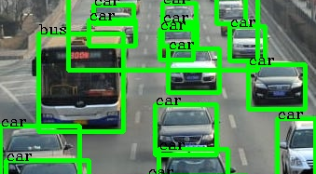
TRL-REPORTED
06
SCOOT 8 AI: headline achievements
30 min
up to 15%
up to 40%
≤12 mo
traffic forecast
journey time
faster detection
typical ROI
look-ahead horizon
vs current-generation systems
incidents + anomalies
vendor estimate
AI adds foresight
Forecast demand • flag anomalies • recommend action
Hardware-agnostic
Real-time dashboards
3rd-party data
Treat these as claims to validate under local pilot conditions.
Source: TRL Software, SCOOT 8 AI launch, 23 Sep 2025 • Detection visual: Adaptive Traffic Signal Timer repo
Jitesh Anand • 124109004 • IIoT A-(1)

Slide 7
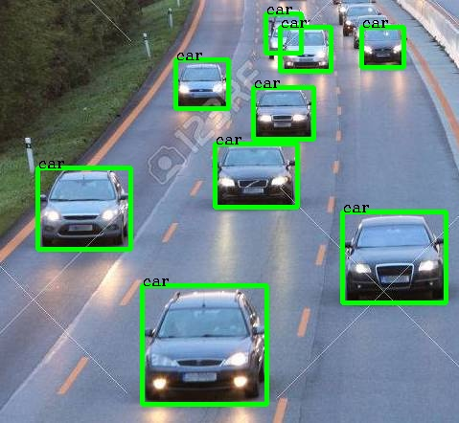
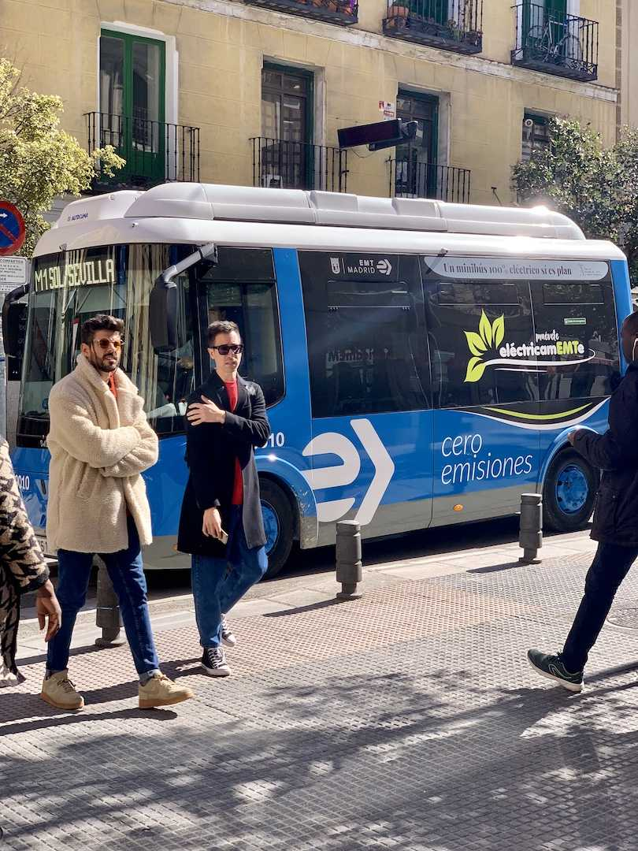
TECHNOLOGY
07
SCOOT 8 AI: broad system architecture
INPUTS
INTELLIGENCE
ACTIONS
AI
Loops • cameras • radar
Digital flow model
Signal plans • priority
Connected data
Transit + pedestrian demand
Demand forecast
Network optimisers
Anomaly detection
Alerts + dashboards
Operator decisions
External traveller info
Hardware-agnostic software layer over compatible field controllers
Architecture synthesized from TRL SCOOT 8/8 AI material and FHWA SCOOT descriptions • Internet visuals credited on slide 20
Jitesh Anand • 124109004 • IIoT A-(1)

Slide 8
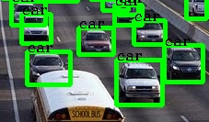
TECHNOLOGY
08
From detector pulse to green time
1
2
3
4
5
6
DETECT
CLEAN
ESTIMATE
FORECAST
OPTIMISE
COMMAND
flow • speed
health • fuse
queues • platoons
0 → 30 min
cycle • split • offset
controller
SECOND-BY-SECOND
EACH CONTROL STEP
+30 MINUTES
↺
measure + update state
test small timing changes
prepare for demand
measure outcome
Sources: TRL SCOOT 8/8 AI; FHWA Traffic Detector Handbook • Detection visual: Adaptive Traffic Signal Timer repo
Jitesh Anand • 124109004 • IIoT A-(1)

Slide 9
CLASSIC SCOOT
09
The three controls inside SCOOT
CYCLE
SPLIT
OFFSET
90 s
N–S
A
E–W
B
Total time for one
signal sequence
How the cycle is
shared as green
Start-time shift between
neighbouring signals
Longer when network demand rises
More demand → more useful green
Align greens with arriving platoons
Source: FHWA Traffic Detector Handbook and FHWA SCOOT overview
Jitesh Anand • 124109004 • IIoT A-(1)

Slide 10
AI LAYER
10
Predictive control: act before the queue forms
Predicted demand
Pre-position green
before spillback
ANOMALY
REACTIVE
Respond after queues are measured
PREDICTIVE
NOW
+30 min
Respond to likely future demand
Source: TRL Software SCOOT 8 AI announcement (forecast horizon and anomaly detection claims)
Jitesh Anand • 124109004 • IIoT A-(1)

Slide 11
CONTROL LOGIC
11
A closed loop that learns every cycle
MEASURE
SCOOT
8 AI
OBSERVE
ACT
Objective
minimise delay + stops
within safety constraints
ESTIMATE
TEST
Small changes • frequent checks • operator visibility
FORECAST
Conceptual loop synthesized from FHWA SCOOT descriptions and TRL SCOOT 8 material
Jitesh Anand • 124109004 • IIoT A-(1)

Slide 12

MULTIMODAL CONTROL
12
One network, many road users
BUS
WALK
CYCLE
EMERGENCY
reliability
safe crossing
progression
priority path
PRIORITY ≠ ALWAYS GREEN
Minimum greens • pedestrian clearance • queue limits • network balance
Policy constraints stay above optimisation.
Source: TRL SCOOT 8 multimodal features • Internet visuals: Ultralytics, PyTorch Hub, Wikispeedia, Apache traffic project
Jitesh Anand • 124109004 • IIoT A-(1)

Slide 13
COMPETITOR COMPARISON
13
SCOOT 8 AI vs SCATS vs Surtrac
CRITERION
SCOOT 8 AI
SCATS
SURTRAC
Control style
Network model + predictive UTC
Real-time adaptive network
Distributed local scheduling
Look-ahead
Up to 30 min
Primarily live adaptive
Short-horizon neighbour plans
Architecture
Central platform + field controllers
Hierarchical / scalable
Intersection agents
Best fit
Coordinated corridors + city networks
Large mature signal networks
Local grids / edge autonomy
Published reach
350+ towns & cities*
60,000+ intersections
50 Pittsburgh sites†
No universal winner
* SCOOT family footprint • † CMU figure as of 2019
Sources: TRL Software; SCATS official site; Carnegie Mellon University Surtrac profile • Different product claims and dates
Jitesh Anand • 124109004 • IIoT A-(1)

Slide 14
EVIDENCE, WITH CONTEXT
14
What the published numbers actually say
15%
12%
25%
33%
journey time
delay
travel time
travel time
SCOOT 8 AI • TRL vendor claim
London SCOOT • GLA average
Surtrac • CMU Pittsburgh report
Bengaluru B-ATCS • reported peaks
These are not head-to-head benchmarks.
Baselines, networks, study periods and reporting methods differ.
Use them to set the order of magnitude—not to promise a Bengaluru result.
Pilot → measure → compare with a pre-agreed baseline
Sources: TRL (2025); Greater London Authority; CMU (2019); Indian Express report on Bengaluru B-ATCS (2024)
Jitesh Anand • 124109004 • IIoT A-(1)

Slide 15
DESIGN ASSESSMENT
15
Which system fits an Indian corridor?
1
5
Network coordination
SCOOT 8 AI
Retrofit potential
SCATS
Distributed resilience
SURTRAC
Published scale
BEST PILOT HYPOTHESIS
SCOOT 8 AI: predictive corridor coordination + controller retrofit—subject to interface audit and local validation.
Scores are an author assessment for the proposed Bengaluru corridor.
Assessment based on published architecture, footprint and Bengaluru integration needs; it is not a vendor benchmark
Jitesh Anand • 124109004 • IIoT A-(1)

Slide 16

PROPOSED IMPLEMENTATION
16
Bengaluru pilot concept
CONCEPT — NOT AN ANNOUNCED DEPLOYMENT
PURPLE CORRIDOR
SURFACE NETWORK
MG Road → Trinity → Halasuru → Indiranagar
8–12
26
1
junctions
weeks
corridor
after field audit
baseline to review
prove then scale
Integrate with existing Bengaluru adaptive-control assets where interfaces permit.
City visuals: Wikispeedia/Wikipedia archive • Existing context: Bengaluru Traffic Police ATCS and reported B-ATCS rollout
Jitesh Anand • 124109004 • IIoT A-(1)

Slide 17
BENGALURU CORRIDOR
17
Pilot architectural map
FIELD CORRIDOR
secure IP / fibre / 4G
TRAFFIC
MANAGEMENT
CENTRE
S1
S2
S3
S4
J
J
J
J
SCOOT 8 AI
MG ROAD
TRINITY
HALASURU
INDIRANAGAR
FIELD
GATEWAY
PLATFORM
USERS
Cameras • loops • radar
signals • UPS
Existing B-ATCS interface
protocol + health checks
Model • forecast • optimise
logs + safe fallback
TMC • traffic police • BMTC
dashboards + traveller data
Conceptual architecture — controller protocol, junction count and exact route require field survey.
Architecture authored for this presentation using TRL/FHWA system descriptions and Bengaluru ATCS context
Jitesh Anand • 124109004 • IIoT A-(1)

Slide 18
PILOT DELIVERY
18
Implementation roadmap: 26 weeks
0
1
2
3
BASELINE
SHADOW MODEL
LIVE PILOT
EVALUATE
4 weeks
6 weeks
12 weeks
4 weeks
Audit controllers
Collect travel-time + stop data
Build network model
Run offline; calibrate
Controlled activation
Daily health review
Before/after analysis
Scale or revise
PROPOSED SUCCESS THRESHOLDS
–10%
median corridor time
–10%
stops
–12%
bus p90 time
≥95%
detector uptime
SAFETY GATE: validated minimum greens + red clearance + automatic fallback to approved timings
Durations and KPI thresholds are proposed for planning; finalize after the baseline audit
Jitesh Anand • 124109004 • IIoT A-(1)

Slide 19
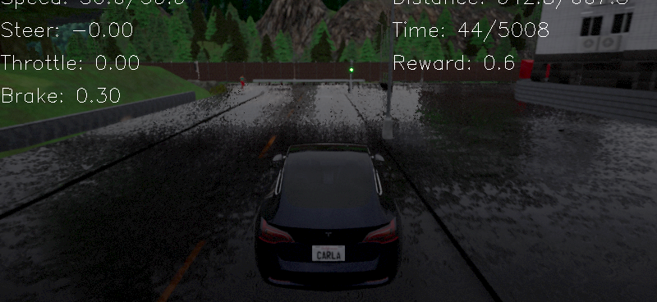
INDIAN DEPLOYMENT
19
Advantages, challenges—and safeguards
ADVANTAGES
CHALLENGES + RESPONSE
Fewer stops
Mixed, weak lane discipline
network coordination
train + calibrate on local classes
More reliable buses
Monsoon + occlusion
conditional priority
sensor fusion + health monitoring
Earlier incident response
Legacy interfaces
predictive anomalies
controller audit + tested gateway
Transparent performance
Power, data, skills
live KPIs + audit trail
UPS + fallback + role-based ops
Optimisation is useful only when detection, safety and operations are dependable.
Challenge analysis authored for Bengaluru conditions • Background visual: DI-drive open-source simulator
Jitesh Anand • 124109004 • IIoT A-(1)

Slide 20
START WITH ONE CORRIDOR.
KEY SOURCES
PROVE IT. SCALE BY EVIDENCE.
1. TRL Software — SCOOT 8 AI (2025)
2. TRL — SCOOT 8 presentation (2024)
3. FHWA — Traffic Detector Handbook
4. SCATS — official system overview
5. Carnegie Mellon — Surtrac (2019)
6. TomTom — Bengaluru Traffic Index 2025
7. Bengaluru Traffic Police — ATCS
8. Indian Express — B-ATCS results (2024)
9. Images: Wikispeedia/Wikipedia archive
10. Images: Adaptive Traffic Signal Timer
11. Images: Ultralytics • PyTorch • DI-drive
BASELINE
FAIL-SAFE
OPEN KPIs
before activation
approved timings
public outcomes
The recommendation
A measured Bengaluru corridor pilot that treats AI as a controlled transport intervention.
Full links + speaking script are in the companion notes file.
Jitesh Anand • 124109004 • IIoT A-(1)

