Slide 1
Recurrent Neural Networks (RNNs)
Week 5

Slide 2
Agenda
What are Neural Networks?
What Neural Networks do?
Why not Neural Networks/Feed forward Networks?
Why/what are Recurrent Neural Networks?
Different Types of RNN’s
Deep view into RNN’s
Character level language model
Back propogation through time(BTT)
Issues of RNN’s?
Advantages & Disadvantages of RNN
Why LSTM’s?

Slide 3
What are Neural networks?
Neural networks are set of algorithms inspired by the functioning of human brain
Notes:
Neural networks are set of algorithms inspired by the functioning of human brian. Generally when you open your eyes, what you see is called data and is processed by the Nuerons(data processing cells) in your brain, and recognises what is around you. That’s how similar the Neural Networks works. They takes a large set of data, process the data(draws out the patterns from data), and outputs what it is.

Slide 4
What they do ?
Neural networks (NN) are universal function approximaters so that means neural networks can learn an approximation of any function f() such that.
y = f(x)

Slide 5
Why Not Neural Networks?
Notes:
There are several scenario’s where the previous understanding of data is important.for example: Reading book, understanding lyrics,..,. These networks do not have memory in order to understand Sequential data like Reading books.
how do we overcome this challenge of understanding previous output?
solution: RNN’s.

Slide 6
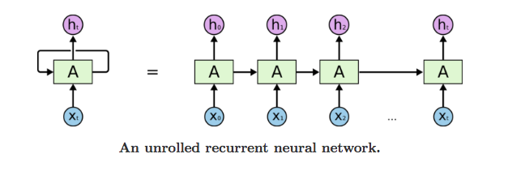
What are RNN’s?
The idea behind RNNs is to make use of sequential information.
Notes:
In a traditional neural network we assume that all inputs (and outputs) are independent of each other. But for many tasks that’s a very bad idea. If you want to predict the next word in a sentence you better know which words came before it. RNNs are called recurrent because they perform the same task for every element of a sequence, with the output being depended on the previous computations and you already know that they have a “memory” which captures information about what has been calculated so far.

Slide 7
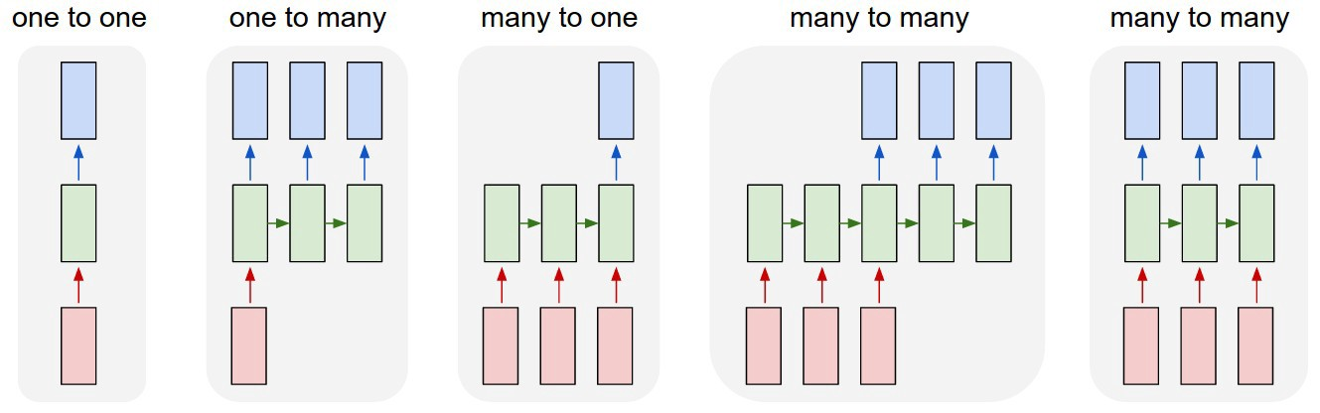
Different types of RNN’s
Notes:
One-to-one:
This also called as Plain/Vaniall Neural networks. It deals with Fixed size of input to Fixed size of Output where they are independent of previous information/output.
Ex: Image classification.
One-to-Many:
it deals with fixed size of information as input that gives sequence of data as output.
Ex:Image Captioning takes image as input and outputs a sentence of words.
Deep Visual-Semantic Alignments for Generating Image Descriptions.Many-to-One:
It takes Sequence of information as input and ouputs a fixed size of output.
Ex:sentiment analysis where a given sentence is classified as expressing positive or negative sentiment.
Many-to-Many:
It takes a Sequence of information as input and process it recurrently outputs a Sequence of data.
Ex: Machine Translation, where an RNN reads a sentence in English and then outputs a sentence in French.

Slide 8
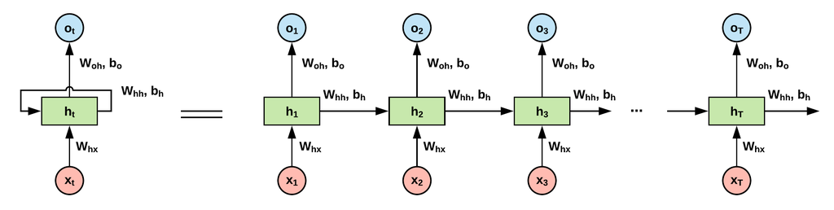
Deep view into RNN’s:

Slide 9
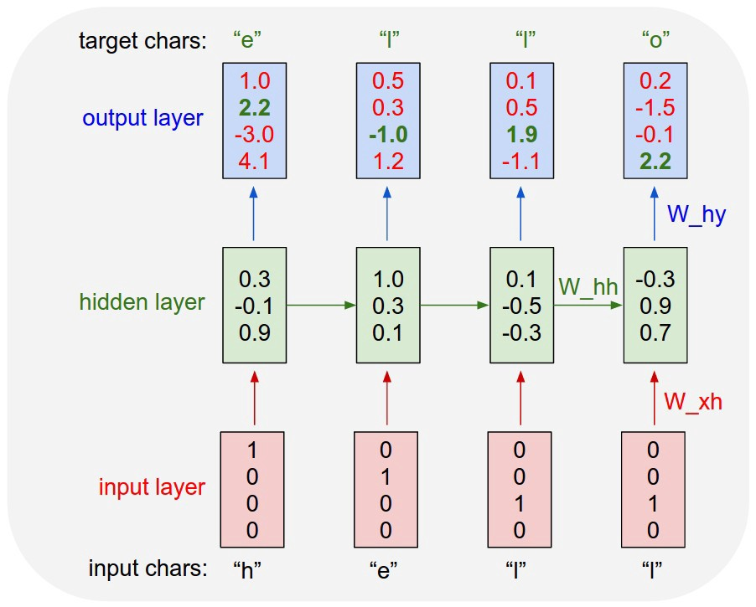
Character level language model:
Notes:
We’ll give the RNN a huge chunk of text and ask it to model the probability distribution of the next character in the sequence given a sequence of previous characters.
As a working example, suppose we only had a vocabulary of four possible letters “helo”, and wanted to train an RNN on the training sequence “hello”. This training sequence is in fact a source of 4 separate training examples: 1. The probability of “e” should be likely given the context of “h”, 2. “l” should be likely in the context of “he”, 3. “l” should also be likely given the context of “hel”, and finally 4. “o” should be likely given the context of “hell”.

Slide 10
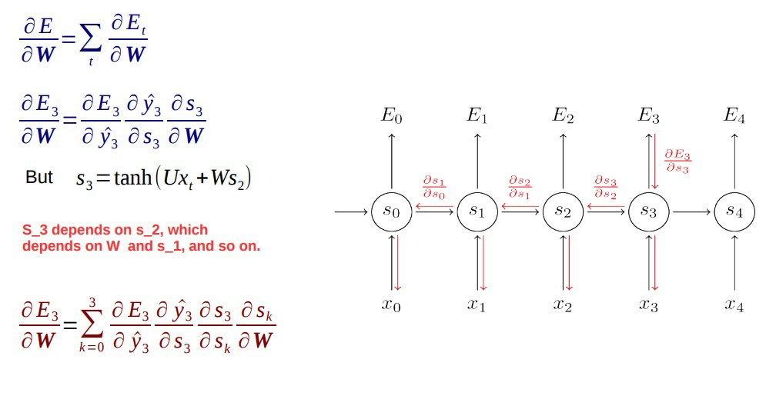
Backpropogate Through Time:
Notes:
Vanishing Gradient
Exploding Gradient

Slide 11
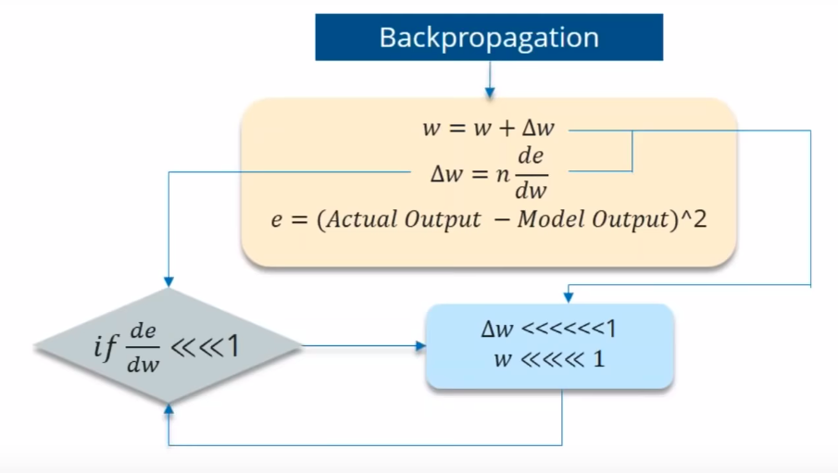
Vanishing gradient
For ex:- Lets say the value decreased like 0.863 →0.532 →0.356 →0.192 →0.117 →0.086 →0.023 →0.019..
Notes:
While you are using Backpropogating through time, you find Error is the difference of Actual and Predicted model. Now what if the partial derivation of error with respect to weight is very less than 1?
If the partial derivation of Error is less than 1, then when it get multiplied with the Learning rate which is also very less. then Multiplying learning rate with partial derivation of Error wont be a big change when compared with previous iteration.
For ex:- Lets say the value decreased like 0.863 →0.532 →0.356 →0.192 →0.117 →0.086 →0.023 →0.019..
you can see that there is no much change in last 3 iterations. This Vanishing of Gradience is called Vanishing Gradience.

Slide 12
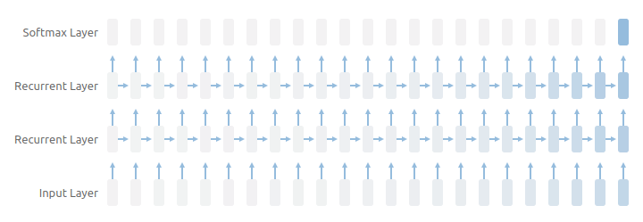
Vanishing Gradient

Slide 13
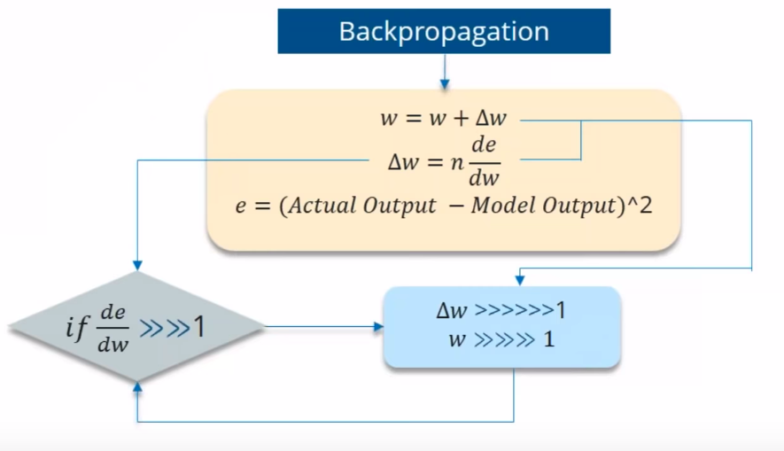
Exploding Gradient

Slide 14
How can you overcome the Challenges of Vanishing and Exploding Gradience?
Vanishing Gradience can be overcome with
Relu activation function.
LSTM, GRU.
Exploding Gradience can be overcome with
Truncated BTT(instead starting backprop at the last time stamp, we can choose similar time stamp, which is just before it.)
Clip Gradience to threshold.
RMSprop to adjust learning rate.

Slide 15
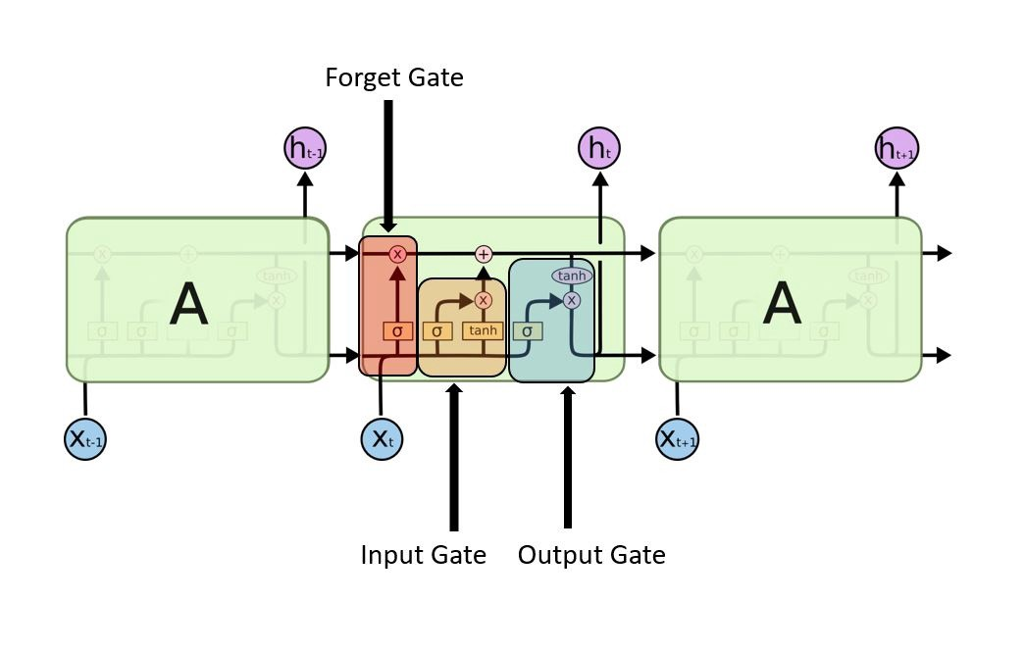
LSTM
Notes:
LSTM’s have a Nature of Remembering information for a long periods of time is their Default behaviour.
LSTM had a three step Process:
look at the below figure that says Every LSTM module will have 3 gates named as Forget gate, Input gate, Output gate.
Forget Gate:
Decides how much of the past you should remember.
This gate Decides which information to be omitted in from the cell in that particular time stamp. It is decided by the sigmoid function.
Update Gate/input gate:
Decides how much of this unit is added to the current state.
Sigmoid function decides which values to let through 0,1. and tanh function gives weightage to the values which are passed deciding their level of importance ranging from-1 to 1.
Output Gate:
Decides which part of the current cell makes it to the output.
Sigmoid function decides which values to let through 0,1. and tanh function gives weightage to the values which are passed deciding their level of importance ranging from-1 to 1 and multiplied with output of Sigmoid.

Slide 16
Advantages & Disadvantages
Advantages of Recurrent Neural Network
The main advantage of RNN over ANN is that RNN can model sequence of data (i.e. time series) so that each sample can be assumed to be dependent on previous ones
Recurrent neural network are even used with convolutional layers to extend the effective pixel neighborhood.
Disadvantages of Recurrent Neural Network
Gradient vanishing and exploding problems.
Training an RNN is a very difficult task.
It cannot process very long sequences if using tanh or relu as an activation function.

