Slide 1
Time Series
CNN RNN

Slide 2
Agenda
Introduction Time Series
Deep learning with Time Series
Multi layer Perceptron
Convolutional Neural Network
LSTM
Hybrid CNN-LSTM

Slide 3
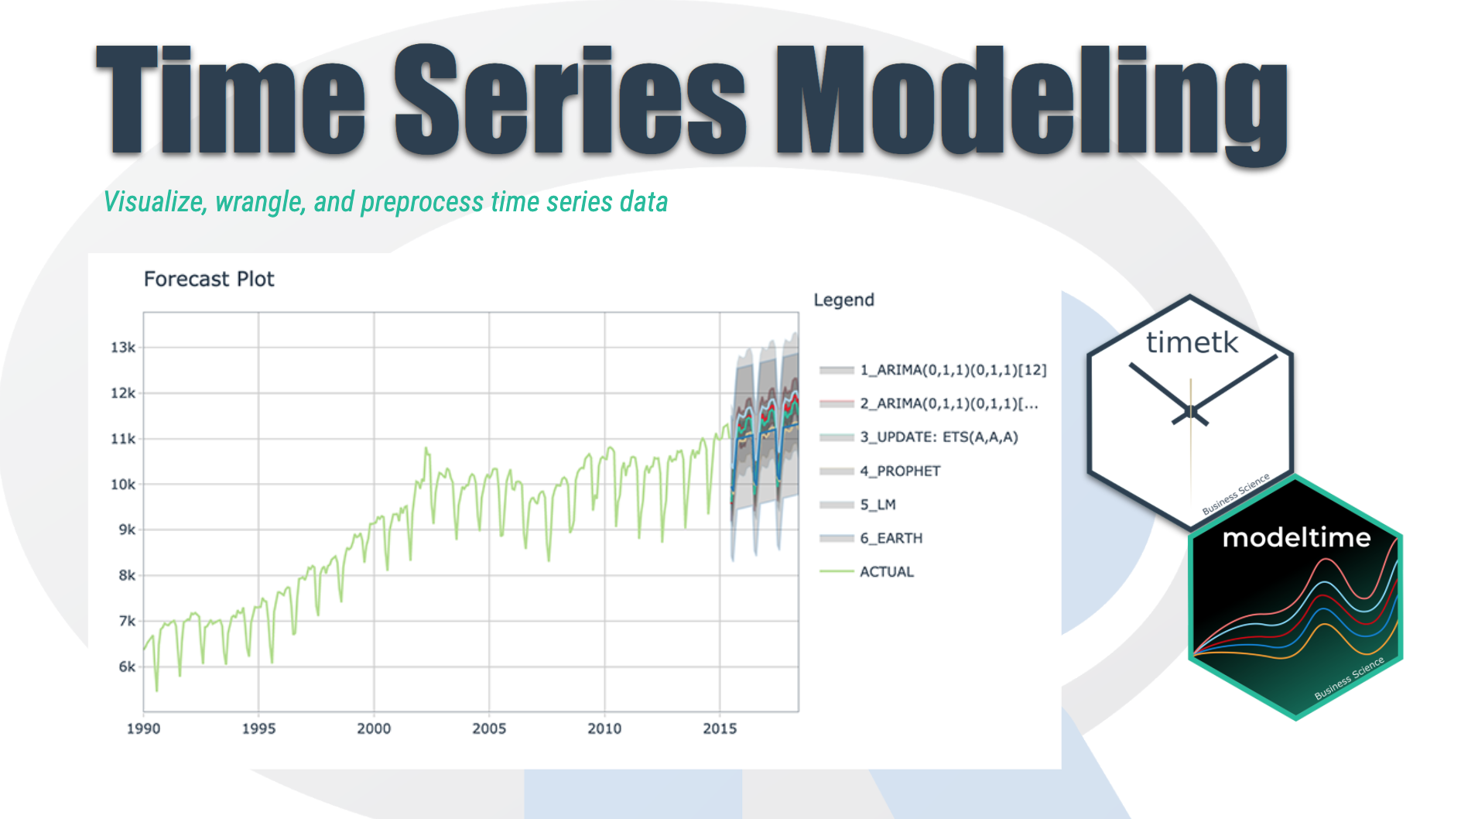
Time Series Introduction
We're going to discover how it differs from other types of data you've previously encountered and why
Time series is a sequence of information which attaches a time period to each value
The value can be pretty much anything measurable.
It depends on time in some way, like prices, humidity or number of people.
As long as the values we record are unambiguous, any medium could be measured with Time series.
There aren't any limitations regarding the total time span of our Time series.
It could be a minute, a day, a month or even a century.
All we need is a starting and an ending point.

Slide 4
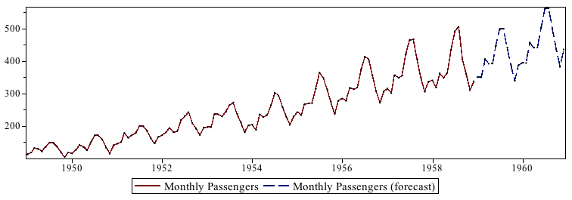
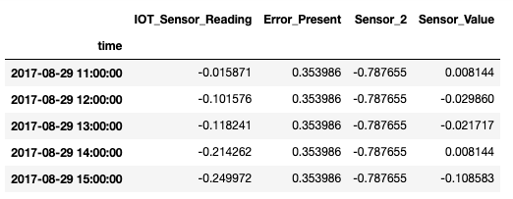
Time Series Basics
Chronological Data
Cannot be shuffled
Each row indicate specific time record
Train – Test split happens chronologically
Data is analyzed univariately and multivariately (for given use case)
Nature of the data represents if it can be predicted or not

Slide 5
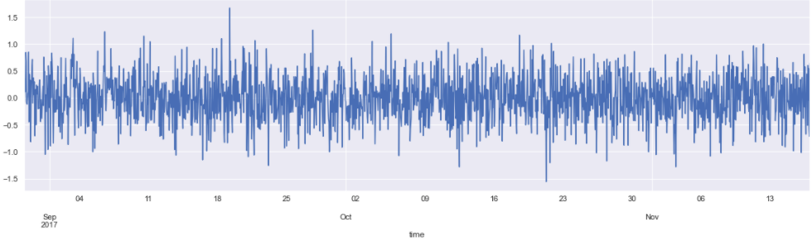
Data Examining & Preprocessing
Reading Data using Pandas – describe, head
Check for null values
Line plot for each feature
Convert Date from String to Date time feature
Setting the desired frequency
Handling missing Values
QQ plots

Slide 6
Deep Learning Time Series
Deep Learning has become a fundamental part of the new generation of Time Series Forecasting models, obtaining excellent results
While in classical Machine Learning models - such as autoregressive models (AR) or exponential smoothing - feature engineering is performed manually and often some parameters are optimized also considering the domain knowledge, Deep Learning models learn features and dynamics only and directly from the data.
Thanks to this, they speed up the process of data preparation and are able to learn more complex data patterns in a more complete way.

Slide 7
It is well known that these traditional Machine Learning models have many limitations:
missing values can really affect the performance of the models;
they are not able to recognize complex patterns in the data;
they usually work well only in few-steps forecasts, not in long term forecast.
The use of Deep Learning for Time Series Forecasting overcomes the traditional Machine Learning disadvantages with many different approaches. In this series, 4 different Deep Learning Architecture for Time Series Forecasting are presented:
Multilayer Perceptron
CNN
LSTM
CNN+LSTM

Slide 8
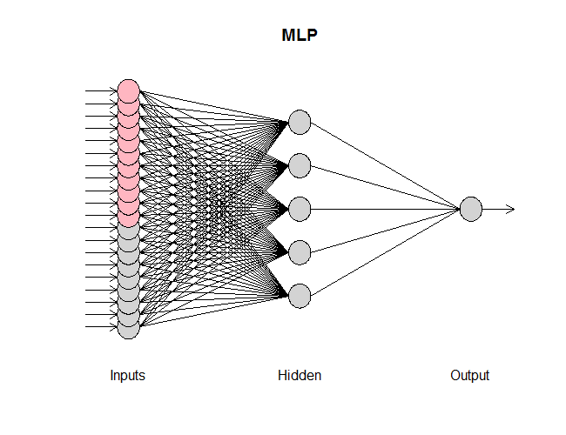
Multilayer Perceptron Time Series
Multilayer Perceptrons, or MLPs for short, can be applied to time series forecasting.
Univariate time series are a dataset comprised of a single series of observations with a temporal ordering and a model is required to learn from the series of past observations to predict the next value in the sequence.
Before a univariate series can be modeled, it must be prepared.
The MLP model will learn a function that maps a sequence of past observations as input to an output observation. As such, the sequence of observations must be transformed into multiple examples from which the model can learn.

Slide 9
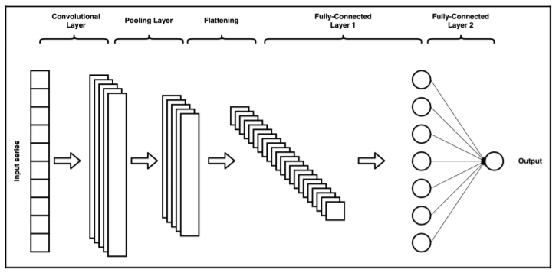
CNN Time Series
Deep CNNs have been quite popular in areas such as Image Processing, Computer Vision, etc. Recently, the research community has been showing a growing interest in using CNNs for time-series forecasting problems.
we will proceed to understand the primary components of a Deep CNN model and understand how these components are also used for time series forecasting. Following are the primary layers of an ordinary CNN model.
1. Convolutional Layer
2. Pooling Layer
3. Fully Connected Layer

Slide 10
CNN Time Series Cont’
Deep CNN model which was able to learn the pattern in the sequence and predict the output accurately.
CNN models are popular for detecting the patterns in the pixel matrix via their convolutional layers.
Similarly, upon suitable treatment, patterns (cyclical and trend components) in the time series data could be learned effectively by the CNN model.
Advanced CNN architecture, combined with other Deep Learning models such as LSTM could yield better performance.

Slide 11
Long Short-Term Memory (LSTM)
Long short-term memory (LSTM) is an artificial recurrent neural network (RNN) architecture used in the field of deep learning. Unlike standard feedforward neural networks, LSTM has feedback connections. It can not only process single data points (e.g. images), but also entire sequences of data (such as speech or video inputs).
Long Short-Term Memory Networks (LSTM) have been developed to overcome the vanishing gradient problem in the standard RNN by improving the gradient flow within the network
LSTMs can be used to model univariate time series forecasting problems.
These are problems comprised of a single series of observations and a model is required to learn from the series of past observations to predict the next value in the sequence.
The LSTM model will learn a function that maps a sequence of past observations as input to an output observation. As such, the sequence of observations must be transformed into multiple examples from which the LSTM can learn.

Slide 12
LSTM Time Series
A Vanilla LSTM is an LSTM model that has a single hidden layer of LSTM units, and an output layer used to make a prediction.
Key in the definition is the shape of the input; that is what the model expects as input for each sample in terms of the number of time steps and the number of features.
With a univariate series, the number of features is one, for one variable
We will predict only a single step value, or more formally, we can say using past values, we will predict only one value for the future. This is why the whole method can be called an LSTM univariate single step type.

Slide 13
Hybrid CNN LSTM Time Series
In Machine Learning, you can now predict values on complex data by using Neural Networks. And for the majority of them, you will send one or several inputs to be analysed. Sometimes, these values are chronological.
For example stock prices in time, video frames, or human-size at a certain age in its life. For this kind of data, we already have some nice layers to treat data in the time range, for example, LSTM. But what if you need to adapt each input before or after this layer? This is where Time Distributed layer can give a hand.

Slide 14
Hybrid CNN LSTM Time Series
The benefit of this model is that the model can support very long input sequences that can be read as blocks or subsequences by the CNN model, then pieced together by the LSTM model.
When using a hybrid CNN-LSTM model, we will further divide each sample into further subsequences. The CNN model will interpret each sub-sequence and the LSTM will piece together the interpretations from the subsequences. As such, we will split each sample into 2 subsequences of 2 times per subsequence.
The CNN will be defined to expect 2 timesteps per subsequence with one feature. The entire CNN model is then wrapped in TimeDistributed wrapper layers so that it can be applied to each subsequence in the sample. The results are then interpreted by the LSTM layer before the model outputs a prediction.

