Slide 1
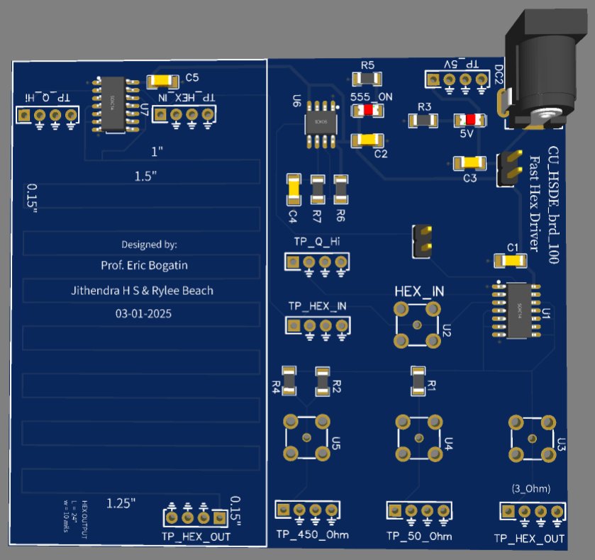
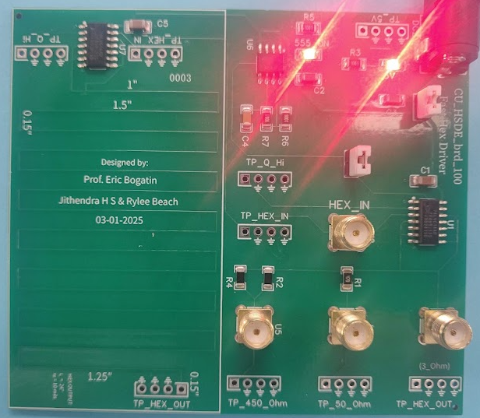
PRJ 100 : Fast Hex Driver

Slide 2
Characterize
5V and 555 timer
Q high Noise
Hex inverter
TD between peaks in the ringing
3, 50, 450ohm at 1M
3, 50, 450ohm at 50ohm

Slide 3
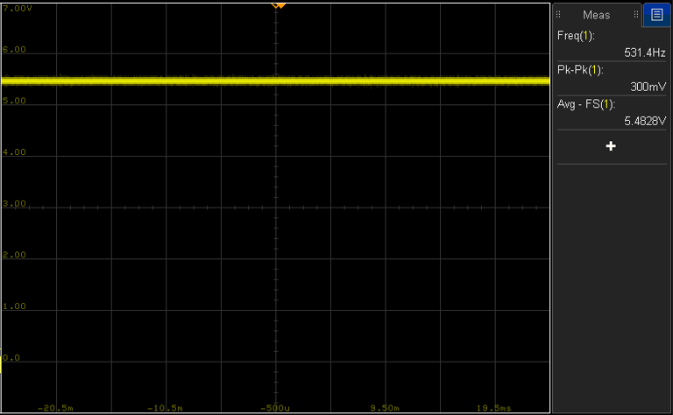
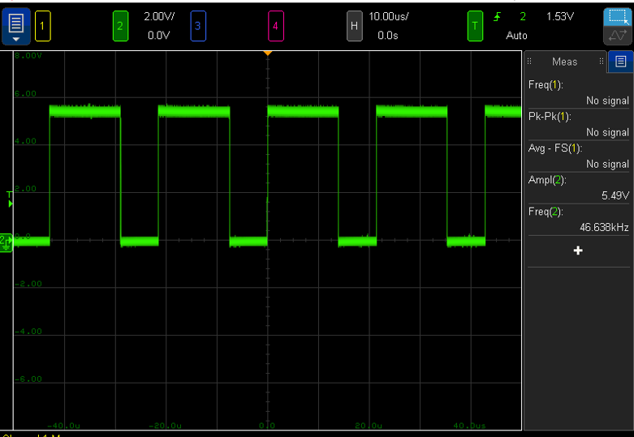
5V and 555 timer
5V rail with no switching load
555 timer o/p

Slide 4
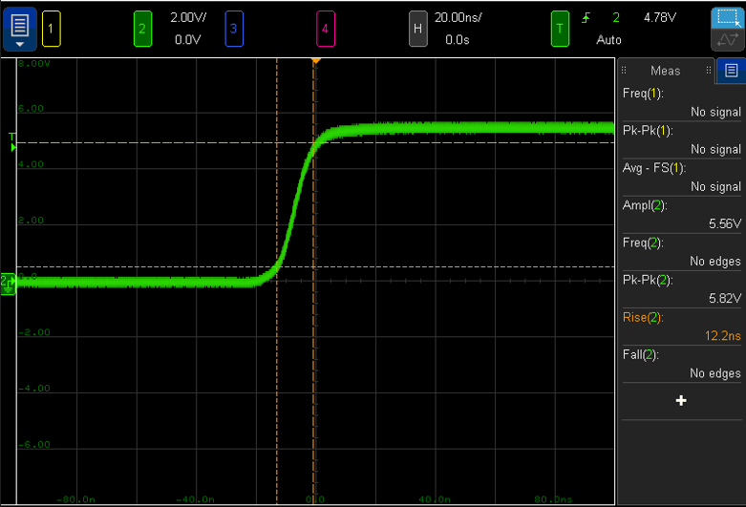
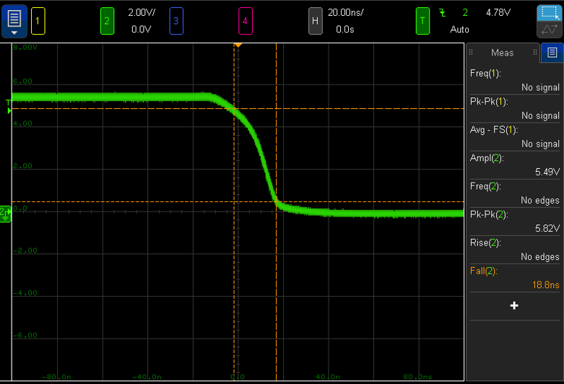
555 timer Rise & fall time

Slide 5
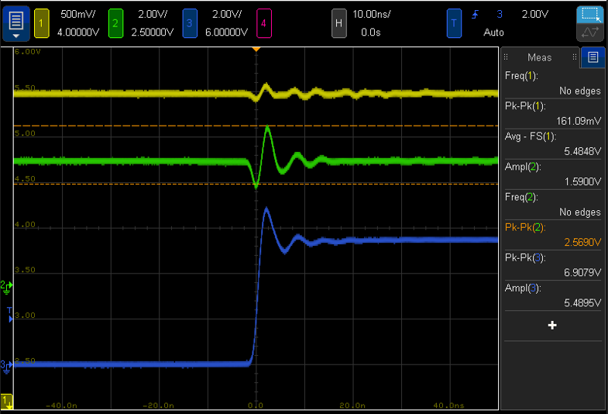
Q Hi noise
5V rail
Q hi
Hex inverter o/p

Slide 6
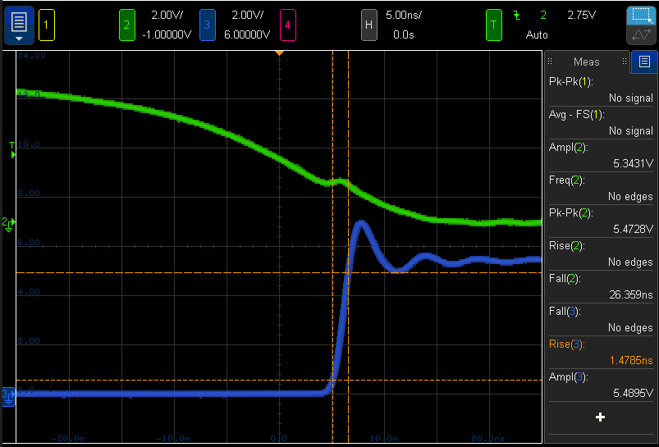
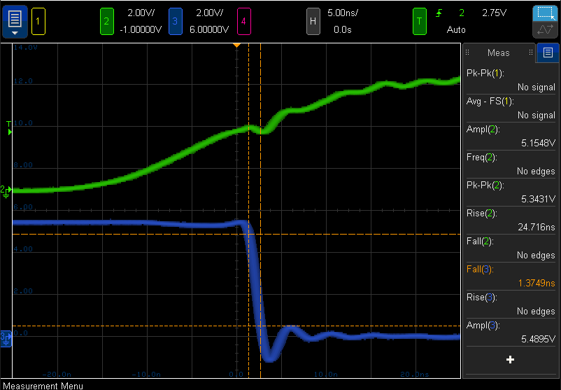
Hex inverter
555 timer falling edge
555 timer rising edge
Hex inverter o/p rising edge
Hex inverter o/p falling edge

Slide 7
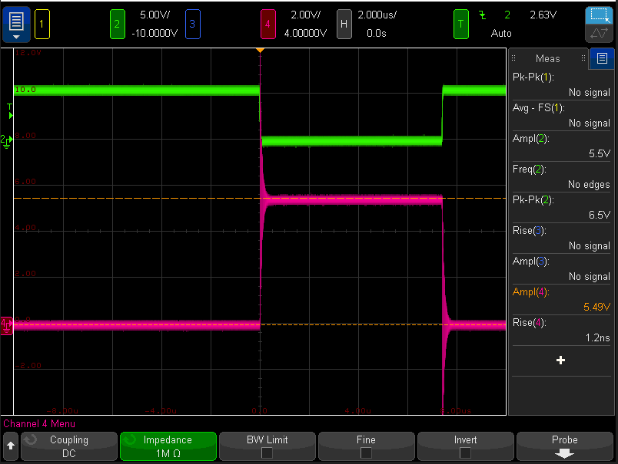



Thevenin resistance
~3Ω

Slide 8
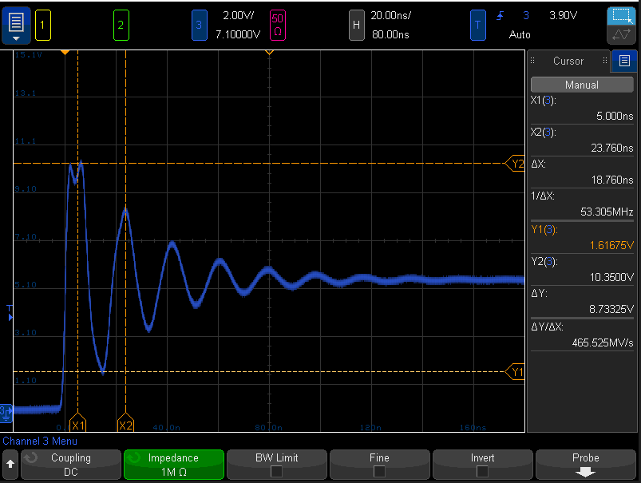
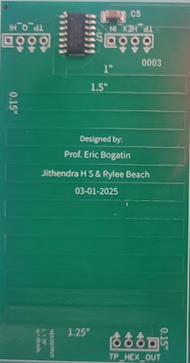
Time delay between peaks in the Ringing
24inch long
For an FR4 substrate, the signal velocity is approximately 6 inches/ns. The spatial extent of the 24-inch trace takes a time delay (TD) of 4 ns. According to the bounce diagram, peaks occur at 4TD, so the expected peak is at 16 ns. However, the measured peak was 18.76 ns due to the parasitic capacitance of the probe.

Slide 9
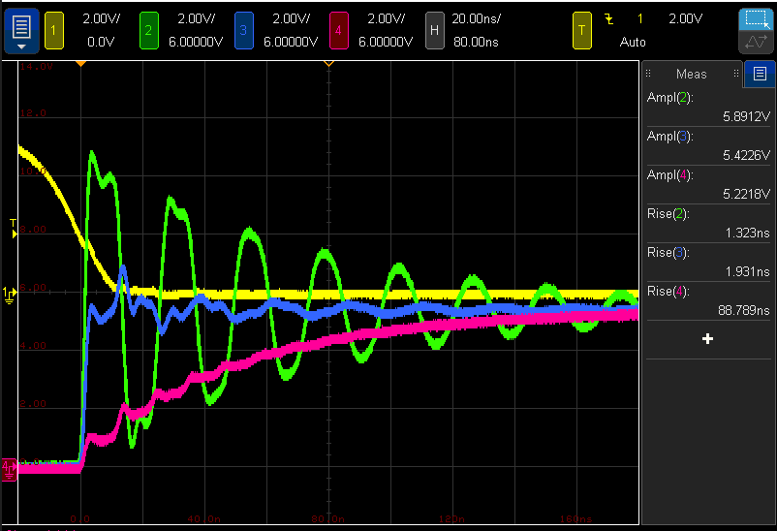
3, 50, 450Ω output impedance VS 1M at scope
Hex inverter I/P
Hex inverter O/P Z =3Ω
Hex inverter O/P Z = 50Ω
Hex inverter O/P Z = 450Ω

Slide 10
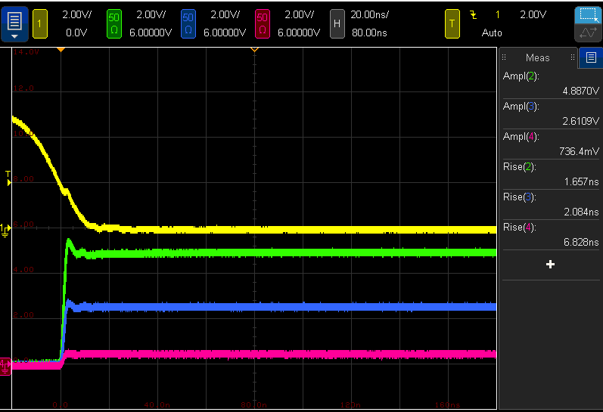
3, 50, 450Ω output impedance VS 50Ω at scope
Acts as a voltage divider
Hex inverter I/P
Hex inverter O/P Z =3Ω
Hex inverter O/P Z = 50Ω
Hex inverter O/P Z = 450Ω

Slide 11
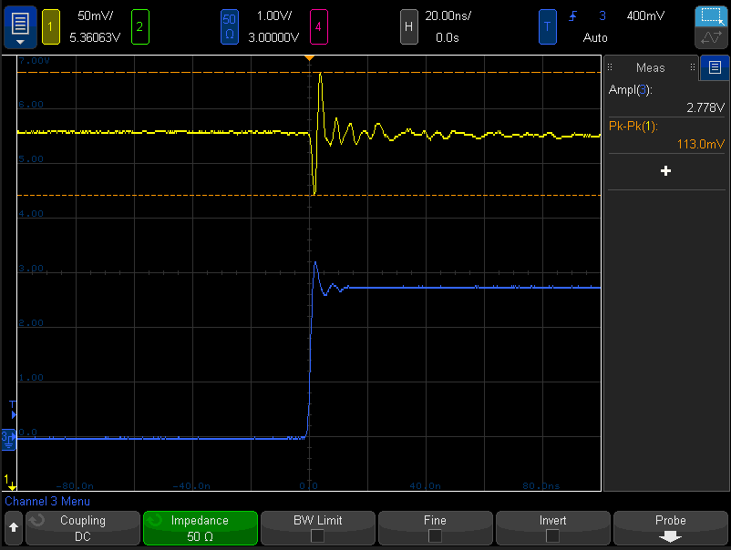
reflection at matched 50Ω impedance?
5V Power rail noise
Hex inverter O/P Z = 50Ω

