Slide 1
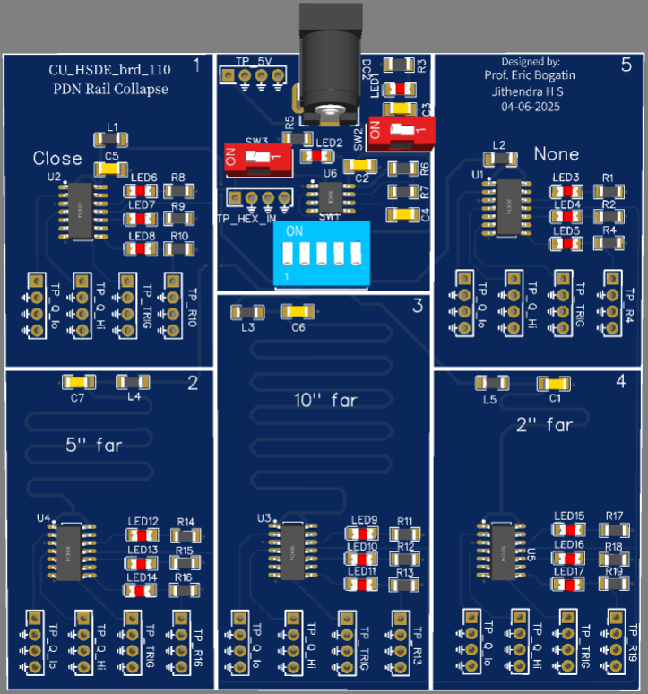
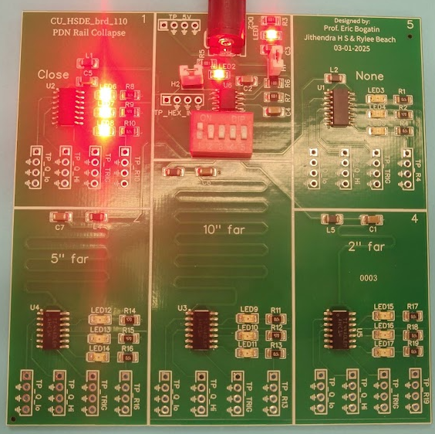
PRJ 110: PDN Rail collapse

Slide 2
Characterize
5V and 555 timer
Rth of the inverter
Current through LED
Ferrite bead filter effect
Qhi and Qlo noise comparison Table
Rise time comparison

Slide 3
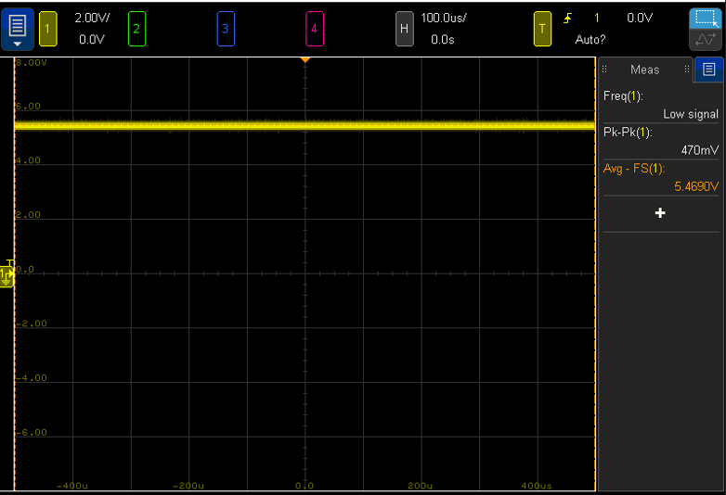
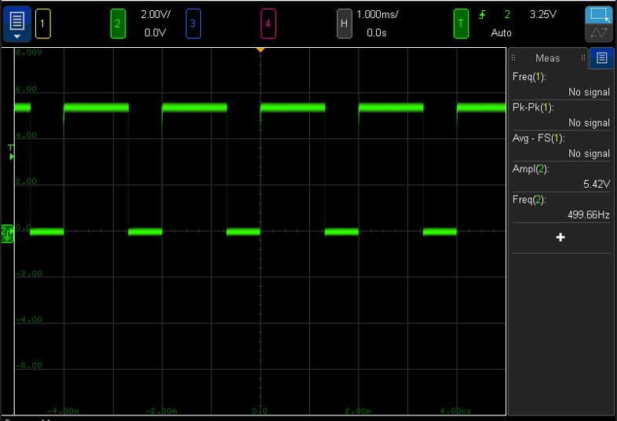
5V and 555 timer
5V rail with no switching load
555 timer o/p

Slide 4
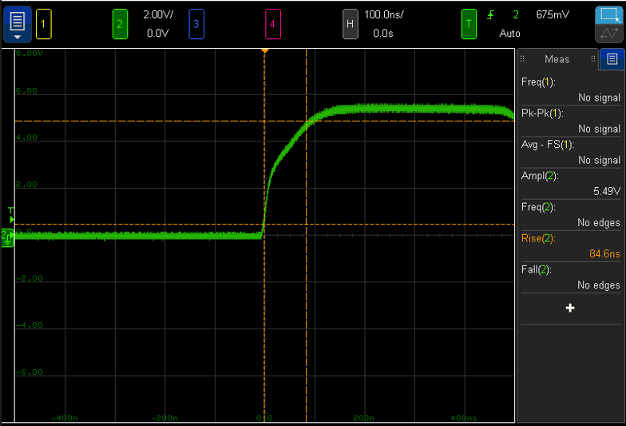
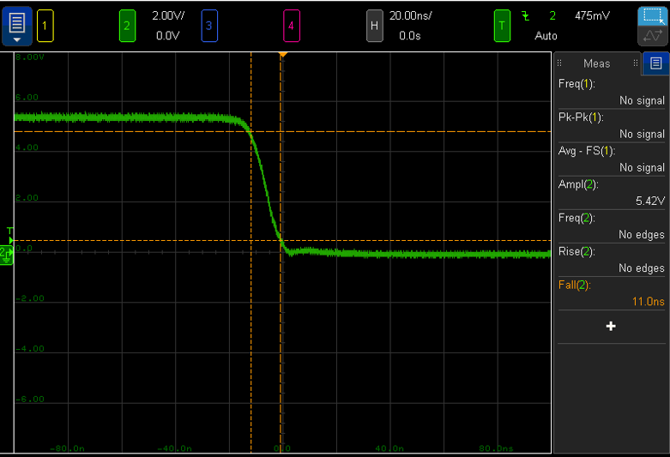
555 timer Rise & fall time

Slide 5
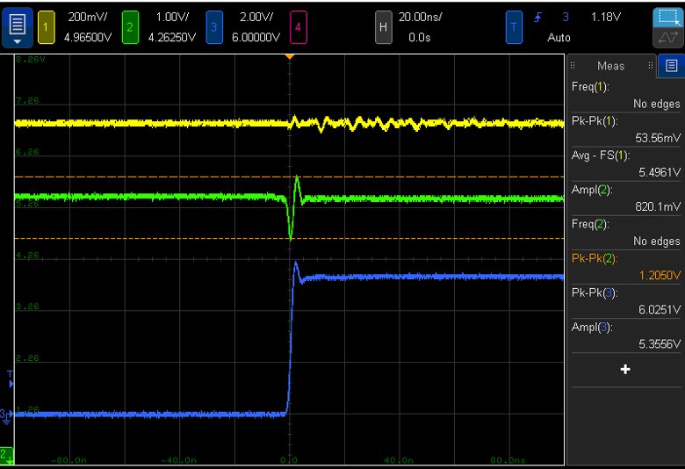
Q Hi noise
5V rail
Q hi
Hex inverter o/p

Slide 6
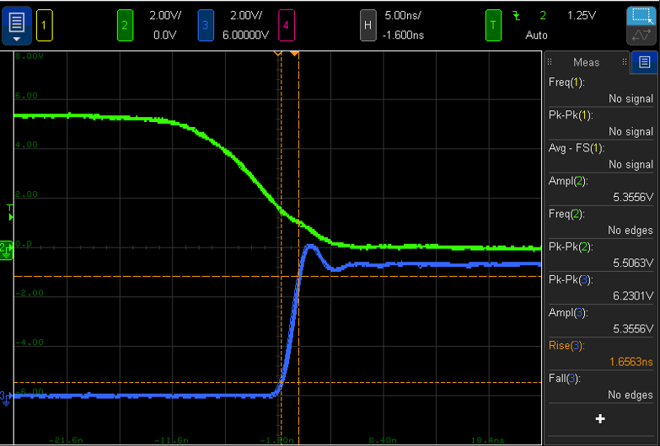
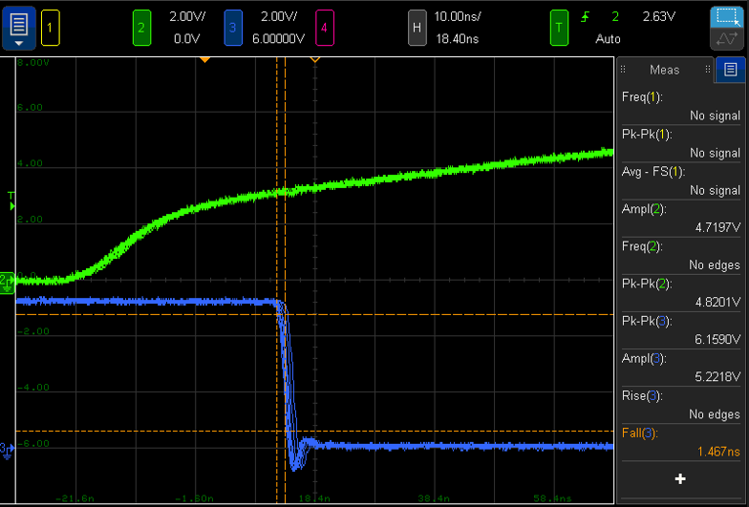
Hex Inverter
555 timer falling edge
555 timer rising edge
Hex inverter o/p rising edge
Hex inverter o/p falling edge

Slide 7
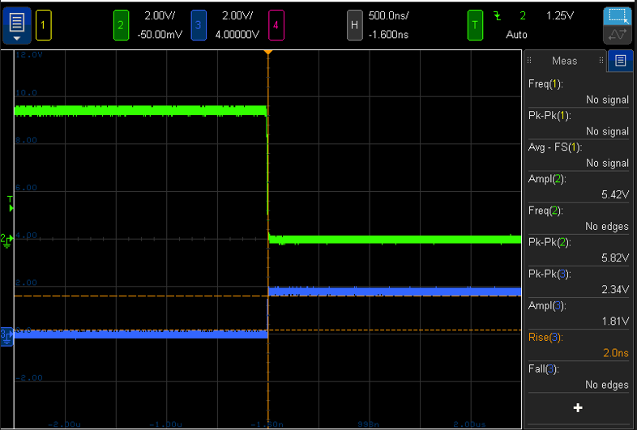
Current Through LED
I = V/R
I = 1.81/47
I = 38.5mA
Rth = 47 *(5.3 – (2 + 1.81))/ (2 +1.81)
Rth = 18.3Ω

Slide 8
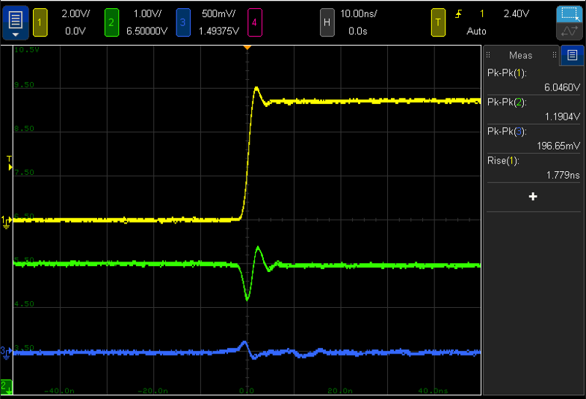
Decap closeby:
Hex trigger
Q hi
Q lo

Slide 9

2inches away:
Hex trigger
Q hi
Q lo

Slide 10
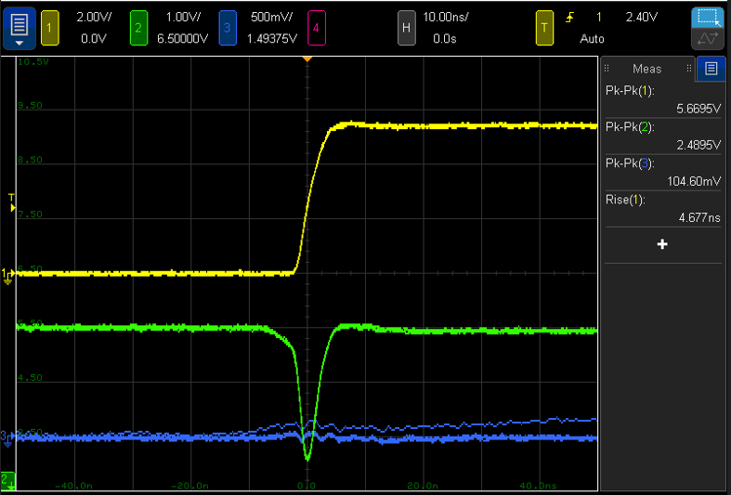
5inches away:
Hex trigger
Q hi
Q lo

Slide 11
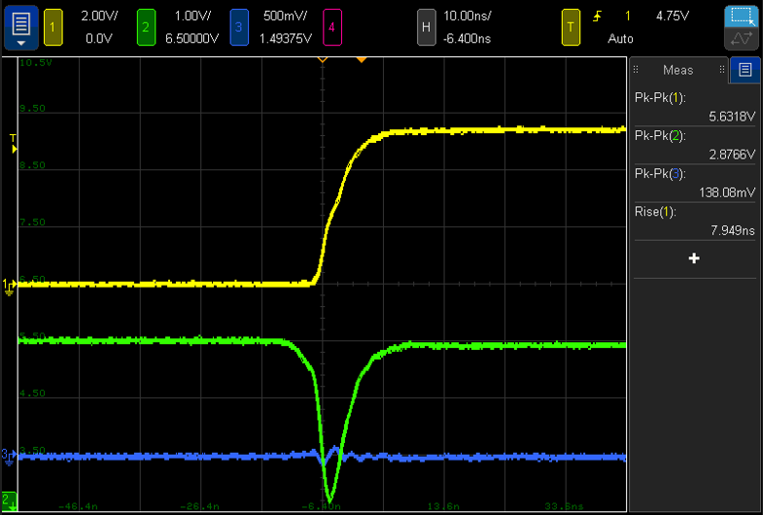
10 inches away:
Hex trigger
Q hi
Q lo

Slide 12
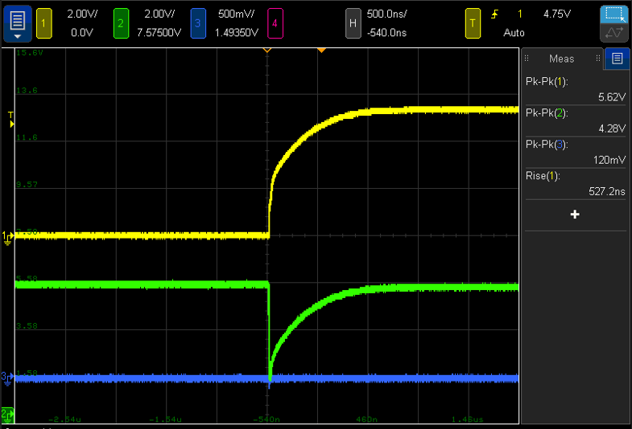
No Decap:
Hex trigger
Q hi
Q lo

Slide 13
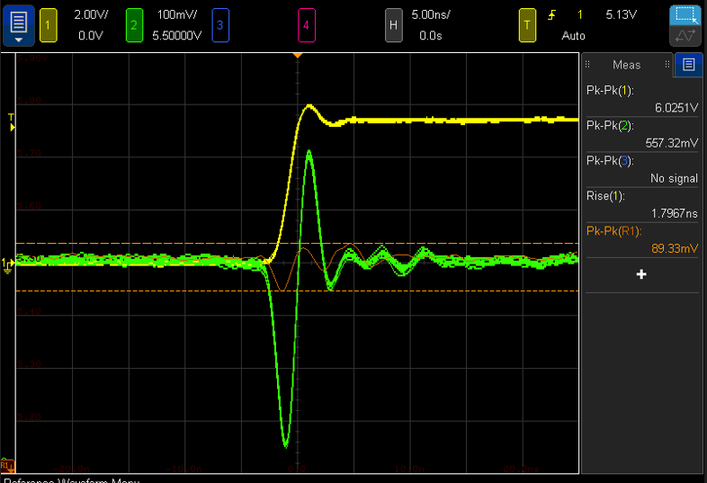
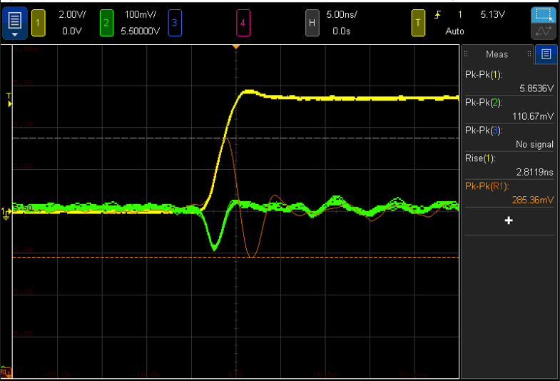
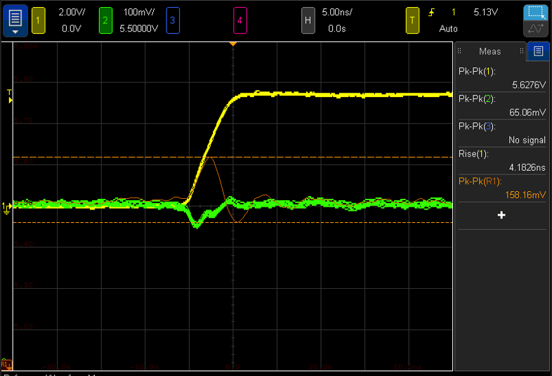
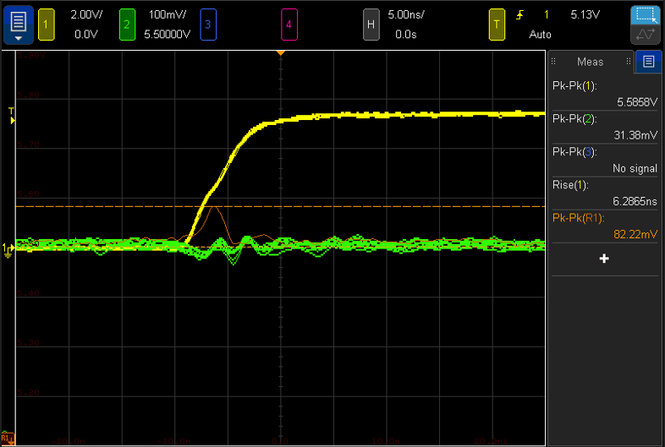
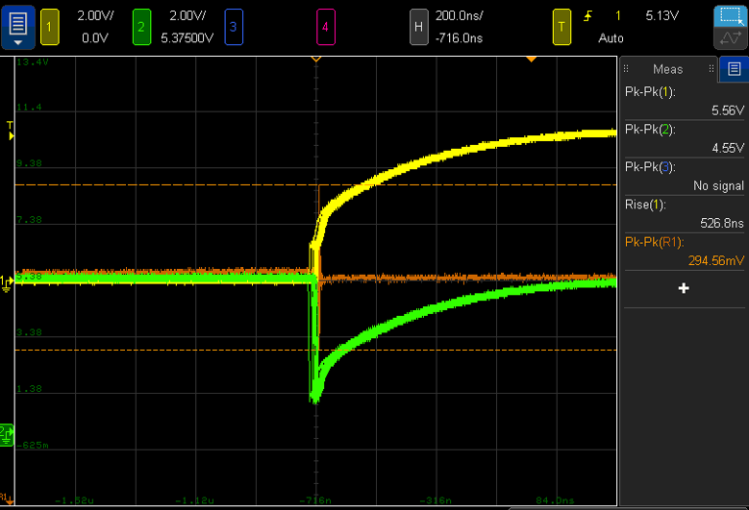
Ferrite bead filter effect

Slide 14
Comparison
Decap placement | Rise time(nsec) | Q hi(V) | Q lo(mV) | Power rail Noise before ferrite(mV) | Power rail Noise after ferrite(mV)
Close | 1.78 | 1.2 | 196 | 89 | 557
2 inch | 2.98 | 2.16 | 138 | 285 | 110
5 inch | 4.67 | 2.48 | 104 | 158 | 65
10 inch | 7.9 | 2.87 | 138 | 82.22 | 31.38
No cap | 527 | 4.28 | 120 | 294 | 4.55V

Slide 15
