Slide 1

ECEN 5823 Spring 2024​
University of Colorado, Boulder
IoT Embedded Firmware: Course Project Plant Observatory System Demonstration​
Team 17 : Jithendra H S, Suhas S R

Slide 2
Overview​
As we are a team of two, we chose Option 2.​
The Plant Observatory System is a prototype designed to monitor greenhouse or plant nursery environments to maintain optimal conditions for plant growth.​
The system consists of two nodes:​
A Low Power Node that monitors ambient environmental conditions, and​
A Central Node that connects to the Low Power Node, logs data to an SD card, and simultaneously connects to the Si Connect app for real-time monitoring.​

Slide 3
Requirements
Central Node (CN)​
Must act as a GATT Client to the Low Power Node (LPN), receive environmental data, and log it to an SD card.​
Must act as a GATT Server to the Si Connect mobile app and maintain simultaneous connections with both the app and the LPN.​
Operates in Energy Mode EM1 during data logging to SD card and transitions to EM2 (sleep mode) when idle to conserve power.

Slide 4
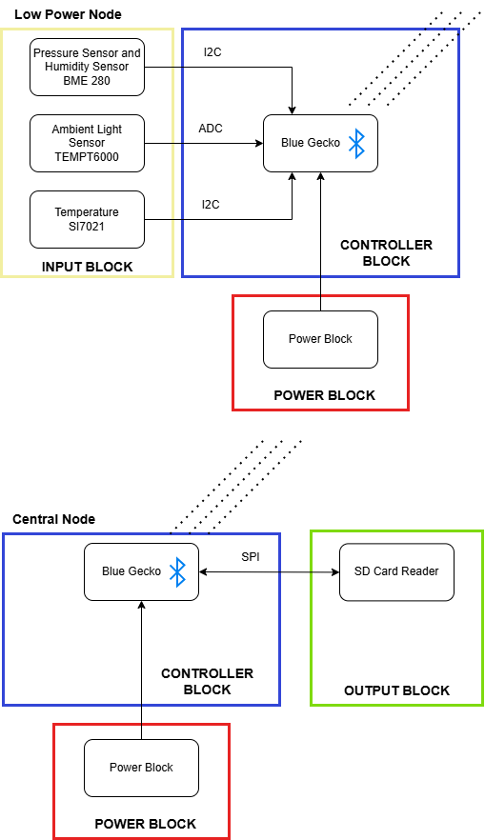
Hardware design flow
Our project consists of two Bluetooth nodes. One acts as a low-power node that periodically collects sensor data and sends it to the other node, called the central node. The central node processes the received data and stores it on an SD card for historical analysis.​
Sensors & storage in our system:​
BME280(Pressure sensing)​
TEMPT6000(Light sensing)​
Si7021(Temperature)​
SD card

Slide 5
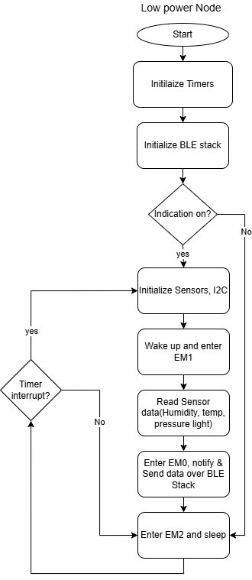
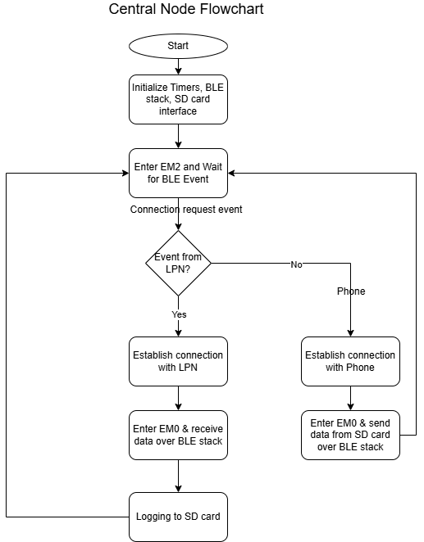
Software flow
Low power node
Central node

Slide 6
Data types and data flow
SD Card Read Service (UUID FFF3)
Characteristics | Characteristics UUID | Characteristics ID | Length (Bytes)
Read Temperature | 2B01 | read_temperature | 36
Read Pressure | 2B02 | read_pressure | 36
Read Humidity | 2B03 | read_humidity | 36
Read Luminosity | 2B04 | read_luminosity | 36
Ambient Luminosity (UUID FFF2)
Characteristics | Characteristics UUID | Characteristics ID | Length (Bytes)
Measure Luminosity | 2D01 | measure_luminosity | 17
Ambient Humidity and Pressure (UUID FFF1)
Characteristics | Characteristics UUID | Characteristics ID | Length (Bytes)
Measure Humidity | 2C01 | measure_humidity | 17
Measure Pressure | 2C02 | measure_pressure | 17
Ambient Temperature (UUID FFF4)
Characteristics | Characteristics UUID | Characteristics ID | Length (Bytes)
Measure Temperature | 2E01 | measure_temperature | 17
Enable Indications | 2E02 | Enable_indications | 1

Slide 7
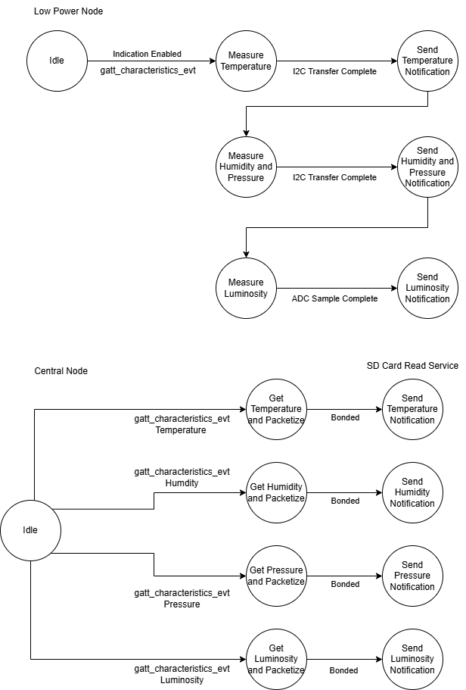
Data types and data flow

Slide 8
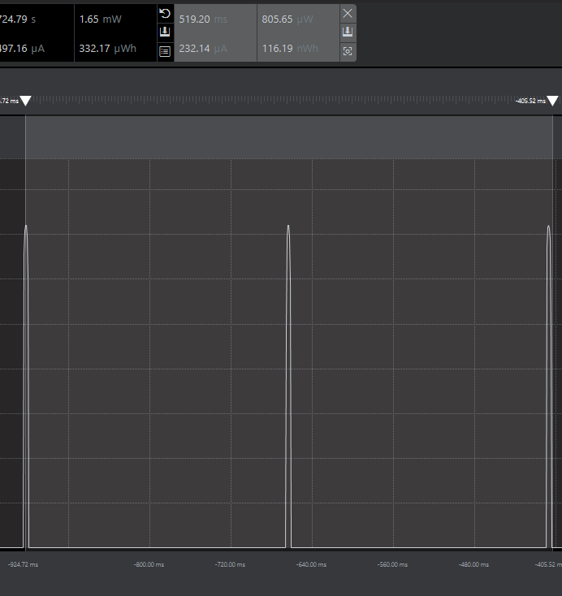
Energy Profile

Slide 9
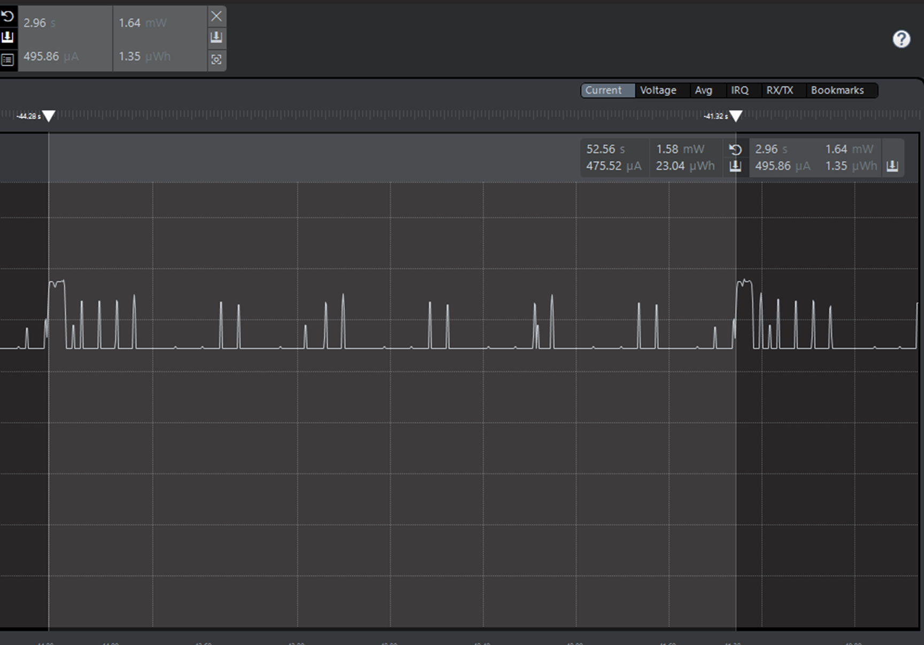
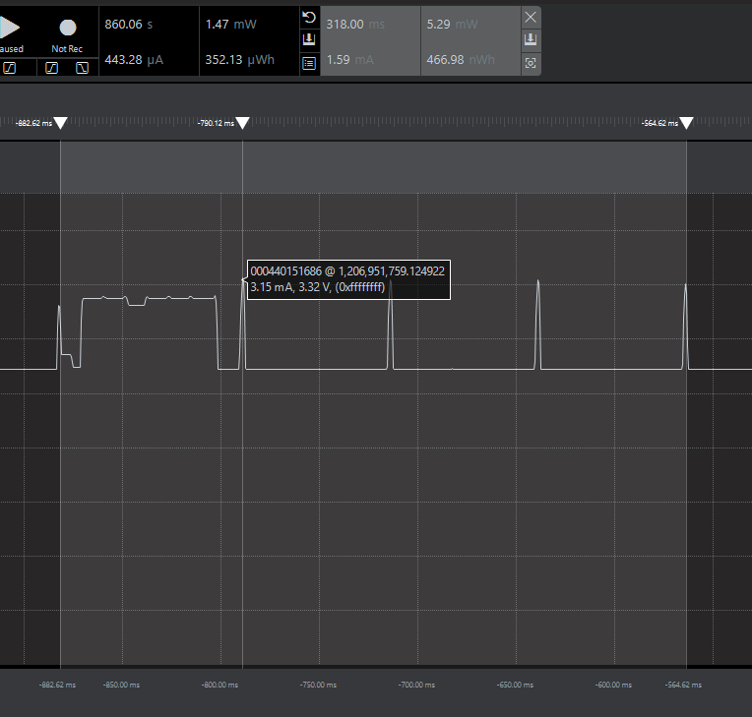
Energy Profile - LPN

Slide 10
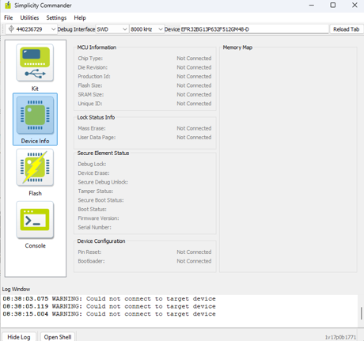
Challenges and Blockages
The basic SD card interface was tested successfully, but at times, we were unable to flash the code. To recover the board from a bricked state, we had to perform several steps, such as:​
Unlocking debug access​
Recovering the board​
Uploading the bootloader​
These steps took considerable time to restore the board for further development. Since the root cause is still unclear, we decided not to incorporate the SD card into the production code to avoid potential flashing issues for the demo.​

Slide 11
Demo!

Slide 12


Thank you

Slide 13
Questions?

