Slide 1
7.3.4 Using power amplifiers as high current buffers in low Z VNA measurements
Presented by:
Jithendra H S

Slide 2
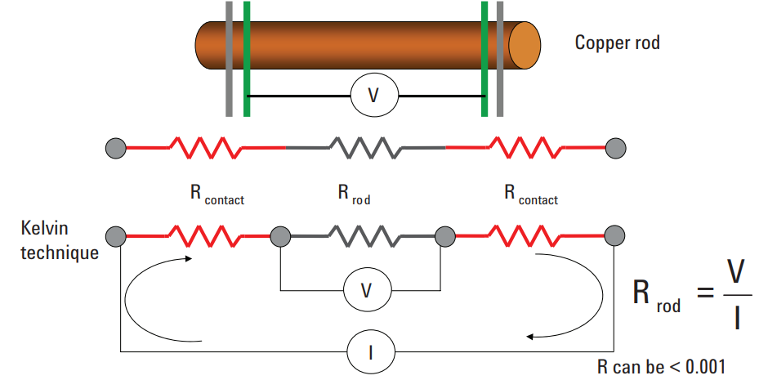
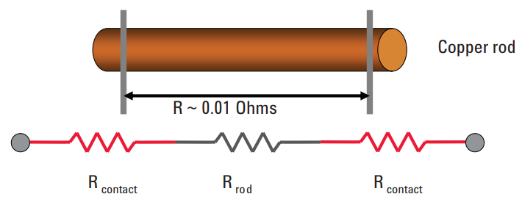
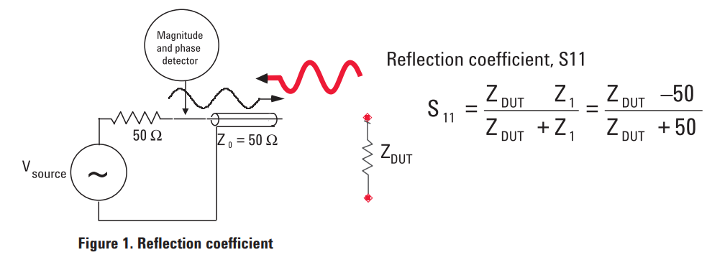
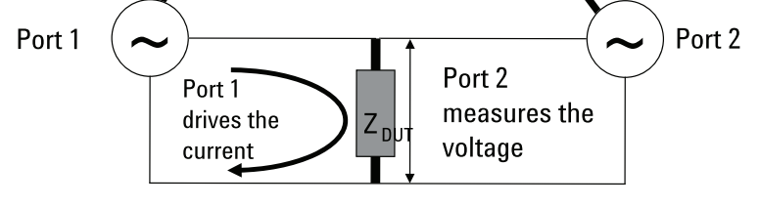
What?
Low Z(PDN impedance):
Impedance in terms mΩ
Package leads
Ceramic capacitors
On-chip capacitance
Power and ground planes
VRM impedance
Impedance measuring methods:
Conventional(DMM)
4 wire(DMM)
1-port(VNA)
2-port(VNA)
Conventional
4-Wire
1-port
2-port

Slide 3
Why?
2-Port Method:
The current from port 1 is limited by the 50-ohm resistance of the VNA source.
This current flows through the low impedance of the DUT, generating a very small voltage across the DUT.
The voltage across the DUT is launched into port 2, where it is received and measured.
The voltage ratio, S21​ (voltage at port 2 to the source voltage from port 1), provides information about the DUT's small impedance.
Current-Amplified 2-Port method:
When the measured voltage level is near the noise floor of the VNA, it becomes challenging to accurately differentiate the low impedance of the DUT.
To overcome this, an amplifier is introduced to:
Boost the voltage, which increases the current across the DUT.
Create a larger voltage drop across the DUT, making it easier for port 2 to measure the impedance.

Slide 4
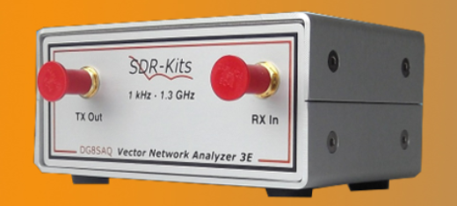
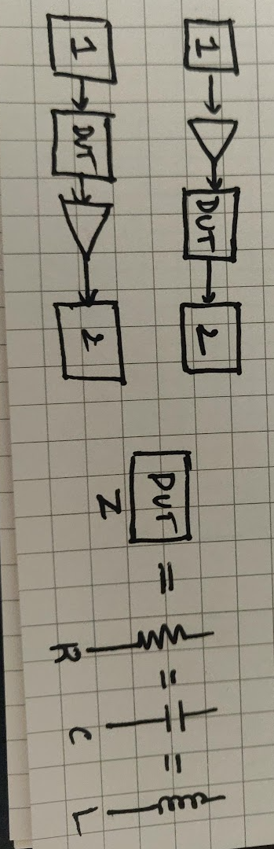
How?
Know the measuring device features and limitations:
Bandwidth:- Measuring amplitude at selected frequency
Noise floor:- Measuring S21 by keeping port 2 open
Power level:- Maximum operating power of ports
Settings for measurements:
1KHz-1GHz Bandwidth
Logarithmic sweep(1000 points)
Test known low Z components for correctness:
Characterization: Measurement
Analysis: Simulation
Selection of power amplifier
Constant insertion loss within the Bandwidth
Low output impedance
Which is better?
Pre-amp
Post amp

Slide 5
Timeline
Week | Tasks | Remarks
1 | Introduction | Completed
2 & 3 | Understanding the VNA | Completed
4 & 5 | Selecting the Power amplifier, look for better options | Completed
6 & 7 | Results interpretation and Model simulation | On-track
8 & 9 | Report preparation and corrections
10 | Buffer!!!
Project 1:
Low Z measurement
Week | Tasks | Remarks
6 & 7 | Introduction
8 & 9 | Characterize set of existing board, Update board design(spin 1)
10 & 11 | Characterize spin 1 boards, Update board design(spin 2)
12 & 13 | Results interpretation and Model simulation
14 & 15 | Report preparation and corrections
16 | Buffer!!!
Project 2:
USB Signal sniff boards

Slide 6
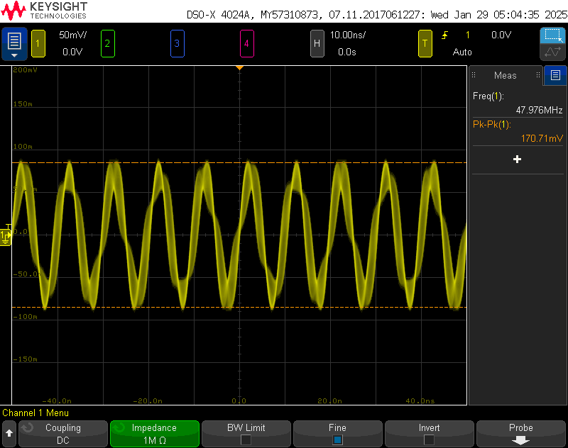
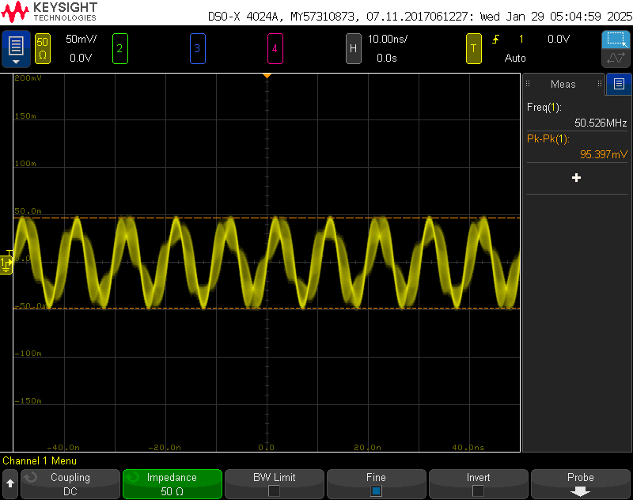
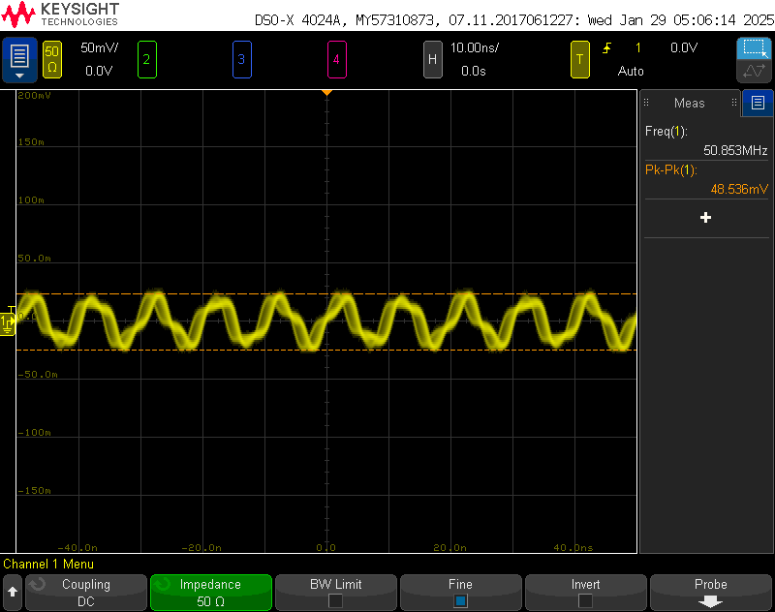
Week 3: Understanding the VNA
Port 1 output:
Max power output : -10dBm
Low power output: -17dBm
Not ideal sine wave : due to frequency sweep
The voltage reduced to half when the oscilloscope channel was switched from high impedance to 50Ω. According to the voltage divider circuit, half the voltage drop occurs across the load resistance only when it is equal to the internal resistance. Therefore, the internal resistance is equal to 50Ω.
200mVpp at High Z
100mVpp at 50ohm
50mVpp at 50ohm with a -6dB attn

Slide 7
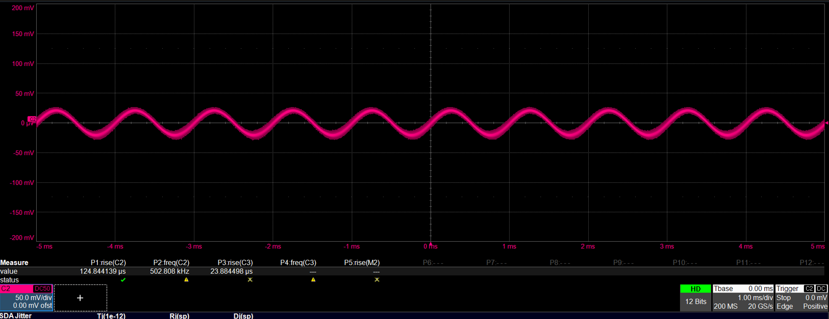
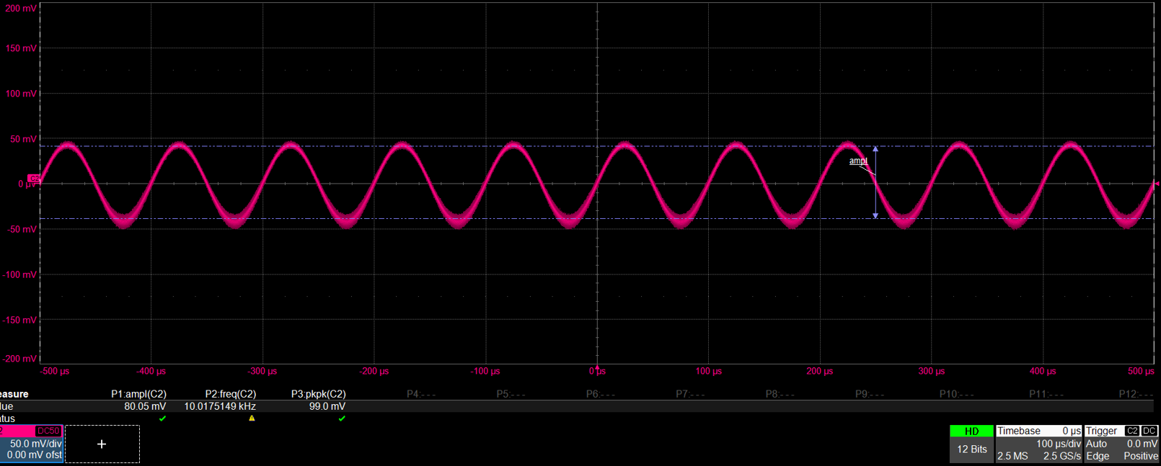
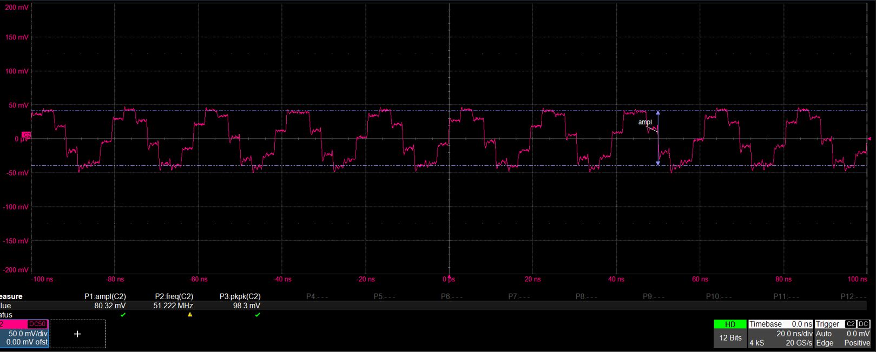
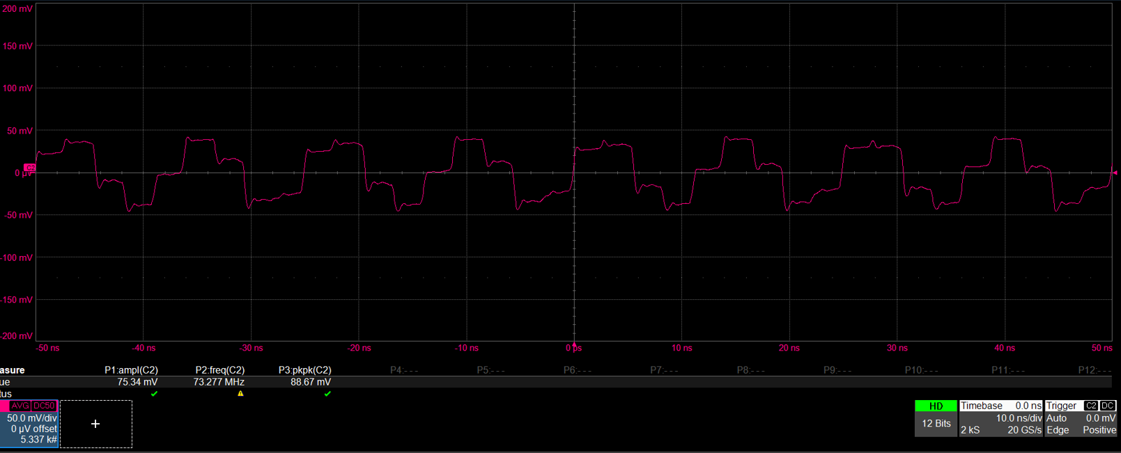
With High BW scope
1KHz: attenuated
10KHz: ~100mVpp
50MHz: ~100mVpp
1GHz: Not sure of what is happening

Slide 8
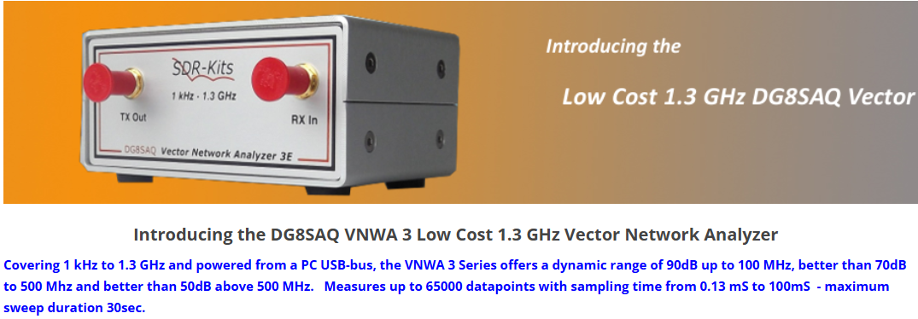
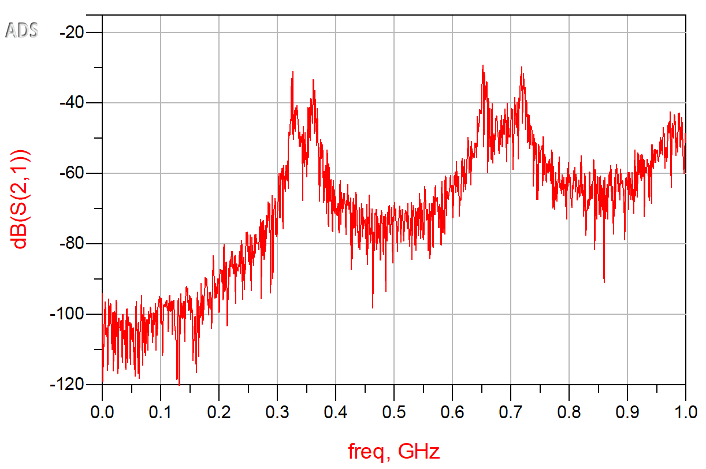
Noise floor
Measured port 2 without any connection after calibration
Noise floor is not constant over the frequency, it varies with frequency as:
-90dB up to 100MHz
-70dB up to 500MHz
-50dB above 500MHz

Slide 9
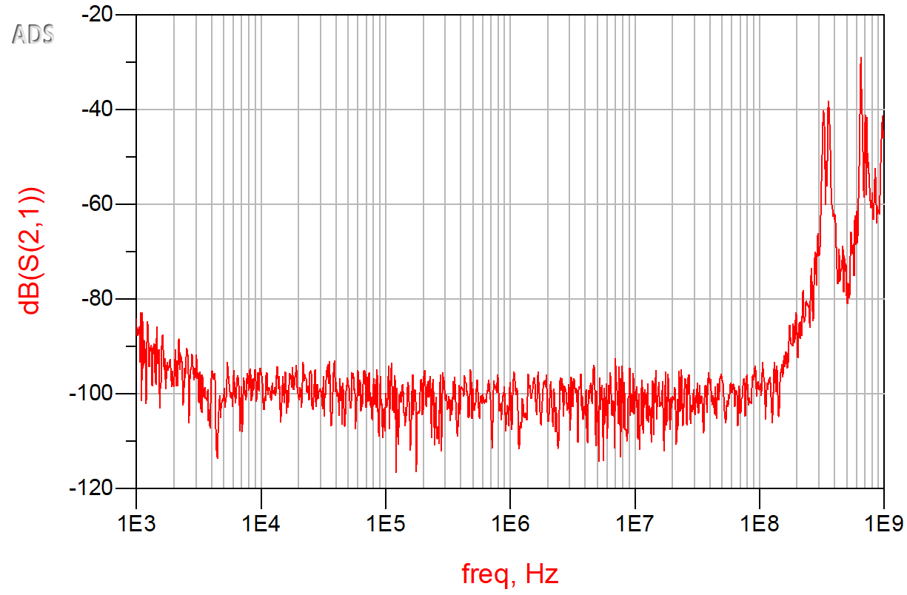
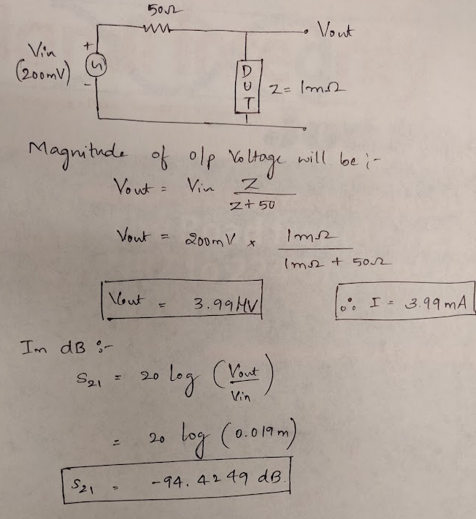
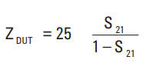
Noise floor- Log sweep
~-100dB
So, with -100dB noise floor the minimum impedance that VNA can measure is 250uΩ

Slide 10
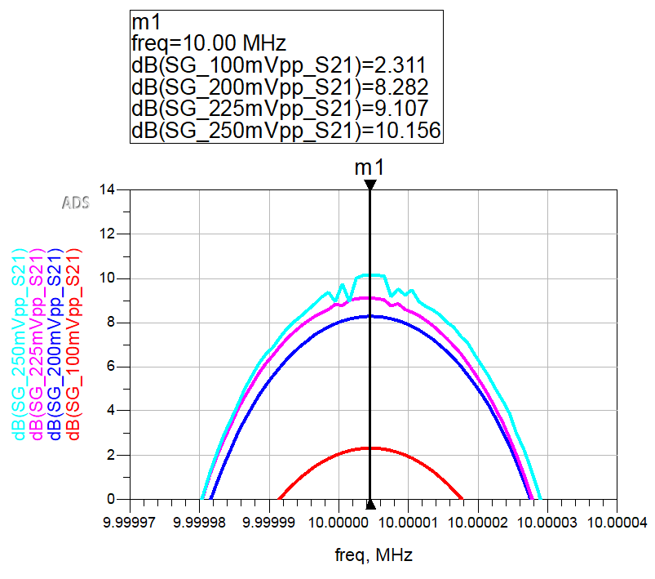
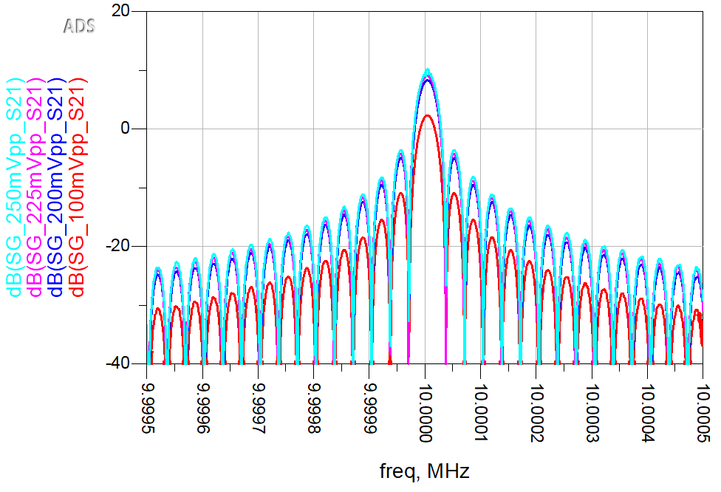
Power level
Port 2 safe input level:
Max input power : 0dBm(225mV)

Slide 11
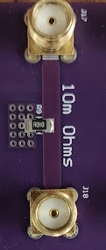
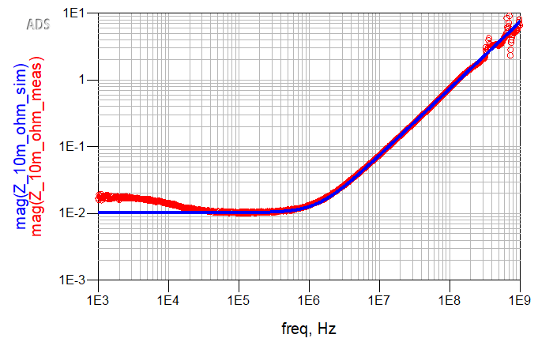
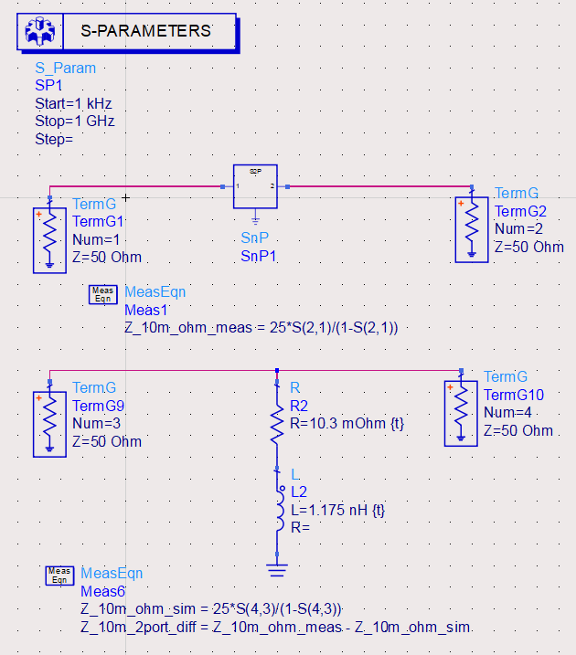
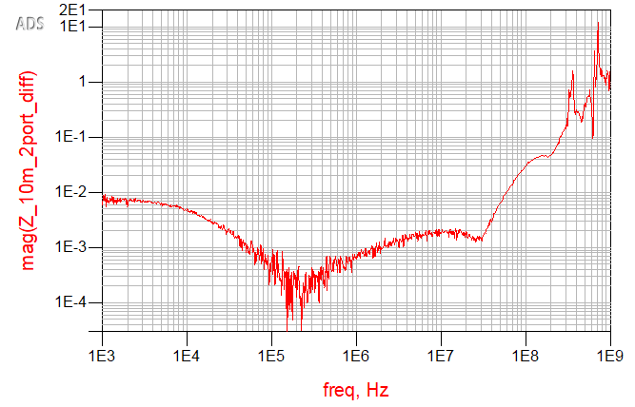
Measured known 10mohm impedance

Slide 12
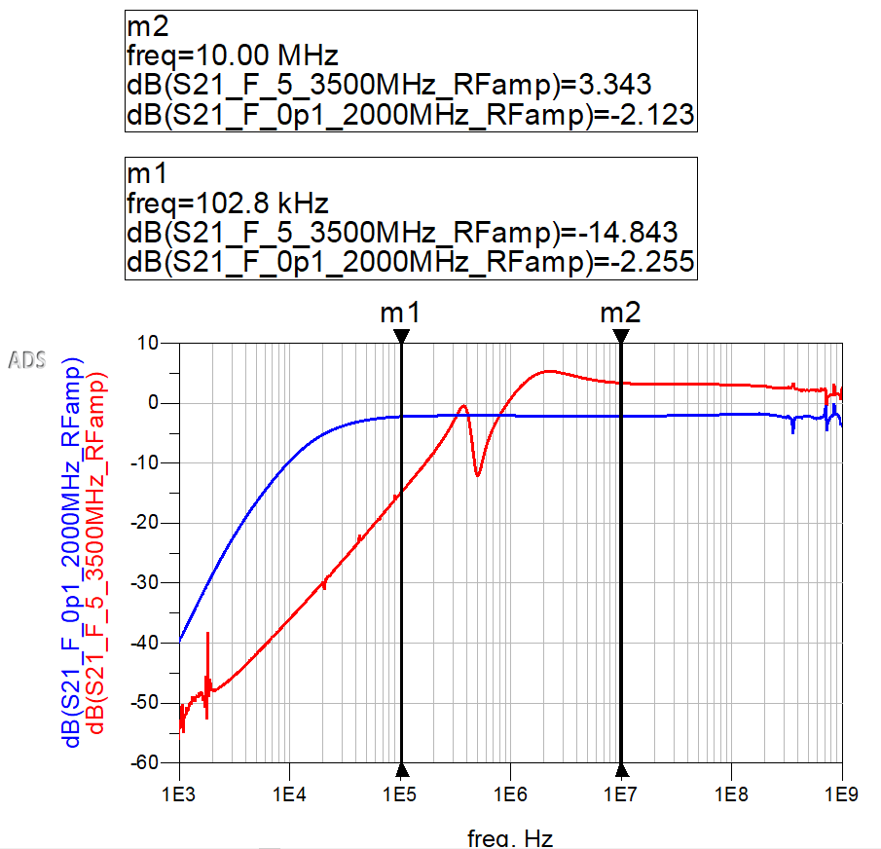
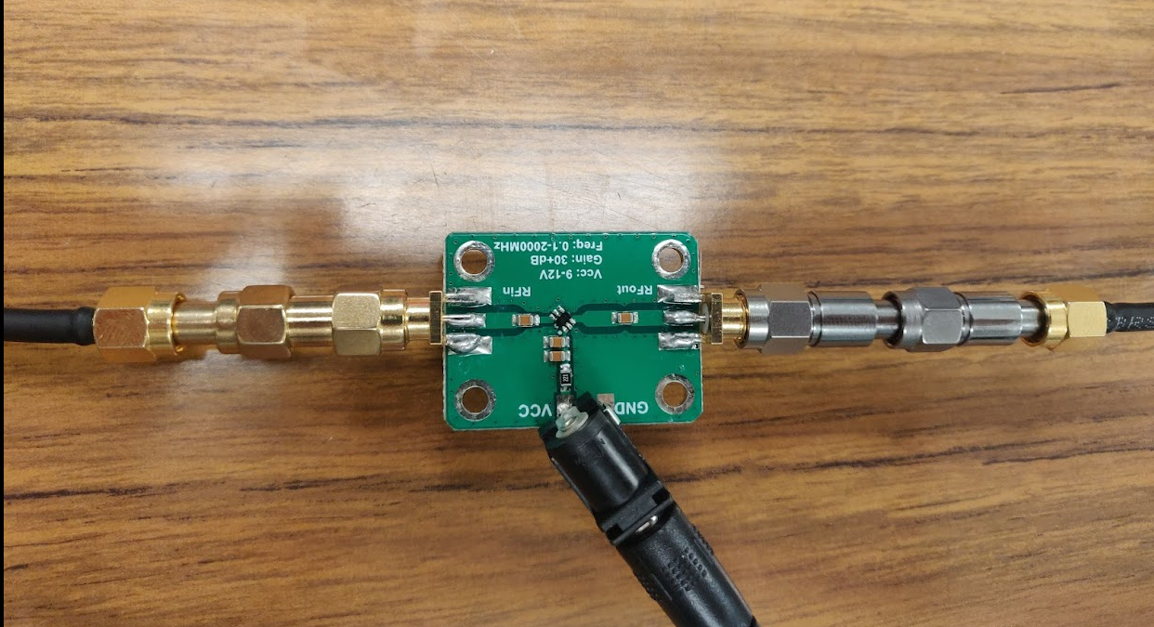
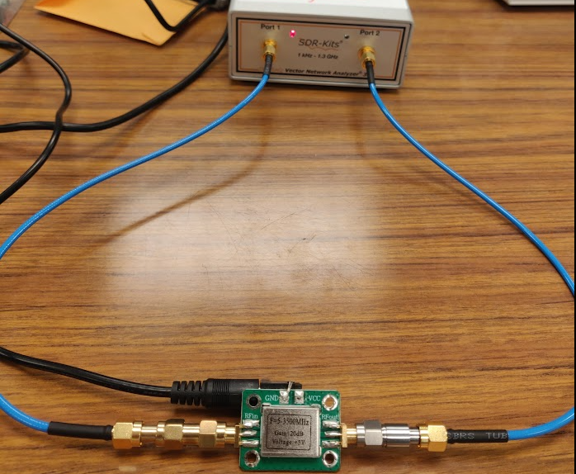
Amp responses
Attenuated by -20dB attenuator
Attenuated by -30dB attenuator

Slide 13
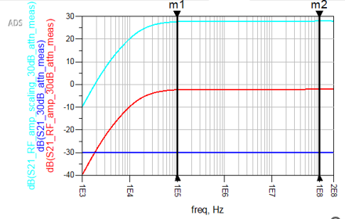





Week 4: RF amplifier gain
Gain= 27.9±0.2dB
=
%

Slide 14
Week 4: RF amplifier gain
Gain= 27.9±0.2dB
=
%

Slide 15
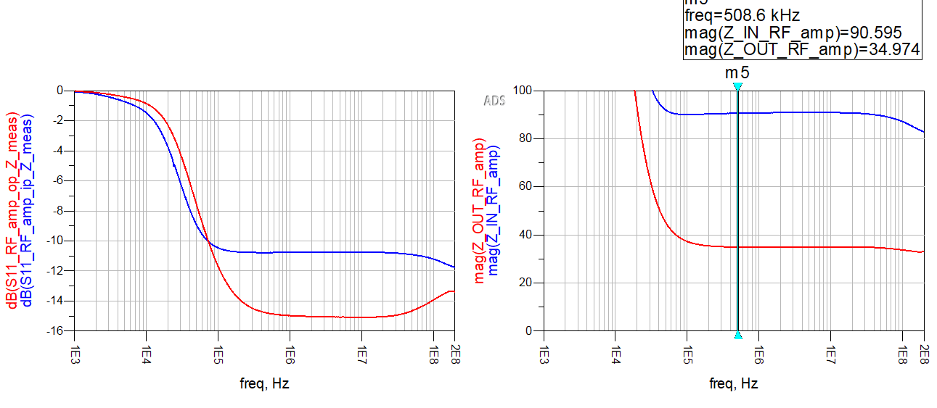
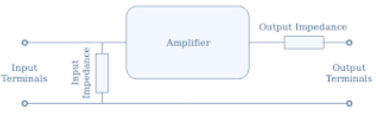

Input and Output Z
Zout =
Zin = ~90ohm
Zout = ~35ohm

Slide 16
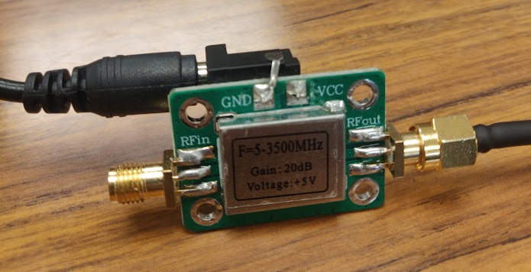
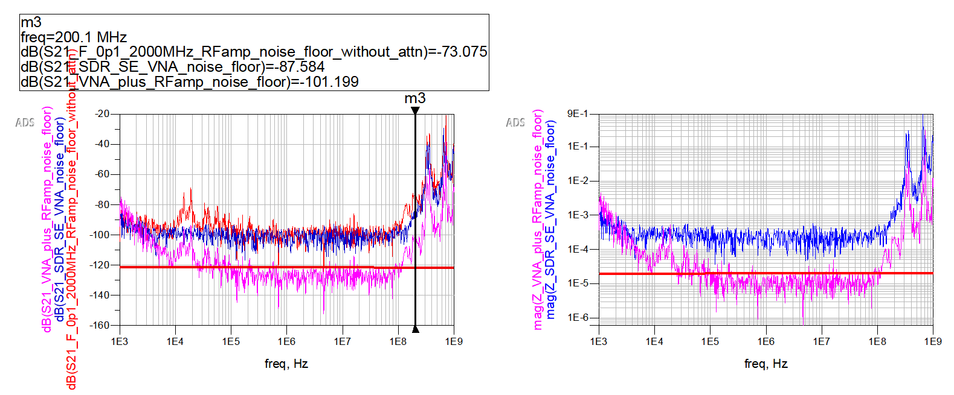
Noise floor with RFamp
Floating
121dB
20uohm
Safety margin after considering noise floor:
SDR VNA: ~95dB, RF amp : ~ 93dB
-93dB –(+28dB) = -121dB -> 22.2u Ω
We can measure the low Z impedance up to:
Therefore 20uΩ

Slide 17
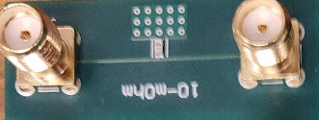
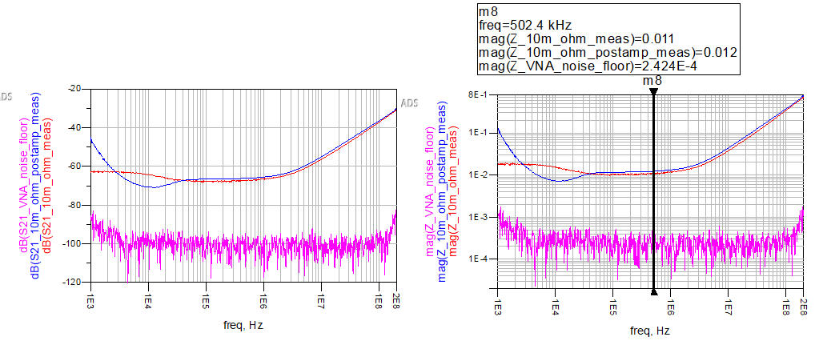

10m Ohm resistor
Expected to be 10mΩ, but measured:
VNA: 11mΩ
Turbo VNA: 12mΩ

Slide 18
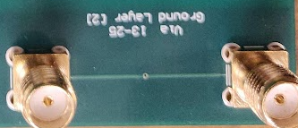
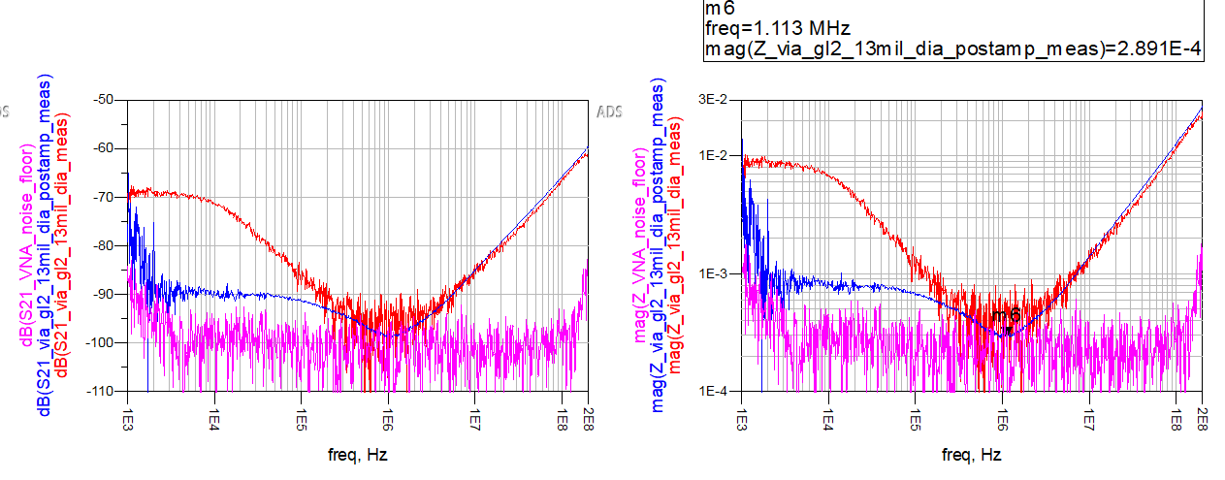
Via resistance – layer 2
Rule of thumb:
Via height = length = 10mil
Via thickness = 0.5Oz
Via diameter = 13mil
R per Sq = 1mΩ
N of Sq = 10/(3.14 *13) = 0.244
R = 0.244* 1mΩ = 244uΩ
The 289uΩ measured is in close agreement with the rule of thumb

Slide 19
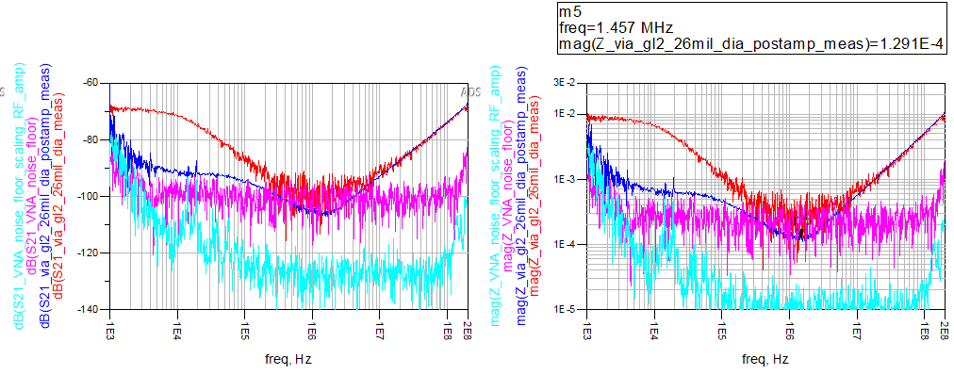
Via resistance – layer 2
Rule of thumb:
Via height = length = 10mil
Via thickness = 0.5Oz
Via diameter = 26mil
R per Sq = 1mΩ
N of Sq = 10/(3.14 * 26) = 0.122
R = 0.122* 1mΩ = 122uΩ
The 129uΩ measured is in close agreement with the rule of thumb
Turbo VNA stands out, as we can see we can measure well below the noise floor of VNA(250uΩ)

Slide 20
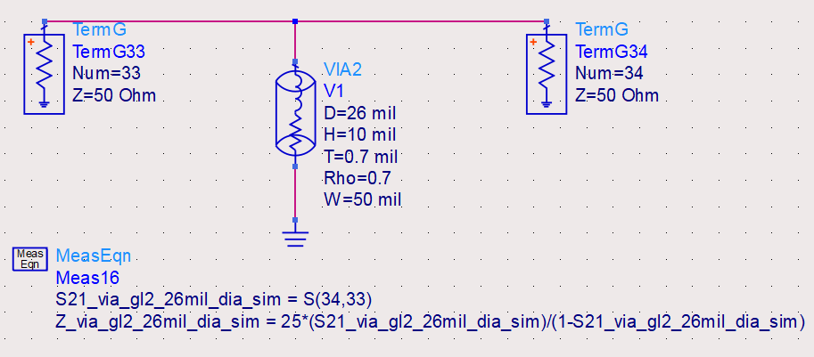
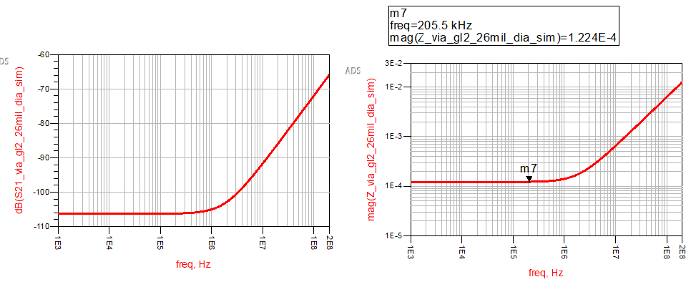
Via resistance simulation– layer 2
Rough estimate:
From ADS Via model:
R= 122 to 130uΩ

Slide 21
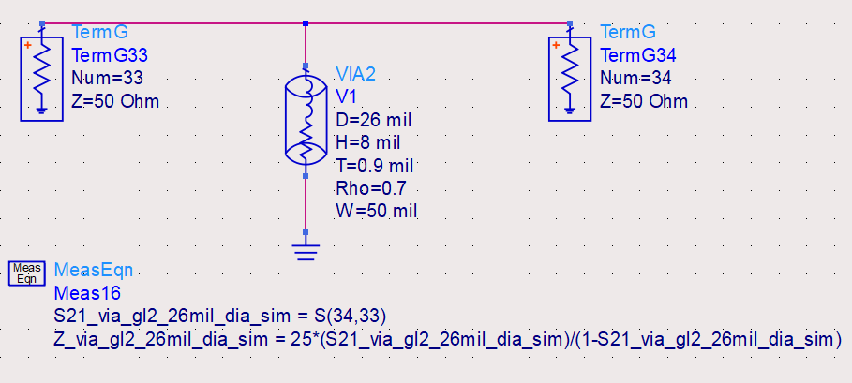
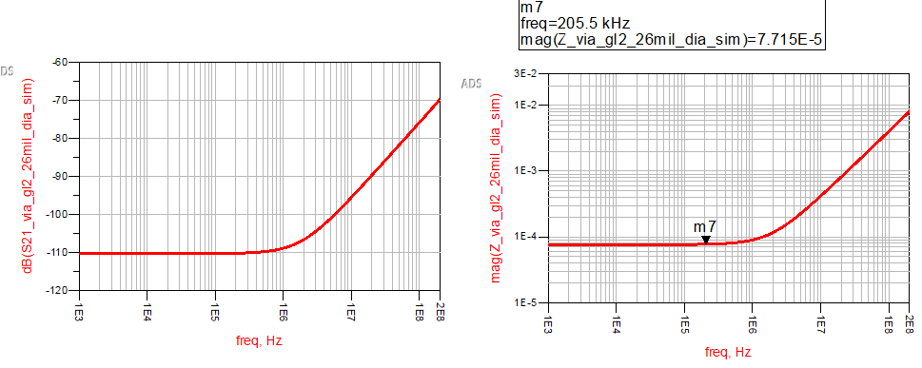
Via resistance simulation– layer 2
Putting the numbers:
From ADS Via model:
R= 77 to 80uΩ Why is this different than rule of thumb and actual measurement?
- Will be discussed next time

Slide 22
So What?
Measuring the ultra low Z with low cost VNA and low-cost RF amp
Methodology for characterizing the RF amp for low Z measurement

Slide 23
Questions?

Slide 24
Dummy

Slide 25
7.3.4 Using power amplifiers as high current buffers in low Z VNA measurements(Turbo VNA)
Presented by:
Jithendra H S
3/26/2025

Slide 26
Agenda
Problem
Proposed Solution
About RF amplifier
Measurement analysis
Limitation

Slide 27
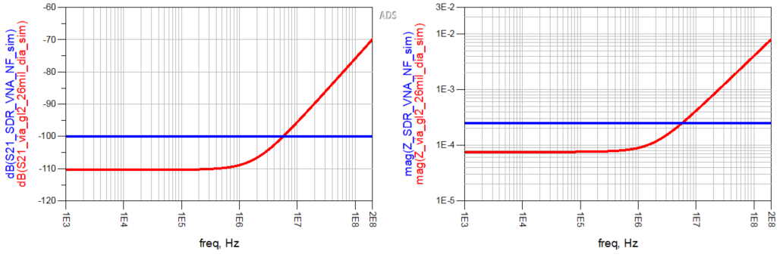
Problem
Min 250uΩ
-100dB VNA Noise floor
Via resistance 75uΩ
Via response
*Simulated using ADS

Slide 28
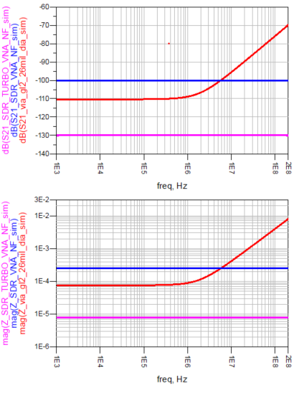
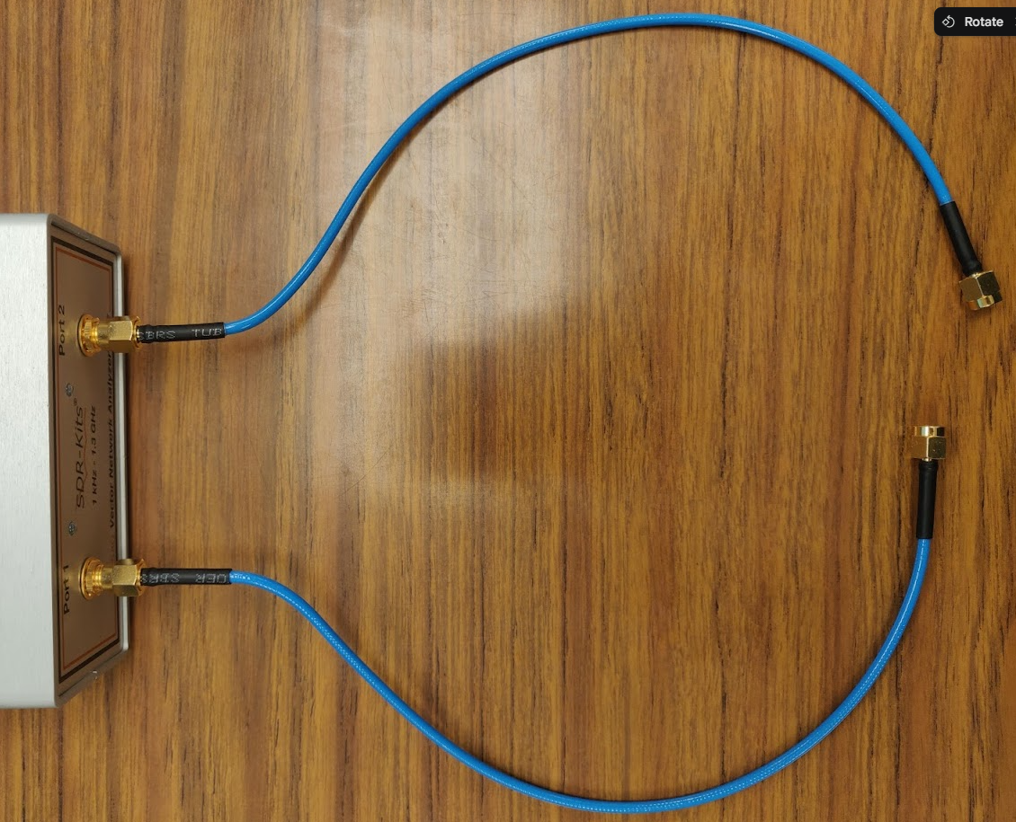
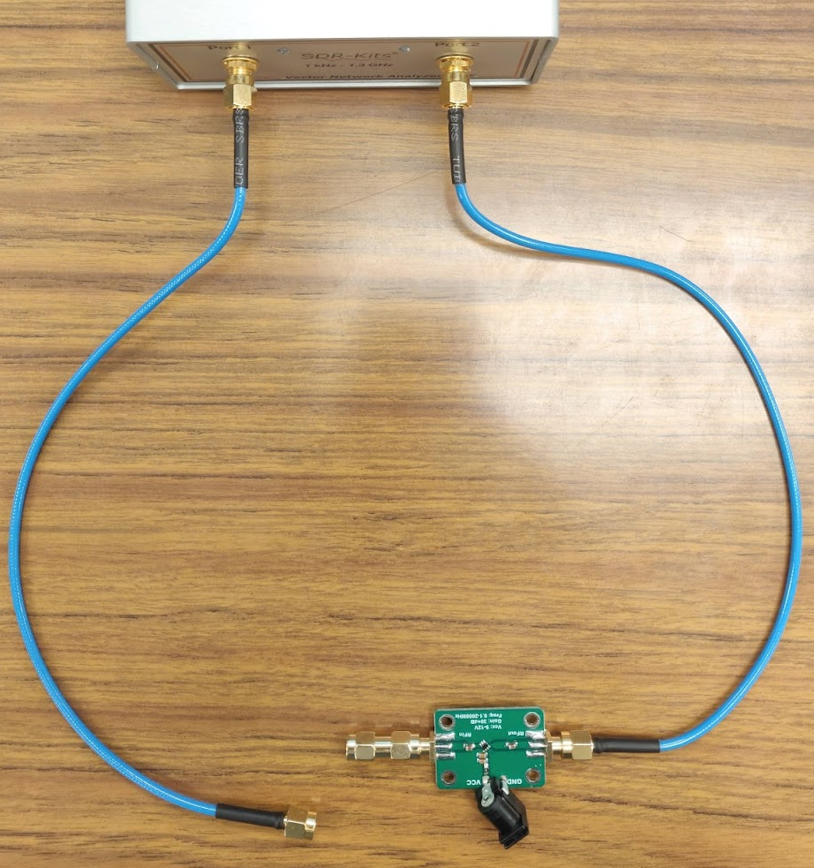
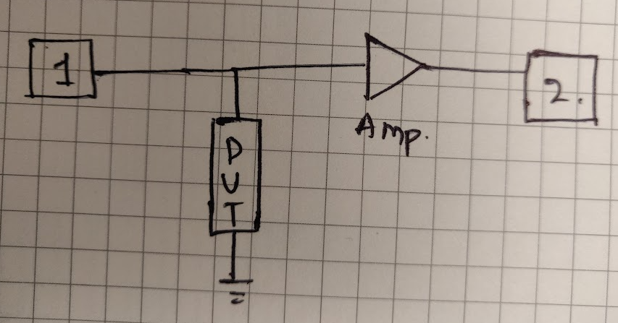
Solution
-100dB VNA Noise floor
Via response
-130dB TURBO VNA Noise floor
Turbo VNA setup
Normal VNA setup
Min 250uΩ
Via resistance 75uΩ
Extended resistance up to 8uΩ

Slide 29
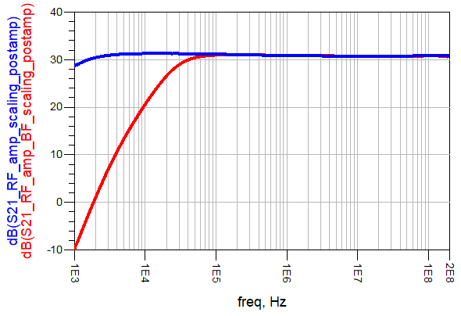
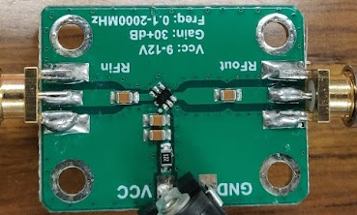
RF amp Improvements
3.3uF DC blocking cap(latest)
Gain = +30.927dB
0.1uF DC blocking cap(early)

Slide 30
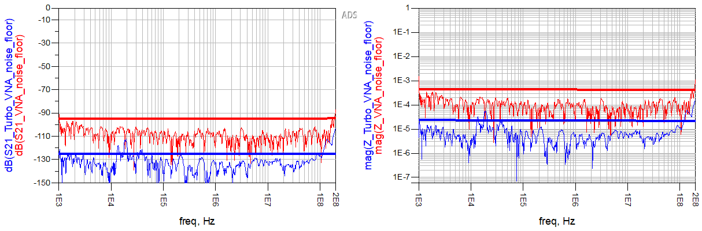
Revised Noise floor
-450uΩ
-95dB
-14uΩ
-125dB
Moving avg: 10pts

Slide 31
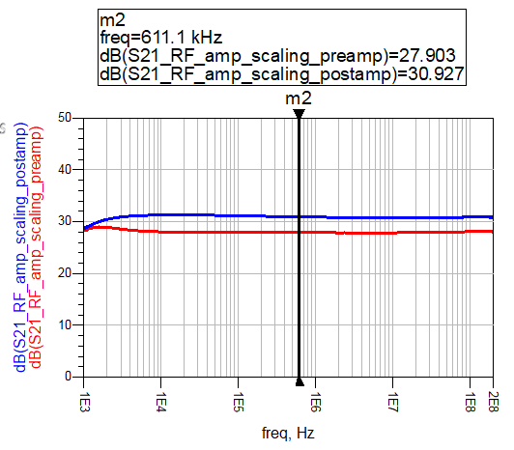



Why Post amp?
Preamplification
Post amplification

Slide 32

Test Board
13mil dia
26mil dia
Up to layer 2
13mil dia
26mil dia
Up to layer 2
Port extension
10m ohm ±1%

Slide 33

10m Ohm resistor
10mΩ±1%
11mΩ
8mΩ

Slide 34

Phase of 10m Ohm resistor
Z = R + jwL
Failing to sample the phase properly

Slide 35

Attenuator setup
-20dB
-10dB
-6dB
-3dB
-1dB
-30dB
-30dB

Slide 36

Consistency check
5°
50°
50°
70°
Supporting resource from Tim Wang Lee: https://groups.io/g/VNWA/topic/looking_for_ways_to_improve/74472949

Slide 37


Via - layer 2
226uΩ
200uΩ
Rule of thumb:
Via height = length = 10mil
Via thickness = 0.5Oz
Via diameter = 13mil
R per Sq = 1mΩ
N of Sq = 10/(3.14 *13) = 0.244
R = 0.244* 1mΩ = 244uΩ
Conclusion: Measured values are around 11% off

Slide 38


Via- layer 2
*Moving avg: 10pts
75uΩ
83uΩ
N of Sq = 10/(3.14 * 26) = 0.122
R = 0.122* 1mΩ = 122uΩ
Rule of thumb:
Via height = length = 10mil
Via thickness = 0.5Oz
Via diameter = 26mil
R per Sq = 1mΩ
Conclusion: Measured values are around 10% off

Slide 39
Summary table
DUT | SDR VNA |  | SDR Turbo VNA
 | Measured | Error % | Measured | Error %
10mΩ | 11mΩ | 10% | 8mΩ | 20%
Via-GL2-13mil(200uΩ) | Saturated | - | 226uΩ | 13%
Via-GL2-26mil(75uΩ) | Saturated | - | 83uΩ | 10.6%

Slide 40
So What?
Measuring ultra-low impedance using an affordable VNA and RF amplifier.
Approach for characterizing the RF amplifier for low impedance measurements.
Despite phase shift limitations at lower frequencies, we can still approximate the structure's resistance closely.

Slide 41
Questions?

Slide 42
7.3.4 Using power amplifiers as high current buffers in low Z VNA measurements(Turbo VNA)
Presented by:
Jithendra H S
4/10/2025

Slide 43
Agenda
Problem statement & Proposed Solution
Artifacts and Improvements
Measurement analysis
Conclusion

Slide 44
Problem Statement
Min 250uΩ
-100dB VNA Noise floor
Via resistance 75uΩ
Via response
*Simulated using ADS

Slide 45



Solution
-100dB VNA Noise floor
Via response
-130dB TURBO VNA Noise floor
Turbo VNA setup
Normal VNA setup
Min 250uΩ
Via resistance 75uΩ
Extended resistance up to 8uΩ

Slide 46
RF amp Improvements
3.3uF DC blocking cap(latest)
Gain = +30.927dB
0.1uF DC blocking cap(early)

Slide 47





Common current artifact
*Source: HSDD wk 3 lecture slides

Slide 48


Revised Noise floor
Moving avg: 10pts

Slide 49
Why Post amp?
Preamplification
Post amplification

Slide 50
Test Board
13mil dia
26mil dia
Up to layer 2
13mil dia
26mil dia
Up to layer 2
Port extension
10m ohm ±1%

Slide 51


10mΩ resistor
11mΩ
10.65mΩ
8mΩ

Slide 52


Similarity metric
Nominal value of the resistor is 10mΩ±1%
The simulation showed the resistance value is about 10.65±.5mΩ
Turbo VNA measurement is 8mΩ, which is off by 20-25%

Slide 53



Via - layer 4
1mΩ
1mΩ
1mΩ
Thickness of Via: 1.2mil

Slide 54



Via - layer 2
179uΩ
122uΩ
192uΩ
Rule of thumb:
Via height = length = 8mil
Via thickness = 1.2mil
Via diameter = 13mil
R per Sq = 0.5mΩ at 1Oz
N of Sq = 8/(3.14 *13) = 0.195
R = 0.195 * (1.4/1.2)0.5mΩ = 113uΩ
*Working on finding the Uncertainty

Slide 55



Via- layer 2
*Moving avg: 10pts
100uΩ
58uΩ
68uΩ
Rule of thumb:
Via height = length = 8mil
Via thickness = 1.2mil
Via diameter = 26mil
R per Sq = 0.5mΩ at 1Oz
N of Sq = 8/(3.14 * 26) = 0.097
R = 0.097 *(1.4/1.2) 0.5mΩ = 56uΩ
*Working on finding the Uncertainty

Slide 56

So What?
Measured ultra-low impedance using an affordable VNA and RF amplifier.
10m ohm, Via etc
Came up with an approach to characterize the RF amplifier for low impedance measurements.
I/P, O/P Z, Wide band gain,
Reduced the limitations, resulting in a wide band amplifier and very less common current
Despite the gain at lower frequencies, we can still approximate the structure's resistance better than a first-order approximation
10mΩ
Via layer 4
Via layer 2
Common current artifact
VNA NF
Turbo VNA NF

Slide 57
Questions?

Slide 58
Dummy

Slide 59

Back up

Slide 60


Simulated Pre and Post amp

Slide 61

Input and Output Z of RF amp

Slide 62
Week 6 update
Analysing the new set of measurements in terms of scaling the RF amp output be removing the influence of 30dB attenuators used to measure Gain using ADS(5hrs)
Compared Pre and Post amplification methods on 10mOhm resistor(4hrs)
Characterized all other low cost RF amps exist in the lab(2hrs)
Week 7:
Take new measurements with respect to Via(2layer and 4 layer) (2hrs)
Characterizing the Via impedance wrt to pre and post amplification method(8hrs)

Slide 63
Week 7 update
Took new measurements with respect to Via(2layer and 4 layer) (1hrs)
Characterizing the Via impedance wrt to pre and post amplification method(8hrs)
Week 8:
Make sense of the uncertainties in pre and post at lower frequencies(6-8 hrs)
Starting to measure the and verify the passive sniffing boards(2hrs)

Slide 64
Week 8 update
Compared VNA and Turbo VNA measurements using ADS(4hrs)
Tried to analyse the mismatch at the lower frequencies (6hrs)
Week 9:
Draft the article and come up with a story(5 hrs)
Recollect the data if required for the article for improvisation(4hrs)

Slide 65
Week 10 update
Re-did the measurements in the post-amp method and bring them into ADS(4hrs)
Tried to analyze the mismatch at the lower frequencies (6hrs)
Week 11:
Draft the article and come up with a story(7 hrs)

Slide 66
Week 12 update
Research about the cause of phase change artifact(6hrs)
Re-did the measurements and analyzed them in ADS(4hrs)
Week 13:
Rework the draft paper and add new findings(6hrs)

Slide 67
Week 13 update
Created a new low impedance structure with the help of components available in the lab, analyzing the results(6hrs)
Rework the draft paper and added new findings(2hrs)
Week 14:
Need to find the DC resistance of the Via and the resistance
Analyse the new structure measurements with DC resistance

