Slide 1
7.3.4 Using power amplifiers as high current buffers in low Z VNA measurements
Presented by:
Jithendra H S
05/01/2025

Slide 2
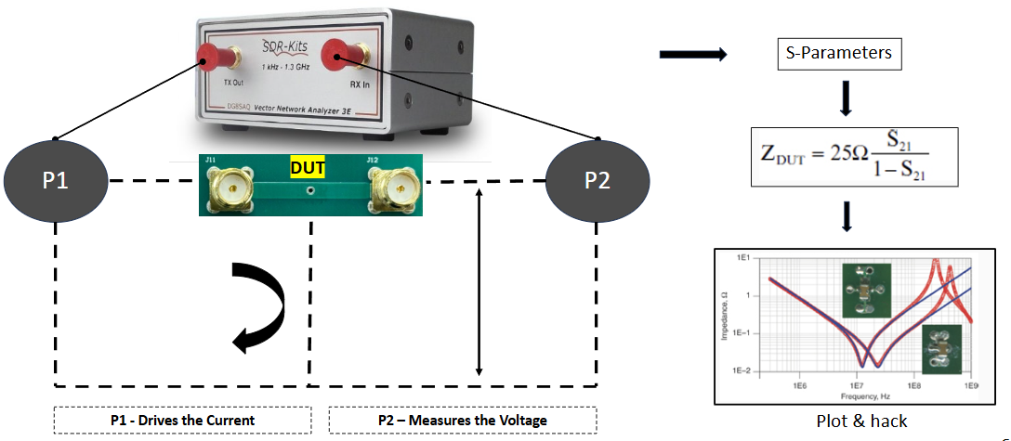
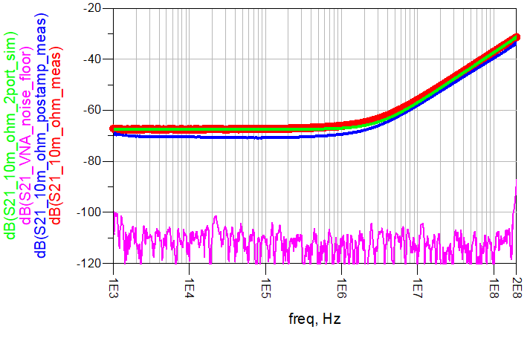
Introduction
The objective of this project is to overcome limitations and measure ultra-low impedance structures, such as resistors, vias, and PDN impedance, using a low-cost SDR VNA and an RF amplifier.
Measurement setup:

Slide 3

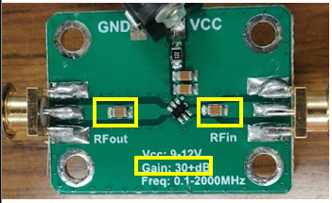
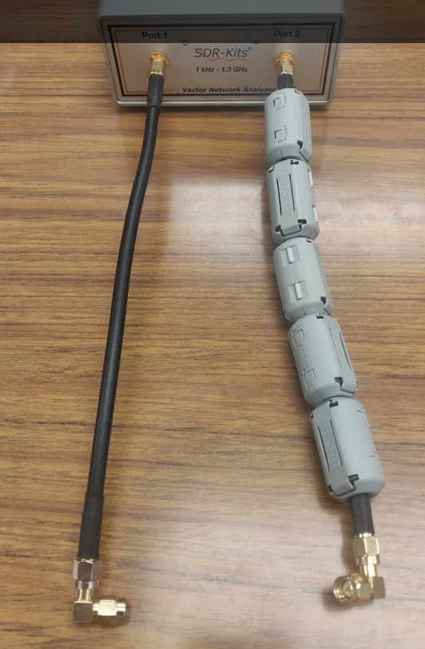
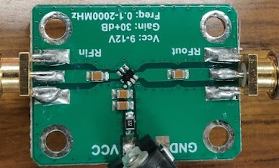
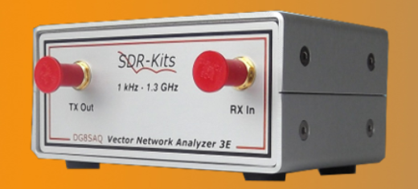
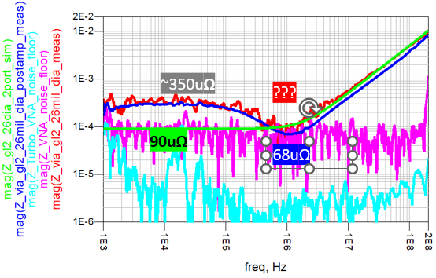
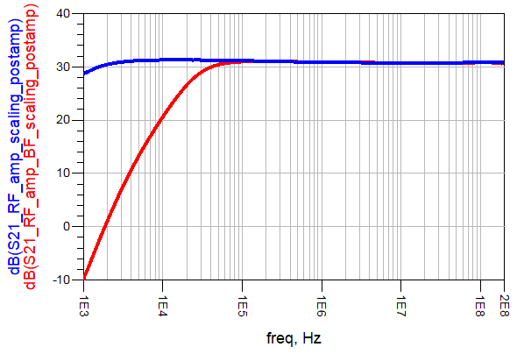
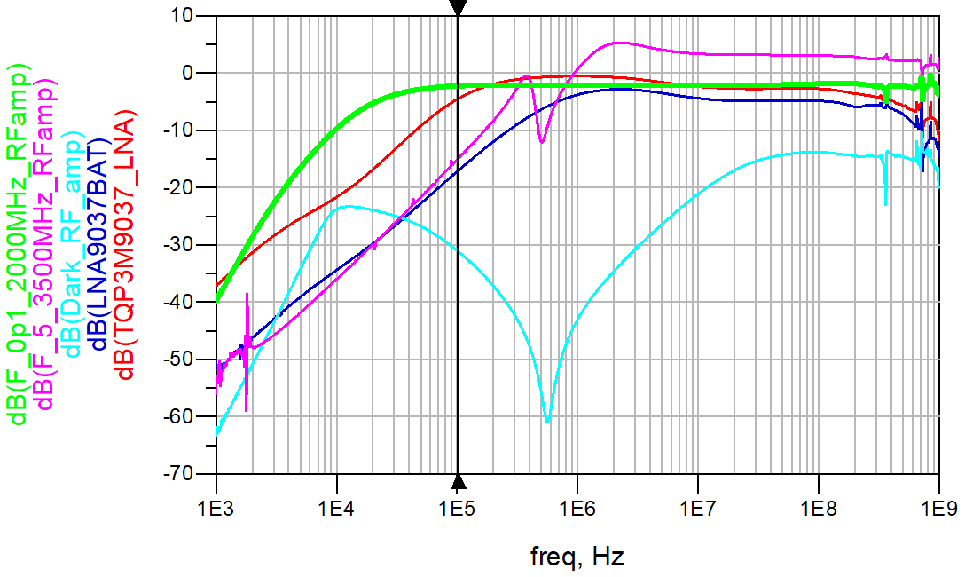
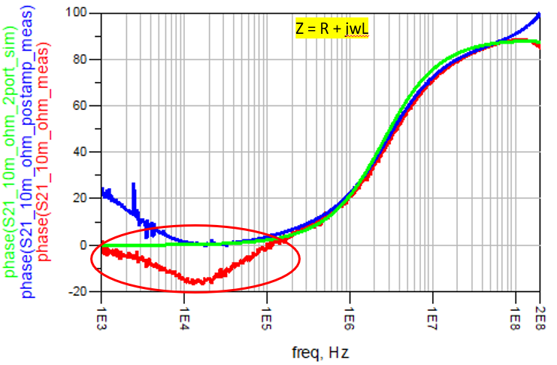
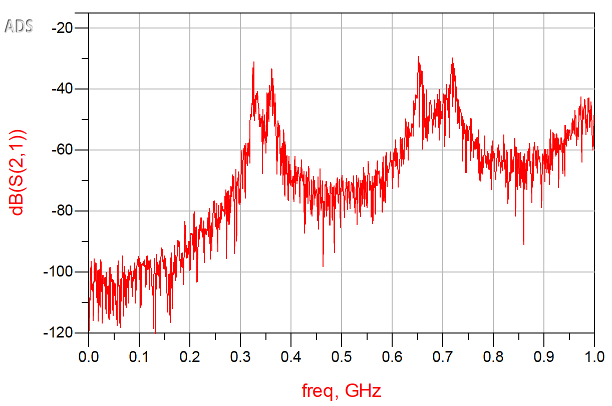
Road map
Ultra low Z measurement
Amplifier optimization
Why an amplifier?
Common current artifact
VNA Characterization

Slide 4
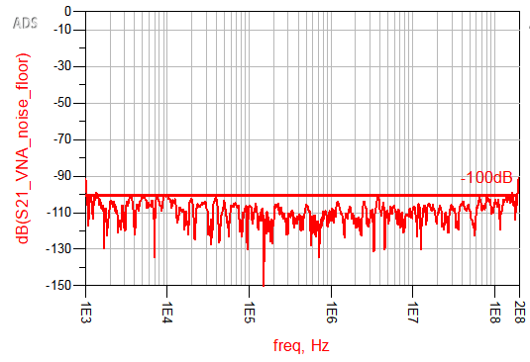
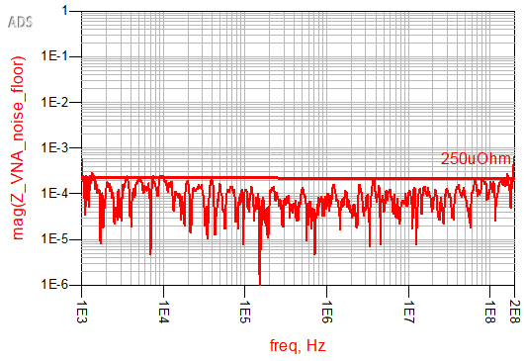
VNA Overview
Power: Max = -10dBm
Min = -17dBm
Voltage Output:
Vpp=200mV
Noise floor:
-100dB up to 100MHz
-70dB up to 500MHz
-50dB above 500 MHz
Max Input power:
0dBm -> 225mV
With a -100dB(1uV) noise floor, the minimum impedance that SDR VNA can measure is up to 250uΩ

Slide 5
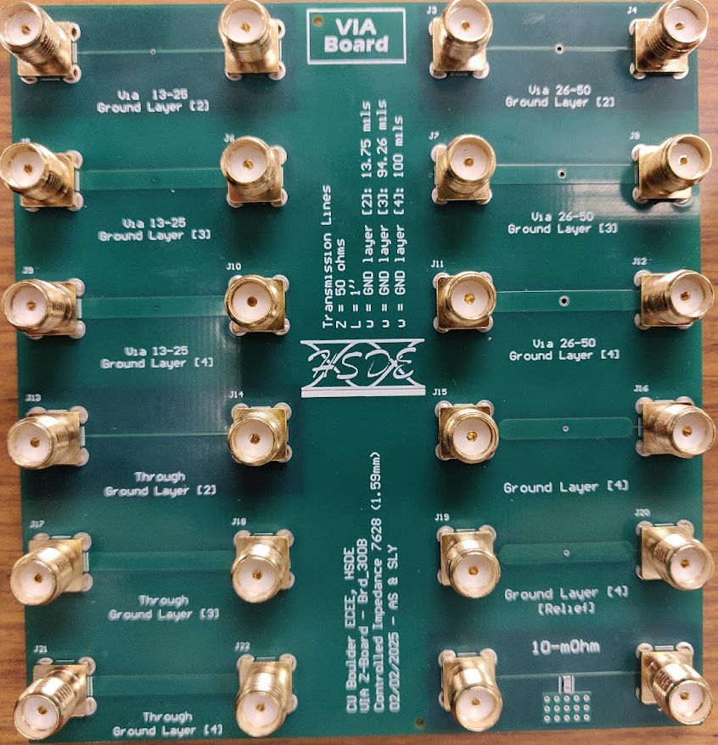
VNA config & Test vehicle
13mil dia
26mil dia
Up to layer 2
Parameter | Settings
Sweep range | 1 KHz to 200 MHz
Datapoints | 1000
Sweep time | 30s
13mil dia
26mil dia
Up to layer 4
Port extension
calibration
10m ohm ±1%
Known structure

Slide 6
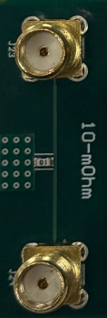
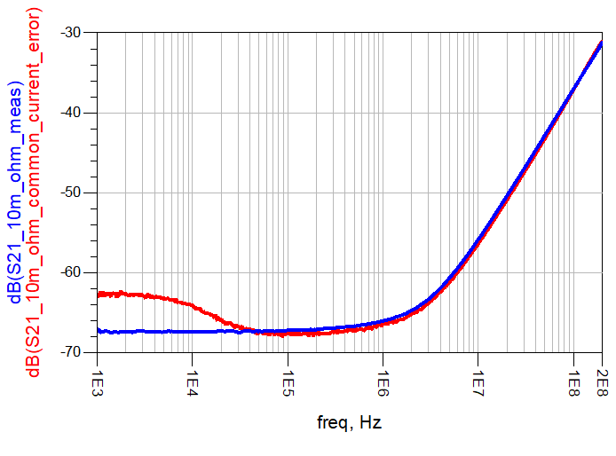
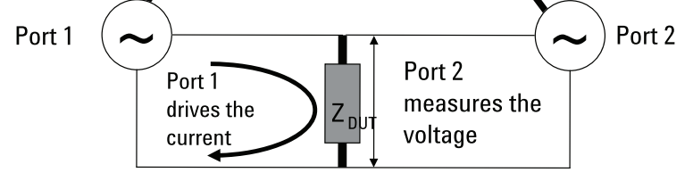
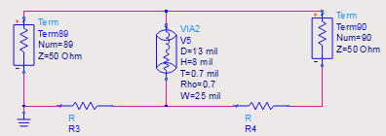
Common current artifact
DUT
Due to the common current
Ferrite choke
Common current limits the low Z measurement to ~25mΩ

Slide 7
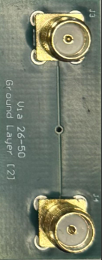
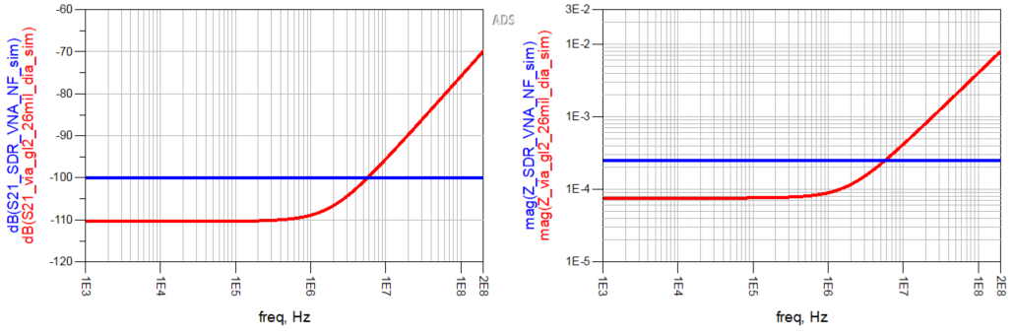

Limitation of Normal VNA
*Simulated using ADS
26 mil Dia
-100dB VNA Noise floor
Min 250uΩ
Rule of thumb:
Via height = length = 8mil
Via thickness = 1.2mil
Via diameter = 26mil
R per Sq = 0.5mΩ at 1Oz
N of Sq = 8/(3.14 * 26) = 0.097
R = 0.097 *(1.4/1.2) 0.5mΩ = 56uΩ
Via resistance 56uΩ
Via response
-110dB(316nV) measurement is not at all possible to measure with a Normal VNA, if you measure always result in 250uΩ

Slide 8
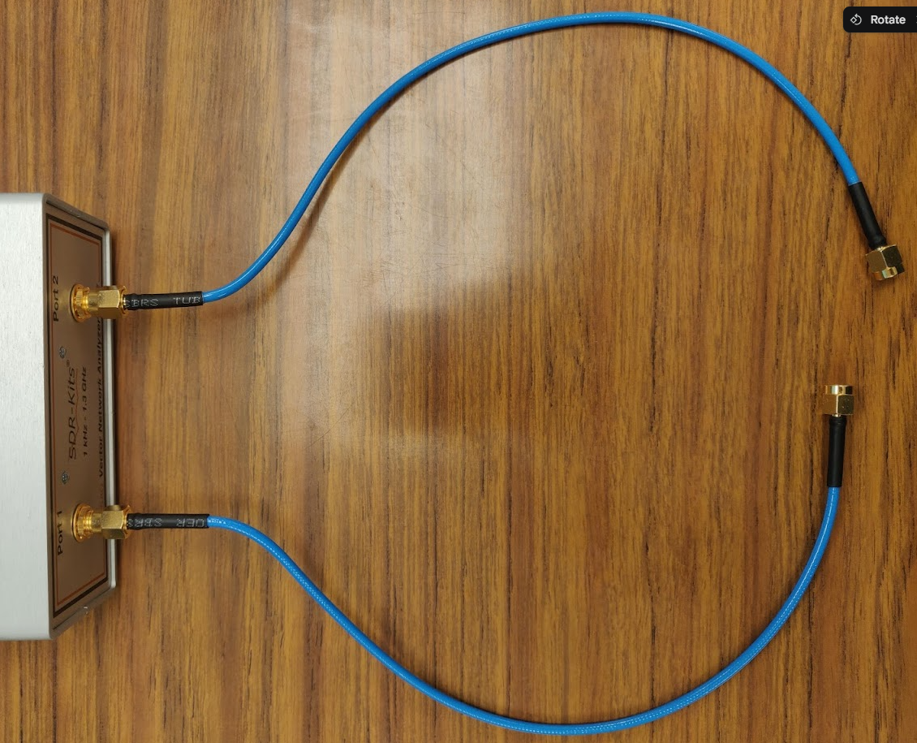
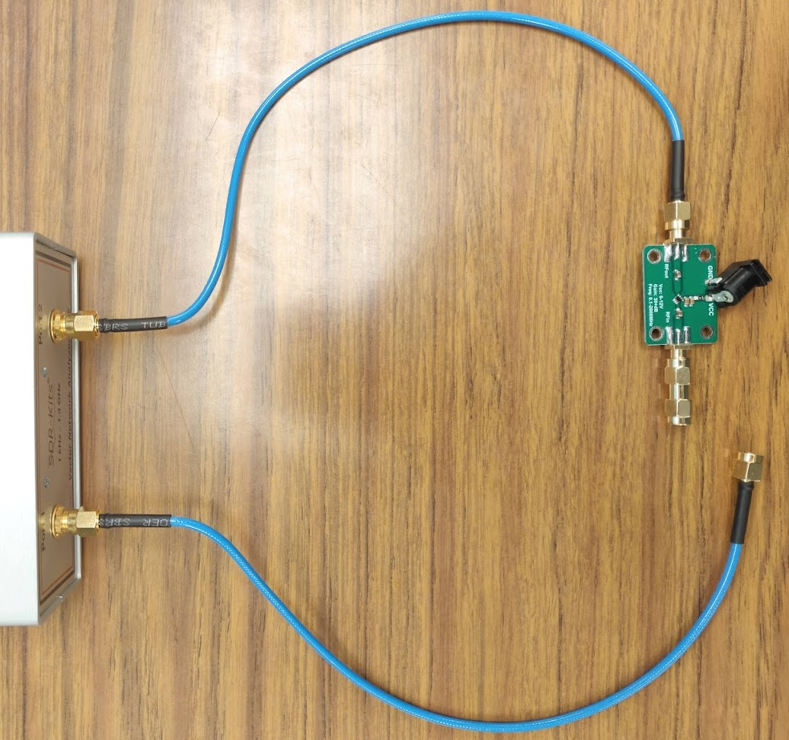
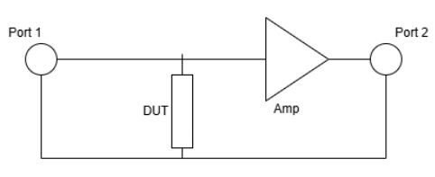
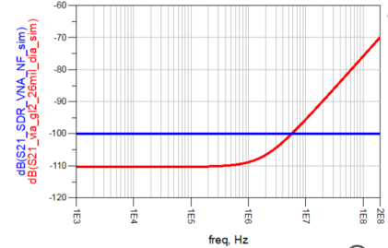
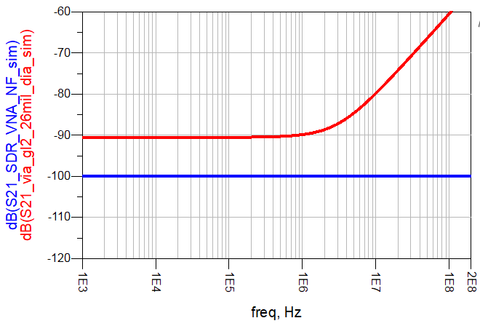
Why Amplification?
+20dB
Normal VNA setup
Turbo VNA setup
Via response
-100dB VNA Noise floor
Via response
-100dB VNA Noise floor
Adding gain to the voltage drop across DUT helps the VNA port to measure the signal without being limited by the noise floor
After that, we need to vector rescale the amplified insertion loss using ADS to get the actual insertion loss across the DUT

Slide 9
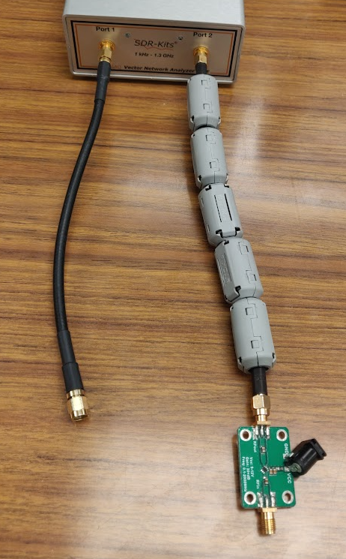
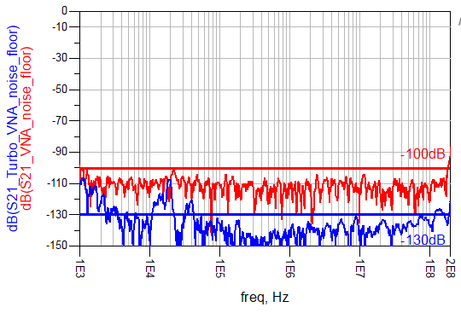
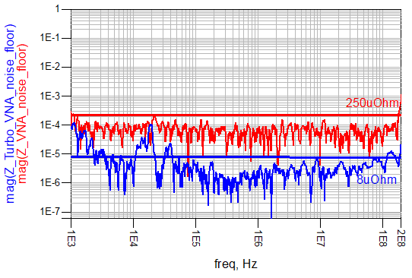
Revised noise floor
*Moving avg: 10pts
Turbo VNA setup
Insertion loss
Corresponding Impedance
Kept Open
Due to the addition of both ferrite chokes & the RF amp, the effective noise floor results in measuring impedance up to 8uΩ

Slide 10
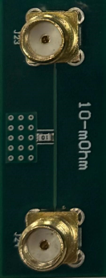
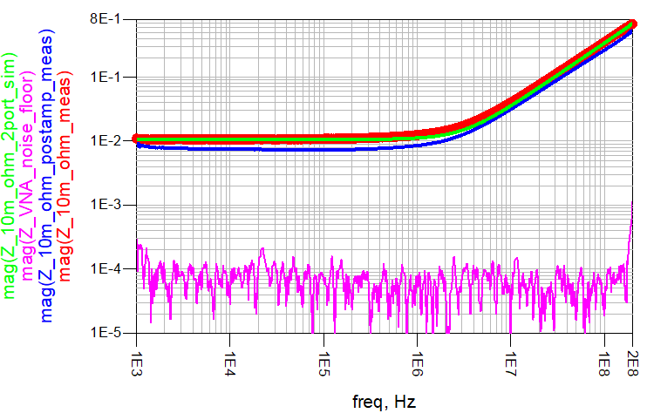
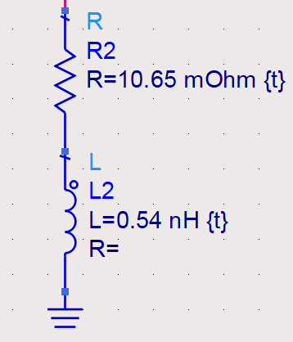
10mΩ resistor
---Normal_VNA_meas
---Turbo_VNA_meas
---Simulated
Insertion loss
Corresponding Impedance
DUT
10.65mΩ
7.65mΩ
RL model
Measuring known structures will reveal the uncertainty in measurement between the Normal and Turbo VNA.

Slide 11
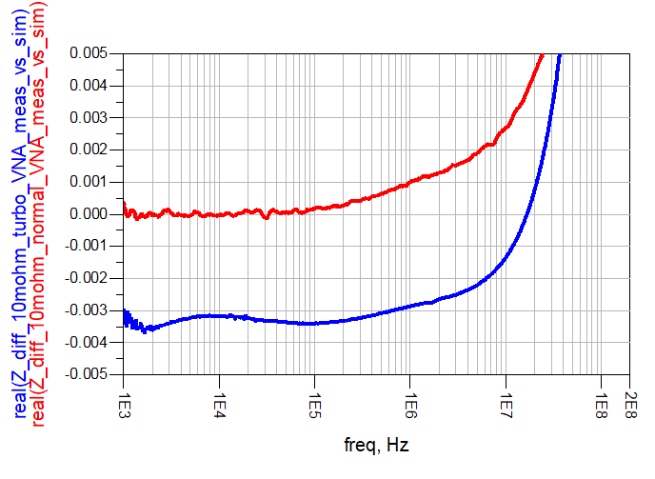
Similarity metric
Normal_VNA_meas - simulated
Turbo_VNA_meas - simulated
Nominal | DC 4 wire method | Normal VNA | Uncertainty | Turbo VNA | Uncertainty
10mΩ±1% | 10.618mΩ | 10.65mΩ | ±0.04mΩ(0.03%) | 7.675mΩ | ±2.9mΩ(27%)

Slide 12
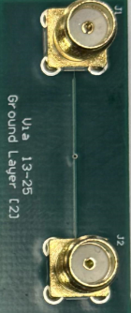
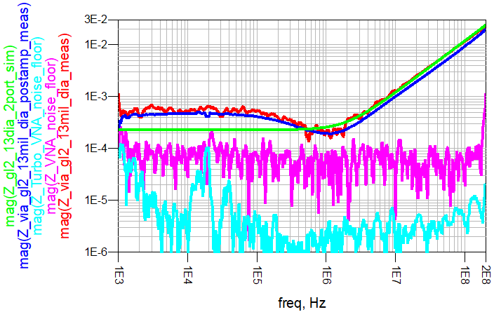
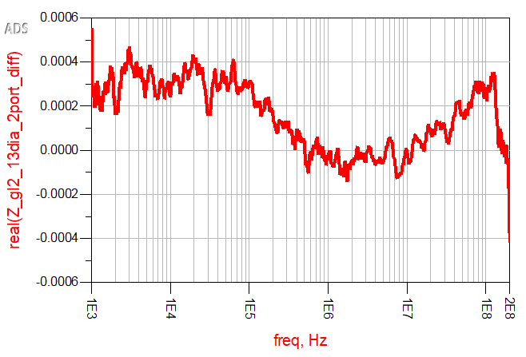
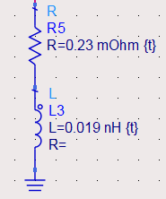
Via - layer 2 -13mil dia
*Moving avg: 10pts
Impedance
Similarity metric
±300uΩ
~550uΩ
192uΩ
DUT
230uΩ
179uΩ
RL model
Rule of thumb | ADS Hacked | DC 4 wire method | Normal VNA | Uncertainty | Turbo VNA | Uncertainty
113uΩ | 230uΩ | 568uΩ | 179uΩ | ±51uΩ(22%) | 192uΩ | ±38uΩ(16%)

Slide 13
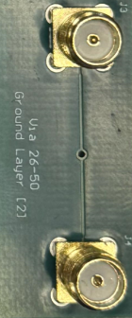
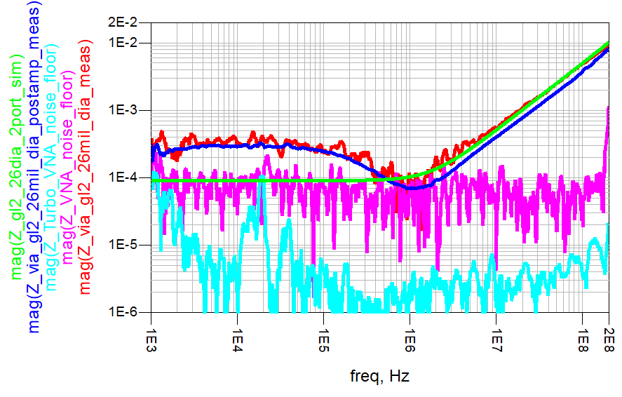
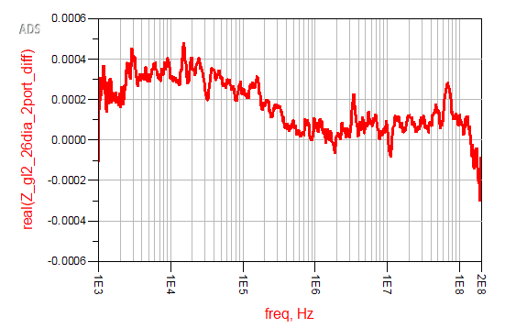
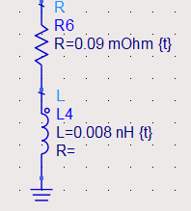
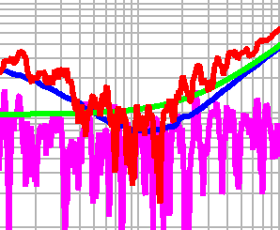
Via- layer 2 – 25mil dia
*Moving avg: 10pts
Impedance
Similarity metric
±300uΩ
DUT
~350uΩ
90uΩ
68uΩ
Overlap with Noise floor
???
RL model
Rule of thumb | ADS Hacked | DC 4 wire method | Normal VNA | Uncertainty | Turbo VNA | Uncertainty
56uΩ | 90uΩ | 346uΩ | NA | NA | 68uΩ | ±22uΩ(24%)

Slide 14
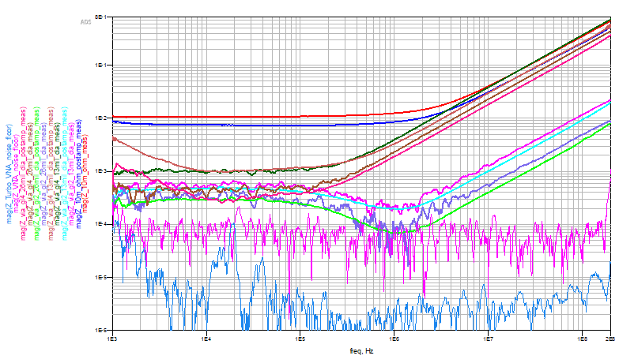
Summary from multiple responses
10mΩ
Via layer 4
Via layer 2
Common current artifact
VNA NF
Turbo VNA NF
Still see a common current artifact with the test vehicle at 0.5mohm range.
Able to extend the noise floor of VNA from -100dB up to -130dB, as we can see with Turbo VNA NF.
By scaling the difference in gain from Normal and turbo VNA, we can reduce the uncertainty and improve the Turbo VNA response.

Slide 15
Takeaway
Can measure ultra-low impedance of up to ~8uΩ using an affordable VNA and RF amplifier.
Steps to characterize the RF amplifier for low impedance measurements in terms of I/P Z, O/P Z, and Wideband gain.
Reduced the limitations:
Common current: Ferrite chokes enabled low flat resistance measurement.
14mΩ - > 0.45mΩ
High pass filter: Change in DC blocking caps enabled low-frequency sweeping.
100KHz - > 1KHz
Despite the gain at lower frequencies, we can still approximate the structure's resistance of ~90uΩ with an uncertainty of ~24%, which is better than a first-order approximation & Normal VNA.

Slide 16
Thank You

Slide 17
Questions?

Slide 18
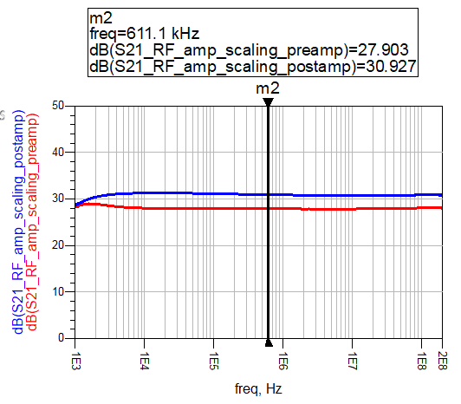
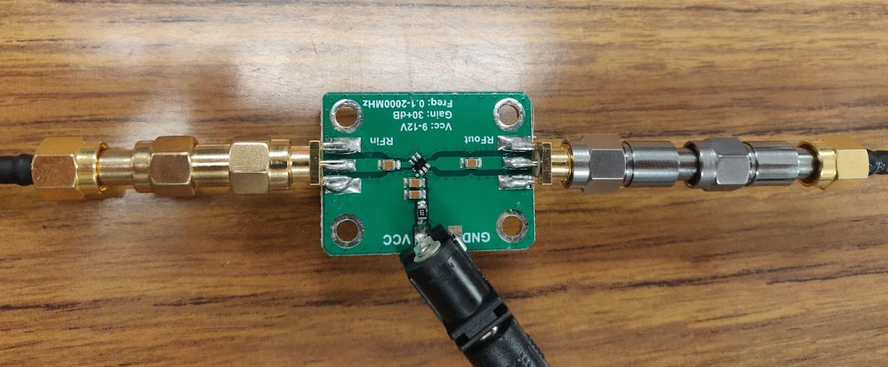

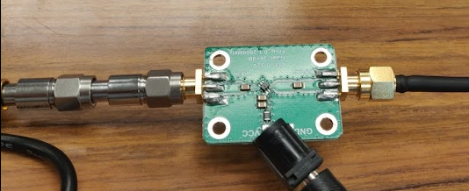
Why Post amp?
Preamplification
-30dB attenuator as DUT
Post amplification
-30dB attenuator as DUT

Slide 19
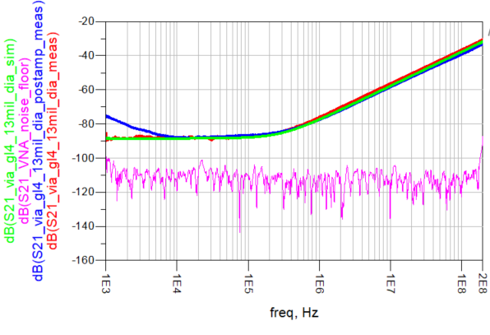
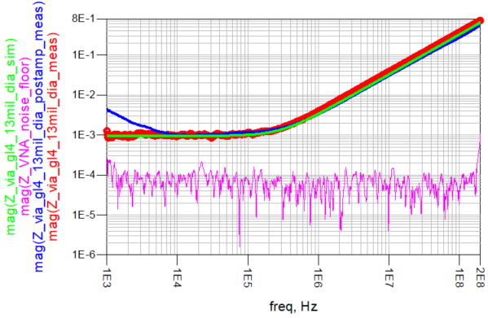
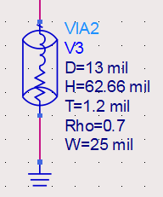
Via - layer 4
1mΩ
1mΩ
1mΩ
Thickness of Via: 1.2mil

Slide 20
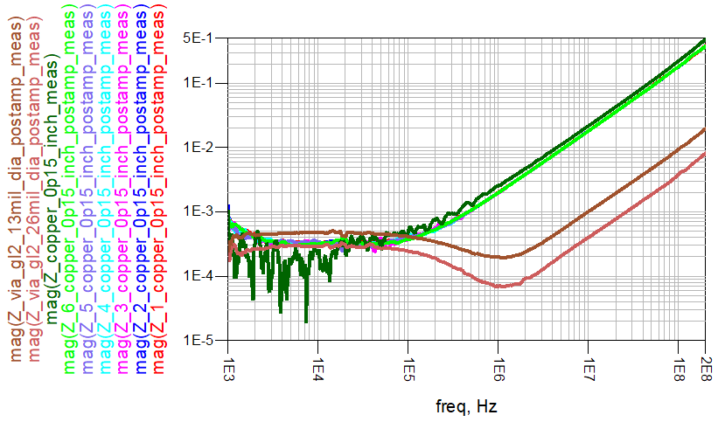
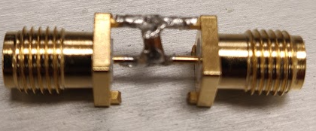
Test Vehicle artifact
Manually measured 280uohm

Slide 21


Via - layer 2
*Moving avg: 10pts
~550uΩ
179uΩ
192uΩ
122uΩ
Rule of thumb | ADS | DC 4 wire method | Normal VNA | Uncertainty | Turbo VNA | Uncertainty
113uΩ | 122uΩ | 568uΩ | 179uΩ | ±57uΩ(46%) | 192uΩ | ±70uΩ(57%)

Slide 22


Via- layer 2
*Moving avg: 10pts
Overlap with Noise floor
~350uΩ
???
58uΩ
68uΩ
Rule of thumb | ADS | DC 4 wire method | Normal VNA | Uncertainty | Turbo VNA | Uncertainty
56uΩ | 58uΩ | 346uΩ | NA | NA | 68uΩ | ±10uΩ(17%)

