Slide 1
Business Objective
This company is the largest online loan marketplace, facilitating personal loans, business loans, and financing of medical procedures. Borrowers can easily access lower interest rate loans through a fast online interface. Lending loans to ‘risky’ applicants is the largest source of financial loss (called credit loss). Credit loss is the amount of money lost by the lender when the borrower refuses to pay or runs away with the money owed. In other words, borrowers who default cause the largest amount of loss to the lenders. In this case, the customers labelled as 'charged-off' are the 'defaulters'. If one is able to identify these risky loan applicants, then such loans can be reduced thereby cutting down the amount of credit loss. Identification of such applicants using EDA is the aim of this case study.

Slide 2
Data understanding and Clean up
Totally 39717 Rows and 111 Columns
Out of which
56 columns have more than 90 percent missing values
9 columns have the same value for the all rows
22 columns are irrelevant
7 columns are miscellaneous
Totally 94 columns are removed
Final number of columns for analysis : 17
Almost 85 % of the columns are filtered
Row clean up : ‘Current’ Loan Status

Slide 3
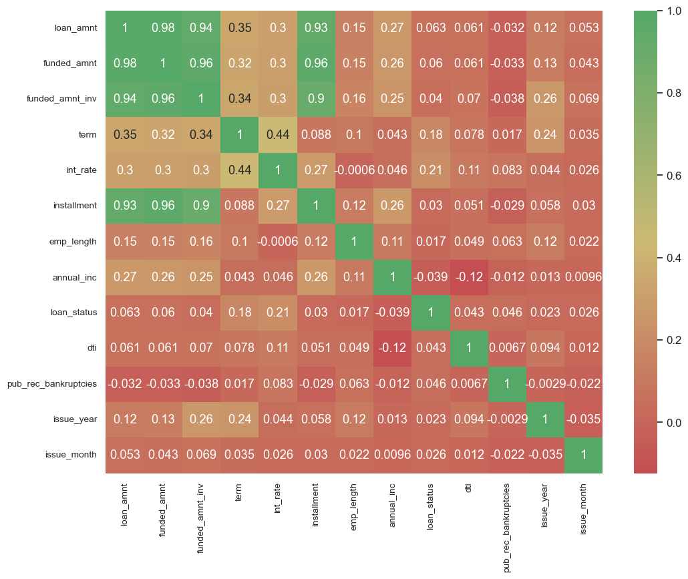
Correlation Matrix
Observations
Let us take sample variable as Loan status
The variables which are relatively higher correlation with respect to loan_status
Int_rate
term

Slide 4
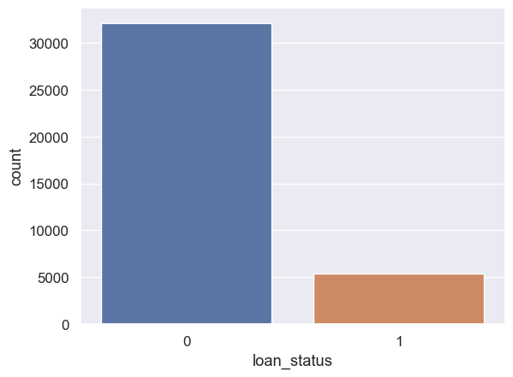
Loan status
The loan status ‘current’ is filtered
'Fully Paid’ is represented as 0
‘Charged off’ is represented as 1
 | Rows | Percentage after filtering
Fully Paid | 32145 | 85.62
Charged Off | 5399 | 14.38
Fully Paid : Charged Off is almost 6 : 1

Slide 5
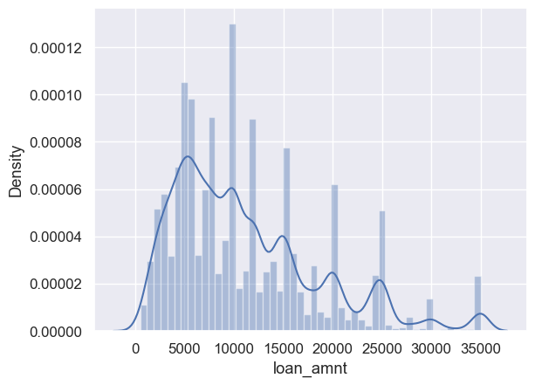
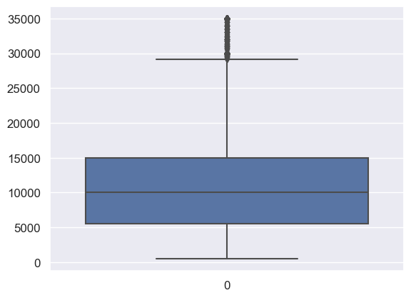
Loan Amount
count 37544.000000
mean 11119.329986
std 7354.098954
min 500.000000
25% 5500.000000
50% 10000.000000
75% 15000.000000
max 35000.000000
Observations
#1. Average Loan amount is 11119
#2. Most of the loan taken are in the range 5500 - 15000
#3. Maximum loan taken is 35000 and minimum is 500

Slide 6
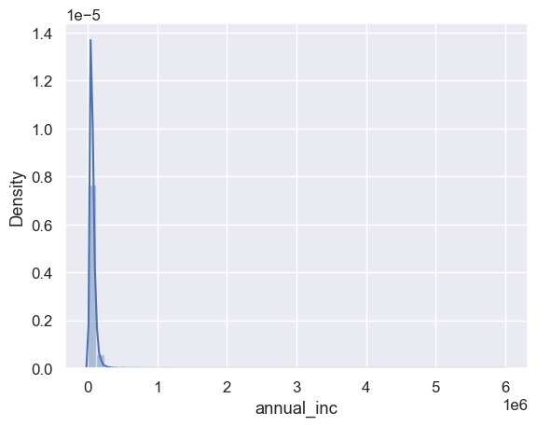
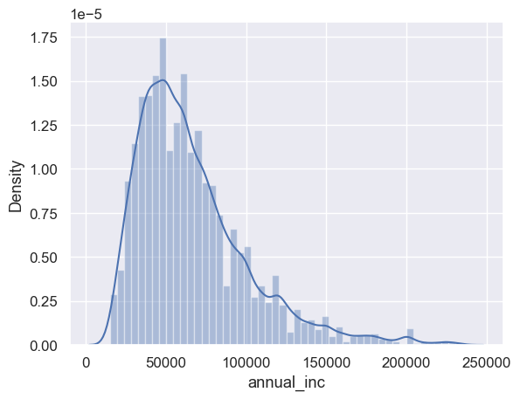
Annual Income
After removal of outliers

Slide 7
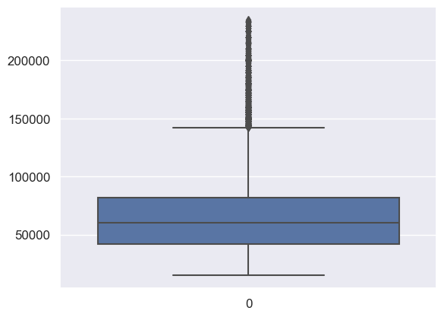
Annual Income
findings
#1. Average salary is 69407
#2. Maximum salary is 6000000 and minimum is 4000
#3. Most applicants have salary range between 41000 and 83000

Slide 8
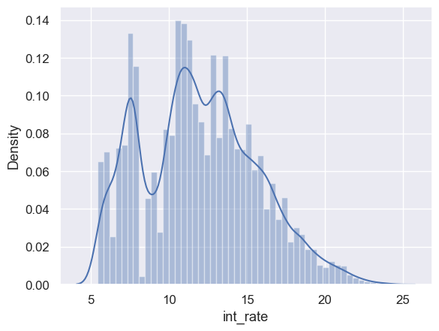
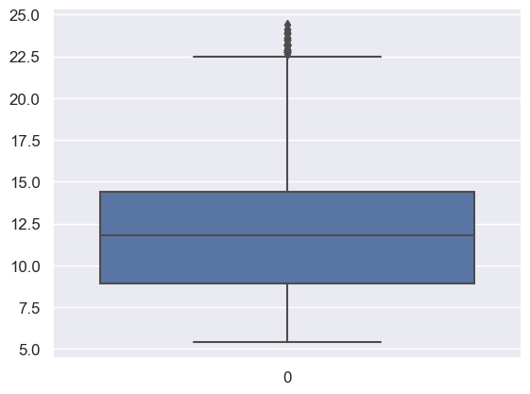
Int_Rate
findings
Average interest rate is 12%(approximately)
Maximum interest rate is 24.4% and minimum is 5.42%
Most loans have interest rate between 8.94% and 14.41%
Bimodal, i.e likely two sets of interest rates
No evident outliers

Slide 9
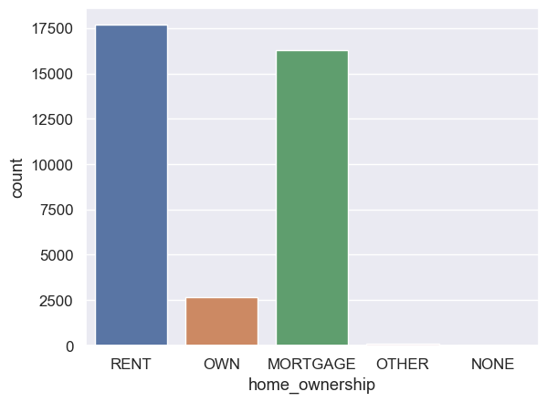
Ownership
Home Ownership | Percentage
RENT | 48.12
MORTGAGE | 44.36
OWN | 7.26
OTHER | 0.26
NONE | 0.01
#Findings
#1. Most people who take loans are staying at rented houses(48%) or have mortgaged their houses(44%).
#2. People with no houses generally doesn't take any loans(0.01%).

Slide 10
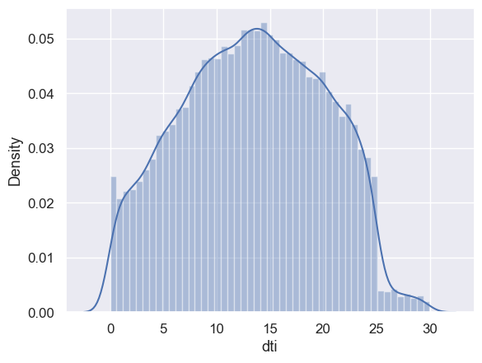
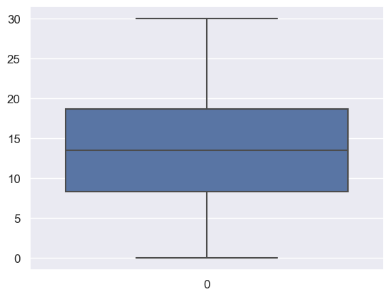
Debt to income ratio(DTI)
count 36762.000000
mean 13.375227
std 6.638618
min 0.000000
25% 8.290000
50% 13.480000
75% 18.620000
max 29.990000
#findings
#1. Average DTI is 13(approximately)
#2. Maximum DTI is 30(approximately) and minimum is 0
#3. Most applicants have DTI between 8.29 and 18.62

Slide 11
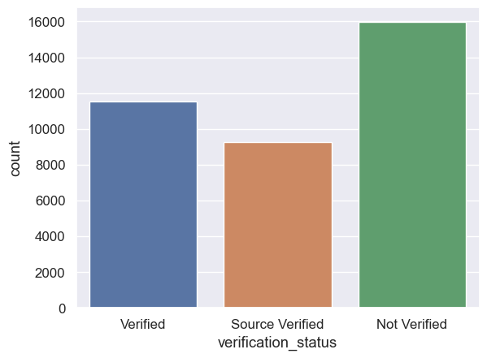
Verification Status
Verification Status | Percentage
Not Verified | 43.46
Verified | 31.37
Source Verified | 25.17
#Findings
#1. Most of the loans taken are by verified people(25% + 31% = 56 %)
#2. Non verified people loans are around 43.5%

Slide 12
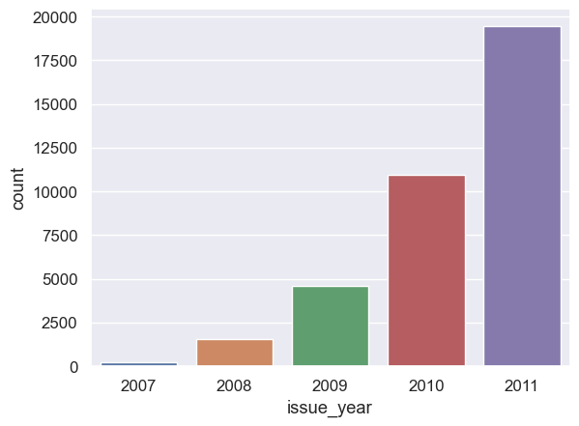
Year of issuance
Year | Perentage
2011 | 52.91
2010 | 29.8
2009 | 12.47
2008 | 4.17
2007 | 0.65
#Findings
#1. Most loans were taken in the year 2011
#2. In 2007 people took least loans(Loan interest rate might be the reason for this. Maybe in 2007-2008 loan interest rates were high)

Slide 13
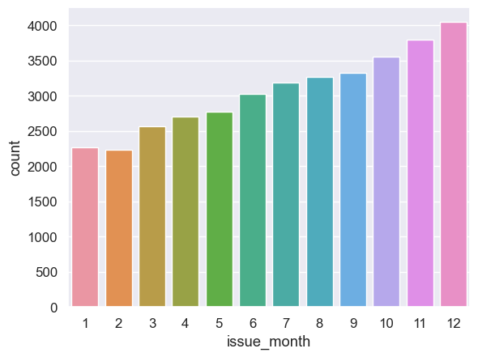
Month of issuance
Month | Percentage
12 | 11.02
11 | 10.33
10 | 9.66
9 | 9.06
8 | 8.88
7 | 8.66
6 | 8.24
5 | 7.56
4 | 7.36
3 | 6.98
1 | 6.18
2 | 6.08
#Findings
#1. At the start of the year people generally take lesser loans
#2. At the end of the year people generally seems to take more loans.

Slide 14
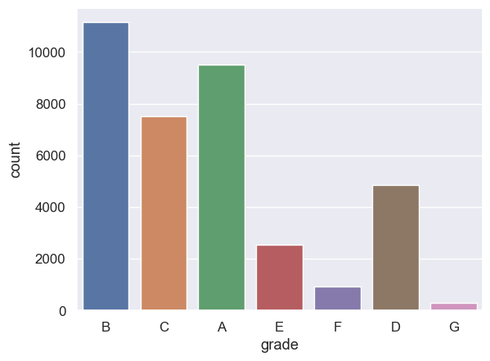
Grade
Grade | Percentage
B | 30.31
A | 25.83
C | 20.4
D | 13.2
E | 6.93
F | 2.54
G | 0.78
#Findings
#1. Grade B generally take more loans than any other grade followed by Grade A and Grade C respectively
#2. Grade F and Grade G applicants take comparatively much lesser loans.

Slide 15
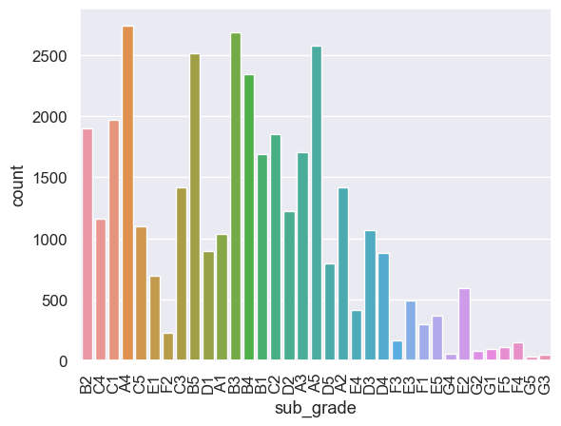
Sub Grade
#Findings
#1. Grade A4, B3, A5 take almost equal amount of loans and maximum number of loans.
#2. Grade G5 applicants take least amount of loans.

Slide 16
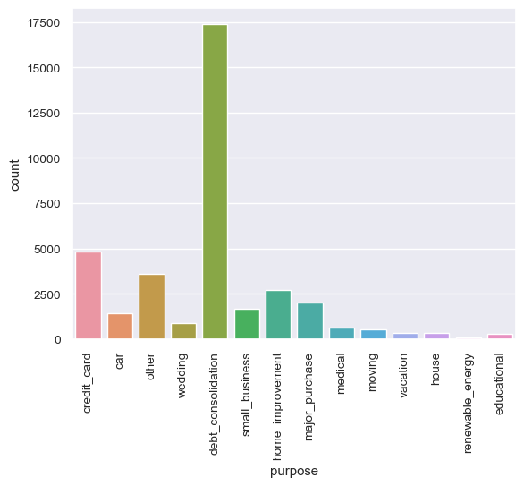
Purpose
Purpose | Percentage
debt_consolidation | 47.33
credit_card | 13.14
other | 9.81
home_improvement | 7.33
major_purchase | 5.52
small_business | 4.52
car | 3.83
wedding | 2.45
medical | 1.74
moving | 1.44
house | 0.93
vacation | 0.93
educational | 0.77
renewable_energy | 0.25
#Findings
#1. almost 50% loans are taken to pay out existing loans.
#2. 13% loans are taken to pay credit card balances.

Slide 17
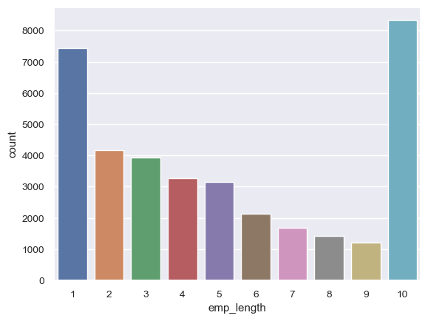
Employee Experience
Employee Length | Percentage
10 | 22.69
1 | 20.22
2 | 11.34
3 | 10.7
4 | 8.92
5 | 8.57
6 | 5.82
7 | 4.59
8 | 3.85
9 | 3.3
#Findings
#1. People tend to take loans at the start i.e. 0-1 years of experience or after 10+ years of experience.
#2. for 5-9 years experienced the loans taken are least.

Slide 18
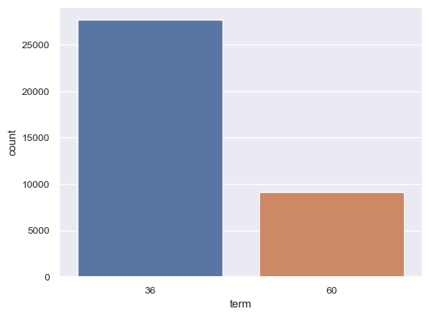
Term
Terms in months | Percentage
36 | 75.22
60 | 24.78
#Findings
#1. almost 75% loans are of lesser duration i.e. 36 months.
#2. long duration loans(60 months) are around 25%

Slide 19
Bivariate Analysis

Slide 20
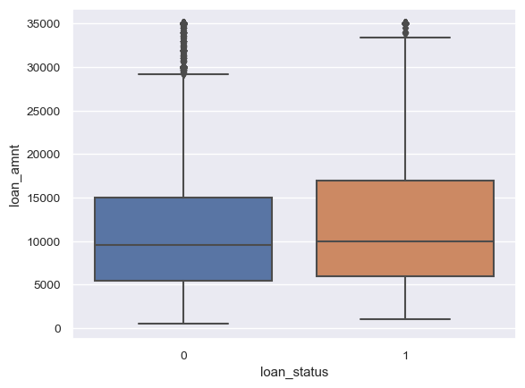
Loan Status vs Loan Amount
#Findings
#1. Average loan amount of defaulter is slightly high
#2. There is no major difference in loan amounts of defaulters.

Slide 21
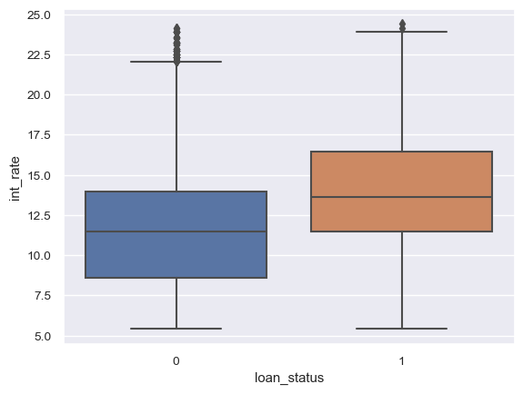
Loan Status vs Int Rate
#Findings
#1. Applicants with high interest rate seems to
default more than lower interest rates.

Slide 22
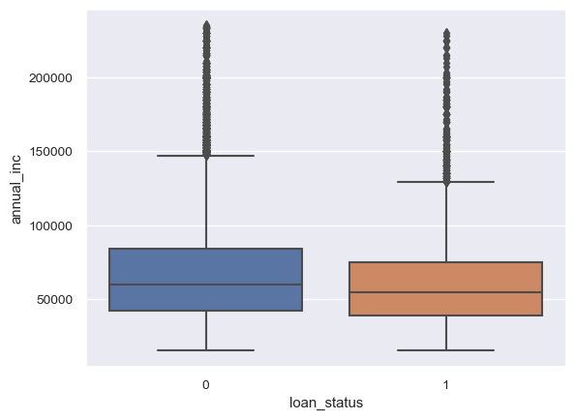
Loan Status vs Annual Income
#Findings
#1. Applicants with higher salary seem to
default a little lesser.

Slide 23
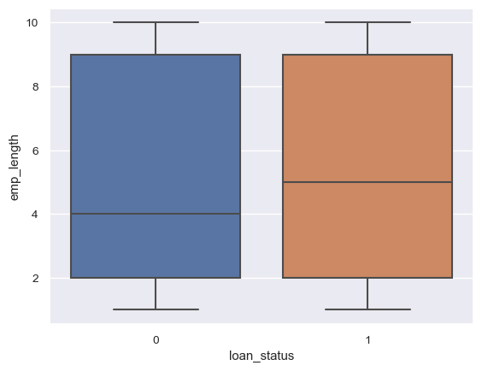
Loan Status vs Emp Length
#Findings
#1. Applicants with longer employment length
seem to default higher.

Slide 24
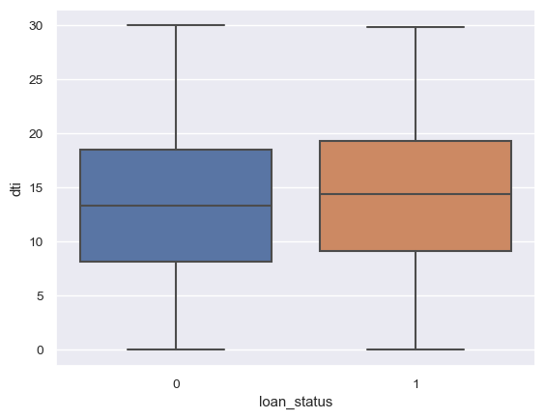
Loan Status vs Emp Length
#Findings
#1. Applicants with longer employment length
seem to default higher.

Slide 25
Loan Status vs dti
#Findings
#1. applicants with higher dti
seems to default a little more.

Slide 26
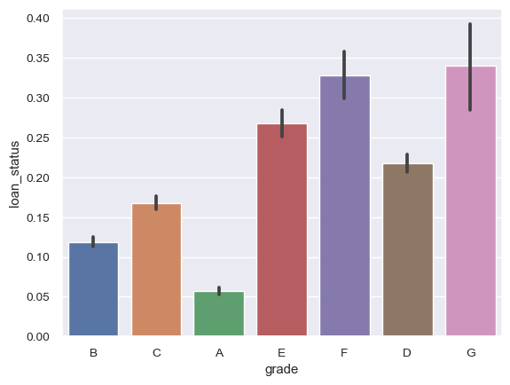
Loan Status vs Grade
#Findings
#Clearly, as the grade of loan goes from A to G, the default rate increases.
#This is expected because the grade is decided by Lending Club based on the riskiness of the loan.

Slide 27
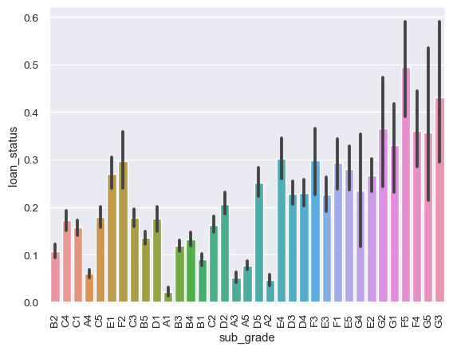
Loan Status vs Grade
#Findings
#as expected - A1 is better than A2 better than A3 and so on

Slide 28
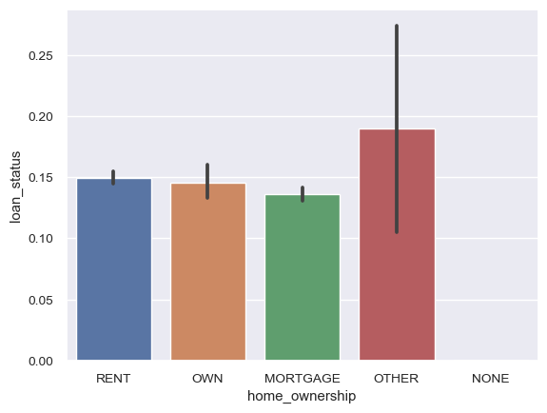
Loan Status Vs Home Ownership
#Findings
#home ownership: not a great discriminator

Slide 29
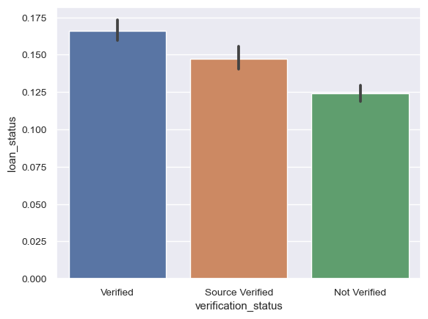
Loan Status Vs Verification Status
#Findings
#surprisingly, verified loans default
more than not verified

Slide 30
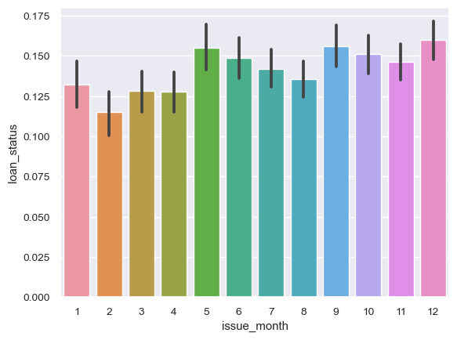
Loan Status Vs Issue Month
#Findings
#1. not much variation across months

Slide 31
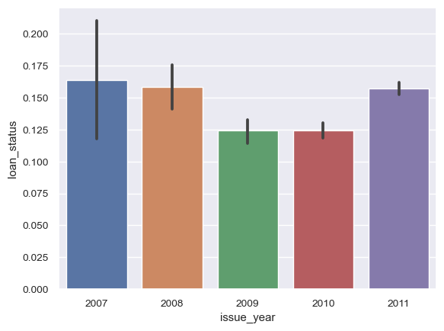
Loan Status Vs Issue Year
#Findings
#the default rate had suddenly increased in 2011, in spite of reducing from 2008 till 2010

Slide 32
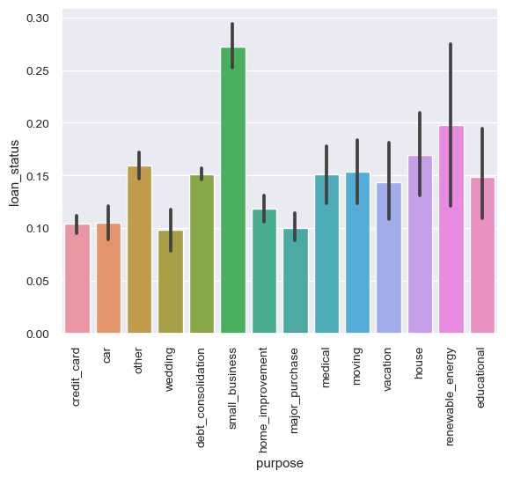
Loan Status Vs Purpose
#Findings #Small business tends to default more

Slide 33
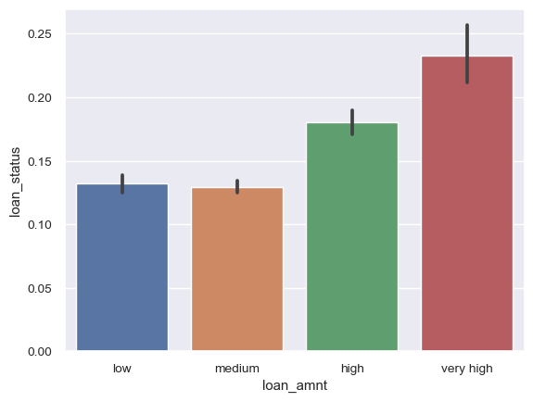
Loan Status Vs loan amount
#Findings
#higher the loan amount, higher the default rate

Slide 34
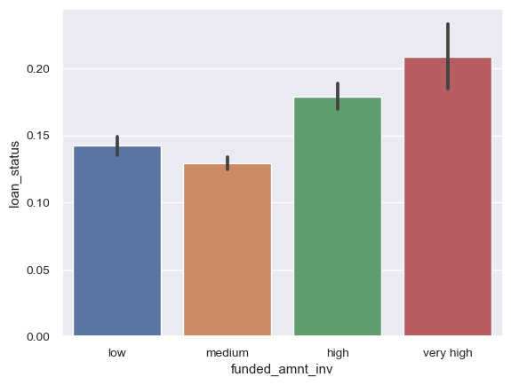
Loan Status Vs Funded_amnt_inv
#Findings
#higher the funded amount by investor,
higher the default rate
#a little dip can be seen from low to medium though

Slide 35
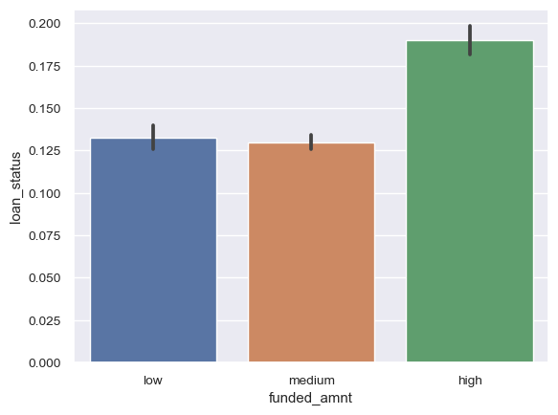
Loan Status Vs Funded_amnt
#Findings
#higher the funded amount, higher the default rate
#a little dip can be seen from low to medium though

Slide 36
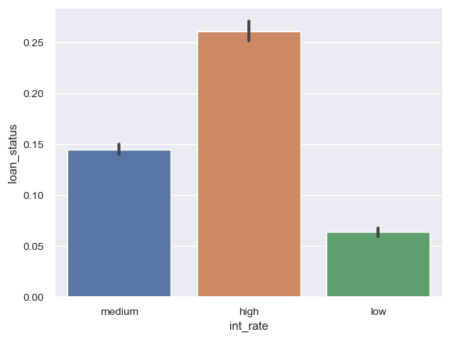
Loan Status Vs Int_Rate
#Findings
#high interest rates default more, as expected

Slide 37
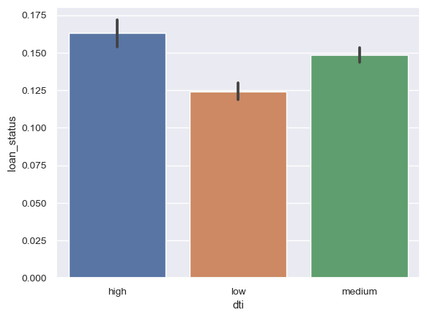
Loan Status Vs DTI
#Findings
#high dti translates into higher default rates, as
expected

Slide 38
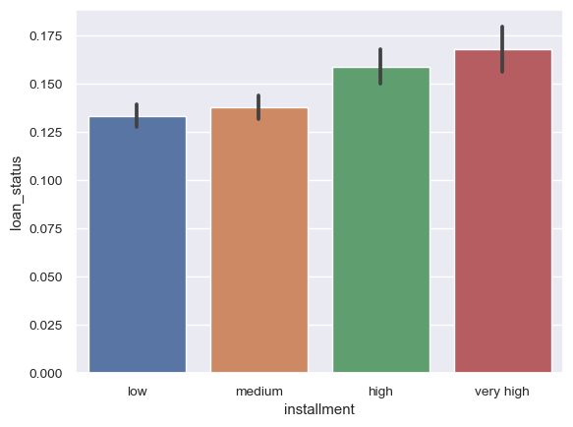
Loan Status Vs Installments
#Findings
#the higher the installment amount,
the higher the default rate

Slide 39
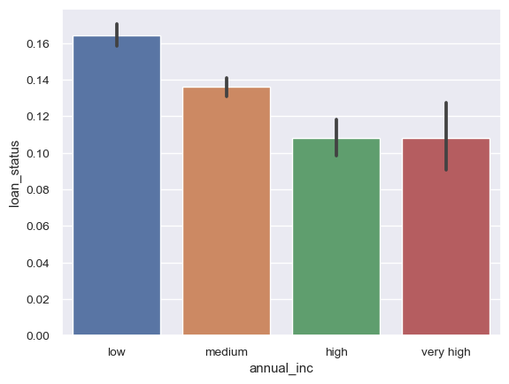
Loan Status Vs Annual Income
#Findings
#lower the annual income, higher the default rate

Slide 40
Segment Analysis

Slide 41

Segmented univariate analysis
#We have now compared the default rates across various variables, and some of the important predictors are purpose of the loan, interest rate, annual income, grade etc.
#In the credit industry, one of the most important factors affecting default is the purpose of the loan - home loans perform differently than credit cards, credit cards are very different from debt consolidation loans etc.
#This comes from business understanding, though let's again have a look at the default rates across the purpose of the loan.

Slide 42
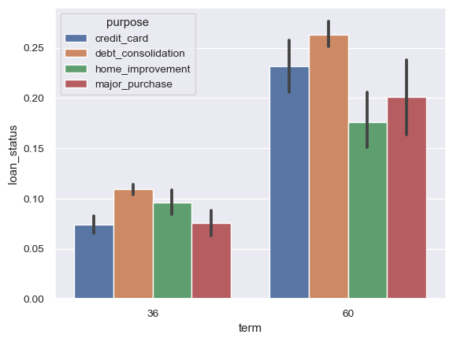
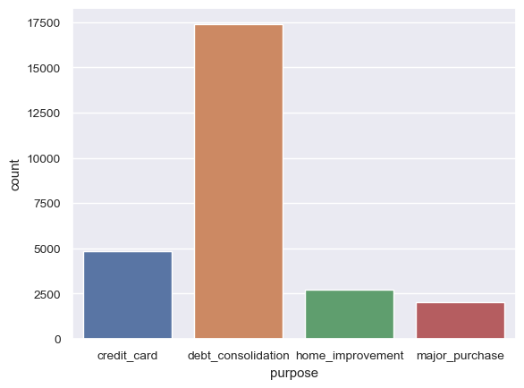
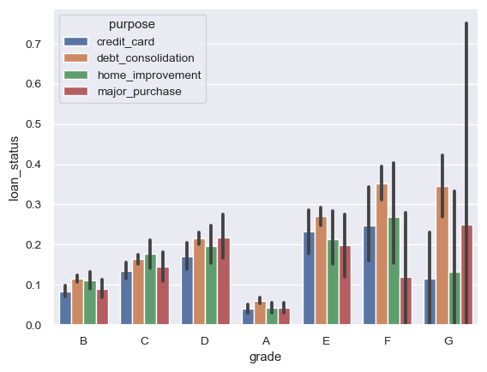
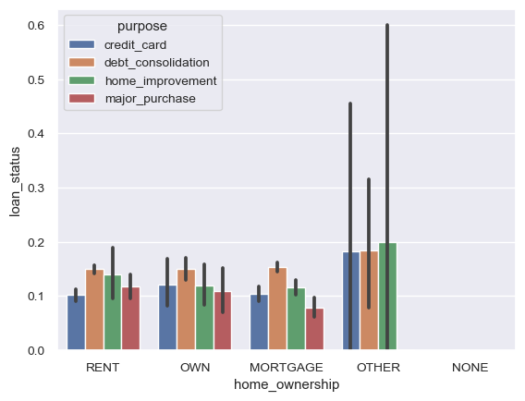

Slide 43
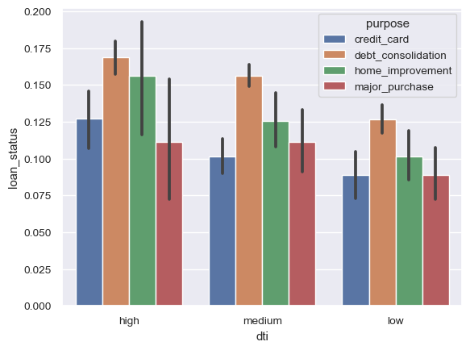
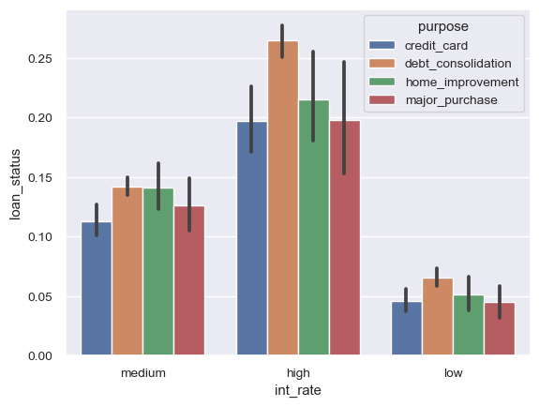
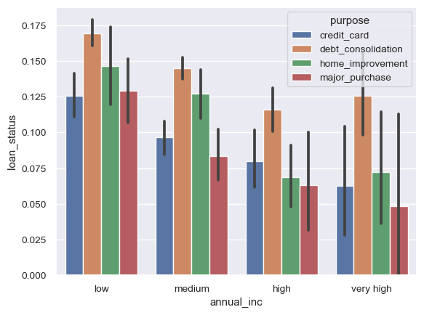
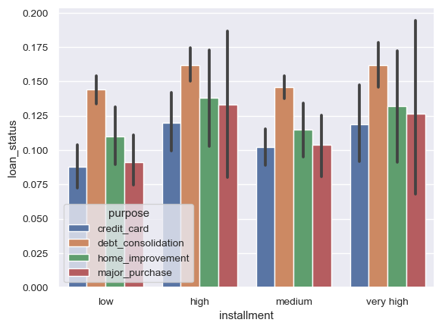

Slide 44
Conclusion
Higher the interest rate higher charged off ratio
Higher the annual income higher the loan amount slightly
Interest rate is increasing with loan amount increase this results in high charged off.
Mostly applicants take loan for debt consolidation and hence the highest default rate is in the same category
Surprisingly verified loans has more default rate than unverified default rates.

