Slide 1
Financial Risk Analytics: Portfolio Optimization for Investment in Blue Chip Companies
Group#8
Jithesh / Vinod Kumar /Tarique / Shivkumar

Slide 2
Problem Statement
Portfolio of 5 stocks in high-quality blue-chip stocks
Maximum exposure of 30% in a single stock
Build a portfolio with Minimum risk
Build a portfolio with Maximum return
Build an optimized portfolio with maximum return and minimum risk

Slide 3
Portfolio stock details
Selecting 10 stocks from BSE : Reliance Industries, HCL Tech, Nestle India, Asian Paints, Bharti Airtel, Infosys, TCS, ITC, Hindustan Unilever, HDFC
Analysis done for past 3 years data (2018 to 2021)
Variables of interest
Close Price: The value of the stock in INR at the trading close time.
Deliverable Quantity: Deliverable quantity is defined as the number of stocks that are marked for delivery (Hold for at least one day)
Delivered to traded ratio (%) : # Delivered / traded stocks for the company. This could be used to gauge if the investors are looking at this stock as a long-term investment.

Slide 4
Top Stocks by Returns- Descriptive Analysis
Highlights
RIL: Ranked 1 in terms of avg returns but the delivered to traded ratio is relatively on a lower level.
Asian Paints: Ranked 2 in terms of avg returns , but like RIL the delivered to traded ratio is at a low level
HUL: This is a case where the delivered to traded ratio is higher, but the returns are ranked lower.
From the data we can infer that the stocks for outright returns may not be the stock the investors are looking to hold on longer

Slide 5
Approach
Minimum Variance Portfolio
Maximum Returns Portfolio
Optimal Portfolio (Max Returns, Min Risk)

Slide 6
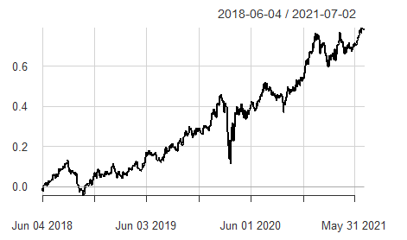
Top 5 stocks with Minimum Variance portfolio
Stock Name | Weights (%)
 | Overall | Pre-Opt | Post-Opt
HINDUNIL | 27.57 | 27.28 | 27.28
TCS | 20.22 | 22.12 | 22.12
NESTLEIND | 16.81 | 20.05 | 20.05
BHARTIARTL | 16.77 | 19.34 | 19.34
INFY | 9.95 | 11.21 | 11.21
Portfolio Metrics
CAPM Beta | 0.66
CAPM Beta Bull | 0.78
CAPM Beta Bear | 0.62
CAPM Alpha | 0.0004
CAPM Jensen Alpha | 0.12
StdDev Sharpe (Rf=0%, p=95%) | .47
Annualized Return | .21
Annualized Std Dev | .2
Annualized Sharpe (Rf=6.5%) | .69
VaR | .048
CVaR | .06
Minimum Variance Portfolio represents a low-risk portfolio characterized by low volatility.
5 stocks based on Minimum variance were selected from the initial 10 stocks (Ref Appendix)
The 5 stocks were then evaluated as a portfolio
Optimization of the portfolio was done to limit exposure in a stock to 30%
Weights pre optimization were below 30% therefore no change was observed post optimization too
CAPM Beta <1 depicts this portfolio performed better than the market benchmark in terms of stability.
The CAPM Jensen Alpha depicts the difference in risk between the market and the portfolio (CAPM Beta)
Value at Risk (VaR): There is a 5% chance of losing 4.8% of the invested value
Portfolio Returns

Slide 7
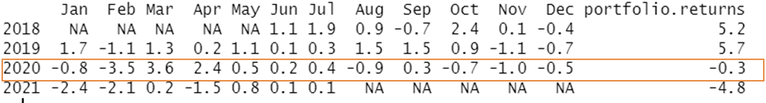
Portfolio Returns calendar and summary Minimum Variance
Returns Calendar
Summary
Overall cumulative returns is moving in the positive direction primarily driven strong performances in years 2018 and 2019.
Due to Covid-19 in 2020 the returns of the portfolio dropped and is continuing to drop in 2021 due to the 2nd and possibly the 3rd waves
A positive change is observed May 2021 onwards indicating a positive investor sentiment

Slide 8
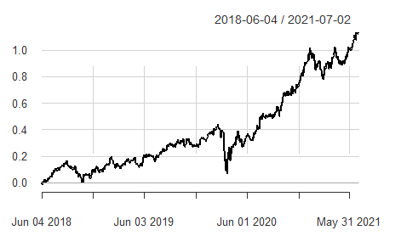
Top 5 stocks with Maximum returns portfolio
Stock Name | Weights (%)
 | Overall | Pre-Opt | Post-Opt
NESTLEIND | 47.91 | 43.27 | 30.00
ITC | -68.95 | -14.97 | 0.00
INFY | 40.56 | 39.31 | 28.14
ASIANPAINT | 36.57 | 4.22 | 15.71
TCS | 33.25 | 28.17 | 26.14
Portfolio Metrics
CAPM Beta | 0.65
CAPM Beta Bull | 0.68
CAPM Beta Bear | 0.66
CAPM Alpha | 0.00061
CAPM Jensen Alpha | 0.21
StdDev Sharpe (Rf=0%, p=95%) | 0.06292871
Annualized Return | 0.2845
Annualized Std Dev | 0.2071
Annualized Sharpe (Rf=6.5%) | 0.9835
VaR | . 0409
CVaR | . 0508
5 stocks based on Maximum returns were selected from the initial 10 stocks against a fixed target risk of 6.5%
The 5 stocks were then evaluated as a portfolio (Ref Appendix)
Negative weights for ITC were a result of short selling allowed in the portfolio
Optimization of the portfolio was done to limit exposure in a stock to 30% which resulted in the weight for ITC going to ~0.00
Value at Risk (VaR): There is a 5% chance of losing 4.09% of the invested value
Portfolio Returns

Slide 9
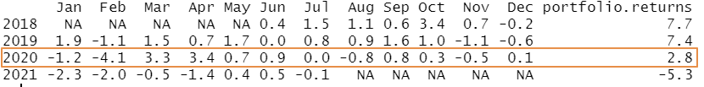
Portfolio Returns calendar and summary Maximum Returns
Returns Calendar
Summary
Overall cumulative returns is moving in the positive direction primarily driven strong performances in years 2018 and 2019 which is much higher than the minimum variance portfolio
Despite Covid-19 in 2020, this portfolio provided positive returns which indicated a better resiliency
2021 sees a drop in returns but overall returns is still better than the Minimum Variance portfolio

Slide 10
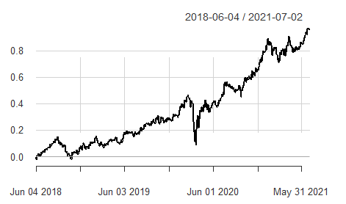
Tangency Portfolio – Top 5 Stocks
Stock Name | Weights (%)
 | Overall | Pre-Opt | Post-Opt
NESTLEIND | 24.77 | 30.64 | 30.64
INFY | 24.43 | 28.06 | 28.06
TCS | 14.07 | 16.44 | 16.44
HINDUNILVR | 11.91 | 12.71 | 12.71
BHARTIARTL | 11.24 | 12.15 | 12.15
Portfolio Metrics
CAPM Beta | 0.66
CAPM Beta Bull | 0.73
CAPM Beta Bear | 0.63
CAPM Alpha | 0.00051
CAPM Jensen Alpha | 0.18
StdDev Sharpe (Rf=0%, p=95%) | 0.056
Annualized Return | 0.26
Annualized Std Dev | 0.20
Annualized Sharpe (Rf=6.5%) | 0.85
VaR | . 051
CVaR | . 059
Tangency Portfolio indicates that the risk to return ratio is maximized
5 stocks based on Tangency Portfolio were selected from the initial 10 stocks
The 5 stocks were then evaluated as a portfolio (Ref Appendix)
Optimization of the portfolio was done to limit exposure in a stock to 30%
Weights pre and post optimization do not see a material change hence they were kept unchanged
Value at Risk (VaR): There is a 5% chance of losing 5.1% of the invested value
Portfolio Returns

Slide 11
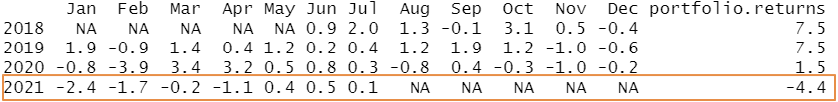
Portfolio Returns calendar and summary Tangency Portfolio
Returns Calendar
Summary
Overall cumulative returns is moving in the positive direction primarily driven strong performances in years 2018 and 2019 which is much higher than the Minimum Variance and Maximum Returns portfolio
Despite Covid-19 in 2020, this portfolio provided positive returns which indicated better resiliency
2021 sees a drop in returns but overall returns is higher compared to the Maximum Returns and Minimum Variance portfolio

Slide 12
Recommendations
Common Stocks Across Portfolios
Common Stocks like Nestle, Infosys, and TCS were picked up in all 3 portfolios which contributes to similar returns and Value at Risk
HUL and Bharti Airtel were part of the Min Variance and the Optimal portfolio which may result in contained risk
The Tangency portfolio is the recommended portfolio as it maximizes return and minimizes risk
Most investors tend to stay invested longer based on the values of % Delivered to Traded ratio (HUL, Infy and Nestle)
The Maximum Returns portfolio has the least VaR , however it had the highest negative returns in 2021.
Summary of Returns across Portfolios
Investment Distribution based on optimal portfolio
Year | Minimum Variance | Maximum Returns | Tangency Portfolio
2018 | 5.2 | 7.7 | 7.5
2019 | 5.7 | 7.4 | 7.5
2020 | -0.3 | 2.8 | 1.5
2021 | -4.8 | -5.3 | -4.4
VaR | 0.048 | 0.0409 | 0.051
Stock Name | Weights (%) | Investment Distribution
NESTLEIND | 30.64 | 3,064,000
INFY | 28.06 | 2,806,000
TCS | 16.44 | 1,644,000
HINDUNILVR | 12.71 | 1,271,000
BHARTIARTL | 12.15 | 1,215,000
Total Investment |  | 10,000,000

Slide 13
Appendix

Slide 14
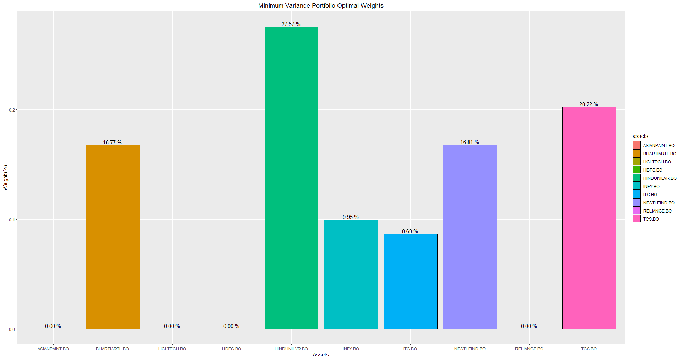
Top 5 Stocks with Minimum Variance
1
2
4
3
5

Slide 15
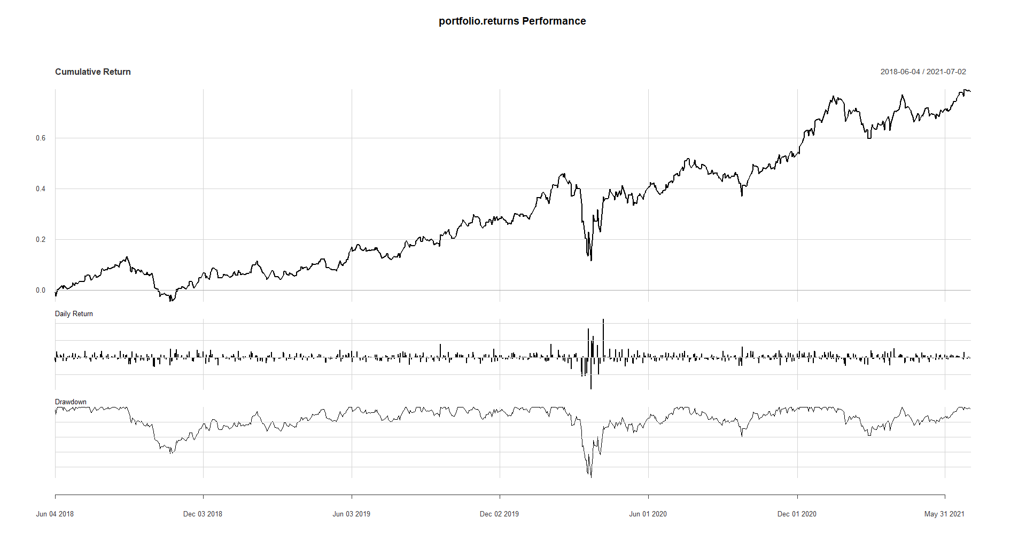
Minimum Variance portfolio returns and drawdown periods

Slide 16
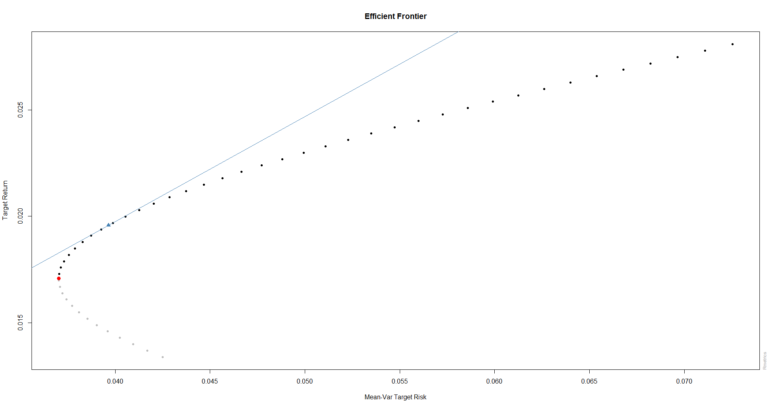
Efficient Frontier

Slide 17
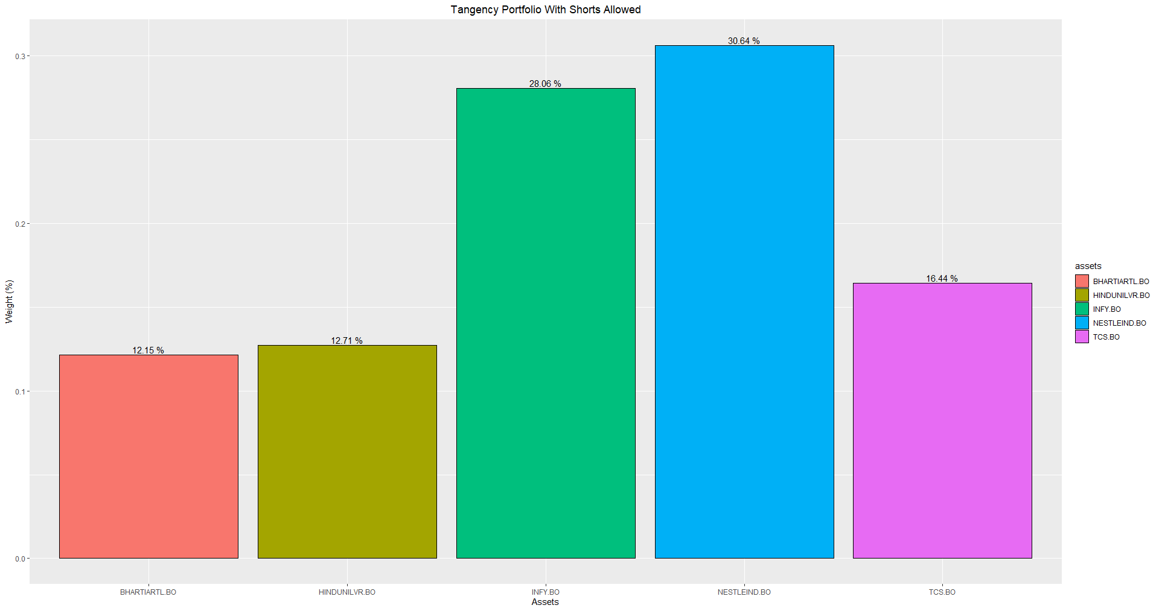
Top 5 Stocks with Short Selling Allowed

Slide 18
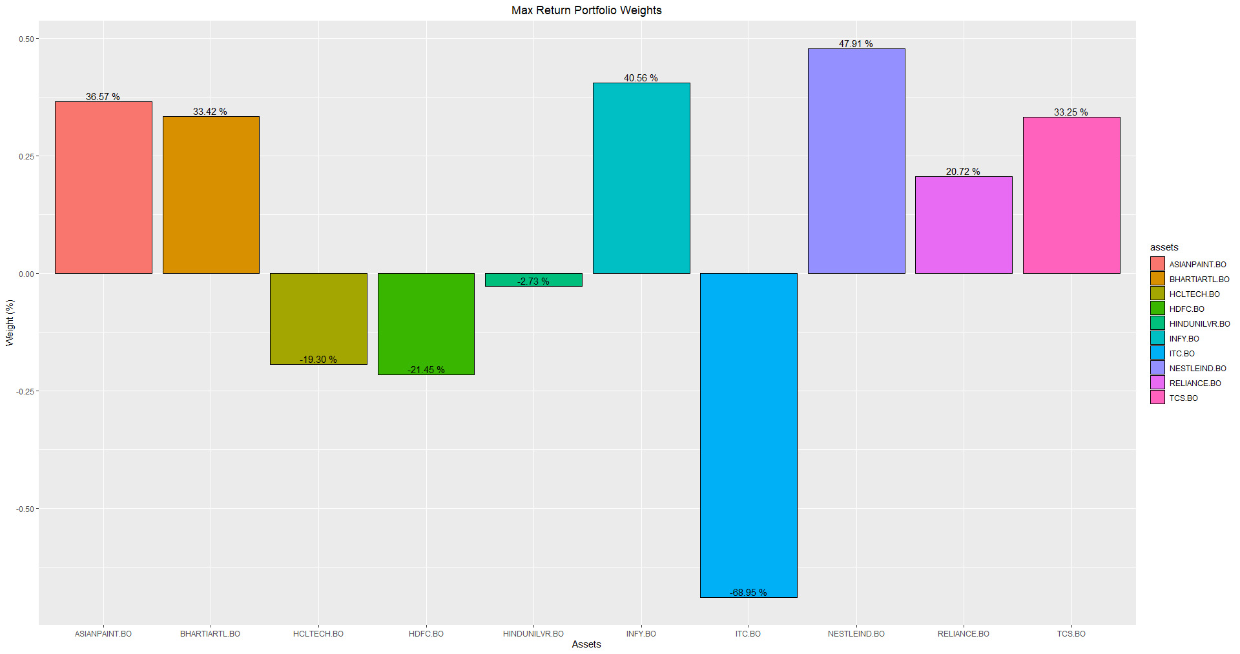
Top 5 Stocks selected with Maximum Returns
1
3
4
5
2
Shorting the ITC stock by -68.95% yields maximum returns

Slide 19
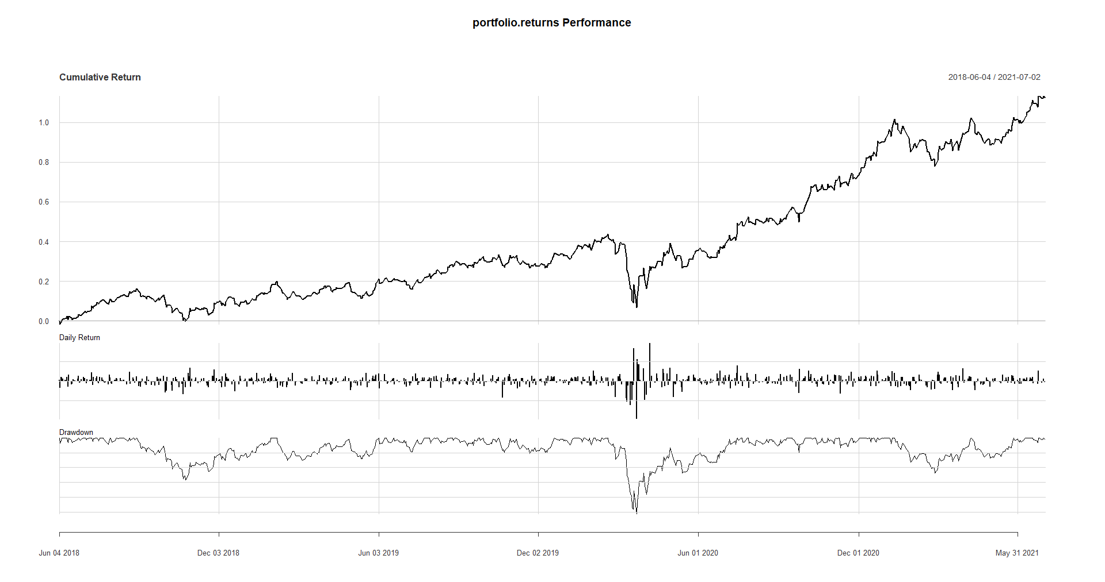
Maximum Returns portfolio returns and drawdown periods

Slide 20
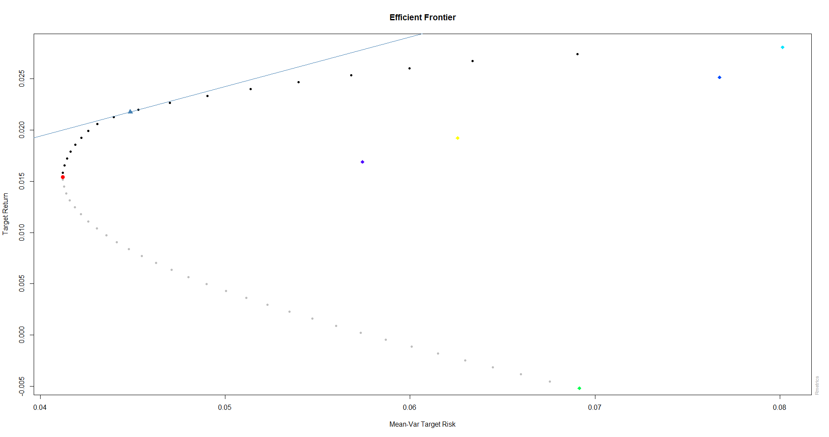
Efficient Frontier

Slide 21
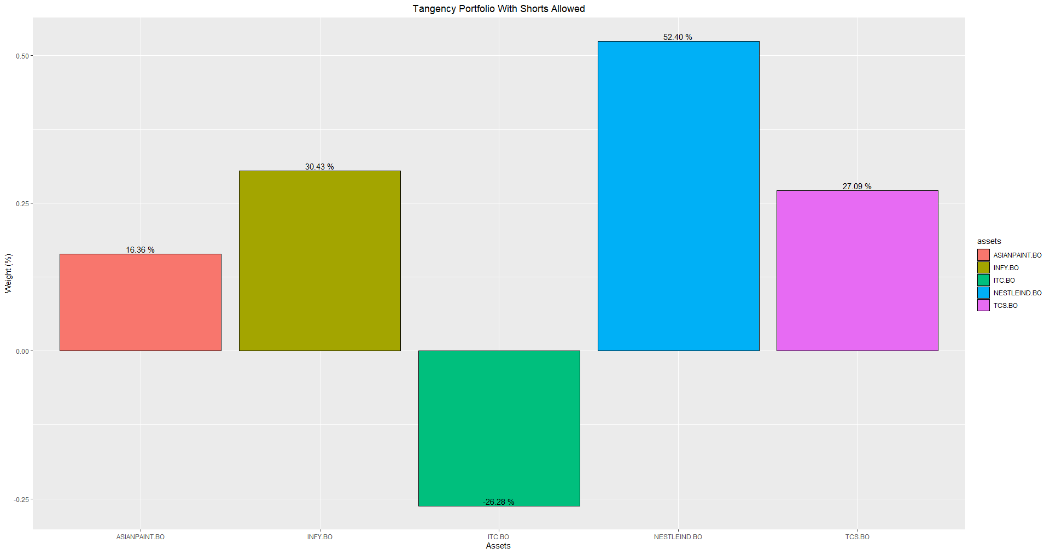
Top 5 Stocks with Short Selling Allowed

Slide 22
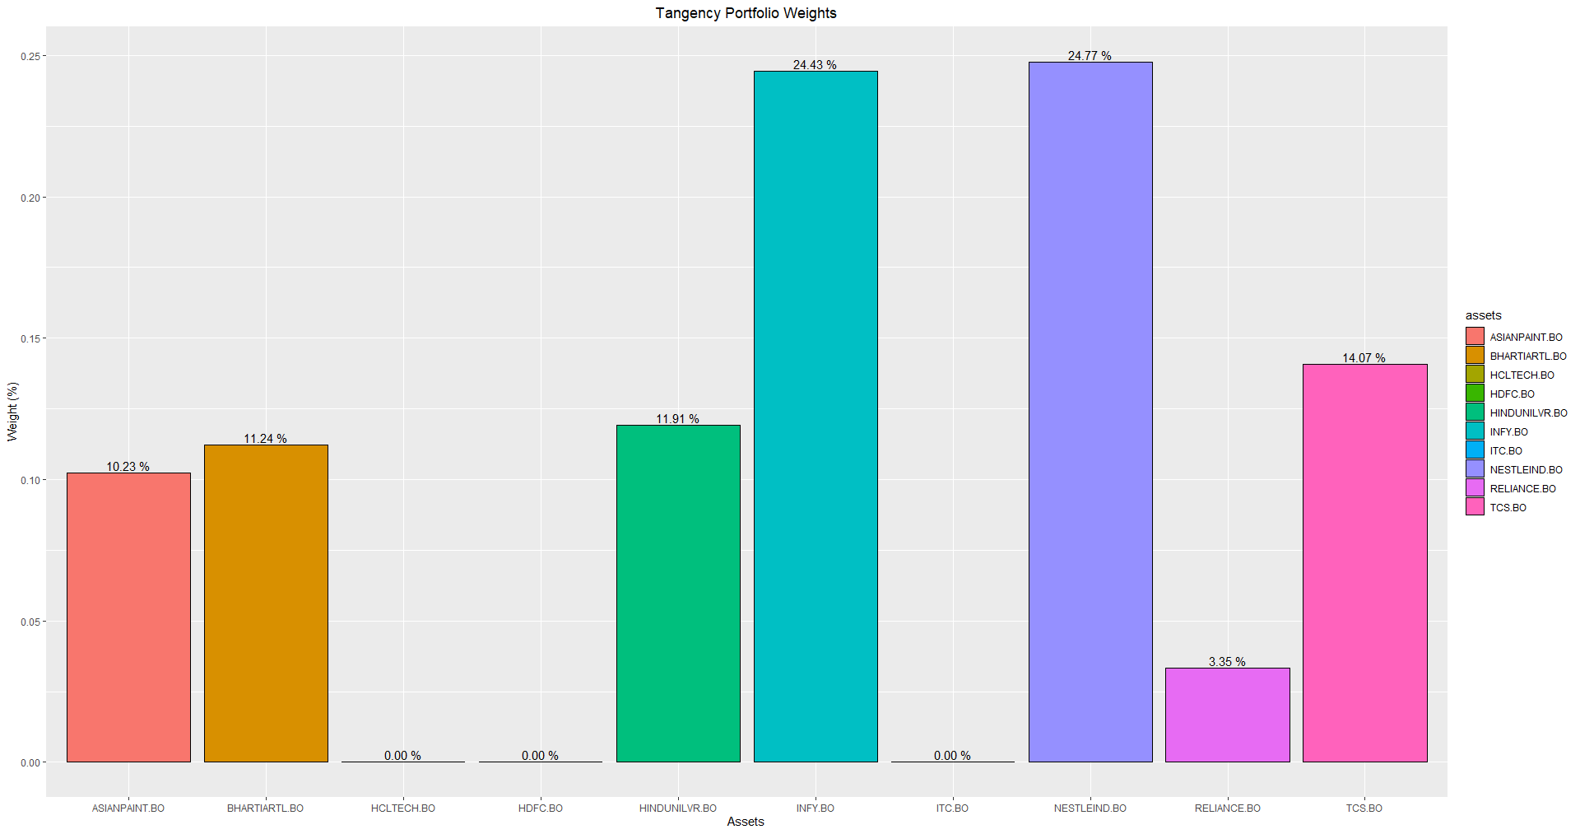
Tangency Weights (Optimal Portfolio)
2
1
3
4
5

Slide 23
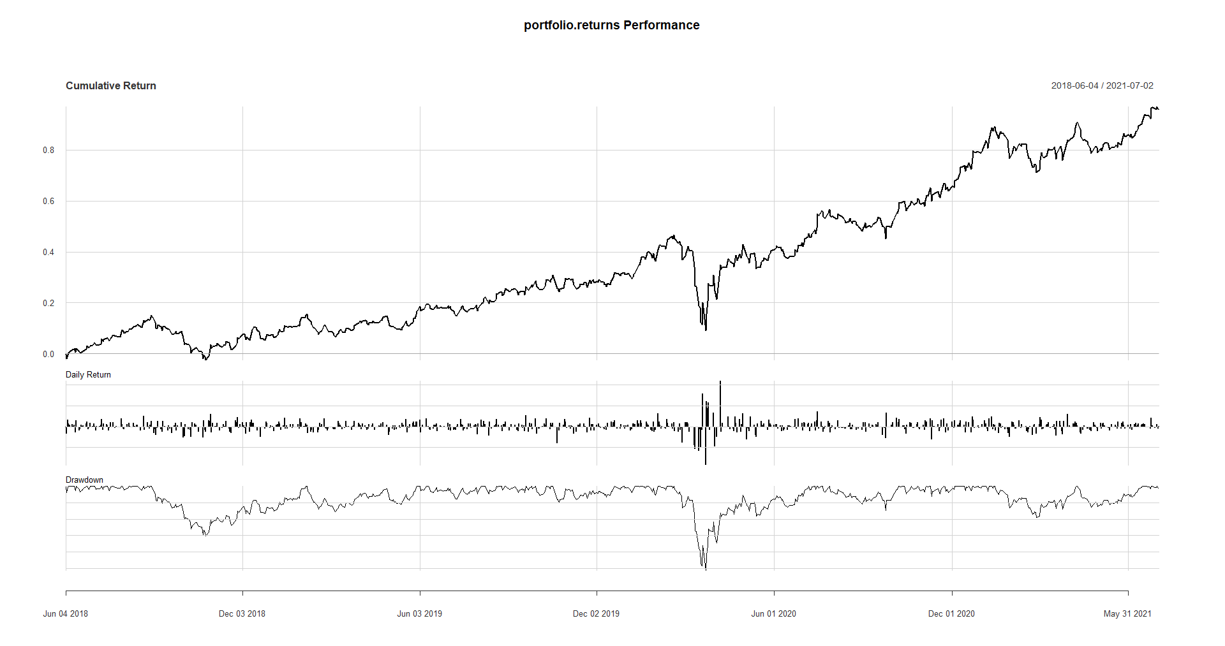
Tangency portfolio returns and drawdown periods

Slide 24
Efficient Frontier

Slide 25
Top 5 Stocks with Short Selling Allowed

