Slide 1


Department of Information Technology
V R Siddhartha Engineering College
Deep Learning Based Waste Classification and Recycling Guidance System
B.Tech in Information Technology
Major Project Review Presentation
PRESENTED BY
Mr. Tarun Sahukari (228W1A1257)
Mr. Jitin Venkata Sai Kamineni (228W1A1223)
Under the guidance of
Dr. Ramesh Mande
ASSISTANT PROFESSOR

Slide 2
Agenda
Introduction and Problem statement
Objectives and Outcomes of the Project
Literature review and Summary
Datasets and Requirements
Algorithms used in the Project
Architecture/Project flow diagram
Implementation steps and Execution
Results obtained
Result analysis
Conclusion and Future work
References

Slide 3
Introduction
Waste management has become a major environmental concern due to the rapid increase in daily waste generation from households, industries, and public spaces.
Improper identification and segregation of waste reduce recycling efficiency, increase landfill burden, and create long-term environmental and resource management problems.
To support efficient and sustainable waste handling, this work develops an intelligent framework that combines deep learning-based waste classification, object detection, and recycling guidance generation for improved waste analysis and disposal support.

Slide 4
Problem Statement
Traditional waste management mainly relies on manual sorting, which is time-consuming, labor-intensive, and highly dependent on human judgment, making it difficult to manage large quantities of mixed waste efficiently.
These limitations often result in poor segregation of recyclable and non-recyclable materials, lower recycling effectiveness, and increased environmental issues such as landfill accumulation, resource loss, and pollution.
To address these challenges, this project presents a deep learning-based waste classification, detection, and recycling guidance framework that combines ResNet-50, hybrid models, YOLOv8, and Retrieval-Augmented Generation to identify waste materials and support proper recycling for sustainable waste management.

Slide 5
Objectives and Outcomes
OBJECTIVES | OUTCOMES
Develop deep learning and hybrid models for accurate waste classification. | An efficient waste classification system capable of identifying waste categories with improved accuracy.
Build a YOLOv8 model to detect and localize multiple waste objects from a single image. | A robust multi-class waste detection model for recognizing multiple materials in mixed waste images.
Integrate a RAG-based module to generate recycling guidance from detected waste classes. | Context-aware recycling guidance for material-specific disposal and recycling recommendations.
Design an interactive interface for image upload, result visualization, and recycling support. | A functional end-to-end application that displays detection results and recycling guidance effectively.
Provide structured output to support proper waste segregation and sustainable handling. | Improved user awareness and practical support for sustainable waste management.

Slide 6
Literature Review
S.no | Publication Details | Dataset Used | Algorithms Used and Results | Remarks
1. | Enhanced YOLOv8-Seg Instance Segmentation for Real-Time Submerged Debris Detection — Amjad A. Alsuwaylimi; 2024, IEEE Access. | TrashCan dataset with 7,212 annotated underwater images for submerged debris detection. | Used Enhanced YOLOv8-Seg models for real-time debris detection and instance segmentation. The YOLOv8 baseline achieved Precision = 54.5%, Recall = 39.3%, and mAP@50 = 45.8%. | The model is effective for underwater debris detection, but its scope is restricted to aquatic environments and it does not provide recycling or disposal guidance.
2. | Contamination Detection from Highly Cluttered Waste Scenes using Computer Vision — Dishant Mewada, Cathaoir Agnew, Eoin M. Grua, Ciarán Eising; 2024, IEEE Access. | Custom recycling waste dataset collected from waste collection trucks and annotated for contamination detection. | Used YOLOv8, Faster-RCNN, Cascade-RCNN, RetinaNet, and Transfer Learning. Achieved high mAP for contamination detection in dense and complex waste scenes. | The system performs well for contamination detection in cluttered waste environments, but it mainly focuses on identifying contaminated materials and does not include recycling recommendation support.
3. | A Reliable and Robust Deep Learning Model for Effective Recyclable Waste Classification — Hossen, M. M., Majid, M. E., Kashem, S. B. A., Khandakar, Nashbat; 2024, IEEE Access. | TrashNet dataset with 2,527 images. | Proposed RWC-Net combining DenseNet-201 and MobileNet-V2. Achieved 95.01% overall accuracy and high F1-scores across recyclable waste classes. | The approach is effective for recyclable waste classification, but its performance may not generalize well to real-world conditions because of limited dataset size, class imbalance, and the absence of object detection capability.
4. | Recycle Waste Detection and Classification Model Using YOLO-V8 for Real-time Waste Management — Rastari, M. A. M., Roslan, R., Hamzah, R., Teo, N. H. I., Shahbudin; 2024, IEEE IICAIET. | Garbage Classification Dataset, Recycled Waste Image Dataset, and Augmented Waste Image Dataset with 10,057 images after augmentation. | Used YOLO-v8 for real-time recyclable waste classification. Achieved 97.63% accuracy and classified waste materials such as paper, glass, metal, and plastic. | The method shows strong performance in controlled settings, but its generalization is limited by fewer waste categories, high-quality image dependency, and lack of evaluation on mixed or overlapping waste scenes.
5. | Title: Enhancing Waste Sorting and Recycling Efficiency: Robust Deep Learning-Based Approach for Classification and Detection — Sayem, F. R., Islam, M. S. B., Naznine, M., Nashbat, M., Hasan-Zia Neural Computing and Applications (2025) | WasteRecycling Plant dataset (WARP) | Used a Dual-Stream Network (DenseNet-201 + Multi-Axis Vision Transformer) for waste classification. Achieved 83.11% classification accuracy on the WaRP dataset. GELAN-E model obtained 63% mAP@50 for waste object detection. Models improved waste sorting and recycling efficiency. | Class imbalance in categories like bottles and detergents affects performance. Visually similar waste items and complex backgrounds cause misclassification. High computational cost of the 2S_DenseViT model limits real-time deployment. Reliance on RGB images only restricts accuracy; multimodal data could improve results.
6. | Title: E-Waste Intelligent Robotic Technology (EIRT): A Deep Learning approach for Electronic Waste Detection, Classification and Sorting — Joseph, I. O., Wangare, N. L., Mahoque, T. P., Tewari, P., & Majumdar 14th ICCCNT IEEE Conference | TrashBox, Waste Pictures, eWaste datasets (total ~5,336 images) | Used EfficientNet-D2 for automated e-waste classification. Achieved 82.32% accuracy across all categories. Classified five e-waste types: Battery, Electronic Board, Home Appliances, Mobile Phone, Mouse. Demonstrated potential for improved e-waste sorting and recycling management. | Performance limited by small dataset and few e-waste categories. Limited environmental variability affects real-world scalability. Robotic system physically handles only three classes, restricting sorting. Sensor reliability and performance in cluttered scenes are not evaluated.

Slide 7
Literature Summary
Deep learning models such as YOLOv8, DenseNet, MobileNet, EfficientNet, and Vision Transformer-based networks are widely used for automated waste detection and classification.
Commonly used datasets include TrashCan, TrashNet, Garbage Classification, WaRP, TrashBox, and eWaste datasets, which support training and evaluation under different waste-management scenarios.
Hybrid and optimized models improve performance through feature fusion, transfer learning, data augmentation, and lightweight architectures, leading to better accuracy and more efficient waste recognition.
Many existing studies are limited to classification only or detection only and do not provide additional support for recycling or disposal decisions.
Common limitations include small datasets, class imbalance, controlled image conditions, and lack of evaluation on cluttered or overlapping waste scenes, which affect real-world deployment.
These gaps highlight the need for an integrated waste management system that combines accurate waste recognition with practical recycling guidance.

Slide 8
Datasets and Requirement specifications
Datasets Used :
Garbage Classification Dataset Used for the ResNet-50 model. Contains 10 waste categories with a total of 19,762 images. Classes include Metal, Glass, Biological Waste, Paper, Battery, Trash, Cardboard, Shoes, Clothes, and Plastic. Source: Kaggle – Garbage Classification V2
Combined Garbage Classification + TrashBox Dataset Used for DenseNet121 + EfficientNet-B0 and ResNet-50 + ViT models. Created by merging both datasets for balanced training. Includes 6 classes: Metal, Glass, Paper, Cardboard, Clothes, and Plastic with 4,000 images each. Source: Kaggle – Garbage Classification V2 and TrashBox
Garbage Classification Dataset (YOLOv8 Format) Used for the YOLOv8 detection model. Collected from Roboflow Universe for multi-class waste detection. Source: Roboflow Universe – Garbage Classification 3
Requirements Specifications :
Programming Language: Python
Classification Models: ResNet-50, DenseNet121 + EfficientNet-B0, ResNet-50 + ViT
Object Detection Model: YOLOv8
RAG Module: FAISS, Google Gemini API
Image Processing: OpenCV
Web Interface: Streamlit
Execution Environment: Kaggle Notebook
Recycling Support: Rule-Based System

Slide 9
Algorithms used in the Project
ResNet-50 + Rule-Based System
Step 1: Collect the Garbage Classification dataset and organize waste images into predefined classes such as metal, glass, paper, cardboard, clothes, and plastic.
Step 2: Resize all images to a fixed input size and apply preprocessing techniques such as normalization and augmentation for stable training.
Step 3: Split the dataset into training, validation, and testing sets for proper model learning and evaluation.
Step 4: Use ResNet-50 as the deep learning classifier to extract visual features and classify the input waste image into the correct category.
Step 5: Generate the predicted waste label based on the highest classification probability.
Step 6: Apply a rule-based system to map the predicted waste class to the corresponding recycling and disposal method.
Step 7: Display the final output as classified waste type along with the recycling guidance.

Slide 10
Algorithms used in the Project
DenseNet121 + EfficientNet-B0 + Rule-Based System
Step 1: Use the combined Garbage Classification and TrashBox dataset with balanced waste classes for training.
Step 2: Resize and preprocess the waste images to create a uniform input for both models.
Step 3: Split the dataset into training, validation, and testing sets for proper evaluation.
Step 4: Use DenseNet121 and EfficientNet-B0 as parallel feature extractors to learn complementary image features.
Step 5: Fuse the extracted features and pass them through classification layers to predict the waste category.
Step 6: Apply a rule-based system to map the predicted class to the corresponding recycling method.
ResNet-50 + Vision Transformer + Rule-Based System
Step 1: Use the balanced combined waste dataset containing classes such as metal, glass, paper, cardboard, clothes, and plastic.
Step 2: Resize and normalize all images so that they can be processed by both ResNet-50 and Vision Transformer.
Step 3: Split the dataset into training, validation, and testing sets for systematic learning.
Step 4: Use ResNet-50 to extract local visual features and Vision Transformer to capture global contextual information.
Step 5: Fuse both feature representations and pass them through classification layers to predict the waste category.
Step 6: Use a rule-based system to generate the recycling and disposal guidance for the predicted waste class.

Slide 11
Algorithms used in the Project
YOLOv8 + RAG Module
Step 1: Collect the garbage detection dataset in YOLOv8 format from Roboflow Universe along with a recycling knowledge base from environmental and municipal resources.
Step 2: Resize the images, prepare annotations, and split the dataset into training, validation, and testing sets.
Step 3: Train the YOLOv8 model to detect and localize multiple waste categories such as paper, plastic, glass, metal, cardboard, and biodegradable waste.
Step 4: Upload an input waste image through the interface and pass it to the trained YOLOv8 detector.
Step 5: Generate bounding boxes, class labels, and confidence scores for each detected waste object in the image.
Step 6: Extract the detected waste labels and pass them to the Retrieval-Augmented Generation module.
Step 7: Use FAISS to retrieve relevant recycling knowledge for each detected waste category from the prepared knowledge base.
Step 8: Provide the retrieved context to the language model to generate structured recycling guidance.
Step 9: Display the final output as the detected waste image with bounding boxes, labels, confidence scores, and step-by-step recycling recommendations.

Slide 12
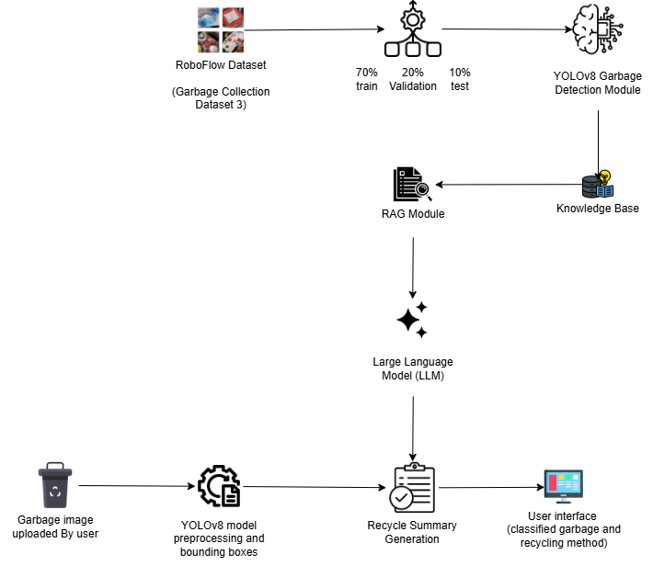
Architecture Diagram

Slide 13
Implementation steps and Execution
Step 1 – Dataset Collection The garbage detection dataset is collected from Roboflow Universe in YOLOv8 format, containing annotated waste images of Paper, Plastic, Glass, Metal, Cardboard, and Biodegradable classes.
Step 2 – Knowledge Base Preparation A recycling knowledge base is prepared separately using environmental guidelines, municipal waste management documents, and curated recycling resources for the RAG module.
Step 3 – Dataset Organization and Splitting The waste image dataset is organized into training, validation, and testing sets in the ratio of 70%, 20%, and 10% for systematic model development.
Step 4 – Image Resizing and Preprocessing All images are resized to 640 × 640 pixels to match the input requirement of the YOLOv8 model. Preprocessing and augmentation techniques such as flipping, scaling, translation, and brightness variation are applied to improve robustness and reduce overfitting.
Step 5 – YOLOv8 Model Training The YOLOv8 model is trained in the Kaggle Notebook environment using Python to learn multi-class object detection and localization of waste objects.
Step 6 – Waste Image Inference During inference, the trained YOLOv8 model processes the uploaded waste image and predicts bounding boxes, class labels, and confidence scores for each detected object.
Step 7 – Detected Waste Label Extraction The detected waste labels are extracted from the YOLOv8 output. If multiple waste objects are identified, each label is processed individually for recommendation generation.

Slide 14
Step 8 – Knowledge Retrieval using RAG The extracted waste labels are passed to the RAG module, where FAISS retrieves relevant recycling information from the prepared knowledge base.
Step 9 – Recycling Guidance Generation The retrieved context is provided to the Google Gemini API, which generates structured recycling guidance including sorting, recycling, and disposal recommendations.
Step 10 – Final Output and Interface Display The final output is displayed through a Streamlit web interface, showing the uploaded image, detected waste objects, confidence scores, and generated recycling summary.

Slide 15
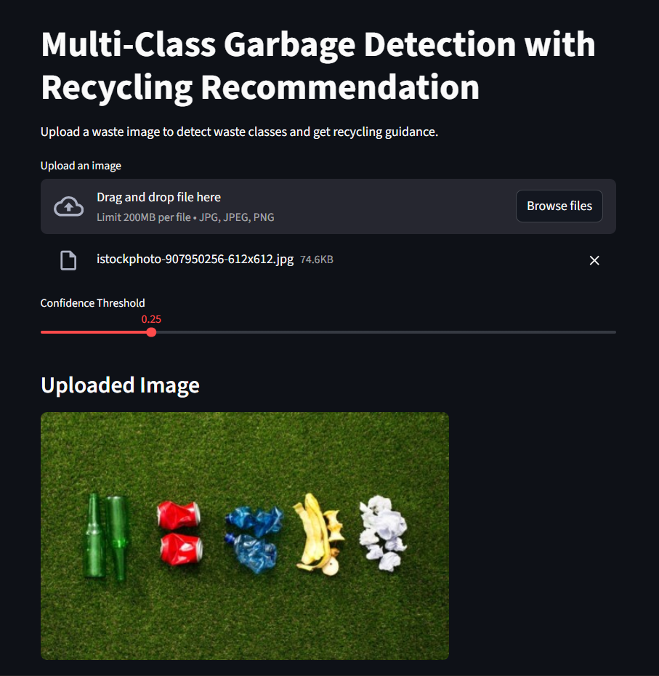
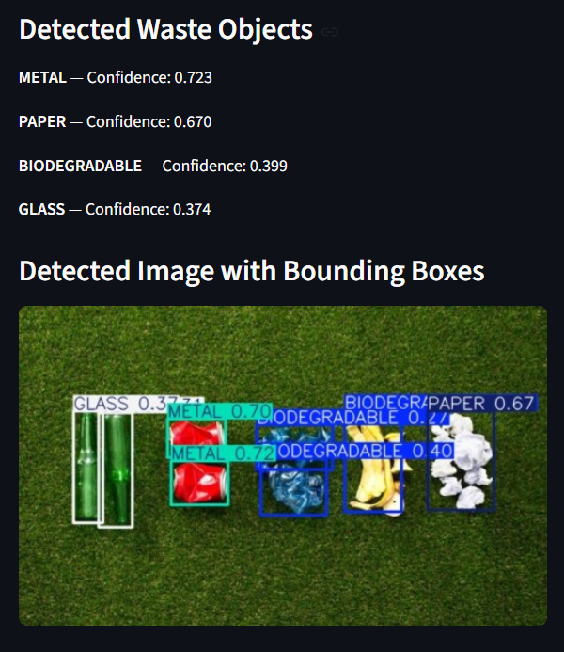
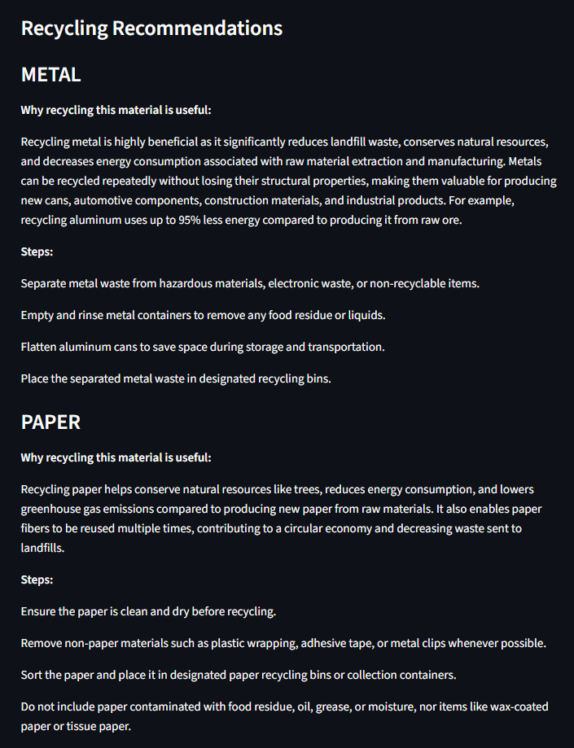
Results obtained
YOLOv8 Result

Slide 16
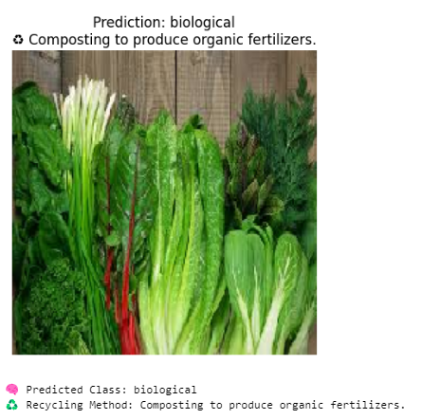
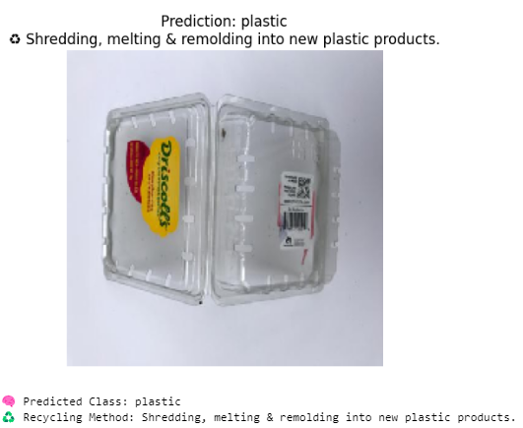
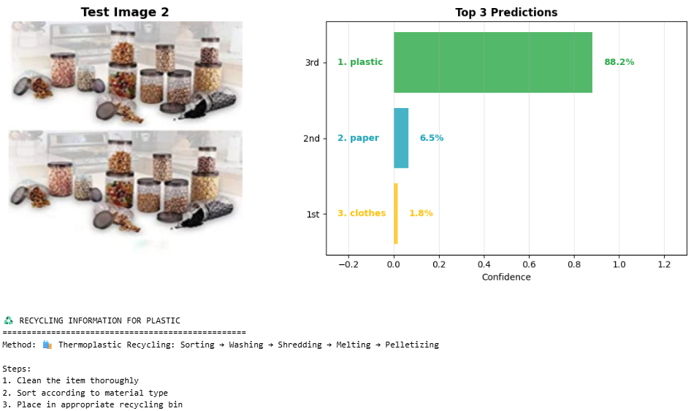
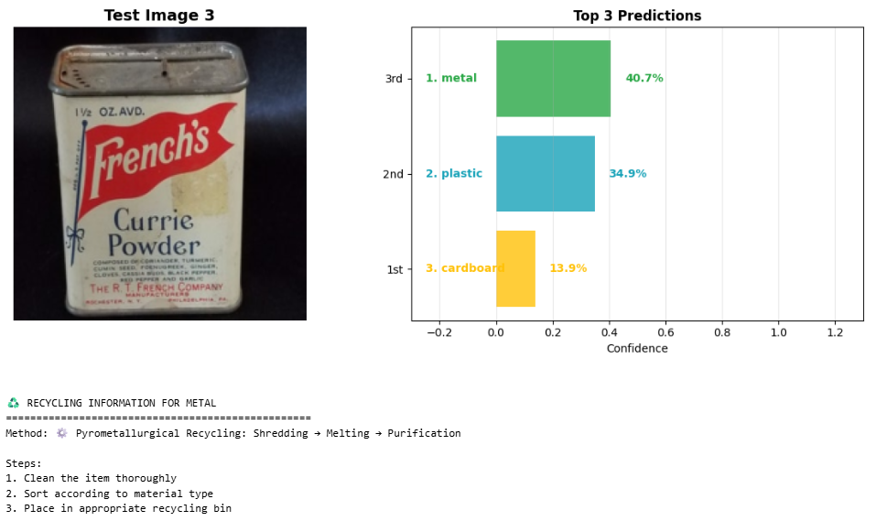
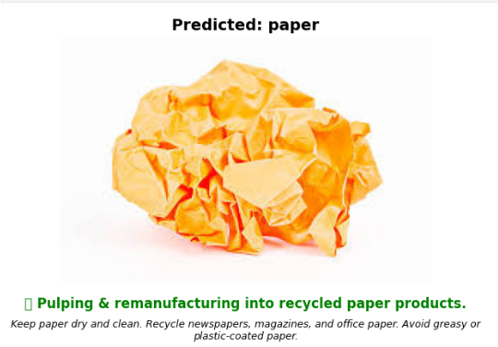
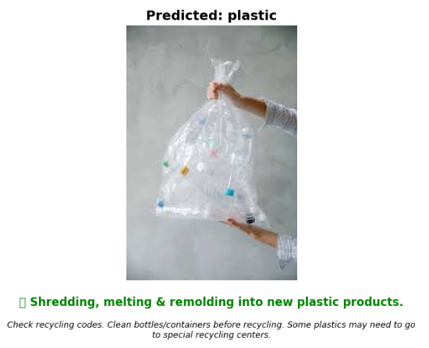
Resnet50 Results
Resnet50 + ViT ( Vision Transformer ) Results:
Densenet121 + EfficientnetB0 Results

Slide 17
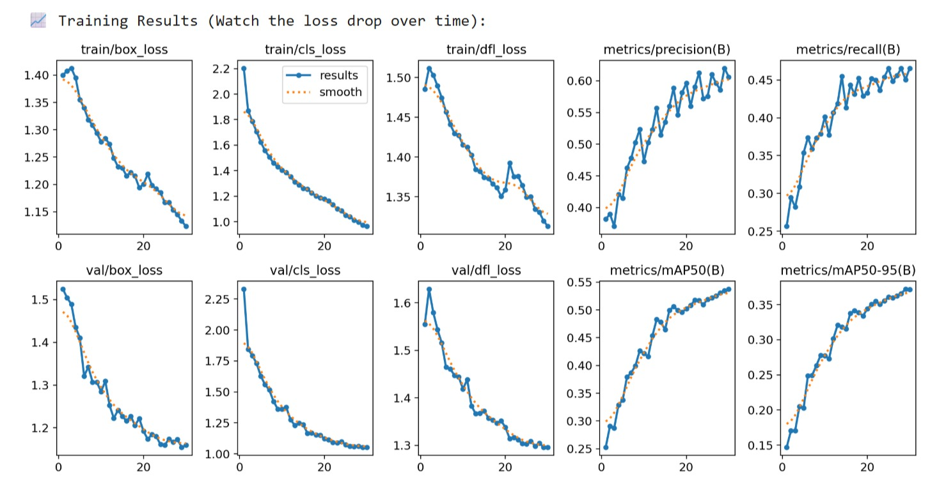
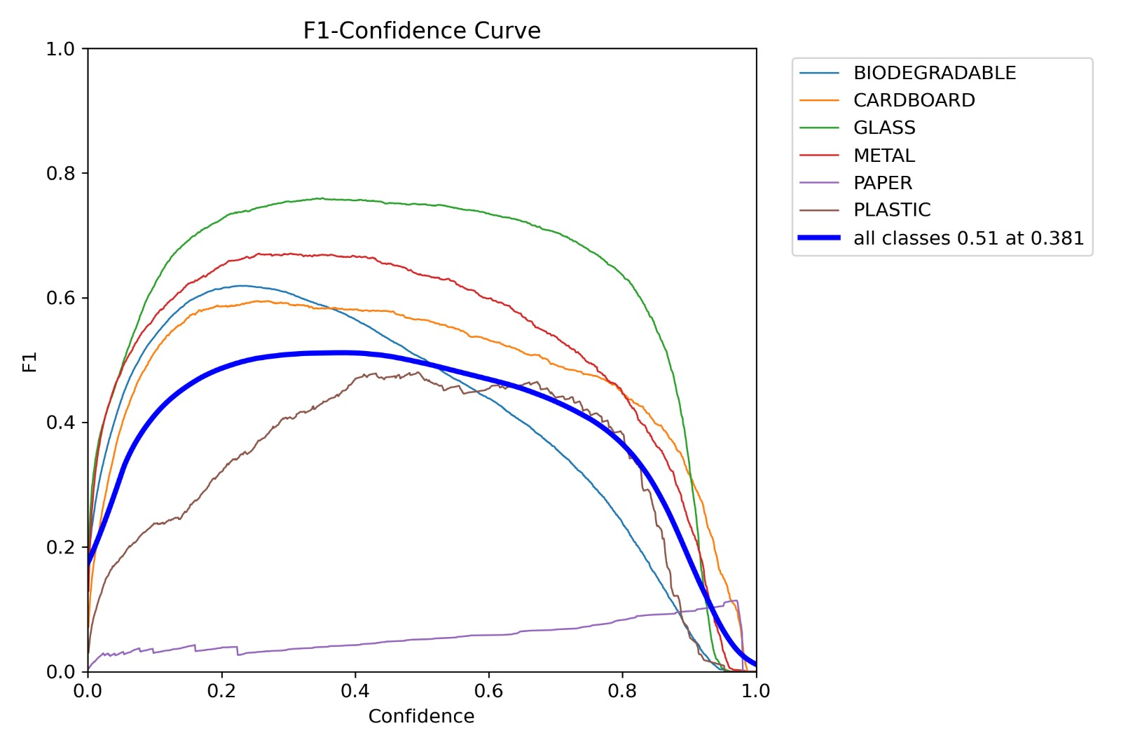
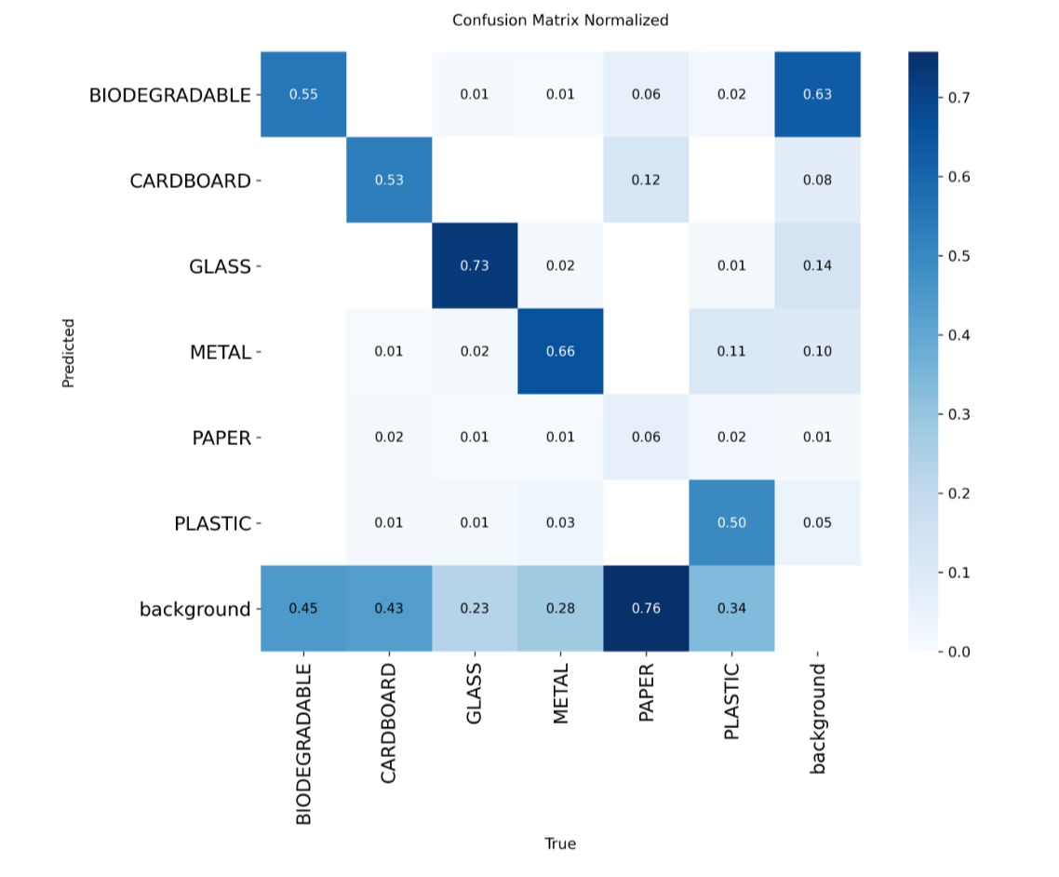
Result analysis
YOLOv8 Result
Training and Validation Loss Graph
Training and Validation Accuracy Graph
Confusion Matrix
F1- Confidence Curve

Slide 18
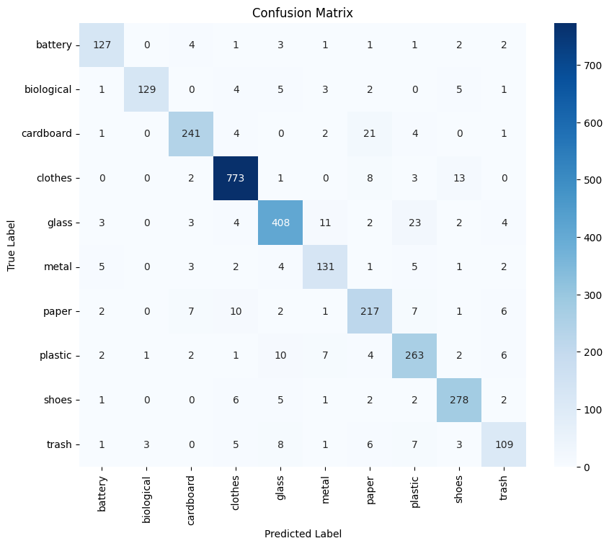
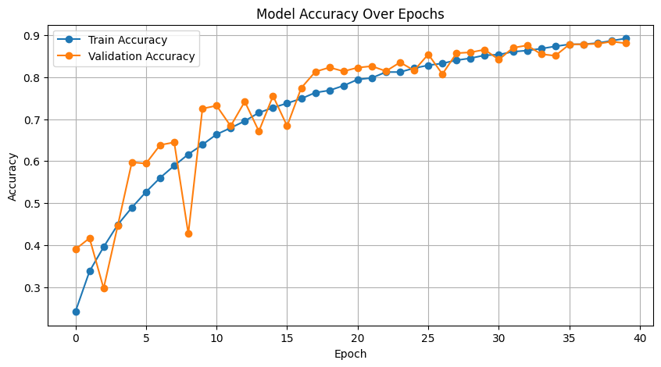
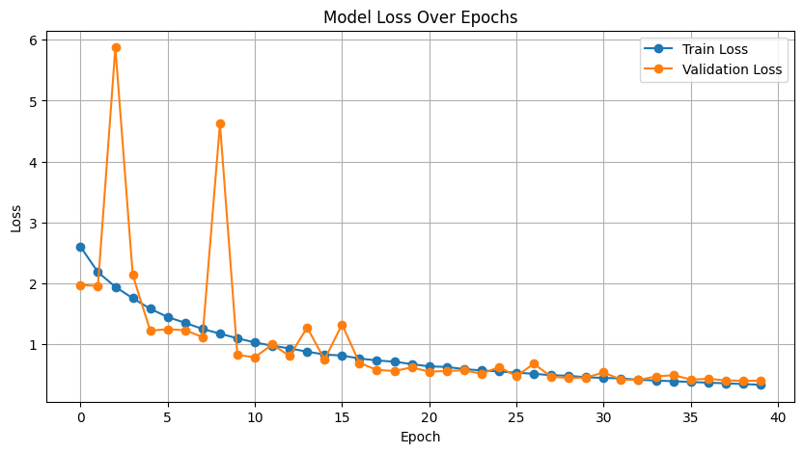
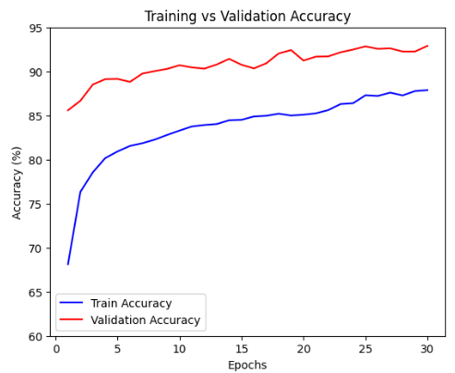
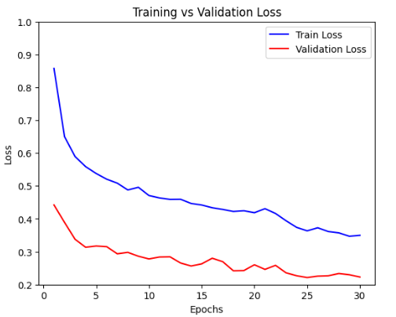
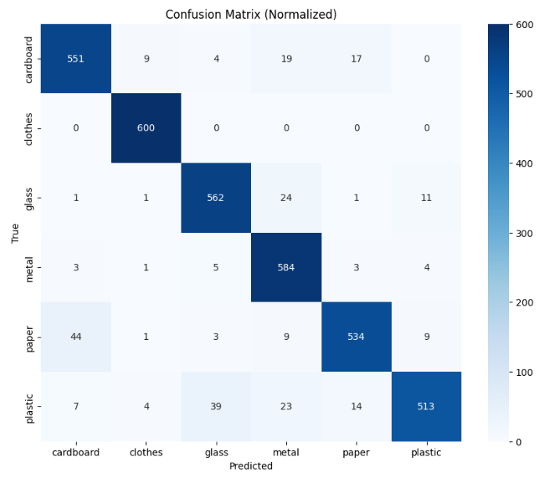
Resnet-50 model :
Training and Validation Accuracy Graph
Training and Validation Loss Graph
Confusion Matrix
DenseNet121 + EfficientNet-B0 model :
Training and Validation Accuracy Graph
Training and Validation
Loss Graph
Confusion Matrix

Slide 19
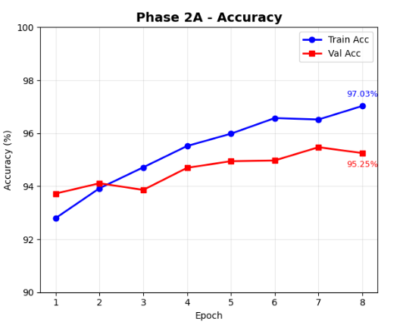
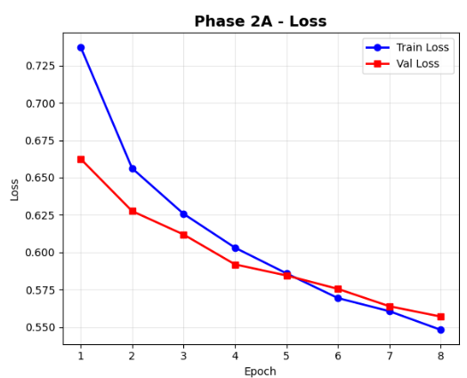
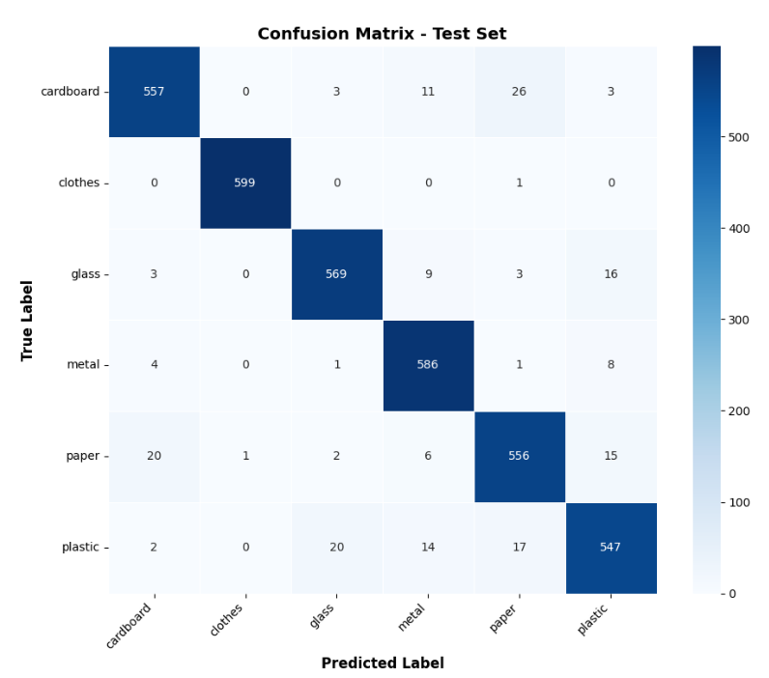
ResNet-50 + ViT model :
Training and Validation
Accuracy Graph
Training and Validation
Loss Graph
Confusion Matrix
Performance Metrices
Metrices | Accuracy | Precision | Recall | F1-Score
YOLOv8 | - | 0.619 | 0.451 | 0.522
Resnet-50 | 90.83% | 0.91 | 0.89 | 0.90
Resnet50+ViT | 97.03% | 0.95 | 0.95 | 0.95
Densenet121 + EfficientnetB0 | 92.35% | 0.92 | 0.92 | 0.92
The YOLOv8 model achieved an mAP@50 of 0.535 and an mAP@50–95 of 0.372, indicating stable object detection performance across the waste categories.

Slide 20
Conclusion
The project successfully developed an intelligent framework for waste classification, detection, and recycling guidance.
The ResNet-50 + Rule-Based System achieved 90.83% classification accuracy, showing strong baseline performance for automated waste classification.
The ResNet-50 + ViT hybrid model achieved 97.03% accuracy, demonstrating improved classification performance through combined local and global feature learning.
The YOLOv8 + RAG framework achieved Precision = 0.619, Recall = 0.451, F1-score = 0.522, mAP@50 = 0.535, and mAP@50-95 = 0.372, showing stable multi-class waste detection performance.
The integration of the RAG module enabled generation of material-specific recycling guidance, making the system more practical for sustainable waste management.
Future Work
Improve detection and classification performance using larger and more diverse waste datasets.
Extend the system for real-time waste monitoring using live image or video streams.
Enhance the recycling knowledge base with more detailed and region-specific disposal guidelines.
Deploy the framework in smart bins, recycling plants, and municipal waste-management applications.
Improve the interface and system scalability for practical large-scale usage.

Slide 21
References
[1] A. A. Alsuwaylimi, “Enhanced YOLOv8-Seg Instance Segmentation for Real-Time Submerged Debris Detection,” IEEE Access, vol. 12, pp. 117833–117849, 2024.
[2] D. Mewada, C. Agnew, E. M. Grua, and C. Eising, “Contamination Detection From Highly Cluttered Waste Scenes Using Computer Vision,” IEEE Access, 2024.
[3] M. M. Hossen, M. E. Majid, S. B. A. Kashem, A. Khandakar, and M. Nashbat, “A Reliable and Robust Deep Learning Model for Effective Recyclable Waste Classification,” IEEE Access, 2024.
[4] M. A. M. Rastari, R. Roslan, R. Hamzah, N. H. I. Teo, and F. E. Shahbudin, “Recycle Waste Detection and Classification Model Using YOLO-V8 for Real-Time Waste Management,” in Proc. 2024 IEEE International Conference on Artificial Intelligence in Engineering and Technology (IICAIET), 2024.
[5] F. R. Sayem, M. S. B. Islam, M. Naznine, M. Nashbat, and M. Hasan-Zia, “Enhancing Waste Sorting and Recycling Efficiency: Robust Deep Learning-Based Approach for Classification and Detection,” Neural Computing and Applications, 2025.
[6] I. O. Joseph, N. L. Wangare, T. P. Mahoque, P. Tewari, and S. Majumdar, “E-Waste Intelligent Robotic Technology (EIRT): A Deep Learning Approach for Electronic Waste Detection, Classification and Sorting,” in Proc. 14th International Conference on Computing Communication and Networking Technologies (ICCCNT), 2023.
[7] N. Ramsurrun, G. Suddul, S. Armoogum, and R. Foogooa, “Recyclable Waste Classification Using Computer Vision and Deep Learning,” in Proc. Zooming Innovation in Consumer Technologies Conf. (ZINC), 2021, doi: 10.1109/ZINC52049.2021.9499291.
[8] F. S. Alsubaei, F. N. Al-Wesabi, and A. M. Hilal, “Deep Learning-Based Small Object Detection and Classification Model for Garbage Waste Management in Smart Cities and IoT Environment,” Applied Sciences, vol. 12, no. 5, p. 2281, 2022, doi: 10.3390/app12052281

Slide 22
[9] M. Malik et al., “Waste Classification for Sustainable Development Using Image Recognition with Deep Learning Neural Network Models,” Sustainability, vol. 14, no. 12, p. 7222, 2022, doi: 10.3390/su14127222.
[10] N. Nnamoko and O. Barrowclough, “Solid Waste Image Classification Using Deep Convolutional Neural Networks,” Infrastructures, vol. 7, no. 4, p. 47, 2022.
[11] Z. Yuan and J. Liu, “A Hybrid Deep Learning Model for Trash Classification Based on Deep Transfer Learning,” Journal of Electrical and Computer Engineering, vol. 2022, Article ID 7608794, 2022, doi: 10.1155/2022/7608794.
[12] M. I. B. Ahmed et al., “Deep Learning Approach to Recyclable Products Classification: Towards Sustainable Waste Management,” Sustainability, vol. 15, no. 14, p. 11138, 2023, doi: 10.3390/su151411138.
[13] N. Li and Y. Chen, “Municipal Solid Waste Classification and Real-Time Detection Using Deep Learning Methods,” Urban Climate, vol. 49, p. 101462, 2023, doi: 10.1016/j.uclim.2023.101462.
[14] S. Poudel and P. Poudyal, “Classification of Waste Materials Using CNN Based on Transfer Learning,” in Proc. Forum for Information Retrieval Evaluation (FIRE), 2023, doi: 10.1145/3574318.3574345.
[15] A. Rahmatulloh et al., “WasteInNet: Deep Learning Model for Real- Time Identification of Various Types of Waste,” Cleaner Waste Systems, vol. 10, p. 100198, 2025, doi: 10.1016/j.clwas.2024.100198.

Slide 23
THANK YOU

