Slide 1


Department of Information Technology
V R Siddhartha Engineering College
Garbage Classification and Recycling Assistance with ViT-ResNet50 Hybrid model
B.Tech in Information Technology
MINI-2 Project Review Presentation
PRESENTED BY
Mr. Tarun Sahukari (228W1A1257)
Mr. Jitin Venkata Sai Kamineni (228W1A1223)
Under the guidance of
Dr. Ramesh Mande
ASSISTANT PROFESSOR

Slide 2
Contents
Introduction and Problem Statement
Objectives and Outcomes of the project
Literature Review and Summary
Datasets and Requirements
Algorithms used in the project
Architecture Diagram
References

Slide 3
Introduction
Traditional waste management relies on manual sorting, which is often slow, labor-intensive, and prone to human error, making it inefficient for large-scale waste handling.
These limitations result in misclassification of waste and improper recycling practices, contributing to increased landfill accumulation, resource wastage, and environmental degradation.
To overcome these challenges, our project introduces an automated waste classification system using a hybrid model built using EfficientNet-B0 and DenseNet-121, combined with a Rule-Based recycling framework. This approach ensures accurate classification, efficient processing, and promotes sustainable waste management practices.

Slide 4
PROBLEM STATEMENT:
The management of waste classification is challenging due to the diverse nature of waste materials and the limitations of manual sorting methods.
Traditional approaches are often slow, error-prone, and inconsistent, leading to inefficient recycling and increased landfill accumulation.
There is a need for an automated, accurate, and scalable system to handle large volumes of waste effectively.
This project proposes a hybrid Deep Learning model, built by combining DenseNet and EfficientNet, to improve classification accuracy and robustness. The system is further integrated with a Rule-Based recycling framework to ensure efficient processing and sustainable waste management practices.

Slide 5
Objectives | Outcomes
Implement deep learning (Hybrid Models) model for accurate waste classification. Automate waste sorting to minimize manual intervention and errors. Use a Rule-Based System to determine optimal recycling methods. | Achieve automated and precise waste classification. Ensure an efficient and reliable recycling process with minimal human effort. Reduce landfill waste and support sustainable, eco-friendly waste management.

Slide 6
Literature Review
S.NO | PUBLICATION DETAILS | DATASETS USED | ALGORITHMS USED AND RESULTS | REMARKS
1. | Title:A Reliable and Robust Deep Learning Model for Effective Recyclable Waste Classification Authors: Hossen, M. M., Majid, M. E., Kashem, S. B. A., Khandakar, Nashbat Publication Year: 2024,IEEE Type: 2024 IEEE Access Publication | TrashNet dataset (2,527 images) | Proposed RWC-Net combining DenseNet-201 and MobileNet-V2. Achieved 95.01% overall accuracy, outperforming existing models. High F1-scores across waste classes (Cardboard, Glass, Metal, Paper, Plastic, Litter). Demonstrates efficient automated waste classification for recycling systems. | Performs well on the TrashNet dataset but may not generalize to real-world conditions. Limited dataset size and class imbalance affect robustness. Assumes clean, single-object images without object detection capability.
2. | Title:Recycle Waste Detection and Classification Model Using YOLO-V8 for Real-time Waste Management Authors: Rastari, M. A. M., Roslan, R., Hamzah, R., Teo, N. H. I., Shahbudin Publication Year: 2024,IEEE Type: 2024 IEEE International Conference on Artificial Intelligence in Engineering and Technology (IICAIET) | Garbage Classification Dataset, Recycled Waste Image Dataset, Augmented Waste Image Dataset. | Used YOLO-v8 for real-time recyclable waste classification. Achieved 97.63% accuracy on the augmented dataset. Trained on 10,057 images with an 80–10–10 train–validation–test split. Successfully classified waste types such as paper, glass, metal, and plastic. | High accuracy achieved under controlled image conditions. Limited waste categories reduce real-world generalization. Performance not evaluated on cluttered or overlapping objects. Dependent on high-quality images, affecting outdoor or low-light usage.

Slide 7
3. | Title: Enhancing Waste Sorting and Recycling Efficiency: Robust Deep Learning-Based Approach for Classification and Detection Authors: Sayem, F. R., Islam, M. S. B., Naznine, M., Nashbat, M., Hasan-Zia Publication Year: 2024,SPRINGER Type: Neural Computing and Applications (2025) | WasteRecycling Plant dataset (WARP) | Used a Dual-Stream Network (DenseNet-201 + Multi-Axis Vision Transformer) for waste classification. Achieved 83.11% classification accuracy on the WaRP dataset. GELAN-E model obtained 63% mAP@50 for waste object detection. Models improved waste sorting and recycling efficiency. | Class imbalance in categories like bottles and detergents affects performance. Visually similar waste items and complex backgrounds cause misclassification. High computational cost of the 2S_DenseViT model limits real-time deployment. Reliance on RGB images only restricts accuracy; multimodal data could improve results.
4. | Title: E-Waste Intelligent Robotic Technology (EIRT): A Deep Learning approach for Electronic Waste Detection, Classification and Sorting Authors: Joseph, I. O., Wangare, N. L., Mahoque, T. P., Tewari, P., & Majumdar Publication Year: 2023,IEEE Type: 14th ICCCNT IEEE Conference | TrashBox, Waste Pictures, eWaste datasets (total ~5,336 images) | Used EfficientNet-D2 for automated e-waste classification. Achieved 82.32% accuracy across all categories. Classified five e-waste types: Battery, Electronic Board, Home Appliances, Mobile Phone, Mouse. Demonstrated potential for improved e-waste sorting and recycling management. | Performance limited by small dataset and few e-waste categories. Limited environmental variability affects real-world scalability. Robotic system physically handles only three classes, restricting sorting. Sensor reliability and performance in cluttered scenes are not evaluated.
5. | Title: Waste Management System using Waste Classification on Mobile Application Authors: Polchan, M., Pukao, A., Cheunban, T., & Sinthupuan Publication Year: 2023,IEEE Type: International Conference on Digital Arts, Media and Technology (DAMT) | Custom dataset (10,000 images across 10 waste types) | MobileNetV2 achieved the highest validation accuracy of 88.64%. Outperformed InceptionV3, ResNet34, VGG16, and CNN models. Trained on 10,000 images covering 10 waste categories. VGG16 and InceptionV3 showed overfitting, while MobileNetV2 remained more reliable. | Model evaluated only in a controlled university environment. Generalization to outdoor and diverse waste conditions is uncertain. Real-time mobile deployment performance is not thoroughly tested. Dataset class balance and lighting variability are not addressed.

Slide 8
6. | Title: Automated Waste Classification using Convolutional Neural Network Authors: Thinakaran, R., Somasekar, J., Neerugatti, V., & Saran, P. G. Publication Year: 2024,IEEE Type: 14th International Conference on Software Technology and Engineering (ICSTE) | UCI Waste Classification dataset | Used a Convolutional Neural Network (CNN) for waste classification. Achieved 90% training accuracy and 85% validation accuracy. Classified waste into organic and recyclable categories. Reduced dependence on manual waste sorting. | Limited to a binary classification task, reducing real-world applicability. Dataset diversity is low, affecting generalization. Performance in dynamic or cluttered environments is not evaluated. Overfitting risks identified without using regularization techniques.
7. | Title: Harnessing Deep Learning for Sustainable Waste Classification: An Innovative Approach Using MobileNetV2 on a Diverse Bag Dataset Authors: Jain, Eshika, and Ravi Kumar. Publication Year: 2024,IEEE Type: International Conference on Cybernation and Computation (CYBERCOM) | Diverse Bag Dataset (3,000 images), including garbage bags, paper bags, and plastic bags | Used MobileNetV2 (CNN) for garbage bag classification. Achieved 98% overall accuracy across all classes. Precision, recall, and F1-scores were above 96% for all categories. Demonstrated reliable performance for automated sorting and recycling. | Evaluated on a small, well-curated dataset with only three bag types. Overfitting observed after a few training epochs. Limited generalization due to absence of noisy real-world data. Does not address mixed waste scenarios or varying lighting conditions.

Slide 9
LITERATURE SUMMARY
Deep learning techniques, including CNNs, EfficientNet, MobileNet and YOLO, are widely used for automated waste classification and recycling management.
Commonly used datasets for waste classification include TrashNet, WasteNet, Garbage Classification, and WARP, providing diverse images of recyclable and non-recyclable waste for training and evaluation.
Data augmentation and preprocessing techniques, such as rotation, flipping, and normalization, help improve model generalization and robustness in waste classification.
Self-attention mechanisms and ensemble learning improve classification accuracy, making waste sorting more efficient and reliable in real-world applications.
The literature highlights advancements in deep learning methodologies, dataset quality, and hybrid approaches, emphasizing the role of automation in sustainable waste management.

Slide 10
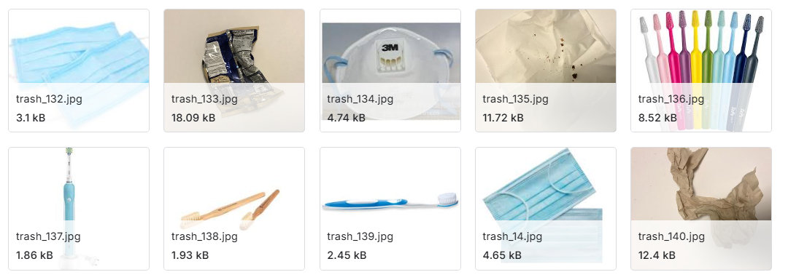
DATASETS AND REQUIREMENTS
DATASET:
Combined Garbage Classification & TrashBox Dataset: The dataset is created by merging the Garbage Classification and TrashBox datasets, ensuring a balanced distribution for effective model training.
The classes include Metal, Glass, Paper, Cardboard, Clothes, and Plastic (4,000 images each).
It is well-suited for developing classification or object detection models and creating AI-powered solutions for sustainable waste disposal.
SOURCE: Kaggle - https://www.kaggle.com/datasets/sumn2u/garbage-classification-v2/data
https://www.kaggle.com/datasets/minhle13/trashbox

Slide 11
REQUIREMENTS:
Hardware:
GPU-enabled system for faster training (e.g. Google Colab, Kaggle )
Minimum 16GB RAM
Software & Frameworks:
Deep Learning Frameworks: PyTorch
Model Architectures: Hybrid Models (DenseNet121 + EfficientNetB0, ResNet50 + Vision Transformer)
Preprocessing Tools: Torchvision,NumPy, Pandas
Programming Language: Python
Evaluation Tools: Scikit-learn (for metrics like accuracy, precision, recall, F1-score, and dataset splitting)

Slide 12
Algorithms used in the Project
Hybrid DenseNet121 + EfficientNet-B0 (Feature Fusion):
Step 1 – Input images are resized to 224×224×3 RGB and normalized using standard preprocessing, ensuring consistency and stable convergence across both backbones.
Step 2 – Two pretrained backbones (DenseNet121 – 1024 channels, EfficientNet-B0 – 1280 channels) trained on ImageNet are used as feature extractors.
Step 3 – Extracted feature maps are aligned using adaptive pooling to ensure equal spatial dimensions.
Step 4 – The feature maps are concatenated (feature-level fusion), forming a 2304-dimensional fused representation that captures complementary patterns.
Step 5 – The fused features are passed through a Global Average Pooling (AdaptiveAvgPool2d) layer and flattened into a compact vector.
Step 6 – A dense classifier head (512 → 256, ReLU) with Dropout (0.5, 0.25) learns non-linear interactions and prevents overfitting.
Step 7 – The final Softmax layer outputs probabilities over 6 waste categories: Paper, Cardboard, Metal, Plastic, Cloth, and Glass.
Step 8 – A rule-based recycling system maps each predicted waste type to its corresponding recycling method and disposal steps, providing practical guidance for sustainable waste management.

Slide 13
Hybrid ResNet-50 + Vision Transformer (Feature Fusion + Fine-Tuning):
Step 1 – Input images are resized to 224×224×3 RGB and normalized to ensure compatibility and stable training.
Step 2 – A pretrained ResNet-50 (177 layers, ImageNet) is used to extract hierarchical convolutional features, capturing local textures and patterns.
Step 3 – A pretrained Vision Transformer (ViT, ImageNet) encodes the image into patch embeddings, capturing global dependencies and contextual relationships.
Step 4 – From ResNet-50, Global Average Pooling (GAP) is applied, while from ViT, the [CLS] token embedding is extracted; both are compact feature vectors representing the image.
Step 5 – The two feature vectors are concatenated (feature-level fusion), combining local CNN-based details with global transformer-based context.
Step 6 – A Dense layer (512 neurons, ReLU) learns non-linear interactions between the fused features, enhancing representation power.
Step 7 – Dropout (0.5) is applied after the dense layer to prevent overfitting and improve model robustness.
Step 8 – Fine-tuning strategy: Lower layers of ResNet-50 and early transformer blocks are frozen, while higher layers and fusion layers are trainable, allowing adaptation to the waste dataset without losing pretrained knowledge.
Step 9 – The final Softmax layer outputs probabilities over 6 waste categories (Paper, Cardboard, Metal, Plastic, Cloth, Glass), enabling accurate classification.

Slide 14
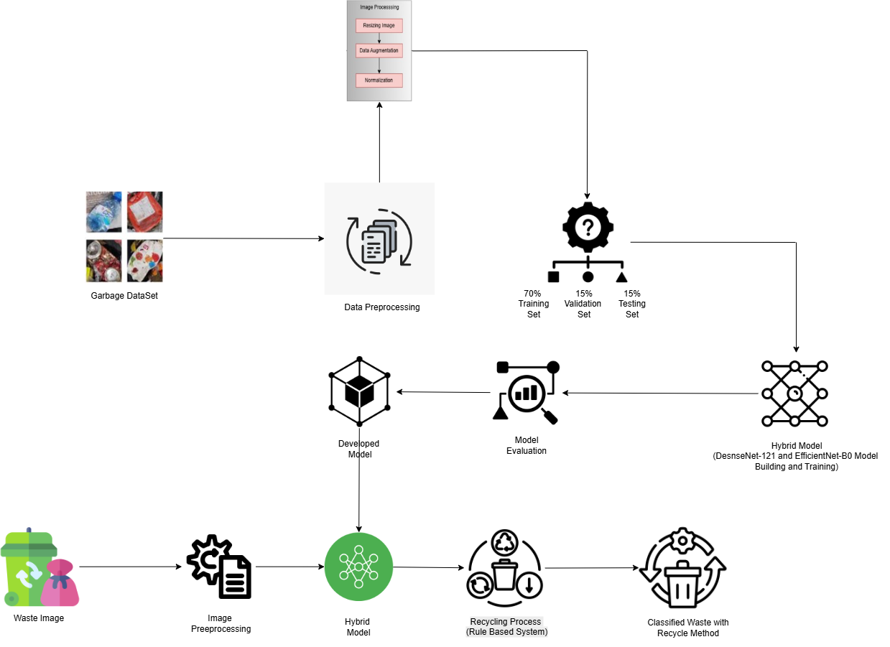
ARCHITECTURE DIAGRAM

Slide 15
Project Execution
Implementation details:
1.Environment Setup
Used Kaggle GPU v2 with PyTorch, Torchvision, NumPy, Pandas, Scikit-learn, and Matplotlib for efficient training and analysis.
2.Dataset
Combined two Kaggle waste datasets into 6 balanced classes with 4000 images each, making 24,000 total, and split into 70% training, 15% validation, and 15% testing for generalization.
3.Image Preprocessing
All images resized to 224×224×3 with normalization and data augmentation (flips, rotations, shifts) for robustness
4. Hybrid Model 1 – DenseNet121 + EfficientNet-B0
Pretrained backbones on ImageNet, features concatenated at fusion layer, followed by dense layers with dropout for classification.
5. Hybrid Model 2 – ResNet-50 + ViT
ResNet captures local features while ViT models global context; features fused and fine-tuned on higher ViT layers with discriminative learning rates.
6.Evaluation
Evaluated models using test accuracy, confusion matrix, and classification report showing precision, recall, and F1-score for each class.

Slide 16
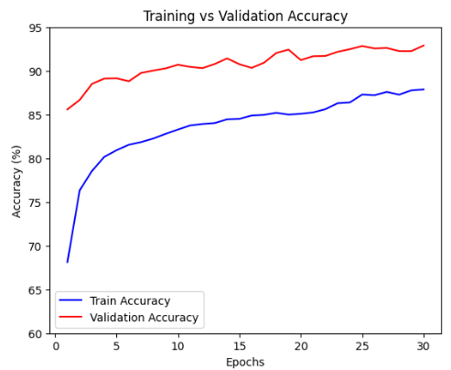
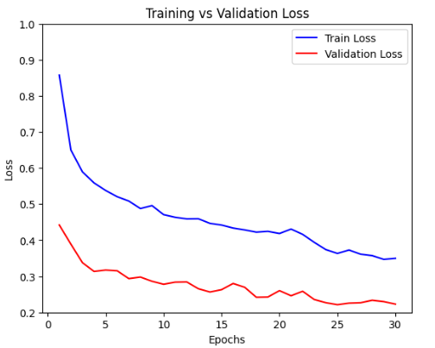
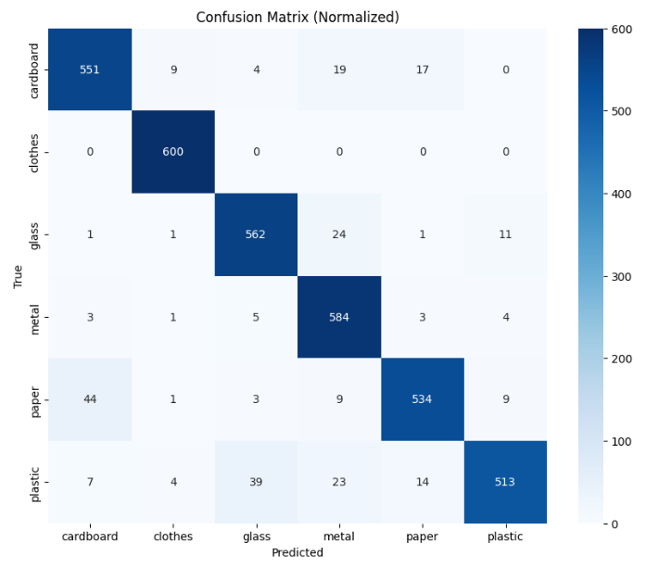
Results
Hybrid Model 1- DenseNet121 + EfficientNet-B0 model:
Training and Validation Accuracy Graph
Training and Validation
Loss Graph
Confusion Matrix

Slide 17
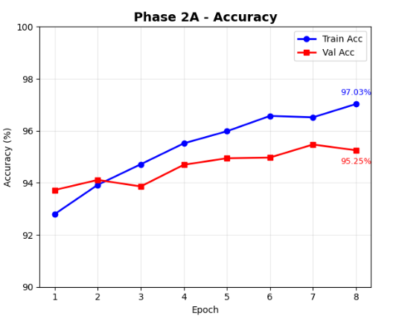
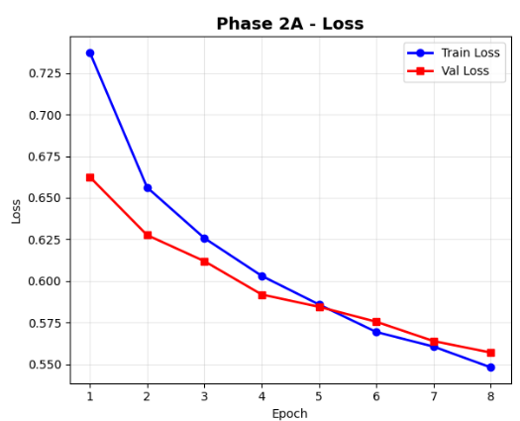
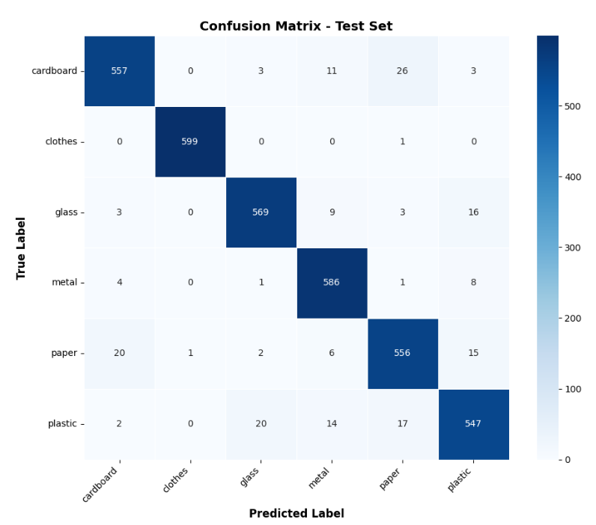
Results
Hybrid Model 2 – ResNet-50 + ViT model:
Training and Validation
Accuracy Graph
Training and Validation
Loss Graph
Confusion Matrix

Slide 18
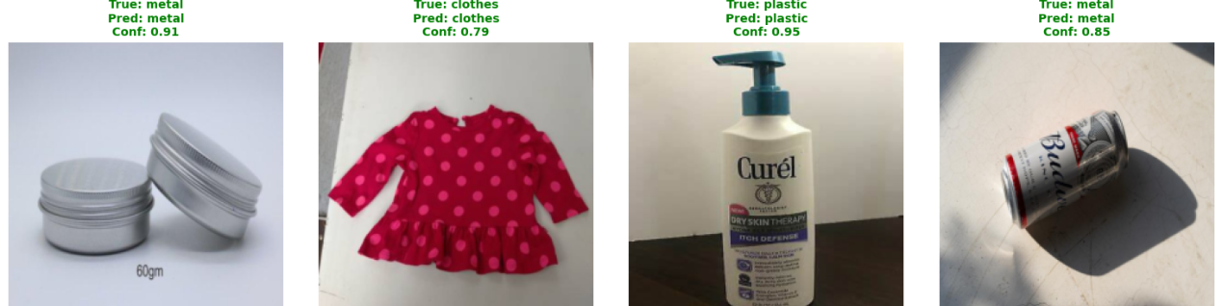
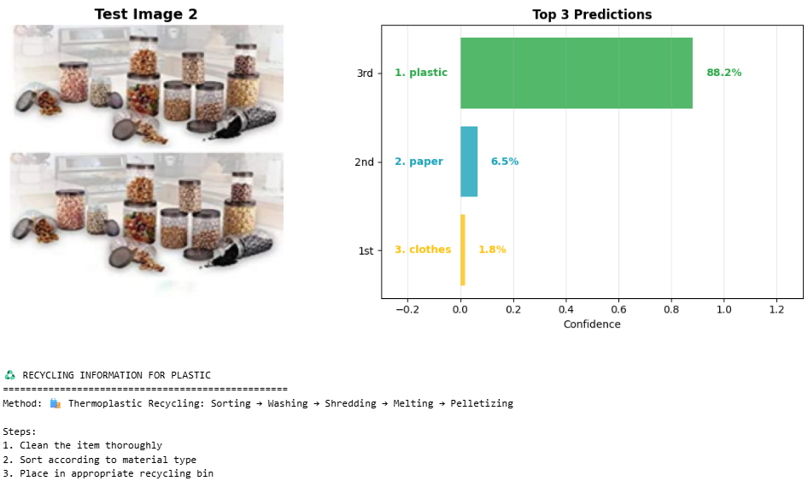
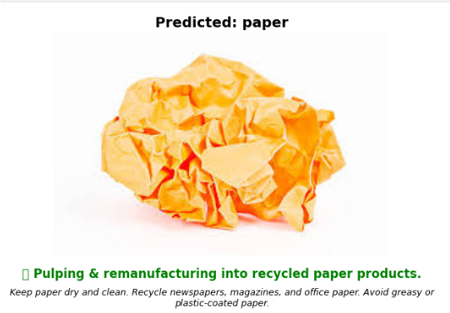
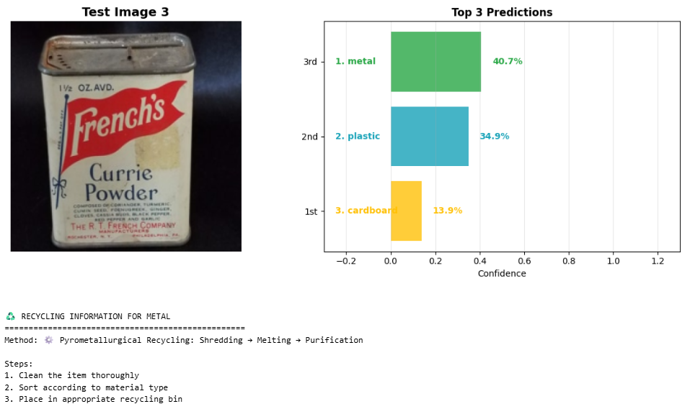
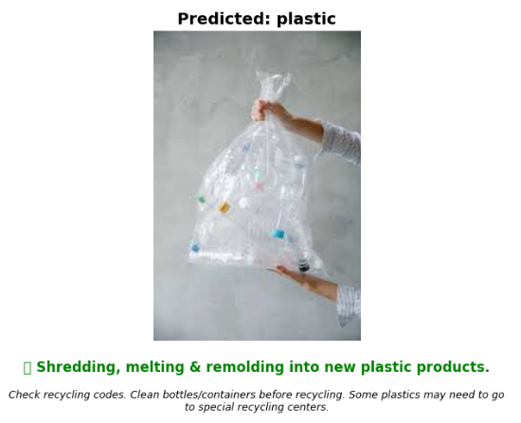
DenseNet121 + EfficientNet-B0 Model Testing
ResNet-50 + ViT Model Testing

Slide 19
REFERENCES
[1] Hossen, M. M., Majid, M. E., Kashem, S. B. A., Khandakar, A., Nashbat, M., Ashraf, A., ... & Chowdhury, M. E. (2024). A reliable and robust deep learning model for effective recyclable waste classification. IEEE Access, 12, 13809-13821.
[2] Rastari, M. A. M., Roslan, R., Hamzah, R., Teo, N. H. I., Shahbudin, F. E., & Samah, K. A. F. A. (2024, August). Recycle waste detection and classification model using YOLO-V8 for real-time waste management. In 2024 IEEE International Conference on Artificial Intelligence in Engineering and Technology (IICAIET) (pp. 372-377). IEEE.
[3] Sayem, F. R., Islam, M. S. B., Naznine, M., Nashbat, M., Hasan-Zia, M., Kunju, A. K. A., ... & Chowdhury, M. E. (2024). Enhancing waste sorting and recycling efficiency: robust deep learning-based approach for classification and detection. Neural Computing and Applications, 1-17.
[4] Joseph, I. O., Wangare, N. L., Mahoque, T. P., Tewari, P., & Majumdar, S. (2023, July). E-Waste Intelligent Robotic Technology (EIRT): A Deep Learning approach for Electronic Waste Detection, Classification and Sorting. In 2023 14th International Conference on Computing Communication and Networking Technologies (ICCCNT) (pp. 1-6). IEEE.
[5] Polchan, M., Pukao, A., Cheunban, T., & Sinthupuan, S. (2023, March). Waste Management System using Waste Classification on Mobile Application. In 2023 Joint International Conference on Digital Arts, Media and Technology with ECTI Northern Section Conference on Electrical, Electronics, Computer and Telecommunications Engineering (ECTI DAMT & NCON) (pp. 229-233). IEEE.
[6] Thinakaran, R., Somasekar, J., Neerugatti, V., & Saran, P. G. (2024, August). Automated Waste Classification using Convolutional Neural Network. In 2024 14th International Conference on Software Technology and Engineering (ICSTE) (pp. 169-173). IEEE.
[7] Jain, E., & Kumar, R. (2024, November). Harnessing Deep Learning for Sustainable Waste Classification: An Innovative Approach Using MobileNetV2 on a Diverse Bag Dataset. In 2024 International Conference on Cybernation and Computation (CYBERCOM) (pp. 335-339). IEEE.

Slide 20


