Slide 1


Department of Information Technology
V R Siddhartha Engineering College
Multi-Class Garbage Detection and RAG-Based Recycling Guidance System Using YOLOv8
B.Tech in Information Technology
Major Project Review Presentation
PRESENTED BY
Mr. Tarun Sahukari (228W1A1257)
Mr. Jitin Venkata Sai Kamineni (228W1A1223)
Under the guidance of
Dr. Ramesh Mande
ASSISTANT PROFESSOR

Slide 2
Contents
Motivation and Problem Statement
Objectives and Outcomes of the project
Literature Survey
Datasets and Requirements Specifications
Methodology and Algorithms involved
Architecture Diagram
Complete Results Obtained
Result Analysis and Observations
Conclusion and Future Work
References

Slide 3
Motivation
Traditional waste management still depends heavily on manual sorting, which is slow, labor-intensive, and often affected by human error, making it unsuitable for handling large volumes of mixed waste efficiently.
Such limitations lead to improper segregation of recyclable and non-recyclable materials, reduce recycling efficiency, and increase environmental problems such as landfill overflow, resource wastage, and pollution.
To overcome these issues, this project proposes a YOLOv8-based multi-class garbage detection system integrated with a Retrieval-Augmented Generation (RAG) framework to automatically identify multiple waste types from images and provide step-by-step recycling guidance for sustainable waste management

Slide 4
Problem Statement
Traditional waste management relies on manual sorting, which is often slow, labor-intensive, and prone to human error, making it inefficient for large-scale waste handling and recycling operations.
These limitations result in improper segregation of waste materials and reduced recycling efficiency, contributing to increased landfill accumulation, environmental pollution, and loss of reusable resources.
To address these challenges, this project introduces an automated multi-garbage detection system using a YOLOv8-based object detection model integrated with a Retrieval-Augmented Generation (RAG) framework. This approach enables accurate identification of multiple waste materials from images and provides step-wise recycling recommendations, promoting efficient and sustainable waste management practices.

Slide 5
Objectives and Outcomes
OBJECTIVES | OUTCOMES
Train a YOLOv8 model to accurately detect and localize multiple waste categories from a single image. | A robust multi-class waste detection model capable of identifying multiple materials in mixed garbage images.
Develop a web interface that allows users to upload images and view detected waste types with bounding boxes and confidence scores. | A functional end-to-end application that visually displays detection results through an interactive upload interface.
Integrate a RAG-based module to provide material-specific recycling instructions based on detected waste classes. | Context-aware recycling guidance generated using RAG for accurate and material-specific disposal recommendations.
Generate a structured output report summarizing detected item counts and recommended recycling steps for each category. | A structured recycling summary that enhances user awareness and promotes proper waste segregation practices.

Slide 6
Literature Survey
S.NO | PUBLICATION DETAILS | DATASETS USED | ALGORITHMS USED AND RESULTS | REMARKS
1. | Title: Enhanced YOLOv8-Seg Instance Segmentation for Real-Time Submerged Debris Detection Authors: Amjad A. Alsuwaylimi Publication Year: 2024 Type: IEEE Access, Vol. 12, pp. 117833–117849, DOI: 10.1109/ACCESS.2024.3448258 | TrashCan dataset, an underwater waste instance-segmentation dataset with 7,212 annotated images, designed for submerged debris and marine trash detection in underwater environments | Algorithms: Enhanced YOLOv8-Seg models, particularly the YOLOv8 baseline, were used for real-time underwater debris detection and instance segmentation. Result: The YOLOv8 baseline achieved Precision = 54.5%, Recall = 39.3%, and mAP@50 = 45.8% for submerged debris detection. | While the model performs fairly well for underwater debris detection, its scope is restricted to a specific aquatic environment and its recall remains limited. The system only detects debris and does not assist the user with recycling or disposal actions. In contrast, the proposed project is more application-oriented because it not only detects multiple waste categories but also generates step-by-step recycling guidance, thereby extending the work from simple detection to intelligent waste management support.
2. | Title: Contamination Detection from Highly Cluttered Waste Scenes using Computer Vision Authors: Dishant Mewada, Cathaoir Agnew, Eoin M. Grua, Ciarán Eising. Publication Year: 2024 Type: IEEE Access | Custom dataset of recycling waste collected from waste collection trucks and annotated for contamination detection | Algorithms: YOLOv8, Faster-RCNN, Cascade-RCNN, RetinaNet, Transfer Learning Result: Achieved high mean average precision (mAP) for detecting contamination in dense waste scenes and demonstrated the effectiveness of YOLOv8 in complex real-world environments. | Although the system performs well for contamination detection in dense waste environments, it mainly focuses on identifying contaminated materials rather than providing recycling guidance. The model requires specialized annotated datasets collected from trucks, which may limit reproducibility and scalability for general waste classification systems.

Slide 7
Literature Survey
S.NO | PUBLICATION DETAILS | DATASETS USED | ALGORITHMS USED AND RESULTS | REMARKS
3. | Title: YOLOv8-based Waste Detection System for Recycling Plants: A Deep Learning Approach Authors: Meet Shroff, Anshul Desai, and Devansh Garg Publication Year: 2023 Type: IEEE ICSSAS Conference | Waste Recycling Plant (WaRP) dataset consisting of industrial conveyor belt waste images | Algorithms: YOLOv8m, Convolutional Neural Networks (CNNs), Data Augmentation Result: Achieved 93.41% mAP@0.5, demonstrating strong performance in detecting and classifying multiple waste categories under varying environmental conditions. | While the system achieves high classification accuracy, the dataset size is relatively small (~900 images), which may affect model generalization in real-world waste environments. Additionally, the approach focuses mainly on detection and classification without integrating any knowledge system for recycling recommendations.
4. | Title: Garbage Classification Recognition Based on Improved YOLOv8 Model Authors: Lijuan Qin, Xiaoyu Tang, and Feng Zhang Publication Year: 2024 Type: IEEE Conference | Public garbage classification image datasets | Algorithms: Improved YOLOv8 architecture with C2f_RepGhost module Result: The optimized model design enabled efficient garbage classification with real-time response suitable for mobile devices and edge applications | Although the improved architecture enhances detection efficiency and speed, the study mainly focuses on model optimization rather than integrating broader waste management solutions such as recycling recommendations or knowledge-based assistance.
5. | Title: AI-Powered Standard Operating Procedure Generation and Optimization Using Large Language Models for Chemical Laboratory Applications Authors: Roxane Elias Mallouhy, Hissah Alqahtani, and Sheikha Lardhi Publication Year: 2026 Type: IEEE Access | Equipment manuals, chemical literature, waste disposal guidelines, and safety protocols | Algorithms: Retrieval-Augmented Generation (RAG), Large Language Models (LLMs), Semantic Retrieval. Result: Successfully generated context-aware operating procedures and waste disposal guidance while reducing hallucinations through retrieval-based knowledge grounding. | This RAG and LLM-based system effectively generates structured operating procedures for chemical laboratories. However, it relies strictly on textual knowledge sources and lacks computer vision capabilities. Consequently, it cannot automatically identify or classify physical waste materials from images. Therefore, it is limited to providing procedural guidance rather than real-time waste sorting assistance.

Slide 8
Literature Summary
Recent studies show that deep learning models such as YOLOv8, Faster-RCNN, Cascade-RCNN, and RetinaNet are effective for automated waste detection and classification in different environments. These models are trained on datasets such as custom waste collection images, public garbage datasets, TrashCan, and WaRP, helping improve waste identification accuracy under real-world conditions.
Many works focus on model optimization, transfer learning, data augmentation, and lightweight architectures to achieve better precision, faster inference, and real-time deployment. However, most existing systems are limited to waste detection or classification only and do not provide further support for recycling decisions.
Recent advancements in RAG and LLM-based systems show that AI can also generate context-aware guidance from knowledge sources. This creates an opportunity to combine waste detection with intelligent recycling recommendation, making waste management systems more practical, informative, and user-oriented

Slide 9
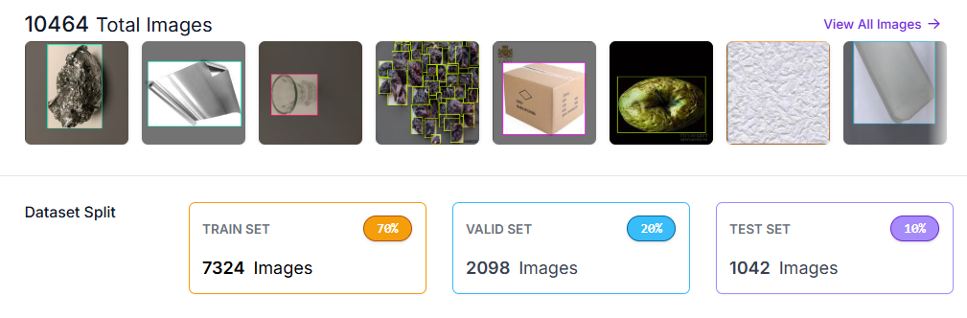
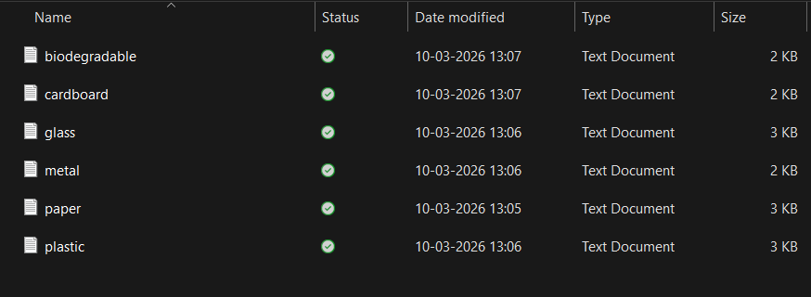
Datasets and Requirement specifications
Dataset:
Garbage Classification Dataset Source: Roboflow Universe – Garbage Classification (YOLOv8 format)
Recycling Knowledge Base Source: Public environmental agency guidelines, municipal waste management documentation, and curated recycling resources
Requirement Specification:
Programming: Python
Object Detection: YOLOv8
Web Interface: Streamlit
AI/NLP (RAG Module): Google Gemini API, FAISS
Image Processing: OpenCV
Environment: Kaggle Notebook

Slide 10
Methodology
Dataset Collection : The Garbage Classification Dataset is collected from Roboflow Universe in YOLOv8 format, containing annotated images of Paper, Plastic, Glass, Metal, Cardboard, and Biodegradable waste. A recycling knowledge base is also created using environmental guidelines and municipal waste management resources.
Dataset Splitting and Training : The dataset is divided into training, validation, and test sets in the ratio of 70%, 20%, and 10%, respectively. The YOLOv8 model is then trained in the Kaggle Notebook environment using Python to learn accurate waste object detection and localization.
Object Detection : The trained YOLOv8 model is used to detect one or multiple waste objects from the uploaded image. It predicts bounding boxes, class labels, and confidence scores for each identified garbage object.
Multi-Object Waste Classification : The detected objects are classified into predefined garbage categories such as Paper, Plastic, Glass, Metal, Cardboard, and Biodegradable. This enables the system to recognize multiple waste materials present in a single image.
Knowledge Retrieval : The detected waste labels are passed to the RAG module, where FAISS retrieves relevant recycling knowledge from the prepared local knowledge base. This ensures that the response is based on category-specific recycling information.
Recycling Guidance Generation : The retrieved context is provided to the Google Gemini API, which generates structured recycling recommendations for each detected waste object. The output includes proper handling, sorting, recycling, and disposal methods.
User Interface and Output : The system is integrated into a Streamlit web application where the user uploads a garbage image, views the YOLOv8 detection results with bounding boxes and confidence scores, and receives the generated recycling summary.

Slide 11
Algorithms Involved
Step 1 – Input Image Acquisition The system accepts an input image uploaded by the user through the web interface. The image may contain one or multiple waste objects such as paper, plastic, glass, metal, cardboard, or biodegradable materials.
Step 2 – YOLOv8 Object Detection A trained YOLOv8 object detection model processes the uploaded image to detect and localize waste objects. The model predicts bounding boxes, class labels, and confidence scores for each detected object directly from the input image.
Step 3 – Multi-Object Waste Classification The model identifies multiple waste categories present in the image and classifies them into six predefined classes: Paper, Plastic, Glass, Metal, Cardboard, and Biodegradable. Each detected object is associated with its corresponding bounding box and confidence score.
Step 4 – Bounding Box Visualization The detected waste objects are highlighted on the image using bounding boxes and labels. Each label displays the predicted waste type along with its confidence score, allowing users to clearly understand the detection results.
Step 5 – Detected Waste Extraction The predicted class labels are extracted from the YOLOv8 detection output. If multiple waste objects are detected, each class label is processed individually for recycling guidance generation.
Step 6 – Knowledge Retrieval using RAG A Retrieval-Augmented Generation module searches a local knowledge base that contains recycling guidelines for each waste category. Relevant information is retrieved based on the detected waste class.
Step 7 – Context Processing The retrieved recycling knowledge is organized and prepared as contextual input so that the generated response remains accurate, relevant, and grounded in the knowledge base.

Slide 12
Algorithms Involved
Step 8 – LLM-Based Recycling Guidance Generation A Large Language Model formats the retrieved knowledge into a structured explanation. This includes a short description of the waste type and step-by-step recycling instructions. The LLM improves readability and sentence variation while preserving factual correctness from the retrieved content.
Step 9 – Recycling Recommendation Output For each detected waste object, the system generates step-by-step recycling guidance, which may include: Preparation or cleaning of the waste material Sorting and separation process Recycling or processing method Environmental benefits and proper disposal practices
Step 10 – Final System Output The system displays: The original image with bounding boxes marking detected waste objects The detected waste class names with confidence scores Step-by-step recycling recommendations generated through the RAG framework

Slide 13
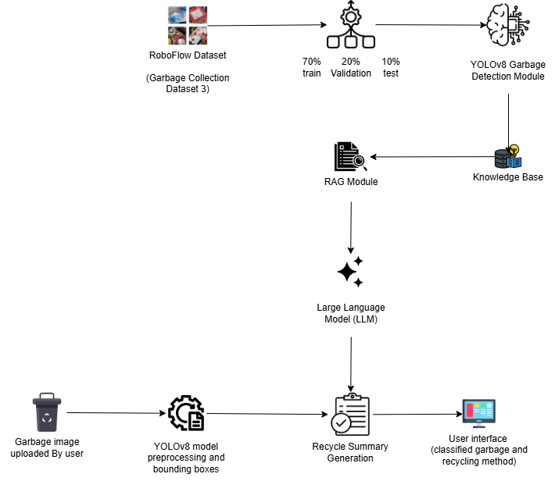
Architecture Diagram

Slide 14
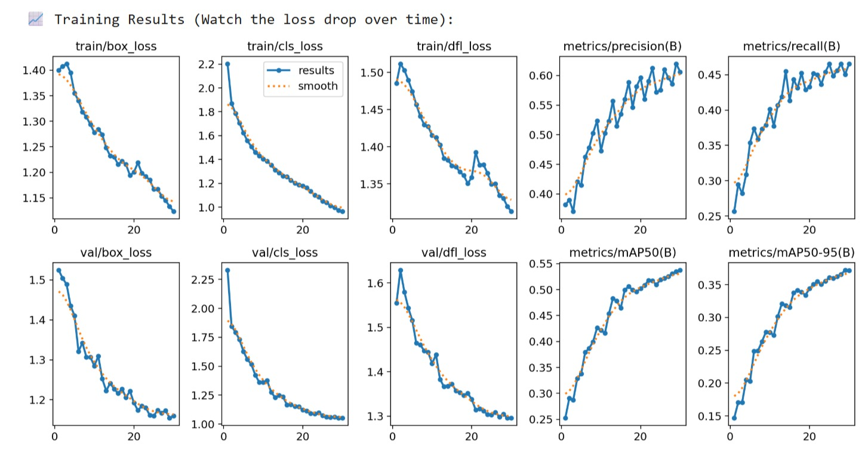
Complete Results Obtained
Mean Average Precision and Loss Graphs

Slide 15
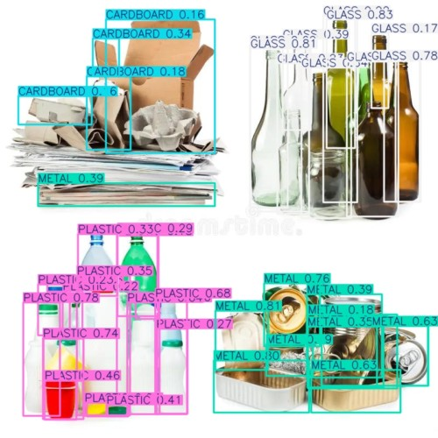
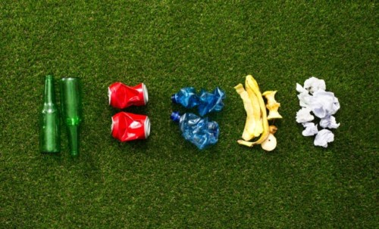
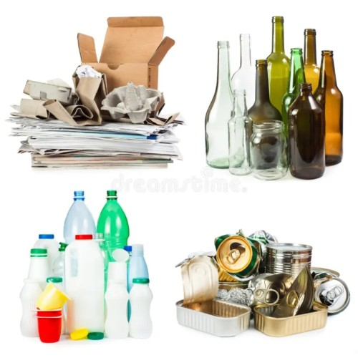
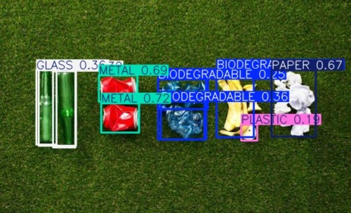
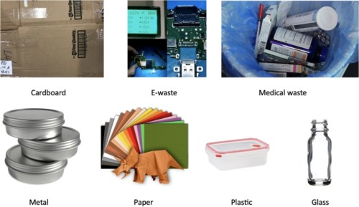
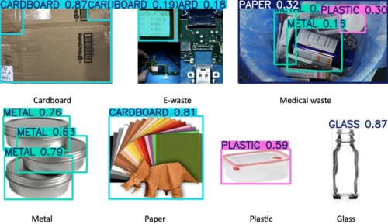
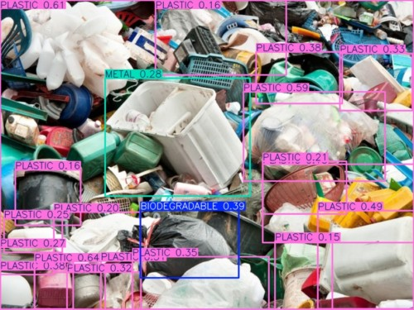
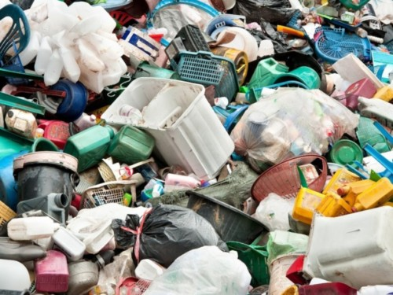
Complete Results Obtained
Image Uploaded By User
Detected Waste with Bounding Boxes

Slide 16
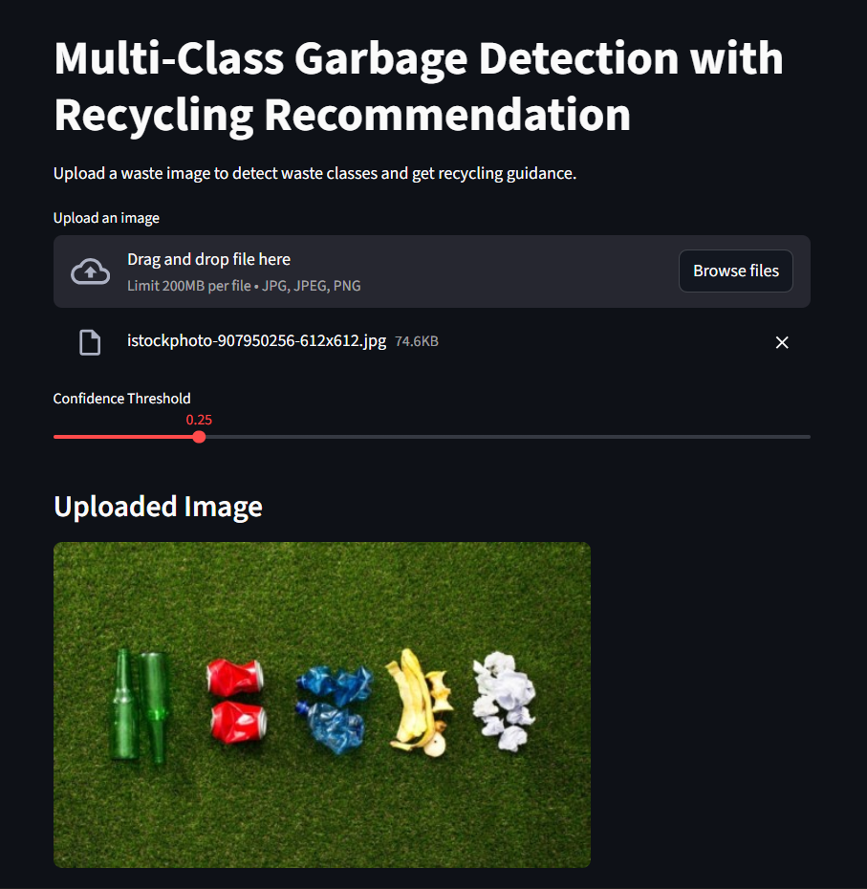
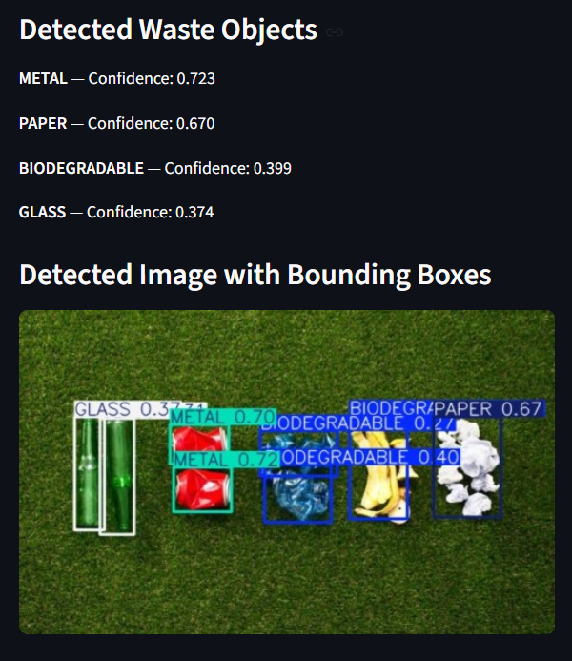
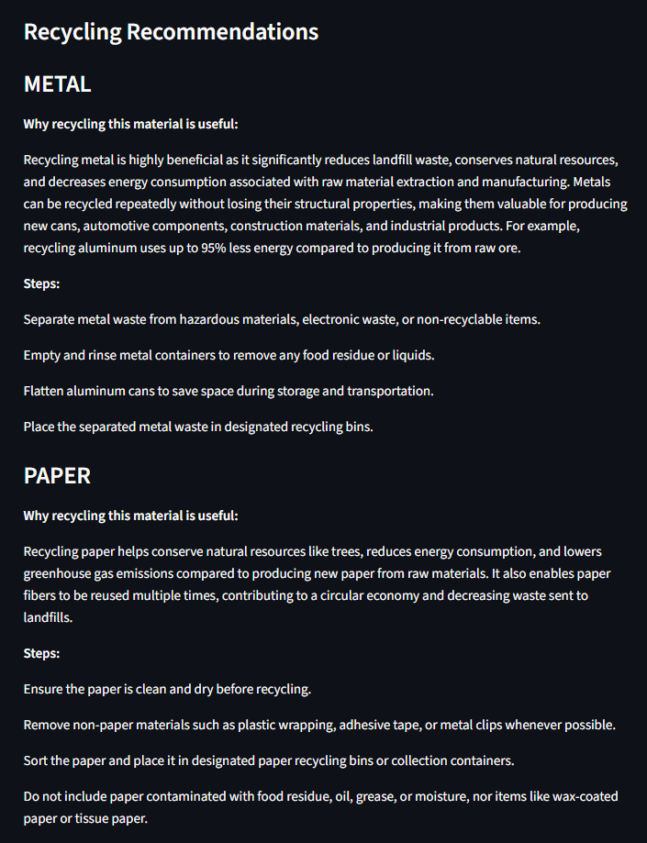
Complete Results Obtained
User Interface

Slide 17
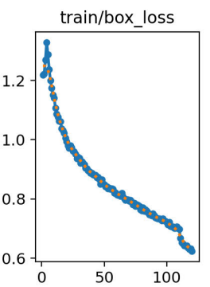
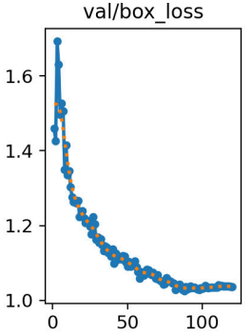
Result Analysis and Observations
Loss Graph obtained in our project
Loss Graph obtained in the base paper
Our project’s train/box loss decreases from about 1.40 to 1.12, and the val/box loss reduces from about 1.52 to 1.16
The base paper’s train/box loss decreases from about 1.20 to 0.62, showing lower final training loss in the base paper. val/box loss reduces from about 1.70 to 1.03

Slide 18
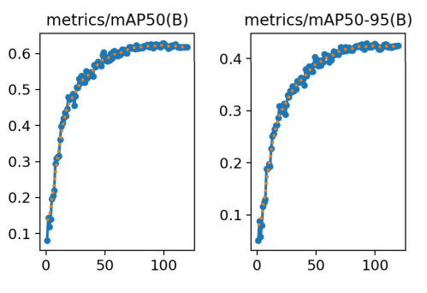
Result Analysis and Observations
mAP@50 and mAP@50-95 Graph obtained in our project
mAP@50 and mAP@50-95 Graph obtained in the base paper
Our project achieved mAP@50 = 0.535 and mAP@50-95 = 0.372.
the base paper achieved approximately mAP@50 = 0.61 and mAP@50-95 = 0.42.

Slide 19
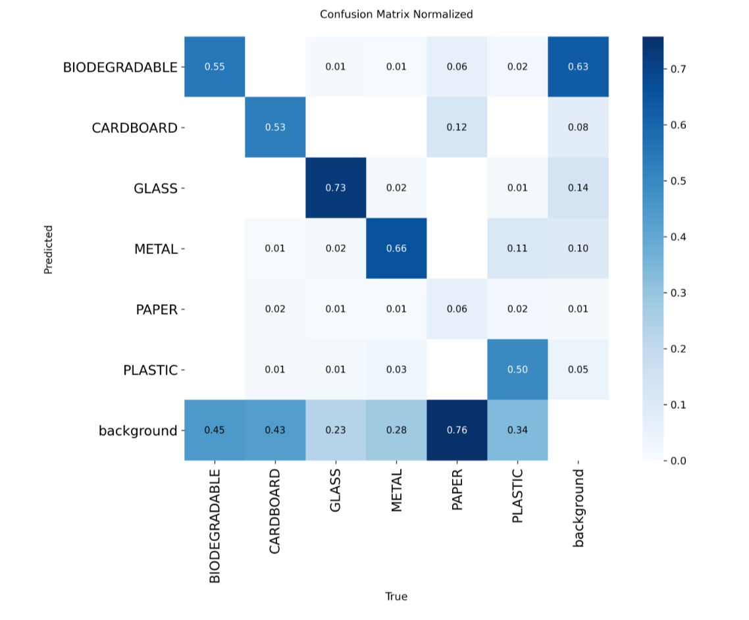
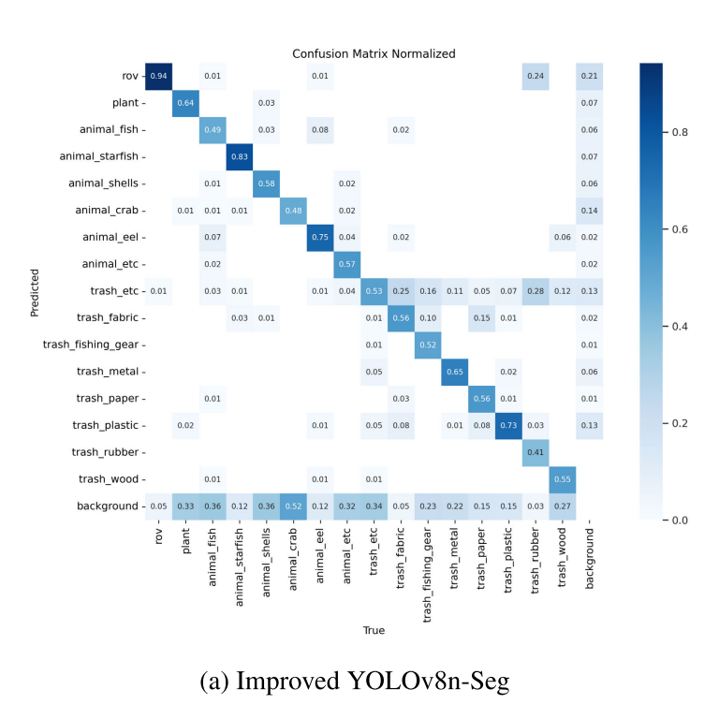
Result Analysis and Observations
Confusion Matrix Obtained for our Dataset in our project
Confusion Matrix Obtained in the base paper

Slide 20
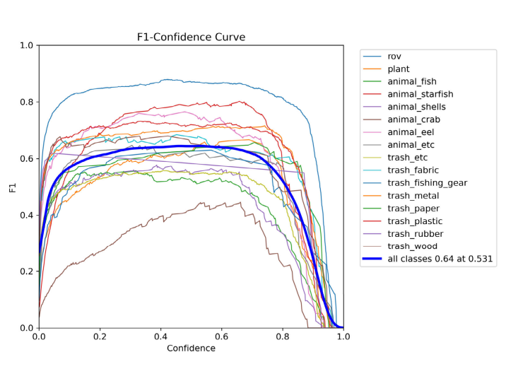
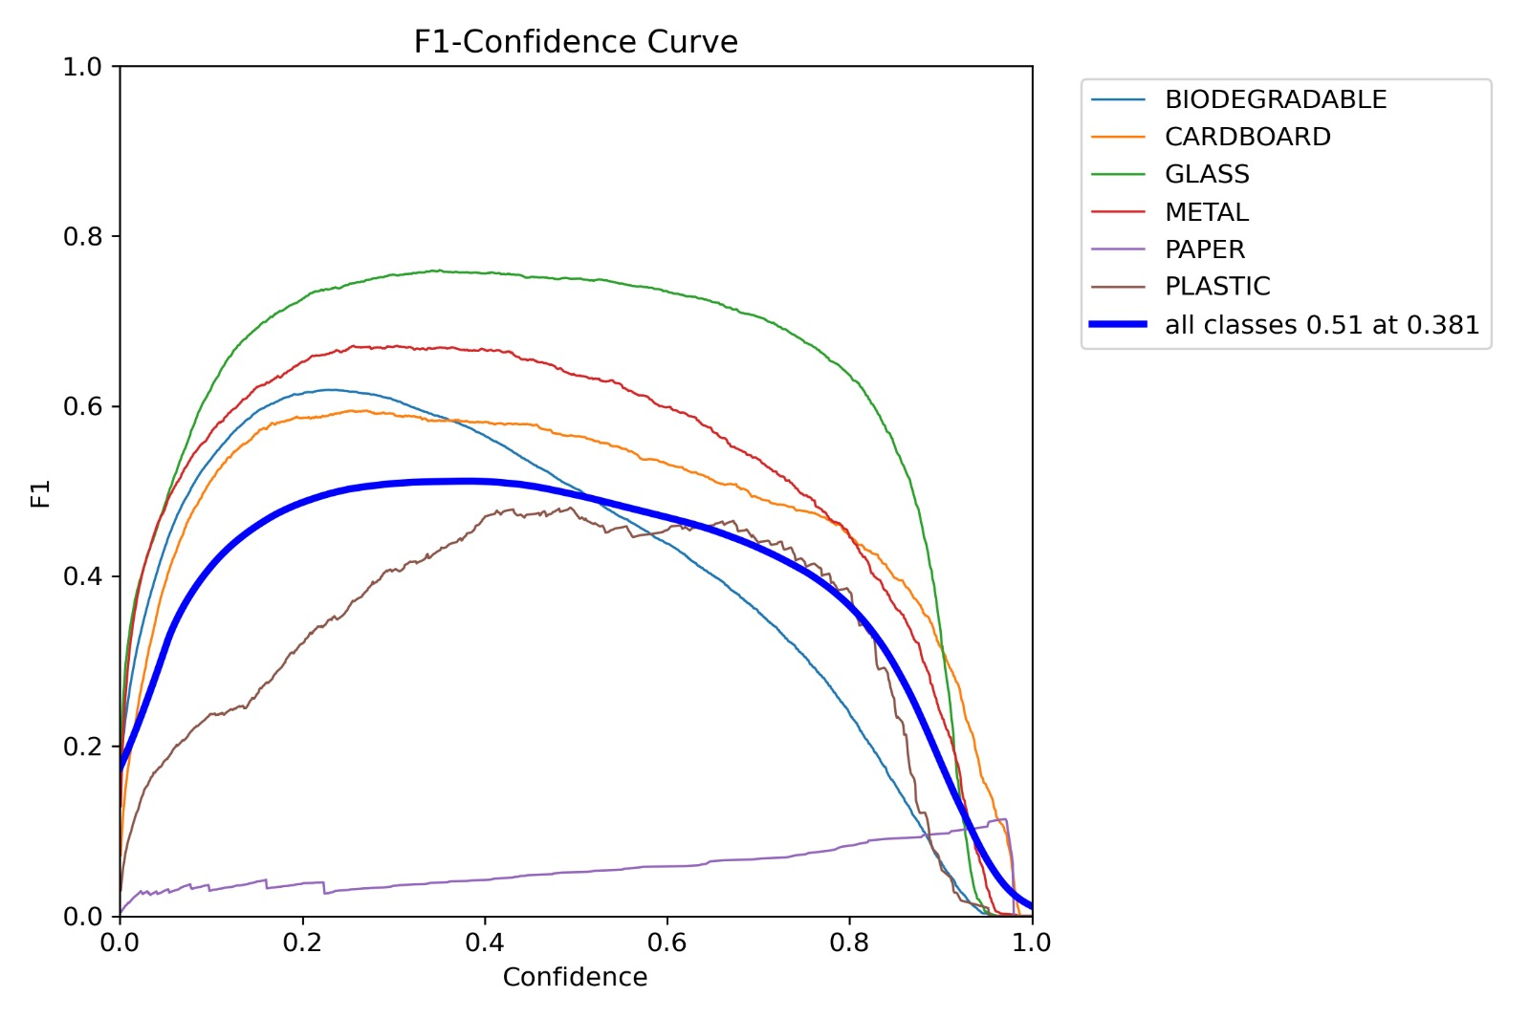
Result Analysis and Observations
F1-Confidence Curve for each class obtained in our project
F1-Confidence Curve for each class obtained in the base Paper

Slide 21
Result Analysis and Observations
Metrices | Our Project | Base Paper
mAP@50 | 53.5% | 61%
mAP@50-95 | 37.2% | 42%
Precision | 61.9% | 70%
Recall | 45.1% | 60%
F1-Score | 52.2% | 64.62%

Slide 22
Conclusion
• The proposed system successfully integrates YOLOv8-based multi-class garbage detection with a RAG-based recycling guidance framework to support intelligent and sustainable waste management.
• The model can identify multiple waste categories from a single image and generate useful recycling recommendations based on the detected materials.
• Experimental evaluation shows that the detection module achieved a Precision of 0.619, Recall of 0.451, mAP@50 of 0.535, mAP@50-95 of 0.372, and F1-score of 0.522.
• These results indicate stable and effective performance for multi-class garbage recognition.
• The findings show that the model is able to learn meaningful visual features for waste detection while maintaining balanced overall detection capability.
• By combining object detection with knowledge-based recycling support, the proposed system goes beyond traditional waste classification methods.
• The system provides a more practical solution for smart waste segregation and environmental sustainability.

Slide 23
Future Work
• The proposed system can be extended in the future by installing a camera inside a garbage truck for live waste monitoring and tracking.
• Instead of analyzing only uploaded images, the model can be connected to a real-time video stream to continuously detect and track different waste materials during collection and dumping.
• This improvement would make the system more practical for large-scale municipal waste management applications.
• It can help monitor waste composition in real time and identify recyclable materials during the waste collection process.
• The live tracking framework can support faster decision-making and improve the efficiency of waste handling operations.
• Such an enhancement can further increase automation, reduce manual inspection, and make the overall waste management process smarter and more effective.

Slide 24
References
[1] A. A. Alsuwaylimi, “Enhanced YOLOv8-Seg Instance Segmentation for Real-Time Submerged Debris Detection,” IEEE Access, vol. 12, pp. 117833-117849, 2024, doi: 10.1109/ACCESS.2024.3448258.
[2] D. Mewada, C. Agnew, E. M. Grua, C. Eising, P. Denny, M. Heffernan, K. Tierney, P. van de Ven, and A. Scanlan, “Contamination Detection From Highly Cluttered Waste Scenes Using Computer Vision,” IEEE Access, vol. 12, pp. 129434-129446, 2024, doi: 10.1109/ACCESS.2024.3456469.
[3] M. Shroff, A. Desai, and D. Garg, “YOLOv8-based Waste Detection System for Recycling Plants: A Deep Learning Approach,” in Proceedings of the IEEE International Conference on Self Sustainable Artificial Intelligence Systems (ICSSAS), 2023, doi: 10.1109/ICSSAS57918.2023.10331643.
[4] L. Qin, X. Tang, and F. Zhang, “Garbage Classification Recognition Based on Improved YOLOv8 Model,” in Proceedings of the IEEE International Conference on Image Processing (ICIP), 2024, doi: 10.1109/ICIP60790.2024.00118.
[5] R. E. Mallouhy, H. Alqahtani, and S. Lardhi, “AI-Powered Standard Operating Procedure Generation and Optimization Using Large Language Models for Chemical Laboratory Applications,” IEEE Access, vol. 14, pp. 19383-19395, 2026, doi: 10.1109/ACCESS.2026.3660770.

Slide 25
THANK YOU

