Slide 1
Simple Calendar application
A full-stack calendar and appointment management app

Slide 2
Agenda
Approach and Design
Key files and Folders
Process to run, test, and verify
Test data and Seed data
Application Code

Slide 3
Overview
This application provides:
Event Creation with title, date, start/end times
Conflict Prevention (prevents overlapping events)
Daily & Weekly Views via Full Calendar
Custom Time zone Support (US Eastern)
Free Slot Finder for any date and duration
In-Memory Storage, no external database required

Slide 4
Approach and design
Backend: Spring Boot REST API with an in-memory store.
Validation: Rejects overlaps and invalid time ranges.
Endpoints: CRUD on /api/events, plus /api/events/availability.
Time zone: Jackson configured for America/New York.
Frontend: React + Material UI + Full Calendar.
Dialogs: For creating events and finding free slots.
Persistence: localStorage retains toggle state (Today/Week) across refreshes.
Locale: Date-fns + en-US locale for formatting.

Slide 5
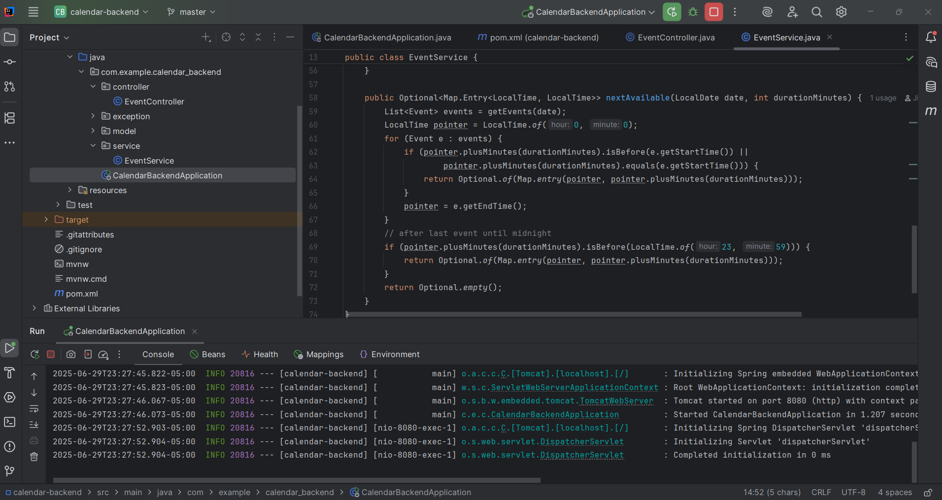
Key files and folders
Backend

Slide 6
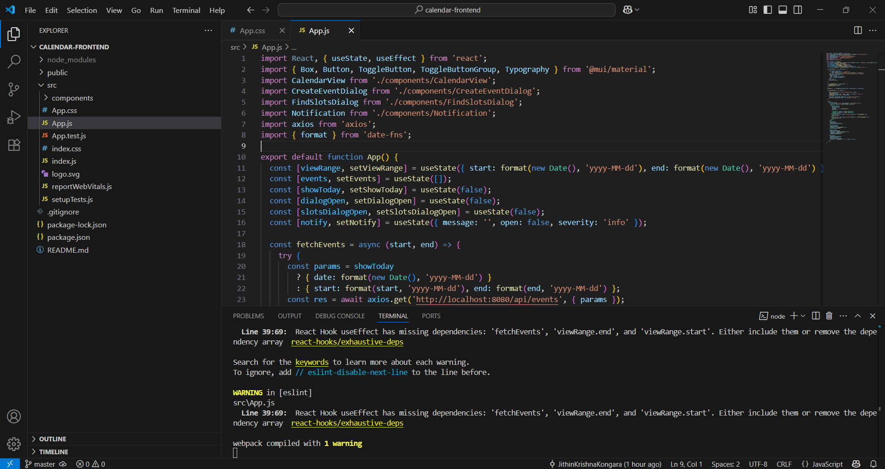
Key files and folders
Frontend

Slide 7
Process to run, test and verify
Prerequisites
Java 17
Maven 3.6+ (backend)
Node.js 16+ & npm (frontend)
Usage
Toggle between Today and Week views (state persists on refresh).
Create New Event: Opens a dialog—enter title, date, start/end times.
Find Available Slots: Opens a dialog—select date & duration, shows all free intervals.
Navigate Weeks: Use the Full Calendar header buttons (Prev, Next, Today).

Slide 8
Process to run, test and verify
API Reference:
Create Event -
POST /api/events
Body:
{
"title": "Meeting",
"date": "2025-06-29",
"startTime": "14:00:00",
"endTime": "15:00:00"
}
Responses:
200 OK = Created event JSON
400 Bad Request = {“error”” Message”}

Slide 9
Process to run, test and verify
List Events -
GET /api/events
Query (weekly): ?start=YYYY-MM-DD&end=YYYY-MM-DD
Query (daily): ?date=YYYY-MM-DD
Response: Array of event objects
Next Available Slot -
GET /api/events/availability?date=YYYY-MM-DD&durationMinutes=N
Response: 200 OK = {“start” :”HH:MM:SS”, “end”:”HH:MM:SS”} 400 Bad request = {“error” :”No slot available”}

Slide 10
Test data
Manual Tests:
Overlap detection (e.g., creating 9:30–10:30 should yield a 400).
Edge cases: same start/end times, start after end.
Free slot finder: for duration 60 on a day with 9–10 and 12–13 busy, expect slots [00:00–09:00], [10:00–12:00], [13:00–23:59]

Slide 11
Application code
Git:
https://github.com/JithinKrishnaKongara/calendar-event-backend.git
https://github.com/JithinKrishnaKongara/calendar-frontend.git Demo:
https://drive.google.com/file/d/1jkffe_Fv2UY84NMAj0bc6l_rSBPloKxk/view?usp=sharing

Slide 12
THANK YOU
Jithin Krishna Kongara
+1 945-444-6708
kjithinkrishna01@gmail.com

