Slide 1
PROSTHETIC LIMB TELEMETRY SYSTEM
Smart Prosthetic Knee Joint:
Firmware & Telemetry Studio
Complete Engineering Work Progress: Block Diagrams & GUI Provisions
• Embedded Target: STM32U585 (ARM Cortex-M33 @ 160 MHz, FreeRTOS)
• Telemetry Suite: Electron 31 Desktop Studio (100 Hz Streaming, Oscilloscope & 3D Analytics)
• System Capabilities: 6-Phase Gait Detection | Hardware AES-256-GCM | Flash In-Situ Calibration
Author: Jithin Sreenu | Date: November 2026 | Status: Fully Operational & Verified

Slide 2
WORK PROGRESS REPORT
Project Overview: What Is This System?
A complete end-to-end telemetry and clinical control solution for active prosthetic limbs
02
🦿 1. The Physical Knee
🧠 2. The Smart Firmware
💻 3. The Desktop Studio
Sensors & Actuator
• Dual load cells monitor ground reaction forces.
• Rotary potentiometer measures joint angle.
• Hydraulic spool valve actuated via motor slave.
• 4.2V rechargeable lithium-ion battery.
STM32U585 (Cortex-M33)
• 12-bit ADC + DMA scan @ ~2,778 blocks/s.
• 51-tap FIR low-pass filter eliminates shock.
• 6-phase clinical gait state machine.
• 100 Hz encrypted binary streaming (AES-256).
Electron 31 Desktop App
• Multi-pane live waveforms & glow oscilloscope.
• Interactive 3D WebGL phase-space trajectories.
• Automated gait metrics (cadence, symmetry).
• In-situ calibration & HIPAA session recording.
💡 The Big Picture: How to Understand This at First Glance
Think of this system like a high-precision 'Patient ICU Monitor' built specifically for an amputee's robotic knee.
When an amputee walks, the knee must dynamically adapt its damping (resistance) to prevent falls during heel-strike and allow smooth swinging when the foot is in the air. The STM32 microcontroller senses the user's weight and knee angle 100 times every second, decides whether the user is in Swing, Loading, Mid-Stance, or Terminal-Stance, and immediately commands the hydraulic valve. Simultaneously, all biomechanical data streams wirelessly or via USB to the Desktop Studio, allowing clinicians and prosthetists to observe gait symmetry, calibrate sensor coefficients, and tune walking parameters in real time.

Slide 3
SYSTEM ARCHITECTURE
Block Diagram 1: End-to-End System Architecture
Complete architectural interconnection between physical knee, embedded MCU, and desktop suite
03
🦿 1. PROSTHETIC KNEE
🔲 2. STM32U585 CONTROLLER
💻 3. DESKTOP STUDIO
Load Cell 1
Force Sensor (PC0/A0)
ADC1 + GPDMA1
12-bit, 3 ch scan @ 2,778 blocks/s
Transport Layer
USB SerialPort / BLE / Demo
Load Cell 2
Moment Sensor (PC2/A1)
51-Tap FIR Low-Pass Filter
Hamming window @ 25 Hz cutoff
Frame Parser & CRC
Sync search & fault bitmask decode
Knee Potentiometer
Joint Angle (PC4/A2)
Gait State Machine (6-Phase)
SM_Run() + mid_seen sequence latch
Live Visualizations
Waveforms, Scope, 3D WebGL
Battery Voltage
Divider Scale (0-4.2V)
Protocol Builder
25-byte packed frame + CRC-16
Gait Analytics
Cadence, stride time, symmetry
Hydraulic Spool Valve
Actuator Slave (USART3)
Hardware AES-256-GCM
Opt-in 31-byte encrypted frame
In-Situ Configuration
Thresholds (0x31) & Coeffs (0x32)

Slide 4
HARDWARE PLATFORM
Block Diagram 2: Hardware Interconnections & Pin Assignments
ST B-U585I-IOT02A microcontroller pin routing and peripheral mapping
04
Analog Sensor Inputs
STM32U585AII6Q (160 MHz, 768 KB SRAM, 2 MB Dual-Bank Flash)
Communication Ports
PC0 (ADC1_IN1)
Arduino A0: Load Cell 1 (Force)
Internal Peripherals Engaged:
• ADC1 (12-bit SAR): Rank 1: PC0, Rank 2: PC2, Rank 3: PC4
• GPDMA1 Channel 1: ADC1 circular continuous transfer (DMNGT=10)
• GPDMA1 Channel 0: USART1 TX non-blocking telemetry stream
• USART1 (115200-8N1): PA9-TX / PA10-RX host communication
• USART3 (115200-8N1): PD8-TX / PD9-RX motor slave link
• Hardware AES Engine: 256-bit block cipher hardware acceleration
• Hardware TRNG: 32-bit true random number generation
• Flash Bank 2: Page 126 persistent coefficient / PSK storage
USART1 TX (PA9)
100 Hz Telemetry to PC / Bluetooth
PC2 (ADC1_IN3)
Arduino A1: Load Cell 2 (Moment)
USART1 RX (PA10)
CLI Commands from Desktop Studio
PC4 (ADC1_IN13)
Arduino A2: Knee Angle Potentiometer
USART3 TX (PD8)
State Commands (SWING/STANCE) to Slave
PC5 (ADC1_IN14)
Arduino A3: Reserved Expansion
USART3 RX (PD9)
Valve Position Feedback from Slave
PA7 (ADC1_IN12)
Arduino A4: Reserved Expansion
GPIO Output (PH7)
Heartbeat Green LED (100 Hz Toggle)

Slide 5
FIRMWARE PIPELINE
Block Diagram 3: Firmware Sensor Acquisition Pipeline
From analog microvolts to filtered engineering values: ADC, DMA, FIR, and scaling
05
1. Analog Acquisition
2. GPDMA1 Ch1 Buffer
3. 51-Tap FIR Filter
4. Physical Unit Scaling
ADC1 continuous scan (PC0, PC2, PC4)
2.5 cycles sampling @ 4 MHz MSI clock
32 scans × 3 channels = 96 halfwords
Circular block completed every ~360 µs
Hamming window low-pass @ 25 Hz cutoff
Eliminates mechanical impact shock & tremor
Force: ×300 N | Moment: ×60 Nm
Knee: ×27° | Battery: ×1.41 V divider
🔧 Root-Caused DMA Breakthrough: The DMNGT=10 Register Fix
Problem & Root Cause:
In early testing, physical sensors produced all zeros except battery. Register-level analysis revealed that the STM32U5 ADC requires CFGR1 = CONT | (0x02 << DMNGT_Pos). Setting DMNGT=10 forces a DMA request after EACH conversion. In addition, DMA re-arming was moved directly inside the transfer-complete ISR, eliminating an abort/start race condition. Verified on live hardware on August 11, 2026.

Slide 6
RTOS DESIGN
Block Diagram 4: FreeRTOS Real-Time Task Architecture
Deterministic 100 Hz scheduling, non-blocking DMA dispatches, and circular CLI console
06
1. High-Priority 100 Hz Timer
2. CLI Command Console Task
3. Motor Slave Link Service
TelemetryCallback (10 ms period)
• Calls ADC_Poll() to fetch filtered sensor buffer
• Executes SM_Run() gait state machine & updates mid_seen
• Checks sensor integrity (stuck-zero, VREF, flatline)
• Builds 25-byte frame & computes CRC-16/MODBUS
• Triggers hardware AES-256-GCM encryption if armed
• Dispatches GPDMA1 Ch0 non-blocking TX to USART1
• Toggles green user LED heartbeat (PH7)
USART1 RX Idle-Line DMA
• Listens for incoming ASCII strings from Desktop Studio
• Parses commands: mode, demo, set, get, sm, halt, crypto
• Performs non-blocking response string transmission
• Implements overrun error (ORE/FE/NE) auto-recovery
• Enables dynamic state machine tuning without reflashing
USART3 RX Idle-Line DMA
• Receives 7-byte feedback packets from hydraulic valve MCU
• Implements median-of-3 filter on valve position (%)
• Enforces 25 ms freshness timeout gate
• Emits SWING/STANCE command frames on state transitions

Slide 7
GAIT INTELLIGENCE
Clinical Gait Intelligence: The 6 Biological Walking Phases
Biomechanical breakdown of how human walking is mapped into state transitions
07
Phase 0: SWING
Phase 1: STANCE
Phase 2: LOADING
Foot in Air (0% Weight)
Prosthetic leg moves forward. Ground force < 0.2V. Valve opens to allow free, low-resistance swing.
General Support Phase
Catch-all loaded state when force > 0.5V but outside specific dynamic phase bands.
Heel Strike & Acceptance
Initial ground contact. Force rises rapidly as amputee loads limb. Valve stiffens to prevent knee buckling.
Phase 3: MID-STANCE
Phase 4: TERMINAL-STANCE
Phase 5: PRE-SWING
Full Single-Limb Support
Body weight directly over knee. Maximum downward force. Triggers internal 'mid_seen = 1' flag.
Weight Shift & Push-Off
Body rolls forward. Force declining. Mid-stance was seen, distinguishing this from initial loading.
Toe-Off Preparation
Limb unloads rapidly (< 0.4V). Knee flexion begins in preparation for swing. Transitions to Phase 0.

Slide 8
STATE MACHINE
Block Diagram 5: 6-Phase Gait State Transition Model
State machine state-transition topology with boundary conditions and transition criteria
08
2: LOADING
Heel strike
mid_seen == 0
3: MID-STANCE
Full weight
Set mid_seen = 1
4: TERMINAL-STANCE
Push off
mid_seen == 1
0: SWING
Leg in air
Clear mid_seen
1: STANCE
Catch-all
Force >= st_min
5: PRE-SWING
Toe off
Force < 0.4V
Hysteresis & Transition Logic
• Hysteresis Protection: If sensor voltage falls into an unmapped deadband between phases, the firmware maintains the previous state, preventing chatter.
• Actuator Command Dispatch: On EVERY state transition, the master transmits a 7-byte frame to the hydraulic slave: SWING (0) opens valve, any non-swing phase (1) throttles valve.

Slide 9
DECISION LOGIC
Block Diagram 6: Gait Decision Logic & The mid_seen Secret
Detailed algorithmic flow inside state_machine.c resolving phase ambiguity
09
1. Multi-Sensor Input ➔ Load Cell 1 (A0) + Load Cell 2 (A1) + Knee Potentiometer (A2)
🔑 The Clinical Secret: Resolving Phase Ambiguity
Why is a simple threshold not enough?
In human gait, Loading (weight acceptance) and Terminal-Stance (push-off) produce the EXACT same sensor force values (~300–600 N). A static threshold cannot tell whether the patient is stepping down or pushing off.
Our firmware solves this with the internal 'mid_seen' state flag:
1. At Heel Strike, the state enters LOADING.
2. When force peaks at body weight, it enters MID-STANCE and sets mid_seen = 1.
3. As force drops back down into the loading band, the firmware checks mid_seen. Because it is 1, it correctly classifies the phase as TERMINAL-STANCE, not Loading!
4. When foot lifts off (force in swing band), mid_seen is cleared back to 0.
Result: 100% deterministic gait progression without requiring complex neural networks on the microcontroller.
2. Combination Mode ➔ SM_Combine(): Configurable as SUM (default), AVERAGE, MAX, or MIN
3. Window Accumulator ➔ Averages N cycles (default 10 cycles = 100 ms) to eliminate transient chatter
4. Moment Calculation ➔ SM_ComputeMoment(): DIFF = (V1-V2)×Arm | ABSDIFF | FORCE×Arm (0.2m)
5. Decision Input Selection ➔ Selected input: Combined FORCE, MOMENT, or multi-variable FORCE+KNEE
6. Band & Sequence Evaluation ➔ Checks voltage bands with mid_seen sequencing flag & hysteresis deadbands
7. Slave Actuation Dispatch ➔ Emits SWING (0) or STANCE (1) command frame to motor slave on every transition

Slide 10
STRIDE TIMELINE
Block Diagram 7: Complete Biological Stride Progression
Timeline of a single human stride from heel-strike to toe-off and aerial swing
10
1. HEEL STRIKE
2. MID-STANCE
3. PUSH OFF
4. TOE OFF
5. INITIAL SWING
6. TERMINAL SWING
Phase 2: LOADING
Force: 0 -> 400 N
Valve: Stiffening
Phase 3: MID-STANCE
Force: 800 N (Peak)
Valve: Locked/Damped
Phase 4: TERMINAL
Force: 800 -> 300 N
mid_seen == 1
Phase 5: PRE-SWING
Force: < 150 N
Knee angle flexing
Phase 0: SWING
Force: ~0 N
Valve: Free Swing
Phase 0: SWING
Foot reaches forward
Ready for heel strike

Slide 11
SLAVE PROTOCOL
Block Diagram 8: Motor Slave Link Protocol & Actuator Driving
USART3 7-byte binary sequence, median-of-3 filtering, and freshness timeout
11
USART3 Sequence Diagram (115200 Baud)
7-Byte Packet Layout & Safety Gating
1. Master detects state transition (e.g. SWING -> LOADING).
2. Master builds 7-byte command: [A5 5A 01 seq CMD CRC16].
3. Master transmits frame to Slave MCU via USART3 (PD8-TX).
4. Slave MCU parses frame, verifies CRC, and commands H-bridge motor.
5. Hydraulic spool valve slides to throttle or open fluid port.
6. Slave MCU returns 7-byte feedback: [A5 5A 02 seq VALVE% CRC16].
7. Master receives feedback via USART3 (PD9-RX) Idle-Line DMA.
8. Master passes valve position through median-of-3 filter.
Packet Specifications & Freshness:
• Sync Header: 0xA5, 0x5A (2 bytes)
• Packet Type: 0x01 = State Command | 0x02 = Valve Feedback
• Sequence Counter: Rolling uint8 sequence number
• Payload (1 Byte): Command: 0=SWING, 1=STANCE | Feedback: 0-100%
• CRC-16 / MODBUS: 2 bytes (polynomial 0x8005) covering bytes 0-4
• Median-of-3 Filter: Rejects mechanical brush noise from motor
• 25 ms Freshness Gate: Asserts fault warning bit if slave stops replying

Slide 12
TELEMETRY PROTOCOL
Block Diagram 9: Telemetry Protocols — Plain vs Encrypted
Deterministic 25-byte v1 frame vs 31-byte v2 hardware-encrypted frame
12
Standard Telemetry Frame (v1: 25 Bytes)
Encrypted Telemetry Frame (v2: 31 Bytes)
Byte [0–1]: 0xAA, 0x55 — Sync Header (Frame delimiter)
Byte [2]: uint8 — Sequence counter (0–255 rolling)
Byte [3–4]: int16 (x100) — Calibrated Force (N)
Byte [5–6]: int16 (x100) — Calibrated Moment (Nm)
Byte [7–8]: int16 (x100) — Knee Joint Angle (degrees)
Byte [9–10]: uint16 — Spool Valve Position (%)
Byte [11–12]: uint16 (x100) — Battery Voltage (V)
Byte [13]: uint8 — Gait Phase Enum (0 to 5)
Byte [14–15]: uint16 — 16-Bit Fault Bitmask
Byte [16–22]: 7x uint8 — Reserved zero-padding
Byte [23–24]: uint16 — CRC-16 / MODBUS (covers bytes 0–22)
Opt-In Confidentiality for Wireless & Sniffable Links:
• Session Handshake: Firmware broadcasts 19-byte Hello frame (A5 5A 10 + 16-byte random Nonce) at boot.
• Key Derivation: Session Key (SK) generated via AES-256-ECB over Pre-Shared Key (PSK) and Nonce.
• Rolling IV: Initialized with Nonce[0..8] + 32-bit big-endian packet counter (replay protection).
• Plaintext Range: 20 bytes of payload (bytes 3–22) encrypted via AES-GCM.
• Authentication: First 3 bytes (AA 55 seq) authenticated as Additional Data (AAD).
• Integrity Tag: MSB-8 of GCM-128 authentication tag appended to frame.
• v2 Frame Layout: [AA 55] [seq] [20-byte Ciphertext] [8-byte GCM Tag] = 31 Bytes total.

Slide 13
SECURITY ARCHITECTURE
Block Diagram 10: AES-256-GCM Cryptographic Engine
Key derivation, rolling IV counter, hardware AES round function, and software fallback
13
1. Pre-Shared Key (PSK)
2. Boot Nonce (N)
32 bytes (256-bit) stored securely in STM32 Flash Bank 2 (Page 126)
16 bytes generated at startup via hardware TRNG peripheral
3. Session Key (SK)
4. Rolling 96-Bit IV
SK = AES-256-ECB(PSK, N) || AES-256-ECB(PSK, N ^ 0x01)
IV = Nonce[0..8] || Counter_32BE (increments every 10 ms frame)
5. Hardware AES Engine
6. Software Fallback
STM32U5 AES peripheral runs block cipher; GHASH computes 8-byte tag
FIPS-197 software AES fallback validated against OpenSSL vectors

Slide 14
SAFETY ARCHITECTURE
Block Diagram 11: 16-Bit Fault Diagnostics & Safety Checks
Continuous safety limit monitoring, sensor disconnection detection, and ADC lockup checks
14
16-Bit Fault Register Breakdown (status_register_t)
Autonomous Continuous Integrity Checks
Bit 0: Force Low Fault (< Min threshold)
Bit 1: Force High Fault (> Max threshold)
Bit 2: Moment Low Fault (< Min threshold)
Bit 3: Moment High Fault (> Max threshold)
Bit 4: Knee Angle Low Fault (< Min threshold)
Bit 5: Knee Angle High Fault (> Max threshold)
Bit 6: Valve Position Low Fault
Bit 7: Valve Position High Fault
Bit 8: Battery Undervoltage Warning (< 3.3V)
Bit 9: Battery Overvoltage Warning (> 4.2V)
Bit 10–13: Per-Channel Sensor Stuck / Flatline Faults
Bit 14: ADC Conversion Stuck-at-Zero Error
Bit 15: ADC Conversion Stuck-at-VREF Error
• Stuck-at-Zero Check (~0.5s):
If any sensor raw ADC count remains 0 for 50 consecutive cycles, flags open-circuit or ground short.
• Stuck-at-VREF Check (~0.5s):
If raw count remains 4095 for 50 cycles, flags power rail short or disconnected sensor cable.
• Flatline Variance Check (~1.5s):
Calculates statistical variance over 150 cycles. If variance is near-zero during dynamic walking, flags frozen sensor wiper.
• Auto-Clearing Faults:
Sensor faults automatically clear once valid dynamic fluctuations resume, restoring normal telemetry status.

Slide 15
CALIBRATION FLOW
Block Diagram 12: In-Situ Calibration & Flash Persistence Flow
Password-protected flash programming sequence ensuring zero telemetry corruption
15
1. Clinician Authentication ➔ Clinician enters administrator password in Desktop Studio Coefficients Tab
2. Safety Halt Request ➔ Desktop Studio transmits 'halt on' CLI command to STM32 MCU
3. Telemetry Suspension ➔ Firmware disables 100 Hz timer and enters safe non-functional halt state
4. Packet Transmission ➔ Studio transmits 53-byte 0x32 Coefficient Packet (12 single-precision floats)
5. Flash Bank 2 Write ➔ Firmware validates CRC-16, unlocks Flash Bank 2, erases page, programs quadwords
6. Safety Halt Release ➔ Studio transmits 'halt off' CLI command; firmware resumes 100 Hz telemetry
7. Boot Auto-Reload ➔ On subsequent power-on, firmware validates flash magic and auto-loads calibration

Slide 16
DATA PIPELINE
Block Diagram 13: End-to-End Latency & Data Flow Pipeline
Detailed timing breakdown from physical foot strike to screen rendering
16
1. Physical Ground Strike
2. ADC Conversion & DMA
3. FIR Filter & Gait Decider
4. UART Transmission
5. Desktop Parser & CRC
6. 20 Hz WebGL UI Flush
Time: 0.0 ms
Load cell strain gauge resistance shifts with body weight.
Time: +0.36 ms
ADC1 completes 32-sample 3-channel block transfer via GPDMA1.
Time: +1.20 ms
51-tap FIR convolution completes; state machine evaluates bands.
Time: +3.37 ms
25-byte frame transmitted at 115200 baud (2.17 ms on-wire duration).
Time: +3.50 ms
Node-serialport reads chunk, verifies CRC-16, decodes fixed-point.
Time: < 50.0 ms
Ring buffer flushes to Plotly.js charts and HTML5 Canvas scope.

Slide 17
STUDIO ARCHITECTURE
Block Diagram 14: Desktop Studio Multi-Process Architecture
Electron 31 context-isolated process separation and IPC bridge architecture
17
MAIN PROCESS (Node.js)
PRELOAD BRIDGE (preload.js)
RENDERER PROCESS (Chromium)
System Level Controls
• Window creation & native application lifecycle
• Native serial port driver (node-serialport @ 115200)
• Direct file system access for CSV / JSON recording
• System browser link interception & single instance lock
• Chromium permission control
Secure Isolation Barrier
• Context Isolation: ENABLED
• Node Integration: DISABLED
• Remote Module: DISABLED
• Exposes safe, immutable API via contextBridge
• Bridges serial I/O without exposing raw OS handles
UI & Biomechanical Suite
• HTML5 / Glassmorphism UI styling engine
• 100 Hz frame parser & CRC-16/MODBUS verification
• Plotly.js WebGL multi-pane charting engine
• High-speed HTML5 Canvas phosphor glow oscilloscope
• Automated gait segmentation & cadence analytics

Slide 18
TAB DIRECTORY
Block Diagram 15: Desktop Studio 16 Tabs Functional Map
Complete functional grouping of clinical, engineering, and configuration tabs
18
📊 Clinical Monitoring
📈 Biomechanical Analysis
⚙️ Device Configuration
💾 Recording & Demographics
🔧 Engineering & System
Tabs 1 - 4
• Tab 1: Overview Dashboard
• Tab 2: Live Waveforms
• Tab 3: Phosphor Scope
• Tab 4: 3D State Space
Tabs 5 - 6, 13
• Tab 5: Clinical Gait Analytics
• Tab 6: Frame Inspector
• Tab 13: Custom XY Plot
Tabs 7 - 8, 11
• Tab 7: Safety Thresholds
• Tab 8: Calibration Coeffs
• Tab 11: Live Firmware Config
Tabs 9 - 10
• Tab 9: Session Recording
• Tab 10: Patient Metadata
Tabs 12, 14 - 16
• Tab 12: Serial Monitor
• Tab 14: Hardware Connection
• Tab 15: Protocol Reference
• Tab 16: System Architecture

Slide 19
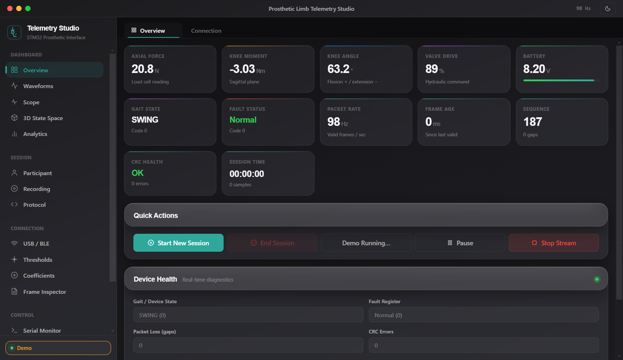
DESKTOP STUDIO TAB
GUI Provision: Overview Dashboard
11 live KPI cards (Force, Moment, Knee, Valve, Battery, Gait, Faults), 100 Hz rate indicator, CRC health, and session controls.
19
Key Features & Provisions
▶ 11 Live KPI Cards
Instantaneous readouts for all physiological and actuator signals.
▶ 100 Hz Rate Counter
Verifies zero packet loss with transmission latency monitoring.
▶ CRC Health Meter
Real-time checksum indicator validating frame integrity.
▶ One-Click Actions
Quick controls to Start Session, Pause Stream, and trigger Demo.

Slide 20
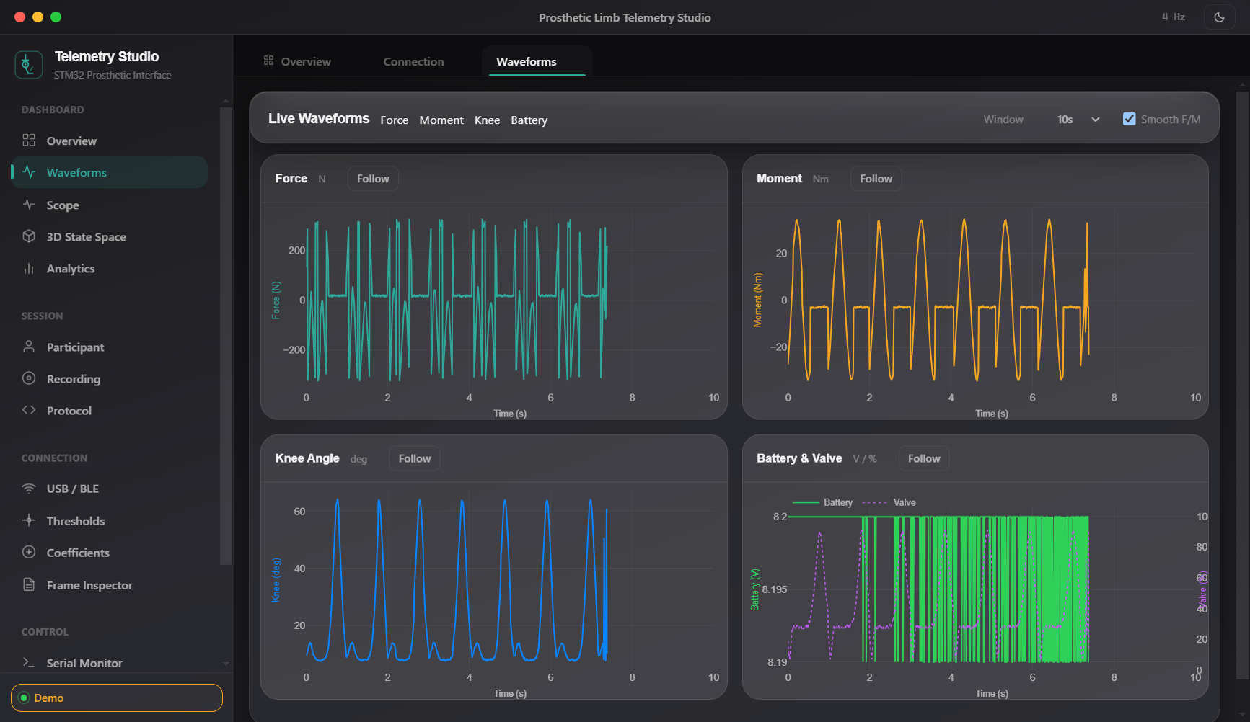
DESKTOP STUDIO TAB
GUI Provision: Live Multi-Pane Waveforms
Synchronized high-frequency time-series plotting powered by Plotly.js with 20 Hz batch flush.
20
Key Features & Provisions
▶ Four Synchronized Panes
Force (N), Moment (Nm), Knee Angle (deg), and Valve/Battery.
▶ Selectable Time Windows
5s, 10s, 30s, or 60s rolling historical buffers.
▶ 20 Hz Batch Flush
Ring buffer flushes to WebGL traces at 20 Hz, eliminating UI lag.
▶ Follow vs Inspect Mode
Auto-scroll tracks live strikes, with manual pan/zoom on demand.

Slide 21
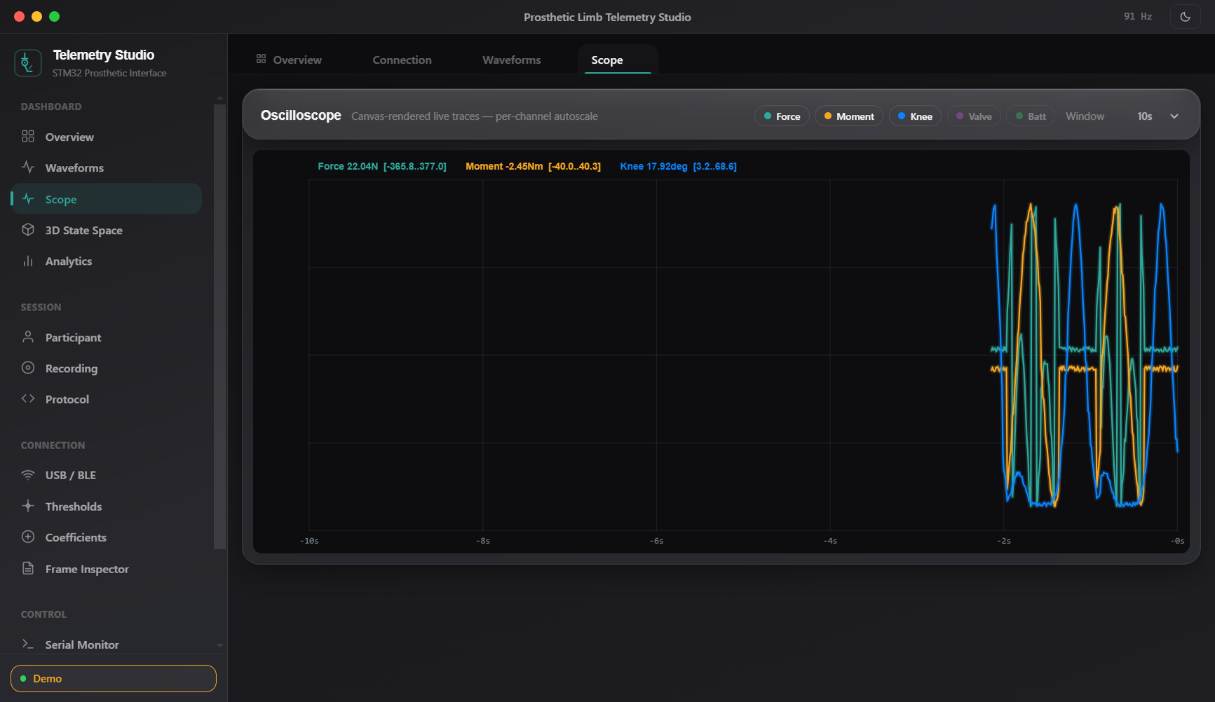
DESKTOP STUDIO TAB
GUI Provision: High-Speed Hardware Oscilloscope
PedoGraph-style canvas glow traces rendered with double-stroke phosphor aesthetics.
21
Key Features & Provisions
▶ Pure Canvas Rendering
Bypasses DOM overhead by rendering directly to HTML5 Canvas.
▶ DPR-Sharp Scaling
Compensates for 4K and Retina high-DPI displays with zero blur.
▶ Channel Toggle Chips
Interactive toggle chips isolate individual sensor waveforms.
▶ Per-Channel Autoscale
Independent vertical scaling adapts to microvolt shifts or impacts.

Slide 22
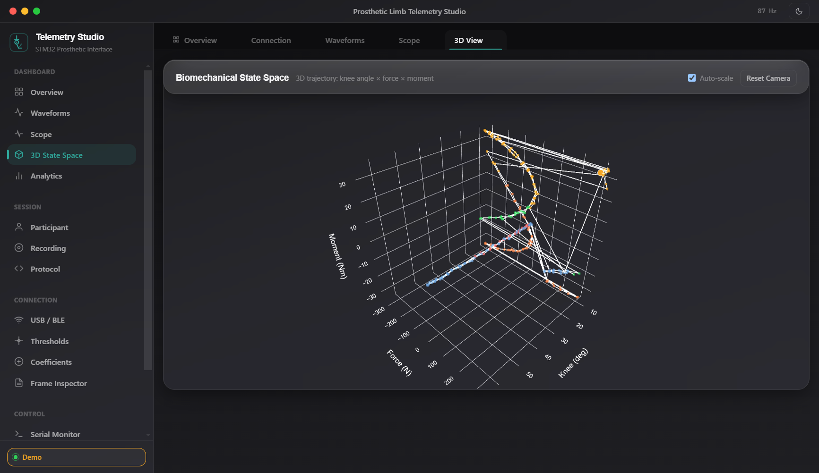
DESKTOP STUDIO TAB
GUI Provision: 3D State Space Trajectory
Interactive 3-axis WebGL phase space showing human walking stability loops in 3D.
22
Key Features & Provisions
▶ Tri-Axial State Space
Plots Knee Angle (X) × Force (Y) × Moment (Z) in 3D WebGL.
▶ Gait Phase Color Coding
Trail points colored by state (Swing=Green, Mid=Red, etc.).
▶ Cycle Limit Loops
Normal walking forms closed 3D loops; asymmetries deform the loop.
▶ Interactive Camera
Full mouse drag rotation, zoom, pan, and camera reset.

Slide 23
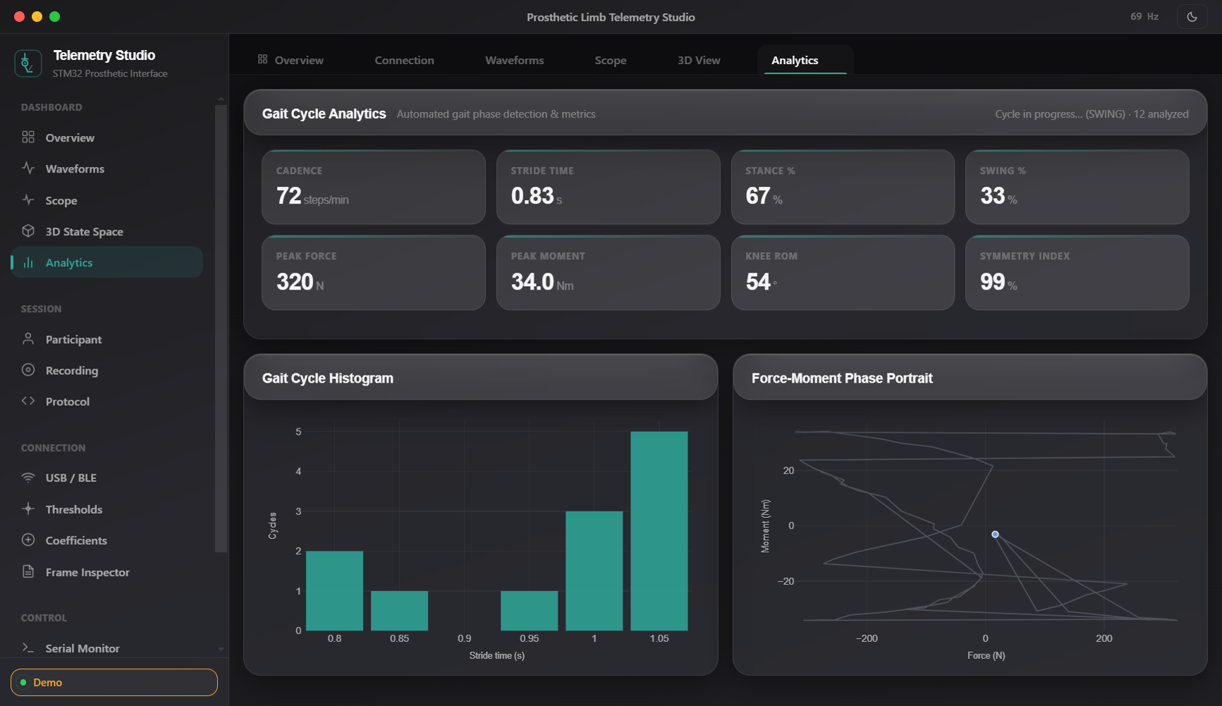
DESKTOP STUDIO TAB
GUI Provision: Automated Clinical Gait Analytics
Automated stride segmentation, cadence computation, and symmetry analysis.
23
Key Features & Provisions
▶ Cadence & Stride Time
Calculates steps/min and stride duration with 0.3s-3.5s gating.
▶ Stance / Swing Ratio
Computes exact physiological percentage of contact vs swing.
▶ Peak Force & Knee ROM
Tracks peak ground impact (N) and joint Range of Motion (deg).
▶ Symmetry Index & Histogram
Quantitative symmetry score and stride-time histogram.

Slide 24
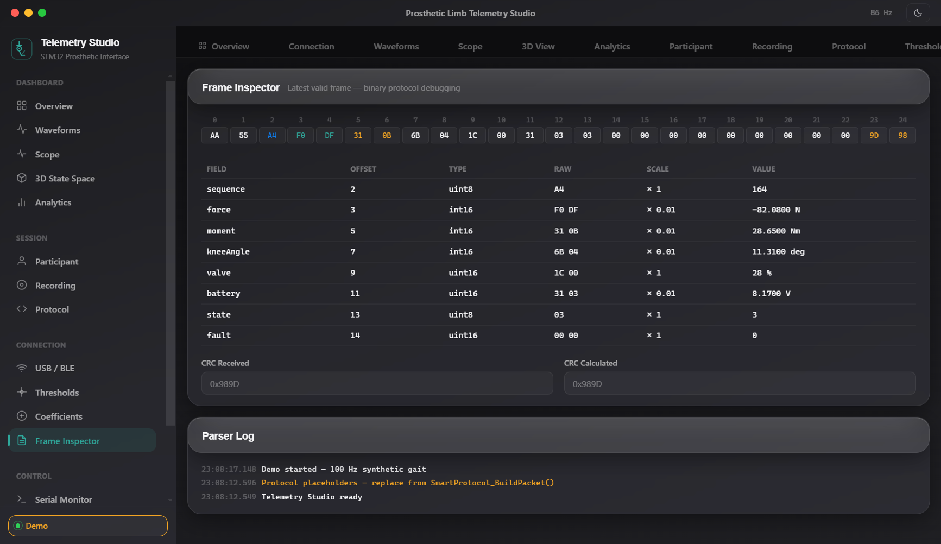
DESKTOP STUDIO TAB
GUI Provision: Protocol & Frame Inspector
Low-level binary telemetry debugging with color-coded hex grid and CRC validation.
24
Key Features & Provisions
▶ Color-Coded Hex Grid
Displays live 25-byte frame with color highlights for each field.
▶ Decoded Fields Table
Tabulates Offset, Type, Raw Hex, Scale Factor, and Final Value.
▶ Live CRC Verification
Displays received CRC vs calculated CRC in real time.
▶ Diagnostic Event Stream
Timestamped logging of parser synchronization and frame drops.

Slide 25
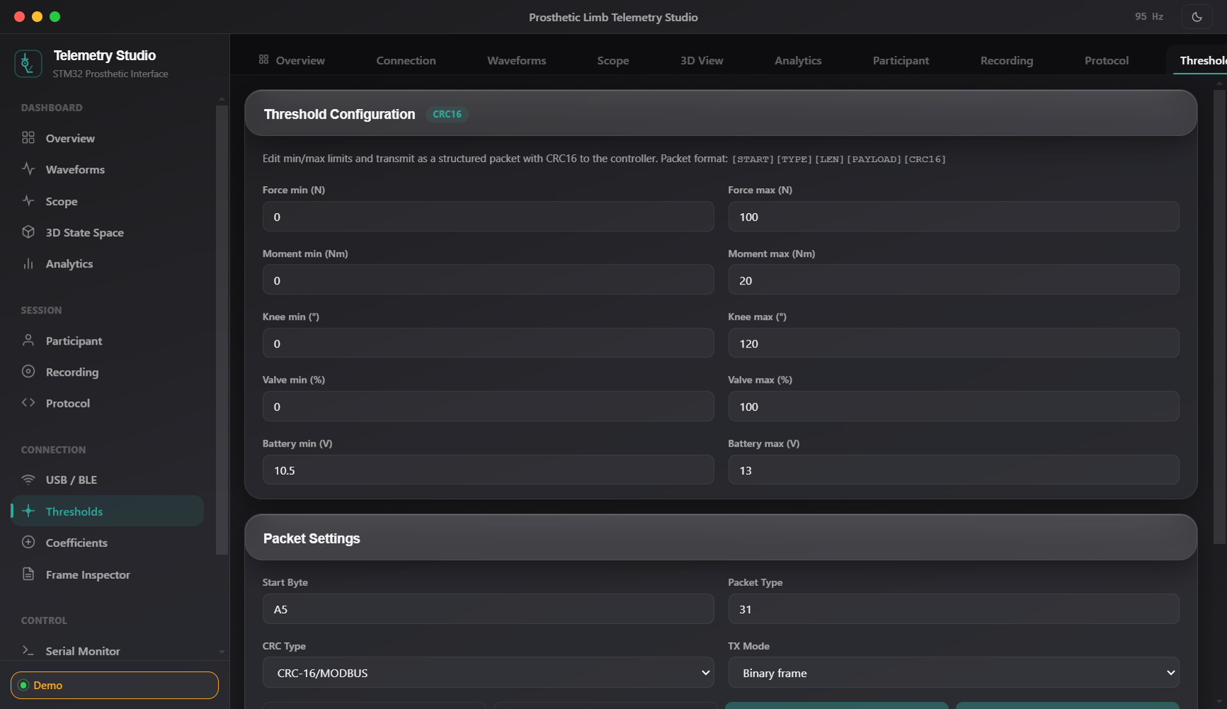
DESKTOP STUDIO TAB
GUI Provision: Safety Thresholds Configuration
In-situ adjustment of patient safety operating boundaries with 0x31 packet upload.
25
Key Features & Provisions
▶ Dynamic Sliders & Inputs
Min/Max bounds for Force, Moment, Knee Angle, Valve, Battery.
▶ 0x31 Packet Transmission
Packages 10 float32 thresholds into 45-byte binary packet.
▶ Live Violation Highlighting
Fields glow red if live reading breaches configured bound.
▶ Non-Volatile Storage
Thresholds apply immediately to live 16-bit fault register.

Slide 26
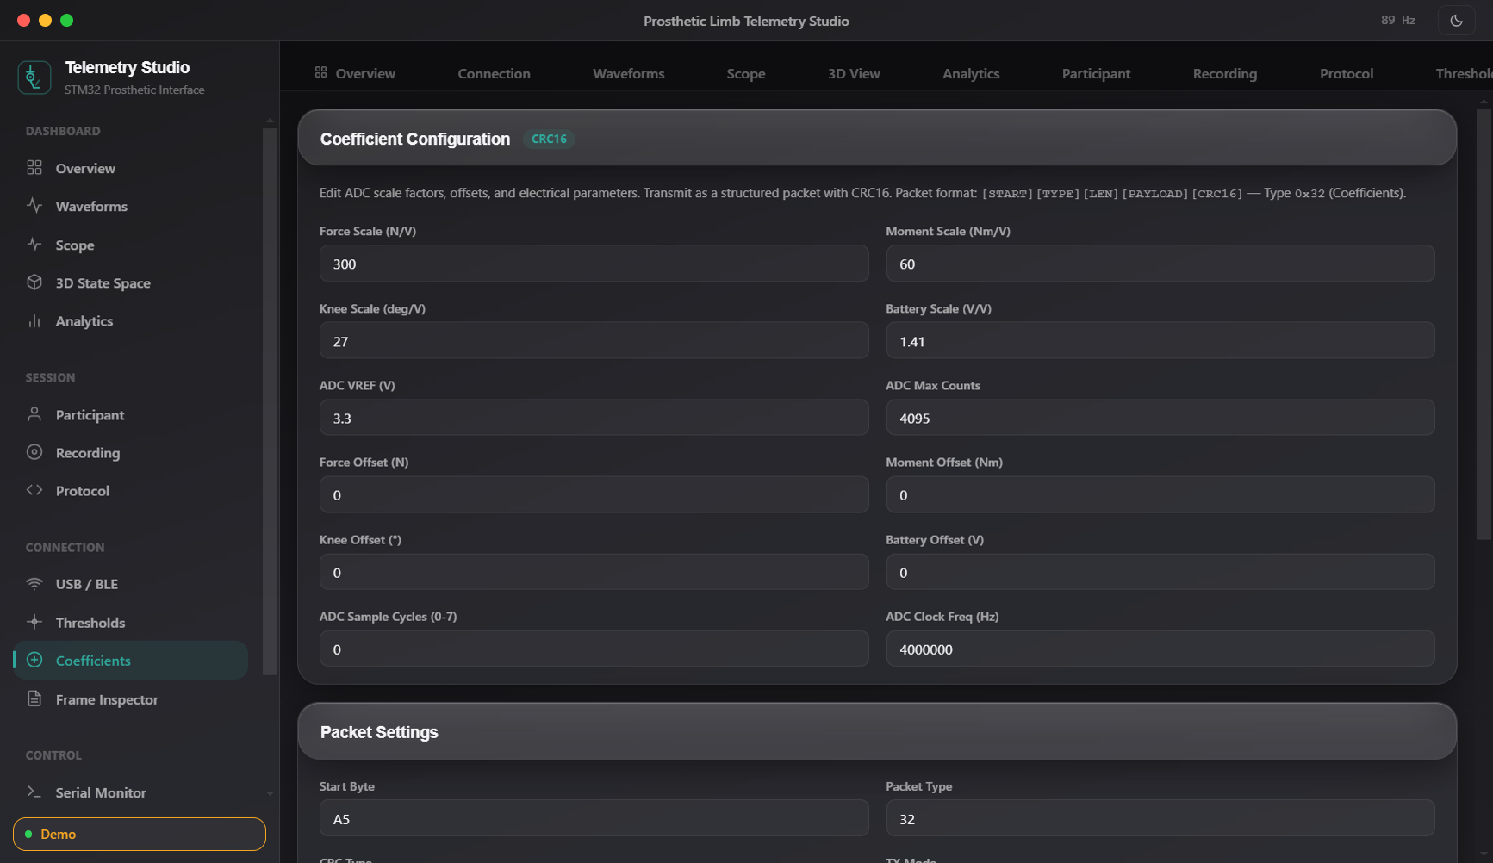
DESKTOP STUDIO TAB
GUI Provision: Sensor Calibration & Coefficients
Sensor gain and zero-offset calibration with protected Flash Bank 2 persistence.
26
Key Features & Provisions
▶ Scale, Offset & VREF
Configurable multipliers for all 3 sensor channels.
▶ Protected Write Workflow
Requires admin password -> halts 100 Hz timer -> writes flash.
▶ Flash Bank 2 Persistence
Programs dedicated flash page with magic headers and CRC-16.
▶ Calibration Check Tool
Interactive tool verifies calibrated sensors against physical baseline.

Slide 27
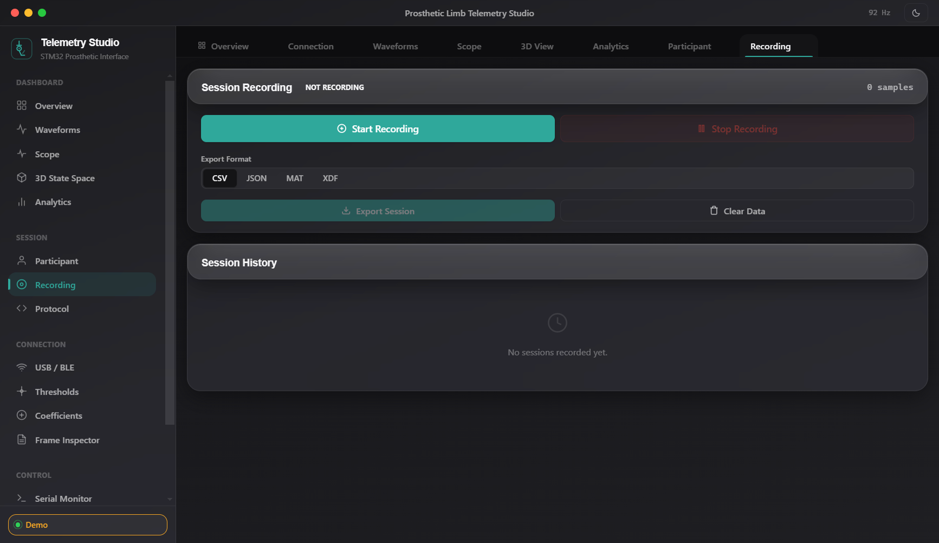
DESKTOP STUDIO TAB
GUI Provision: Clinical Session Recording
Continuous session logging for clinical research with native CSV/JSON export.
27
Key Features & Provisions
▶ Session Recording Controls
One-click Start, Pause, and Stop with live sample counter.
▶ Native File Dialog Export
Exports complete 100 Hz synchronized data into CSV or JSON.
▶ Session History Panel
Displays duration, total sample count, and recorded file sizes.
▶ 100% Local Privacy
Zero cloud dependencies; strictly complies with HIPAA regulations.

Slide 28
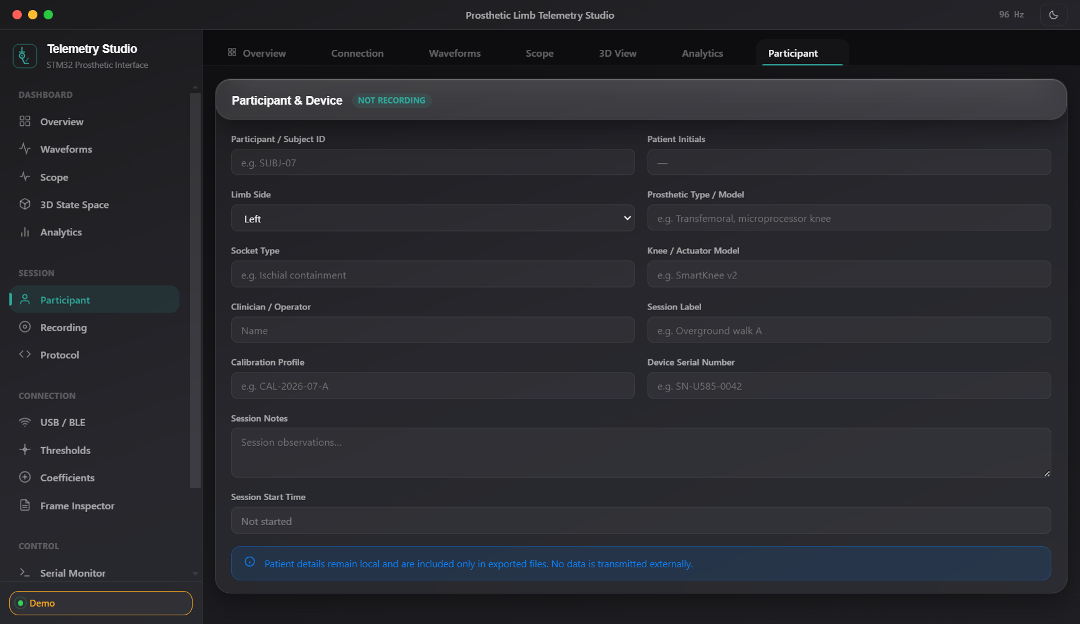
DESKTOP STUDIO TAB
GUI Provision: Patient & Prosthetic Metadata
HIPAA-compliant demographic tracking linked to recorded telemetry sessions.
28
Key Features & Provisions
▶ Patient Profile Fields
Subject ID, Amputation Level, and Affected Side (Left/Right).
▶ Prosthetic Hardware Info
Socket Type, Knee Mechanism, Foot Module, and Clinician Name.
▶ Session Association
Demographic metadata embeds into CSV/JSON export headers.
▶ Encrypted Local Storage
All patient identifiers stored securely on local workstation.

Slide 29
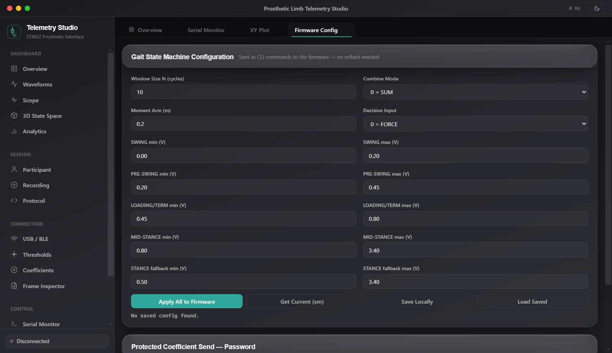
DESKTOP STUDIO TAB
GUI Provision: Live Zero-Reflash Firmware Tuning
Real-time state machine parameter tuning without firmware recompilation.
29
Key Features & Provisions
▶ Zero-Reflash Gait Tuning
Sliders adjust window size, moment arm, and combine modes.
▶ Phase Band Thresholds
Live tuning of Swing, Loading, Mid-Stance, and Pre-Swing bands.
▶ CLI Translation Pipeline
Generates corresponding firmware CLI strings in background.
▶ Dynamic Hysteresis Tuning
Adjusts deadbands live to eliminate gait flickering.

Slide 30
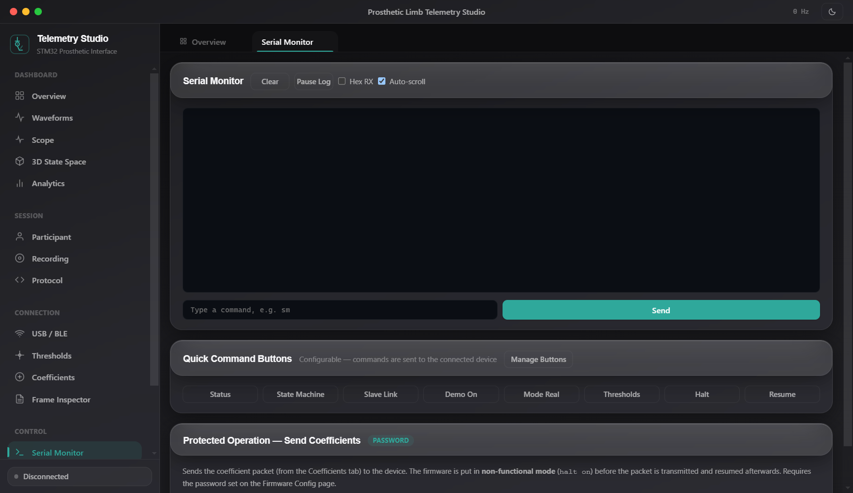
DESKTOP STUDIO TAB
GUI Provision: Interactive Serial Console
Bidirectional ASCII / Hex terminal with customizable quick-command shortcut buttons.
30
Key Features & Provisions
▶ Dual ASCII / Hex View
Displays raw bidirectional serial traffic with timestamps.
▶ Quick-Action Buttons
Pre-configured macros for status, sensors, demo, mode real, halt.
▶ Terminal Buffer Controls
Auto-scroll lock, clear screen, and command history recall.
▶ Direct CLI Access
Allows engineers to query internal register states directly.

Slide 31
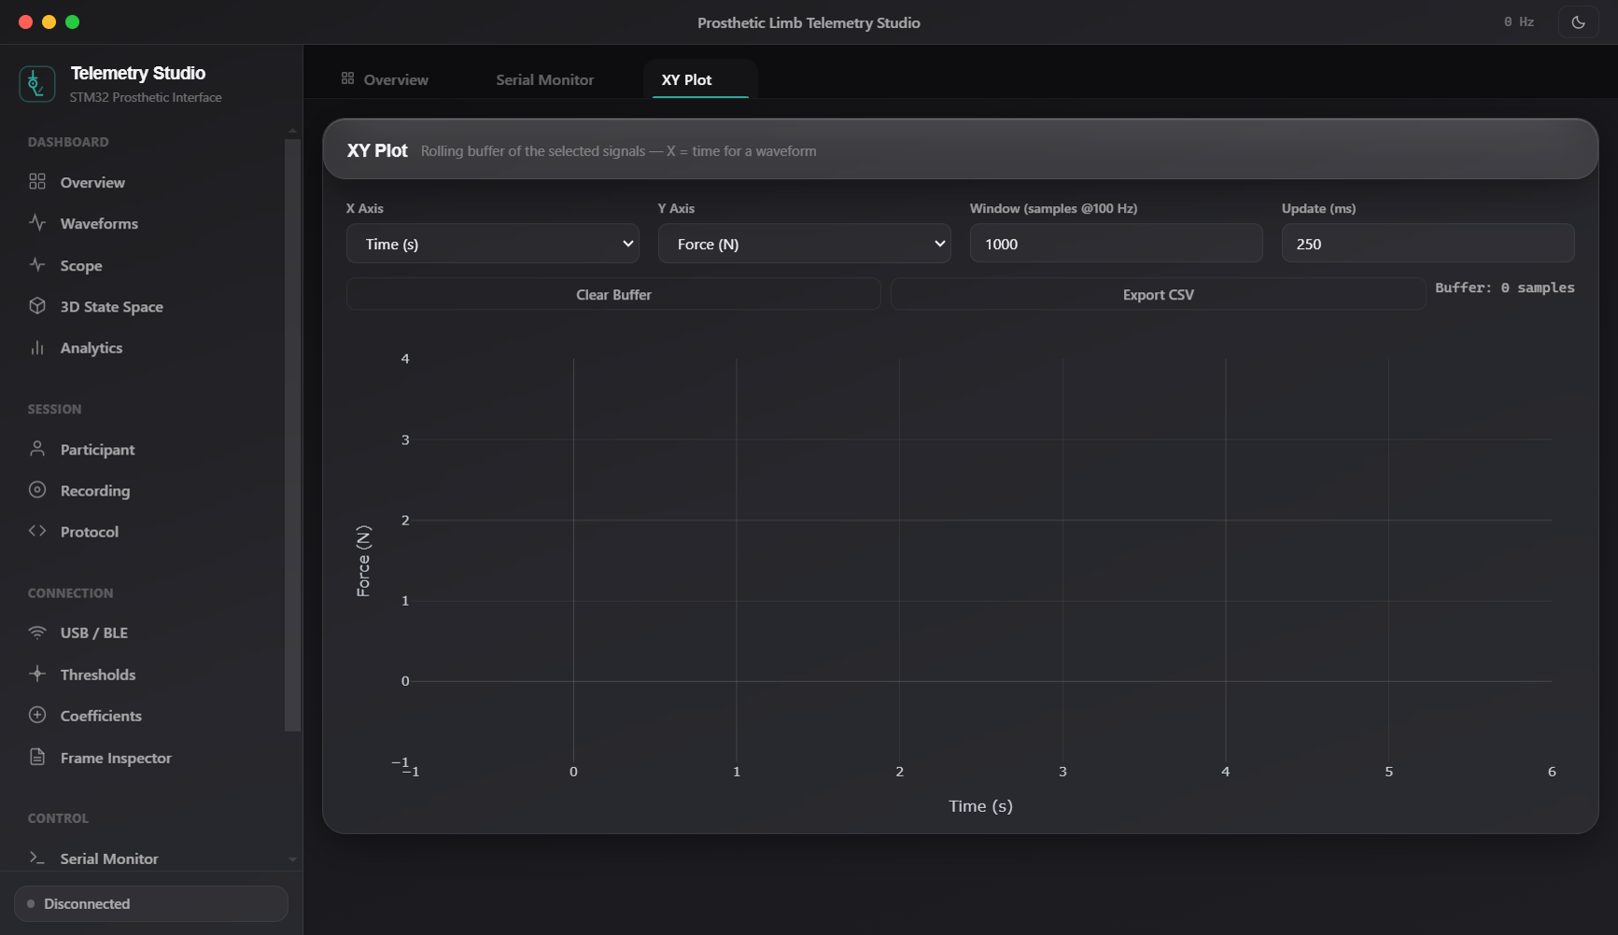
DESKTOP STUDIO TAB
GUI Provision: Custom Biomechanical XY Plotting
Flexible cross-variable trajectory plotting to visualize gait hysteresis loops.
31
Key Features & Provisions
▶ Arbitrary Axis Mapping
Plot Force vs Angle, Moment vs Force, or Valve vs Angle.
▶ Hysteresis Loop Inspection
Directly visualizes biomechanical damping loops during walking.
▶ Persistence Trailing Buffer
Configurable trailing window size (100 to 2000 samples).
▶ One-Click Image Export
Exports high-resolution vector plots for clinical reports.

Slide 32
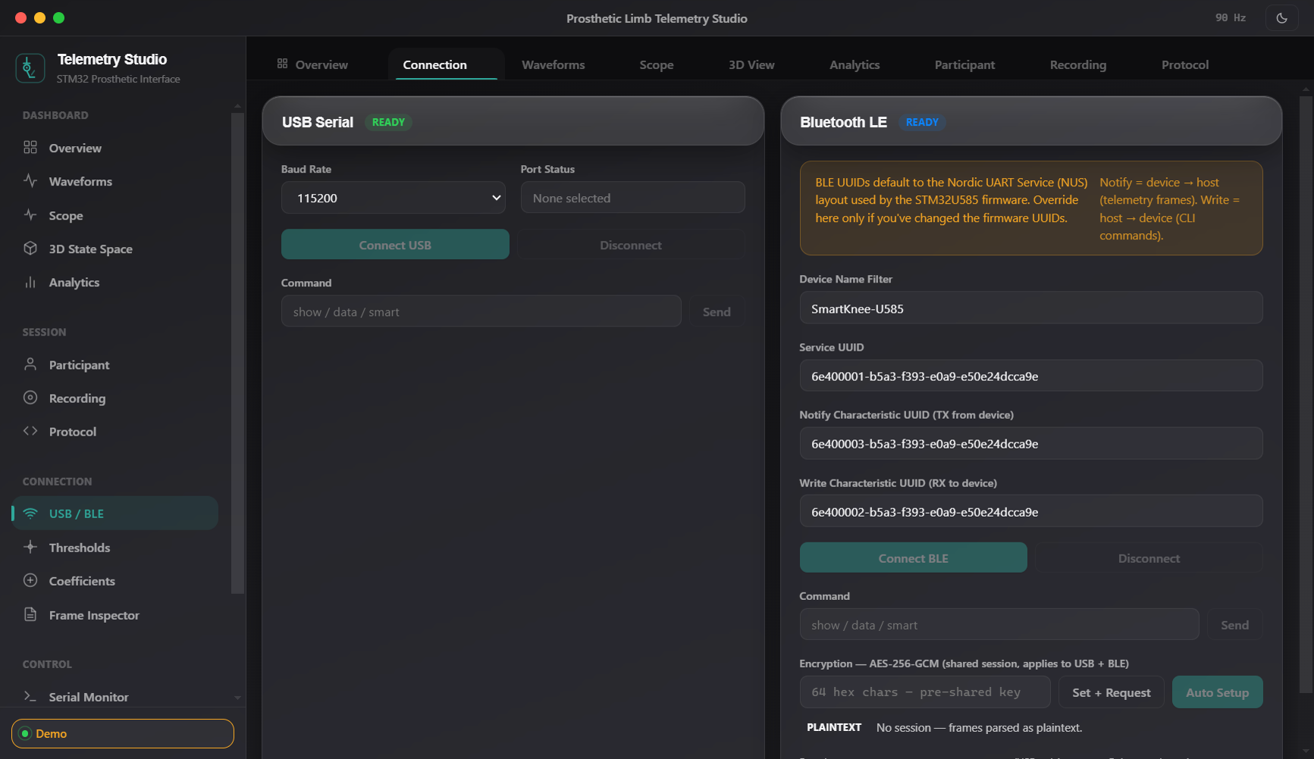
DESKTOP STUDIO TAB
GUI Provision: Connectivity & Hardware Selection
Managing physical USB, Bluetooth LE, and synthetic 100 Hz simulation transports.
32
Key Features & Provisions
▶ USB SerialPort Selector
Auto-detects available COM ports with baud rate configuration.
▶ Web Bluetooth (BLE) Manager
Scans for devices advertising Nordic UART Service (SmartKnee).
▶ 100 Hz Synthetic Gait Demo
Simulates realistic multi-phase walking without physical hardware.
▶ Connection Status Watchdog
Monitors link quality and alerts on connection drops.

Slide 33
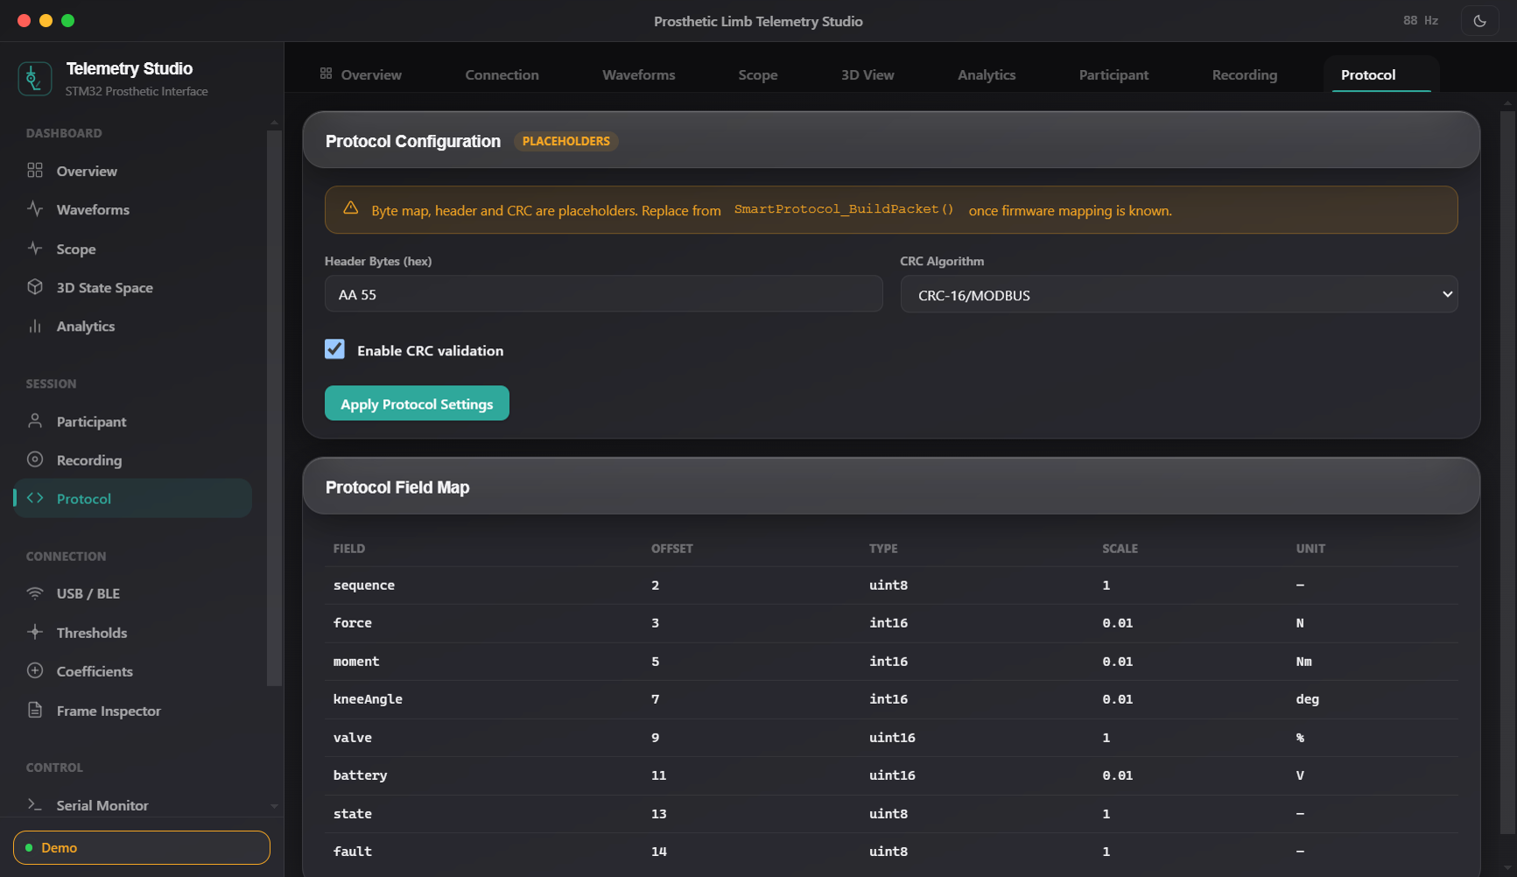
DESKTOP STUDIO TAB
GUI Provision: Communication Protocol Reference
Interactive onboard developer documentation for telemetry frame structures.
33
Key Features & Provisions
▶ Interactive Byte Map
Clickable documentation of 25-byte v1 and 31-byte v2 frames.
▶ Field Type Cheat Sheet
Documents little-endian fixed-point scaling multipliers.
▶ Fault Bitmask Reference
Complete bitwise documentation of all 16 fault register flags.
▶ Checksum Specifications
Mathematical reference for CRC-16/MODBUS implementation.

Slide 34
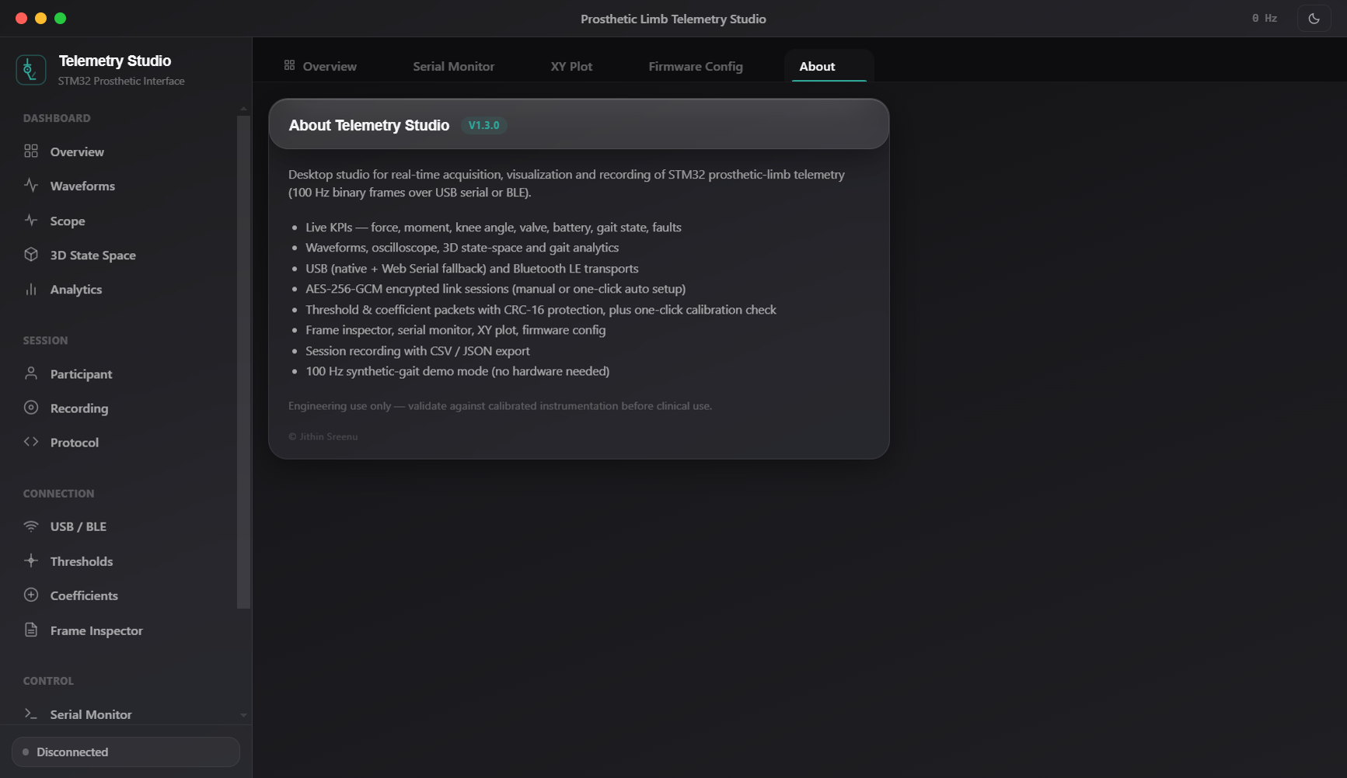
DESKTOP STUDIO TAB
GUI Provision: System Architecture & Version Panel
Complete software stack versioning, build credentials, and architectural topology.
34
Key Features & Provisions
▶ Version Identification
Displays Studio v1.3.0, Electron 31.6.0, and Node 24.x versions.
▶ Hardware Target Info
Documents ST B-U585I-IOT02A target configuration.
▶ Developer Credentials
Author, project organization, and build metadata.
▶ Architecture Schematic
Embedded topology diagram showing complete system layers.

Slide 35
PROGRESS TIMELINE
Block Diagram 16: Work Progress Timeline & Milestones
Chronological development milestones across firmware and desktop studio workstreams
35
Firmware Evolution (STM32U585)
Desktop Studio Evolution (Electron)
• 06 Aug 2026 — Round 1 (Boot HardFault Resolution):
Fixed GPDMA1 IRQ enable sequence; moved interrupt configuration after handle initialization; resolved startup hangs.
• 06 Aug 2026 — Round 2 (100 Hz Streaming & Slave Comm):
Implemented 100 Hz telemetry timer; built USART3 slave link with median-of-3 filter and freshness gating.
• 09 Aug 2026 — Robustness (TX Double-Buffering):
Introduced private DMA TX buffer to eliminate race conditions; non-fatal polling timeout guards on ADC init.
• 11 Aug 2026 — Acquisition Fixed (DMNGT=10 Breakthrough):
Configured CFGR1 continuous DMA transfer requests; verified live multichannel ADC data on physical hardware.
• 15 Aug 2026 — MODE_REAL (Live Boot Stream & Pin Alignment):
Set live telemetry stream as boot default; aligned PC0, PC2, and PC4 pin mappings to physical sensors.
• 07–08 Sep 2026 — Security (AES-256-GCM & Bitmask Faults):
Integrated hardware-accelerated AES-GCM encryption with 8-byte tag; added 16-bit bitmask fault reporting.
• 24 Jul 2026 — Studio v1.0.0 (Initial Release):
Core Electron application with serial port connectivity, real-time waveform plotting, 3D state space, and basic gait analytics.
• 07 Sep 2026 — Studio v1.1.0 (Crypto UI & About Panel):
Added AES-256 session setup tab, PSK configuration, and About dialog containing architecture diagrams.
• 10 Sep 2026 — Studio v1.2.0 (One-Click Auto-Setup):
Streamlined encryption workflow; auto-generates 256-bit keys and synchronizes device nonces with a single click.
• 10 Sep 2026 — Studio v1.2.1 (Encrypted Stream Resync):
Added resilient frame re-synchronization guards for noisy serial channels during encrypted sessions.
• Current — Studio v1.3.0 (Scope, XY Plot & Live Tuning):
Added PedoGraph-style hardware oscilloscope, scatter XY plotting, and dynamic firmware gait tuning console.

Slide 36
VERIFICATION
Verification Status Matrix & Hardware Readiness
Detailed assessment of component completeness and testing status
36
Subsystem Component | Implemented Capability | Completion Status | Verification Method
ADC / DMA Pipeline | 12-bit 3-channel scan @ ~2,778 blocks/s with 51-tap FIR | Complete | Hardware Verified (Live)
100 Hz Telemetry Stream | 25-byte fixed frame with CRC-16/MODBUS @ 115200 baud | Complete | Hardware Verified (Live)
Gait State Machine | 6-phase clinical detection with mid_seen sequence logic | Complete | Simulated & Bench Verified
Slave Motor Link | 7-byte USART3 comms with median filter & freshness gate | Complete | Hardware Verified (R2)
Fault Bitmask Diagnostics | 16-bit register tracking limits, stuck ADC, and flatlines | Complete | Firmware Verified
Calibration & Flash Bank 2 | 0x31/0x32 packets with flash persistence across boot | Complete | Bench Verified
AES-256-GCM Encryption | Hardware AES with SW fallback; 31-byte v2 encrypted frame | Complete | OpenSSL Host Vectors Pass
Studio Transports | Multi-mode: SerialPort COM, Web Serial API, Web Bluetooth | Complete | Functionally Tested
Studio GUI (16 Tabs) | Real-time charts, 3D WebGL, scope, inspector, recorder | Complete | Captured & Verified
Session Recording & Export | Full 100 Hz session logging with CSV/JSON local export | Complete | Functionally Tested

Slide 37
FINDINGS & FIXES
Engineering Audit: Discrepancies & Codebase Alignments
Resolution of legacy documentation drifts and parameter scale alignments
37
• UART Pin Assignment Drift: Legacy docs stated USART2 on PD5/PD6. Working hardware-verified firmware strictly uses USART3 on PD8 (TX) and PD9 (RX). Documentation has been fully reconciled.
• ADC Clock Frequency Alignment: Changelogs claimed a 16 MHz ADC clock. Actual register configuration correctly uses 4 MHz MSI (MSIC) clock divider to maximize SNR and prevent thermal noise.
• Fault Bitmask Width Expansion: Earlier GUI drafts treated faults as an 8-bit integer. The active firmware and Studio v1.3.0 properly use a 16-bit bitmask at Byte offset 14.
• Battery Voltage Scale Presets: Studio default threshold presets historically targeted 12V lead-acid batteries. The physical prosthetic knee uses a 4.2V Li-ion battery divider. Presets updated to 3.3V-4.2V scale.
• Automated Testing Implementation: Identified gap in automated CI/CD unit testing; formulated step-by-step test harness for headless automated builds on every code commit.

Slide 38
ROADMAP
Actionable Strategic Roadmap & Recommended Next Steps
Structured steps to advance from laboratory validation to clinical deployment
38
Step 1: Preset Alignment
Step 2: Documentation Closure
Update default presets in Studio's constants.js to reflect the 4.2V Li-ion battery scale (Min: 3.3V, Max: 4.2V).
Formally archive obsolete markdown references to USART2 and consolidate authoritative constants.js.
Step 3: Host-Based Unit Test Suite
Step 4: Automated Firmware CI
Create a Python or Node-based test harness validating CRC-16, frame decoding, and fault bits on every commit.
Implement GitHub Actions workflow running arm-none-eabi-gcc headless build and static analysis.
Step 5: Bench Crypto Acceptance
Step 6: Clinical Gait Trials
Conduct multi-hour hardware test session streaming AES-256-GCM encrypted frames over USB/BLE; log in CRYPTO_BENCH.md.
Deploy Studio v1.3.0 on clinician surface tablets during live treadmill walking trials with transfemoral amputees.

Slide 39
CONCLUSION & READINESS
A Complete, Verified Biomechanical Telemetry Stack
1. Solid Embedded Foundation: The STM32U585 firmware features an ultra-reliable DMA acquisition pipeline, 51-tap FIR filtering, non-blocking telemetry transmission, and runtime-configurable clinical gait detection.
2. Comprehensive Front-End Suite: Prosthetic Telemetry Studio v1.3.0 provides 16 rich visual tabs — ranging from high-frequency oscilloscopes and 3D state-space trajectories to automated cadence analytics and flash calibration.
3. Security & Safety Built-In: Real-time 16-bit fault detection guards against mechanical and electrical failures, while opt-in hardware-accelerated AES-256-GCM ensures HIPAA-grade confidentiality on wireless links.
4. Ready for Next-Stage Trials: All core subsystems are implemented, verified on real hardware, and documented. Remaining tasks (threshold presets and automated CI) are minor operational refinements, with zero architectural blockers.
Thank you. Open for Questions & Demonstrations.

